Slide 1
Medicaid, Medicare, and the ACA: Covering Changing Policies in the Context of the
US Health Care Affordability Challenge
Diagnosing the US Health Care System Fellowship
September 23, 2026

Slide 2
The US Health System: Costs and Coverage
The US is an outlier in terms of costs and health insurance coverage
About half of Americans are insured through an employer
Nearly all adults 65 and older have Medicare
The ACA moved us closer toward universal coverage, mainly by strengthening Medicaid and the individual market to fill key gaps
HR 1 (OBBBA) places new restrictions on ACA coverage options

Slide 3
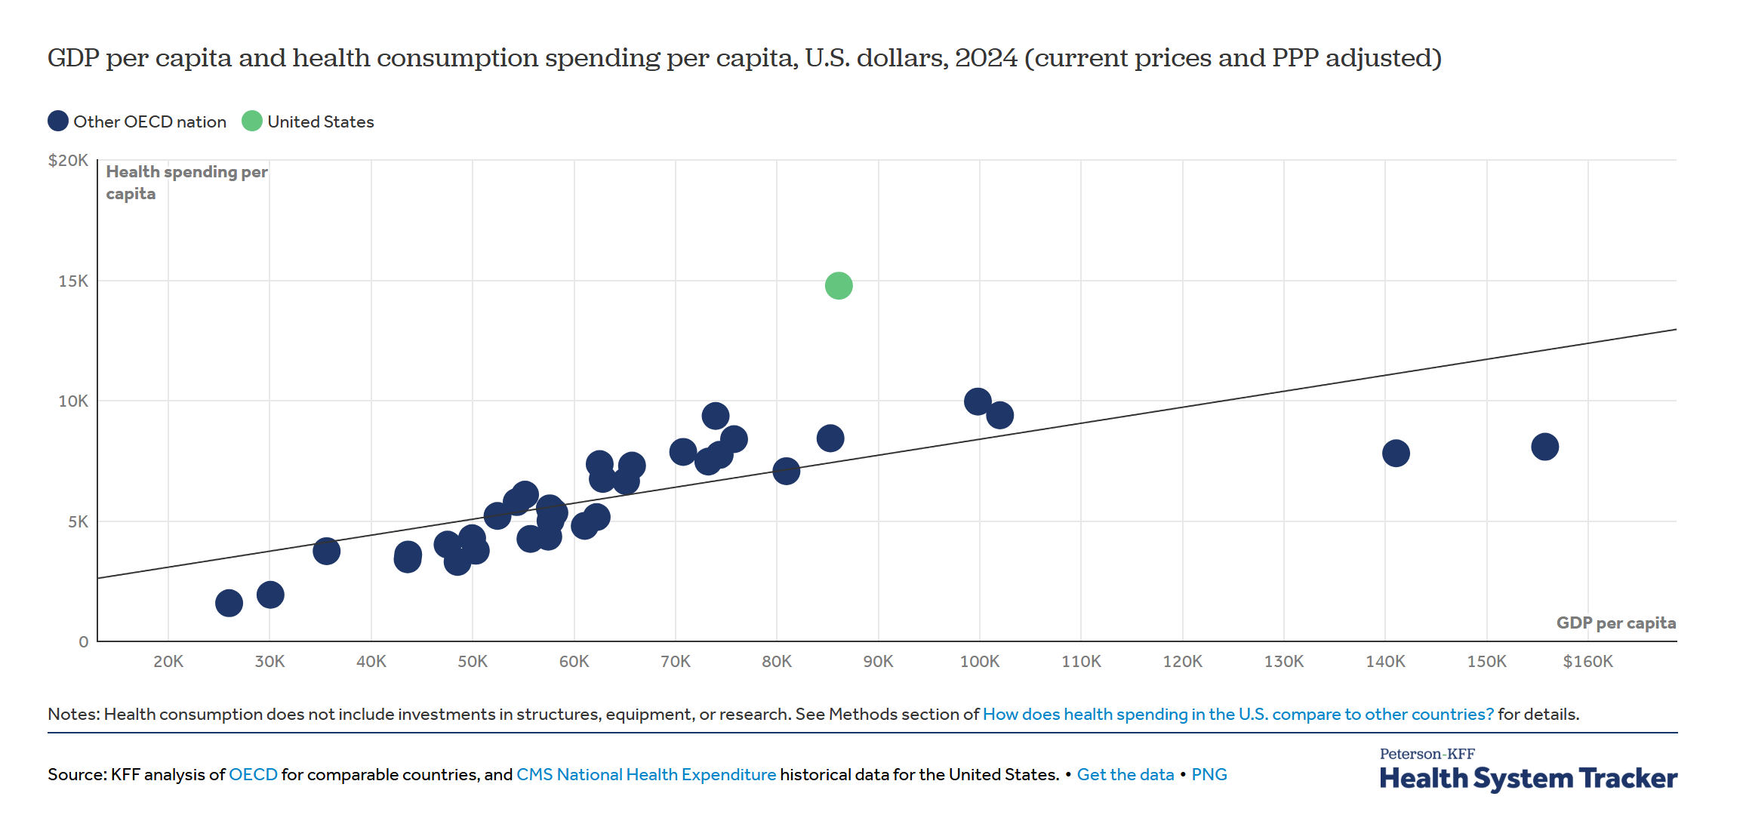
Compared To Other Countries, We Pay More And Get Less From Our Healthcare System
High healthcare costs are
“the tapeworm on American competitiveness.” – Warren Buffett (2010)

Slide 4
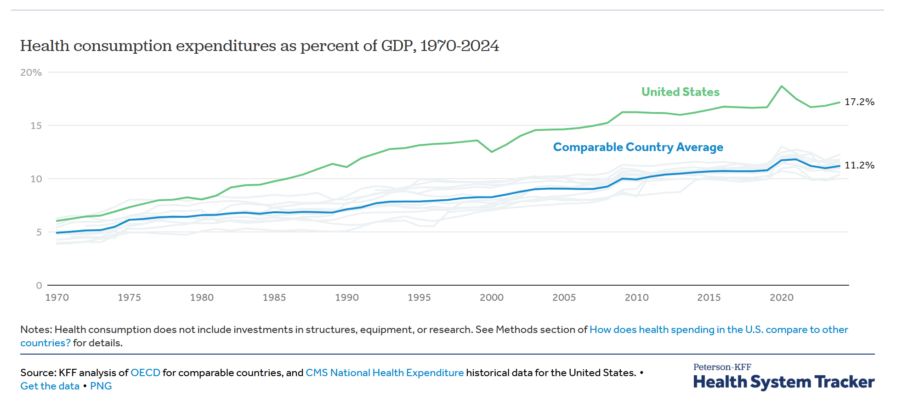
We Are Outliers: Our Cost Trend Has Diverged

Slide 5
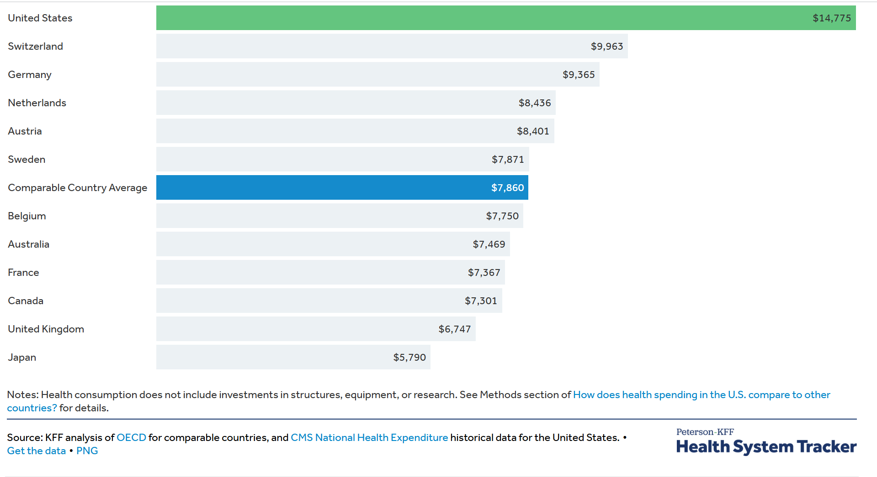
We Pay Roughly Twice As Much Per Capita

Slide 6
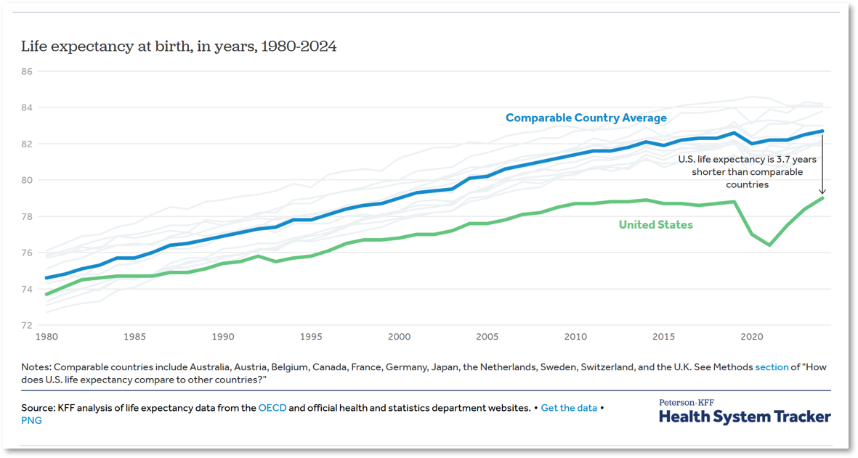
And We Have Worse Health Outcomes

Slide 7
‘American Exceptionalism’ In Healthcare Means:
Higher prices for
health services and prescription drugs
Higher administrative costs and burden
More uninsurance and medical debt
Poorer health outcomes

Slide 8
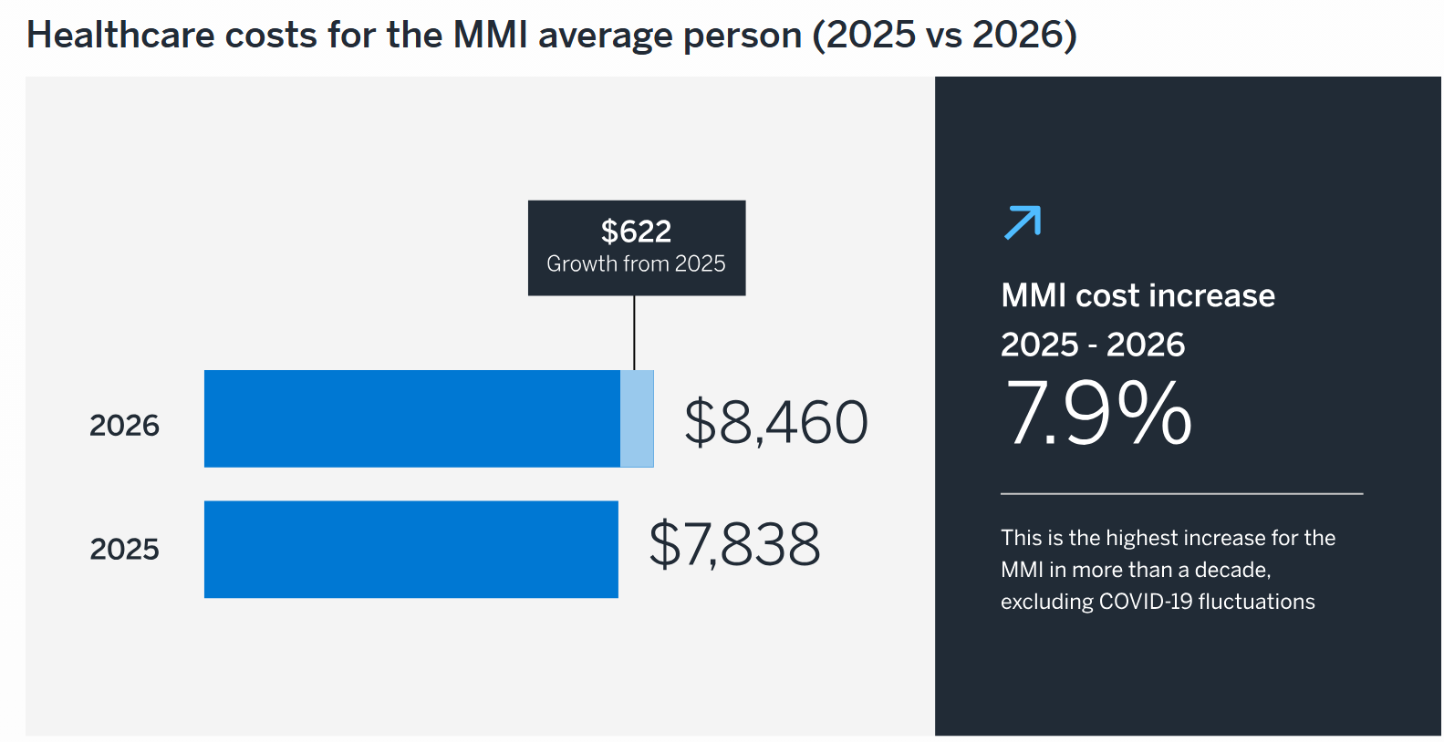
Cost Of An Average Employer Plan In 2026
$37,824 for a family of four
$8,460 per person
7.9% increase from 2025, highest increase in more than a decade
Source: Milliman Medical Index

Slide 9
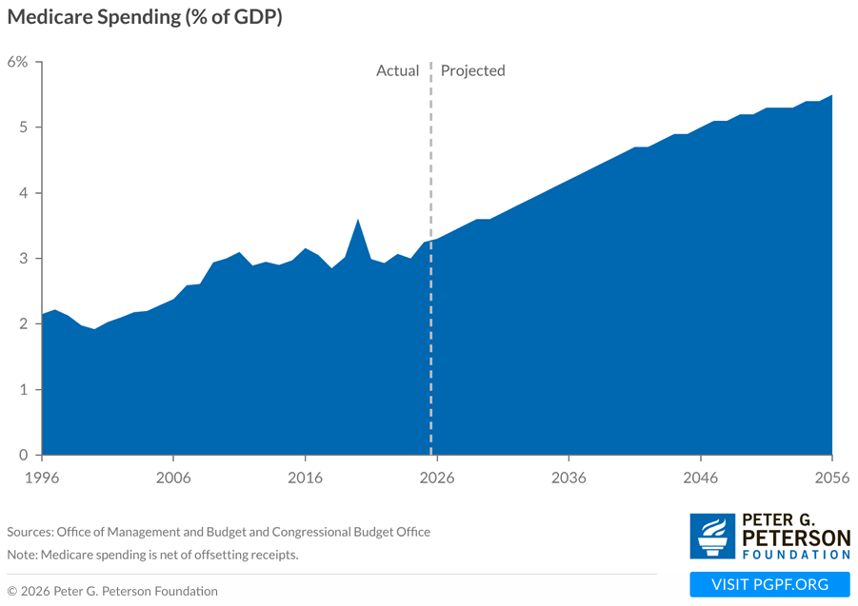
Medicare Cost Growth Will Raise Federal Spending
Source: Peter G. Peterson Foundation

Slide 10
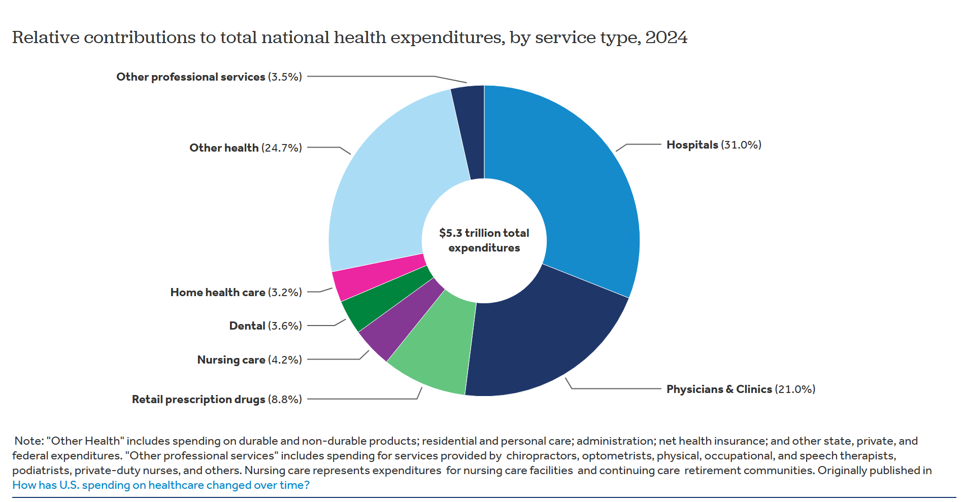
Components Of National Healthcare Spending

Slide 11
Nearly Half Of Adults Ages 18-64 Had Difficulty Affording Healthcare For Their Families In 2025
Source: Karpman et al. 2026. Nearly Half of Working-Age Adults Had Difficulties Affording Health Care in 2025. Urban Institute.

Slide 12
How To Bend The Cost Curve?
Prices
  Transparency
  Competition
  Regulation
Utilization
  Upstream factors
  Primary and preventive care
  Value-based payment
Administrative burden
  Simplify eligibility
  Create more efficient data infrastructure
  Reduce costly friction between providers and insurers

Slide 13
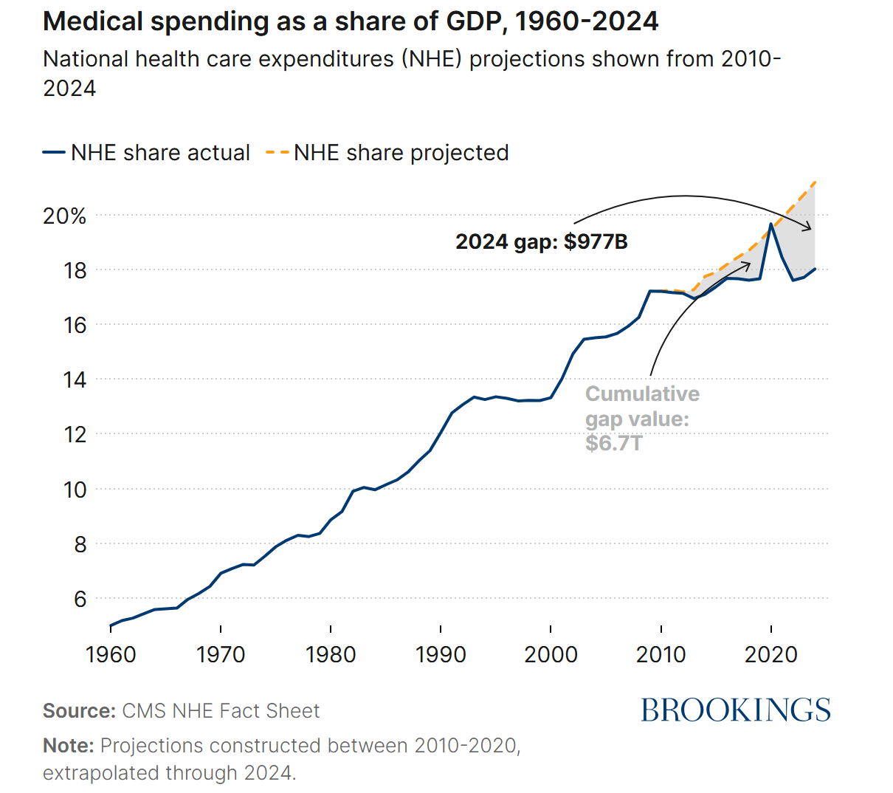
A Little Good News… We May Have Bent The Cost Curve A Little Bit
Brookings report by David Cutler and Lev Klarnet (March 2026)
Medical spending as a share of GDP actually below projections
Technology now reducing costs
Changing the production function
The authors explore reasons for the slower growth and “conclude that the United States has bent the healthcare cost curve, though not as much as it could be or will need to be bent.”

Slide 14
Medicaid and the ACA: Overview
  Background on Medicaid and the ACA
  Key Changes Under HR 1
  Covering Changing Policies and Eligibility Rules

Slide 15
Medicaid’s Role in the US Health System (1)
  Created alongside Medicare in 1965 to finance health care services for designated poor and disabled groups
    Families with dependent children, blind, disabled
  Expanded to cover additional groups
    Low-income pregnant women and children; parents; adults with incomes up to 138% of the federal poverty level [FPL] under the ACA
  Addition of the Children’s Health Insurance Program (CHIP) in 1997
  Covers Medicare premiums and wraparound coverage for low-income Medicare beneficiaries

Slide 16
Medicaid’s Role in the US Health System (2)
  Entitlement program jointly financed by federal and state government
  States must conform to federal standards for eligibility and benefits, but have flexibility over eligibility thresholds, service delivery, payment, etc.
    e.g., Medicaid/CHIP limit for children ranges from 190% to 405% FPL
  40 states and DC adopted the optional ACA Medicaid expansion
    AL, FL, GA, KS, MS, SC, TN, TX, WI, WY yet to expand; median eligibility for parents of 34% FPL in 2024; no eligibility for other nondisabled adults
  Over 73 million Americans covered by Medicaid/CHIP as of May 2026, including nearly 20 million under the ACA Medicaid expansion

Slide 17
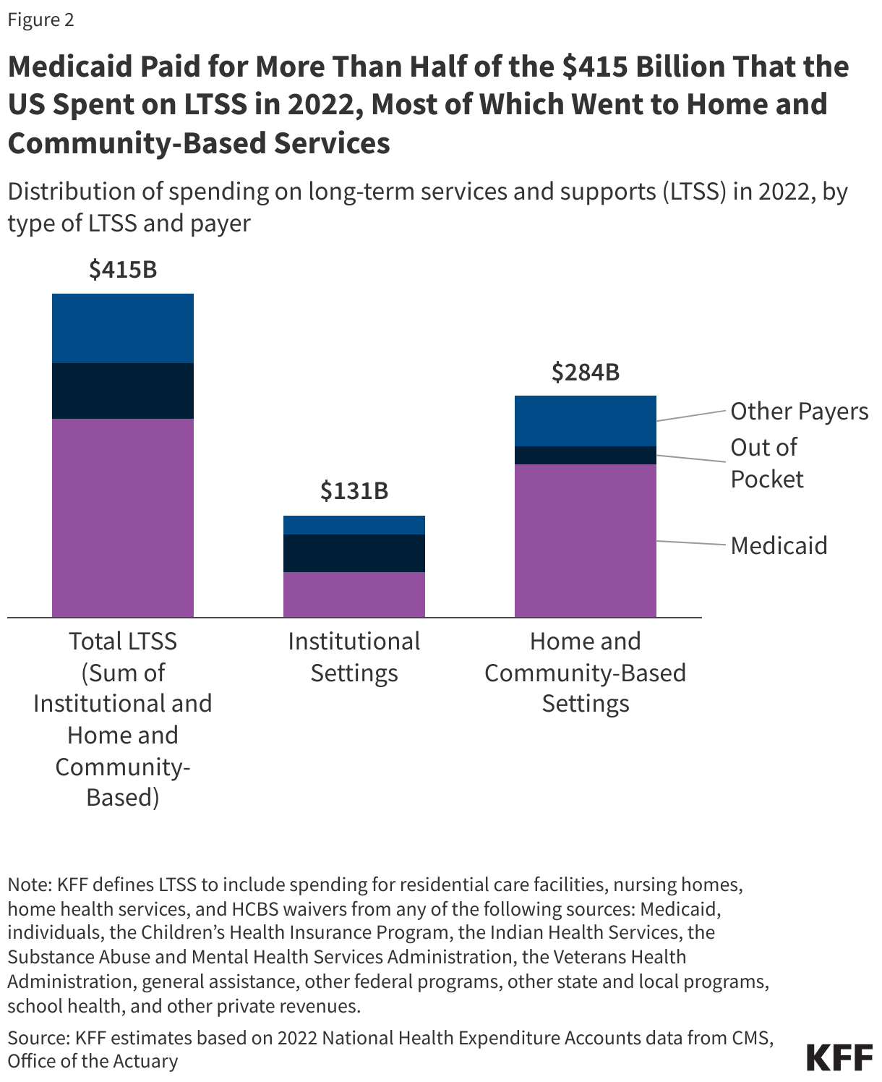
Medicaid pays over 60% of all spending on long-term services and supports
45% of spending in institutional settings and 69% in home and community-based settings is covered by Medicaid
Source: KFF, 10 Things About Long-Term Services and Supports (LTSS)

Slide 18
ACA Individual Market Reforms
  Guaranteed issue
  Modified community rating
  Essential health benefits
  No lifetime/annual dollar limits
  Prohibit rescission of coverage
  Actuarial value standards
  Maximum out-of-pocket spending limits
  Minimum medical loss ratios
  Minimum medical loss ratios
  Dependent coverage up to age 26
  Preventive care without cost sharing
  Marketplaces to compare plans and shop for coverage
  Income and price-linked subsidies
  Individual mandate
For further detail, see Blumberg and Holahan. 2024. The ACA’s Transformation of Private Health Insurance. Urban Institute.

Slide 19
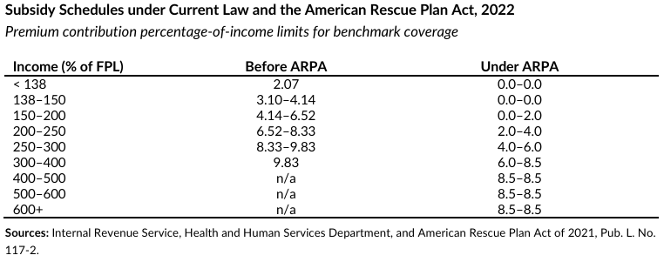
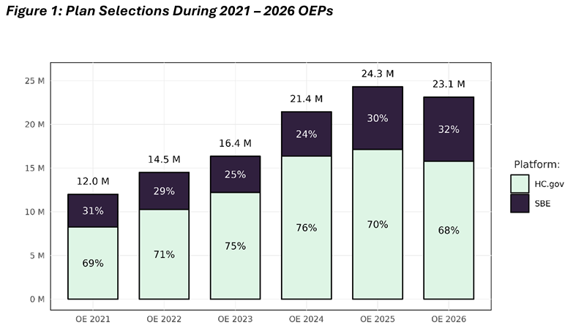
Marketplaces
Premium tax credits (PTCs) if income <400% FPL
PTC amount tied to second-lowest cost silver plan locally available
  Cost of benchmark plan capped at a % of family income
American Rescue Plan Act of 2021 increased PTC amount and extended eligibility above 400% FPL
  Extended through 2025 by Inflation Reduction Act
Sources: McMorrow et al. 2021; CMS 2026

Slide 20
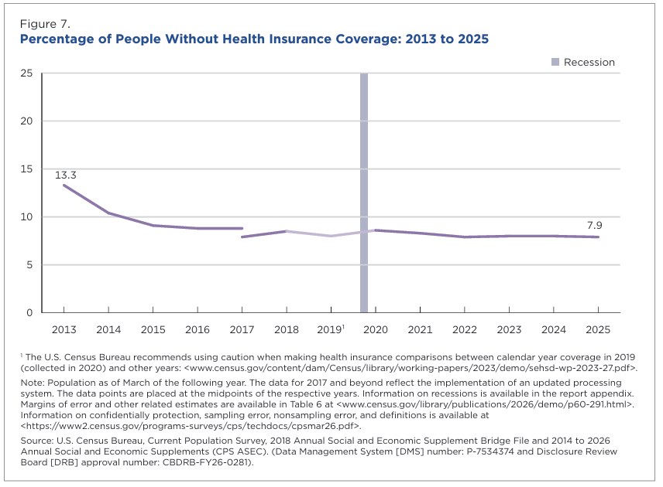
The number of uninsured people in the US declined by 40% under the ACA…
…but recent policy changes are expected to increase the uninsured rate and families’ exposure to high costs and reduce health care access.
Source: Bunch LN, Ketema H. 2026. “Health Insurance Coverage in the United States: 2025.” Washington, DC: US Census Bureau.
https://www2.census.gov/library/publications/2026/demo/p60-291.pdf.

Slide 21
Medicaid Changes in HR 1 (1)
  CBO projects HR 1 will reduce Medicaid enrollment by more than 11 million over 10 years
  Largest cut to Medicaid in the program’s history: over $900 billion
  Many provisions target ACA Medicaid expansion
  Substantial restrictions on state funding along with federal funding cuts

Slide 22
Medicaid Changes in HR 1 (2)
  Terminates eligibility for certain lawfully present immigrants (Oct. 2026)
  Work requirements for ACA expansion coverage (Jan. 2027)
  Eligibility redeterminations for expansion coverage every 6 months instead of 12 months (Jan. 2027)
  Limits retroactive coverage to 1 month for expansion, 2 months otherwise (Jan. 2027)
  Additional changes:
    Cost sharing of up to $35 for selected services for expansion enrollees with income >100% FPL
    Prohibits new or increased provider taxes
    Reduces state-directed payments
    Reduced federal funding for states with certain payment errors

Slide 23
Marketplace Changes in HR 1
  Terminates eligibility for PTCs for certain lawfully present immigrants
  Pre-enrollment verification
    Eliminates automatic reenrollment for PTC recipients
    Eliminates provisional eligibility for PTCs while undergoing verification process
  Eliminates caps on repayment for excess PTC amounts
  Denies PTCs for prior failure to file taxes and reconcile PTC
  Eliminates PTCs for certain low-income people obtaining Marketplace coverage through a special enrollment period unless they have a qualifying life event
  If denied Medicaid because of work requirements, cannot qualify for PTCs

Slide 24
Covering HR 1
  Few direct changes in eligibility
  Creates more administrative complexity and paperwork burden for enrollees
  Increases administrative burden and costs for state agencies
  Staggered implementation of key provisions between 2026 and 2029

Slide 25
Covering HR 1: Medicaid Work Requirements and Definitions of “Able-Bodied” vs. Disabled
  Work requirements affect the expansion group
  They do not target adults with Medicaid through disability-based pathways
    i.e., people who receive SSI and are unable to engage in “substantial gainful activity”
  This can lead to the mistaken assumption that all expansion enrollees are “able-bodied” adults, and that a significant share can work but choose not to
  But 2/3 of Medicaid-enrolled adults with disabilities (i.e., functional limitations) qualify through non-SSI eligibility pathways, including the ACA expansion
  Between one-third and one-half of expansion enrollees have chronic health conditions, including many with behavioral health conditions

Slide 26
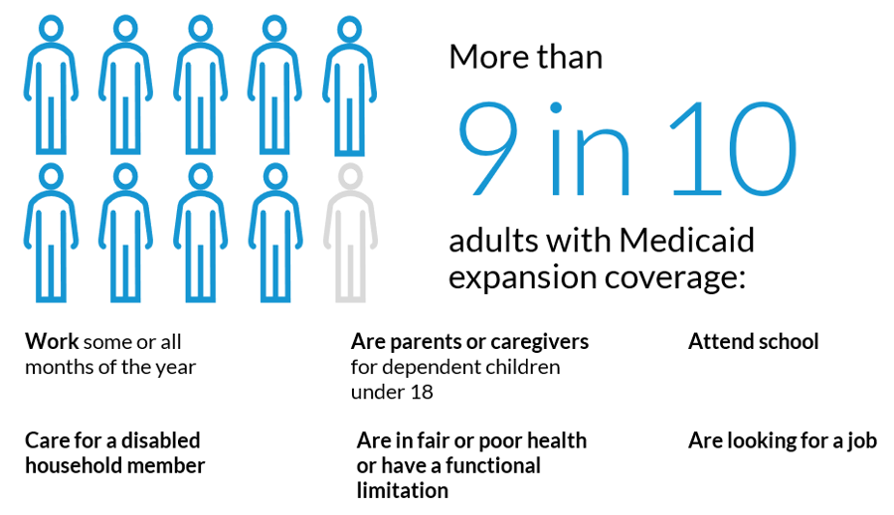
Covering HR 1: Most Expansion Enrollees Are Working, Looking for Work, or Could Meet Exemption Criteria
Source: Karpman et al. 2025. Assessing Potential Coverage Losses Among Medicaid Expansion Adults Under a Federal Medicaid Work Requirement. Urban Institute.

Slide 27
Covering HR 1: Coverage Loss Under Work Requirements Is Driven by Low Awareness and Added Paperwork Burden
  Medicaid work requirements in AR reduced coverage, did not boost employment
  Most were working or had characteristics that should have made them exempt
  Limited awareness and understanding of policy, difficulty with reporting process
  States can mitigate coverage loss, e.g., by maximizing use of data to automatically verify compliance and exemptions, and simplifying application and renewal forms
  CMS guidance makes this difficult
    Limits medical frailty exemptions to those who can demonstrate conditions that impair their ability to meet work requirements
    Limits self-attestation in 2028 – large-scale disenrollment may not happen all at once
For detail on work requirements in Arkansas, see Gangopadhyaya and Karpman 2025; Sommers et al. 2019, 2020; Hill and Burroughs 2019.

Slide 28
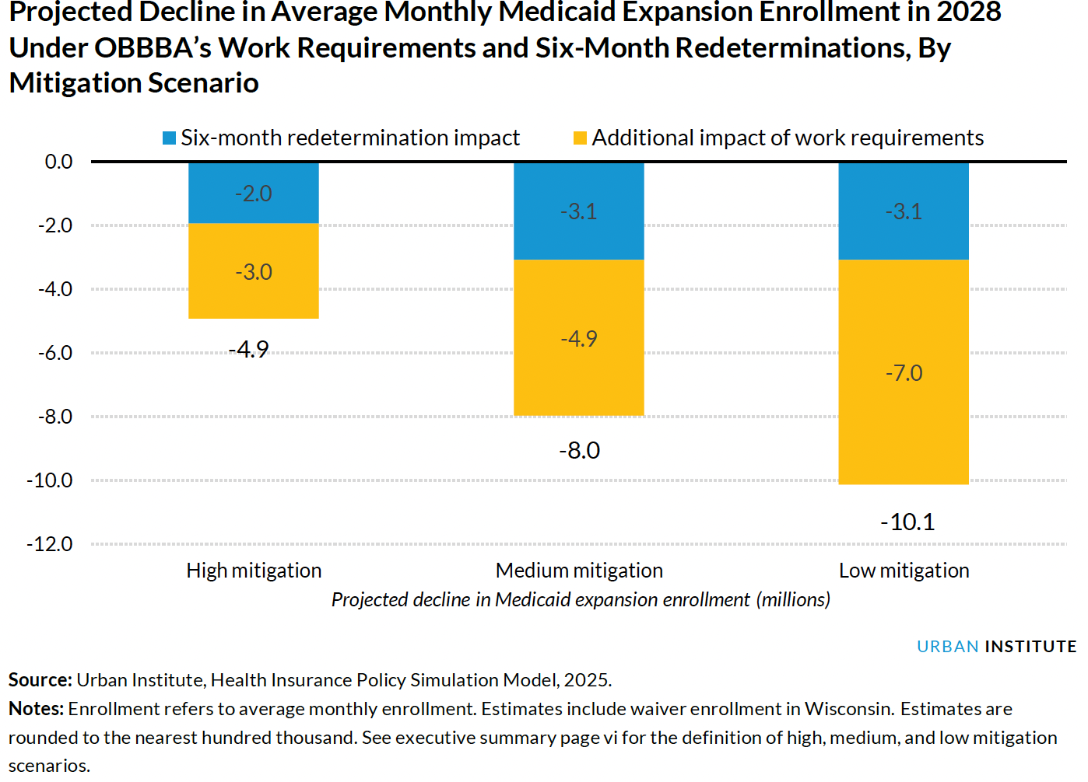
Projected Decline in Average Monthly Medicaid Expansion Enrollment in 2028 Under OBBBA’s Work Requirements and Six-Month Redeterminations, By Mitigation Scenario
Source: Buettgens et al. 2026.

Slide 29
Covering HR 1: Implications of Coverage Loss
  CBO projects HR 1 will increase number of uninsured by 10 million
    Combined impact of HR 1 and expiring PTCs increase uninsured by over 14 million
  Potential consequences include:
    Reduced access to and use of health care
    Higher mortality
    Increased medical debt
    Uncompensated care costs and reduced financial stability for health care providers
    Higher state administrative costs

Slide 30
Selected Urban Institute research publications
Stricter Rules for Medical Frailty Exemptions from Medicaid Work Requirements Put Adults with Significant Health Needs at High Risk of Losing Health Care
The New Federal Rule on Medicaid Work Requirements Understates Likely Coverage Losses and Overestimates Potential Employment Gains
Projected Reductions in Medicaid Expansion Enrollment Under OBBBA’s Work Requirements and Six-Month Redeterminations
Up to 2.3 Million Young Adults Ages 19 to 24 Could Lose Medicaid Under OBBBA’s Work Requirements and More-Frequent Redeterminations
Loss of Enhanced Subsidies and OBBBA Could Cut Young Adults’ Subsidized Marketplace Coverage by More than Half
Many Working People Would Be Shut Out of Medicaid under Proposed Work Requirements: Findings from the Survey of Income and Program Participation
Nearly Half of Working-Age Adults Had Difficulties Affording Health Care in 2025
New Evidence Confirms Arkansas’s Medicaid Work Requirement Did Not Boost Employment
4.8 Million People Will Lose Coverage in 2026 If Enhanced Premium Tax Credits Expire
Reconciliation Bill Would Cut Marketplace Enrollment by over 5 Million People

Slide 31
Thank You!
Katherine Hempstead
Robert Wood Johnson Foundation
KHempstead@RWJF.org
Michael Karpman
Urban Institute
mkarpman@urban.org

