Slide 1

Evidence-based election coverage: A toolkit for journalists

Slide 2

Who am I?
I’m Carmen Nobel, a longtime journalist who spent eight years as program director and editor-in-chief of The Journalist’s Resource at Harvard University’s Shorenstein Center.
PowerPoint design is not one of my strengths, so bear with me …
This summer I’m co-leading an election coverage project for SciLine.

Slide 3
What’s SciLine?
SciLine (SciLine.org) is a free service for journalists and scientists based at the American Association for the Advancement of Science. SciLine has the singular mission of enhancing the amount and quality of scientific evidence in news stories.

Slide 4


Expert Matching Service
When you need research-backed facts or scientific context for a story, SciLine can help connect you to a deeply knowledgeable expert-source. Simply fill out a form on the website.
Journalist: “Help! I need to find a scientist in Florida who can talk about red snapper spawning patterns, and my deadline is tomorrow!”
SciLine: “Sure! Give us a couple of hours!”

Slide 5
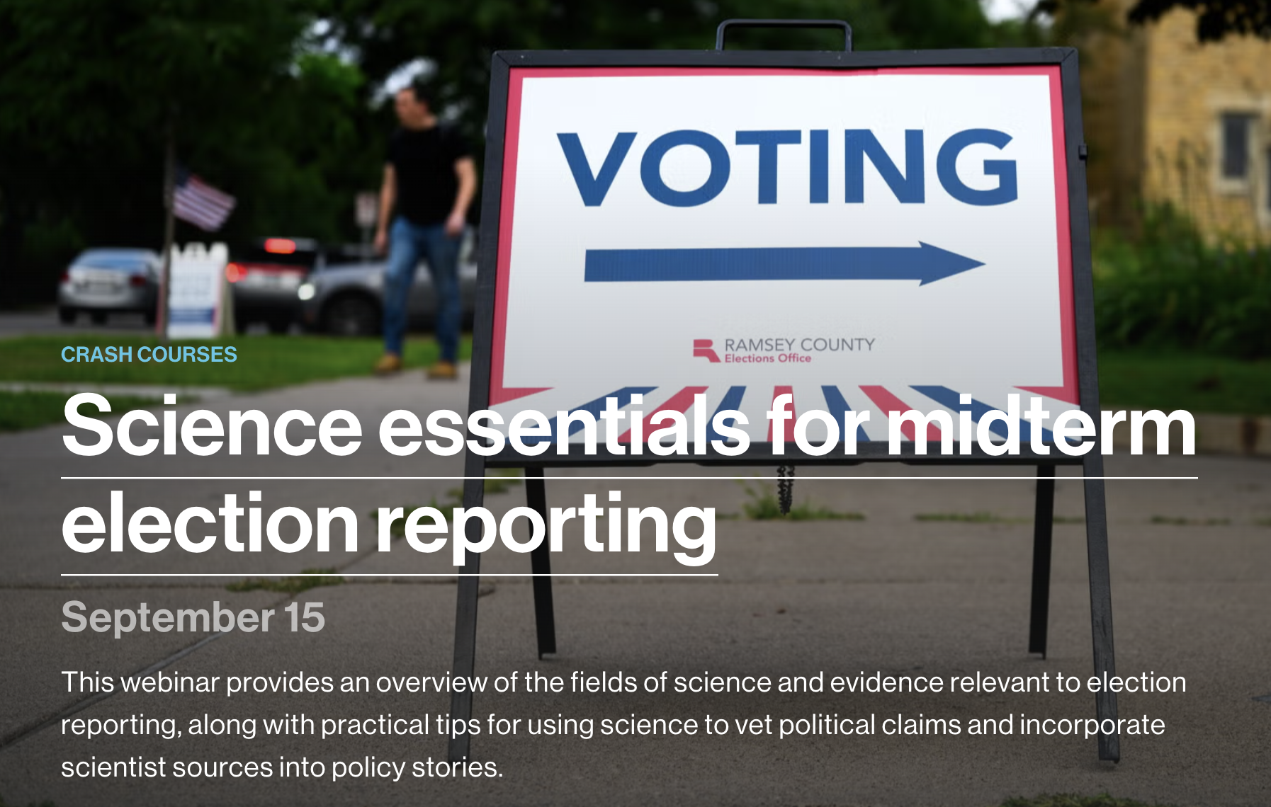
Crash Courses
These free hour-long training sessions, co-led by a veteran science reporter and a Ph.D. scientist, are designed to quickly convey practical tips for strengthening news stories with science-backed evidence.
Notes:
Tomorrow at 1 p.m. ET

Slide 6

Reporting resources
The website features a growing library of free reporting guides, tips sheets, and story ideas to strengthen your coverage of many, many topics with scientific evidence.
That now includes a series of reporting guides to help you cover the 2026 elections!

Slide 7
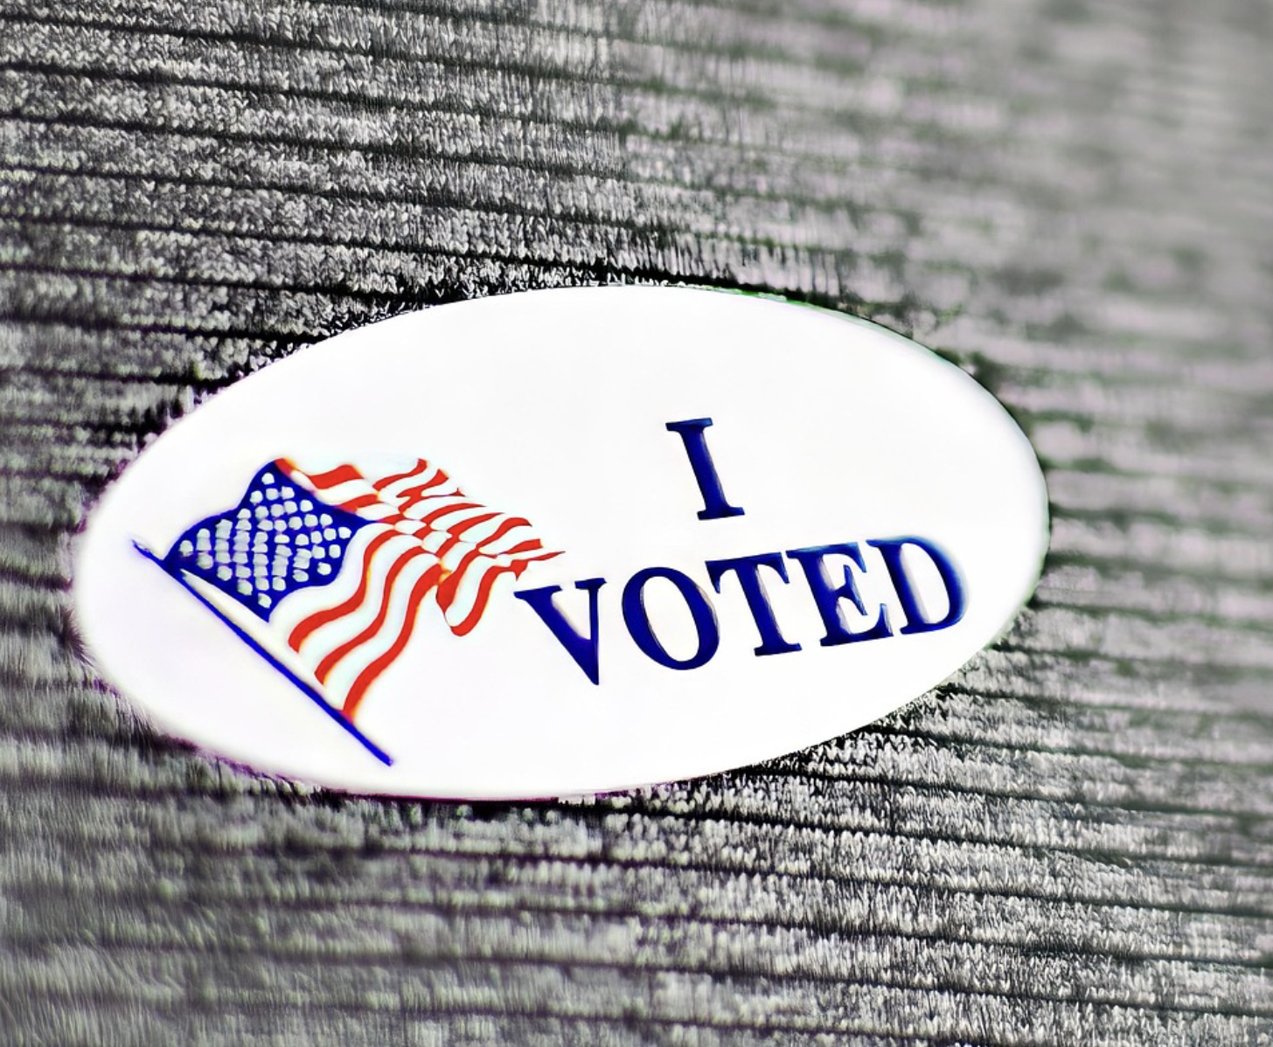
Introducing the evidence-based election coverage toolkit
https://www.sciline.org/resource-list/covering-midterm-elections-2026/

Slide 8
Why?
SciLine offers these reporting resources to help journalists step back from political back-and-forth and show voters what evidence-based research can tell us about the biggest issues at stake in the midterm elections.
SciLine Election-Issues Series | Newsroom Briefing

Slide 9

Beyond the horse race
Dozens of academic studies find that focusing on who’s ahead in the polls and ignoring the policy issues is associated with:
Distrust in politicians.
Distrust of news outlets.
An uninformed electorate.
Inaccurate reporting of opinion poll data.
Source: The Journalist’s Resource, 2023

Slide 10
“
There’s a bit of a perfect storm of challenges out there for journalists with this election. Resources are a challenge as always, issues that didn’t used to be controversial are now politicized, and disinformation is moving at the speed and sophistication of AI.
MATT DeRIENZO
Director of SciLine
SciLine Election-Issues Series | Newsroom Briefing

Slide 11
REPORTING GUIDE
Voting Machines:
What Journalists Need to Know
Helping journalists recognize misinformation, avoid errors, and find local story ideas with help from researchers who study U.S. elections and voting technology
Source: sciline.org/elections/voting-machines-ballot-technology

Slide 12
Why we created the voting machine guide
Politicized disinformation
Recently, President Trump and some of his supporters have revived disproven assertions that voting machines helped sway the 2020 presidential election by “flipping” elections.
“For a host of reasons, the potential vulnerability of individual voting machines doesn't translate into systemic vulnerability.”
It's a local story
Local and state officials are responsible for purchasing, funding, and securing voting equipment.
Journalists can demystify the topic
Local journalists can build relationships with local election workers, cover equipment malfunctions when they happen, ask to observe pre-election machine testing, and explain area-specific post-election audits to their audiences.
— Mark Lindeman, PhD., policy and strategy director of Verified Voting
Sources: SciLine, “Voting Machines” guide; Executive Order 14248; Verified Voting
2

Slide 13
How Americans Cast Their Ballots
69.5%
26.5%
98%
vote on hand-marked paper ballots, counted by optical scanners
vote where ballot-marking devices (BMDs) are used for all voters
of 2024 ballots were recorded on paper so voters could verify them, up from 93% in 2020.
Sources: Verified Voting;; U.S. Election Assistance Commission
3

Slide 14
What the research says
Claims about voting machine fraud in the 2020 election are not supported by scientific evidence.
A May 2025 study examined audits of the 2020 election in 27 states. The authors find “clear and consistent evidence that the vote count was exceptionally accurate” after analyzing more than 71.7 million votes from 856 regional governments in those states.
“These studies show that both hand counting and scanners can be very accurate, but scanners are better,” Stewart wrote.“They also found that when rare, large discrepancies do arise, they occur because of poll workers’ decisions, such as stopping counting because they were tired or not counting write-in ballots considered irrelevant.” –
Charles Stewart III, Kenan Sahin Distinguished Professor of Political Science at MIT
Voting machine counts are more accurate than hand counts.
Showing people how audits work can bolster trust in the electoral process.
Notes:
Second is from two MIT Media Lab studies. Third was from a study that showed some people a video about Risk Limited Audits.

Slide 15
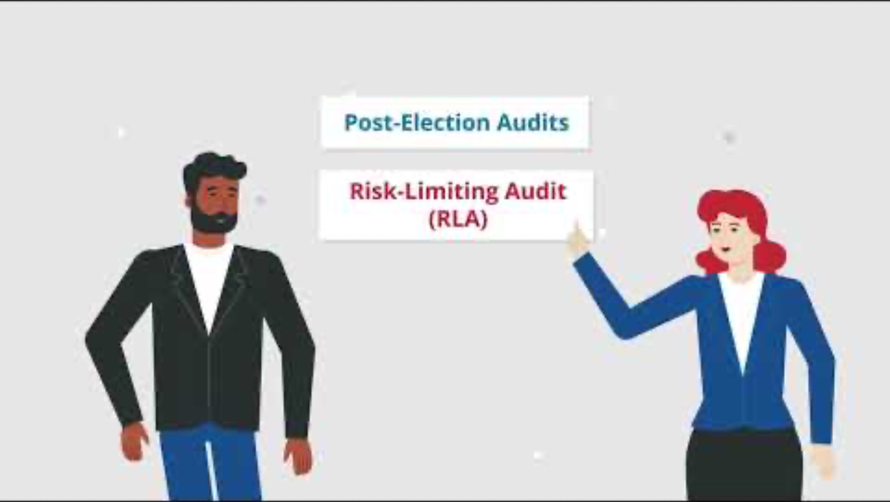
Verified Voting explains Risk Limited Audits
Many states perform a kind of post-election audit called a Risk Limiting Audit (RLA) to verify that counts are accurate. To find out what type of audits your jurisdiction uses, contact your Secretary of State’s office or the official responsible for elections in your coverage area.

Slide 16
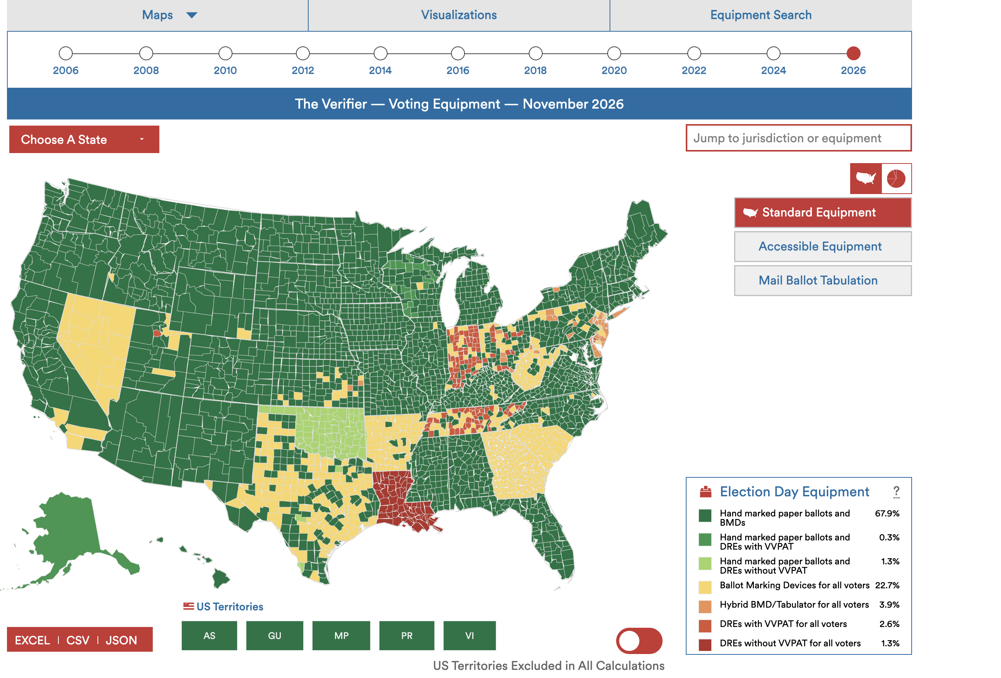
Useful tool: Verified Voting’s interactive voting equipment map

Slide 17
REPORTING GUIDE
Voting by Mail:
What Journalists Need to Know
Helping journalists recognize misinformation, avoid errors, and identify local story ideas with help from researchers who study U.S. elections and mail voting
Source: sciline.org/learn/voting-by-mail

Slide 18
Why we created the
voting by mail guide
Political pressure to restrict it
With control of Congress at stake in 2026, the Trump administration is pushing to restrict mail-in voting, even though the process is traditionally governed state by state.
“Reporters will sometimes get that wrong: they’ll say, ‘You have to mail it in,’ but you might not have to.”
It's a local story
State policies on how and when mail ballots must be requested, completed, submitted, collected, verified, and counted vary considerably.
Journalists can explain the terminology
— Mindy Romero, director of the
Center for Inclusive Democracy
The terminology can be misleading. Though commonly known as “mail ballots” and “mail-in ballots,” these ballots also can be returned in person, with options (like drop boxes) varying by state.
Source: SciLine, “Voting by Mail” guide
2

Slide 19
The three ways states handle mail voting
8
28
14
Universal Mail Voting
No-Excuse Absentee
Excuse Required
Eight states + D.C. mail a ballot automatically to every registered voter
Twenty-eight states let any voter request a mail ballot without giving a reason
Foureen states require voters to provide a qualifying excuse to vote by mail
Source: National Council of State Legislatures
4

Slide 20
Mail ballot fraud is very rare.
What the
research says
Researchers at the Brookings Institution, a nonpartisan think tank, examined cases of fraud reported during elections in 2016, 2018, 2020 and 2022 and estimated there were about four cases of fraud for every 10 million mail ballots cast, on average.
“Get acquainted with the facts around mail-in voting because there is a lot of misinformation.”
Universal vote-by-mail policies don’t appear to benefit one party over another.
When researchers examined election data from 1996 to 2018 in three states with universal vote-by-mail policies—California, Washington, and Utah—they found that the policy “does not appear to tilt turnout toward the Democratic party, nor does it appear to affect election outcomes meaningfully.”
— Mindy Romero, a political sociologist at the University of Southern California
Mail ballot rejection rates vary across states, as do the reasons election officials reject mail ballots.

Slide 21
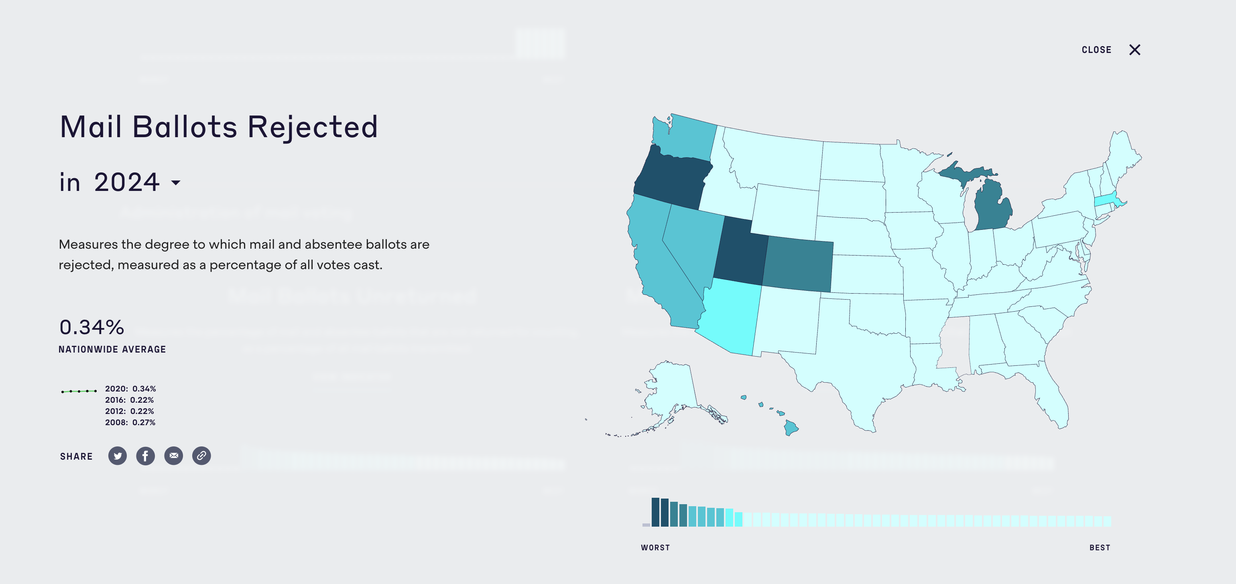
Useful tool: MIT’s Election Performance Index

Slide 22
REPORTING GUIDE
When redistricting becomes gerrymandering:
What journalists need to know
Helping journalists understand how redistricting becomes gerrymandering, evaluate claims with evidence, and find local story ideas with help from researchers who study U.S. elections
Source: sciline.org/elections/redistricting

Slide 23
Why we created the
redistricting guide
An unprecedented mid-decade redistricting wave
President Trump asked Texas Republicans to redraw congressional lines mid-decade to help the GOP hold the U.S. House. Texas complied, and other states followed, some countering to help Democrats.
“...state legislative elections in 2026 are ‘just going to be massively important.’”
It's a local story
Most states put redistricting power in the hands of elected state legislators. Whichever party controls the legislature can redraw the map in its own favor.
— Christopher Warshaw, Georgetown University
Journalists can explain the science
Statistical measures like “the efficiency gap” let journalists assess gerrymandering at the state level.
Source: SciLine, “When Redistricting Becomes
Gerrymandering” guide

Slide 24
Three Ways Maps Get Gerrymandered
Packing
Cracking
Stacking
Party A draws maps that “pack” voters likely to vote for Party B into one or two districts. Even if Party B wins 52 percent of the statewide vote, the state ends up with more members of Congress (or more members in the state legislature) from Party A.
This is essentially packing in reverse. Party A divides Party B’s likely voters among many different districts, so that they have a harder time winning a majority in any (or in as many) districts.
Put equal numbers of lower-income and higher-income voters in a district. Since research finds higher-income voters turn out at substantially higher rates, they’re more likely to end up with the representative they’d prefer.
Sources: SciLine, “When Redistricting Becomes Gerrymandering” guide
5

Slide 25
What the
research says
Gerrymandering can be measured with statistical methods.
Political scientists use measures like the efficiency gap, which counts each party’s “wasted” votes, to detect a map’s partisan bias with mathematical rigor.
“The ‘efficiency gap’ captures whether a redistricting plan is potentially biased against a party by making that party waste more votes than the other.”
Higher-income voting presincts turn out at much higher rates
A 2025 nationwide precinct-level study of the 2020 presidential election found a 27-percentage-point turnout gap between the highest- and lowest-income precincts. This indicates why ”stacking” works.
— Barry Burden, director of the Elections Research Center at University of Wisconsin, Madison
Most people have no idea how redistricting is handled in their state.
Source: SciLine, “When Redistricting Becomes
Gerrymandering” guide

Slide 26
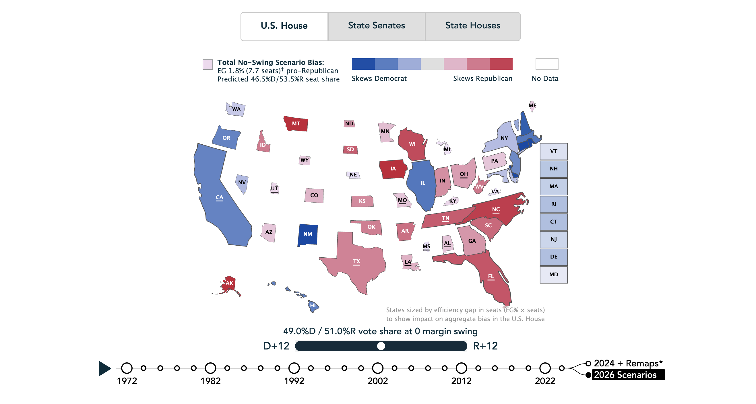
Useful tool: Planscore.org has interactive maps that use statistical measures to assess the fairess of each state’s redistricting maps.

