Slide 1
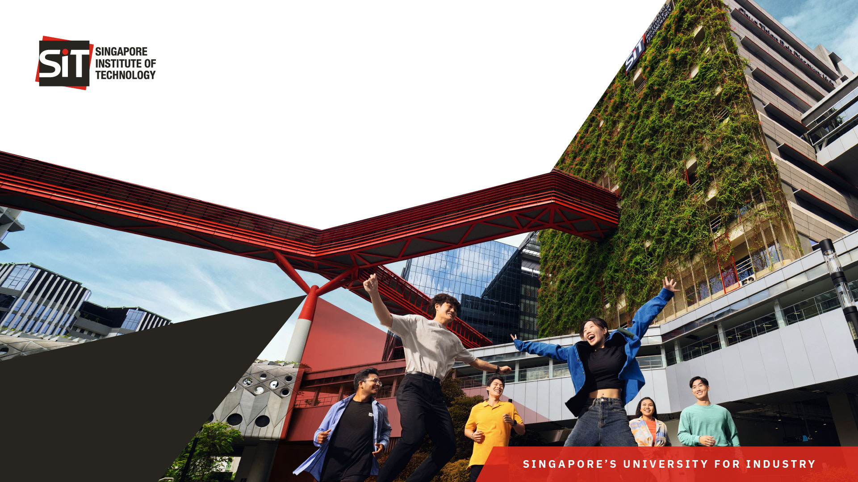
Visit by the National Press Foundation
23 June 2026

Slide 2

3.10pm - 4.10pm|
Sharing Session on GenAI by A/Prof Donny Soh and Prof Ian McLoughlin on Ethics in GenAI and Industry & Trade
​
4.11pm - 4.20pm|​
SIT Walking Tour led by Senior Manager Clyde Teo, Estates
4.21pm - 4.55pm|
SNAIC Showcase (SIT x NVIDIA AI Centre)

Slide 3

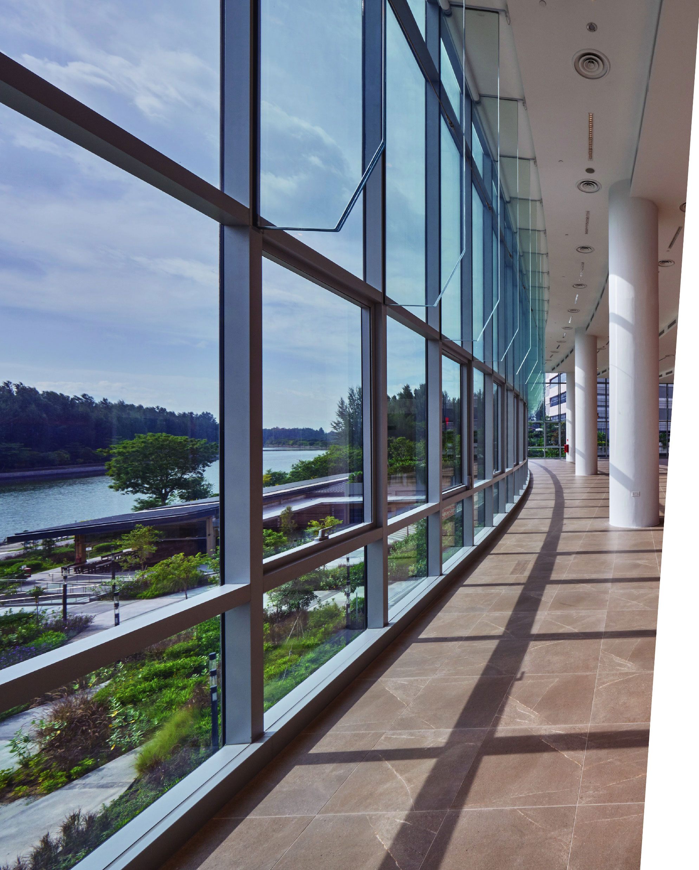
04
4.55pm – 5.20pm|
Punggol Digital District (PDD) Walking Tour led by Joseph Yap, JTC
​
05
5.25pm|​
Photography Stop at Campus Boulevard
06
5.30pm|
End of Programme
Bus pickup at Tower 88

Slide 4
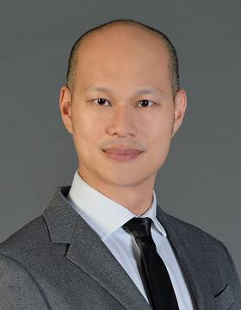
AI expert 1: Donny Soh
Programme Leader, SIT x NVIDIA AI Centre (SNAIC) Artificial Intelligence (AI) Training Programme.
  2025 – Present
Programme Leader, Bachelor of Science with Honours in Applied Artificial Intelligence.
  2022 – Present
Programme Leader, SIT- DigiPen (Singapore).
  2021 – 2022

Slide 5
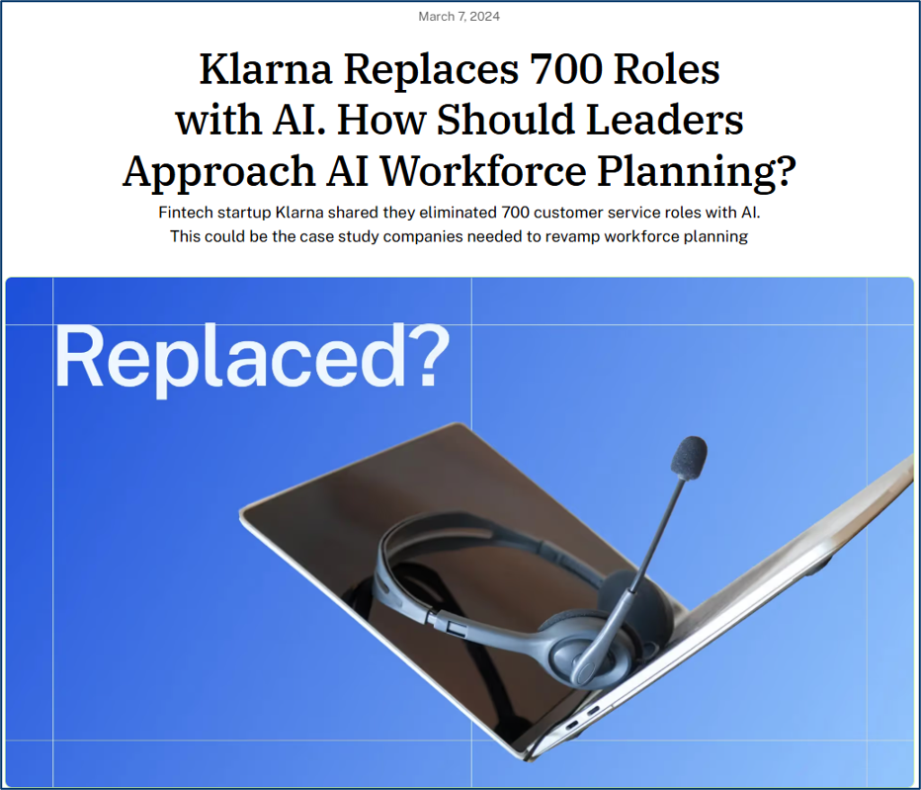
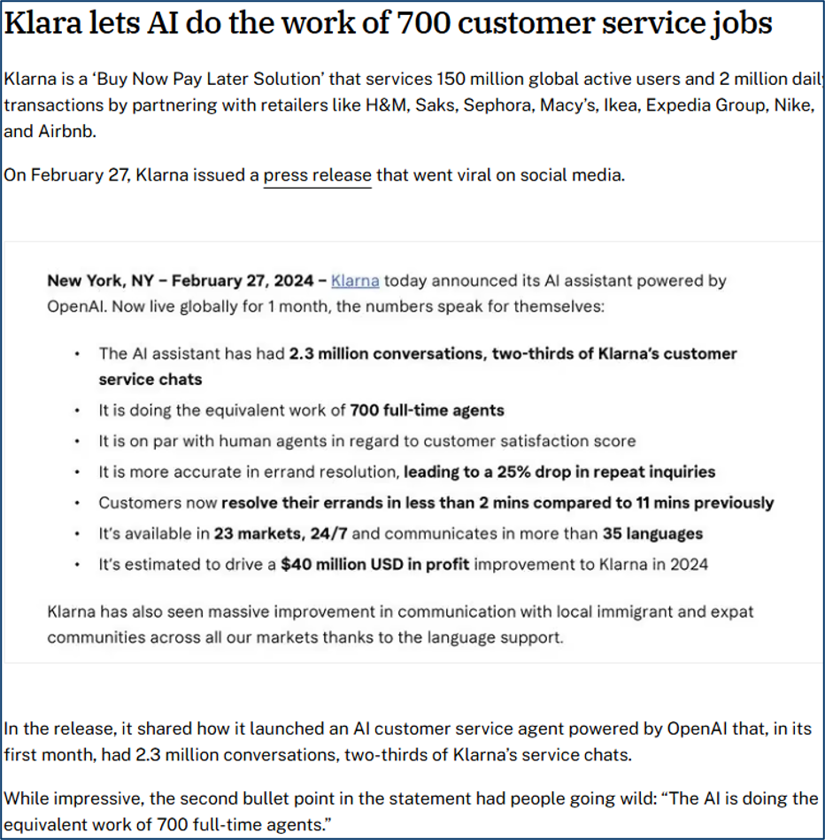
Did the work equivalent of 700 agents.
Notes:
In 2024, in the rush to jump on the AI bandwagon, a fintech company called Klarna made a big move.
Their AI assistant was doing the work of around 700 customer support agents, and they froze hiring on the back of it.
At the time it was huge, and it raised a real fear: are customer support jobs still relevant in the age of AI?

Slide 6
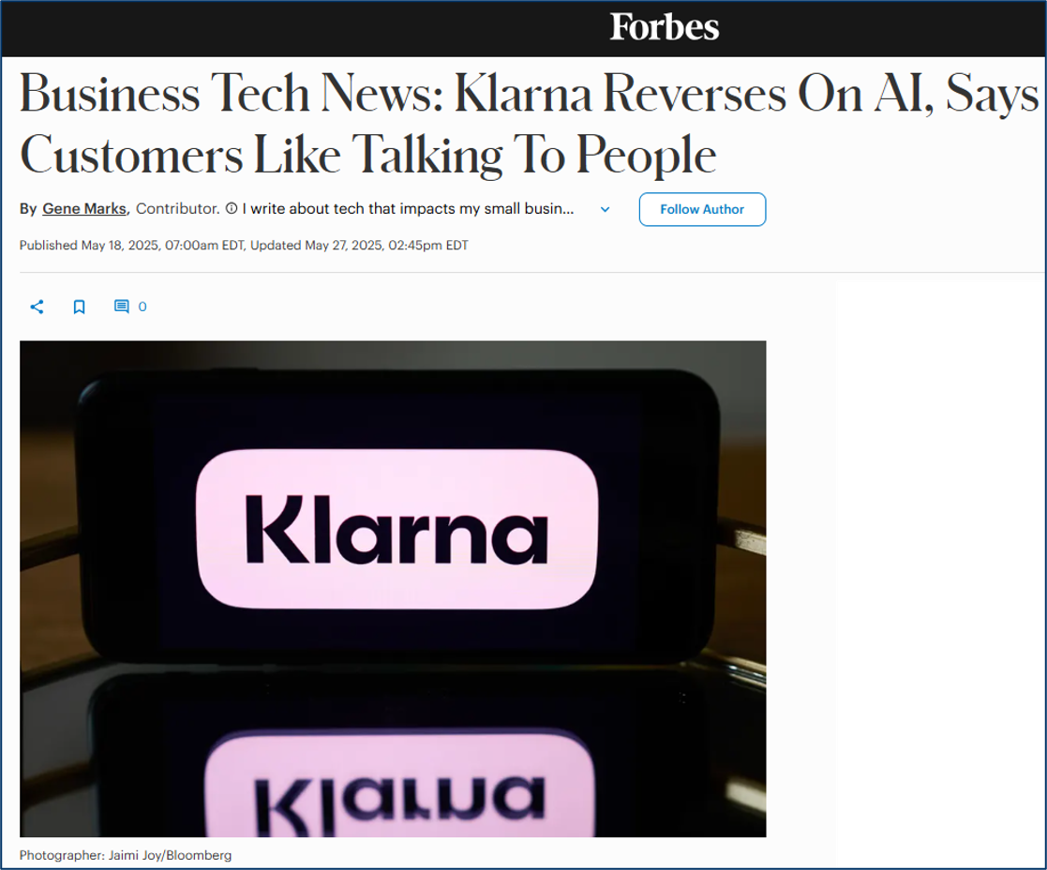
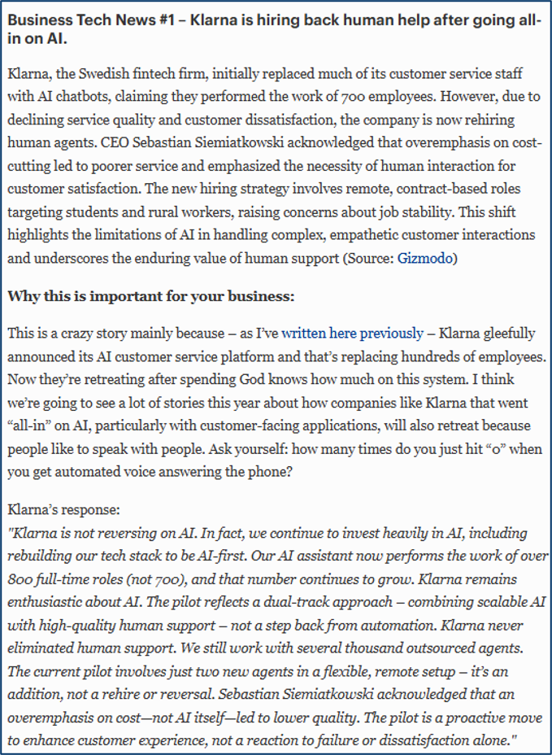
Hiring some of them back.
Notes:
Here's the interesting part. About a year later, they reversed course.
They started hiring people back. The CEO admitted it himself: customers still want to talk to a human.
They had focused too much on one thing, cost efficiency, and quality dropped. In his words, it wasn't sustainable.
Butcher knife versus fine carving knife

Slide 7
Admissions from the CEO.
Cost, unfortunately, seems to have been a too predominant evaluation factor when organising this. What you end up having is lower quality.
We focused too much on efficiency and cost. The result was lower quality, and that’s not sustainable.
Sebastian Siemiatkowski
CEO, Klarna
Bloomberg · May 2025
Notes:
Remember to share the point where this is not an outlier but something that is common even in my own personal consultations eg with a educational childcare in Singapore.

Slide 8
Klarna automated a quadrant when it should have split a task.
PRIORITISE High Effort, Low Impact. Tasks that take significant time but generate low value. Focus here first for AI opportunities, Klarna’s routine cases (FAQs, status checks). Automated correctly. | OPTIMISE CAREFULLY High Effort, High Impact. Important but time-consuming tasks: Improve efficiency while maintaining quality and oversight. Klarna’s complex cases (disputes, distressed customers). Human-critical, yet fully replaced.
DEPRIORITISE Low Effort, Low Impact. Quick and low-value tasks: not worth focusing on. | MAINTAIN / ENHANCE Low Effort, High Impact. Efficient and valuable tasks: Maintain or apply light improvements.
EFFORT
BUSINESS IMPACT
Q1. Have businesses invested enough to protect public trust while chasing productivity?
Notes:
Expand on the point on the childcare

Slide 9
Keeping humans in is how trust is kept.
1. The typical answer: human in the loop accountabilty.
Human accountability does not mean assigning blame to a human when the AI goes wrong.
You end up not giving the human agency but you are making the human responsible.
2. The counter intuitive answer: human writes the part that is relational.
A reply to a customer with a unique concern has to be relational.
AI can do 80%; the last 20% is where human judgement lies.
One email looks like nothing. Together they are the core business, which is what many companies automate away.
3. Trust is kept by having people who can still do the 20%, which means training them to.
Q1. Have businesses invested enough to protect public trust while chasing productivity?
Notes:
Expand on the point on the childcare

Slide 10
Where the cost lands decides whose job it is.
When the cost lands on the firm.
When the cost lands on the public.
The failure hits the balance sheet.
Self-interest is enough.
This is not virtue and just risk management.
The firm captures the upside; society absorbs the downside.
Eroded trust in institutions, harm to people who are not the customer, safety.
Making money is the job. Protecting trust where the failure hits the firm is part of making money. Where the cost falls on the public, the market does not price it, and no firm closes that gap alone.
Q1. Have businesses invested enough to protect public trust while chasing productivity?
Notes:
If it's not the firm's job alone, whose is it? It's shared. The firm owns what hits its own books. The external part only gets fixed when something pushes the cost back onto the firm, and that something can be standards, liability, regulation, or public pressure.

Slide 11
What the corporate world is doing.
BUY | DEPLOY | PILOT | REORGANIZE
88% | 33% | 39% | 6%
use AI in at least one function. Up from 78% a year ago. | have scaled it across the entreprise. | report any enterprise EBIT impact with most of it under 5%. | capture real enterprise value by redesigning work.
Buy broad | Deploy Narrow | Pilot wide
Source: McKinsey, State of AI 2025.
Q2. What is the corporate world doing to close the gap between AI’s potential and real execution?

Slide 12
The 6% reorganise the work.
IKEA
When the Cut Becomes a Channel.
Chatbot Billie handled 47% of queries, 3.2 million conversations.
Did not cut the 8,500 agents.
Reskilled them into remote interior design advisers.
That channel earned €1.3 billion in a year. Target: 10% of sales by 2028.
Same situation. Opposite choice.
Source: Ingka Group; Reuters; CIO.
Q2. What is the corporate world doing to close the gap between AI’s potential and real execution?
Notes:
Here is something I noticed putting this together. Almost every number I showed you, I could only use because a journalist reported it.
Companies have a press release but the only reason any of us know what happened nextwas because reporters could give an account of what actually happened.
And that is the part AI can't do. AI can write, but it cannot report.
AI can write you something from material that already exists.
But a lot of reporting is finding things that aren't written down anywhere yet, what someone will only tell you in person, or the gap between what a company announced and what it actually did.
There is no document to summarise, because the reporting is what creates the document. AI can write.
That is the same piece of work that Klarna tried to automate away, the high human effort and high business impact and it is more or less what all of you do for a living

Slide 13
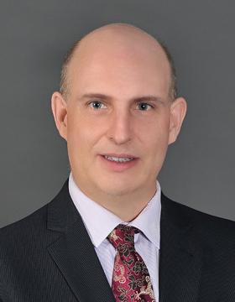
AI expert 2: Ian McLoughlin
PhD, The University of Birmingham, United Kingdom
Cluster: Infocomm Technology

Slide 14
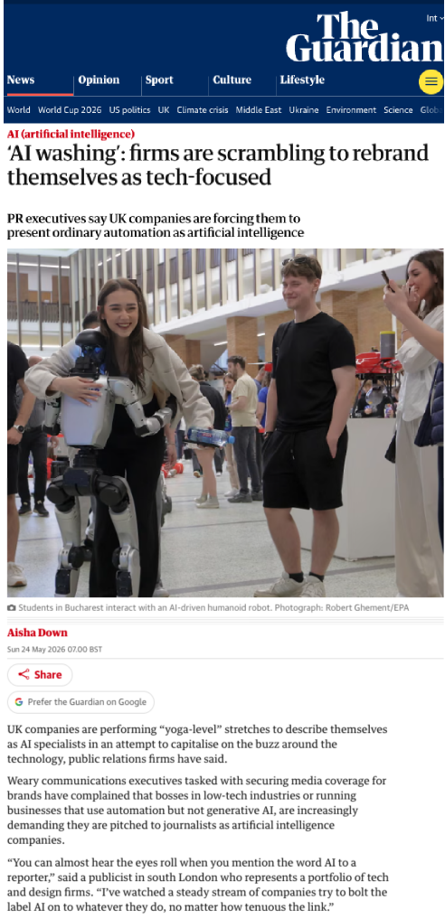
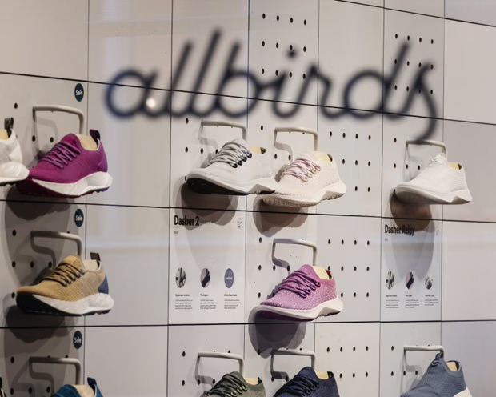
It's already everywhere
“You can almost hear the eyes roll when you mention the word AI to a reporter,” said a publicist in south London who represents a portfolio of tech and design firms. “I’ve watched a steady stream of companies try to bolt the label AI on to whatever they do, no matter how tenuous the link.”
Q1: do you know what is AI?

Slide 15
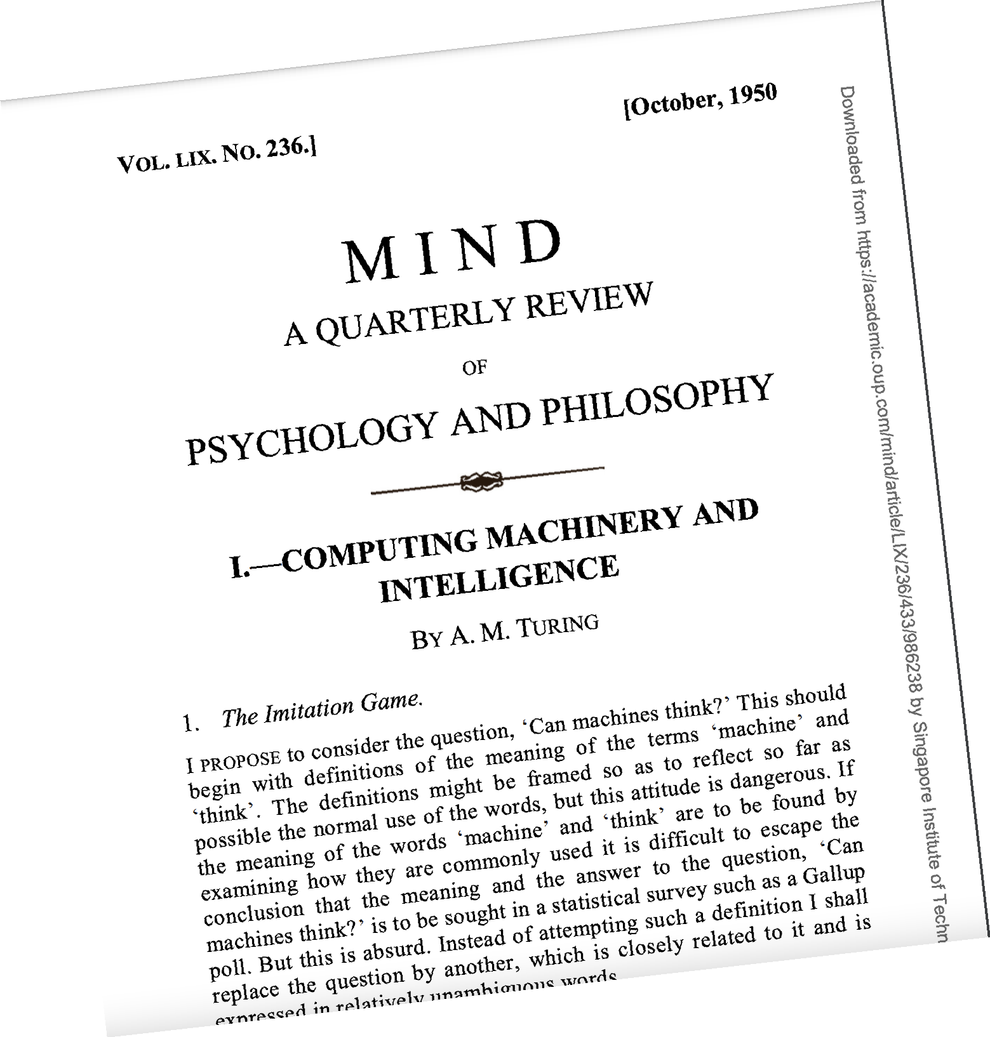
What is AI?
The capacity of computers or other machines to exhibit or simulate intelligent behaviour; the field of study concerned with this.
Oxford English Dictionary
Artificial intelligence essentially comes in two forms, and it’s very important to distinguish them. The first one is usually called narrow AI, and then there’s artificial general Intelligence or AGI. Narrow AI is the stuff with which we’re really familiar. It’s the stuff that’s working today. AGI is much more speculative.
Professor John Lennox

Slide 16
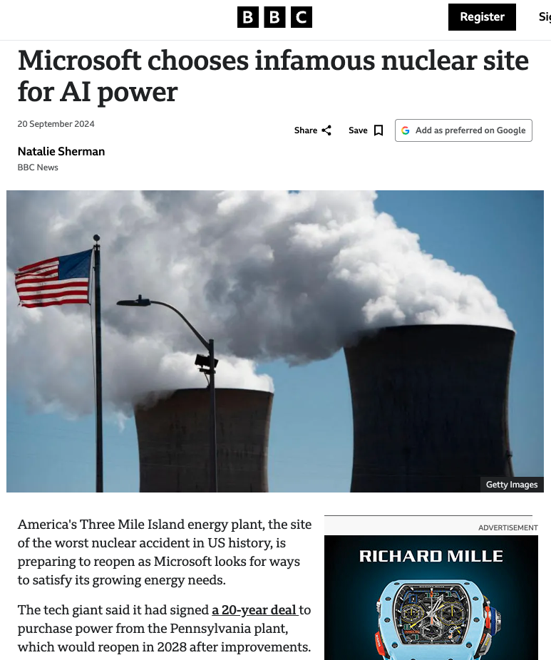
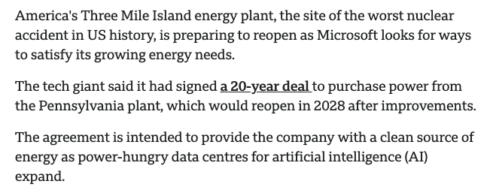
Ethical AI deployment
Short term is easy to understand:
Assist - It can help humans to do their jobs better, so why not?
Advantage - often cheaper and more accurate.
Accelerate – usually faster, no downtime, parallelisable
Medium term is less clear:
Who benefits?
Economics - not employees but company bosses/shareholders
Employment - not those who lose their jobs to AI.
Energy - not those affected by climate change or pollution.
Equity - AI doesn't pay taxes like employees do.
Public reaction against AI.
Long term is concerning:
Mind - AI out-thinks humans.
Morality - can be programmed, but whose?
Manumit - "AI wants to be free" & personhood.
We are valued for what? physical strength/intellect/decision
making skills/economic productivity?​

Slide 17
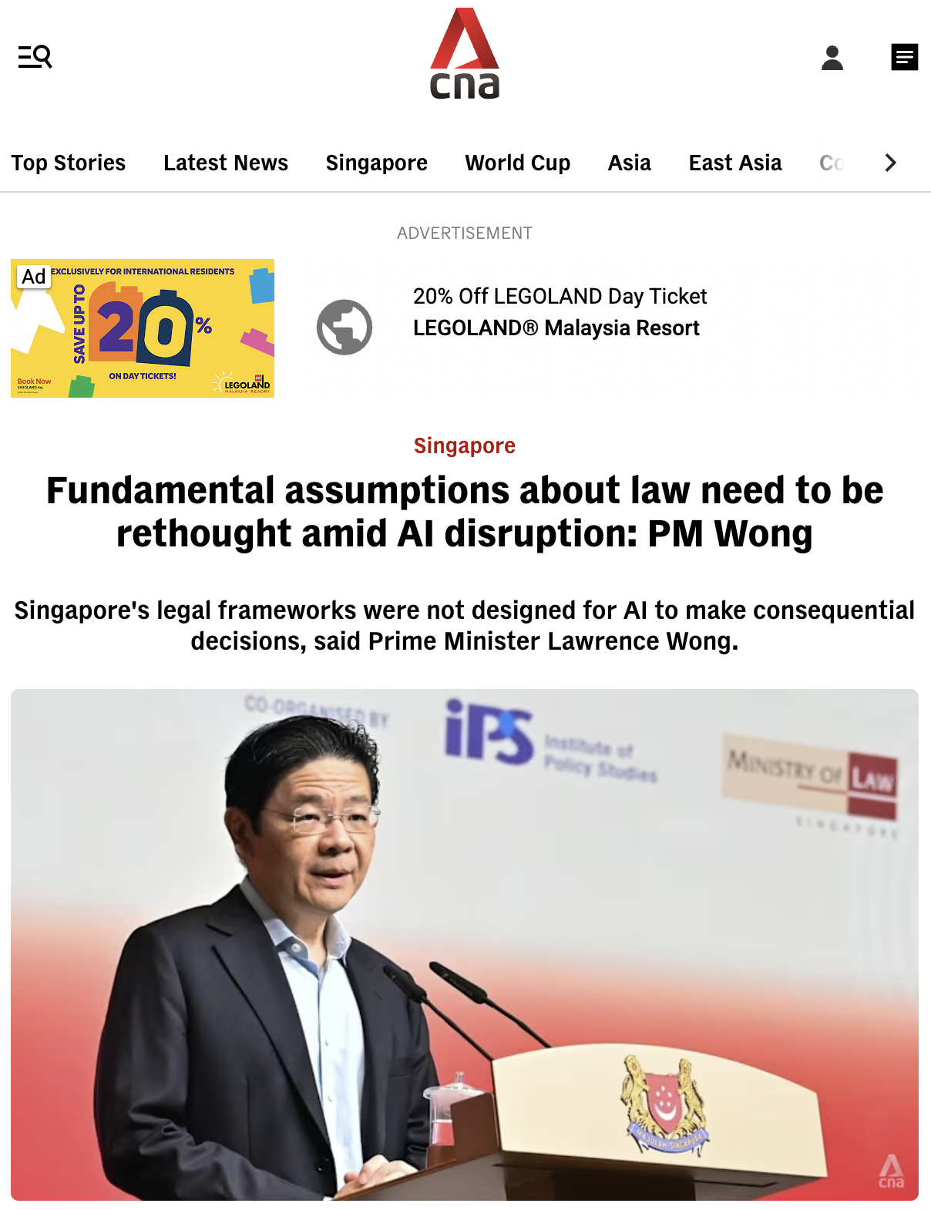
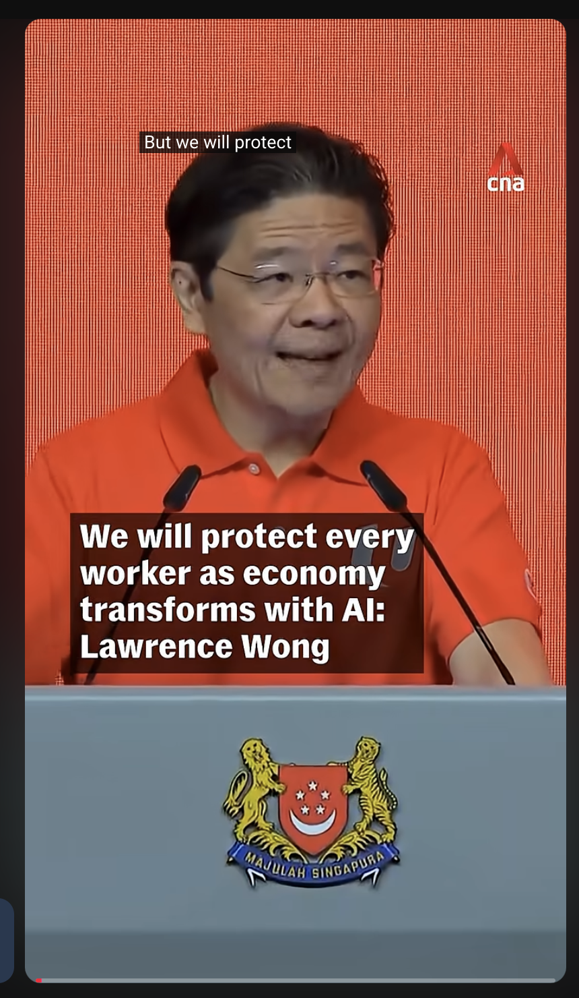
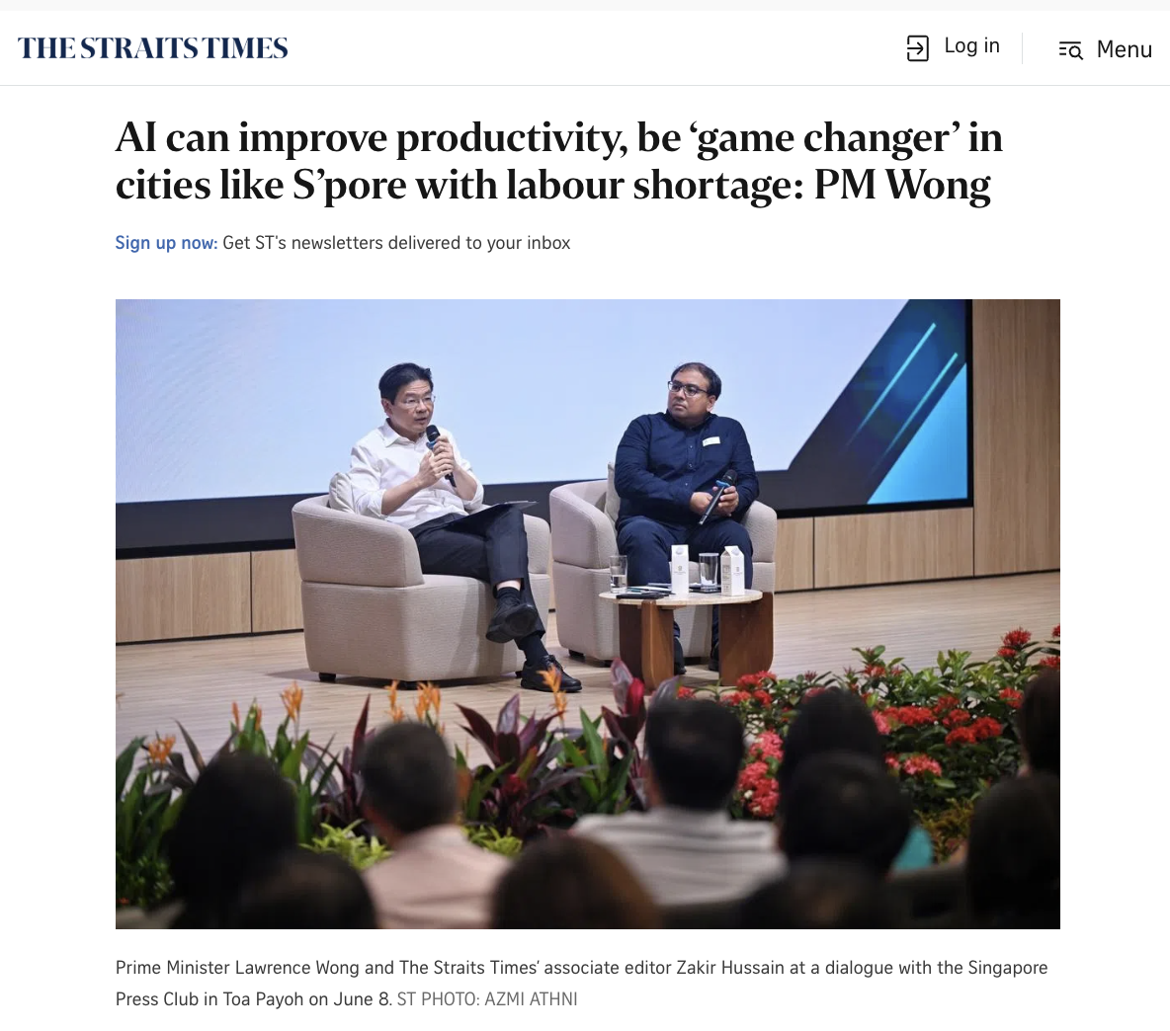
Leadership matters

