Slide 1






OSINT 101
TRAINING
Open-Source Intelligence for Journalists
Janhvi Mohan Bhojwani
National Press Foundation Widening the Pipeline Fellowship
Monday, June 8, 2026 · Session 1

Slide 2
OVERVIEW
Today's Agenda
What is OSINT + how it's used in journalism
Skills: search, verification, metadata, reverse image search, geolocation
Tips, tricks & what to watch out for
Case studies: real verification scenarios
Takeaways, Resources, Q&A

Slide 3

BASICS
What is OSINT?
Open-Source Intelligence:
Researching, gathering and analyzing free
and publicly available information online to
have a fuller understanding of something
Social Media
Satellite Imagery
Public Records
X, Telegram, TikTok, Instagram, Facebook, Snapchat, YouTube
Google Maps, Mapillary, Google Earth, NASA Worldview
Government databases, court filings, professional licenses
Industries using OSINT: Cybersecurity, Banking and Finance, Law Enforcement and Government, Marketing, Journalism and Research

Slide 4
BASICS
OSINT in journalism
In journalism: breaking news verification · conflict documentation · accountability reporting · finding sources · weather/everyday situations · elections misinformation monitoring · long term projects and investigations · social media profile of a mass shooting
●Digital First Responders:
Find, verify and obtain permission for user generated content (photos/videos by users who are not journalists) during breaking news and complicated situations.
Doing research to gather more information/leads as an incident escalates.
Verifying social media posts/profiles of people to use in a story.
Finding sources online for a story.
Incident occurs
Open source intelligence journalists begin monitoring the situation online
News crews get to the scene
Breaking news reporting is published
Longer form reporting & investigations published

Slide 5



BASICS
OSINT in journalism
Conflict UGC
Breaking News
Verifying footage from wars in Gaza, Ukraine, Iran, and other conflict zones under deadline pressure
Rapid verification during live events: protests, mass casualty incidents, viral videos
Social Investigations
Geolocation
Tracing identities across platforms, verifying social media profiles using public records and cross-linking
Pinpointing locations from architectural details, road geometry, satellite imagery and street view

Slide 6


BASICS
OSINT in journalism
User Generated Content
Open Source Intelligence
UGC
OSINT
Posts, pictures, and videos created by members of the public who are not affiliated with the media.
Analyzing and verifying content using free online tools and publicly available information.
Examples:
What it lets you do:
A bystander's video of a crash posted to X
Instagram reels from a protest
Telegram footage from a conflict zone
A Facebook Live from the scene of an incident
Geolocate a video to a specific street corner
Confirm when a video was originally posted
Trace a social media profile across platforms
Cross-match two UGC videos to each other
When assessing a video, always be skeptical and stop to ask yourself “how do I know what this video claims?”

Slide 7
BASICS
User Generated Content (UGC)
Posts, photos, and videos posted by users on social media who are not affiliated with a media outlet.
How do you verify UGC?
1
GOLD STANDARD
Speak to the person who filmed it
Trace it down to the person who filmed it. Reach out directly to the person who posted the content. Confirm what they filmed, when, and where.
Get permission to use it. Direct source contact removes almost all ambiguity.
2
SOURCE CORROBORATION
Show it to someone who can confirm it
Show it to a source who can speak to the authenticity of the video. This could be officials, locals, relatives of the person in the video.
Someone with firsthand knowledge of the event can corroborate the video
OSINT-LED VERIFICATION
3
Use only what you can see and hear
This is where OSINT techniques become essential. Assessing authenticity based on what we see in the video by itself: Geolocating, (match architectural details to satellite imagery) reverse image searching, analyzing metadata and as many markers and clues in the video that could line up in corroborating the video.
In practice you often use all three together. Each one that confirms something adds another layer of confidence.
1. Discover
2. Cross Reference against reporting
3. Geolocate
4. Authenticate
5. Publish

Slide 8


WHAT GOES WRONG
How UGC Mistakes Usually Happen
Not necessarily because of malicious users spreading disinformation
Mostly because of the rumor mill.
Assuming we know what something is
Based on what other people, including other journalists, are already saying about it. Once a wrong ID circulates, it spreads rapidly.
Trusting the source of the source
If a major outlet published it, it must be verified. Not true. One newsroom's mistake becomes everyone's mistake very quickly.
Skipping worst-case scenario thinking
Not asking: what is the absolute worst thing this could turn out to be? If it was a different truck robbery, a different country, a different year, AI generated video
Unless you know who filmed UGC, or an authoritative source can confirm what it shows: all you know is what you can physically see and hear in the video.

Slide 9
VERIFICATION FRAMEWORK
Always Think Worst-Case Scenario
Before you verify, define what failure looks like.
Looting after a snowstorm
WORST CASE
It is a different incident where looting took place, could have been in a different city, on a different date.
FIX IT
Step 1 is always to get reporting. Then match what the reporting says to what you can see in the video.
A video claiming to show lockdown at a mall due to a possible shooter
WORST CASE
It is old footage from a different incident, or from a completely mall in a different state or country
FIX IT
Reverse image search every key frame. No hits from before the reported date is a good sign, not a guarantee.
A social media profile you believe belongs to a suspect
WORST CASE
It belongs to someone with the same name who has nothing to do with the incident.
FIX IT
Build a chain of evidence. Public records, cross-linked profiles, photo matches. each one adds a layer of corroboration.
Do not assume content is verified just because another outlet has shared it. Always try to gather reporting from officials directly.

Slide 10

TOOLS & TECHNIQUES
Core Tools
Reverse Image Search
Metadata / EXIF
Geolocation
Google Lens · TinEye · Yandex
ExifTool · Jeffrey's Exif Viewer · Forensically
Google Earth · SunCalc · Street View
Can help with finding the original source, detect reused/misattributed photos
Extract GPS, device, timestamp embedded in files
Pin a location using landmarks, shadows, road patterns
Advanced Search
Social Media OSINT
Video Verification
Wayback Machine · Boolean Searches
Account history · Cross-linking · Public records
InVID · YouTube DataViewer · Hive
Surface archived pages, old versions, searches to limit or widen your searches
Map networks, verify accounts, trace cross-platform IDs
Authenticate videos, check upload date, detect AI content

Slide 11
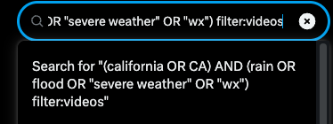
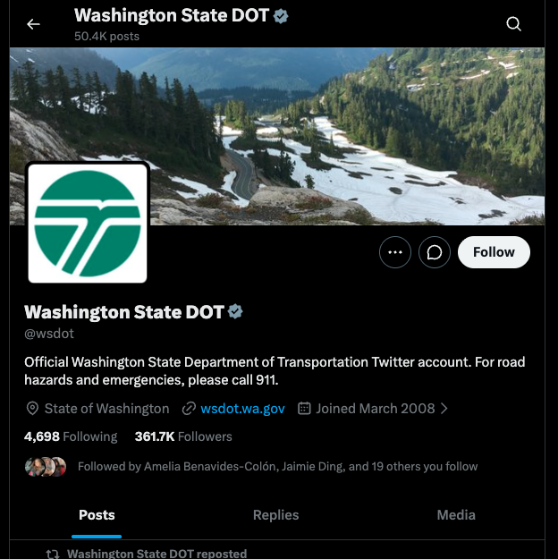

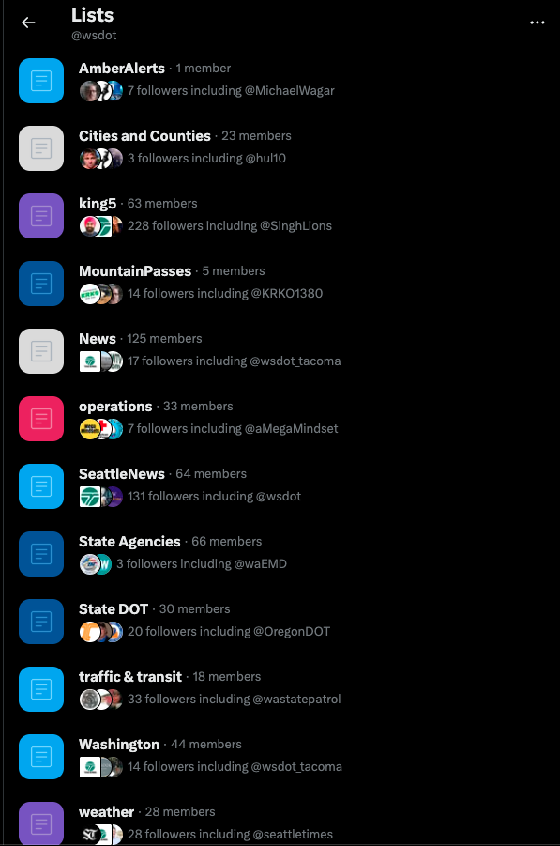
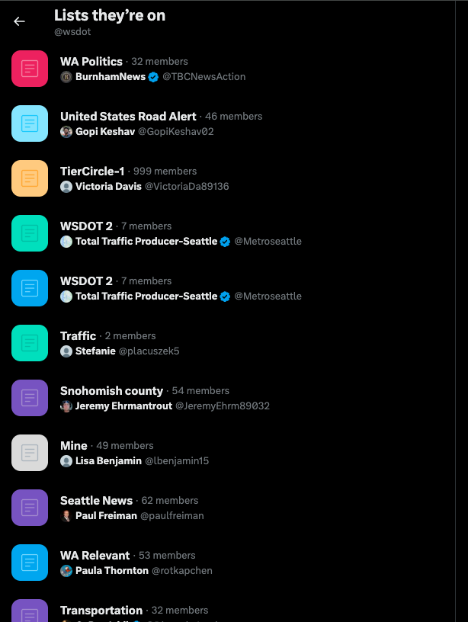
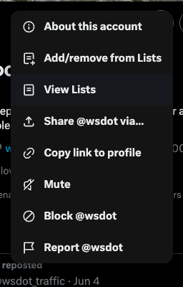
Tips and Tricks
TOOLS & TECHNIQUES
Boolean searches:
X lists:

Slide 12
CASE
STUDIES
3 real verification cases from the field
01
02
03
Social profiles — Willy Maceo
Social and video — Ma'khia Bryant
Dallas Love Field airport incident

Slide 13
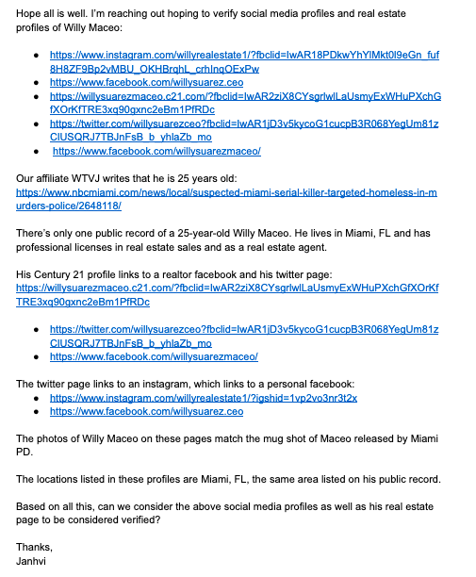


CASE 01 · SOCIAL PROFILES
Verifying Social
Media Profiles
Willy Maceo — Suspected Miami serial killer
Start with public records
Only one 25-year-old Willy Maceo in Miami. Professional licenses in real estate confirm identity and location.
Follow the cross-links
Century 21 profile → Twitter → Instagram → personal Facebook. Each platform links to the next, forming a chain.
Photo match to official source
Profile photos across all platforms match Miami PD mugshot. Location listed as Miami, FL throughout.
Key lesson: Build a chain of linked evidence — public records → professional profile → social platforms → official photo match

Slide 14

CASE 02 · SOCIAL AND VIDEO VERIFICATION
Verifying Through a Social Connection
Ma'khia Bryant & Paula Bryant — Columbus, Ohio officer-involved shooting
Start with a witness on video
In a Facebook Live showing aftermath, commenter Johnnie Jdot Dotson says he personally knows the mother. His friends list is open. Searching it returns one Bryant: Paula Bryant.
Cross-reference with a local reporter
Reporter Lacey Crisp tweets she spoke to Paula Bryant, mother of Ma'khia, and shares a photo of Paula holding a phone with Ma'khia's Facebook profile on screen.
Lock it down with public records + family interaction
Paula's public record shows her nursing license, Mansfield/Columbus addresses matching her profile bio, and an email address for Ma'khia. Ma'khia calls Paula 'mom' in comments; Paula responds 'baby.' Potential relatives (Debra Wilcox, Kha'Lil Bryant) confirmed in posts and public records.
Key lesson: A third person's open friends list can be the bridge — social connections corroborate identity when direct records don't exist

Slide 15
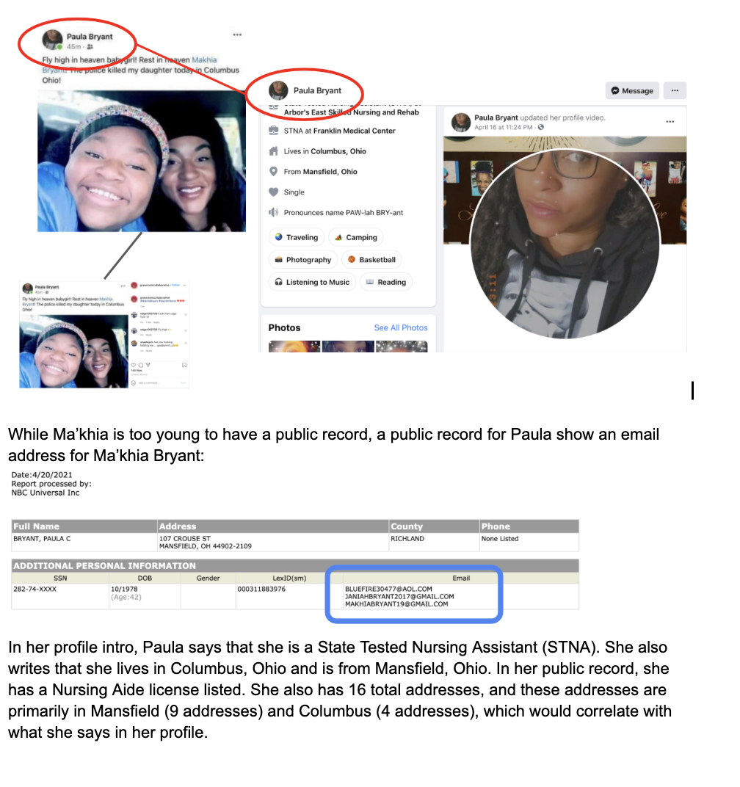
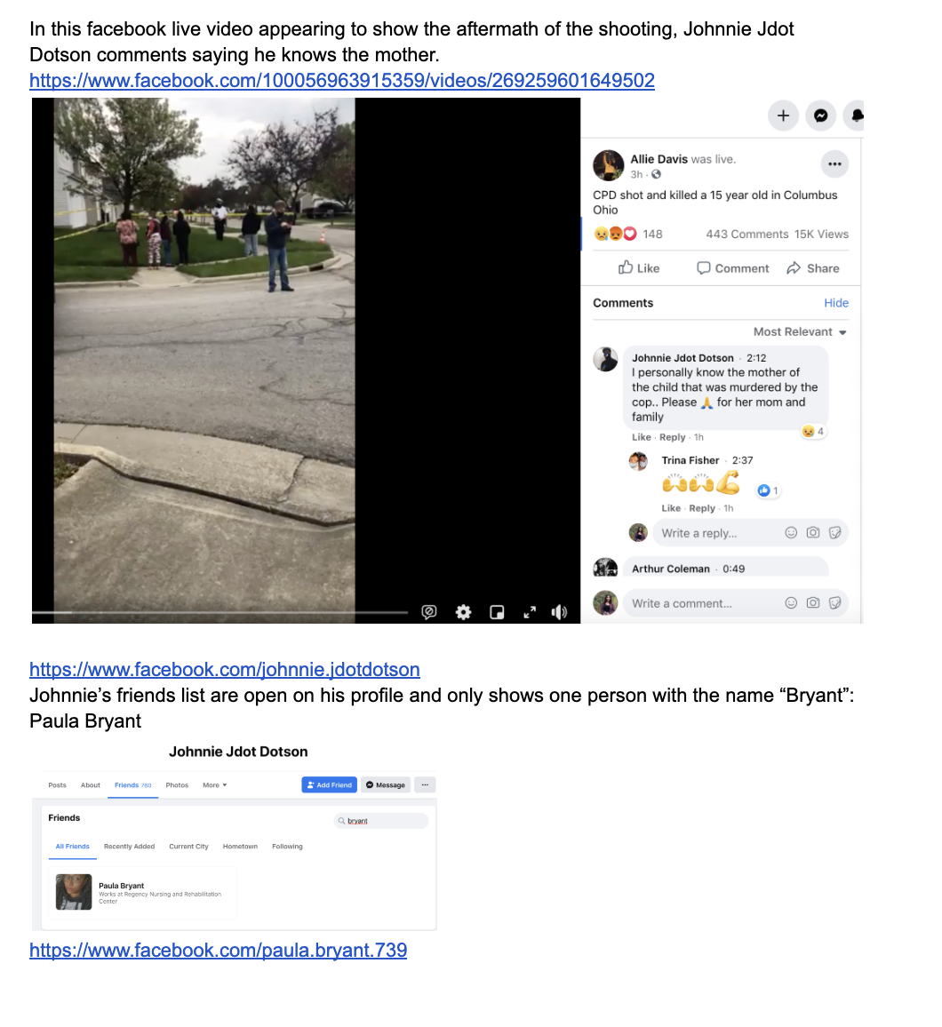
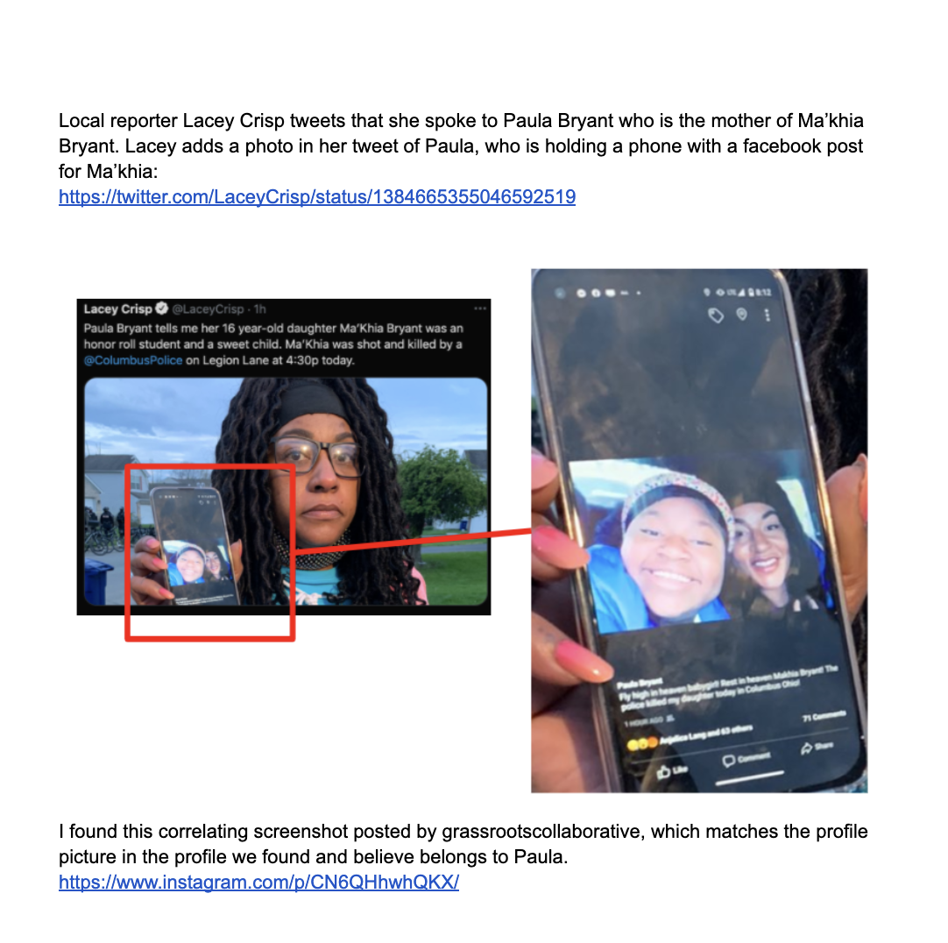
Ma'khia Bryant

Slide 16
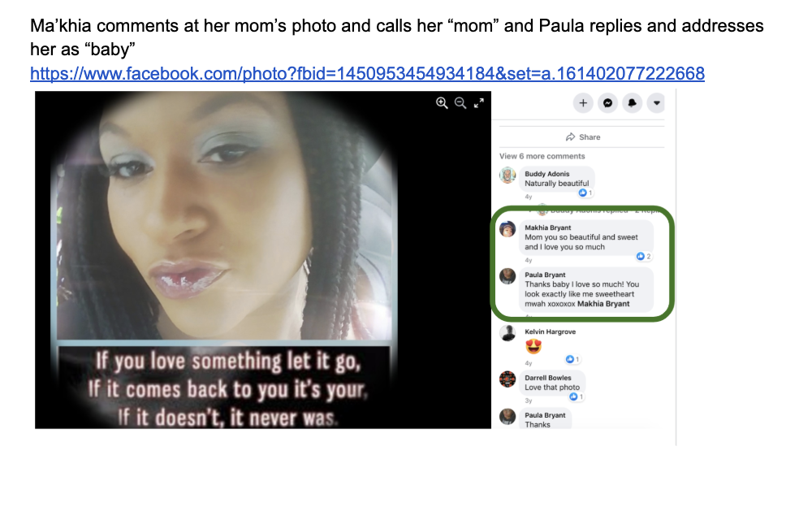
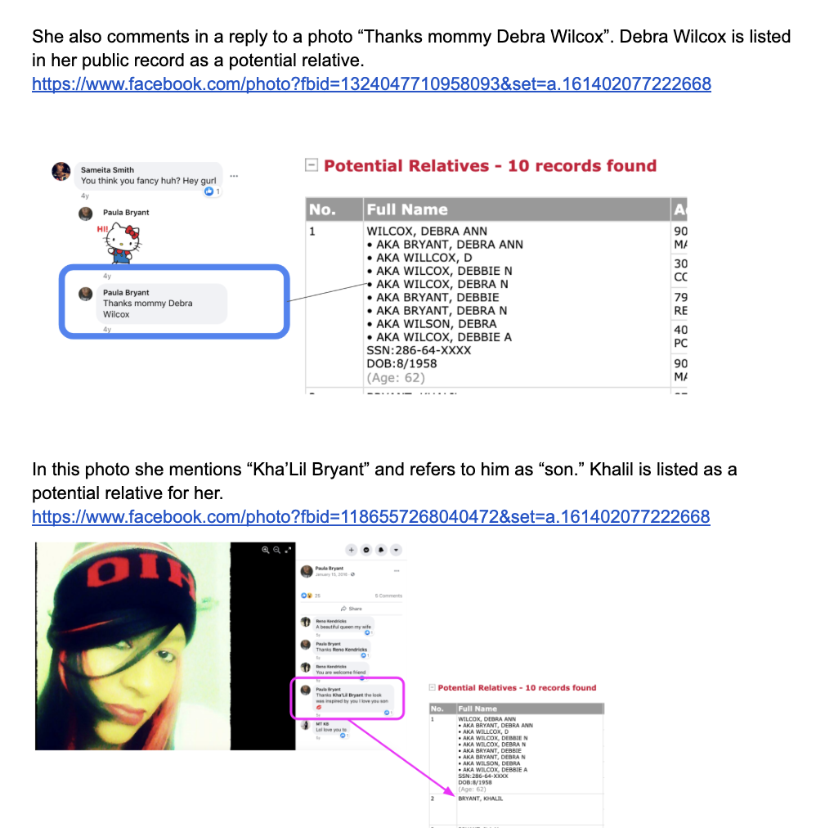
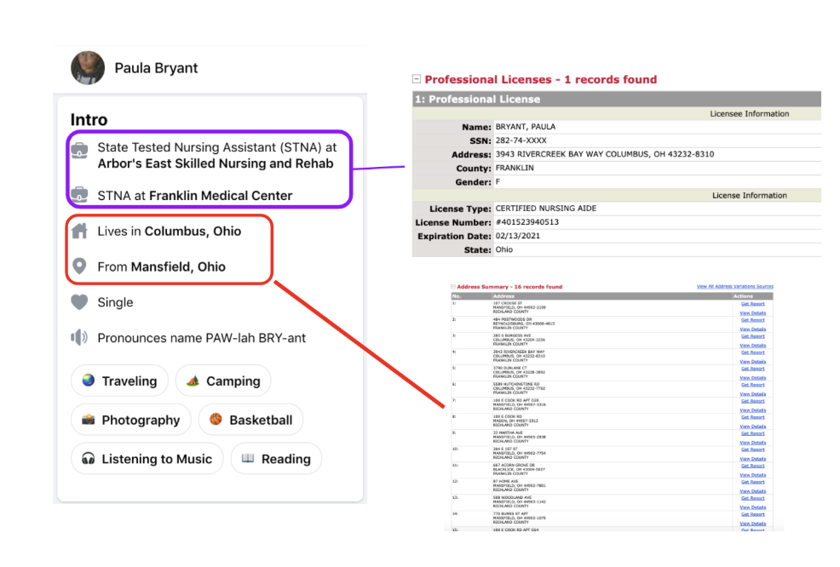
Ma'khia Bryant

Slide 17
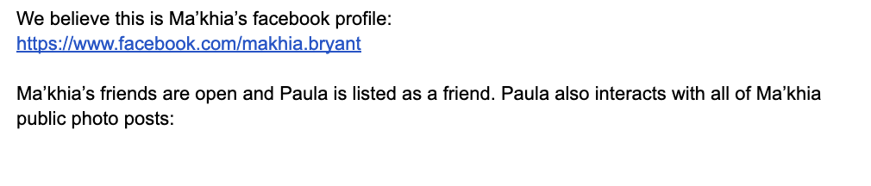
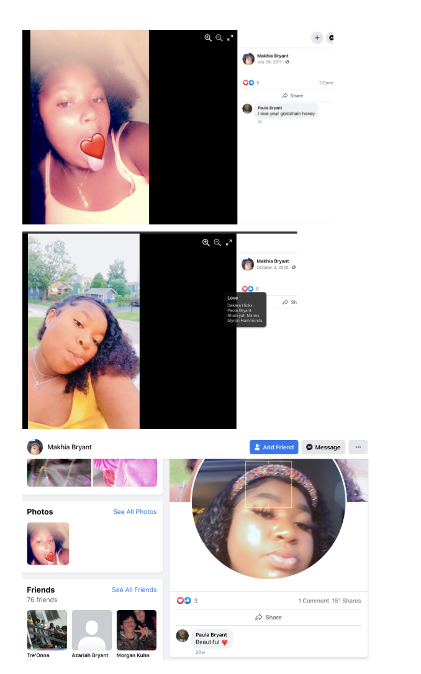
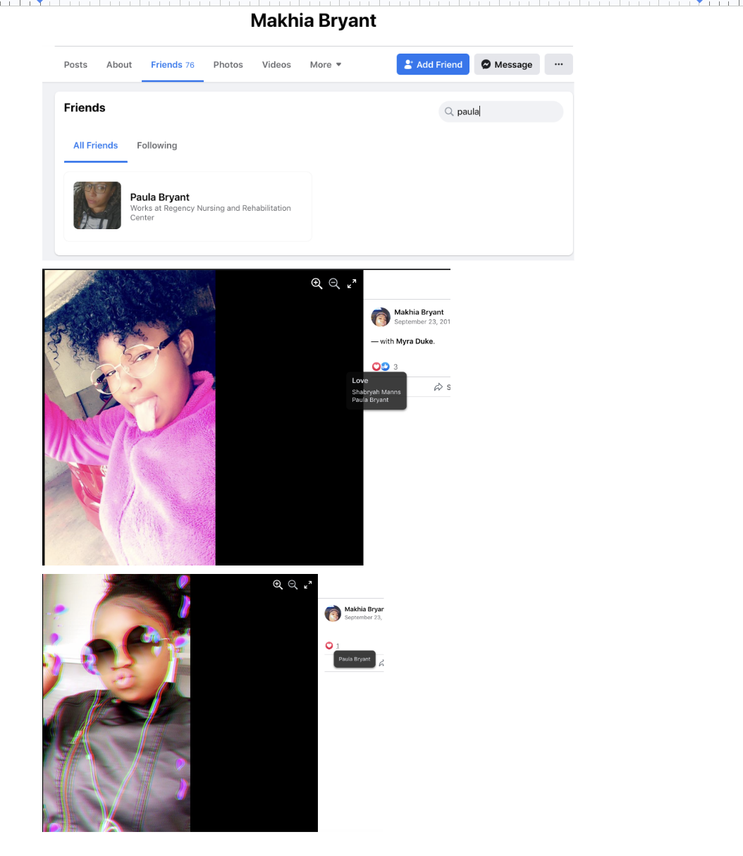
Ma'khia Bryant

Slide 18
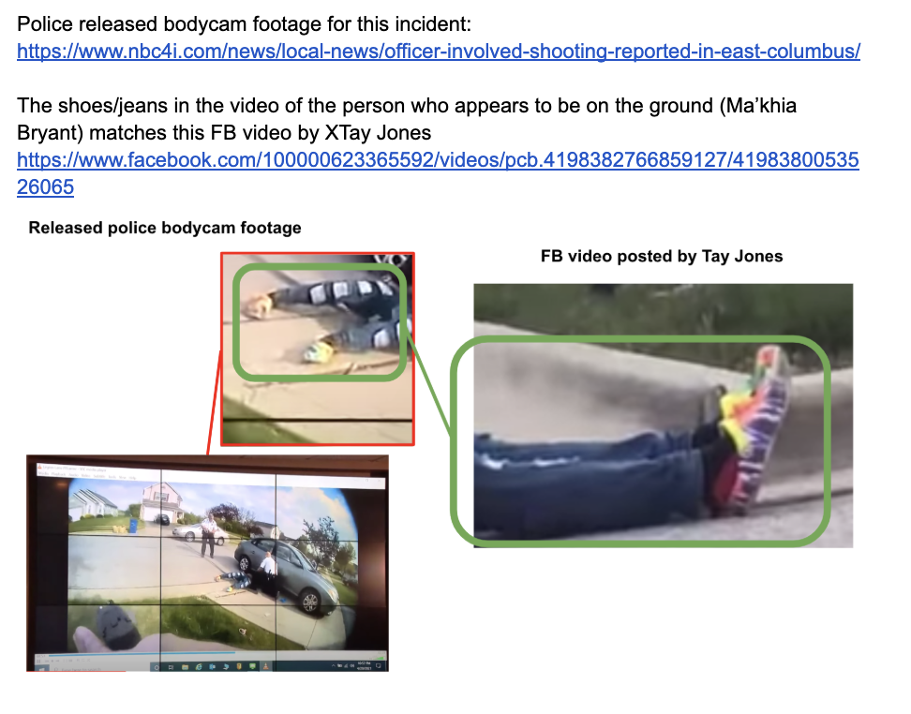
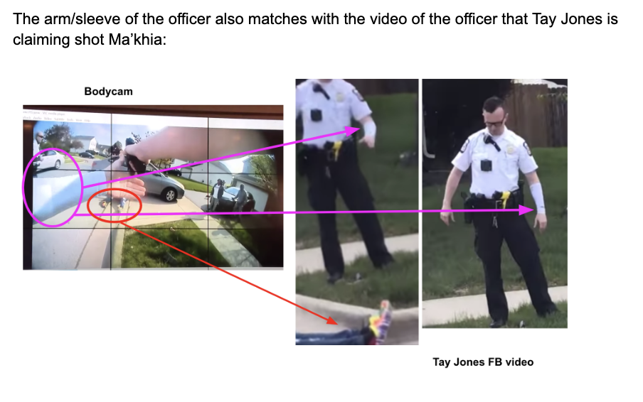
Ma'khia Bryant - UGC VIDEO

Slide 19
CASE 03 · VIRAL VIDEO VERIFICATION
Verifying a Viral Incident Video
Michael Singleton — Dallas Love Field Airport, April 18, 2025
Filmmaker contacted directly
Subject commented on the video
Family identified him
Person who filmed confirmed date, location, and gave use permission.
Michael Singleton commented on the FB post describing what happened — in his own words.
His daughter commented identifying him as her father, noted he couldn't board his CA flight.
Video timestamp visible
Uniform + location details match
Interior location confirmed
Timestamp seen at 0:20 in the video matches the reported date and time of the incident.
'Love Field' + plane logo on sleeve, 'DALLAS POLICE' on back. Matched official Dallas PD Love Field Unit social media.
Airport interior matches Starbucks near Gate 6. Southwest Airlines logo visible — consistent with the airport.
Key lesson: Six independent confirmation points — each one alone is insufficient, together they build an airtight case

Slide 20
CASE 03 · VIRAL VIDEO VERIFICATION
Verifying a Viral Incident Video
Michael Singleton — Dallas Love Field Airport, April 18, 2025
Filmmaker contacted directly
Subject commented on the video
Family identified him
Person who filmed confirmed date, location, and gave use permission.
Michael Singleton commented on the FB post describing what happened — in his own words.
His daughter commented identifying him as her father, noted he couldn't board his CA flight.
Video timestamp visible
Uniform + location details match
Interior location confirmed
Timestamp seen at 0:20 in the video matches the reported date and time of the incident.
'Love Field' + plane logo on sleeve, 'DALLAS POLICE' on back. Matched official Dallas PD Love Field Unit social media.
Airport interior matches Starbucks near Gate 6. Southwest Airlines logo visible — consistent with the airport.
Key lesson: Six independent confirmation points — each one alone is insufficient, together they build an airtight case

Slide 21
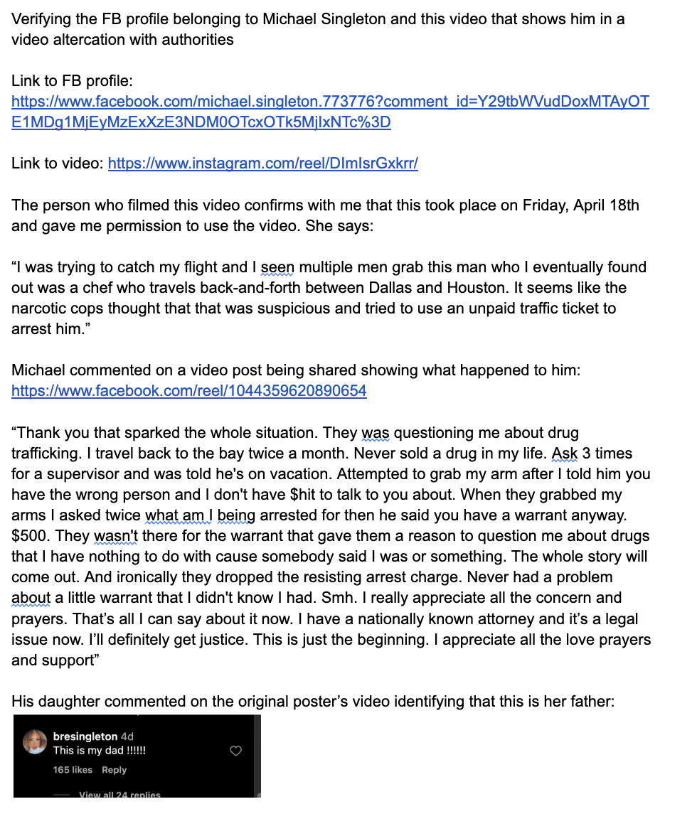
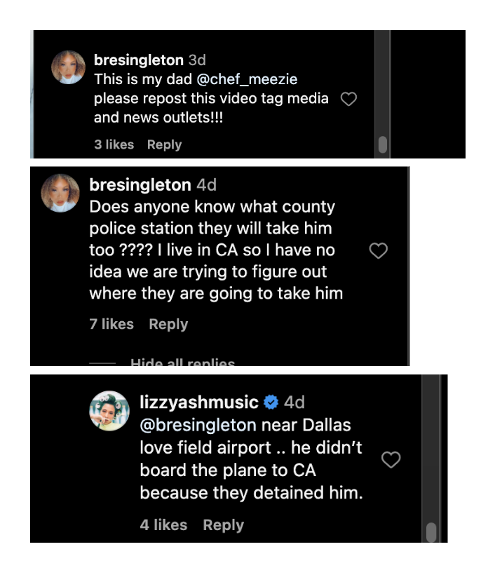
CASE 03 · VIRAL VIDEO VERIFICATION

Slide 22
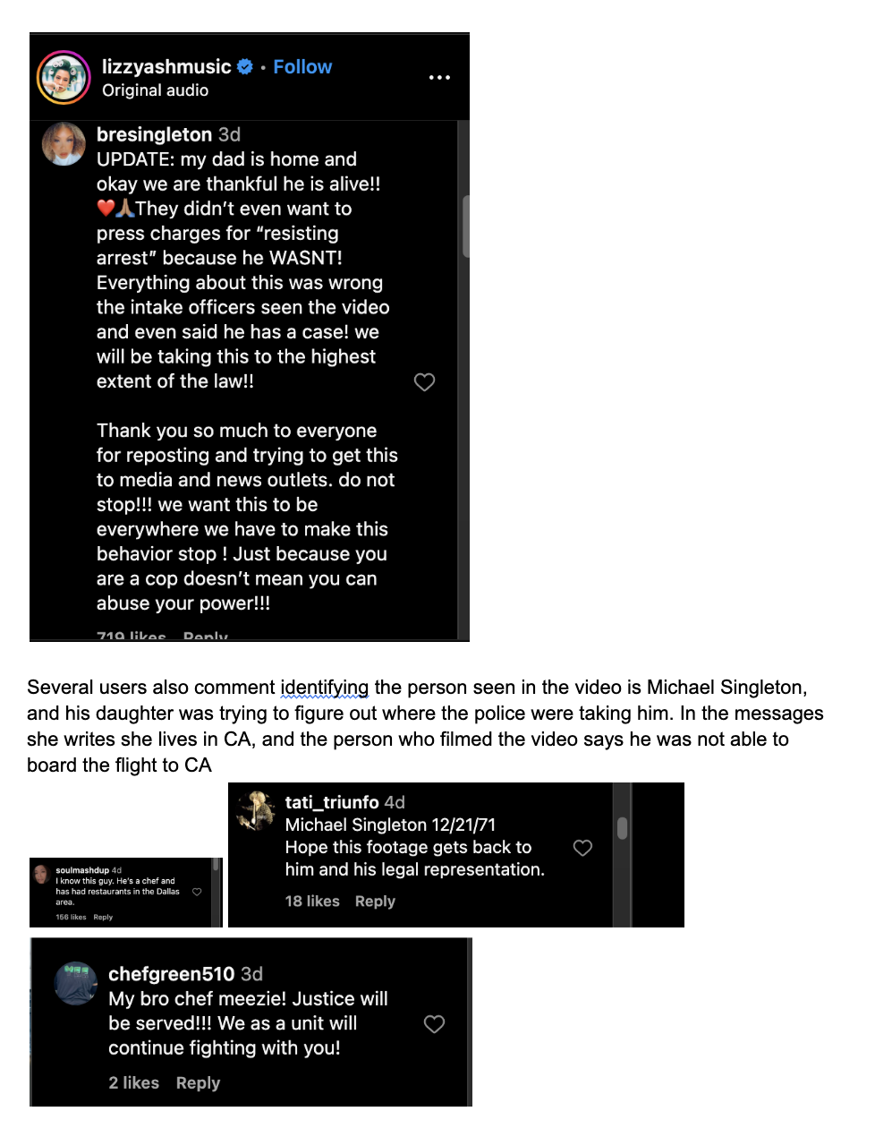
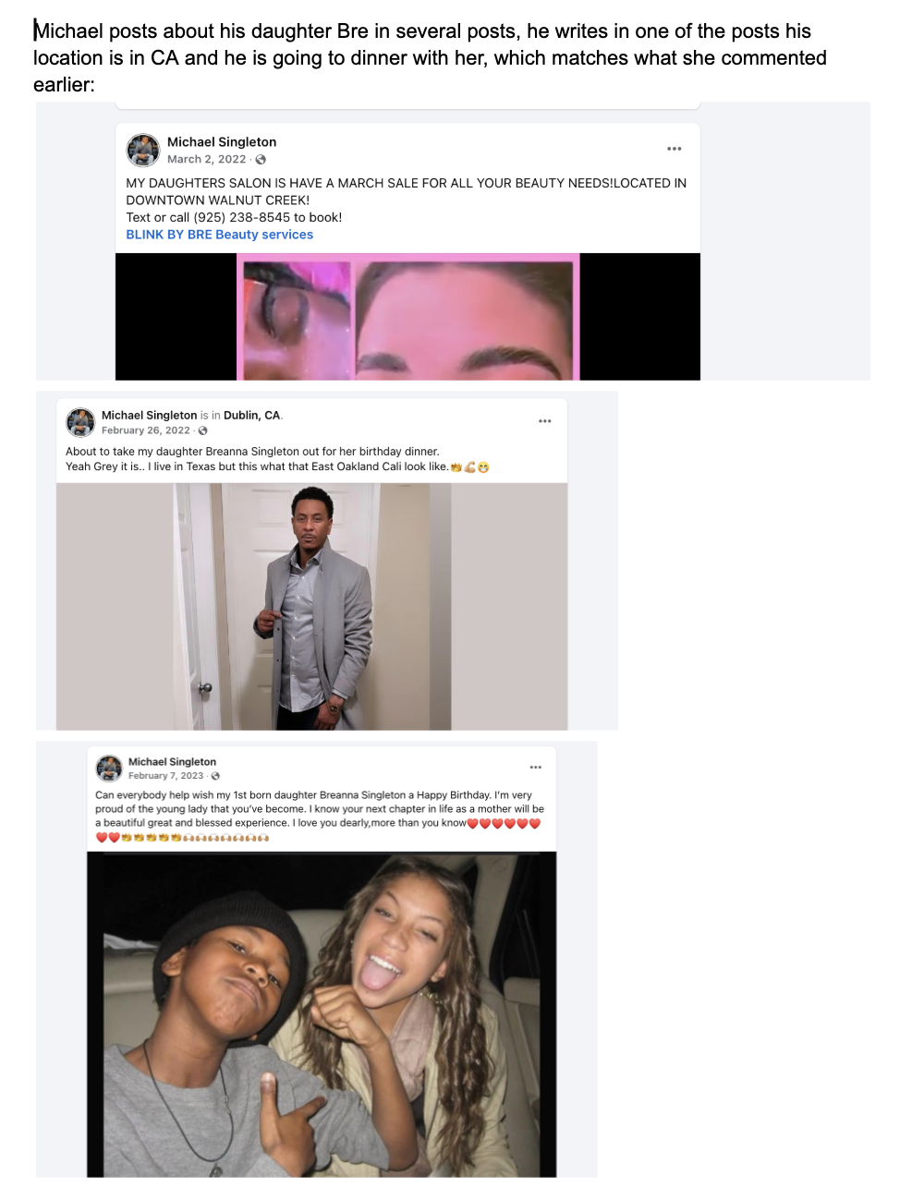
CASE 03 · VIRAL VIDEO VERIFICATION

Slide 23
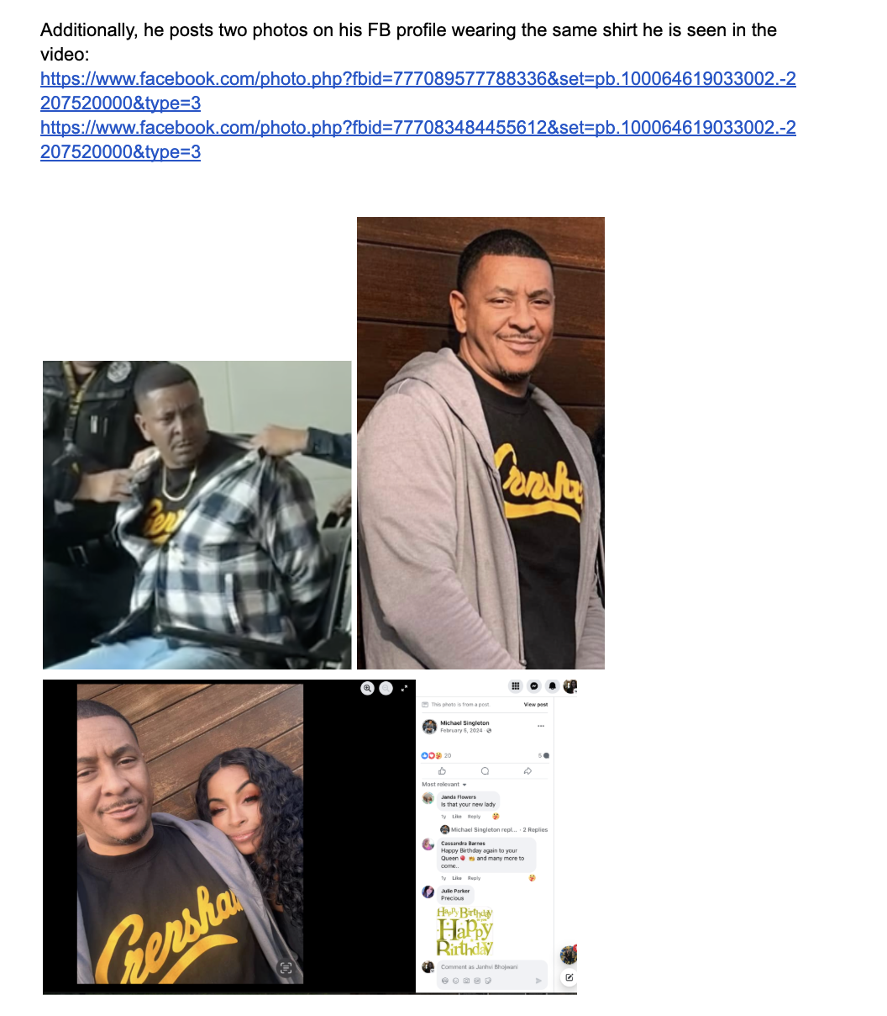
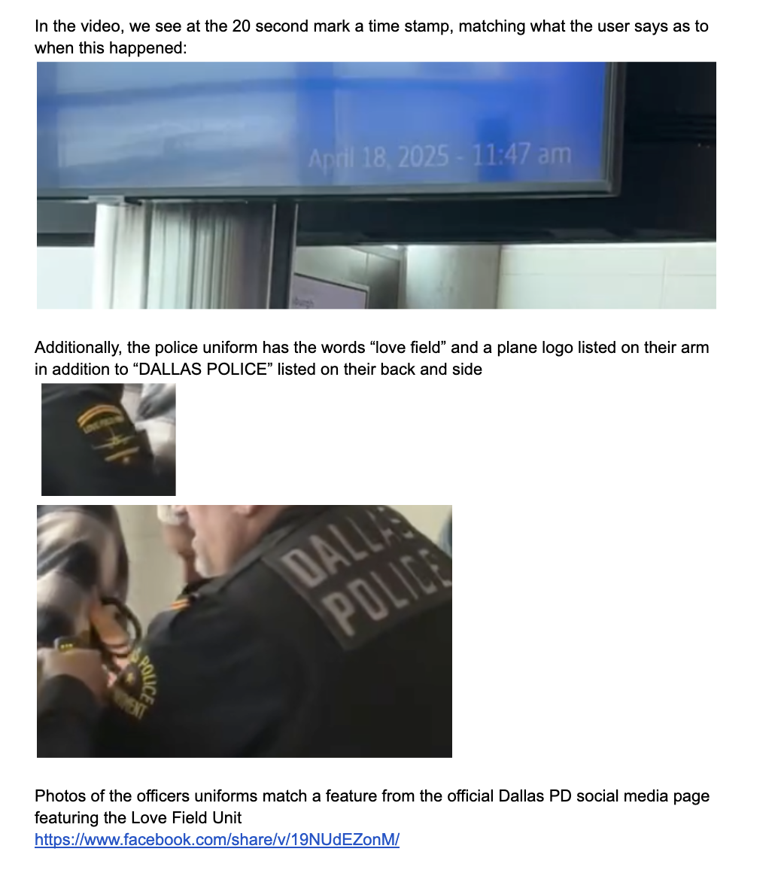
CASE 03 · VIRAL VIDEO VERIFICATION

Slide 24
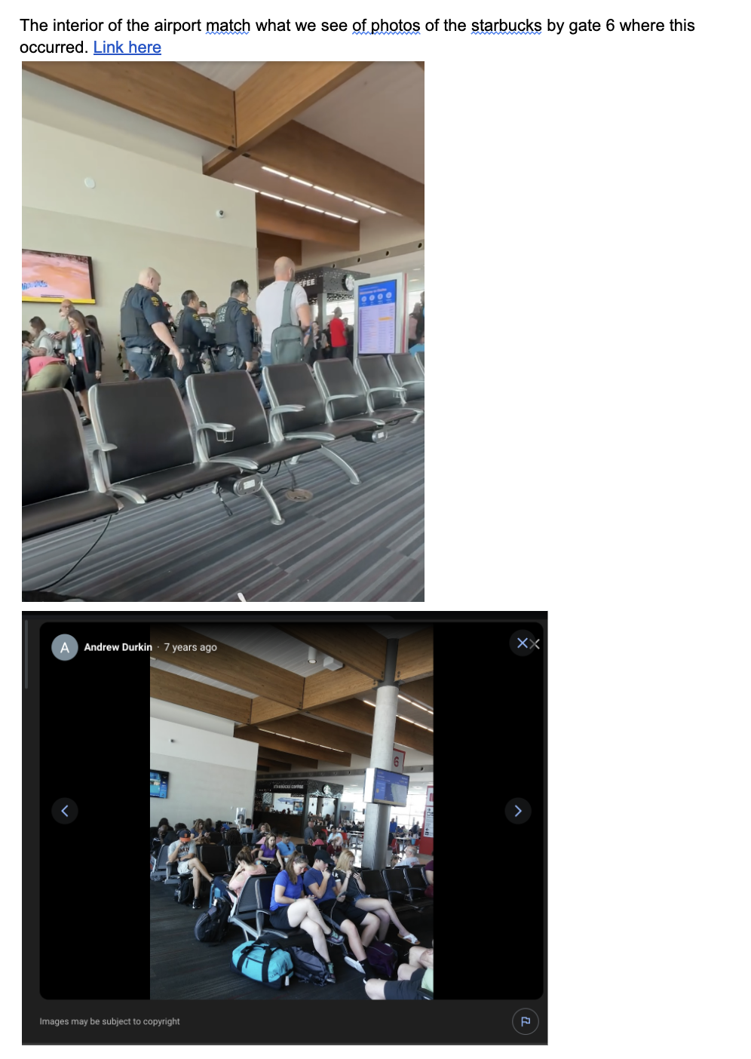
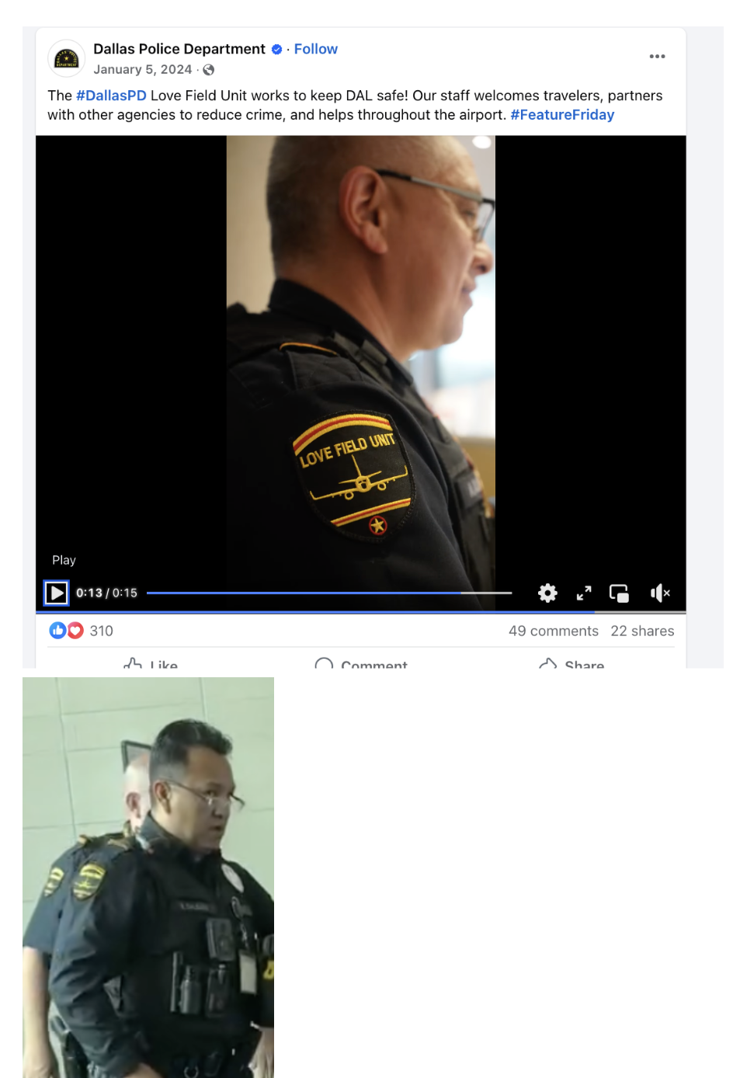
CASE 03 · VIRAL VIDEO VERIFICATION

Slide 25
TIPS & PITFALLS
Tips, Tricks & Red Flags
✓ Tips & Tricks
⚠ Red Flags
Start with public records — they anchor everything else
Always try to reach the person directly for confirmation
Use the subject's own posts to corroborate their location and identity
Yandex often finds images Google misses — especially for non-Western content
Archive pages with the Wayback Machine before they disappear
For foreign content, get a translator — don't rely on auto-translate alone
Document every step of your verification process as you go
No upload history — brand new account posting breaking news
Reverse image search returns much older results for the same image
Location metadata missing or inconsistent with claimed location
Video/photo is suspiciously perfect — no noise, grain, or compression
Story matches one side's narrative too neatly
Can only find the content on one account or platform
Watermarks or logos from known satire or manipulated content accounts

Slide 26

Q&A
Any Questions?
Feel free to reach out:
janhvi@janhvimbhojwani.com
Quick Reference
Reverse image: Google Lens · TinEye · Yandex
Video: InVID · YouTube DataViewer
Geolocation: Google Earth · SunCalc · Mapillary
Metadata: ExifTool · Jeffrey's Exif Viewer
Search: Google Dorks, Boolean Search
Learning: Bellingcat · GIJN · First Draft

