Slide 1
The Systemic Crisis: Reporting and Humanizing the Realities of Health Workers’ Mental Health
Melissa Armstrong, Chief Experience Officer
May 14, 2026

Slide 2

Wellbeing First for Healthcare
We envision a world where seeking mental health care is universally viewed as a sign of strength for health workers.
We believe every health worker should have access to mental health care and professional wellbeing support that they may need, at every moment in their career.
We are dedicated to addressing the operational practices and processes driving health worker burnout, while changing how the healthcare industry supports health workers’ mental health.

Slide 3
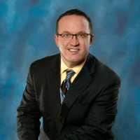

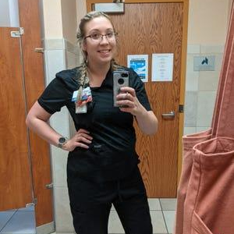
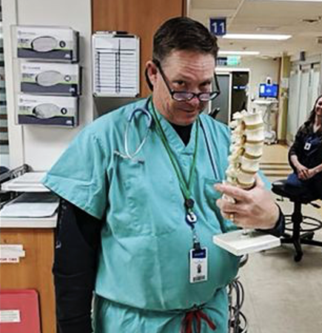

Why We Protect Health Workers’ Professional Wellbeing and Mental Health

Slide 4
‘A Letter to my Abuser’
“Ever since I was young, I expressed interest in healthcare and becoming a nurse, so I began my study. I gave my heart. My body, and my mind to you; dedicated long hours and days and gave you all my all. I have cried with patients, with their families, and for them. I held their hands, and they held mine as I moved forward in my nursing career….
I no longer feel like you care about me or the people you say you serve...when we dare to think we are finally going to get the love and support we deserve, we get a pizza party and free pens for the “healthcare heroes”...
I so desperately want to continue to help people, but I cannot stay in this abusive relationship…
Each day, you ask me to do more with less.”

Slide 5



Why We Protect Health Workers’ Professional Wellbeing and Mental Health
Twenty-two million U.S. health workers are caring for the health of our entire country.
To care for others, health workers must also be cared for—but our health workers are experiencing a burnout and mental health crisis.
46% of health workers experienced burnout in 2022 (up from 32% in 2018)
44% of health workers intend to leave their job (up from 33% in 2018)
Higher levels of poor mental health days and being harassed compared to all other type of workers

Slide 6
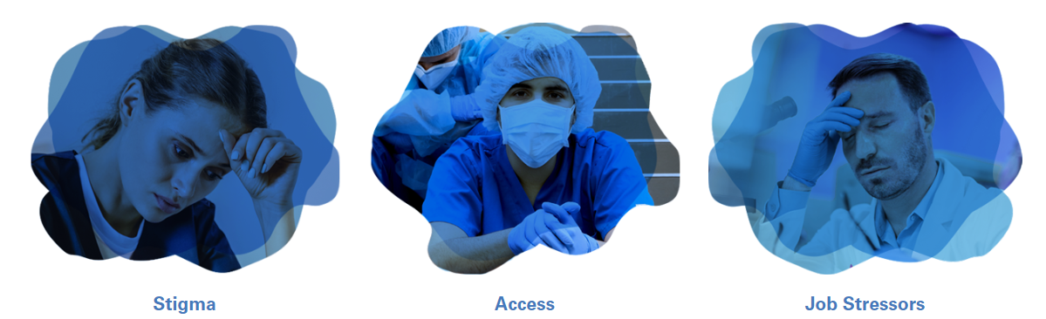
3 Primary Drivers of Suicide in the Healthcare Workforce
www.aha.org/suicideprevention/health-care-workforce/suicide-prevention-guide
Notes:
Stef

Slide 7
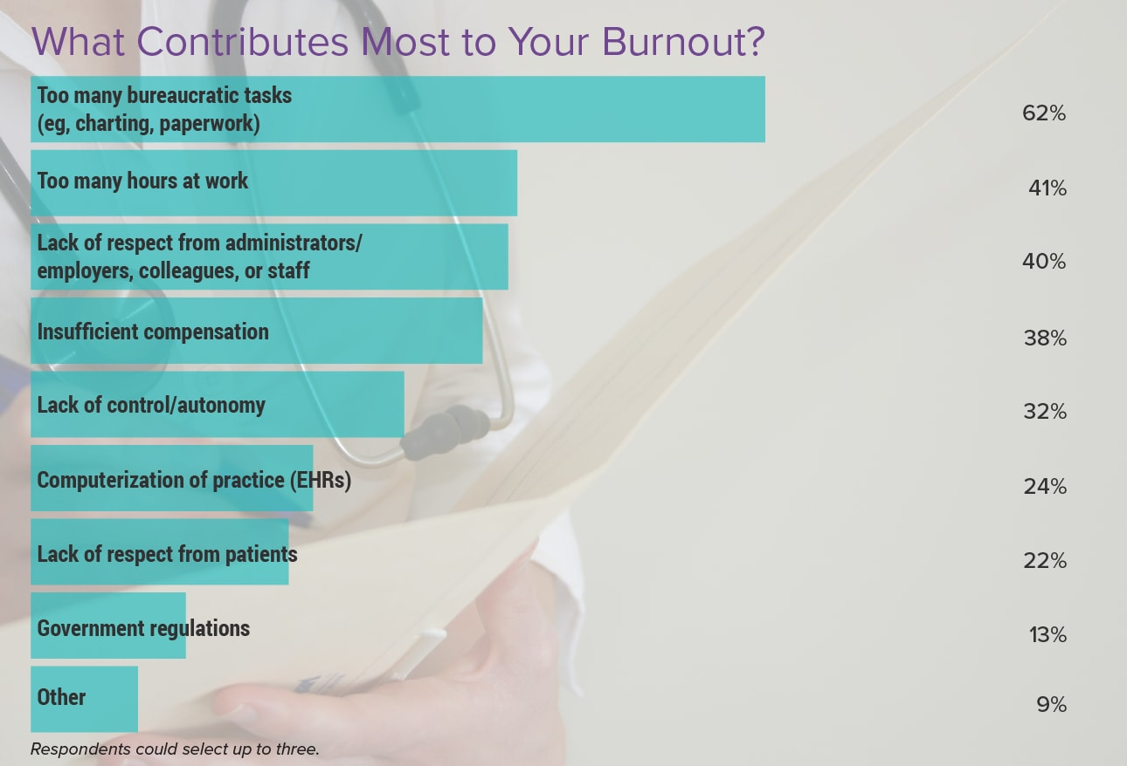
Administrative Burden is the
#1 Driver of Burnout
Medscape Physician Burnout & Depression Report 2024: 'We Have Much Work to Do'
Notes:
Corey

Slide 8
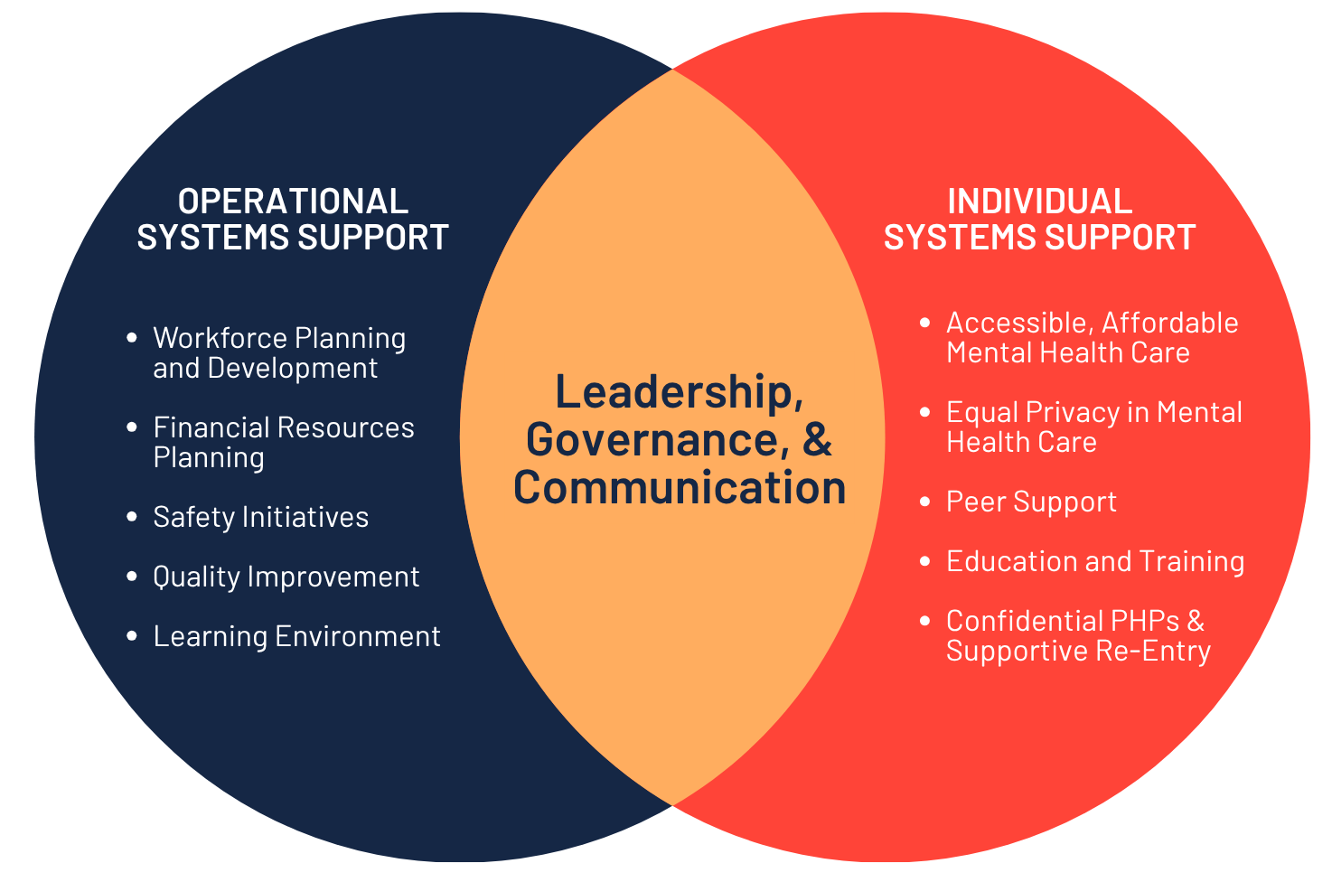
Building a Thriving, Sustainable Workforce Where Health Workers Have the Support, Structures, and Culture they Need

Slide 9



Putting our Healthcare Workforces’
Wellbeing First
As the leading nonprofit exclusively focused on health worker wellbeing and mental health, we:
Accelerate Solutions
Advocate for Health Workers
Advance Collaboration

Slide 10
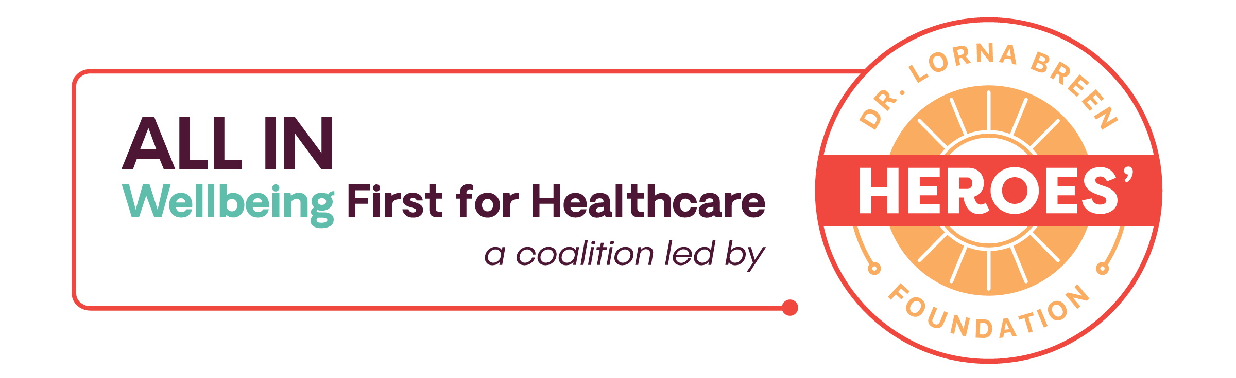
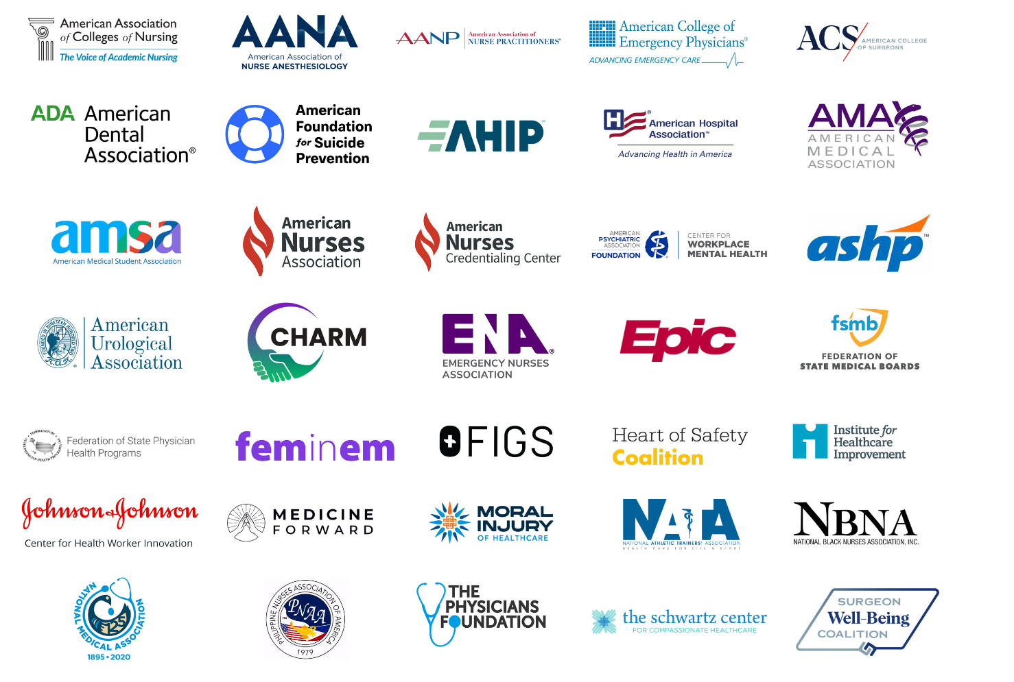
Our Collaborators
We bring 35+ interprofessional, cross-sector national organizations together to advance practical wellbeing solutions and remove barriers to mental health care for the healthcare workforce.

Slide 11
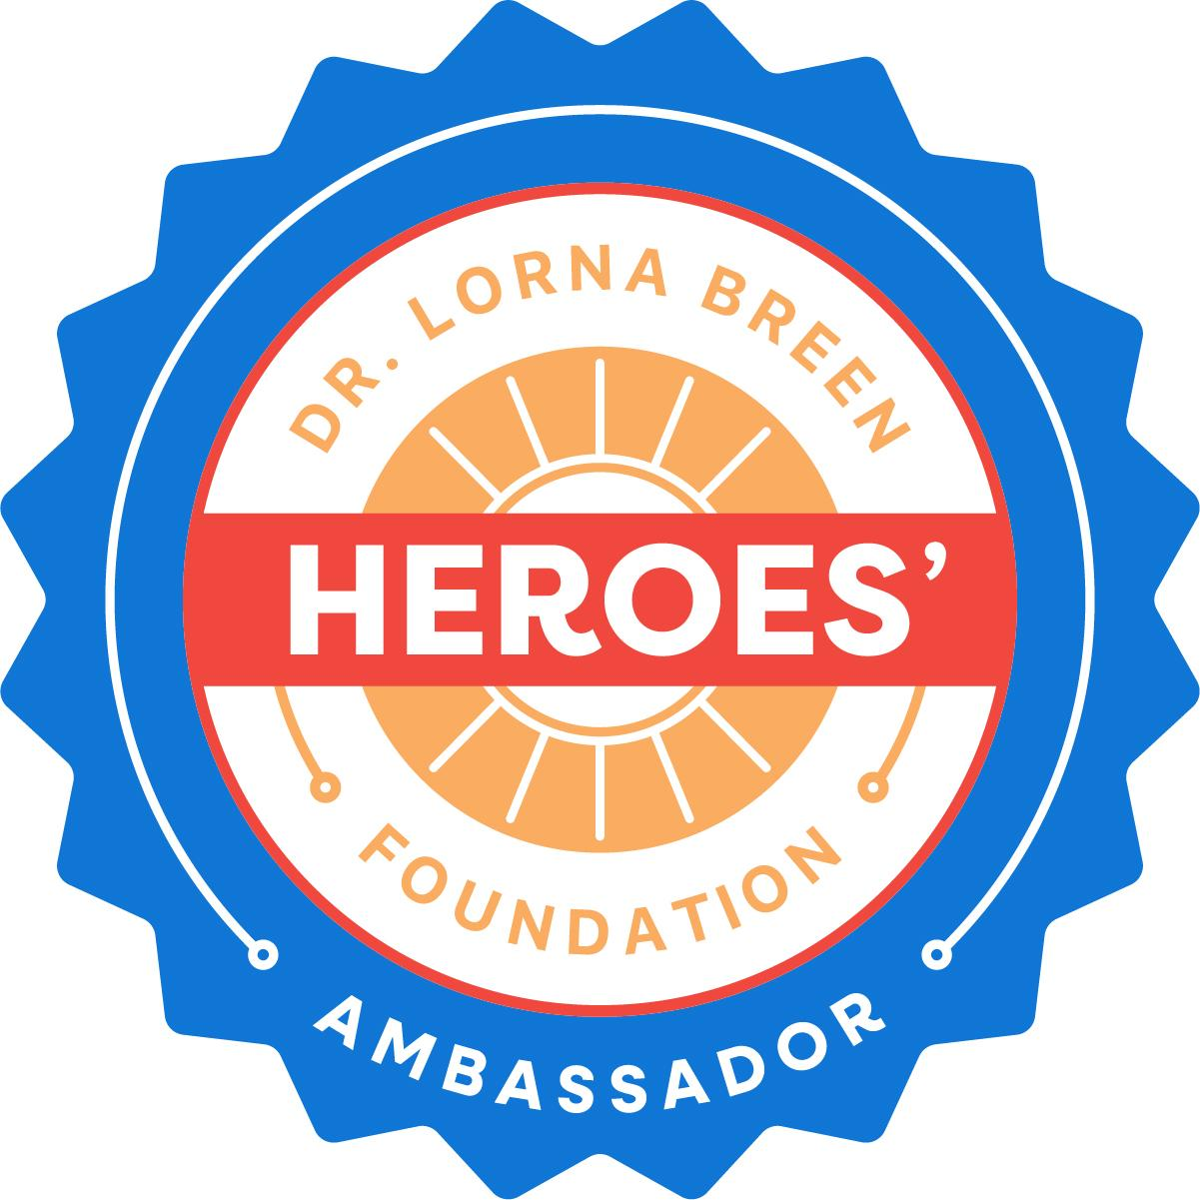
Our Collaborators
Our Ambassador Community brings individuals together to harness our collective strength and make a lasting impact for our healthcare workforces’ mental health and wellbeing.
300+ health workers, students, patients, family members, academics, and healthcare leaders engaging with the Foundation to protect and support health workers’ professional wellbeing and mental health.

Slide 12
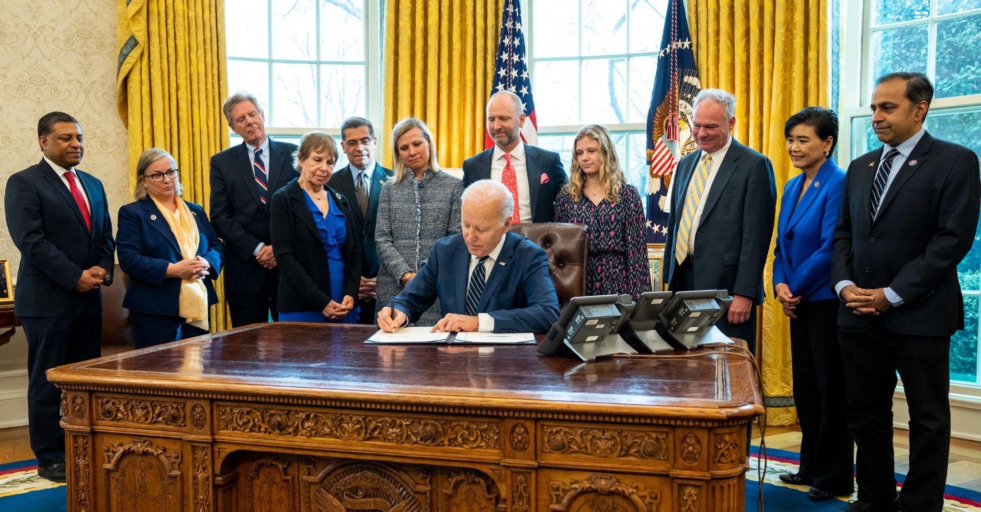
March 18, 2022
Notes:
COREY
In 2022, after nearly two years of advocacy following the death of my sister-in-law, Dr. Lorna Breen, we helped pass the Dr. Lorna Breen Health Care Provider Protection Act—the first federal law focused on the mental health of healthcare workers. It passed unanimously, authorizing $135 million in funding over three years for hospital-based programs, training, research, and national campaigns to improve mental health while reducing burnout and stigma. This legislation marked a turning point with its recognition that protecting the mental health of our healthcare workforce is essential to the health of our entire system.

Slide 13

Programs
Created by the Lorna Breen Act
The landmark Lorna Breen Act has already saved lives and improved the systems in which health workers are educated, trained, and practice by:
HRSA Grant Programs: Supporting 250,000+ health workers across 44 evidence-informed initiatives at hospitals, health systems, health professions schools, and community organizations
NIOSH/CDC Program: Providing 35,000+ healthcare leaders with training and resources to address the specific operational drivers of their workforce’s burnout.
Notes:
COREY
The landmark Lorna Breen Act has already transformed and saved lives and improved the systems in which health workers are educated, trained, and practice by:
Supporting 250,000+ health workers across 45 evidence-informed initiatives at hospitals, health systems, health professions schools, and community organizations to improve health workers’ mental health.
Providing innovative training materials for 35,000+ healthcare leaders to address the specific operational factors and burdens that drive their workforce’s burnout.

Slide 14
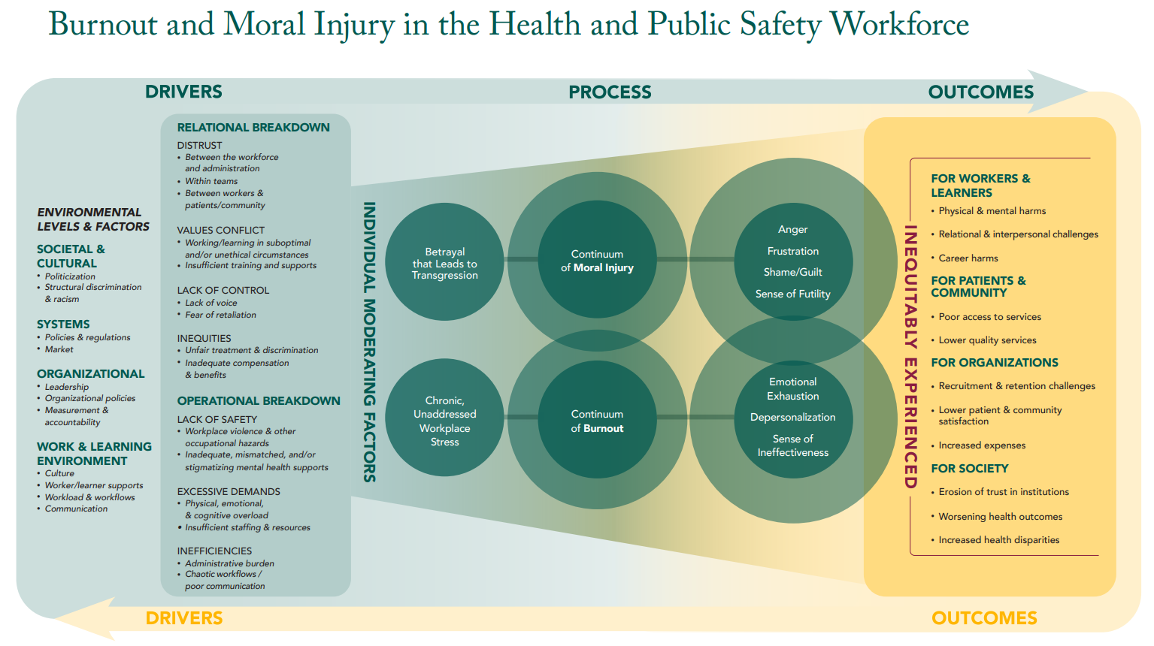





National Framework
Notes:
Following the passage of the Lorna Breen Act, the American Rescue Plan Act of 2021 then provided $120 million for grants to address health worker burnout and mental health.
The Fitzhugh Mullan Institute for Health Workforce Equity partnered with the Institute for Healthcare Improvement, Moral Injury in Healthcare, and the American Federation of Teachers to create the Workplace Change Collaborative (WCC). The WCC is funded by the Health Resources and Services Administration (HRSA). WCC supports 44 HRSA grantees in reducing burnout, improving mental health, and addressing moral injury among health and public safety workers and learners by fostering shared learning and empowering grantees to lead organizational change.
The National Framework consists of two parts: 1) the drivers, process, and outcomes of burnout and moral injury and 2) actionable strategies for addressing burnout and moral injury. This slide shows the first part.
Distal drivers of burnout and moral injury include environmental factors that occur on multiple levels. Proximal drivers can loosely fit into two categories: those that contribute to relational breakdown and those that contribute to operational breakdown.
The processes for burnout and moral injury are distinct but also appear to be related. The connection between them has not been fully elucidated.
Burnout and moral injury result in harmful outcomes for workers and learners, patients and community, organizations, and society. Additionally, as the arrow at the bottom of the graphic indicates, the outcomes of burnout and moral injury can feed back to the drivers, creating a vicious cycle. For example, as organizations experience recruitment and retention challenges because of burnout and moral injury, the workers who remain at an organization may have even more excessive demands placed upon them and encounter more situations that raise values conflicts, heightening the risk of burnout and moral injury.

Slide 15
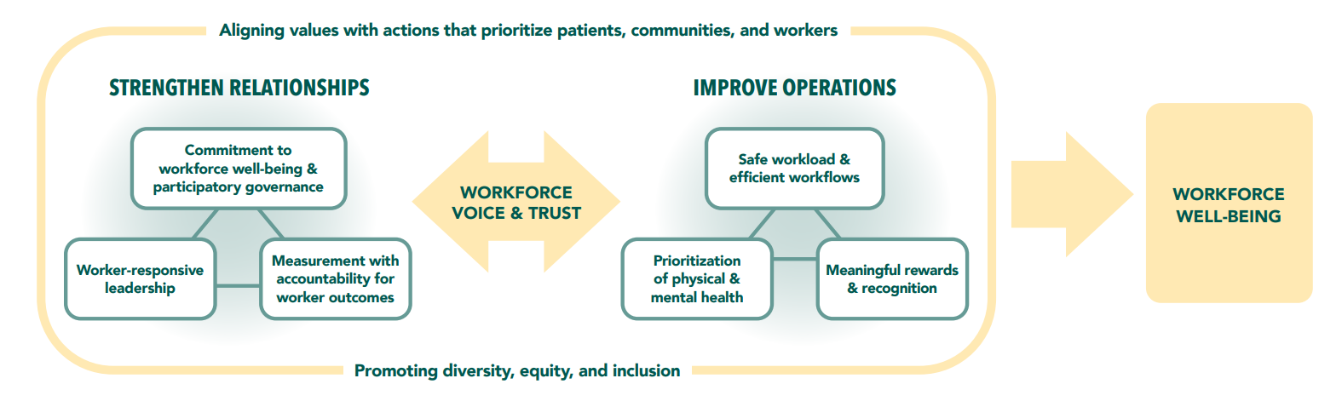
Strategies: Creating Better Working & Learning Environments
Notes:
Part 2 of the National Framework provides a high-level guide for strategies to address burnout and moral injury. Traditionally, strategies for workforce well-being have focused at the individual level or on operational issues. These are important and necessary, yet insufficient. Broader strategies of values alignment, promoting DEI, and garnering worker/learner voice and trust, as well as strengthening relationships, must also be prioritized.

Slide 16

Strategies In Action Across 24 States
Some grantees:
Reduced burnout by 37%
Lowered turnover by 35%
Decreased mental health conditions by 50%
86% of grantees instituted wellbeing programs
70% of grantees provided peer and crisis support
55% of grantees offered mental health services
34% of grantees redesigned workloads and workflows
Explore the Framework,
Strategies, & Grantee Spotlights
Notes:
Details on key successes to highlight
Organizational change – reorienting the organization toward prioritizing the workforce's wellbeing, including sustainable infrastructure for wellness, gaining leadership buy-in, establishing data collection systems and setting up regular measurements of wellbeing, and even new collaborations between groups that were previously siloed
Program publicity – meaning the program is known within the organization or publishing of findings
Participant enthusiasm and improvements – many shared that their biggest success was seeing their target populations improve – reduced stigma, reduced burnout, improved mental health, improved resiliency, improved access to resources, positive feedback given about the program
Visit wpchange.org to find evidence, resources, and spotlights for strategies healthcare organizations can take to align values; facilitate workforce voice and trust; promote diversity, equity, and inclusion; strengthen leadership and commitment; establish governance structures; measure workforce well-being; and demonstrate accountability for well-being.

Slide 17
GAO Report
Lorna Breen Act Programs
Direct Impact on Workforce Retention and Stability
Evidence-Based Clinical Improvement in Mental Health
Addresses the Burnout Surge (46% and Growing)
Grantees demonstrated higher retention than non-participants
Grantees reported reduced symptoms of depression and anxiety
Identified a significant increase in burnout rates 32% in 2018 to 46% in 2022
Burnout is a long-term threat to healthcare system
Notes:
1. Direct Impact on Workforce Retention and Stability
The GAO report explicitly highlights that grant program participants demonstrated higher job retention compared to non-participants. Given the projected national shortage of nurses and physicians, this finding makes a strong economic and operational argument for extension. Every dollar invested in the Breen Act is an investment in preventing the "brain drain" of our healthcare system. Their analysis confirms that these programs are not just "nice to have"; rather, they are an essential tool for maintaining the 17-million-person healthcare workforce.
2. Evidence-Based Clinical Improvement in Mental Health
The report confirms that grantees reported reduced symptoms of depression and anxiety among participants. This moves the needle from "wellness perks" to "clinical effectiveness." These programs provide evidence-based interventions that deliver measurable results in reducing the severity of mental health conditions. By extending these grants, Congress ensures that the "helpers" receive the same level of care and efficacy they provide to their patients.
3. Addressing the "Burnout Surge" (46% and Growing)
The GAO identified a significant increase in burnout rates, rising from 32% in 2018 to 46% in 2022. The report underscores that the crisis did not end with the COVID-19 pandemic; rather, it has become institutionalized as a long-term threat. The baseline for burnout has shifted upward permanently. Their data illustrates that the demand for these resources is outstripping current capacity. Funding will be critical to meet this "new normal" and prevent the total collapse of worker well-being.

Slide 18

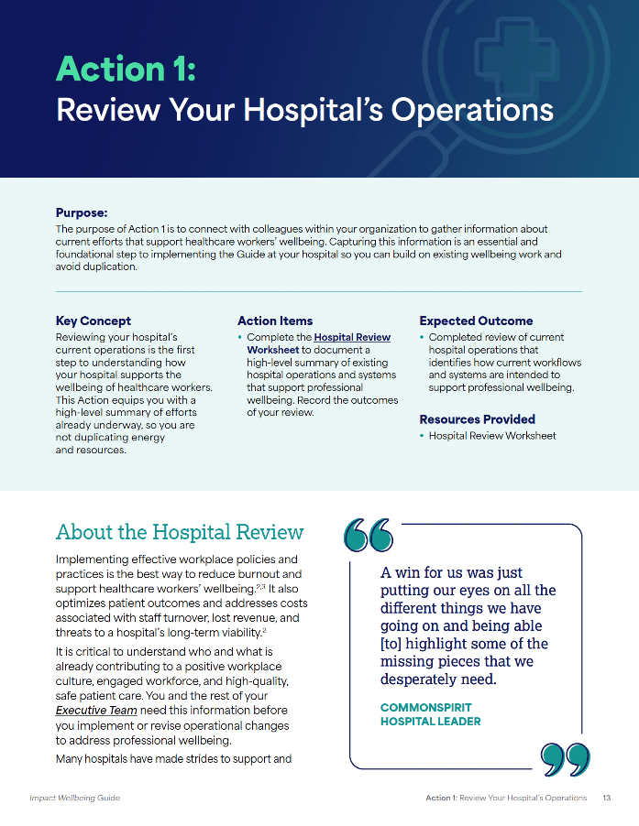
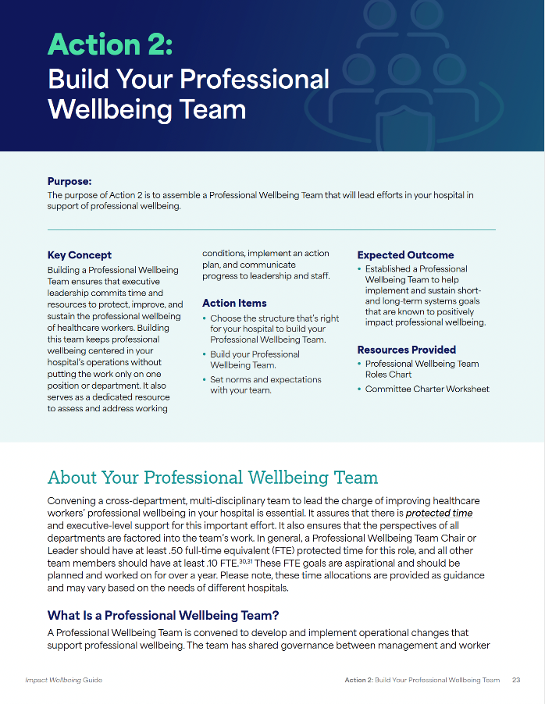
Innovative Education & Training Program
The National Institute for Occupational Safety and Health (NIOSH), in partnership with the Dr. Lorna Breen Heroes’ Foundation, developed the Impact Wellbeing campaign, including the Impact Wellbeing Guide.​
CommonSpirit Health hospitals in AR, IA, KY, and NE pilot-tested the guide, enabling them to make significant changes to improve their workplace operations.
The Guide provides step-by-step guidance to hospital leaders on how to integrate professional wellbeing into their existing systems and operations.
Notes:
STEF
The National Institute for Occupational Safety and Health (NIOSH), developed Impact Wellbeing, a campaign to improve the mental health and wellbeing of healthcare workers to reduce negative health outcomes, including suicide.
Based on formative research findings, a primary goal of our campaign is to engage hospital leaders to revise existing or implement new evidence-informed operational policies that reduce burnout and improve the professional wellbeing of hospital staff.​
To support this goal, NIOSH in partnership with the Dr. Lorna Breen Heroes’ Foundation developed the Impact Wellbeing Guide, which includes six actions hospital leaders can take to improve professional wellbeing.
The Guide equips healthcare leaders to improve health workers’ experience and wellbeing while improving patient experience, improving population health, and reducing costs.
We leveraged our network to work on this and got feedback from all of our ALL IN coalition, then there were peer reviewers and labor reviewers (AFT nurses union)
The Guide was real-world tested in six CommonSpirit hospitals across the U.S. this past July through December 2023. The Guide then went through a lengthy revision process to incorporate CommonSpirit feedback for greater clarity and to provide a wider range of tools and resources.
Links for Chat
About the Impact Wellbeing Guide: https://www.cdc.gov/niosh/impactwellbeing/guide/
Learn more about NIOSH: https://www.cdc.gov/niosh/index.htm

Slide 19
Using the Impact Wellbeing Guide
This guide includes six actions that you can take to improve the professional wellbeing of your workforce.
1
Conduct a review of your hospital’s operations to determine how they support professional wellbeing.
  Develop a suite of communication tools that help you share updates with your workforce about your hospital’s journey to improve professional wellbeing.
4
2
  Build a dedicated team to support professional wellbeing at your hospital.
5
  Integrate professional wellbeing measures into an ongoing quality improvement project at your hospital.
3
  Achieve significant advances in the professional
  wellbeing of your workforce by updating credentialing application questions.
6
  Create a 12-month plan to continue to move your professional wellbeing work forward.
Notes:
STEF:
Talking Points
The Actions are designed to build on each other and to be implemented over six months
This guide helps hospitals integrate professional wellbeing into existing systems and operations.

Slide 20

“… all the things that have been swimming around in my brain were organized on paper, and I felt very seen. I think [the Guide] will be a great framework for the systemic and organizational changes that we need to make, and I’m planning to present it to our leadership team. As a social worker, I’m trained to assess challenges from a systems perspective and have been frustrated at how healthcare operates in silos.”
- Allison Chan, LICSW
Senior Wellbeing Program Developer
MedStar Health
Notes:
STEF

Slide 21
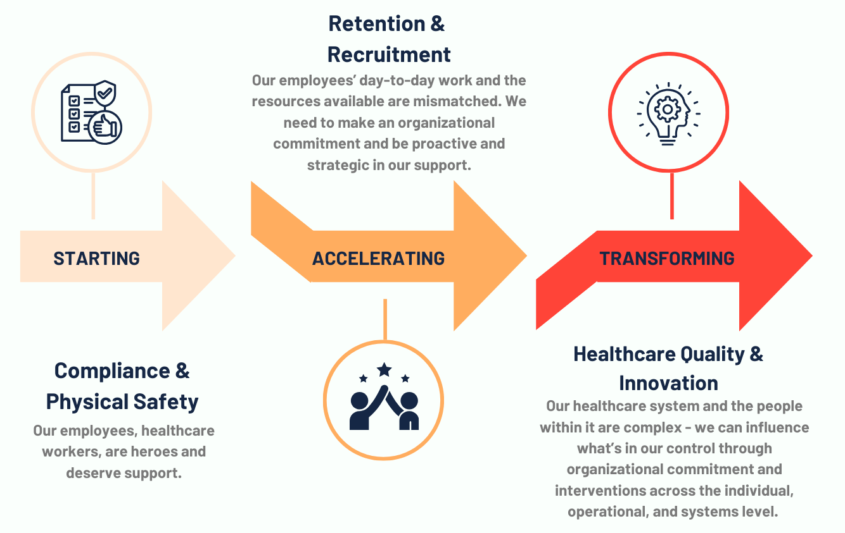
Is An Organization Building a Thriving, Sustainable Workforce?

Slide 22
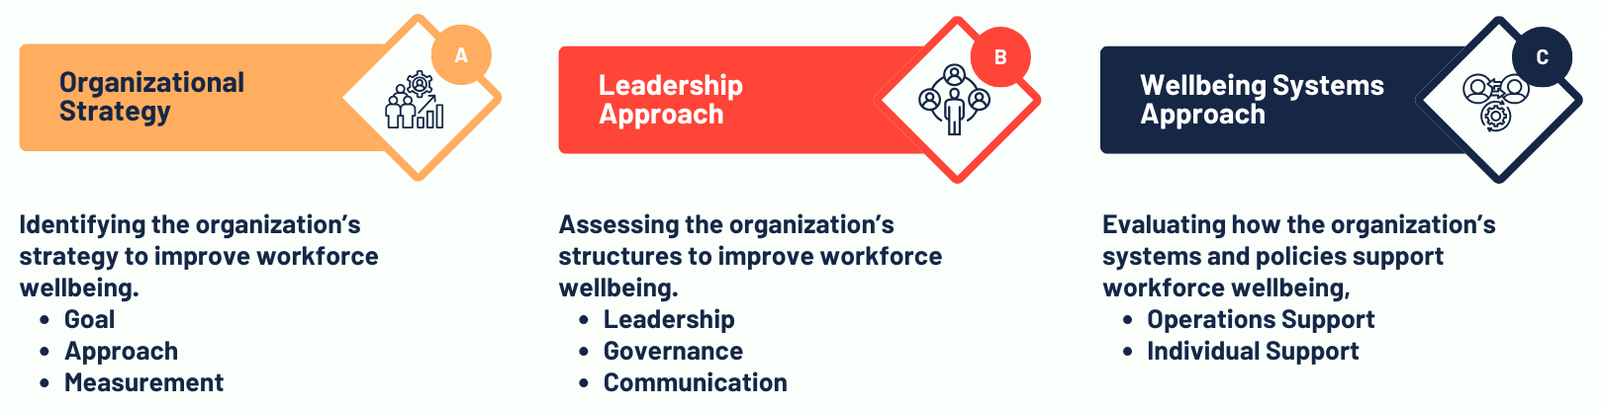
The Breen Scale ™
Assessing Organizational Wellbeing

Slide 23
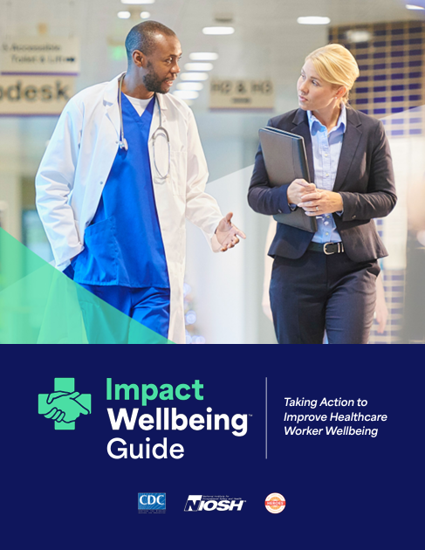
Caring for Caregivers (C4C)
The national technical assistance center to improve workplace policies and practices that reduce burnout and normalize help-seeking.
Guided by experts to go beyond encouraging self-care and resilience to focus on systems-level improvements.
Equipped to implement practices and programs that effectively address staff burnout, poor mental health, and turnover.

Slide 24

















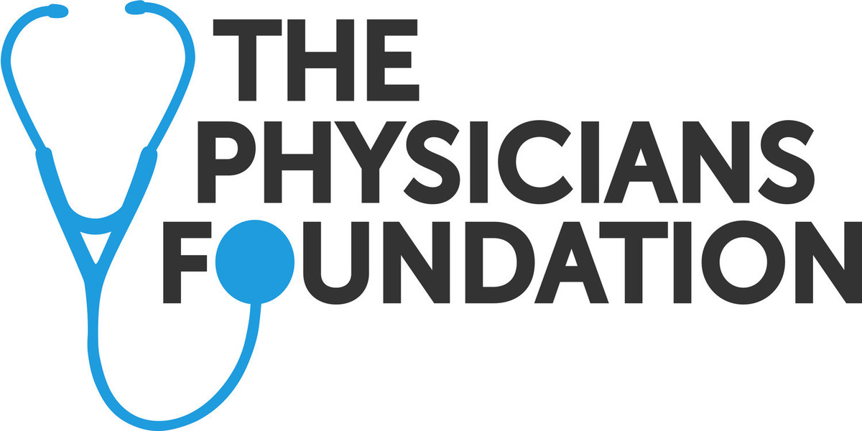


Our C4C Communities
Caring for
New Jersey’s
Caregivers
Caring for
North Carolina’s
Caregivers
Caring for
Virginia’s
Caregivers
Caring for
Wisconsin’s
Caregivers
Caring for
J+C’s
Caregivers
in collaboration with
in collaboration with
in collaboration with
in collaboration with
in collaboration with
Caring for Caregivers
is supported by
Notes:
We partner with organizations to guide effective leadership and culture transformation that creates better workplace environments for health workers’ wellbeing and mental health.

Slide 25

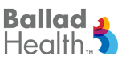










Caring for Virginia’s Caregivers
Our Impact
80%
500,000
100
hospitals ensured mental health care protections in their credentialing processes
licensed health workers across 62 professions protected from disclosing their mental health care through first-of-its-kind state law
healthcare leaders trained in implementing the coordinated, proactive Wellbeing Systems Approach

Slide 26

We had never provided health workers with the avenues, tools, and support that they needed to be able to speak up and say we need help. As we engaged in this journey, we started seeing really positive things like retention, engagement, better quality of work, and better patient experience scores. We even saw our traveling nurses wanting to stay in our rural Virginia community saying ‘this is the first place I've been where I feel healthy, where I feel like I can actually get the help that I need.’
Tiffany Covarrubias-Lyttle, MSN, RN, NE-BC
Centra

Slide 27

Caring for Virginia’s Caregivers
Our Impact
7
Health systems implemented quality improvement projects to address administrative burden
Some health systems:
Reduced documentation time by 10-15 minutes per patient visit
Reduced unnecessary alerts by 52%-73% per month
Improved satisfaction with time spent documenting by 47%

Slide 28

The weight of health worker burnout—the long hours, the documentation burden, the emotional toll—was real and relentless. Our partnership with the Foundation was the catalyst for systemic change. They challenged us to address that documentation burden directly, leading us to deploy ambient AI scribe technology. The impact is undeniable: 17 providers in a small, focused pilot saved 100 hours of documentation time in four months. This isn't just efficiency; this is reduced cognitive load and, as one physician put it, literally getting their life back so they can enjoy more time with their family.
Gregory Szlyk, MD, FACS
Mary Washington Health Care

Slide 29

Be ALL IN for Health Workers Mental Health
Support health workers’ access to mental health care.
A stronger system is within reach.

Slide 30

Let’s Eliminate Systemic Barriers to
Mental Health Care for Health Workers
Learn how to better support health workers access to mental health care
Act to eliminate systemic barriers to mental health care for health workers
Communicate to health workers it is safe to seek mental health care
Notes:
By working together, we can build a system that prioritizes mental health for those who care for us, ensuring health workers can access mental health care without fear of repercussions.

Slide 31
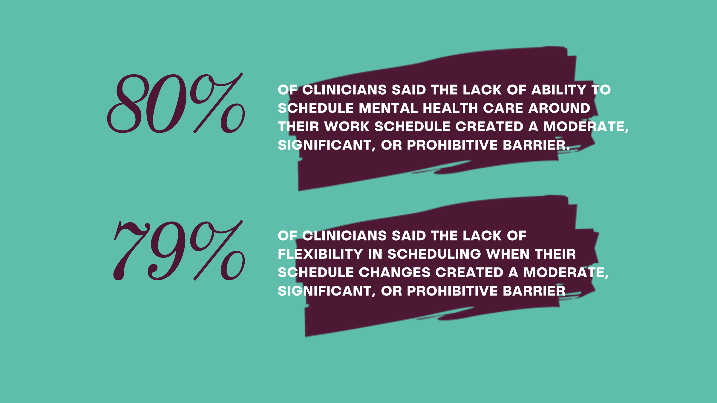






Be ALL IN for Health Workers’ Mental Health
By working together, we can build a system that prioritizes mental health for those who care for us, ensuring health workers can access mental health care without fear of repercussions.
ACCESSIBLE AND AFFORDABLE
MENTAL HEALTH CARE
CONFIDENTIAL PROFESSIONAL HEALTH PROGRAM SUPPORT
EQUAL PRIVACY IN
MENTAL HEALTH CARE
CONFIDENTIAL
PEER SUPPORT
EDUCATION & TRAINING ON MENTAL HEALTH
SUPPORTIVE PATHWAY
FOR RE-ENTRY
Notes:
More than 2,000 nurse practitioners, physician assistants, physicians and registered nurses participated in a survey that informed our research report, Clinician Perceptions of Barriers to Access Mental Health Care, to understand individual, structural and cultural barriers that prevent clinicians from seeking mental health care.
The report shows that the cost of mental health services without insurance and lack of schedule flexibility created the greatest logistical barriers to accessing mental health care for clinicians.

Slide 32
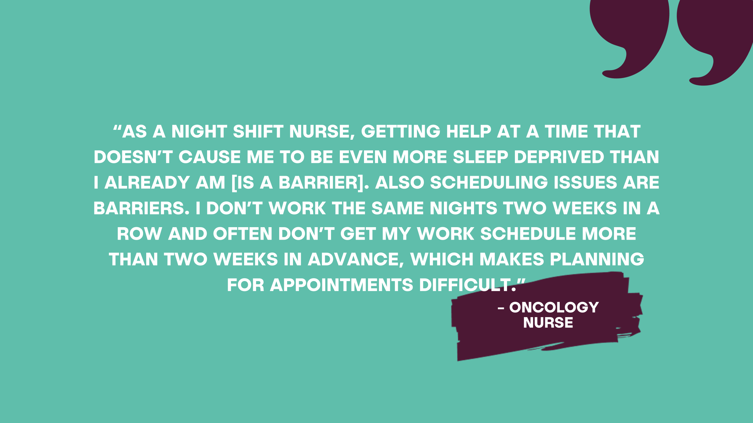
Notes:
Women physicians surveyed experience these barriers more significantly than their male counterparts, while female nurses reported lack of schedule flexibility as a barrier more often than their male counterparts.
Cost challenges strike younger mid-career nurses more than older nurses with no difference by gender.

Slide 33
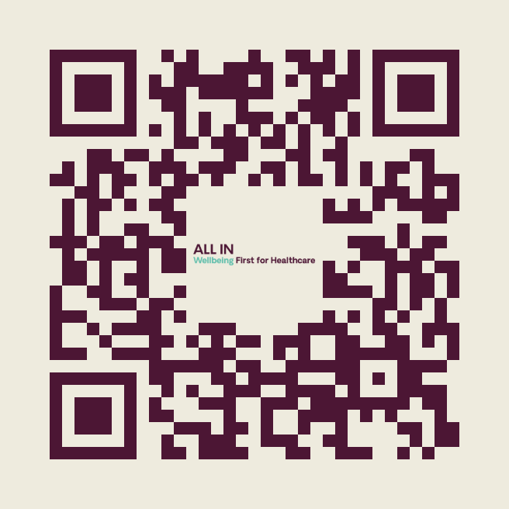
Be ALL IN for Health Workers Mental Health
ENSURE ACCESSIBLE AND AFFORDABLE
MENTAL HEALTH CARE
STRENGTHEN CONFIDENTIAL PROFESSIONAL/PHYSICIAN HEALTH PROGRAM SUPPORT
COMMIT TO EQUAL PRIVACY IN
MENTAL HEALTH CARE
GUARANTEE CONFIDENTIAL
PEER SUPPORT
ENCOURAGE EDUCATION AND TRAINING ON MENTAL HEALTH AND PROFESSIONAL WELLBEING
ADVANCE A SUPPORTIVE
PATHWAY FOR RE-ENTRY
Notes:
Melissa

Slide 34
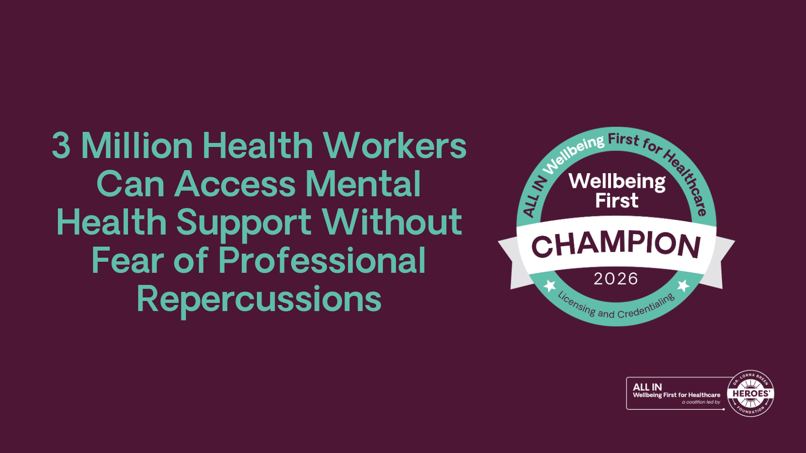
Notes:
The Wellbeing First Champion Challenge program is a transparent source of truth for health workers.
When health workers are deciding in which state or organization to work, the Badge serves as a standardized form of education & communication that a location will not require health workers to answer intrusive mental health questions.
As of January 26, 70 licensure boards and 2,115 hospitals and care facilities have made it safer for more than 2.64 million licensed and 438,000 credentialed health workers to seek mental health care.

Slide 35
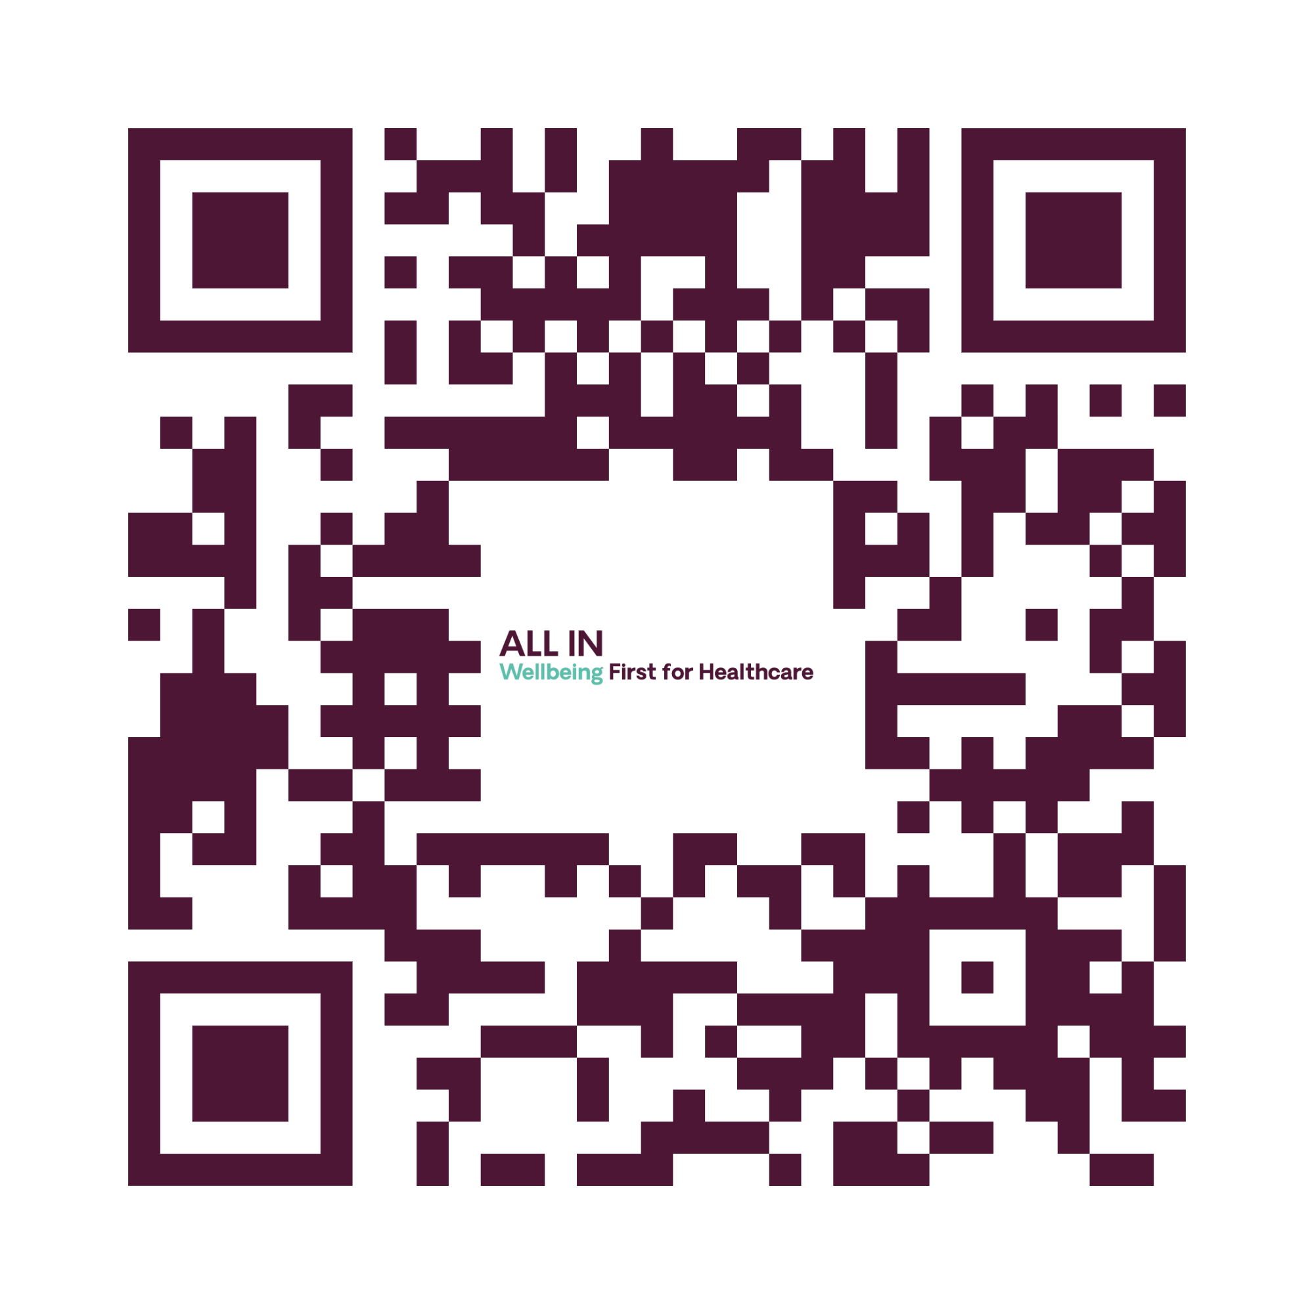
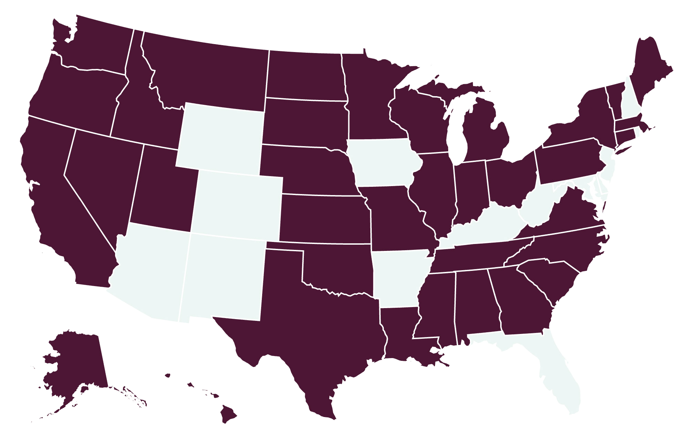
Wellbeing First Champions for Medical Licensing
Our Impact
43 medical licensure boards verified their licensure applications do not include intrusive mental health questions—benefiting nearly 1.1 million physicians.
as of Jan. 26, 2026

Slide 36
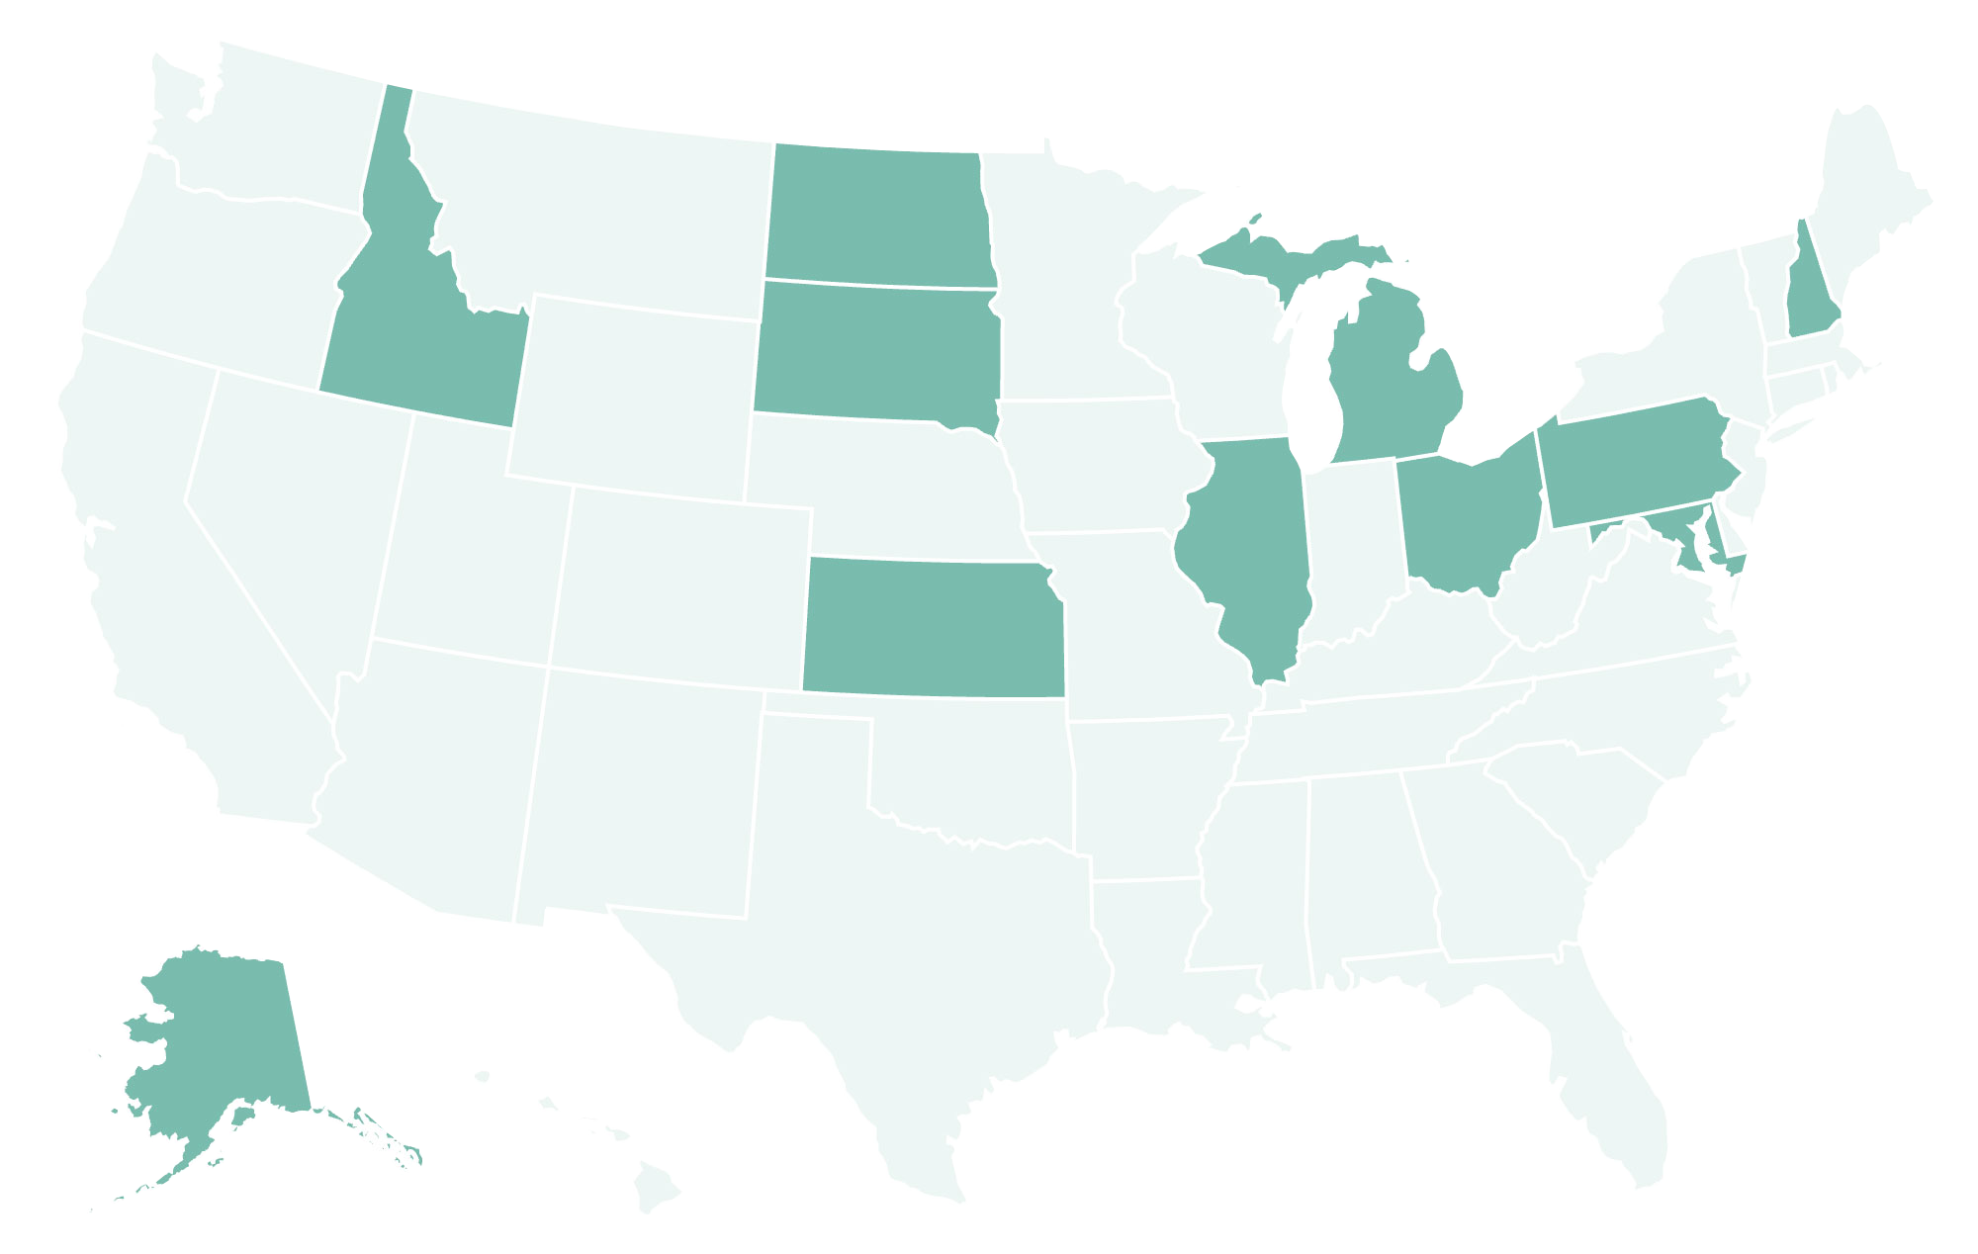
Wellbeing First Champions for Pharmacy Licensing
Our Impact
11 pharmacy licensure boards verified their licensure applications do not include intrusive mental health questions—benefiting more than 362,000 pharmacy professionals.
as of Jan. 26, 2026

Slide 37
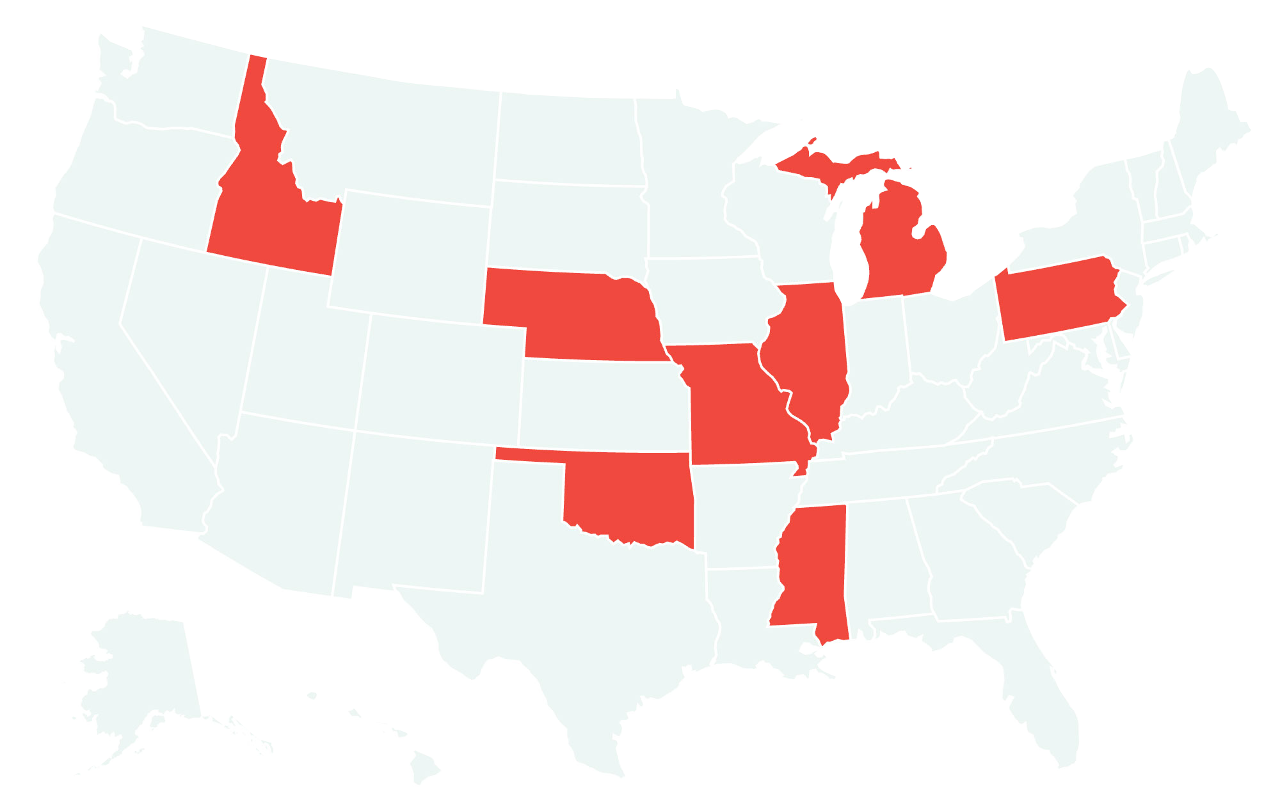
Wellbeing First Champions for Nurse Licensing
Our Impact
8 nursing licensure boards verified their licensure applications do not include intrusive mental health questions—benefiting nearly 1.1 million nurses.
as of Jan. 26, 2026

Slide 38
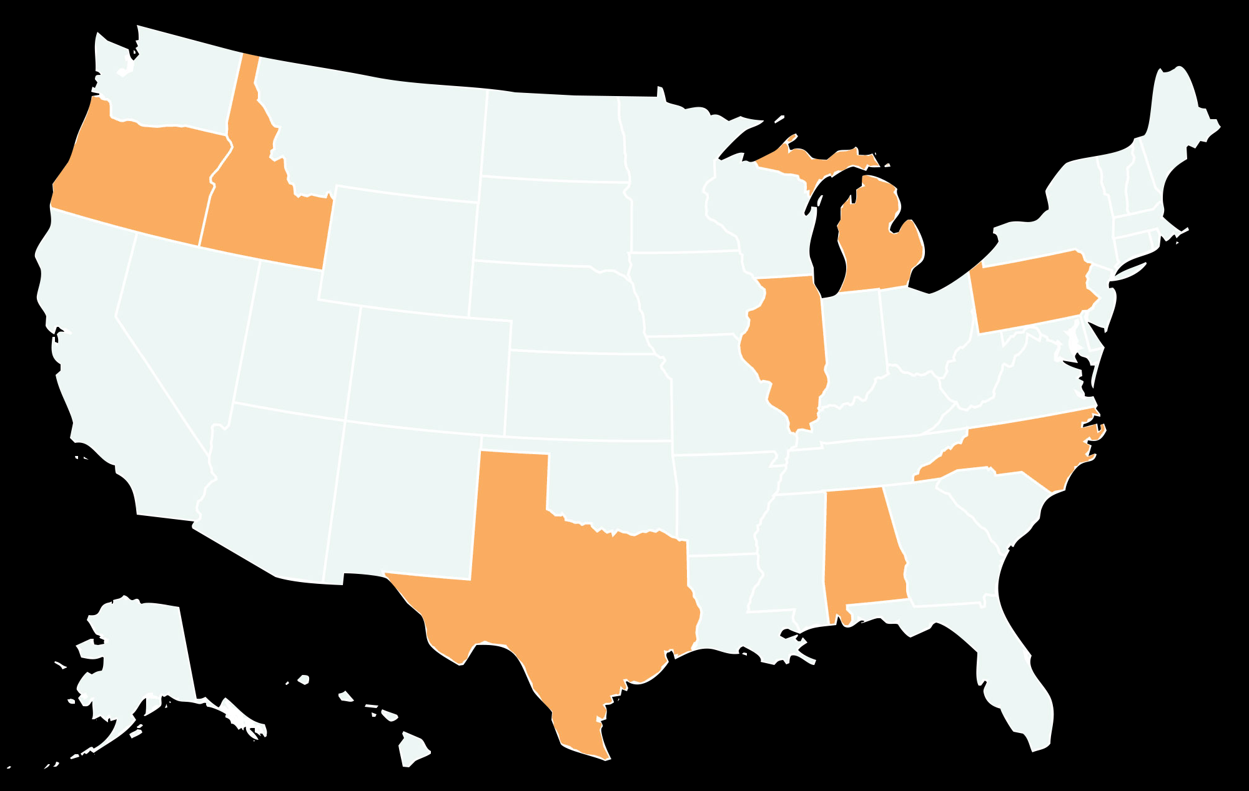
Wellbeing First Champions for Dental Licensing
Our Impact
8 dental licensure boards verified their licensure applications do not include intrusive mental health questions—benefiting more than 113,000 dental professionals.
as of Jan. 26, 2026

Slide 39
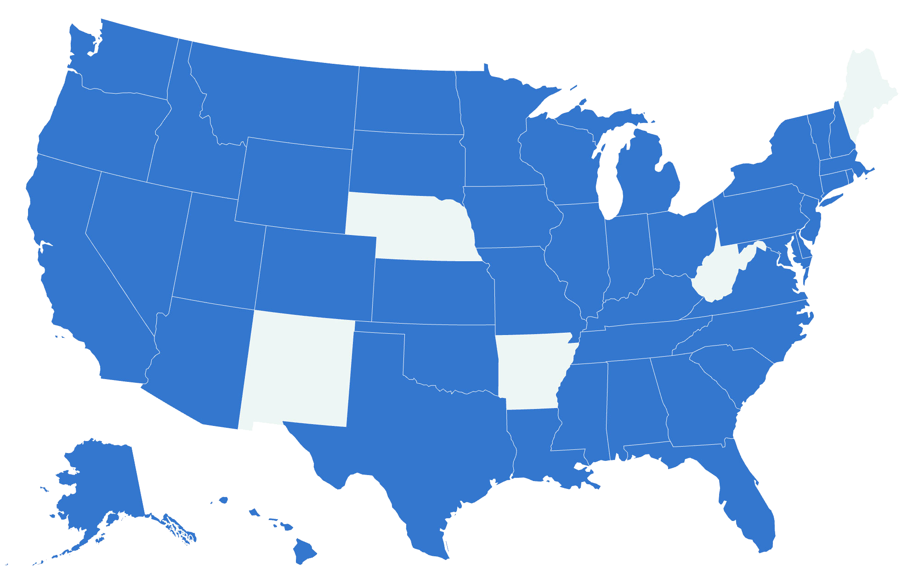
Wellbeing First Champions for Credentialing
Our Impact
1,194 hospitals, freestanding emergency departments, and freestanding surgery centers as well as 921 urgent care centers and independent primary care clinics verified their credentialing applications do not include intrusive mental health questions—benefiting more than 438,000 credentialed health workers.
10 medical/staffing groups, health plans, and professional liability insurers verified their credentialing applications—benefiting nearly 115,000 credentialed health workers.
as of Jan. 26, 2026

Slide 40
Covering
Health Workers’ Mental Health

Slide 41
Change the Culture of Silence
How sharing individual stories addresses healthcare's deep-rooted mental health stigma.
For generations, the "superhero" myth has forced health workers to hide mental health struggles for fear of judgment or professional ruin.
Journalists accelerate cultural change by amplifying stories of those choosing to speak out, normalizing care-seeking and directly address this longstanding stigma.

Slide 42
Investigate Regulators
Are the licensing boards in your state discouraging health workers from seeking mental health care?
Investigate your own state licensure boards to see if their licensing applications still include intrusive, stigmatizing mental health questions and if they may violate the Americans with Disabilities Act.
If your state licensure boards are already supportive to mental health, speak with health workers for helping to address stigma.

Slide 43
Spotlight Local Impact
How are local healthcare systems structurally changing the workplace to retain their workforce and ensure safe, quality patient care?
Find a hospital in your coverage area that has moved past superficial wellness initiatives and is actively adopting a wellbeing systems approach—moving the focus from individual resilience to systems change— such as optimizing clinical workflows with new technologies to enhance both the clinician and patient experience.

Slide 44
Dive Deeper into Rural America
What happens to a rural community when its health workers leave due to a lack of systemic support, and how is federal policy attempting to stop the bleeding?
Tell the human story of health workers who have left the profession because the workplace environment failed to support them as human beings. Tie these local stories to the broader national advocacy landscape, such as the Dr. Lorna Breen Health Care Provider Protection Act, which funds and scales wellbeing programs nationwide, or Rural Transformation Grants.

Slide 45
Thank You!
Melissa Armstrong
Chief Experience Officer
melissa@drbreenheroes.org
If you or someone you know is in crisis, call or text 988 or chat at 988lifeline.org.

