Slide 1
The State of Mental Health at Work
NAMI / Ipsos 2026 Workplace Mental Health Poll
Barb Solish, National Director, Program Innovation
National Alliance on Mental Illness (NAMI)

Slide 2
Methodology
Third annual NAMI-Ipsos Workplace Mental Health Poll
Conducted January 27 – February 2, 2026
Ipsos KnowledgePanel® (probability-based)
n = 2,153 United States full-time employees, age 18+
Companies with 100+ employees, across industries
Margin of error: ±2.3 percentage points (95% confidence)
Trended against 2024 and 2025 data where available

Slide 3
Workers are stressed!
Though % stressed is similar, “Very stressed” has steadily increased since 2024
70% report feeling stressed about the state of the world
43% concerned about their own mental health (up from 35% in 2024)
53% report job-related burnout in the past year
1 in 4 have considered quitting due to mental health impact

Slide 4
…And overwhelmed.

Slide 5
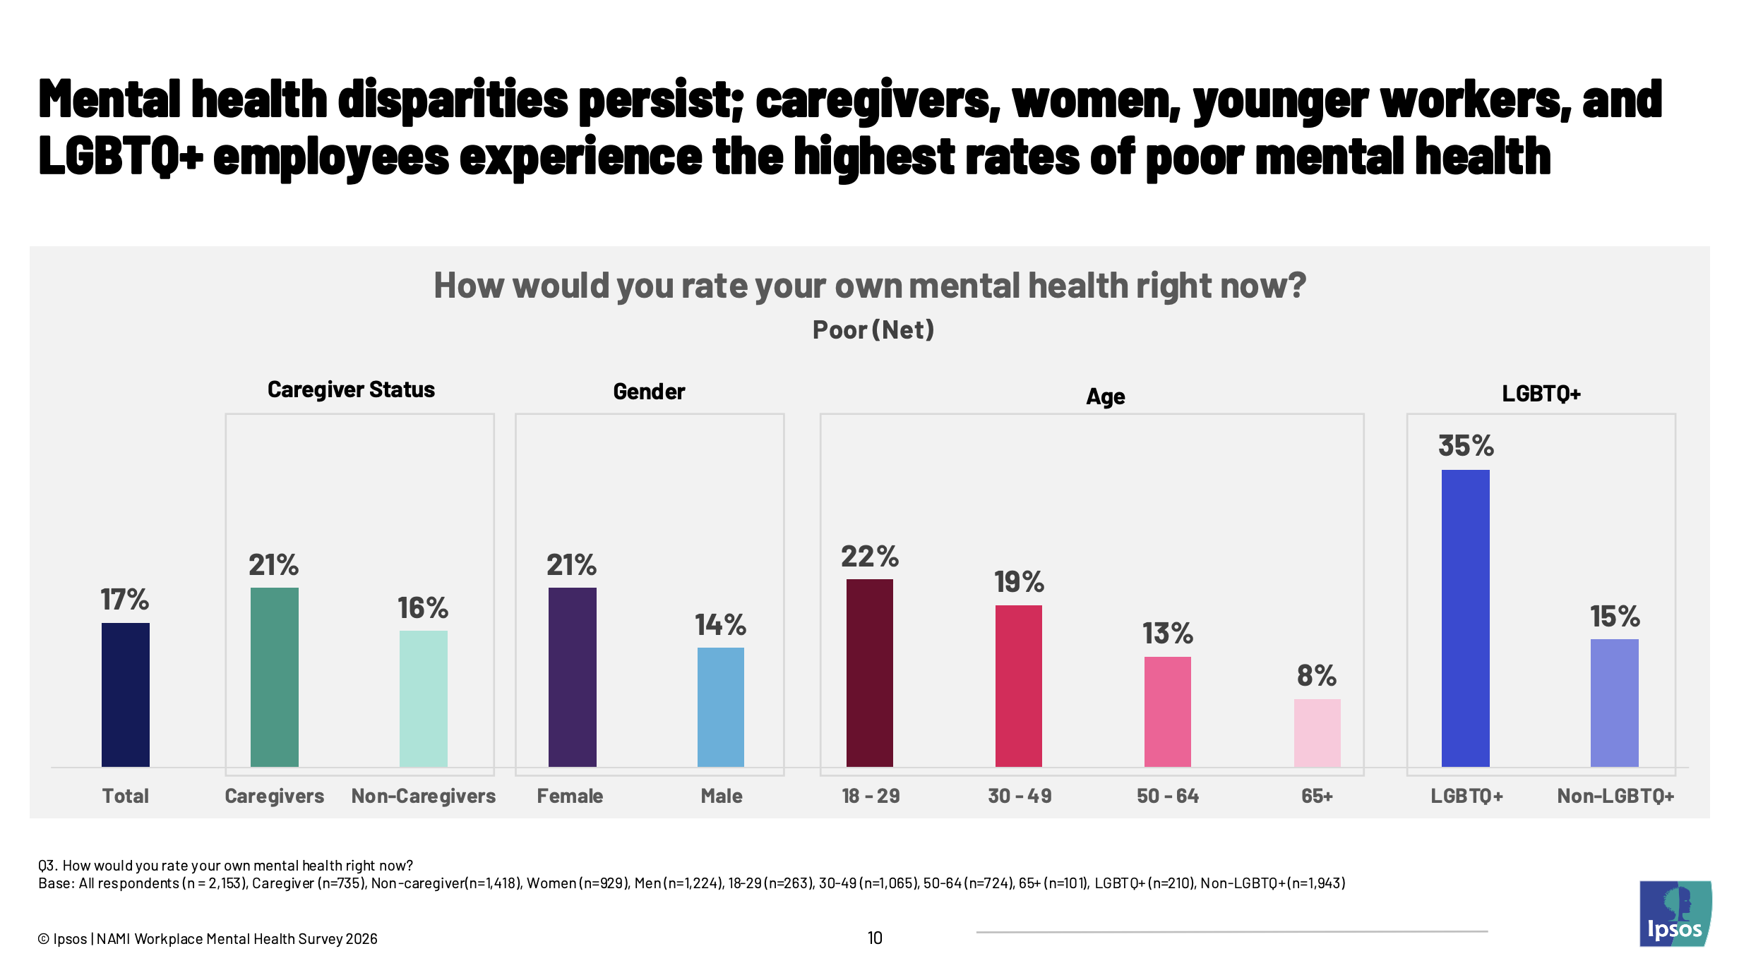

Slide 6
The Comfort Gap
3 in 4
employees say it is appropriate to discuss mental health at work
…but only 61% actually feel comfortable doing so.

Slide 7
Comfort Gap Compared to Other Topics

Slide 8
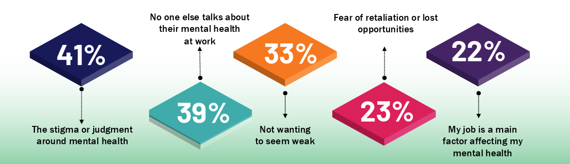
Why People Stay Silent

Slide 9
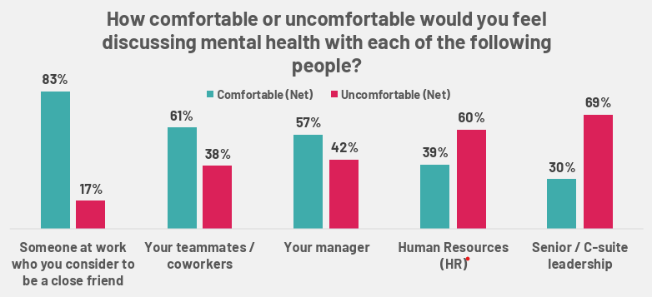
Who Do People Trust?

Slide 10
Caregivers Carry a Heavier Load

Slide 11
Benefits Awareness Gap
~25% of employees don't know if their employer offers:
Mental health care benefits
Employee Assistance Programs (EAP)
Flexible work arrangements for mental health
Sick days for mental health
…but 80%+ say these benefits are or would be important to a positive workplace culture

Slide 12
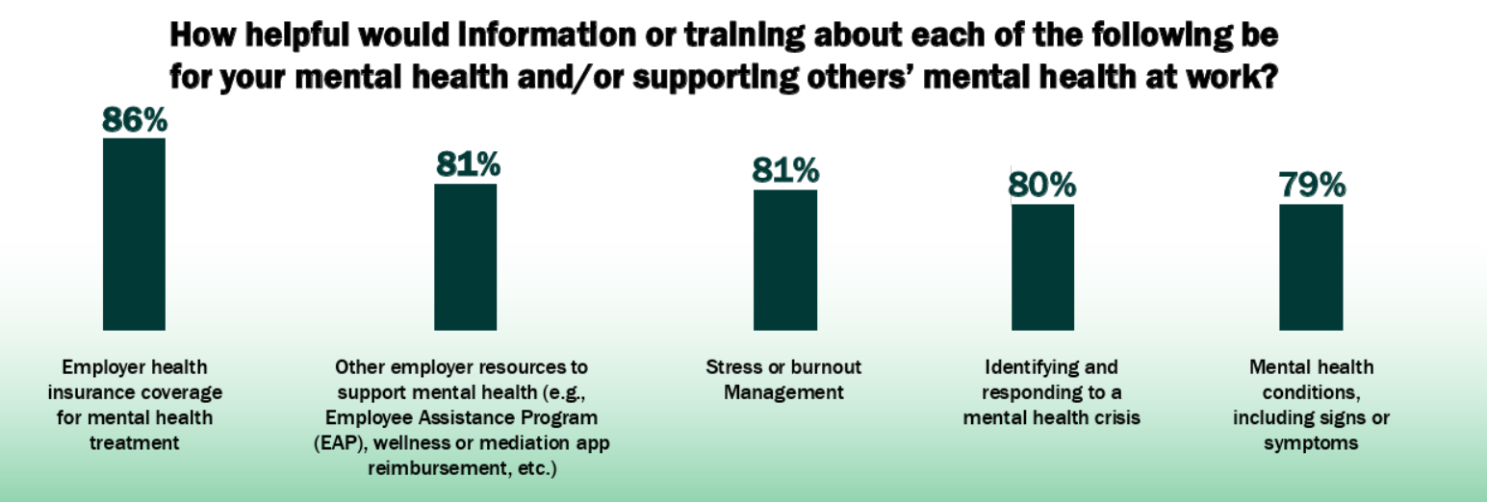
Training Gap
….but less than 1 in 3 have received ANY mental health training
  Only 32% trained on employer mental health resources
  Only ~25% trained on mental health conditions/symptoms

Slide 13
Training Changes Everything

Slide 14
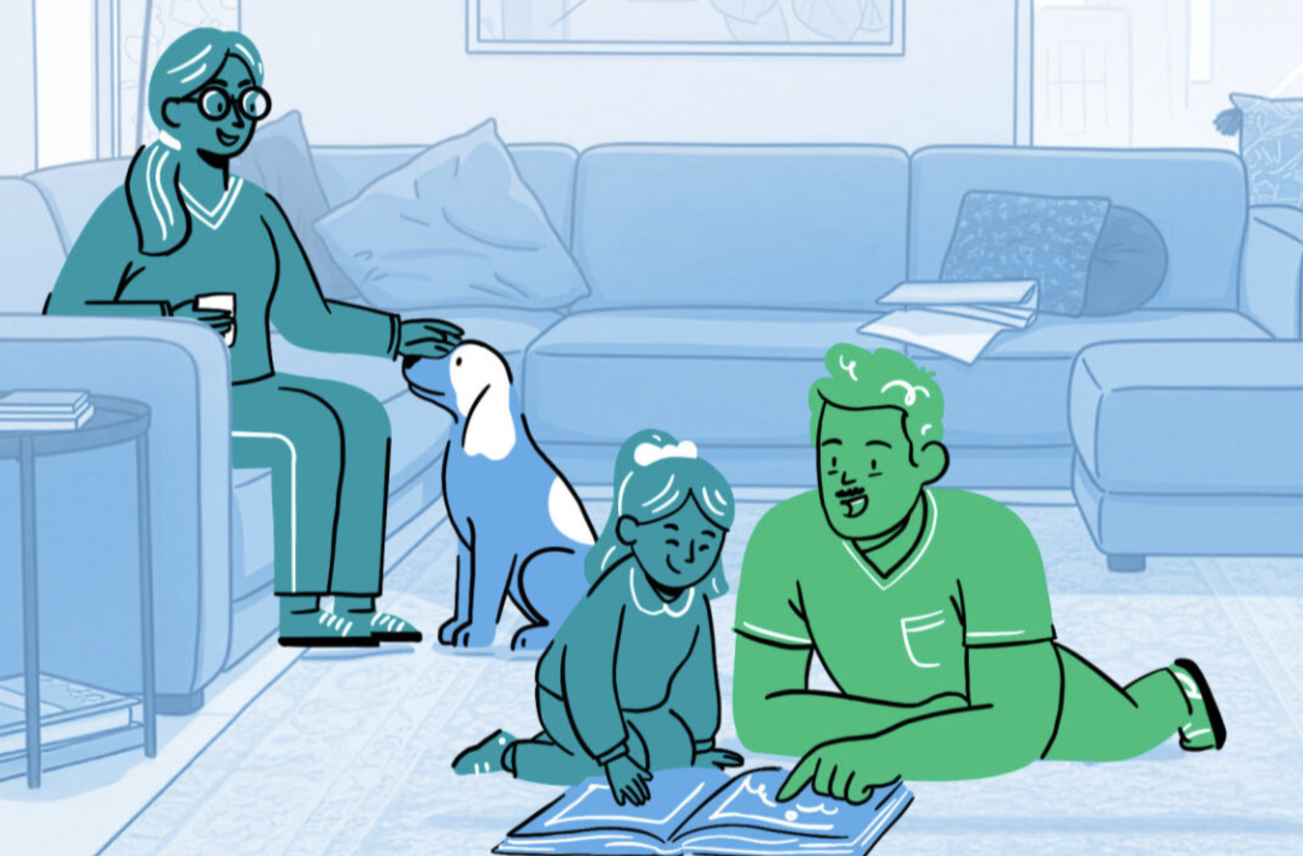
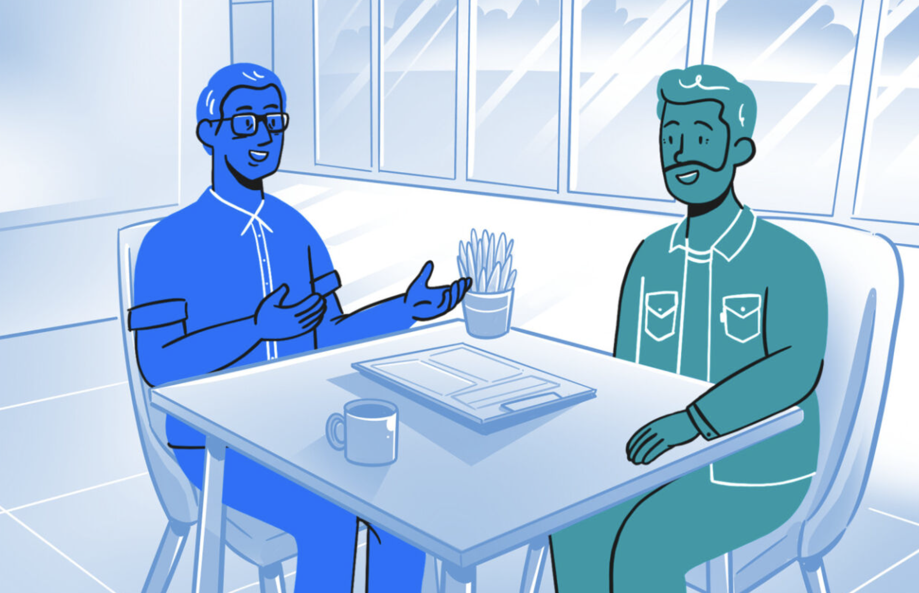

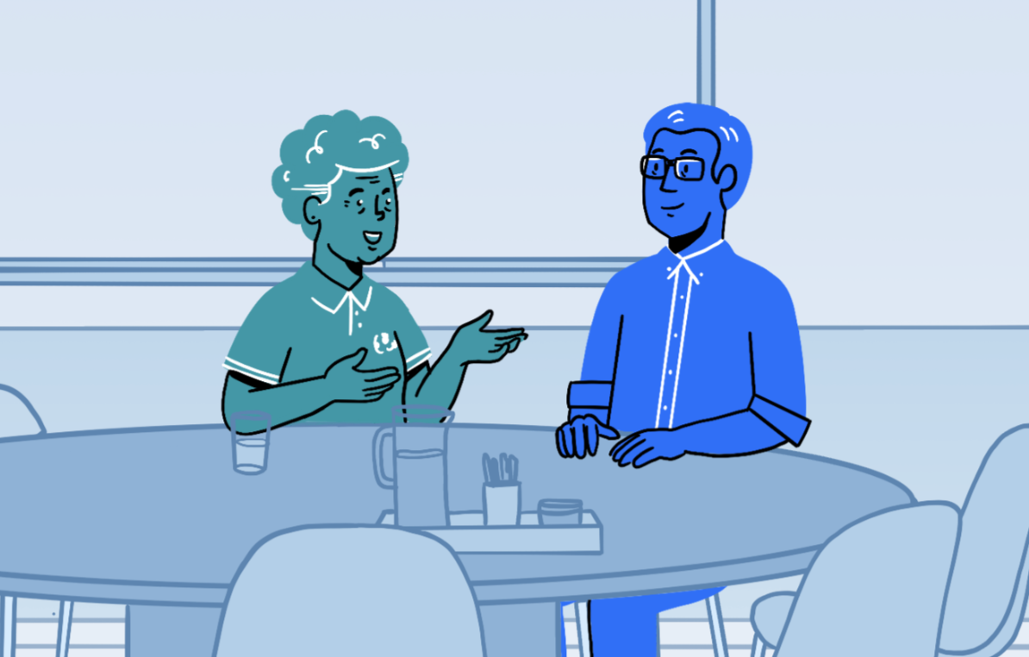
You Can Ask!
<30 Minutes
You Can Ask by NAMI encourages teams to support each other’s mental well-being. Learn how to:
Spot the warning signs of a mental health concern
Reach out in a workplace environment without overstepping professional boundaries
Build confidence in your ability to offer words of support that are authentic to you
Know where to go for resources and next steps
FREE
25%
MHA
71%
NAMI
On-Demand

Slide 15
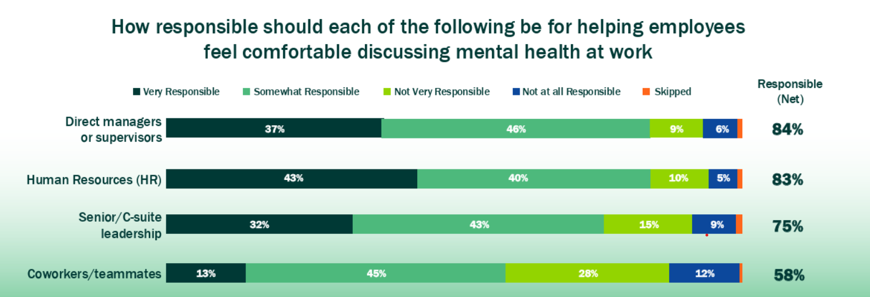
Managers are the Linchpin

Slide 16
Managers are the Linchpin
Only 28% of managers have received training to support mental health conversations
Nearly 1 in 3 managers say their company hasn't provided enough resources

Slide 17
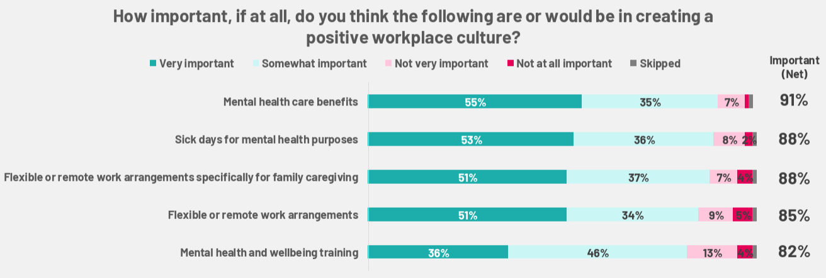
What Employees Want

Slide 18
Stories Worth Telling
Why is mental health the last taboo topic?
  Opportunity for individual storytelling
  Manager angle – navigating without support, can’t show vulnerability
Training
  Huge demand
  Why it’s helpful (& doesn’t have to be intensive!)
State of the world stress
  What employers are or aren’t doing
Caregivers
  Quiet brain drain from quitting
How can we support them without stigmatizing?
Managers
  73% burned out; who is supporting the supporters?
Lack of awareness of benefits
Breaking the silence – leadership modeling

Slide 19
Thank you!
www.nami.org/MentalHealthAtWork2026
stigmafree.nami.org
Want to learn more? Email media@nami.org

