Slide 1

National Press Foundation
Betsy Schwartz
APAF Center for Workplace Mental Health
May 13, 2026

Slide 2
The Workplace Mental Health Gap
Mental health conditions are more common than cancer, diabetes or heart conditions.
1 in 5
Only 50.6% receive mental health treatment
adults in the US experiences a mental health condition
(NIMH)
(NIMH)
65%
65%
of benefit leaders report drastic increases in mental health leave.
of employees say they feel more stressed than they did five years ago.
Lyra
(Forrester/Spring Health 2025)
Notes:
“Mental health conditions are more common than cancer, diabetes or heart conditions” ComPsych, Mental Health Leaves of Absence Continue to Proliferate Among U.S. Workers According to New ComPsych Data, https://www.compsych.com/press-release/mental-health-leaves-of-absence-continue-to-proliferate-among-u-s-workers-according-to-new-compsych-data/#:~:text=This%20represents%20a%2022%25%20increase,the%20first%20quarter%20of%202024.
Mental health leaves are surging. Sixty-five (64%) percent of benefits leaders report drastic increases in our survey—a sign that resilience is wearing thin and traditional benefit strategies can’t keep pace with today’s pressures. “Lyra 2026 Workforce Mental Health Trends Forecast”
According to a 2025 commissioned study conducted by Forrester Consulting on behalf of Spring Health, 65% of employees say they feel as or more stressed than they were five years ago
In addition:
“Crisis readiness starts with preparation “Nearly 9 in 10 benefits leaders say their teams are expected to respond to mental health crises without adequate training. This gap between strategy and readiness puts both employees and organizations at risk.”
NAMI/Ipsos poll: Barriers to seeking support:
Awareness related to stigma and fear of retaliation etc:
39% of all employees said they fear judgement and stigma related to mental health
38% said no one else talks about their mental health at work
33% do not want to seem weak
22% fear of retaliation
22% cite their job as reason for poor mental health

Slide 3
Why Supporting Mental Health Matters Matters
Employee health, retention, productivity — and your bottom line are impacted by mental health.
6 in 10
$12,000
149%
of surveyed employees have considered quitting their jobs as a result of their mental health.
dollar loss in productivity for each highly stressed employee, per year.
higher annual healthcare costs for employees with untreated depression.
(AAPL, 2025)
(Spring Health 2026)
(Headspace, 2025)
Notes:
Employees with untreated depression incur 149% higher annual healthcare costs than their peers” [Spring Health, Bend-The-Medical-Trend.pdf}
“6 in 10 of surveyed employees have considered quitting their jobs as a result of their mental health.” [Headspace Workforce State of Mind 2025.]
“It’s estimated that there is a $12,000 loss in productivity for each highly stressed employee per year ,”
[American Association for Physician Leadership, Employee Stress Is a Business Risk—Not an HR Problem | AAPL Publication]
In addition:
It is estimated that missed work due to poor mental health costs the US economy $47.6 billion annually.
One in three Americans say their mental health is negatively impacted by their jobs, according to SHRM research.
Thirty percent of the 1,000 workers surveyed reported feeling overwhelmed at work, while 29% said their jobs make them feel anxious at least once a week. (How Major Companies Are Addressing Mental Health In The Workplace, Forbes
“60% of employees worldwide say their job is the biggest factor influencing their mental health.” [UKG Workplace report 2025]
Nearly half (48%) have left jobs for mental health reasons. [Mindshare 2025]
Mental illness is the single greatest cause of worker disability worldwide. [World Health Organization]
SO YOU CAN SEE WHY ….“88% of HR and benefits leaders identified mental health as a top priority the next two years” (Spring Health, 2025 5 Trends Shaping the Future)

Slide 4


Employee Engagement in the U.S.
Gallup 2026 poll reveals:​
31% of U.S employees are “engaged in their work” ​
62% of the workforce struggles with engagement
Greatest decline among the youngest workers and managers (especially female)​
​
Highly engaged workforces are 21% more profitable with 41% lower absenteeism. ​
​
Lack of engagement costs the world economy $438 billion in lost productivity.

Slide 5

Factors Contributing to Engagement and Disengagement
Clarity of roles and expectations
Recognition for work and contributions
Professional Development
Loneliness
Remote Work
Connection to a mission or purpose

Slide 6
What Influences Workplace Culture
Trust & Psychological Safety
Growth Opportunities
A Sense of Belonging
Environment that supports Mastery, Autonomy, and Purpose
Flexibility

Slide 7
The ROI​
56% of companies report getting more than
$2 back for every $1 spent on wellness programs
In the U.S., the cost of untreated mental illness can be staggering – with approximately $200 billion spent on it annually.
Notes:
In fact, 95% of HR leaders tracking ROI report positive returns from their wellbeing programs. These aren’t just minor improvements. A full 56% of companies report getting more than $2 back for every $1 spent Source: https://wellhub.com/en-us/blog/wellness-and-benefits-programs/benefits-of-employee-wellness-program/ which states: "
WellHub just released a 2025 report based on a pulse survey 1,500 CEOs and business leaders across 10 global markets:
More than 80% report positive returns from their wellness programs, and one in three say that return tops 100%.
97% say wellness boosts productivity, 67% see less absenteeism, and 73% report stronger retention”
And a striking 74% say that top talent won’t even consider their company unless it demonstrates a real commitment to wellbeing

Slide 8
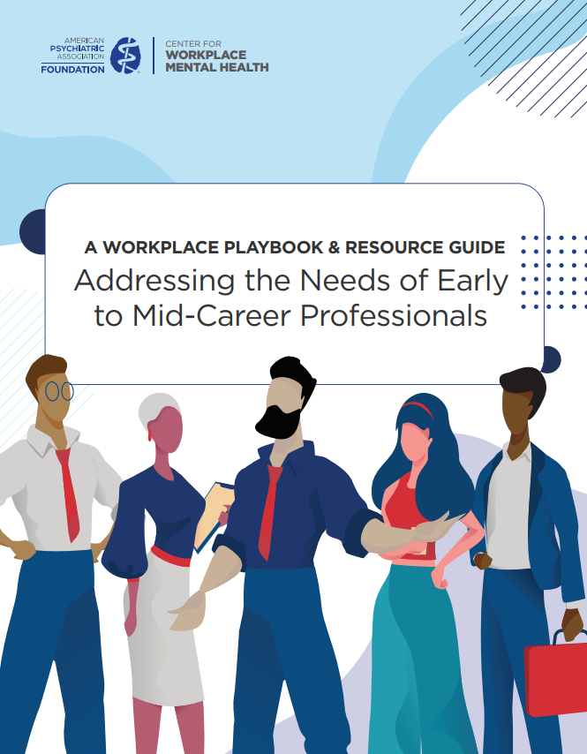

Slide 9
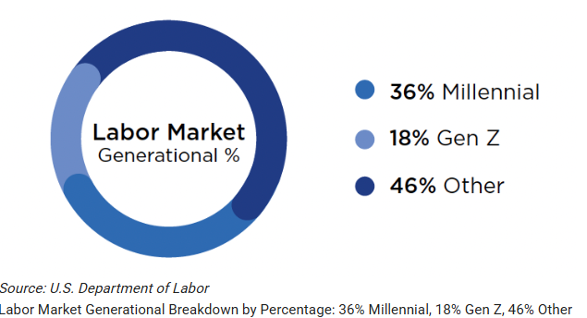

Slide 10
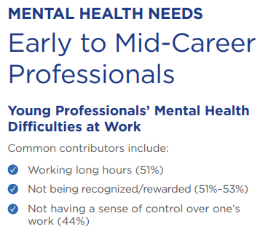

Slide 11
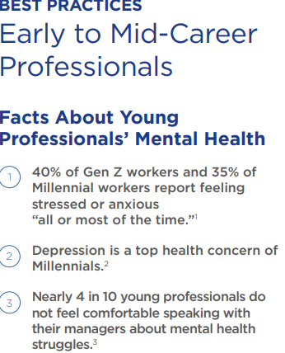

Slide 12
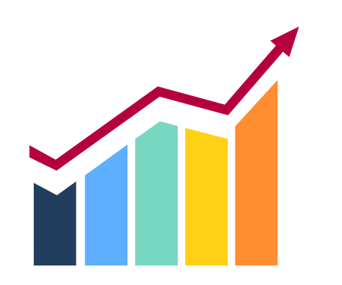
M
M
Employees spend 20-30 hours a week on family caregiving
U.S. adults serve as caregivers
National Alliance for Caregiving and AARP
Forbes
B
B
Cost of caregiving each year due to lost productivity, turnover, and healthcare claims
Homethrive.com.
Caregivers quit their jobs due to their caregiving duties
Rosalyn Carter Institute for Caregivers.

Slide 13
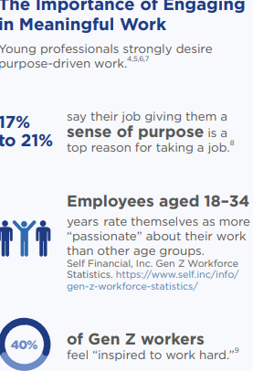


Slide 14
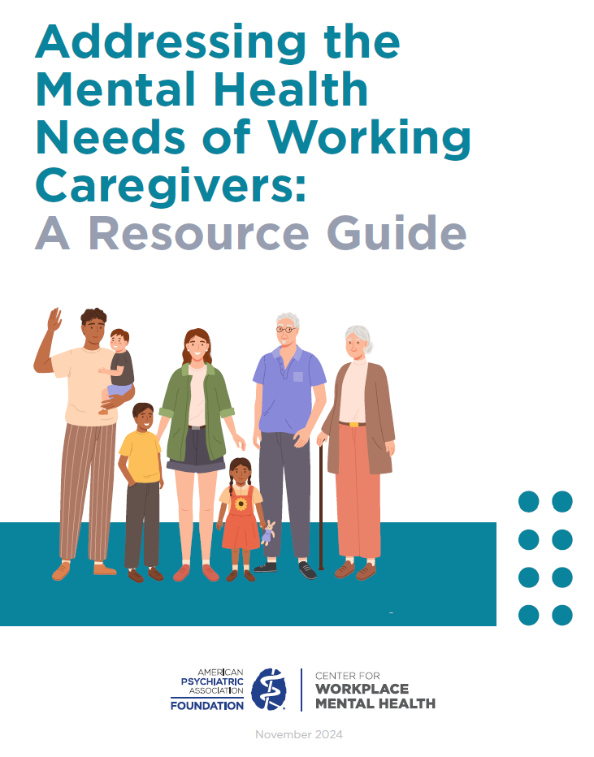
Defining the Caregiver
A Case for Supporting Caregivers in the Workplace
Identifying the Caregiver
Caregiver Mental Health in the Workplace
Caregiver Mental Health: Myths vs. Facts
Best Practices for Caregivers in the Workplace
Resources
Paramount Case Study: Addressing the “Sandwich Generation’s” Mental Health Through Robust Caregiver Employee Benefits

Slide 15
Why Employers Should Care
Supporting working caregivers is the right thing to do. Caregiving affects nearly everyone.
Caregivers have unique strengths that can benefit companies while boosting their own career progression.
Offering caregiver assistance is a form of preventative care.
Protecting working caregivers is a smart approach to talent management.

Slide 16


The range of impacts that caregiving has on your employees
Physical: Chronic stress erodes the immune system, which leads to both minor and major illnesses. Poor health behaviors (not sleeping, eating, exercising, or visiting a doctor) undermine caregiver health.
Emotional: Chronic stress contributes to mental health issues. The use of prescription medication for anxiety or depression is 2-3 times more than in the general population. About 60% report depression.
Financial: Caregivers spend $10,000 annually for out-of-pocket costs. The average lost lifetime wages, pension, and Social Security benefits for caregivers over 50 is about $300,000. The average income lost by caregivers each year is 33%.
Interpersonal: Feelings of isolation and family struggles are common. Caregiver strain is directly influenced by family conflict and disagreements, by changing roles and unequal distribution of caregiving tasks.
Occupational: 60% report the need to make workplace adaptations: rearrange schedules, cut hours, take unpaid leave, forgo promotion, resign or retire early. Roughly 52% of caregivers felt their career was negatively impacted by their caregiving situation, while 11% of caregivers lost their job due to caregiving.
Source: Genworth, Beyond Dollars, 2015.

Slide 17

Best Practices for Supporting Working Caregivers
Create a culture that is supportive of caregiving.
Offer flexible work arrangements and time off options
Provide a comprehensive range of caregiver-specific benefits, programs, and supports.
Training people managers on mental health, empathy & compassion

Slide 18

Best Practices for Supporting Working Caregivers
Create a culture that is supportive of caregiving.
Conduct an assessment. Assessment tools are critical because working caregivers may not self-disclose their caregiving status.
Demographics
What supports do they have, and what do they still need
Type, intensity, and duration of caregiver tasks
Perceived level of stress or burden
The health of the caregiver
The training opportunities and supports that might benefit the caregiver.
Establish a Caregiver Employee Resource Group
Ensure employees learn about and understand paid family leave and other benefits
Leverage the power of storytelling
Tap into leaders to see if anyone will share their own caregiving experience with others

Slide 19
2. Offer flexible work arrangements and time off options.
shared/donated time off
PTO rollover
PTO company “matching” program
unlimited vacation
the option of working reduced hours
flexible schedules
job sharing
Remote or hybrid work.
3. Provide a comprehensive range of caregiver-specific benefits, programs, and supports.
4. Training people managers on mental health,
empathy & compassion.

