Slide 1
Covering Workplace Mental Health
When the Way We Work Is the Story
Notes:
Journalist. Author. Storyteller.
I’m driven to understand how we create a world where all people, across race, class and gender, can live a Good Life
With equal opportunity for Meaningful work. Love, care and connection with others. Time for joy, leisure, laughter and play
(What drives me is a vision of a fairer, egalitarian world.)

Slide 2
Connect the Personal & Political
Look for Root Causes
Follow the Data
Tell the Whole Story – Be Inclusive
Look for Bright Spots

Slide 3
The Vision
Notes:
The Good Life
Work, Love, Play
TIME
Wholehearted living

Slide 4
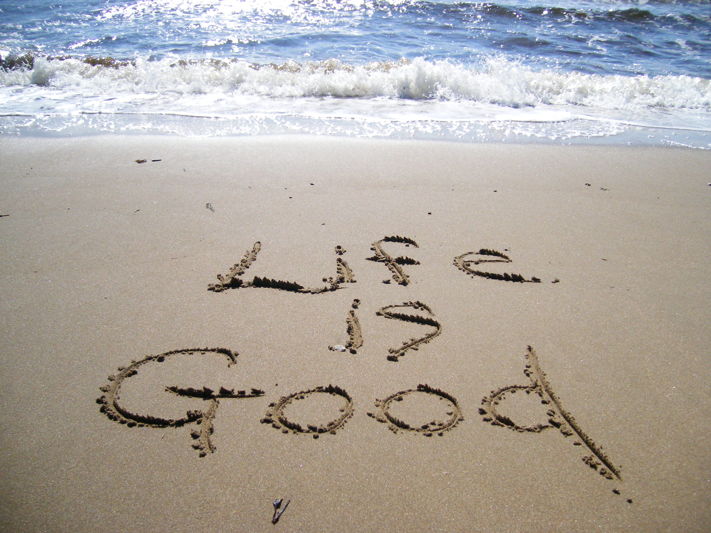
©Deborah Larson | Dreamstime
Notes:
It’s time for a new story of work
The way things are don’t have to be the way things will be
Now, when my husband asks if I want to go on a hike, I turn off my computer and go.
Future is a choice
It will be up to all of us
To imagine a better future of work – BELIEVE that it’s possible.
And use our suffering, learn from our insight, draw on our will and take action. Take the next best step – indiv. Org. policy
Change is never linear
Can be surprising.
But with strength and hope – and persistence -
We can all get to

Slide 5
Current Reality

Slide 6
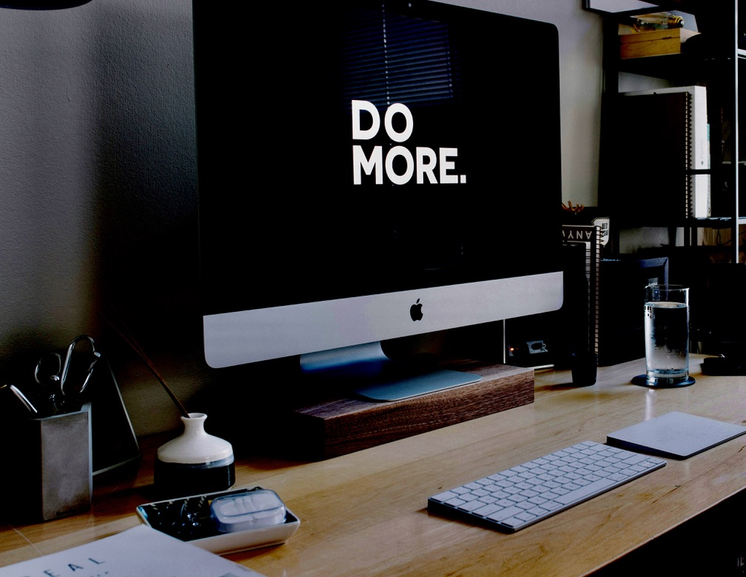
Greedy Work. It’s 3 am …
Carl Heyerdahl | Unsplash
Notes:
But here’s where I found myself one night …
Cardiologist’s office. Acute stress
1973 psychoanalyst Allen Wheelis published a small book, How People Change
Outlined 5 steps of transformation
https://www.themarginalian.org/2023/07/04/allen-wheelis-how-people-change/

Slide 7

When Your Boss is an Algorithm
Vincent Tsui for HBR
Notes:
Technology isn’t creating this, it’s exacerbating existing underlying social problems,” said Aiha Nguyen, who heads the Labor Futures Initiative at Data and Society Research Institute and recently chaired a panel at a labor conference entitled “When Your Boss is an Algorithm.” “Unpredictable schedules are another form of precarity of work, which we’ve been seeing for awhile.”
And what many employers like Target and other big box retailers, grocery stores and fast food restaurant chains have been inputting into their complicated scheduling algorithms that have sprung up in recent years has been driven by one goal: increasing efficiency to increase profits. In a capitalist economy, that’s hardly surprising. The idea sounds laudable, even. Especially in an era dubbed “retail apocalypse” when brick and mortar stores are under increasing pressure from online retail and many, like Forever2, Payless, ToysRUs and Sears, are declaring bankruptcy. It sounds like a brilliant plan to use Big Data to better track customer demand, then come up with a smart software algorithm to figure out how many workers you need and when to most efficiently deploy them. The cost of labor is the single largest controllable expense for retailers. So it’s the first place they looked to cut.
Now, Big Data rules. In addition to complex and fine-grained analyses of previous years’ sales patterns, by the month, day, and hour, some stores have begun to use sensors and video cameras to track foot traffic, shopper movements and their “dwell time” in front of certain products. Some scheduling software programs track weather patterns, local and regional events like football games and concerts, as well as Twitter traffic to make real time adjustments to their demand projections. More rain predicted; more customers likely to dash indoors to buy stuff. More last-minute calls to workers to come in. Or, when the rain doesn’t bring in the expected rush, more workers called in at the last minute to send home, often without pay.
But while the algorithms have perhaps become increasingly sophisticated tracking unpredictable and fluctuating customer demand (more on that later), what they haven’t been programmed to do is treat human beings as anything other than interchangeable puzzle pieces. As a result, algorithmic scheduling has wreaked nothing short of utter havoc in the lives, health, financial stability and future prospects of millions of retail workers – one out of every 10 workers in the United States – trapping many of them and their families in a never-ending cycle of precarious and unpredictable low-wage work.
On the tech side, “algorithmic management,” as it’s called, got its start during World War II, when, as Cathy O’Neill writes in Weapons of Math Destruction, U.S. and British mathematicians began using applied mathematics for “operations research,” to track how much Allied resources were spent compared to enemy resources destroyed. After the war, companies began applying operations research to a vast number of business functions, from setting flight and train schedules and assigning work crews to them to urban design and managing supply chains.
In the 1960s, when Toyota pioneered a highly efficient “Just in Time” manufacturing system – ordering parts as needed rather than storing them in massive warehouses - the idea quickly spread to businesses around the globe. Scheduling software for hourly workers is merely an extension of that same efficiency mindset, O’Neill writes. Except instead of car parts being ordered on demand, it’s people. And the algorithm treats them as if they were both interchangeable puzzle pieces.
Under threat of expanding e-commerce, brick and mortar retailers began using technology to collect data on customers to track their demand. Some, in addition to video cameras and sensors, use WiFi hotspots to connect to customer phones to track their in store movements. Some, including Saks 5th Ave stores in Canada, have used facial recognition software to gauge demographic information as well as shopper mood - even adjusting the store’s music selection to entice customers to buy.
Soon, smart software could forecast customer demand in 15-minute increments. And smart software companies like Kronos, Shiftboard, Workplace and others began selling software that could do the same for workers – use algorithms to schedule their time in 15-minute chunks to better match demand and, in the name of efficiency, slash labor costs. And, in the last five years, industry leaders told me, the more the big companies invested, the cheaper and more widely available to a variety of businesses the scheduling software became.
To Charles DeWitt, former vice president for business development at Kronos, “it’s like magic,” he told the New York Times. To Cornell professor of Information Science Karen Levy, it’s “refractive surveillance,” or technology designed to collect data about one party’s behavior that winds up being used as a management tool to control another’s, often with unintended harm.

Slide 8

Work-Life Conflict
Marco | Adobe Stock
Notes:
Heavy demands at work and home
Children, though older, now I was also helping my mother navigate the bitter waters of preparing for the end of her life

Slide 9
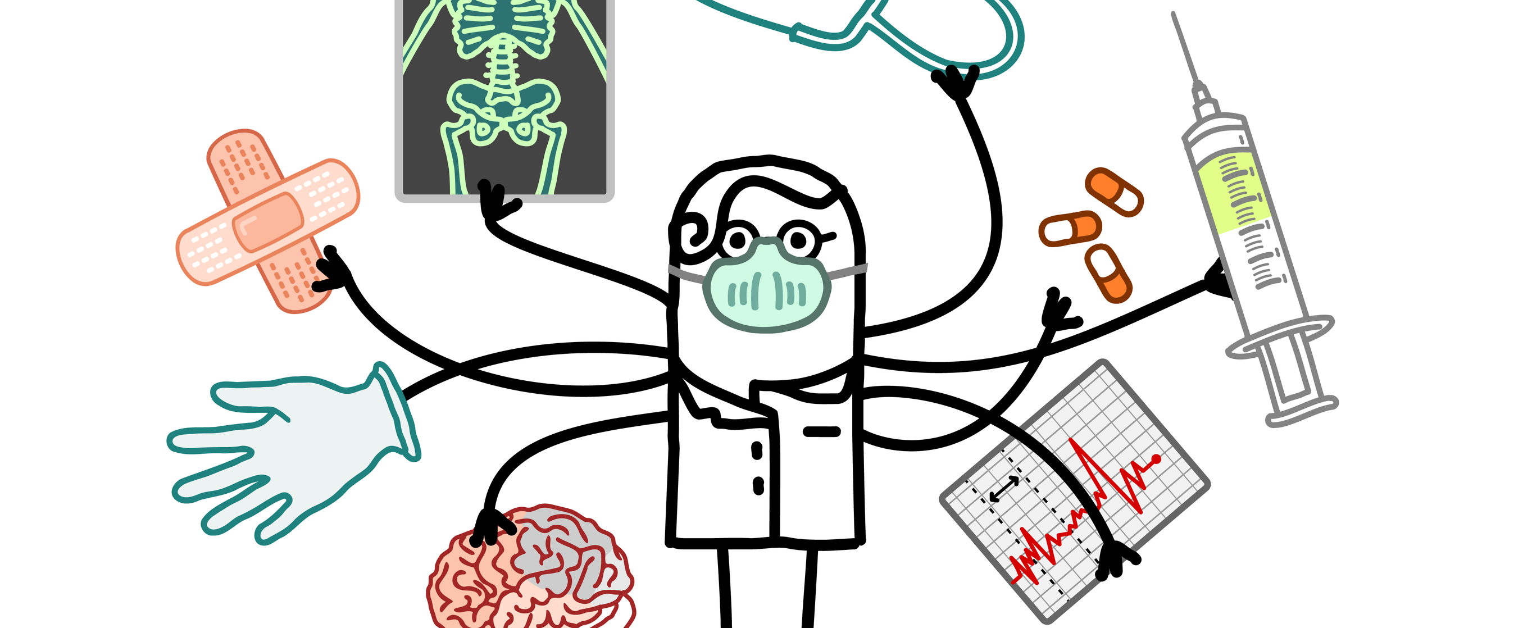
Work-Work Conflict
© N.I. | Dreamstime
Notes:
Work becoming greedier, Claudia Goldin
Alison Wyn and her colleagues at Stanford came up with the term
“This combination of different work roles is what drove a lot of tension. For some people, it was even more stressful than work-life conflict,” says Alison Wynn, study author and postdoctoral fellow. “In order to be a really good physician, that takes all of you. To be a really good researcher, or to be a really good teacher and mentor, that takes all of you. And it’s really difficult to divide yourself between all those different roles.”
Layoffs – expecting fewer and fewer workers to do more and more
https://www.ft.com/content/68499e9a-60f1-11e9-9300-0becfc937c37

Slide 10
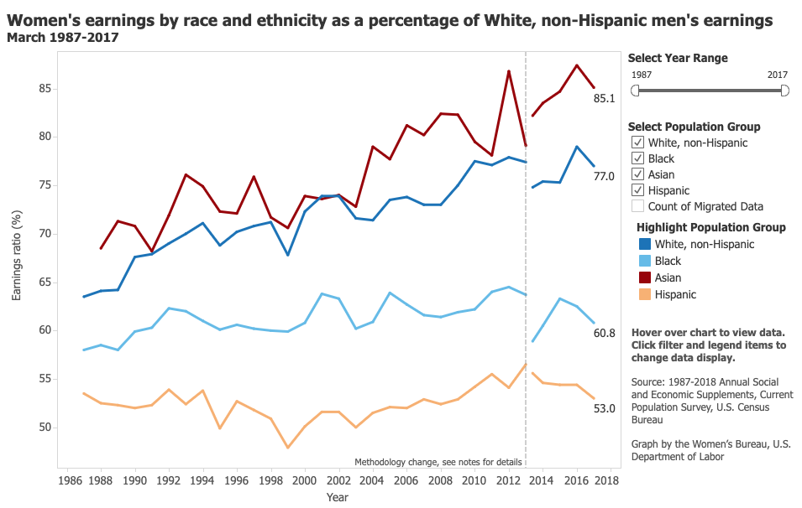
Gender and Race Wage Gap
Women’s Bureau - U.S. Department of Labor
Notes:
IWPR Report – Parity w/ white men:
Asian Women – 2025
White women – 2055
All women/ All Men – 2059
Black women – 2133
Hispanic women – 2220
https://www.nytimes.com/2016/03/20/upshot/as-women-take-over-a-male-dominated-field-the-pay-drops.html
Still, even when women join men in the same fields, the pay gap remains. Men and women are paid differently not just when they do different jobs but also when they do the same work. Research by Claudia Goldin, a Harvard economist, has found that a pay gap persists within occupations. Female physicians, for instance, earn 71 percent of what male physicians earn, and lawyers earn 82 percent.
After sifting through the data, Ms. Blau and Mr. Kahn concluded that pure discrimination may account for 38 percent of the gender pay gap. Discrimination could also indirectly cause an even larger portion of the pay gap, they said, for instance, by discouraging women from pursuing high-paying, male-dominated careers in the first place.
“Some of it undoubtedly does represent the preferences of women, either for particular job types or some flexibility, but there could be barriers to entry for women and these could be very subtle,” Ms. Blau said. “It could be because the very culture and male dominance of the occupation acts as a deterrent.”
A new study from researchers at Cornell University found that the difference between the occupations and industries in which men and women work has recently become the single largest cause of the gender pay gap, accounting for more than half of it. In fact, another study shows, when women enter fields in greater numbers, pay declines — for the very same jobs that more men were doing before.
Consider the discrepancies in jobs requiring similar education and responsibility, or similar skills, but divided by gender. The median earnings of information technology managers (mostly men) are 27 percent higher than human resources managers (mostly women), according to Bureau of Labor Statistics data. At the other end of the wage spectrum, janitors (usually men) earn 22 percent more than maids and housecleaners (usually women).
Once women start doing a job, “It just doesn’t look like it’s as important to the bottom line or requires as much skill,” said Paula England, a sociology professor at New York University. “Gender bias sneaks into those decisions.”
And there was substantial evidence that employers placed a lower value on work done by women. “It’s not that women are always picking lesser things in terms of skill and importance,” Ms. England said. “It’s just that the employers are deciding to pay it less.”
A striking example is to be found in the field of recreation — working in parks or leading camps — which went from predominantly male to female from 1950 to 2000. Median hourly wages in this field declined 57 percentage points, accounting for the change in the value of the dollar, according to a complex formula used by Professor Levanon. The job of ticket agent also went from mainly male to female during this period, and wages dropped 43 percentage points.
While the pay gap has been closing, it remains wide. Over all, in fields where men are the majority, the median pay is $962 a week — 21 percent higher than in occupations with a majority of women, according to another new study, published Friday by Third Way, a research group that aims to advance centrist policy ideas.

Slide 11
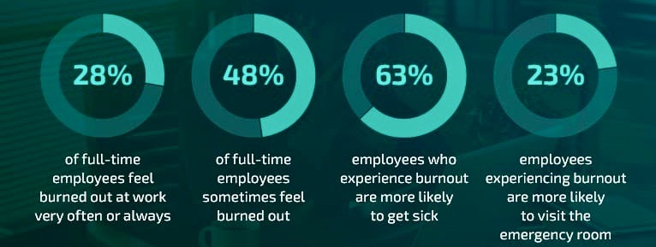
Burnout, Stress & Overwhelm
Gallup, 2024
Notes:
Gallup State of the Workplace – US and Canada – half workers experience high daily stress – highest of any region surveyed on the globe
The pressure to address job burnout became so intense in 2019 that the World Health Organization declared burnout an occupational phenomenon in the 11th revision of the International Classification of Diseases.
The World Health Organization offers this burnout definition: "a syndrome conceptualized as resulting from chronic workplace stress that has not been successfully managed.”
https://www.gallup.com/workplace/349484/state-of-the-global-workplace.aspx
Disengagement cost the world economy $438 billion in 2024.
Global employee engagement fell two points to 21% last year, with lost productivity costing the global economy $438 billion.
Engaged employees produce better business outcomes than disengaged employees — and engaged teams have a measurable impact on organizational performance.

Slide 12


Brave New World
Alissa Eckert, Dan Higgins | CDC
© JaroonIttiwannapong | Dreamstime.com

Slide 13
How did we Get Here?
Notes:
Leslie Hammer & Ellen Ernst-Kossek research

Slide 14
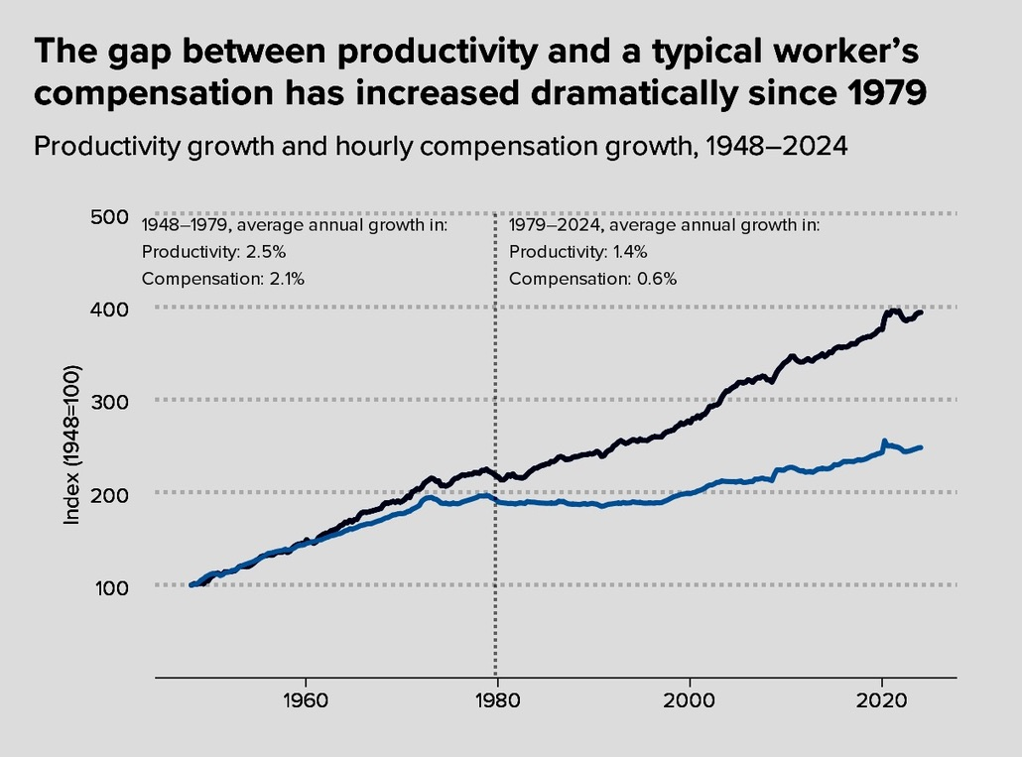
Working Harder & Falling Further Behind
Economic Policy Institute
Notes:
Av. Wage, adjusted for inflation, hasn’t budged since 1980s
Minimum wage stuck at $7.25 since 2009
Housing, child care, health care costs rising
4 in 10 americans can’t scrape together $400 for an emergency – recent Fed report
Not enjoying the fruits of their labor
https://www.theatlantic.com/business/archive/2015/02/why-the-gap-between-worker-pay-and-productivity-is-so-problematic/385931/
https://www.epi.org/productivity-pay-gap/
Productivity–Pay Tracker
Change 1979–2022:
Productivity
+64.7%
Hourly pay
+14.8%
Productivity has grown 4.4x as much as pay
This reflects growing inequality in wages – more growth at the upper end. These are “typical” nonsupervisory worker wages

Slide 15
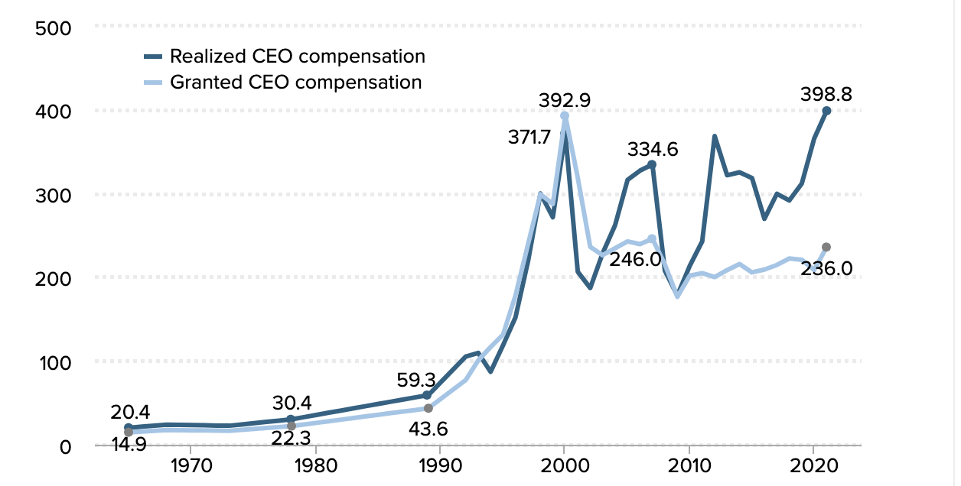
CEOs make 399 x more
Economic Policy Institute
Notes:
CEOs are
At 1 time, 30x more
RAND Corp – 1975 – 2018 $50 trillion shifted from the bottom 90 percent to the top 1 percent
One union member – economic inequality so gargantuan as to be obscene
https://www.epi.org/publication/ceo-pay-in-2021/

Slide 16
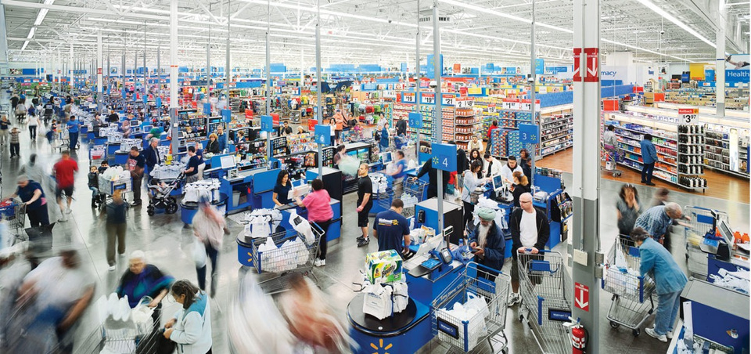
The “Crappification” of U.S. Jobs
Low pay/ no benefits
Insecurity/ instability
Chaotic Time
© Stephen Wilkes | stephenwilkes.com
Notes:
And rich economy for who?
44 percent of the workforce low wage
In lowest paying professions – 2/3 are women, many women of color
-GAO 70 percent on Medicaid and SNAP work full time

Slide 17
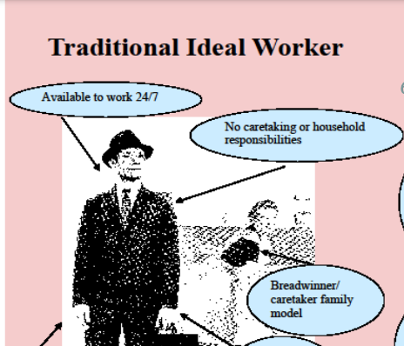
The Ideal Worker
Dr. Barb Silver, Univ. of Rhode Island
Notes:
Co-workers mostly male
Long work hours – to show commitment for advancement
Face time – being on the job was crucial
Linear career path – steady employment

Slide 18
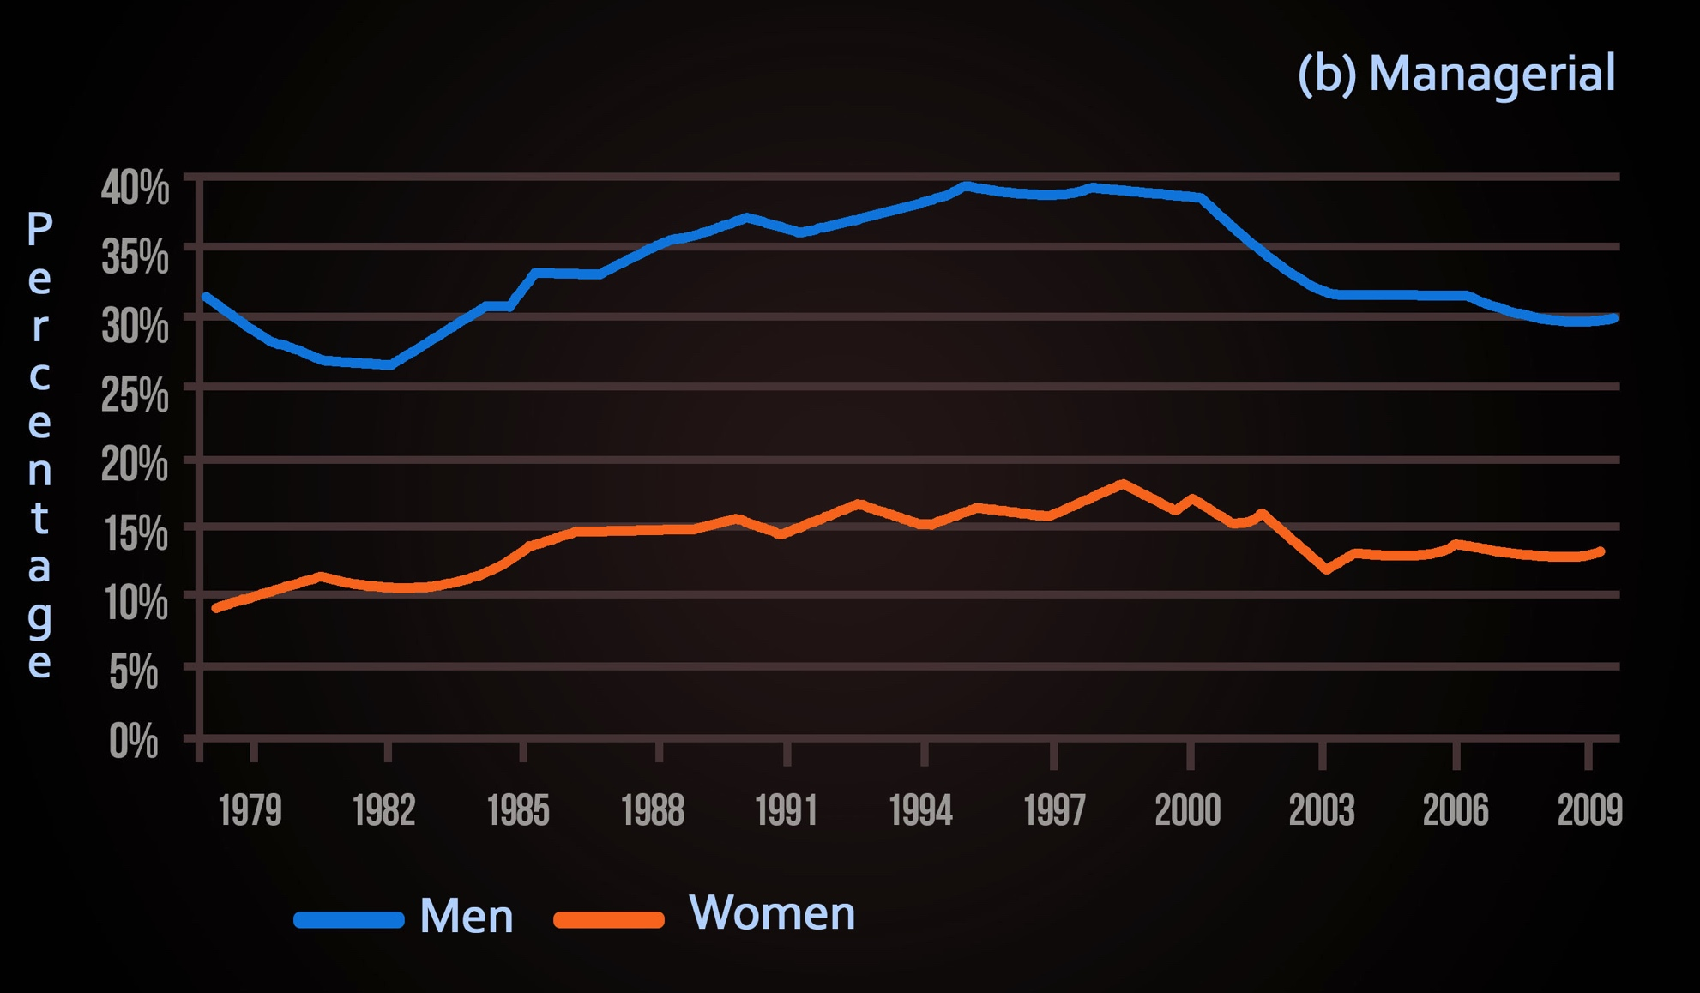
Overwork Gender Gap
Cha & Weeden, American Sociological Review, 2014

Slide 19
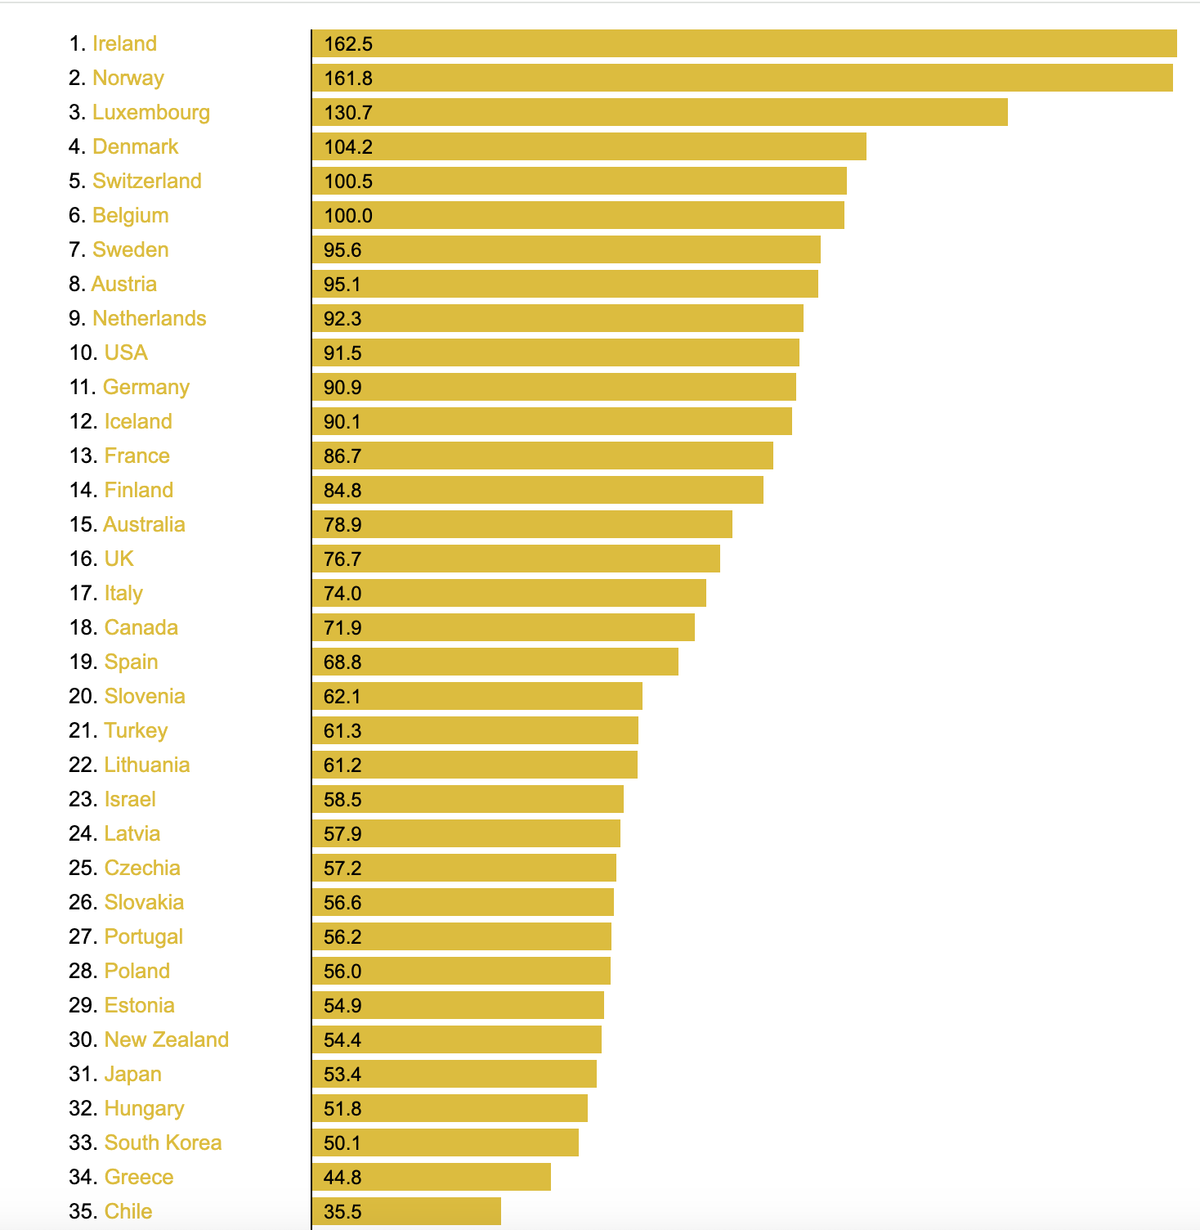
Long Work Hours
Yet the United States is not the most productive
GDP per hours worked 2022
Theglobaleconomy.com
Notes:
U.S. workers work among the longest hours of any advanced econ.
Knowledge workers overwork 1 job – living up to Ideal worker norm – always on, always available
Hourly and low-wage workers over work in multiple jobs, side hustles or gigs – also expected to be on call, always on, always available – for a lot lower pay
Long overwork hours, as Youngju Cha has shown, also factor into the gender wage gap. Expected to be primary caregivers, there’s just no way for women or caregivers to put in long hours
We think that’s what it takes – just the way it is – to have a booming rich economy
Yet aren’t the most productive
https://www.theglobaleconomy.com/rankings/productivity_current_USD/

Slide 20
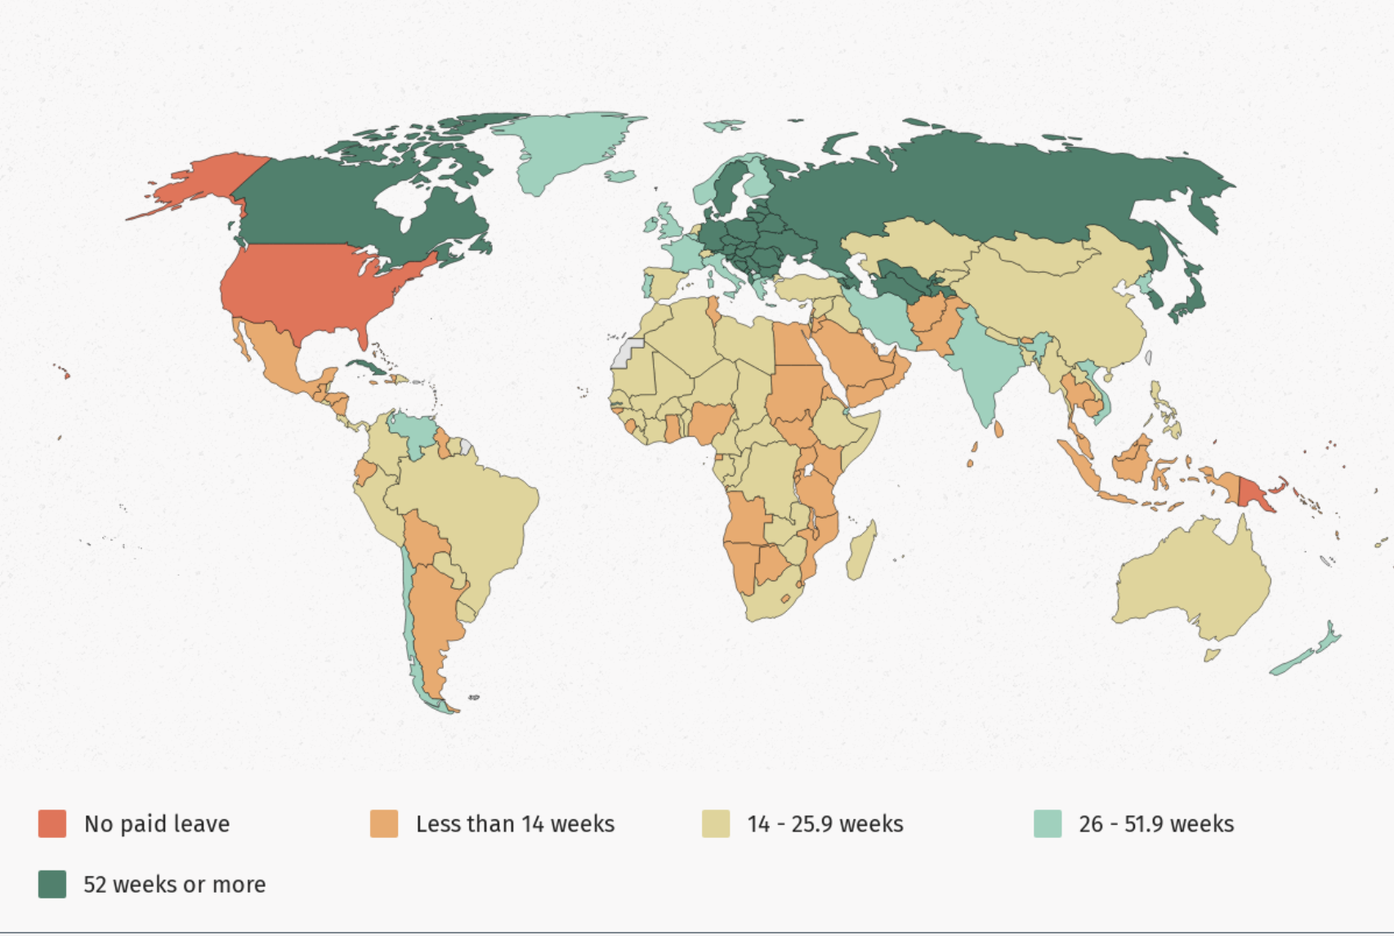
Little support
World Policy Analysis Center 2022
Notes:
Policies show what we value and shape our culture, our attitudes, choices, sense of the possible
No work time limits for salaried workers –
We value work
https://www.worldpolicycenter.org/sites/default/files/media-server/maps/920.png
https://www.worldpolicycenter.org/policies/is-paid-annual-leave-available-to-workers

Slide 21
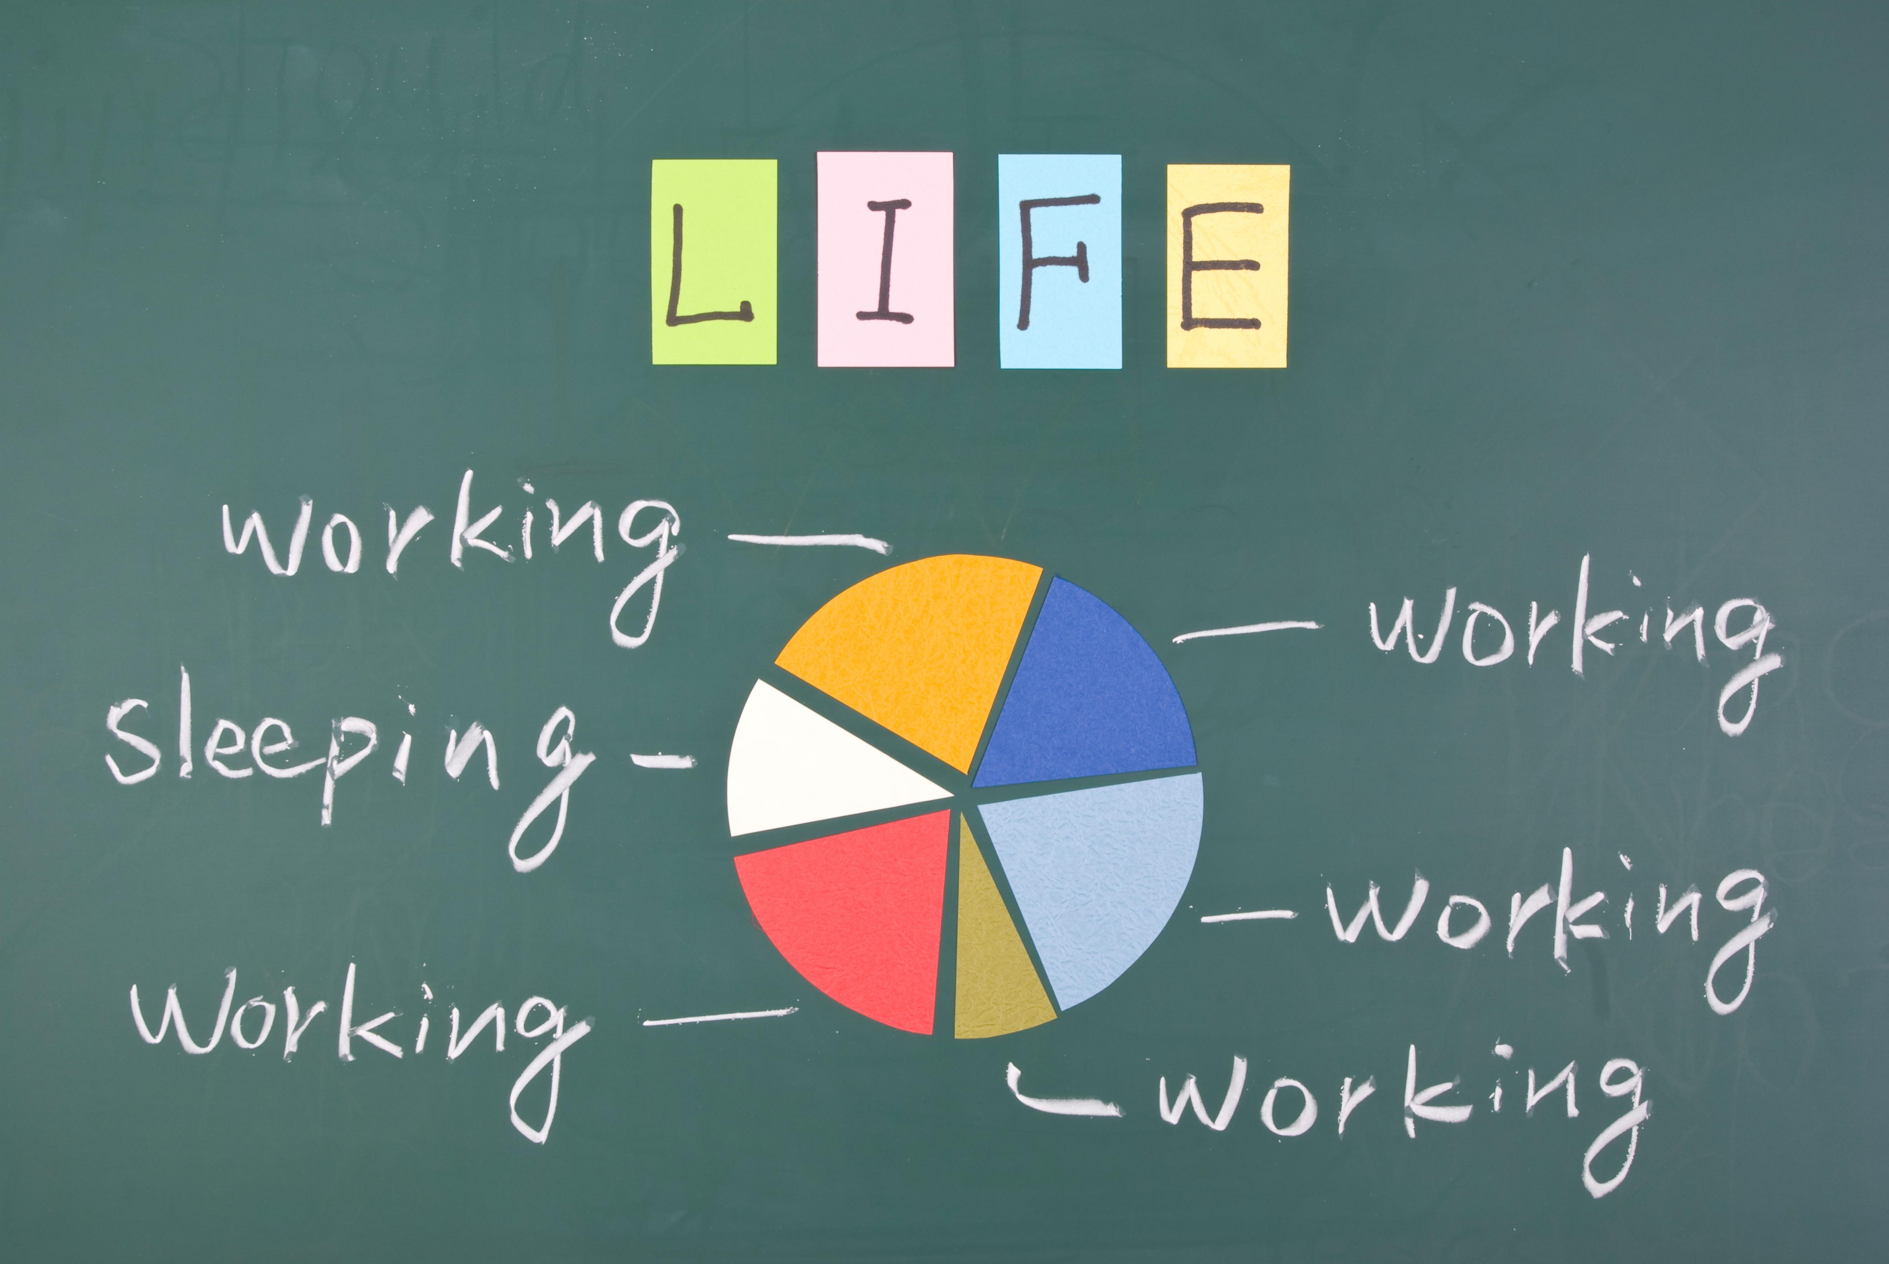
Work: 5th leading cause of death
© Revensis | Dreamstime.com

Slide 22
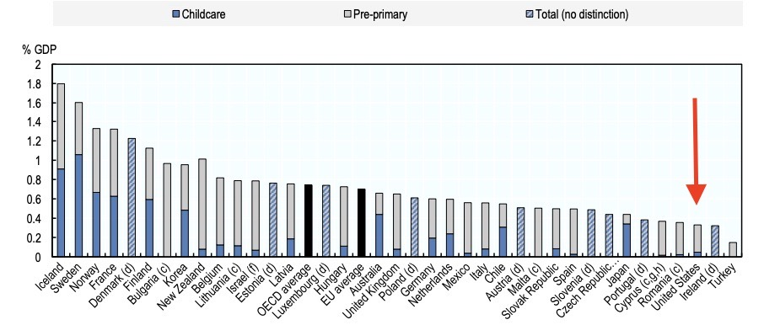
Little investment in childcare

Slide 23
Where Do we Go From Here?
Notes:
Leslie Hammer & Ellen Ernst-Kossek research

Slide 24
Work Redesign
Reduce Work Demands
Increase Worker Control
Increase Worker Support
Notes:
Leslie Hammer & Ellen Ernst-Kossek research

Slide 25

Work Stress
5th leading cause of death
$190 billion in health care costs/year
120,000 excess deaths/year
Estrada Anton | Shutterstock
Notes:
Recent Gallup State of the Global Workplace – 57 percent workers in US and Canada stressed at work every day. Highest of any countries
Metaanalysis of 10 psychosocial stressors at work
Work-life conflict
Toxic work cultures
Job insecurity
Work-life conflict
Creates so much acute and chronic illness that wow work is the 5th leading cause of death
Jeff Pfeffer “The workplace has become hazardous to our health”
I may not have been having a heart attack that one late night.
But many others are.

Slide 26

Lunchtime Yoga isn’t Enough
© Ocusfocus | Dreamstime.com
Notes:
Individual responses – to individual “problems” – the wellness movement
Misses the point
We are part of systems. Behavioral science – we are influenced by our environments
Cultural norms, policies
Tough to take on the system on your own. BUT … not impossible

Slide 27
Good Work: Get the Basics Right
See Workers as Assets
Offer Fair Pay and Hours/ Schedule Control
Create Cultures of Trust, Transparency, Respect & Psychological Safety
Connect Workers to Mission & Purpose
Provide a Promising Future/ Path Forward
Make Room for Care, Wellbeing, and Life

Slide 28

Tackling Burnout: Getting to the Root
Peopleimages
Notes:
Lorna Breen Heroes Foundation
-administrative paperwork - training
-staffing
-removing mental health treatment stigma from regulations
-creating cultures of wellbeing
-2019 WHO classified burnout as a “serious occupational phenomenon”
Long before covid crisis - 1 in ev 2 physicians show at least 1 symptom of burnout
Doctors and nurses highest suicide rates
Long work hours, work-work conflict, paperwork
Iron man culture
Stigma – they CAN’T seek help, like I did. A sign of weakness. Also worry could cost them their medical license
Corey Feist. Lost a family member – early days of covid – sick. Breakdown. Sought psychiatric treatment – then later committed suicide – so worried that she’d lose her medical license and not be able to do the work she loved
Now, the Dr. Lorna Breen Heroes Foundation
-changing medical licensing standards – 25 states and counting – remove the threat of losing license for seeking mental health treatment
-working to reduce paperwork burden, practical solutions
-in 18 mos passed bipartisan legislation, $135 million – look for and share best practices and solutions
“We don’t need more resilient canaries. We need a new coal mine”
https://www.who.int/news/item/28-05-2019-burn-out-an-occupational-phenomenon-international-classification-of-diseases

Slide 29
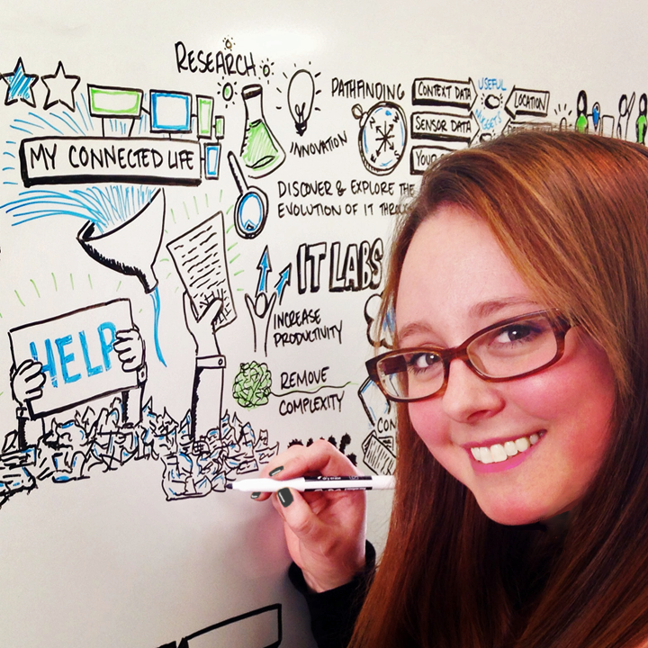
Why Redesigns Fail
Leaders
Status Quo
Beliefs
Echo Chamber
Corporate Monoculture
Intel
Notes:
https://community.intel.com/t5/Blogs/Intel/We-Are-Intel/Freelance-Nation-Brings-More-Flexible-Work-Options-to-Intel/post/1334264
Freelancer and Whiteboard Illustrator Sarah Moyle
Prior to joining Freelance Nation, Sarah Moyle had worked in Human Resources for four years. She heard about it from a mentor who was familiar with the program and enthusiastically recommended it. “I was really yearning for more creative work,” says Sarah. “And I had gotten into doing some explanatory whiteboard videos and graphic facilitation to help people grasp ideas and processes. So I saw Freelance Nation as a way to continue focusing on that and building up those skills.”
As a new mom, Sarah especially appreciates the flexibility Freelance Nation offers. “It’s great to be in control of my own schedule—and it’s been a real lifesaver at times. Like when my son’s six-month vaccinations coincided with his first tooth. It was a Monday morning, and—as you can guess—he was not a happy camper. But I was able to stay with him and give him the extra attention he needed that day. Then I just finished up my work later that night.”
Sarah also values the many development opportunities Freelance Nation provides. “We’re often able to partner with other Freelancers who have different skills or levels of expertise, and we’re encouraged to learn from them. So if there’s a particular set of skills I want to grow or gain, I can choose to work on projects with people I want to learn from.”
And if Sarah ever wondered whether working as a Freelancer would hold back her career growth in any way, she certainly doesn’t now. “Oh, definitely not. I’m constantly learning new skills and getting exposure to different parts of the company—more than I ever would otherwise. And the work I do makes a real difference here.” In fact, Sarah recently helped a client business group clinch a big contract with an important customer. “I received an urgent call asking if I could fly down to assist in a critical presentation. They said they could really benefit from having a graphic recorder there, so I quickly rearranged my schedule and was on my way. At the end of the meeting, the customers were all smiles—and I later heard that my visualizations played a key role in making a positive impression on our customer, positioning us to secure the contract. I couldn’t have been more proud.”

Slide 30
The Power of Bright Spots
Notes:
Leslie Hammer & Ellen Ernst-Kossek research

Slide 31

Scheduling that Works
Fair Schedules:
Increased wellbeing
Reduced Stress
Better Sleep Quality
More time with family
Economic security
Increased Productivity
Improved Sales
High return on investment
Courtesy of Ashley Worthen, former Albertson’s Worker
Notes:
Ashley Worthen
Chaotic schedules
Family held hostage – child care – trapped in economic precarity
Joined union – fight for fair and predictable schedules. Oregon became the first state to pass. Other cities. Some companies committed to it as well.
“Everyone is happier. Everyone sleeps better. The atmosphere at the store is so much better for workers and managers”

Slide 32

Short Work Hours =
Operational Excellence Mission in Disguise
Solbórg Preschool
Notes:
https://community.intel.com/t5/Blogs/Intel/We-Are-Intel/Freelance-Nation-Brings-More-Flexible-Work-Options-to-Intel/post/1334264
Freelancer and Whiteboard Illustrator Sarah Moyle
Prior to joining Freelance Nation, Sarah Moyle had worked in Human Resources for four years. She heard about it from a mentor who was familiar with the program and enthusiastically recommended it. “I was really yearning for more creative work,” says Sarah. “And I had gotten into doing some explanatory whiteboard videos and graphic facilitation to help people grasp ideas and processes. So I saw Freelance Nation as a way to continue focusing on that and building up those skills.”
As a new mom, Sarah especially appreciates the flexibility Freelance Nation offers. “It’s great to be in control of my own schedule—and it’s been a real lifesaver at times. Like when my son’s six-month vaccinations coincided with his first tooth. It was a Monday morning, and—as you can guess—he was not a happy camper. But I was able to stay with him and give him the extra attention he needed that day. Then I just finished up my work later that night.”
Sarah also values the many development opportunities Freelance Nation provides. “We’re often able to partner with other Freelancers who have different skills or levels of expertise, and we’re encouraged to learn from them. So if there’s a particular set of skills I want to grow or gain, I can choose to work on projects with people I want to learn from.”
And if Sarah ever wondered whether working as a Freelancer would hold back her career growth in any way, she certainly doesn’t now. “Oh, definitely not. I’m constantly learning new skills and getting exposure to different parts of the company—more than I ever would otherwise. And the work I do makes a real difference here.” In fact, Sarah recently helped a client business group clinch a big contract with an important customer. “I received an urgent call asking if I could fly down to assist in a critical presentation. They said they could really benefit from having a graphic recorder there, so I quickly rearranged my schedule and was on my way. At the end of the meeting, the customers were all smiles—and I later heard that my visualizations played a key role in making a positive impression on our customer, positioning us to secure the contract. I couldn’t have been more proud.”

Slide 33
Designing Fair Policies for All
© Albertshakirov | Dreamstime.com
Notes:
HBS – ¾ workers have care responsibilities
Men and paid leave – lawfirm – White & Case – 2018 - had to opt out, rather than request.
https://www.ft.com/content/0c313e88-a89a-11e9-90e9-fc4b9d9528b4
Please use the sharing tools found via the share button at the top or side of articles. Copying articles to share with others is a breach of FT.com T&Cs and Copyright Policy. Email licensing@ft.com to buy additional rights. Subscribers may share up to 10 or 20 articles per month using the gift article service. More information can be found here.
https://www.ft.com/content/0c313e88-a89a-11e9-90e9-fc4b9d9528b4
Managers were given training and guidelines. (Do treat men and women equally. Do not imply that use of parental leave will be a detriment to careers.) It took 18 months and meetings with 50 stakeholders for everyone to buy in. In 2018, 35 women and 34 men used the leave. Some staff grumbled. But David Koschik, an influential executive committee member, spoke up at a meeting, saying: “In the legal industry, we cannot expect to make significant strides in the advancement of women until we give men the same opportunity to take responsibility as parents.” Ms Philpot says that his intervention swayed the doubters. When everyone has more control over their schedules, or takes paid leave to care for themselves or others, when work-life balance becomes a performance metric for better work, productivity and better health, then women and those with family responsibilities will no longer be stigmatised and we’ll be on the road to creating truly equitable workplaces.
Gender neutral systems – hiring, promotion
Blind. Structured interviews. Compare across question. Relevant task
Flexible work and supportive policies like paid family and medical leave, paid sick days, paid vacation time, and support for care responsibilities are also key to creating cultures that promote well-being rather than workaholism, argues Youngjoo Cha, a sociologist at the University of Indiana who studies long work hours and organizational change. But just as important as crafting the policies, Cha added, is the way organizations implement and talk about them.
“If these policies focus on accommodation for women and mothers and are seen as more feminized, they’re actually not effective and increase the stigma of flexible policies, because people associate using them with a career-limiting move,” she said. “If the policies are framed as more gender-neutral, about employee well-being — something organizations do because they care about employees — those are more effective.”
Cha’s research has also found that transparency, clear communication, and guidelines are key to reducing flexibility stigma — as is making the policies a default rather than requiring employees to ask for or negotiate them. “The policies are much more effective when they’re formalized and rely less on manager discretion.”
Email – make it harder to send after hours, notes that signal new norm
Meetings – meeting with yourself. Make trade offs visible. Divide meetings
Vacation – make part of performance review. “moment” of planning
Schedule Slack – planning fallacy
Commitment devices – present bias (iris bohnet. Alieza yoga)

Slide 34

The Power of Bright Spots
Challenge Status Quo Thinking
Enlarge the Sense of the Possible
Role Models & Roadmaps
Shift of Focus to Systems Change
Notes:
The Good Samaritan Experiment: 1970s, 2 social psychologists wanted to test the person or the situation -what shaped decisions and behavior. Princeton seminary students. Prepare sermon on the Parable of the Good Samaritan. One group told to hurry. Another to take their time. Passed a shabbily dressed man in an alley. 63% of those not in a hurry offered to help the man. Of those in a rush, only 10% did.
Status Quo bias
Present bias (Construal Level theory.) Present is concrete. Future is abstract. Planner-Doer tension. Diets. New Year’s resolutions
Social norms
Novelty
Planning fallacy
Dan Ariely, from podcast - refrigerator: Less about willpower and discipline. More about creating systems that make it easier, less taxing to make the decision in the moment that will benefit you most in the future
Design thinking - Sometimes it’s easier to act your way into a new way of thinking, than to think your way into a new way of acting
Nudges:
-Richard Thaler – American economist at Univ. of Chicago, won Nobel Prize in 2017. co-author of Nudge. Change default options on 401K, pensions. From opt in to opt out. Auto-enroll. That has increased US pension savings by an estimated $7.6 billion annually
It’s less about willpower and discipline to make the best choice, and more about creating systems and environments that make it easier, less taxing, to make the choice that will benefit you most in the long run

Slide 35
@BrigidSchulte
BrigidSchulte.com
@BetterLifeLab
newamerica.org/better-life-lab/

