Slide 1
Making Sense of Scientific Studies in Workplace Mental Health Reporting
TORI ESPENSEN, PHD
May 14, 2026

Slide 2
How to use studies
You don’t have to report a whole story on a single study
Look to studies for evidence you can insert into broader stories
Use new studies as a news peg to cover bigger phenomena
Focus on trends and patterns
Demonstrate the scientific process

Slide 3
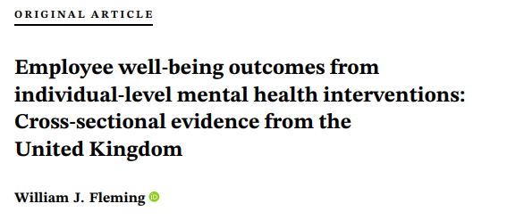
How to read a paper

Slide 4
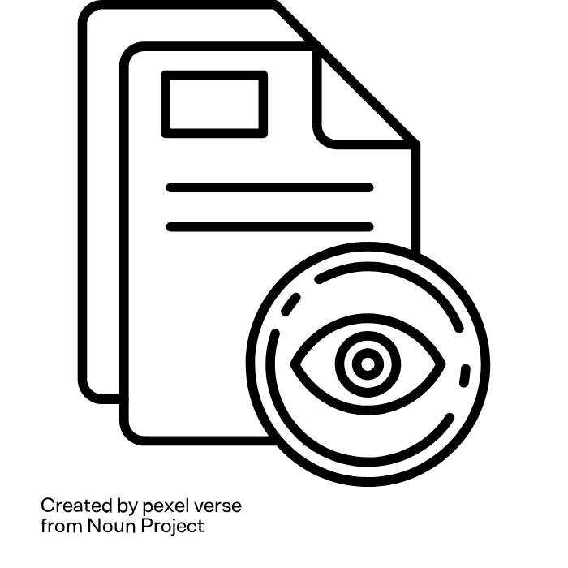
How to read a paper
Start with the abstract

Slide 5
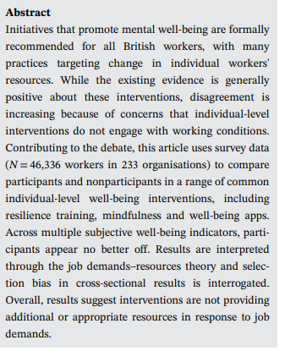

Slide 6
How to read a paper
Start with the abstract
Move to the introduction

Slide 7
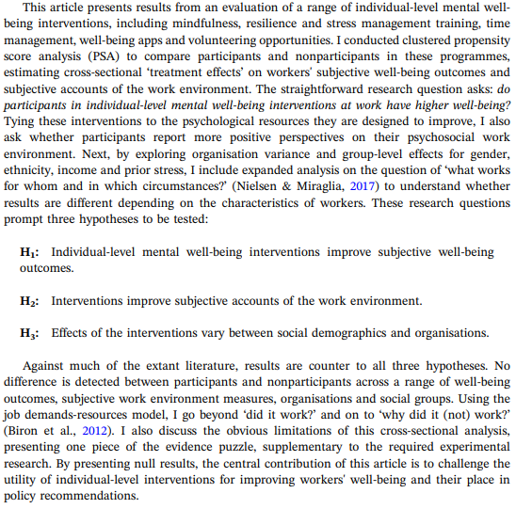
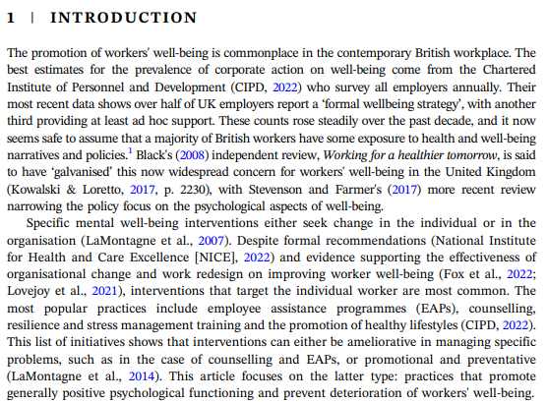

Slide 8
How to read a paper
Start with the abstract
Move to the introduction
Skip to the discussion

Slide 9
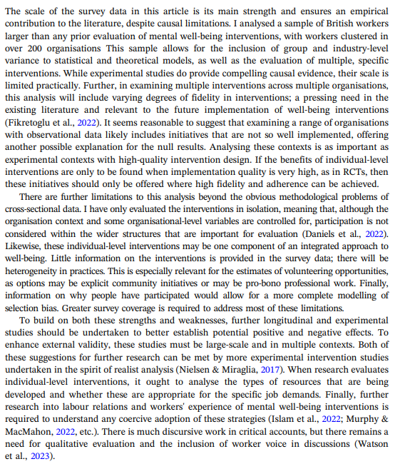
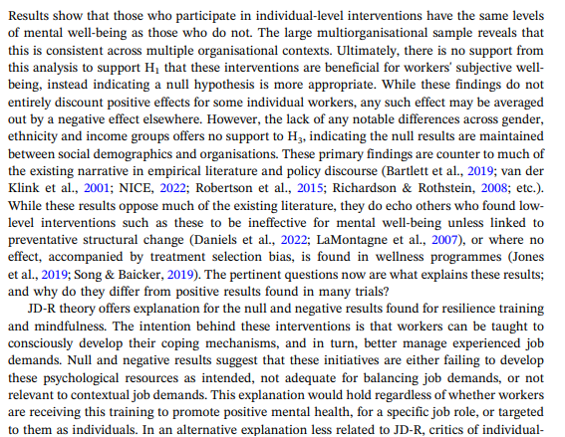

Slide 10
How to read a paper
Start with the abstract
Move to the introduction
Skip to the discussion
Go back up to the results

Slide 11
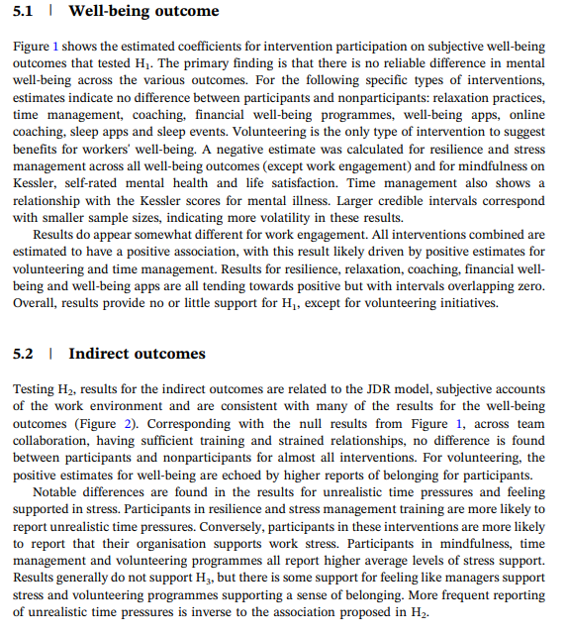
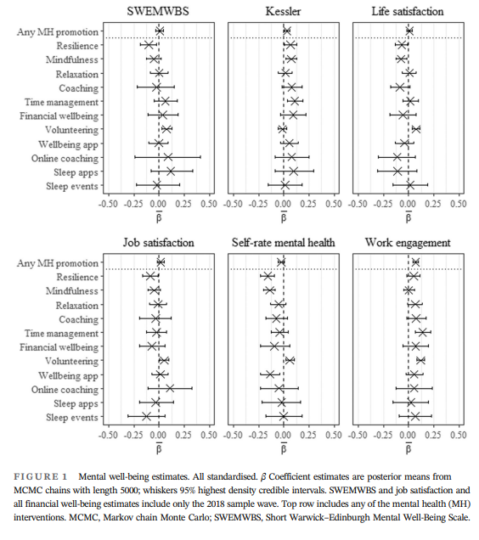

Slide 12
How to read a paper
Start with the abstract
Move to the introduction
Skip to the discussion
Go back up to the results
Read the methods

Slide 13
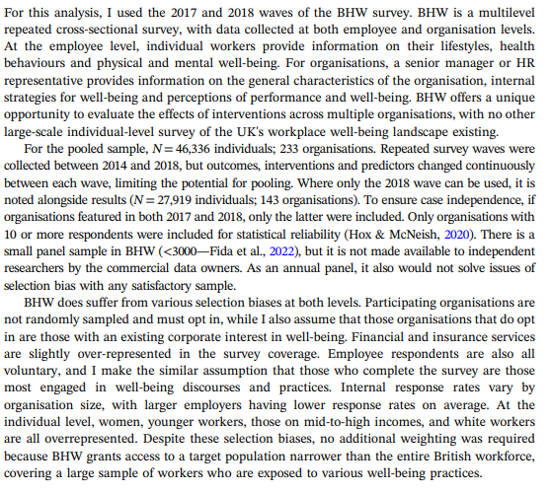

Slide 14
How to read a paper
Start with the abstract
Move to the introduction
Skip to the discussion
Go back up to the results
Read the methods
Don’t forget the acknowledgements

Slide 15
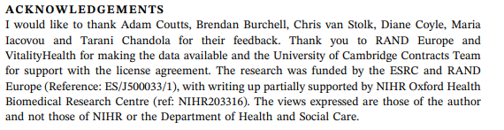

Slide 16

It’s dangerous to go alone! Find an expert source
Look for recent research using scientific paper databases
Look at the reference section
Use your local university—look at faculty web pages or talk to a PIO
Turn to expert databases and lists

Slide 17
It’s dangerous to go alone! Talk to an expert
Is the methodology sound?
Are the conclusions supported by the data?
What limitations or caveats should I keep in mind?
What’s next for this research?
Will this finding stand the test of time?

Slide 18

Quick tips
Don’t use causal language if the study isn’t causal
A study can’t “prove” anything
True breakthroughs are rare
Include important caveats
Check your understanding
Ask for a fact check or follow up

Slide 19
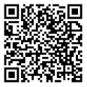
Thank you!
@RealSciLine
tespensen@aaas.org
Scan for science reporting tip sheets!

