Slide 1
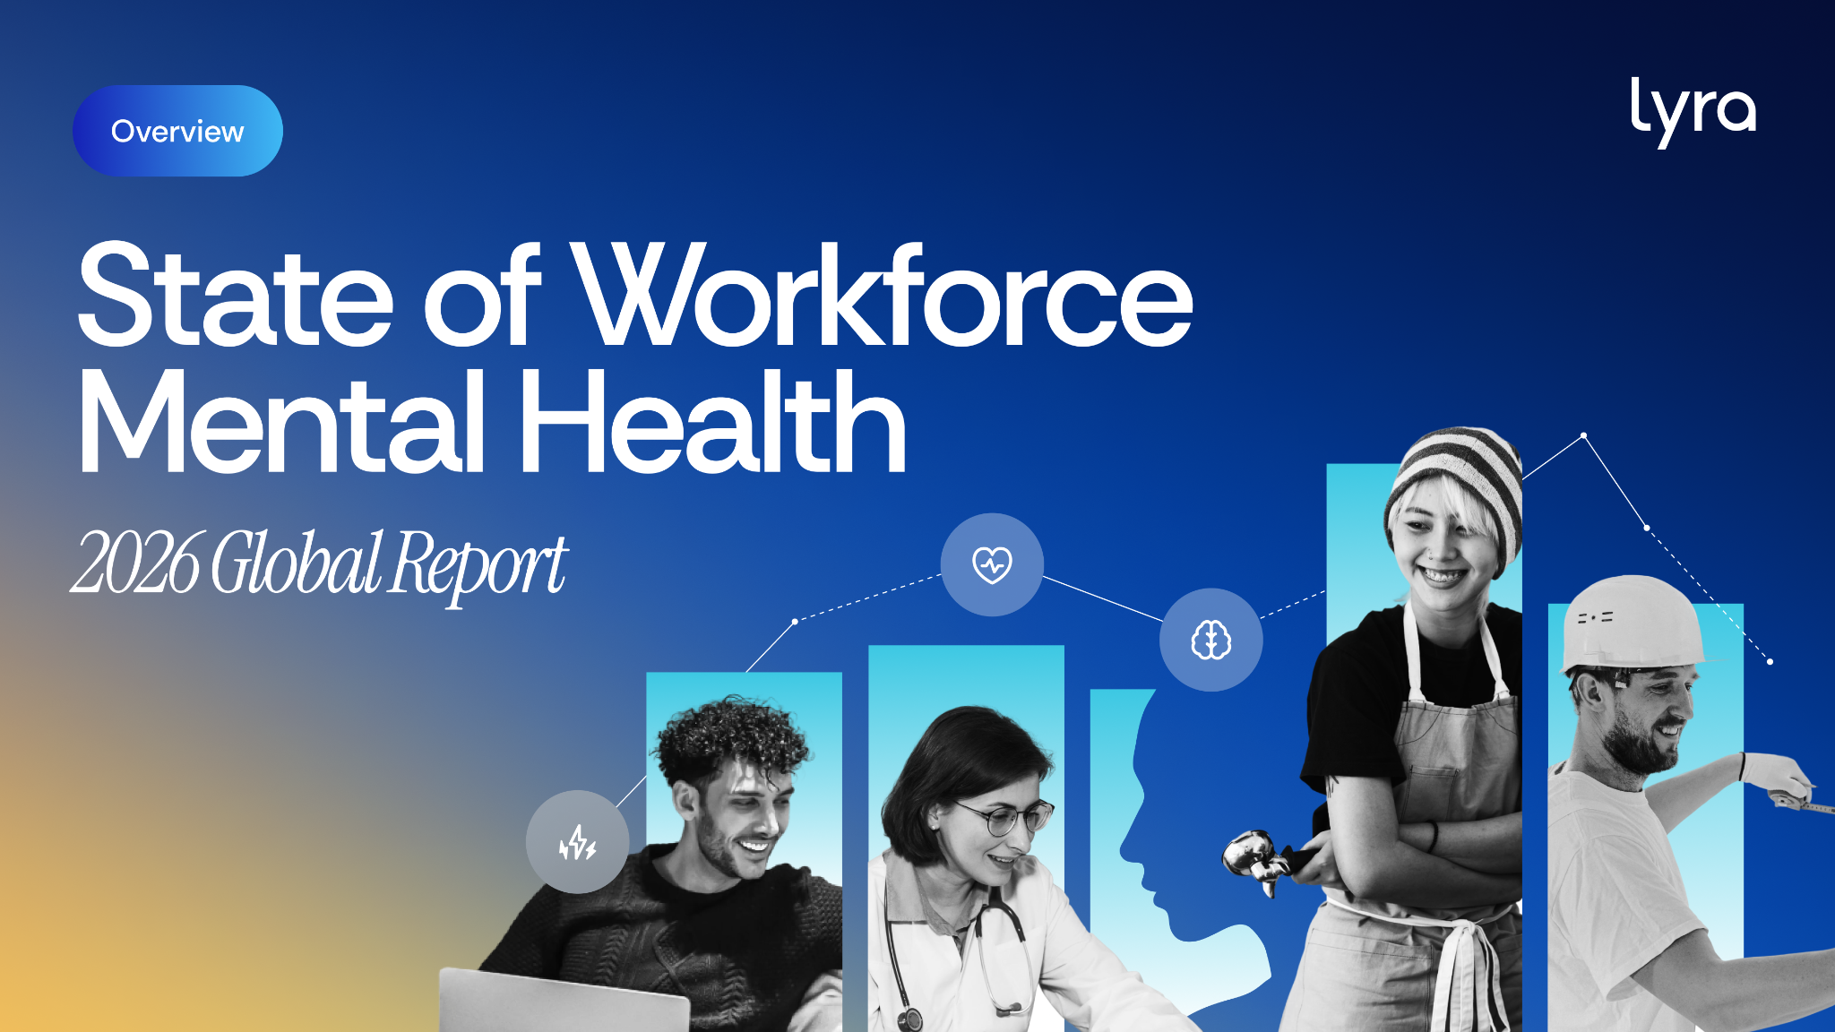
Notes:
Objective: Seamlessly transition from NAMI's presentation into Lyra's clinical data to give journalists a comprehensive, two-part view of the landscape.
Key Message: Build off NAMI's presentation!
Potential framing: While Barb and NAMI just highlighted the crucial cultural and interpersonal dynamics of workplace mental health, Lyra's data looks at the clinical and structural realities.
We are going to look under the hood at the systemic benefit gaps driving today's crisis to help you find your next big workplace story.

Slide 2

Overview
01 | Traditional benefits are being tested as needs grow more complex
02 | Caregiving realities are rewriting the rules
03 | Neurodivergence demands a new model of support
04 | AI is creating new pressures and new possibilities
05 | Managers support others, but lack support themselves
6th annual survey tracking evolving mental health trends
500+ benefits leaders
7,500+ employees in the U.S., Mexico, Canada, France, Germany, and the U.K.
Notes:
6th annual report; draws on surveys of more than 500+ HR leaders and 7,500 employees across six countries.
Media hook: In this year's report, we found a paradox: mental health support is more accessible than ever, yet people are still struggling. Stigma is lower than ever and companies have spent billions on access. Yet, the workforce is actually getting sicker. Here is why.

Slide 3

Employees and leaders experience the gap differently
Employees feel the strain
Organizations see the impact later
say they're merely surviving
Benefits leaders report significant impact
on employee performance over the last year
1 in 3
7 in 10
say their mental health declined in the past year
65%
report more mental health-related leave or disability
1 in 4
Notes:
Background: Business media frequently covers macro executive-vs-employee friction (like RTO mandates), but there's a largely uncovered story around the statistical disconnect in benefit efficacy.
Current Data & Tension: There is a well-intentioned assumption that providing a benefit means the problem is solved. HR leaders are highly confident in their current benefit structures, yet 1 in 3 workers are "merely surviving," 1 in 4 are declining, and HR is seeing a 65% spike in mental health disability leaves.
Potential storylines:
The "Great Disconnect" in benefit perception vs. clinical reality
How out-of-touch benefit models are inadvertently driving the spike in mental health leaves

Slide 4





Traditional benefits are being tested as needs grow more complex
1 in 10
employees
report complex conditions, a 67% increase from last year
Supporting complex mental health needs is a top priority for benefits leaders in 2026.
54%
of employees couldn’t find a high- quality specialist or specialty care
Notes:
Background: "Workplace mental health" is still largely associated with mild burnout or stress.
Current Data & Tension: 10% of employees now report complex conditions—a 67% increase YoY, jumping from 6% in 2024 to 10% in this report. Yet, 54% can't find a specialist. Traditional benefit structures were built for a different era; they simply weren't designed to handle this new level of clinical acuity.
Potential storylines:
The rise of severe mental illness in the active workforce.
How corporate care models need to evolve to support complex patients.

Slide 5
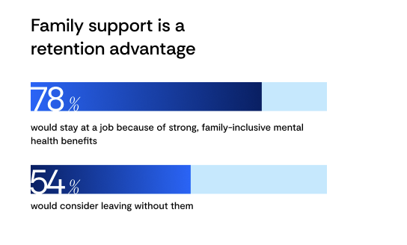



Caregiving realities are rewriting the rules
half
More parents are navigating child mental health needs, but existing benefits often aren’t designed to support the realities families face.
Nearly of working parents supported a child or dependent with mental health needs in the past year
60%
Fewer employees
experienced increased stress or burnout due to their child’s mental health needs
say they can access timely child mental health care YoY
Notes:
Background: The media often treats working parent burnout as an issue of childcare costs or parental leave, entirely missing the pediatric mental health component.
Current Data & Tension: Nearly half of working parents supported a child with mental health needs last year (a massive leap from just 19% in 2022 and maintaining the surge we saw hit 55% in 2024). This leads to burnout for 60% and work struggles for over a third. Yet, 95% of HR leaders believe child care is easy to find. It's the difference between a benefit existing on paper and actually working.
Potential storylines:
The "Second Shift": The administrative nightmare of pediatric care coordination
How the youth mental health crisis is directly impacting working parents
Why HR leaders are disconnected from the modern parent experience

Slide 6

Neurodivergence demands a new model of support
54%
of employees struggled to access timely, neurodivergent-informed care
Neurodivergent needs are becoming more visible, but many organizations are still figuring out how to provide the right support.
83%
of benefits leaders say they're unsure how to best support neurodivergence
91%
of benefits leaders identify neurodivergent employees and dependents as a growing focus
Notes:
Background: Companies genuinely want to support neurodivergent talent, but they face two main hurdles: navigating disclosure anxiety and a lack of specialized clinical infrastructure.
Current Data & Tension: 48% of employees fear disclosure, and 54% can't get specialized care. The challenge is building support systems that don't force employees to "out" themselves to HR to get accommodations, while simultaneously upgrading the benefit network so specialized care actually exists when they do seek it.
Potential storylinets:
Building inclusive benefits that don't force disclosure
The gap between wanting to help and having the specialized clinical infrastructure to do so

Slide 7


AI is creating new pressures and new possibilities
How AI adds pressure
How AI helps
48%
AI is both a productivity tool and a new source of pressure. Implementation helps determine the impact on employees.
46%
feel more productive
feel pressure to always be “on”
43%
44%
feel anxiety about job security
say it improves work-life balance
Notes:
Background: AI is entering an environment where employees already report sustained uncertainty driven by financial pressure (which sits at 57% this year, up from 42% in 2024 and 33% in 2023).
Current Data & Tension: The data splits down the middle: ~45% feel stressed vs. ~45% feel more productive. The tech isn't the variable dictating well-being—the corporate rollout strategy is.
Potential storylines:
The psychological split of why AI is causing extreme anxiety for half the workforce and balance for the other.
Why rollout guardrails matter more than the tool itself / AI isn't ruining employee mental health, poor rollout strategies are
Isolation vs efficiency / the dual reality of AI in the modern workplace

Slide 8

Managers support others, but lack support themselves
Managers are central to workforce well-being, but many feel under-supported.
94%
of benefits leaders say their company provides mental health support for managers
54%
of managers say being a manager has negatively affected their mental health
48%
have considered leaving their role due to mental health pressure
Notes:
Background: While general manager burnout is a known issue, the specific emotional toll of acting as an unofficial workplace therapist is the missing piece of the puzzle.
Current Data & Tension: Companies are relying on untrained managers to be frontline crisis responders. 54% say managing hurts their mental health; half want to quit. HR thinks they're fine (94%).
Potential storylines:
The unpaid emotional labor of middle management
The unaddressed emotional toll driving the middle-management exodus

Slide 9

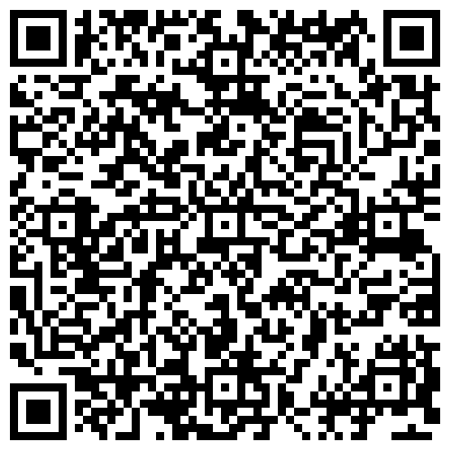
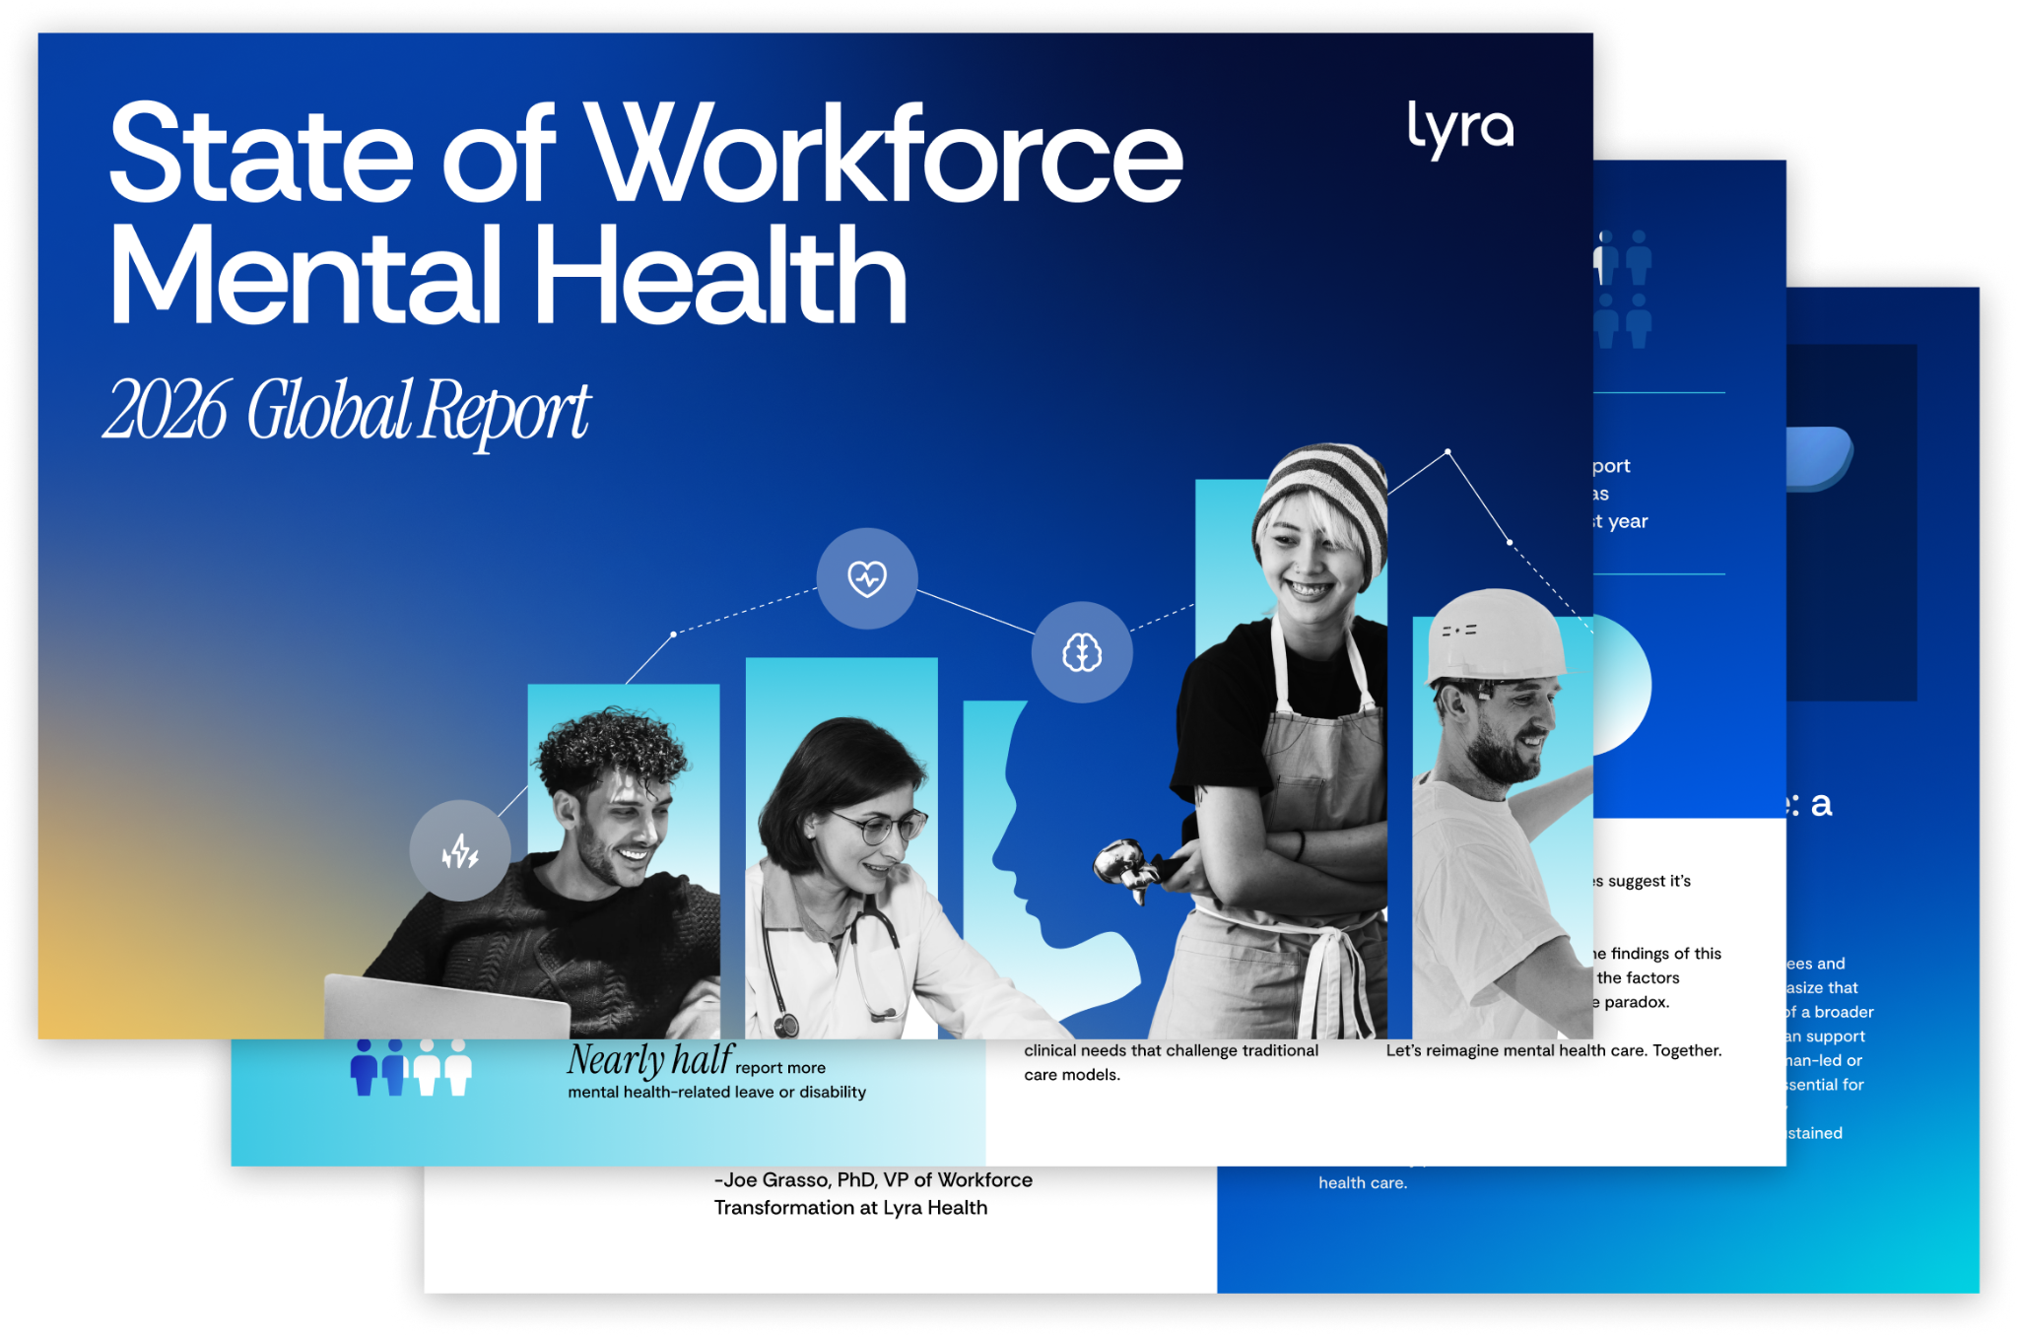
Get the full story
If you’re looking to access our mini-reports, pull specific data cuts, or want to be connected with one of our clinical SMEs for a story you're working on,
Reach out to Rojahne Azwoir at razwoir@lyrahealth.com
Notes:
Recap the core angles; ention that Lyra actually has mini-reports that dive even deeper into these specific data subsets/trends.
CTA: Let the journalists know that if they are working on a more granular piece, they should reach out to Rojahne. She can get them the mini-reports, pull specific data cuts, or even connect them with different Subject Matter Experts (like our specialized clinicians) for interviews! Open for Q&A.

