Slide 1


A Call to Action: The State of Caregiving in the US
NABE Economic Policy Conference

Slide 2



Prevalence of Caregiving
63M
Dramatic growth over the last decade
53M
A nearly 50%
increase in
10 years
43M
2015
2020
2025
Source: Caregiving in the US 2025, NAC & AARP
Notes:
‹#›

Slide 3
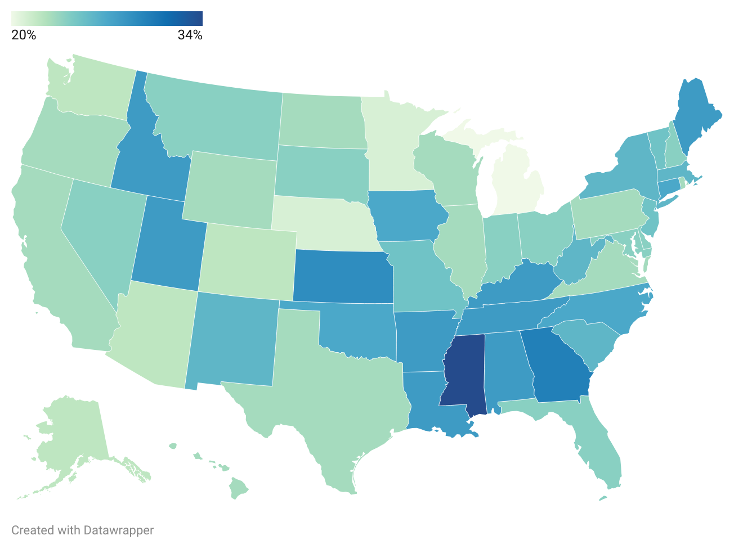
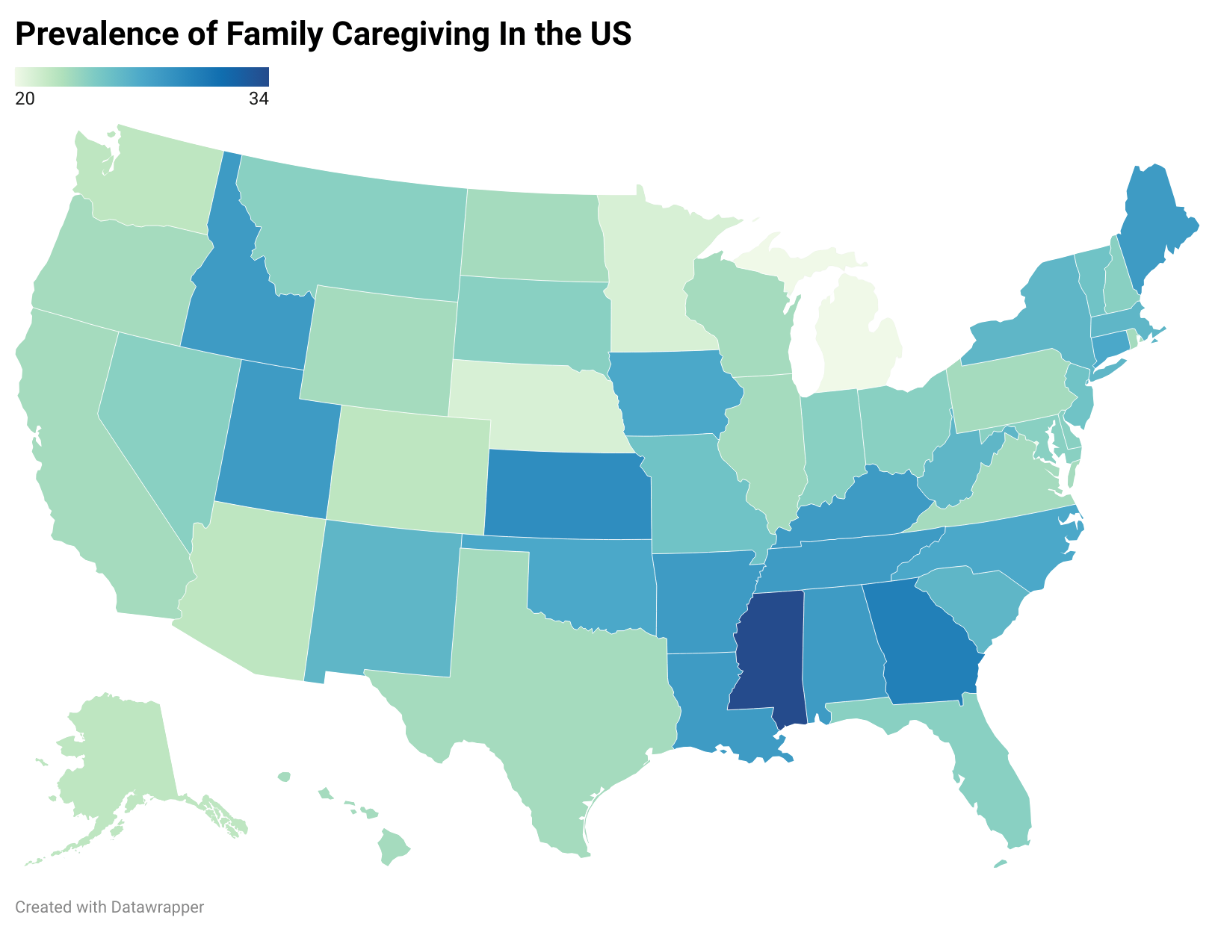
Nearly 1 in 4 Americans Are Family Caregivers
Caregiving spans every community and zip code across the country.
34%
Prevalence of Family Caregivers
20%
Source: Caregiving in the US 2025, NAC & AARP

Slide 4
WHO ARE AMERICA'S CAREGIVERS?
A Diverse Community
51
61%
89%
Average age
Women
Care for relatives
Two in five caregivers are
under the age of 50
38% men — gender gap
remains significant
40% for parents,
15% for spouses
29%
1 in 5
1 in 10
Sandwich generation
Have a disability
Identify as LGBTQ+
Caring for both children
and adults simultaneously
Nearly one in five caregivers
live with a disability
Caregiving spans every
community and identity
Source: Caregiving in the US 2025, NAC & AARP
Notes:
5

Slide 5

Key Insight
Family Caregiving is Intense
57%
Percentage of family caregivers in high-intensity caregiving situations

Slide 6
HEALTH & WELL-BEING
Emotional stress is widespread.
64%
face moderate to high
emotional stress
21% (13m)
45% (28m)
24% (15m)
rate their own health
as fair or poor
experience physical
strain from caregiving
report feeling alone —
an increase since 2020
Source: Caregiving in the US 2025, NAC & AARP
Notes:
10

Slide 7
FINANCIAL HEALTH
The financial impacts are extensive.
47%
of family caregivers experience
a negative financial impact
31% (19m)
28% (18m)
14% (9m)
have stopped saving
due to caregiving costs
cannot afford basic expenses like food due to caregiving
family caregivers have difficulty finding affordable services
Source: Caregiving in the US 2025, NAC & AARP
Notes:
9

Slide 8
WORKING WHILE CAREGIVING
Most balance care & work.
61%
of caregivers work while providing care
70% of those age 18-64
58% (36m)
53% (33m)
27% (17m)
go in late, leave early,
or take time off to
provide care
are paid hourly rather
than salaried — limiting
flexibility
take on debt vs. 20%
of non-working
caregivers
Source: Caregiving in the US 2025, NAC & AARP
Notes:
11

Slide 9
The economic value of unpaid care
To put that in perspective...
Economic Value of family caregiving
$1.1
Trillion
$1.1 trillion
All Health Care Spending by Private Businesses
$968 billion
All Federal, State, and Local Medicaid Spending
$932 billion
The estimated value of care
provided by family caregivers in 2025
All Out-of-Pocket Health Spending
$557 billion
Source: Valuing the Invaluable, AARP Public Policy Institute, 2026

Slide 10




RESILIENCE & SUPPORT
Progress Worth Celebrating
Technology adoption surging
More access to paid leave
Remote monitoring nearly doubled
from 13% (2020) to 25% (2025)
Access doubled since 2015, but only
35% of hourly workers have access
Long-range planning increasing
New payment opportunities
47% of caregivers now report planning
for their own future care needs
11.2 million family caregivers now
receive payment through Medicaid
Notes:
18

Slide 11

Key Insight
Support systems are expanding but the demand for family care is growing faster

Slide 12
WORKFORCE IMPACTS
Caregiving Is Pushing Women Out of Work
42%
Context: More than 455,000 women left the U.S. workforce between January and August 2025.
of women who voluntarily
left their jobs cited caregiving
as the #1 factor
Sources: ¹Catalyst, Caregiving Pressures Top Factor Pushing Women Out of the Workforce, Jan. 2026

Slide 13



WHAT CAREGIVERS WANT
The Support That Matters Most
1 in 3
2/3
Respite services
Payment programs
The single most requested form
of support — time to recharge
Especially valued by lower-income
caregivers providing intensive care
2/3
1 in 2
Income tax credits
Paid leave
Particularly helpful for caregivers
earning more than $50K annually
Want paid leave to balance care and work
Source: Caregiving in the US 2025, NAC & AARP
Notes:
2

Slide 14
POLICY CHALLENGES
The safety net is fraying
$911B
in projected federal Medicaid cuts
over the next decade
10M
$392M
$0
at risk of losing Medicaid
under new eligibility rules
dedicated Medicare benefit for long-term caregiver support
FY 2025 Older Americans Act funding shortfall vs. authorized levels
Sources: KFF (2025 Reconciliation Law analysis); Justice in Aging; NACo OAA Funding Report (2026)
Notes:
9

Slide 15
Limited but Critical Progress
Medicare Reimbursement
Caregiver Tax Credits
New Medicare reimbursement codes for healthcare providers to train family caregivers
Around 10 states offer some form of caregiver tax credit, including red states like Nebraska and Oklahoma.
Paid Leave
Long-term Care Insurance
14 states and the District of Columbia have established a paid family and medical leave program
Washington State established the first public LTC program made possible by a payroll tax.
Source: Caregiving in the US 2025, NAC & AARP
Notes:
2

Slide 16

Key Insight
There is Purpose in Care
51%
Percentage of family caregivers who report finding a sense of purpose and meaning from caregiving

Slide 17

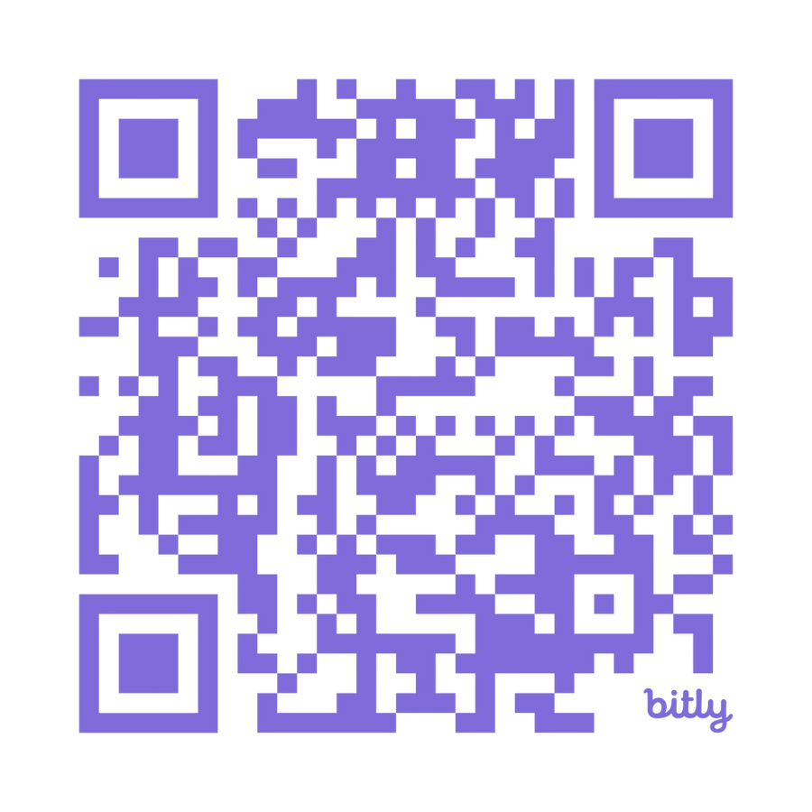
Access the Report

Slide 18



Caregiving in the US was made possible by generous support from:

Slide 19


Thank you
Jason Resendez
Jason.Resendez@caregiving.org
www.caregiving.org

