Slide 1

The Housing Shortage:
Policy Reforms & Their Outcomes
April 2026
Presentation at National Press Foundation

Slide 2
Housing Costs Are Much Higher Than Historical Norms
Half of renters are spending more than 30% of their income on rent
One-quarter of renters are spending more than 50% of their income on rent
Median home price around 5x median income; historical average was roughly 3x
U.S. housing shortage estimated at 4 to 7 million homes

Slide 3
63% of households have 1-2 people; just 23% of housing is multi-family

Slide 4
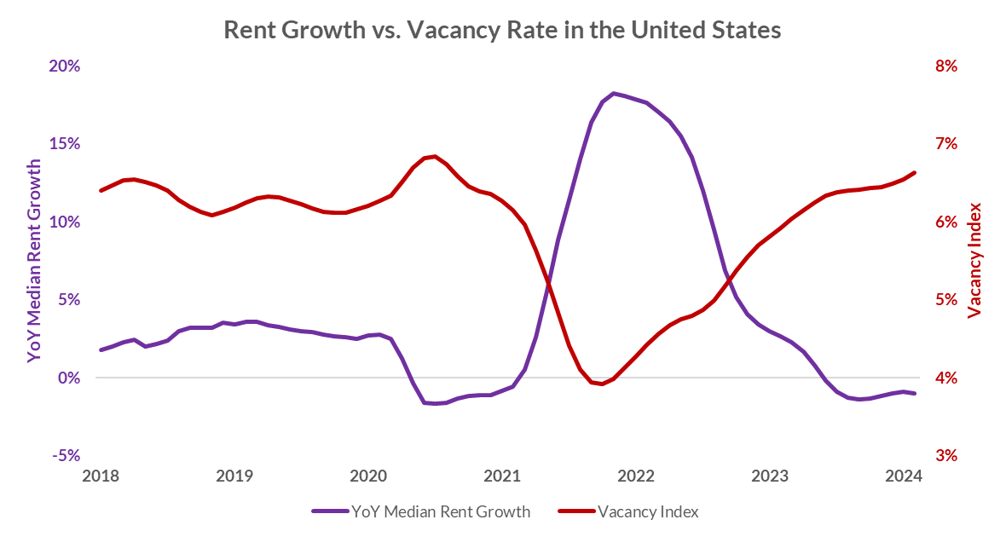
Rents Rise Quickly When Shortages Occur
Source: Data from Apartment List

Slide 5
Rent Growth Is Low Where Housing Has Been Added
The four local jurisdictions shown added proportionally more households than the U.S. overall from 2017-21—indicating low demand was not the cause of their slow rent growth.
Source: Pew’s analysis of Apartment List rent estimate data (Jan. 2017-Jan. 2023) and U.S. Census data on housing units (2017-2021)

Slide 6
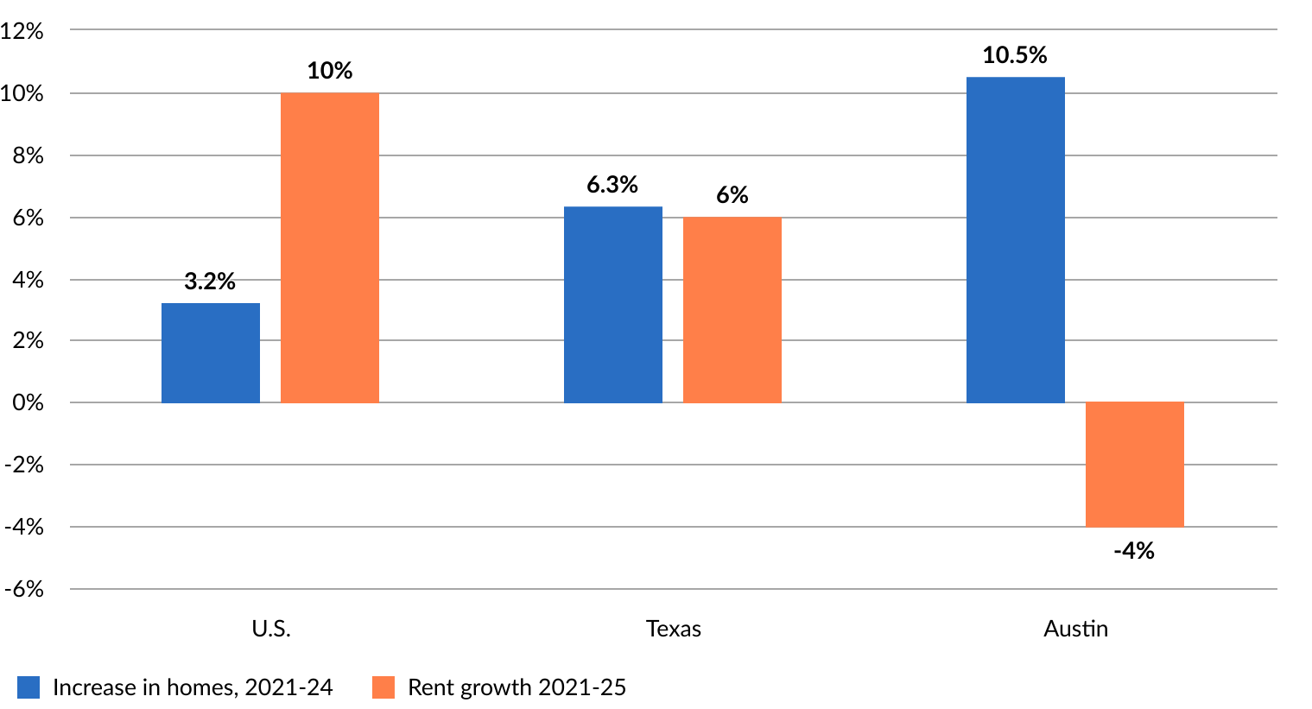
With Austin’s Reforms, Added Housing Has Pushed Down Rents
Adjusted for inflation, Austin’s median rent declined 19% from 2021-2025

Slide 7
Income Needed as Share of Household Median for Austin’s Median Rent to Be Affordable
Sources: Apartment List; HUD

Slide 8
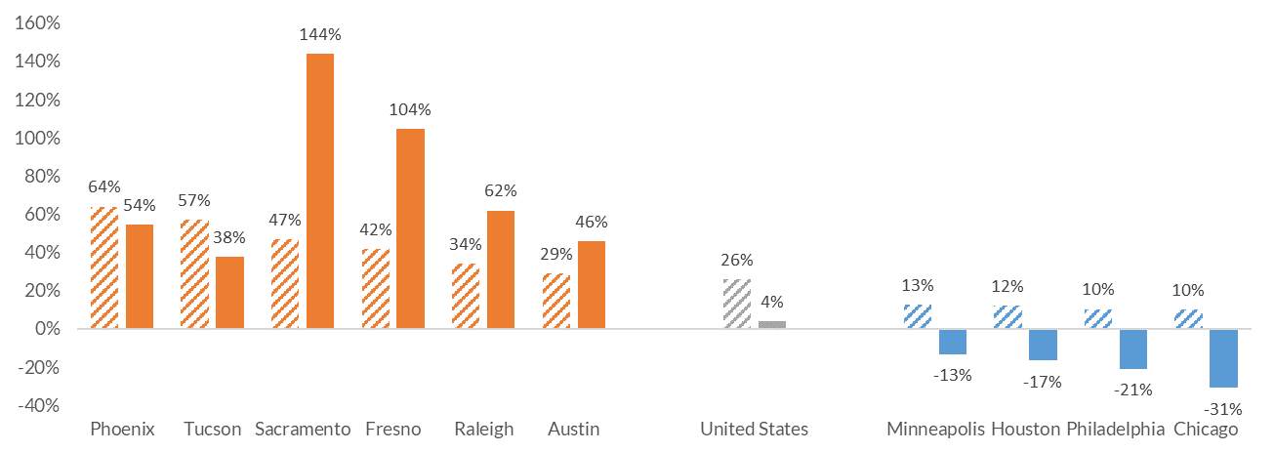


Homelessness Increased in Areas Where Rents Soared
Percent change in homelessness per 10,000 residents, 2017-2022
Rent Growth
Homelessness Rate Growth
Sources: HUD, Census ACS, Apartment List; Homelessness data for CoC level (often county)

Slide 9
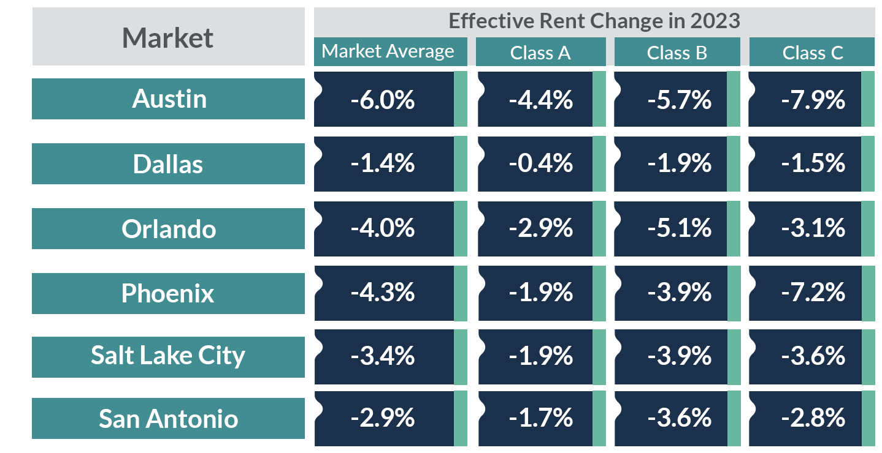
In High-Supply Housing Markets, Low-Income Renters Have Benefitted Most
Source: RealPage rent data

Slide 10
Action on Housing Has Moved from Localities to States
Avg. number of state laws passed annually to allow more homes, nationwide
2011-2016: 1
2017-2022: 18
2023-2024: 48
2025: 100+

Slide 11
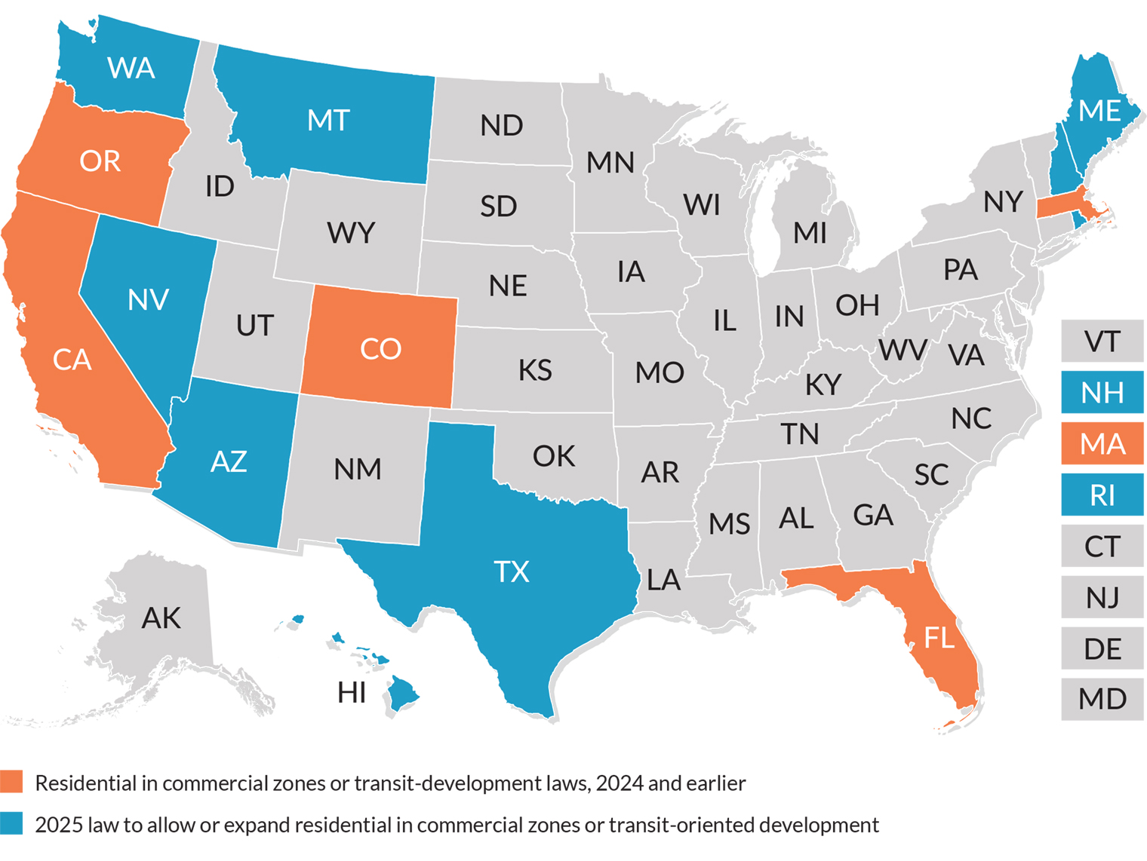
States Allowing Apartments On Commercial Corridors or Near Transit
Replicates Most Effective Local Reform

Slide 12
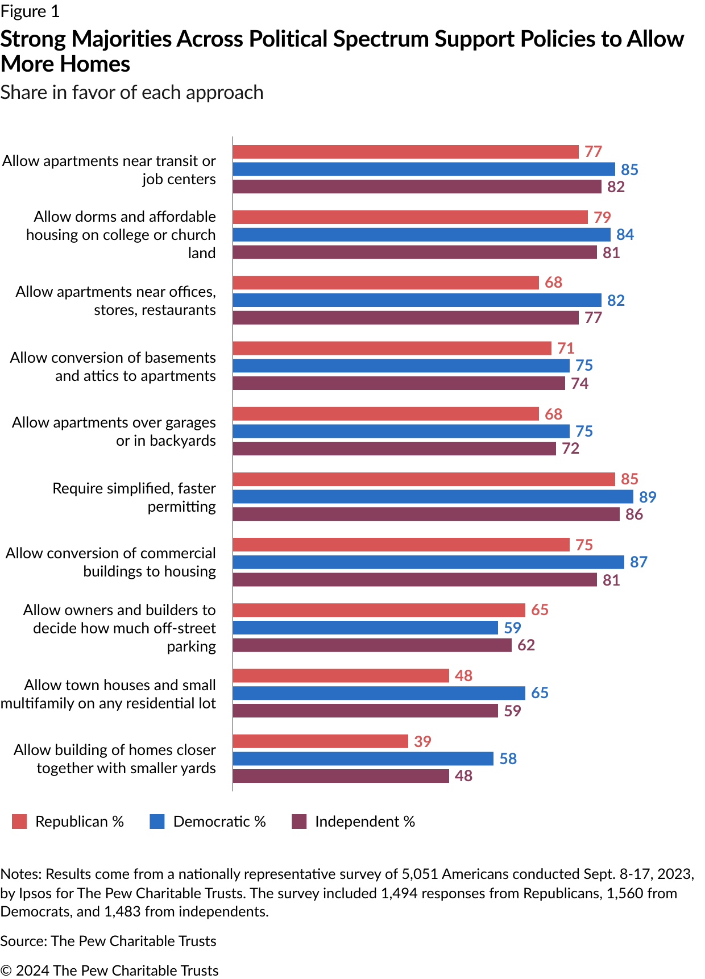
Pew Survey: Share of Americans Favoring Each Policy
Source: https://www.pewtrusts.org/en/research-and-analysis/articles/2024/05/29/strong-support-across-partisan-lines-for-policies-that-boost-housing

Slide 13
Communications:
Omar Martinez
omartinez@pewtrusts.org
The Pew Charitable Trusts
Pew.org/housingpolicy

