Slide 1
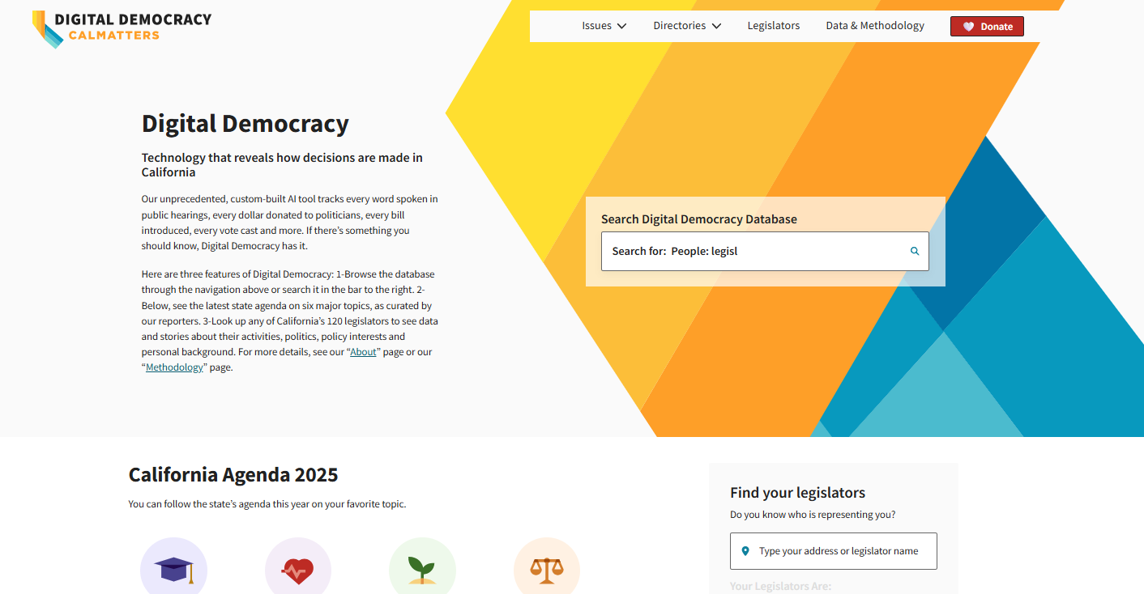

Slide 2
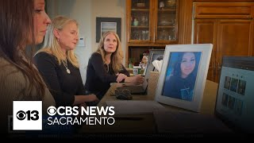

Slide 3
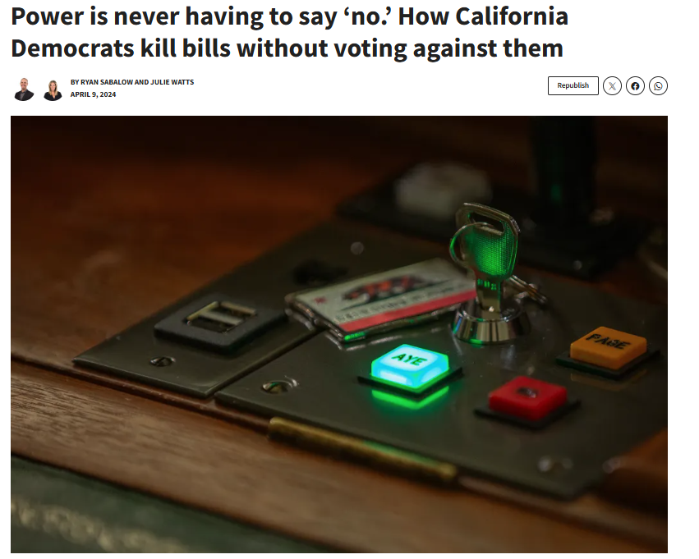

Slide 4
Using our new Digital Democracy database, CalMatters examined more than 1 million votes cast by current legislators since 2017 and found Democrats vote “no” on average less than 1% of the time.
….
“There’s only two fucking buttons on your desk: There’s a green button, and there’s a red button,” then-Assembly Speaker Anthony Rendon told the California Labor Federation last year in remarks reported by Politico. “Ninety-nine percent of the time, the green button is the labor button. Ninety-nine percent of the time, the green button means you’re doing the right thing, and the red button means that you’re an asshole.”

Slide 5
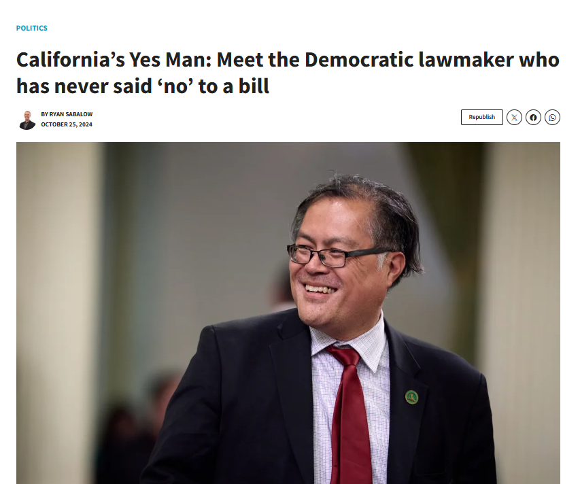

Slide 6
Fong has dutifully said “aye” during committee votes and pushed the green button at his desk on the Assembly floor 9,389 times since he was sworn in on Feb. 22, 2022….
When it comes to not voting, Fong’s only done that 75 times in 9,465 opportunities. In other words, for every 100 bills Fong had the opportunity to vote on, he voted “aye” 99 times. The average non-vote rate for Fong’s fellow Democrats is around 5%.

Slide 7
Digital Democracy and your journalism
It adds context for investigations
It’s great for legislative analysis pieces
It makes fact checks easy
Tipsheets are designed for quick dailies, but they provide useful info for any bill-related story

Slide 8
Why are we doing this?
National politics is all anyone cares about
The most important decisions impacting Americans’ lives are made in statehouses
One-party rule has made Legislatures less transparent and more controlled by special interests
Newsrooms are shrinking

Slide 9
What we’re trying to accomplishing
Who are these legislators?
What are their motivations and how are they influenced?
What undemocratic processes are giving moneyed special interests an edge?
An ideal DD story is less about what a bill does and more about what it says about lawmakers
DD helps the public engage and hold their legislators accountable

Slide 10
So how does it work?
Every word spoken
Every dollar spent
Every vote cast (or not cast)
Facial and voice recognition software
AI writes the initial transcript
Paid humans (mosty CalPoly San Luis Obispo students) check transcripts for accuracy
Political contributions come from Open Secrets
Everything else from a public record
Lobbyist/advocates positions on bills are tracked
Tipsheets generated for reporters based on each hearing
You can see how often lawmaker votes align with lobbying org positions and their money!!!!

Slide 11
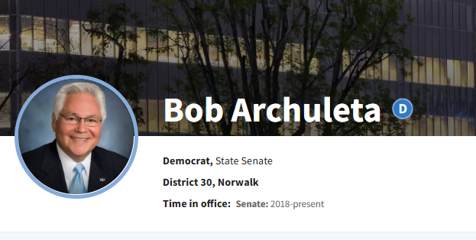
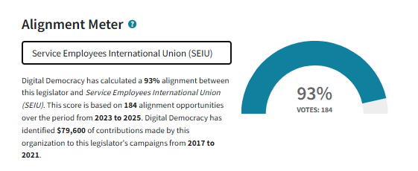

Slide 12
Digital Democracy’s tipsheet system makes campaign finance reporting a breeze for dailies and enterprise stories.

Slide 13
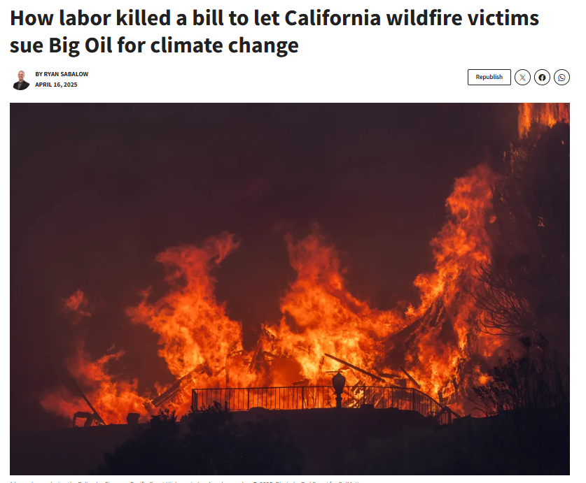

Slide 14
But the Legislature’s biggest donors that opposed SB 222 are the trade unions. The State Building and Construction Trades Council, the California State Association Of Electrical Workers and the California State Pipe Trades Council and their affiliate unions have given at least $12 million since 2015, according to Digital Democracy.

Slide 15
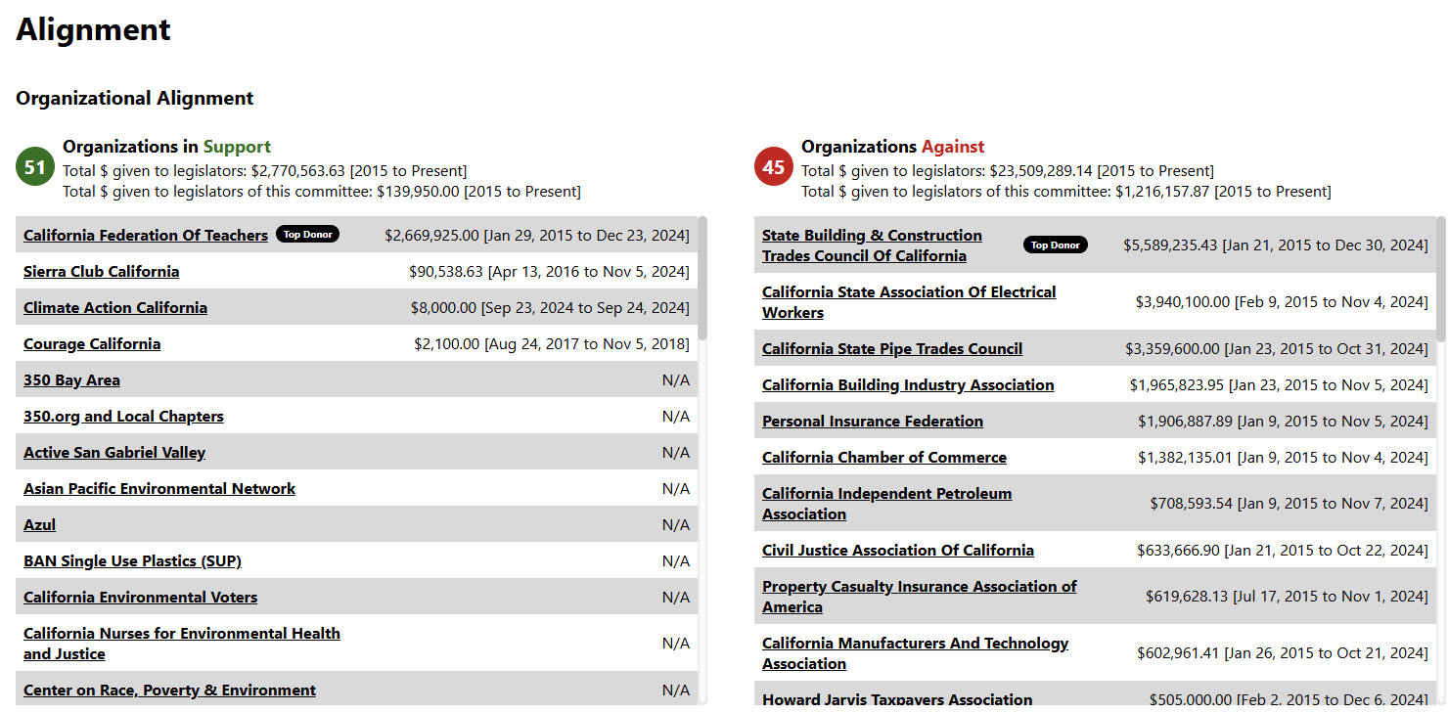

Slide 16
How do tipsheets work?
Every committee hearing and floor vote gets a tipsheet
Phenoms: Triggers we’ve asked the AI to flag and weight
Examples of phenoms:
  Leadership swapping committee members for a tough vote
  “Gut and amends”
  Members of the same party split on a vote
  An unusual amount of money
  An unusual amount of testimony
  Voting against your money
  Labor groups split on a bill
  Close votes
  Bills dying in committee
    Mike Fong voting no
More phenom triggers = more newsworthiness. Top of the stack

Slide 17
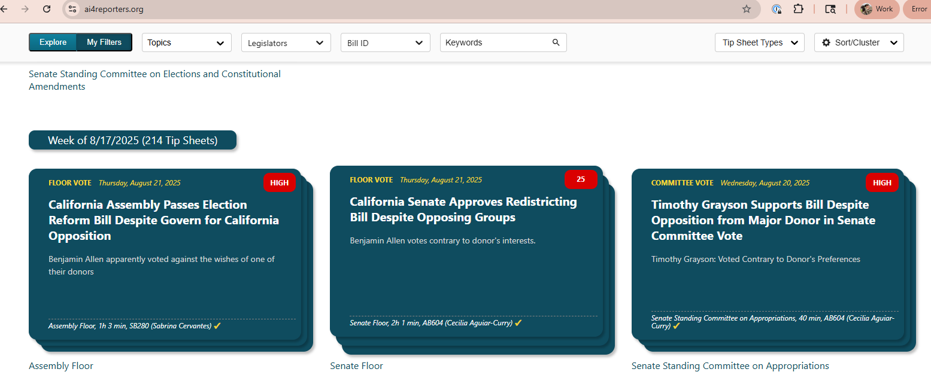

Slide 18
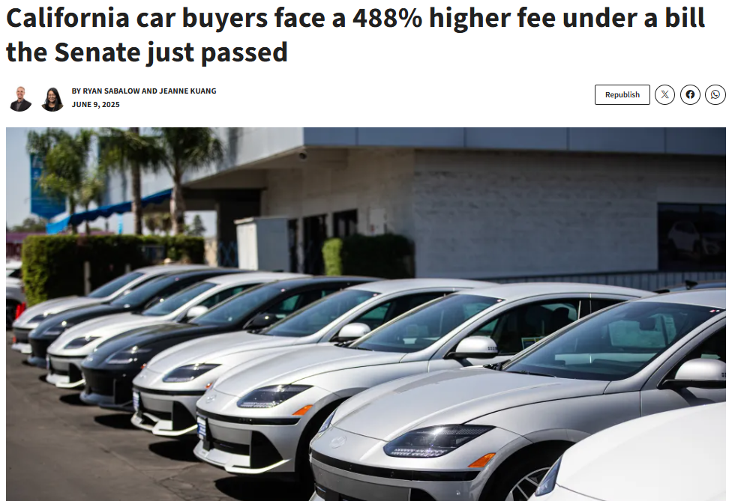

Slide 19
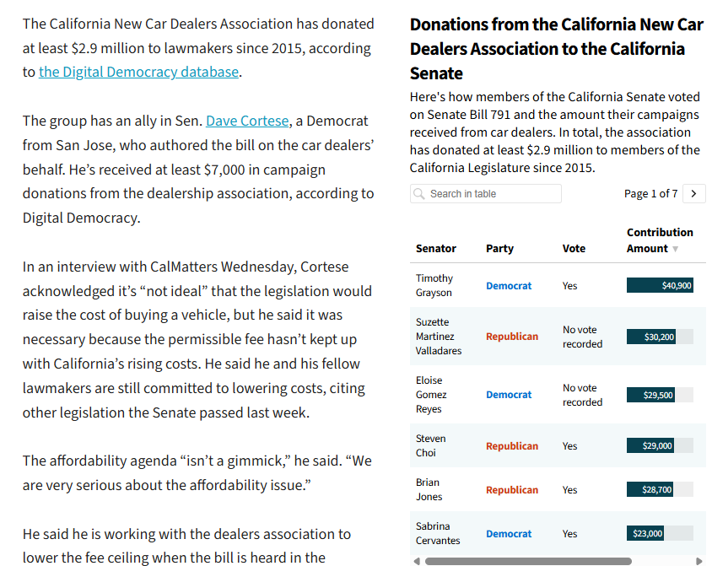

Slide 20
Twenty Democratic senators, including Sen. President Pro Tem Mike McGuire, voted for the measure. McGuire has received at least $13,000 from car dealers since 2016. He didn’t explain his vote Tuesday, and his spokesperson didn’t make him available for an interview.

Slide 21
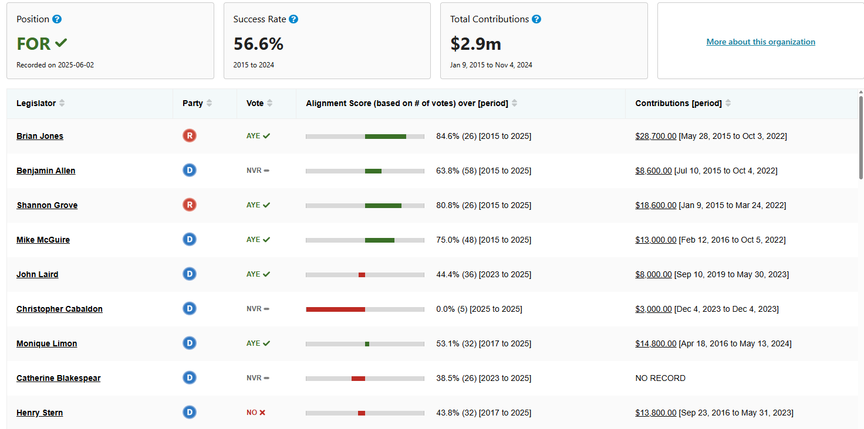

Slide 22
Limitations and challenges
Transcriptions can have mistakes.
Lobbying money isn’t included. Only campaign donations.
The AI is very good at flagging good story ideas, but it’s not very good at saying why.
Transcription can take a while when there are lots and lots of hearings to tag out.
Digital Democracy is a work in progress. It’s getting better every day.
Notes:
Transition to examples of tipsheet dailies

Slide 23
Tipsheets help reporters look for stories without needing to go to the Capitol.
They’re designed for dailies

Slide 24
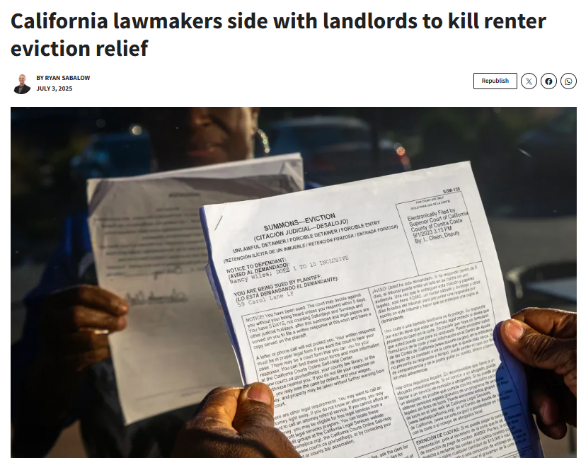

Slide 25
Opposing the bill were some of the state’s biggest political spenders from the business industry, including the California Chamber of Commerce and various landlord, banking and building associations. In total, those groups have given at least $13.7 million to legislators since 2015.

Slide 26
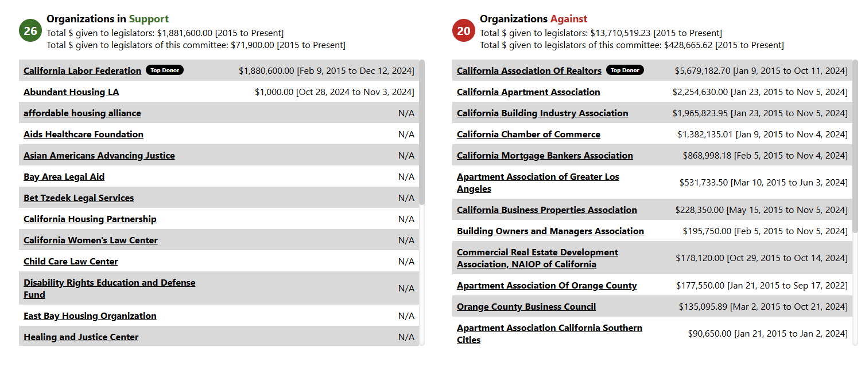

Slide 27
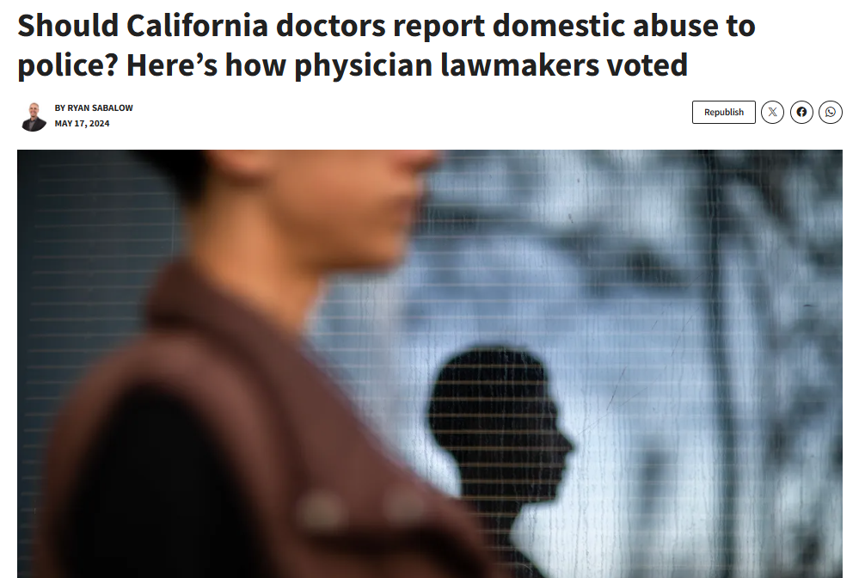

Slide 28
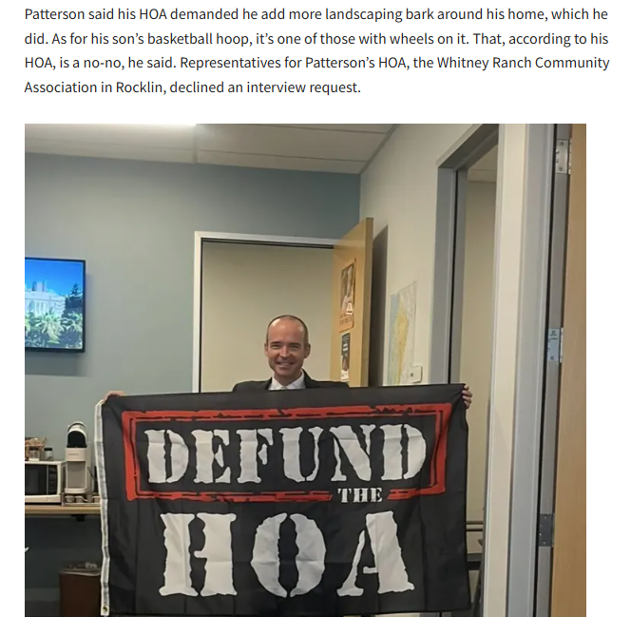

Slide 29
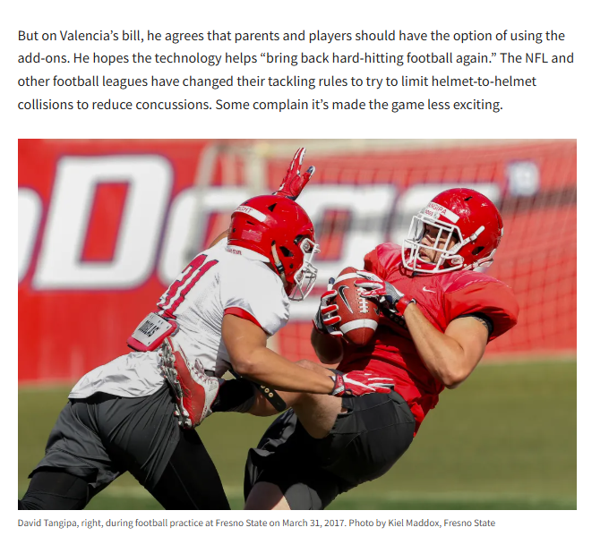

Slide 30
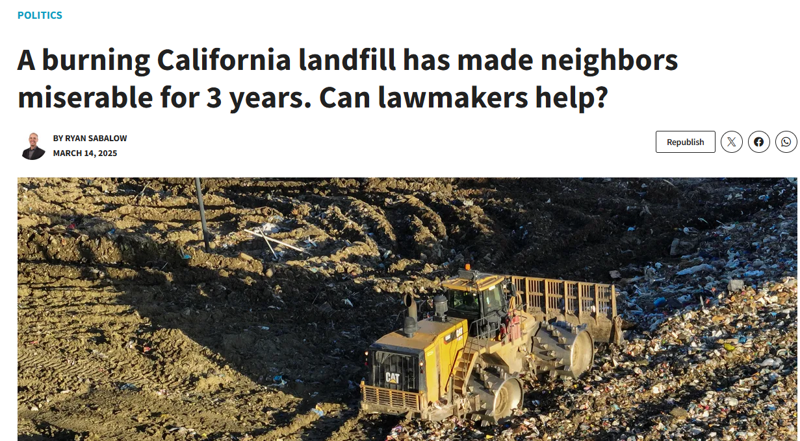

Slide 31
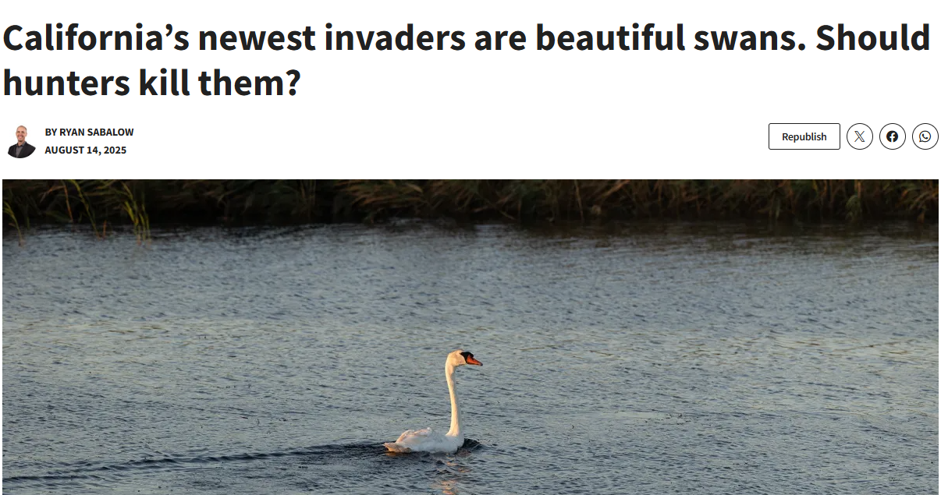

Slide 32
Dailies are great, but what about enterprise and investigations?
Digital Democracy helps there, too.

Slide 33
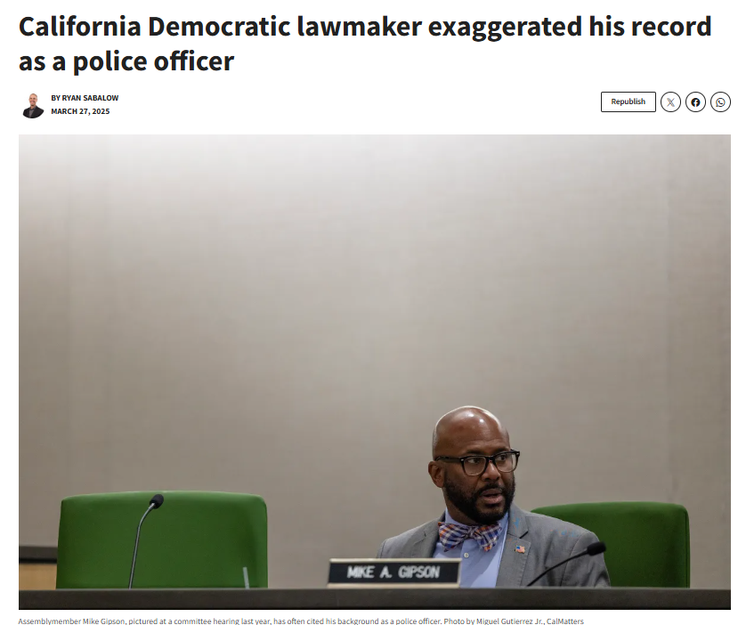

Slide 34
In at least two dozen speeches in the Capitol, Gipson called himself a former police officer, according to the Digital Democracy database. There were no examples in the database of Gipson describing himself as a reserve officer.
In one example, he told a domestic violence committee in 2017 that “as a former police officer, I can’t tell you how many times I had to go in a situation where I had to arrest the husband, in this case, for putting his hands on his wife.”
Notes:
Link to his remarks: https://calmatters.digitaldemocracy.org/hearings/255136?t=1110&f=671e93066f80429d6f1e5f8d3540d38b

Slide 35
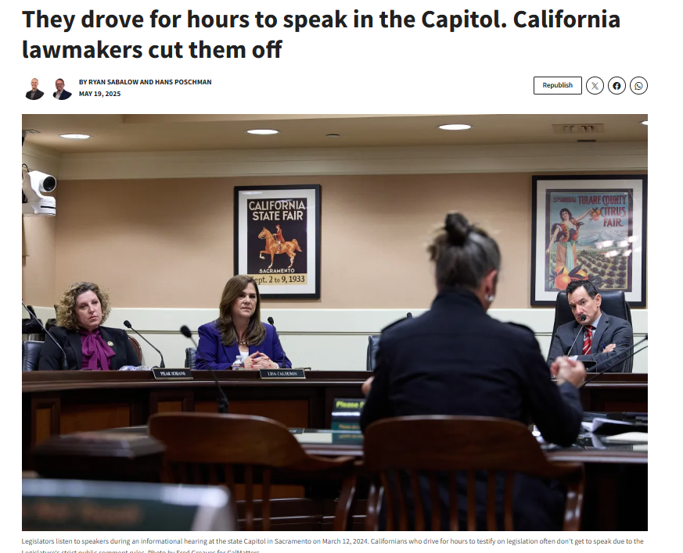

Slide 36
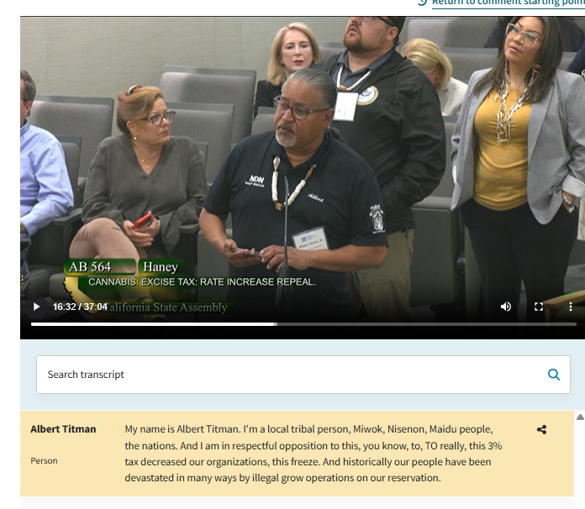
Notes:
Link to his remarks: https://calmatters.digitaldemocracy.org/hearings/258718?t=1021&f=2e2d0d5d6fbda5b8a26d7f6baf85d956

Slide 37
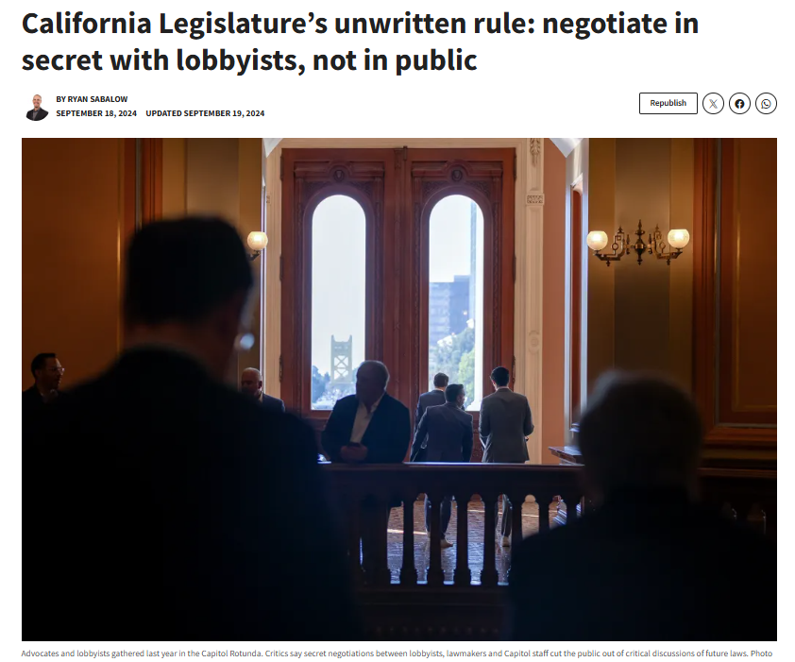

Slide 38
“We have a policy in the Senate … We don’t negotiate amendments from the dais,” Min told his Democratic colleague, Assemblymember David Alvarez, this summer. “We are happy to continue discussing this offline, but I just don’t think it’s appropriate – nor is it in the interest of our time – to be negotiating and discussing particular provisions from the dais.”
Notes:
Link to the exchange: https://calmatters.digitaldemocracy.org/hearings/258075?t=414&f=f2a10fad31c7f078ebdf598b831e4fa1

Slide 39
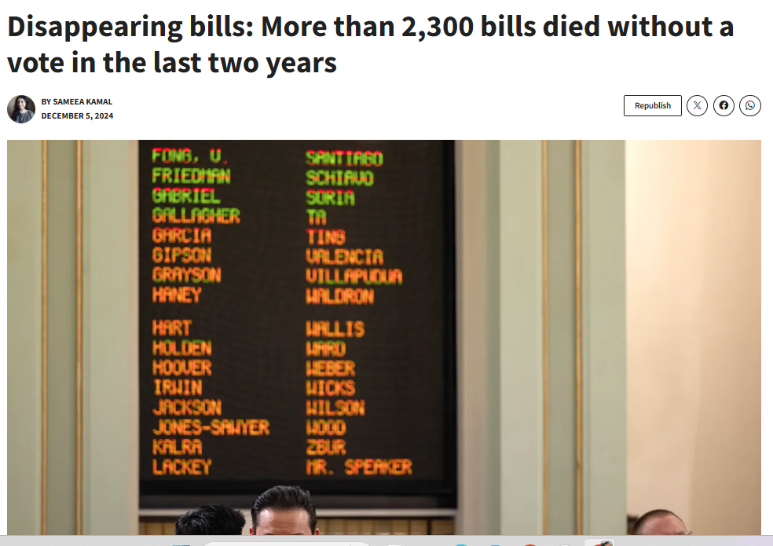

Slide 40
We know how legislatures work: lawmakers introduce bills, debate on them and vote yes or no.
Right?
Not exactly. Of the 2,403 bills that died in the recent two-year session, CalMatters’ Digital Democracy data found just 25 failed because a majority of lawmakers voted “no.”

Slide 41
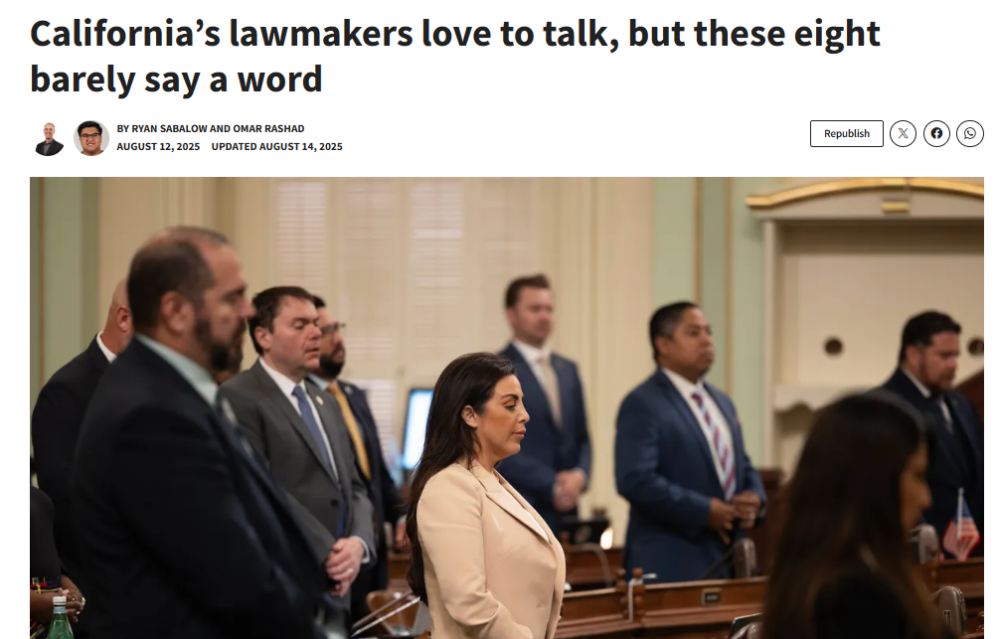

Slide 42
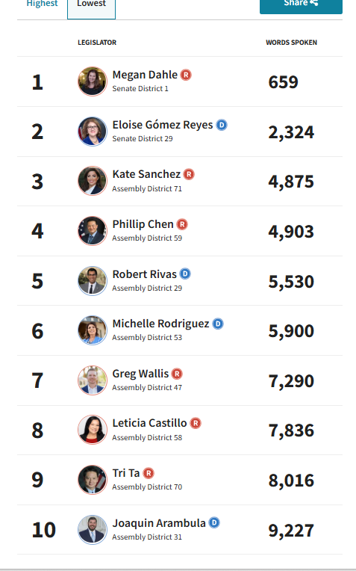

Slide 43
Republican Assemblymember Greg Wallis, who won his Inland Empire Assembly seat in 2022 by one of the smallest margins in state history, has largely stayed silent on the dais since. So far this year, he’s talked for 38 minutes.
“I love the irony of chasing the quiet Assemblymembers for an interview,” Wallis spokesperson Colin Hawley said in an email. “Greg is all about consistency, so in this instance, he’s choosing to keep his words few and let his votes do the talking.”

Slide 44
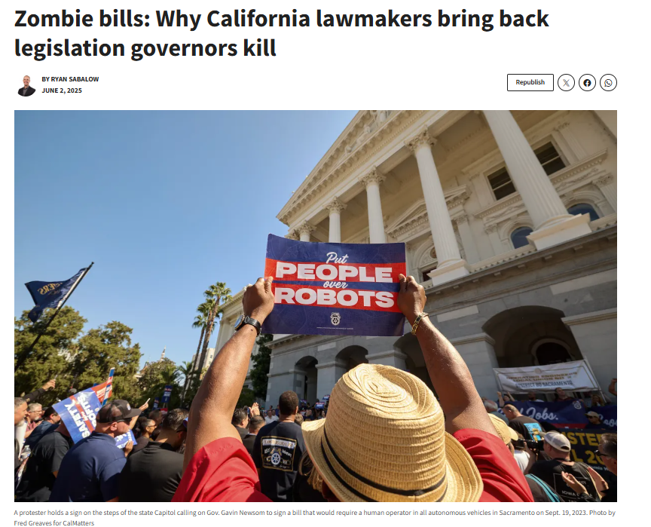
Notes:
Autonomous trucking bill has come back three times.

Slide 45
The Teamsters union is a major funder in the California statehouse, contributing at least $2.7 million to lawmakers’ campaigns since 2015. Aguiar-Curry received at least $15,950 in campaign cash from the Teamsters and its affiliate unions in that time, according to the Digital Democracy database.
But she said that didn’t influence her decision to try again on autonomous trucking.
“I’m not here to serve the lobbyists,” she said.

Slide 46
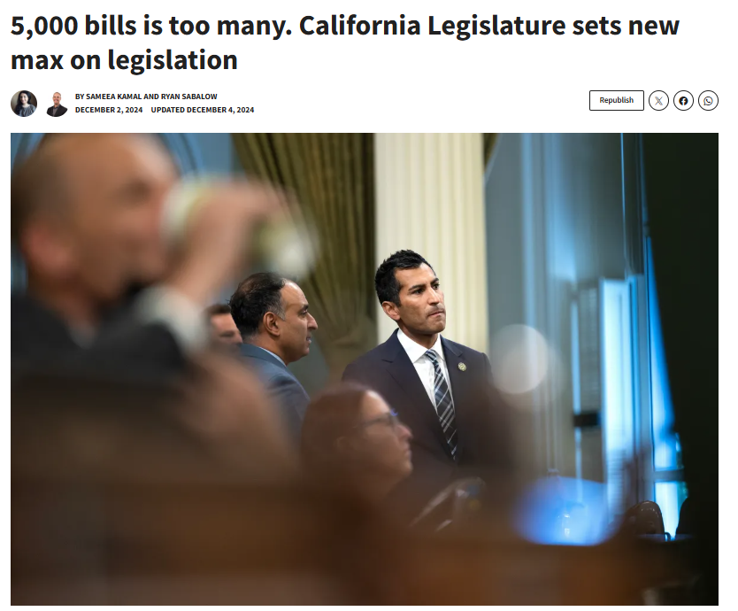

Slide 47
Voters get their own AI legislator tracker
It’s called My Legislator
It’s super cool.

Slide 48
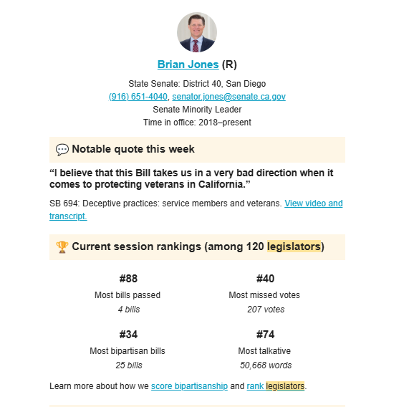

Slide 49
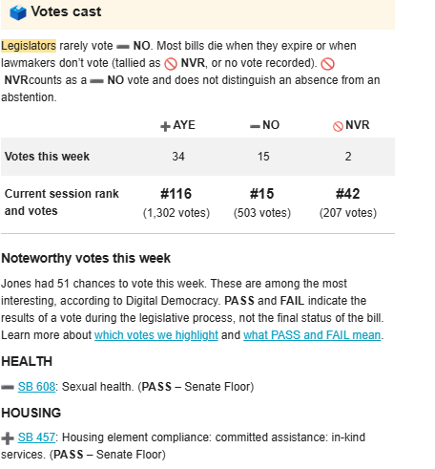

Slide 50
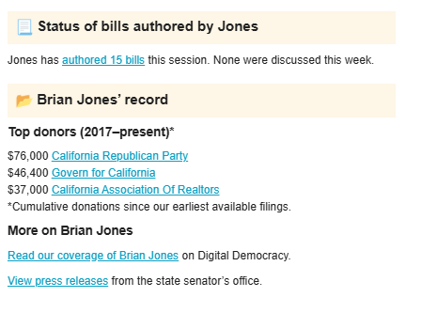

Slide 51
We’re getting great pickup and feedback
“Thank you so much for providing this important information to keep us informed!”
“This is an excellent report and extremely helpful when planning for the upcoming election cycles (to check consistency and alignment of our law makers.)”
“THANK YOU for providing this service!!”

Slide 52
My Legislator stats
Subscribers after four weeks: 8,302
Open rate: 67%
Subscribers who clicked at least one link: 29%

Slide 53
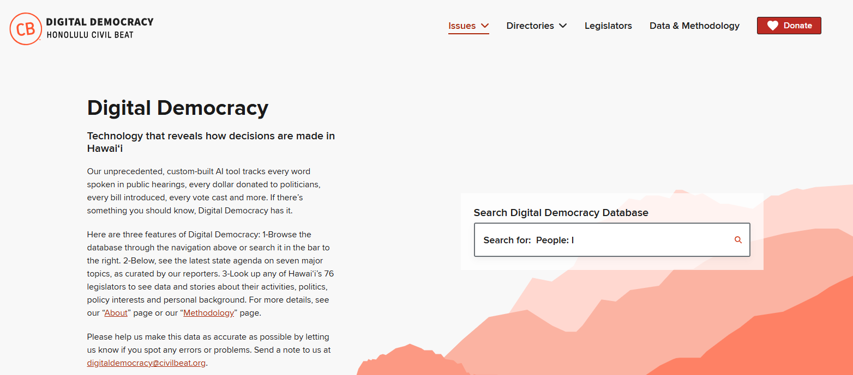

Slide 54
Good things coming this year
Executive branch tipsheets with enforcement records.
Better tipsheet summaries and more phenoms.
Real-time lobbying money in tipsheets.
LLM integration into the main Digital Democracy site.

Slide 55
A spin through Digital Democracy
CalMatters Digital Democracy
CalMatters tipsheets
Notes:
digital
democracy

