Slide 1
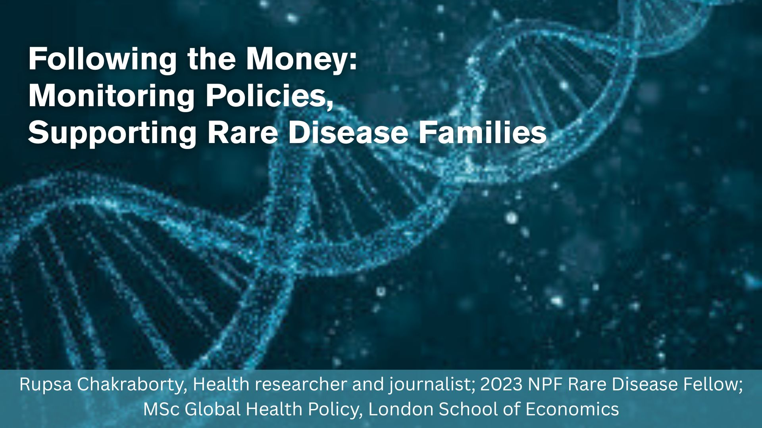
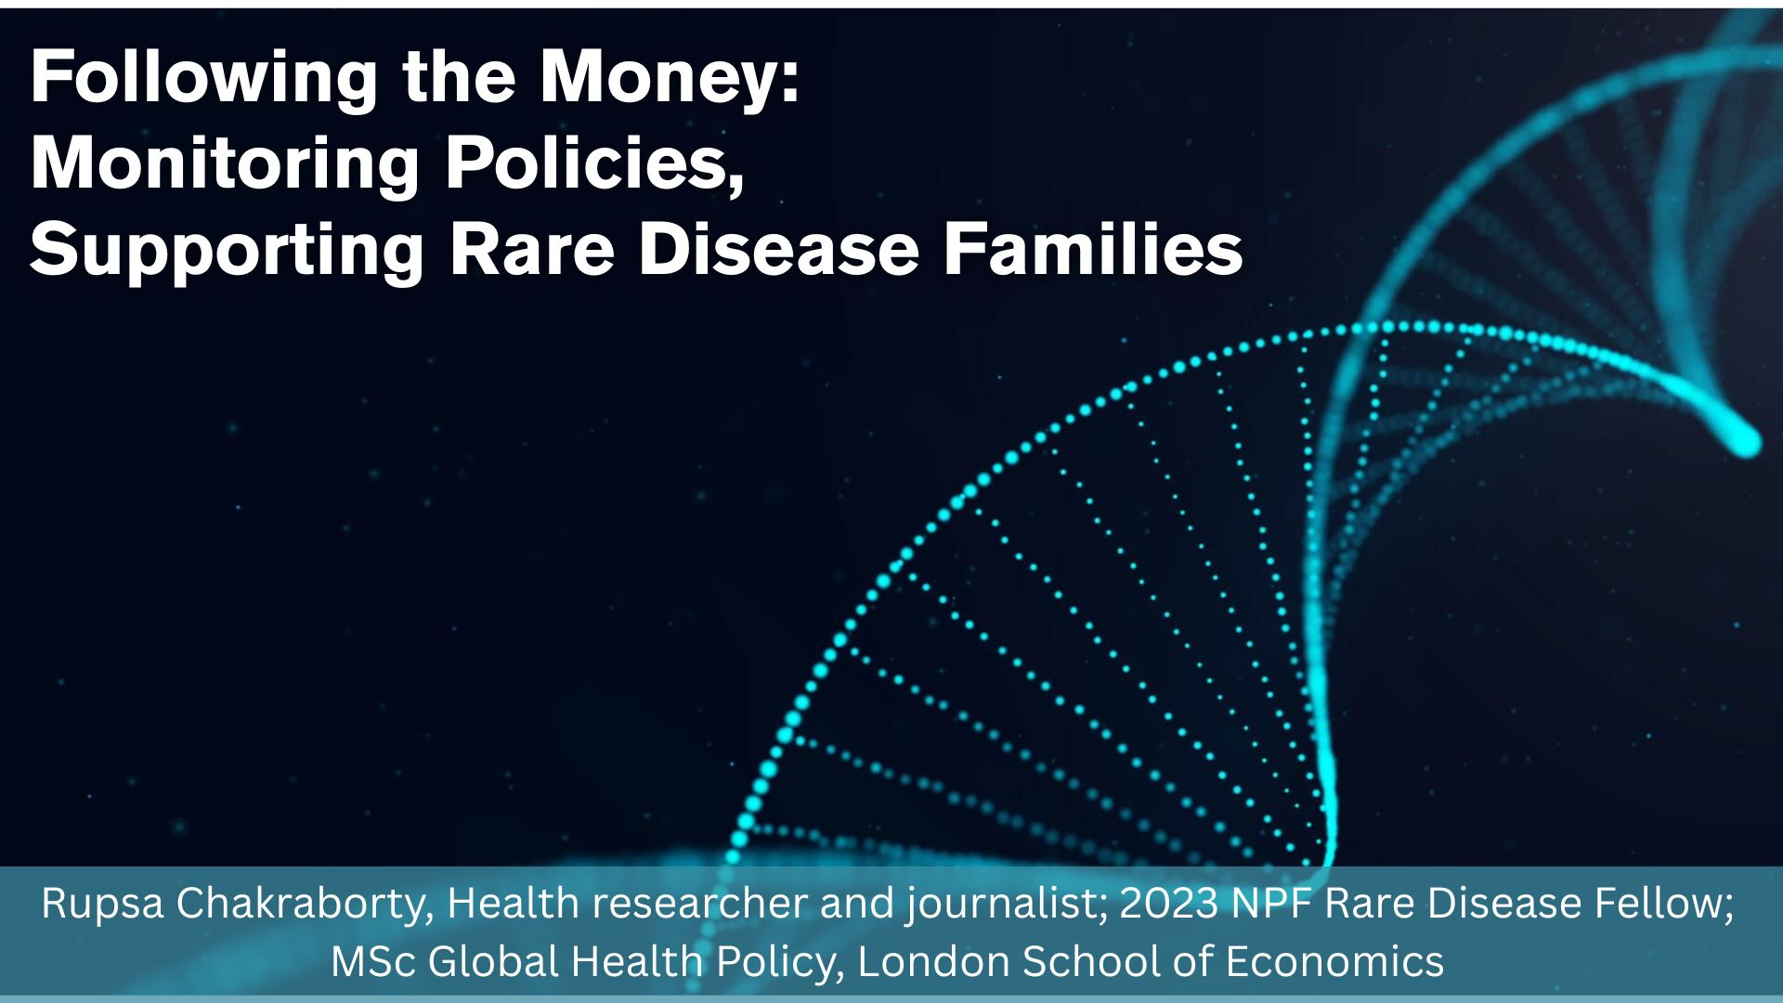

Slide 2
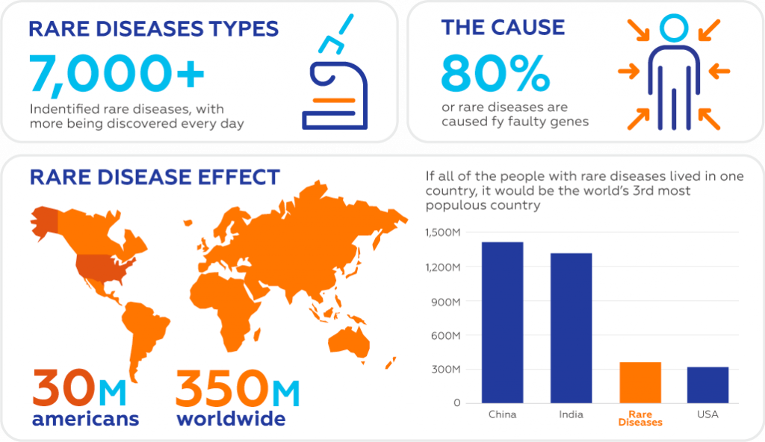

Slide 3
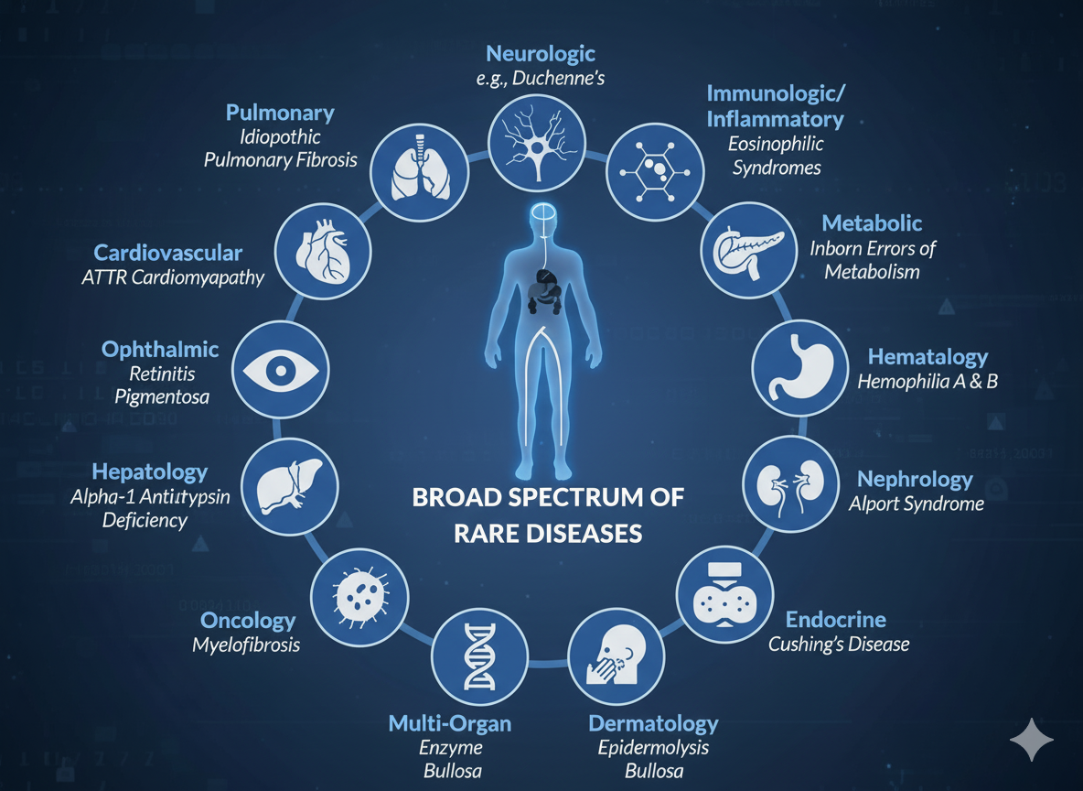
AI Generated

Slide 4
Global Rare Disease Policies: Best-Performing Countries
Country | Policy Strengths | What Makes It a Global Leader
France | Oldest national rare-disease plan (2005); strong coordination between centres; national registries | First country to adopt a rare-disease plan; highly organised network of reference centres; strong patient involvement
Germany | Specialised care networks; fast genetic diagnostics; robust registries | High-quality diagnostics and coordinated pathways reduce diagnostic delays
United Kingdom (England) | Rare Diseases Action Plan 2025; nationwide genomic testing; integrated NHS pathways | Transparent, measurable annual plan; Genomics England enables rapid diagnosis and research
Australia | National Strategic Action Plan (2020); subsidised orphan drugs; national consistency | Comprehensive national coordination; access to therapies across regions; support for early diagnosis
Taiwan | Rare Disease Control & Orphan Drug Act; national insurance coverage; designated centres | Strongest rare-disease insurance support in Asia; guaranteed access to orphan drugs and screening

Slide 5
National Rare Disease Policy (NPRD 2021): What It Promised
Introduced in March 2021 to support India’s ~70 million rare-disease patients.
Three Patient Categories
Group 1: One-time curative therapies (e.g., bone marrow transplant)
Group 2: Long-term, low-cost care
Group 3: Lifelong, high-cost disorders (SMA, Gaucher, Pompe, Fabry, MPS) → Group 3 children are most affected by funding delays and caps.
Funding Mechanism
Government committed up to ₹50 lakh ($60,000) per Group 3 patient.
Funds routed through 13 Centres of Excellence (e.g., KEM, AIIMS).
Hospitals submit treatment plans → Ministry approval required → Funds released.

Slide 6
Why the National Rare Disease Policy failed in India?
Funds don’t reach patients in time Allocations exist on paper, but approvals are slow and inconsistent.
₹50 lakh cap is inadequate Lifelong therapies cost far more, so treatment stops once the cap is exhausted.
Massive under-utilisation of funds COEs spend only a fraction of the money released, resulting in stalled disbursal.
No central tracking & severe documentation delays The government does not maintain a count of all applications received by COEs, and utilisation certificates are often delayed for months.
Crowdfunding/CSR mechanisms are ineffective The system lacks a structured way to channel corporate or public donations to patients who need lifelong therapy.

Slide 7
When the Court Orders Funds, but the System Stalls
Across India, parents have been pushed into the courts to secure treatment already guaranteed under the National Rare Disease Policy. In October 2024, the Delhi High Court ordered the Health Ministry to operationalise a ₹974-crore National Fund for Rare Diseases, calling the right to health “inseparable from the right to life.” Instead of implementing the order, the government appealed to the Supreme Court, where the case remains pending with no interim relief.
Frustrated by stalled orders and bureaucratic silence, families have repeatedly written to the Health Ministry, appealed directly to the Chief Justice, and submitted urgent representations. Yet their pleas only resulted in the next hearing being pushed to March 2026 — another long wait for children who do not have time.

Slide 8


Slide 9
FOLLOWING THE MONEY: Allocated vs Used (The Real Gap)
Between 2021–24, the government disbursed ₹109 crore to Centres of Excellence, yet COEs used only ₹48 crore — less than half.
Actual annual need is ₹2,500 crore, but RTI data (2022–25) shows only ₹191 crore was released — just 1/25th of what patients require.
₹82.98 crore allocated for rare diseases included money for awareness, but ₹0 was actually spent on awareness campaigns.
Funds are released in bulk to hospitals with no patient-wise tracking and no transparency on who receives treatment.
Of over 570 registered LSD patients, only 107 are receiving therapy — the rest remain untreated.
The government's crowdfunding portal registered 4,000+ patients but raised only Rs4 lakh, which wouldn’t even help a single patient.

Slide 10
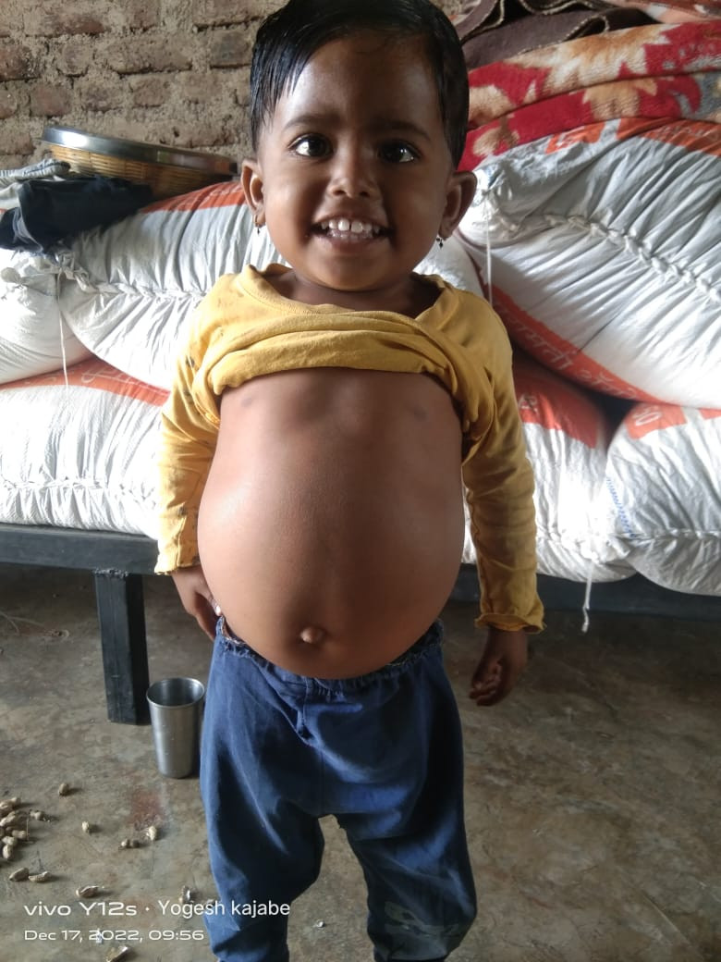
Case Study 1: Arohi Kajabe (3) — Died Waiting for Funds
Diagnosed with Gaucher’s Disease at age 1.
Needed two enzyme infusions/month (₹1 lakh each) — fully treatable.
Her father sold land + borrowed ₹5 lakh, still couldn’t afford treatment.
NPRD promised ₹50 lakh support, but file was never approved.
2 years of waiting → treatment never came → Arohi died at home.
“My only child died before my eyes because I couldn’t afford the medicines,” Yogesh says, sitting on the mud floor of his hut. “Her stomach was swollen, she kept crying, and one day she stopped eating.”

Slide 11
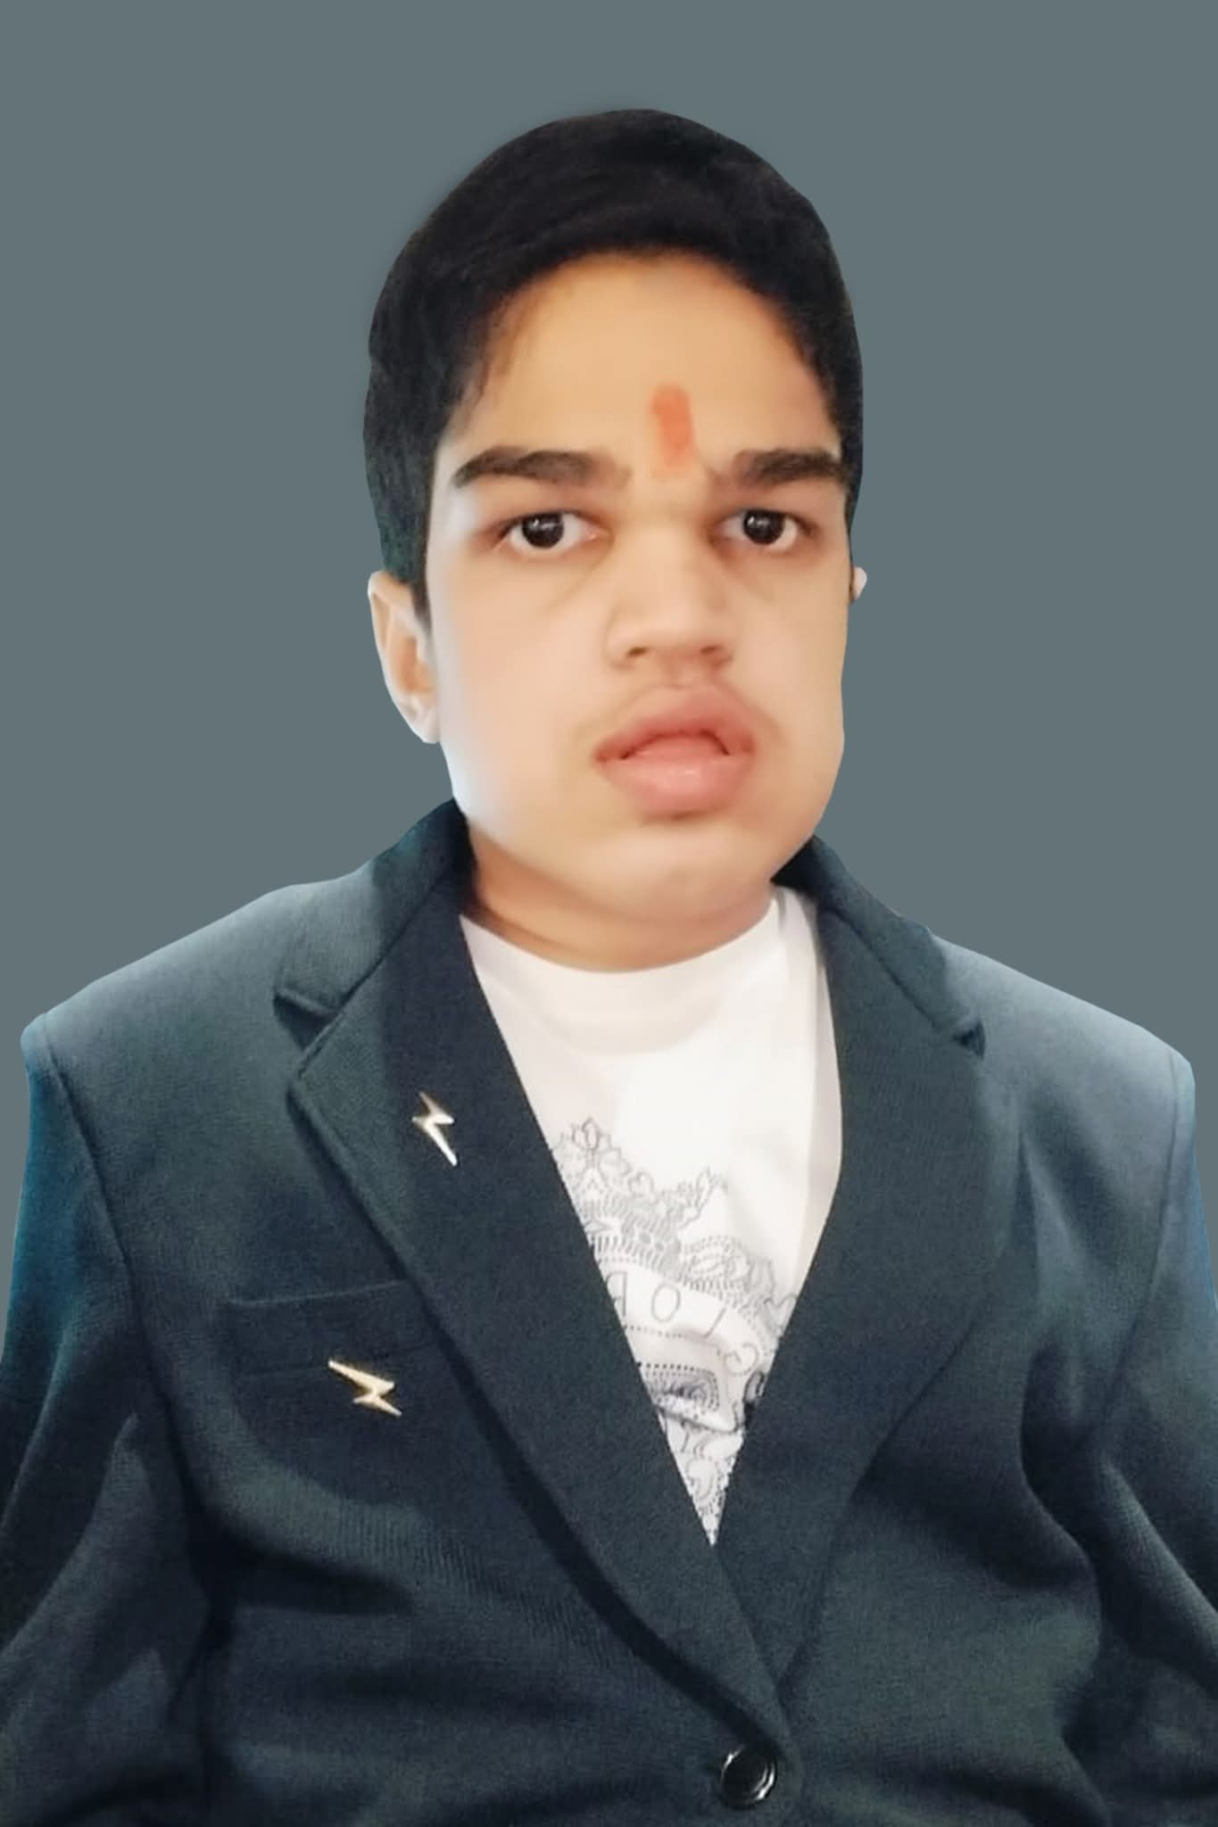
Case Study 3: Shaurya Singh (13) — “Time Was the Cruellest Enemy”
Diagnosed with Hunter Syndrome at age 2.
Waited 7 years for therapy; only received it through a pharma charity.
By the time treatment began, organ & brain damage was irreversible.
Shaurya died at 13 after years of government inaction.
Diagnosed at age 2, he finally received therapy—funded by a pharmaceutical charity—when he was 9. “By then, his body had already suffered irreversible damage,” says Saurabh Singh, his father. “He passed away five years later. This shows how critical it is to start treatment early. Time is the cruelest enemy.”

Slide 12
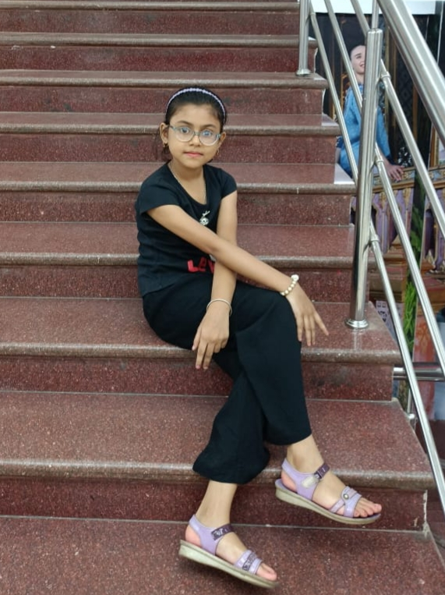
Case Study 2: Adrija Mudi (12) — Treatment Started, Then Cut Off
Diagnosed with Gaucher Type 1 during Covid lockdown.
Parents fought in court → Government released ₹15 lakh first installment.
Treatment worked: organs shrank, seizures stopped, returned to school.
But after hitting the ₹50 lakh cap, treatment stopped in Sept 2023.
Regression already visible: hearing loss, cognitive decline.
“Without therapy, I’m watching her go back to where she was,” Jayanta, her father said, clutching a white folder of medical bills. “She’s already losing her hearing. It feels like we’ve been pushed off a cliff halfway.”

Slide 13
My Work During the NPF Fellowship in 2023
Lack of govt transplant facility cuts survival chances of aplastic anaemia patients
Brief: Despite the high mortality of acquired Aplastic Anaemia, most Indian states have no government-run adult bone-marrow transplant facility. With transplants being the only assured treatment—and costing ₹15–25 lakh in private hospitals—patients are forced to travel long distances or forgo care altogether, leaving many untreated and at risk of dying.
In Nandurbar, with no proper treatment, sickle cell anaemia patients develop deformities, even die
In tribal-dominated Nandurbar district of Maharashtra, patients with Sickle Cell Anaemia suffer severe deformities and even death due to a lack of proper treatment and diagnostics. With no bone-marrow transplant centre, scarce medicines like hydroxyurea, inaccessible blood banks, and no reliable data, many patients go untreated, develop disabilities and lose their lives.
Being Nidhi’s parents: A 24-year journey of joy and struggles with India’s ‘first’ Pompe disease patient
Nidhi, India’s first Pompe disease patient, spent 24 years battling misdiagnosis, high treatment costs, and relentless medical challenges. Her parents spent over ₹4 crore, sold property, and turned their home into an ICU, but a ventilator failure left her in a semi-coma, and she died in 2023 — underscoring the crushing financial and emotional burden on rare-disease families in India.
Despite help from Centre, patients with rare diseases, kin continue to suffer
Rare-disease patients continue to suffer due to years-long diagnostic delays, heavy out-of-pocket expenses, and slow approval of government funds, leaving families financially drained while children deteriorate in the absence of timely treatment.

Slide 14
QUESTIONS?

Slide 15
How to Convince Your Editors?
Give human faces: Start with case studies that make the issue relatable.
Hook with a shocking line: For example—“A child could die if he falls asleep,” “This patient needs ₹1 crore (USD 120,000) every year to survive,” or “She lives with a wheelchair attached to an oxygen tank.”
Bring the economic angle: Show how pharmaceutical companies shy away from manufacturing rare-disease drugs and the conflicts this creates.
Find time proximity: Link the story to timely events—new drug approvals, laws, celebrity diagnoses, petitions, or court rulings.
Highlight cutting-edge inventions: Profile groups working on breakthroughs such as indigenously developed CRISPR tools, gene therapy, or other novel treatments.
Practice solution journalism: Balance grim realities with hopeful stories like patients offering peer counselling, or parents donating their deceased child’s organs for research.

Slide 16
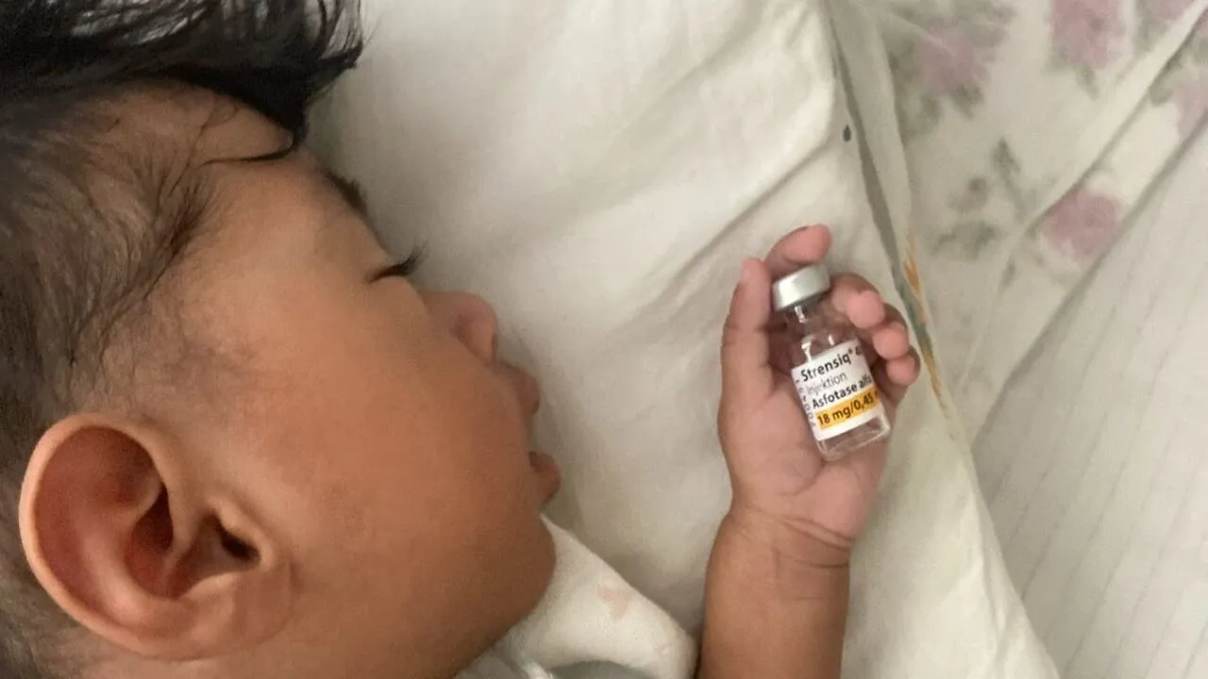
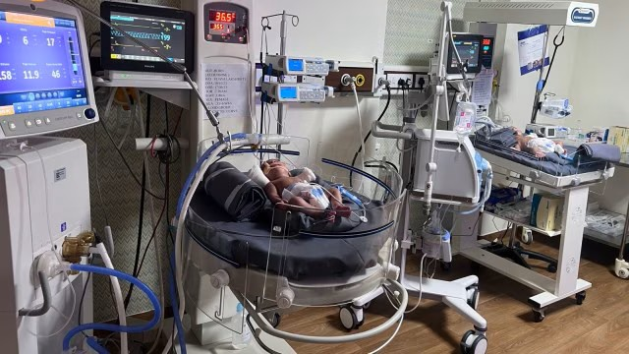
Give human faces: Start with case studies that make the issue relatable.
What if Baby Sera is your child? She has an ultra-rare health condition, needs timely help to stay alive
Rare Disease Day: Sleeping can be life-threatening for these newborns with CCHS

Slide 17
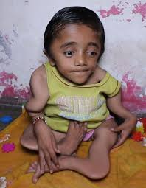
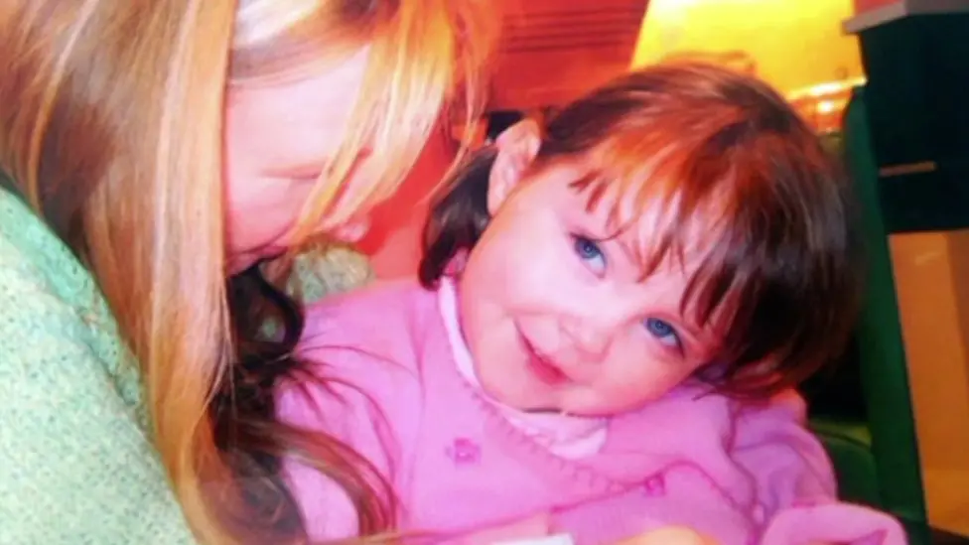
2. Hook with a shocking line: For example—“A child could die if he falls asleep,” “This patient needs ₹1 crore (USD 120,000) every year to survive,” or “She lives with a wheelchair attached to an oxygen tank.”
Boy, 12, is ‘made of glass’ — has broken 100 bones due to rare disease
Rare Disease Day: The family who lost three children

Slide 18
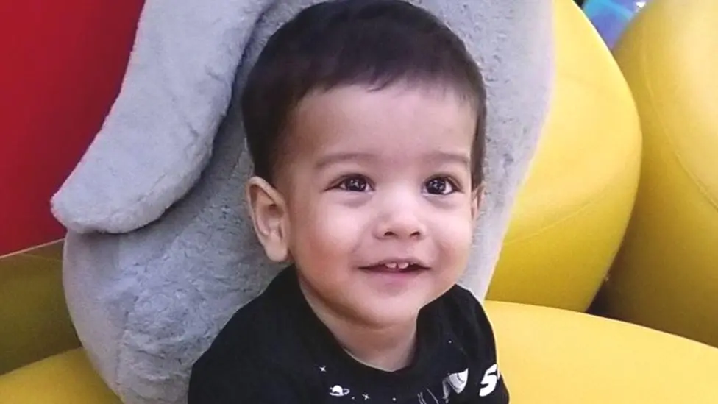
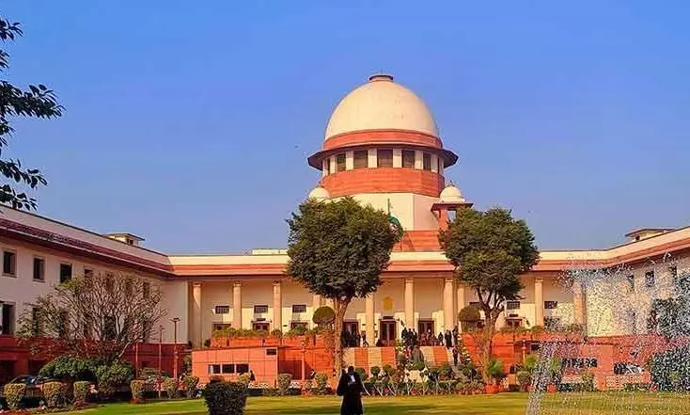
3. Bring the economic angle: Show how pharmaceutical companies shy away from manufacturing rare-disease drugs and the conflicts this creates.
Spinal Muscular Atrophy: Indians who need a $2.1m drug to fight rare disease
SC Asks Why SMA Drug Costs More in India Than in Pakistan, China

Slide 19
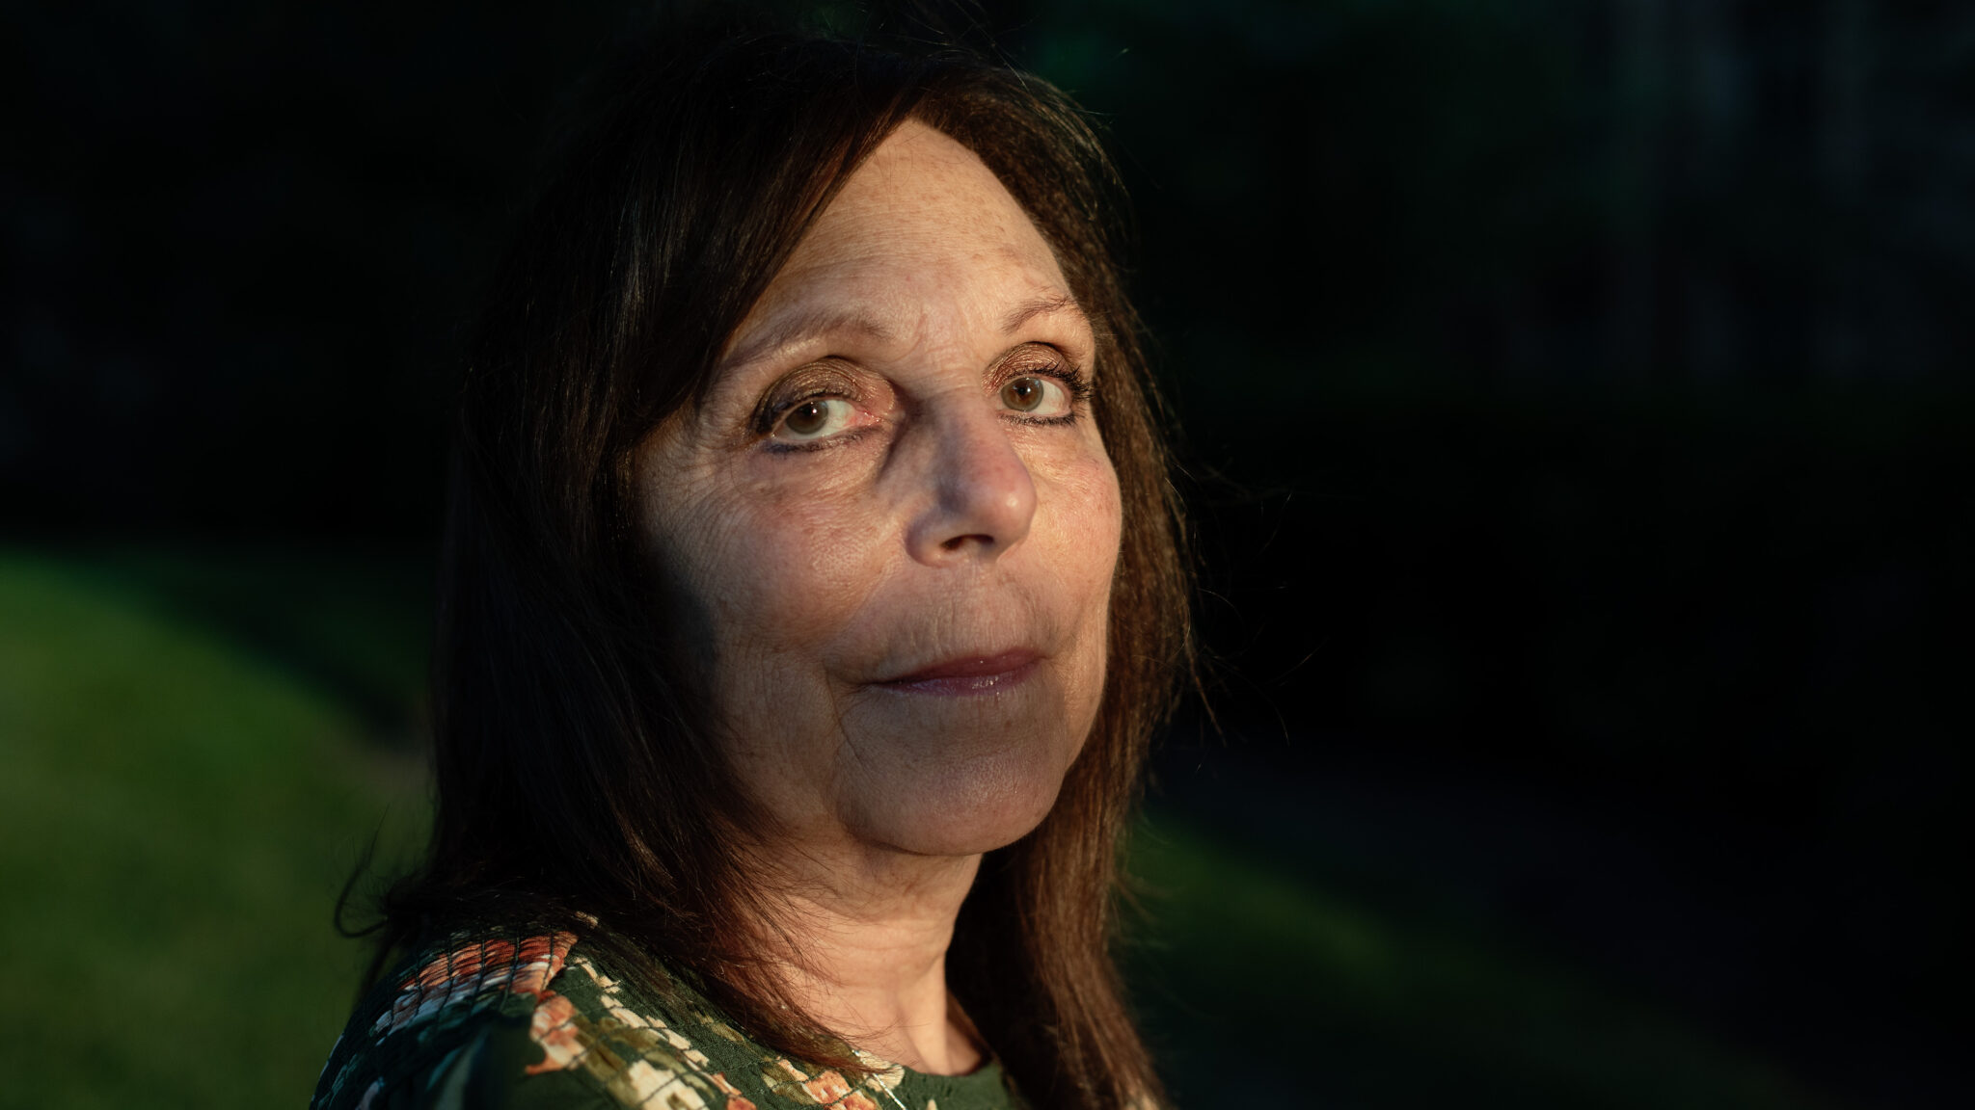

4. Find time proximity: Link the story to timely events—new drug approvals, laws, celebrity diagnoses, petitions, or court rulings.
Rare disease patients caught in Trump crackdown on foreign grant awards
UK approves gene therapy for sickle cell anaemia. Why it offers hope for Indian patients

Slide 20
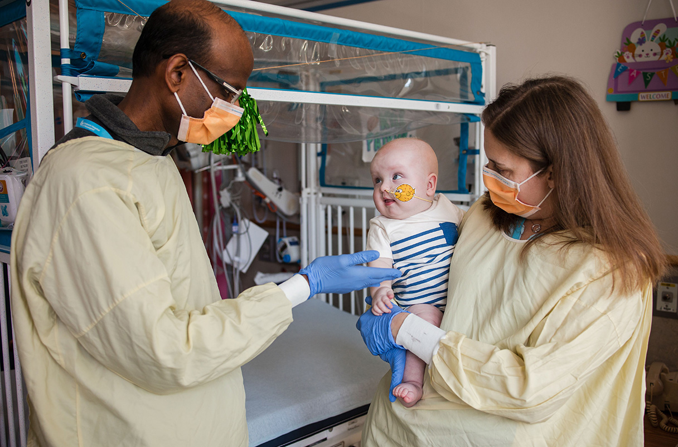

5. Highlight cutting-edge inventions: Profile groups working on breakthroughs such as indigenously developed CRISPR tools, gene therapy, or other novel treatments.
Gene-editing therapy made in just 6 months helps baby with life-threatening disease
Boy, 12, with rare genetic skin disorder can now play football after breakthrough medical trial

Slide 21
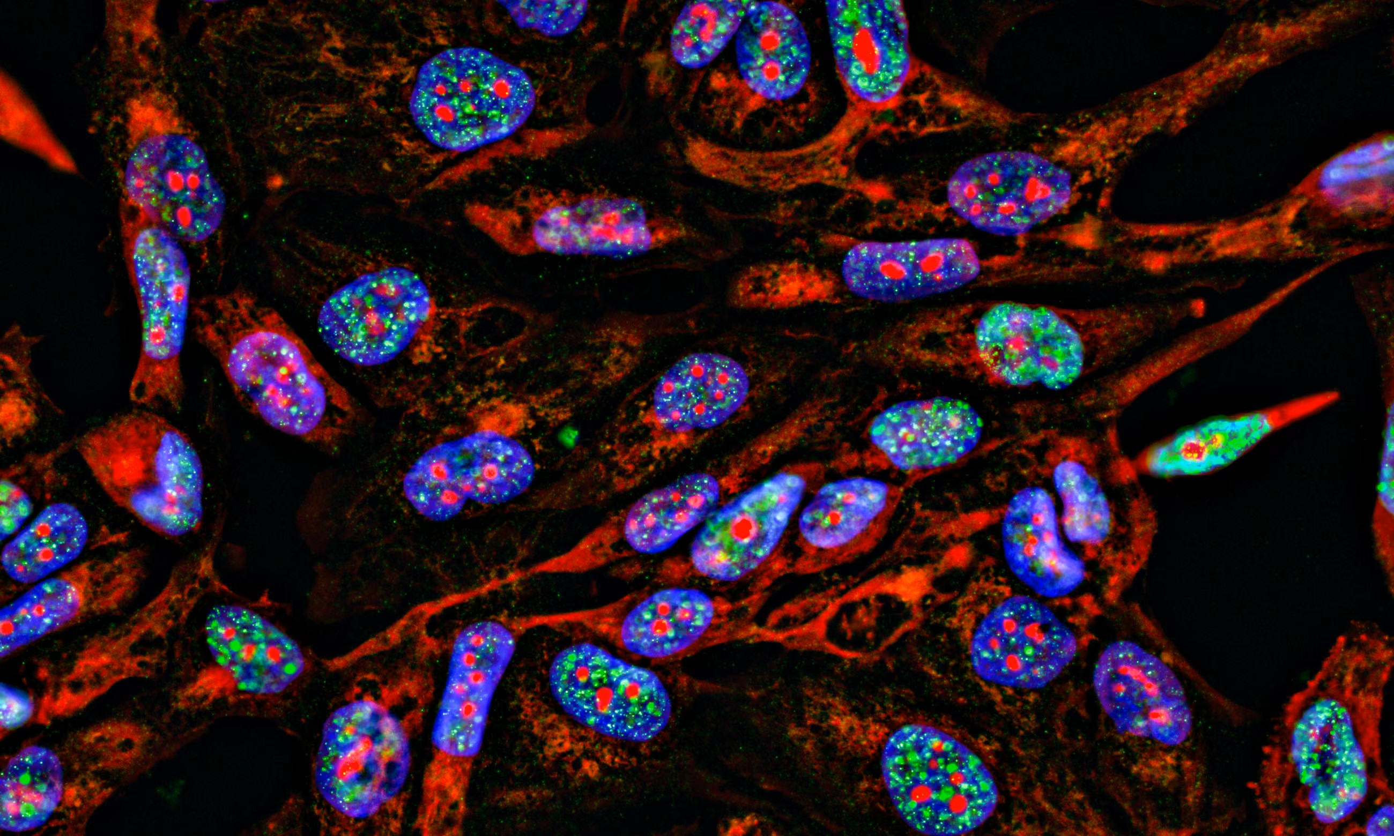
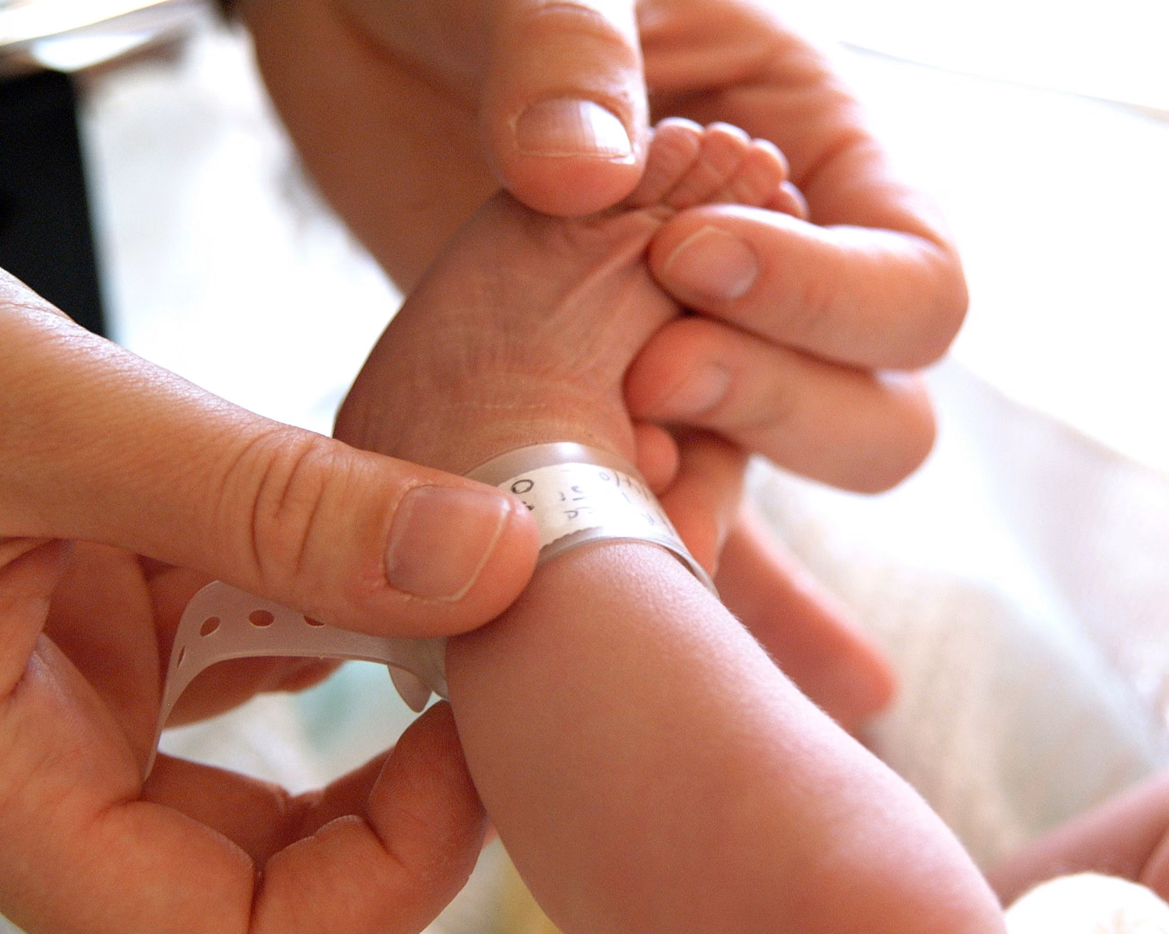
6. Practice solution journalism: Balance grim realities with hopeful stories like patients offering peer counselling, or parents donating their deceased child’s organs for research.
Millions invited to take part in UK scheme to diagnose diseases earlier
Blood test developed that could speed up diagnosis of rare diseases in babies

Slide 22
My Challenges in Covering Rare Diseases
Accessing data: The health department does not maintain accurate data, even fatalities linked to rare diseases are missing.
Tight-lipped officials: Senior officials and pharma companies were difficult to reach due to restrictions, but state-level officers frustrated with poor implementation were more open.
Choosing case studies: With many patients struggling to access the promised ₹50 lakh in government support, selecting stories was tough. I chose those with the most humane and compelling angles.
Impact of the story: Policy change was hard to achieve, so I shared my data with NGOs and parent groups, who used it as evidence in court and before the National Human Rights Commission.
Convincing editors: One of the toughest hurdles was persuading editors to take these stories seriously.

Slide 23
Prime Sources for Journalists
Policy documents: Study government policies closely. For example, India’s National Rare Disease Policy promised ₹5 crore (USD 600,000) to 13 Centres of Excellence for diagnostic labs, but never delivered which I followed up.
NGOs and parent groups: They stay updated on policy changes and are deeply networked.
Court records: Parents often seek financial help through courts, where the government submits internal data not otherwise available.
Scientists: Government lab websites often provide research leads. Convincing scientists to speak may take persistence.
Scholars: Use Google Scholar to find research. Academics are often internationally connected and can provide evidence and context.

Slide 24
Thank you

