Slide 1
Confronting Mental Health Challenges for Rare Disease Patients and Families
  A Caregiver’s Perspective from Kenya
  Presenter: Philip LANGAT
  MNDAK Founder
  email: phillangatk@yahoo.com
  LinkedIn: philip-langat-2a418321a
  Twitter: @PhilipLANG75975
  Presenting Virtually at:
  The National Press Foundation – Rare Disease Reporting Fellowship
  November 17–21, 2025

Slide 2
What Is ALS/MND?
Global & Local Burden
What Is ALS/MND?
• Group of neurological disorders causing progressive degeneration of motor neurons
• Leads to loss of movement, speech, swallowing, and breathing
• Mind remains aware even as the body weakens → emotional strain
• ~63,700 new cases globally per year
(Global Burden of Disease Study 2019; Park et al. 2022)
• Kenya: No national registry or official data
(International Alliance of ALS/MND Associations 2025)
• Local evidence:
Aga Khan University Hospital retrospective review (2010–2023)
160 patients identified in one facility
(Kamadi 2023, unpublished MSc thesis, Aga Khan University Hospital, Nairobi)
Media Impact – With Examples
• ALS/MND remains hidden and misunderstood — even in media
• Journalists affected:
Charlie Bird (Ireland), Sue Baker (UK), Nick Way (Australia), Riz Sunawan (Singapore)
(Public obituaries and media archives: RTÉ, BBC, Channel 9, Mediacorp)

Slide 3




My Family’s Reality
In a family of ten members, three out of nine potential individuals were affected by ALS/MND.
Two extended family members have been affected; other relatives may also have had this neurological condition.
The father initially experienced trigeminal neuralgia, followed by symptoms resembling ALS.
My experience with my brother's illness, including patient management difficulties, limited information, cultural misconceptions, and caregiver stress, led to founding MNDAK.
Two brothers passed away due to ALS/MND.
“In my family ALS/MND is not rare. It is significant.”

Slide 4
My Family’s Journey
My Father
• Suffered from trigeminal neuralgia (a chronic pain condition affecting the facial nerves) from the year 2000—Passed on Oct. 2013
• Experienced severe shock-like pain
• Later developed symptoms consistent with ALS/MND

Slide 5
My Family’s Journey
My brothers
Jonathan – March 2007
• Recognized his fate immediately after diagnosis
• Health declined rapidly
• Passed on three months later, two days after long-awaited Riluzole arrived.
• His sickness marked the beginning of our family’s awareness journey

Slide 6
My Family’s Journey
Andrew – August 2023
• Rested after over two years of courageous battle
• Held Jonathan in his final moments, a memory that may have shaped his own journey
• Embraced learning, technology, and storytelling to live with purpose
• Books, stories, and a resilient mindset gave him strength to live longer
• Knowledge gave him time and a measure of dignity

Slide 7
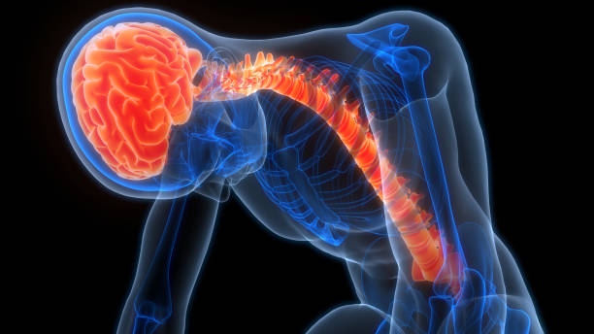
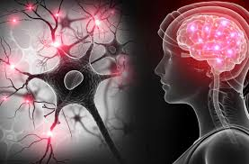
THESE
CONDITIONS
greatly impacted on them and our family, as we witnessed their courage through constant pain and declining health.

Slide 8
Mental and Emotional Toll (Patients & Families)
• Shock and fear at diagnosis
• Anxiety, depression and constant uncertainty
• Stigma and isolation from community
• Emotional exhaustion for patient and caregiver
• Financial strain adding to emotional pain
“The body weakens, but the mind carries the heaviest weight.”

Slide 9

Mental and Emotional Toll : Deep Psychological Strain in the Home
Children absorb stress — disrupted schooling and fear
Fear of dying without dignity after witnessing deaths in ICU
Family roles collapse under the weight of illness
Behaviour changes strain relationships
Limited mental-health support worsens distress
Caregiver guilt and fear of “being next”
“Behind every person with ALS is a family quietly breaking.”

Slide 10
Cultural & Social Misconceptions
• Witchcraft, curses and ancestral punishment
• Prayer relied on as “treatment”
• Travelling for anointing oils & miracle solutions
• Traditional medicine without proper diagnosis
• Stigma → silence → delayed care
• Families hide illness to avoid judgement
• Giving up medical care because illness is seen as “untreatable”
“Ignorance becomes a second disease.”

Slide 11
Major Challenges
• Health system: few ALS/MND specialists; ICU not suited — need gentler care settings
• Financial pressure: insurance exhausted; many uninsured; caregiver costs; relocation hardship
• Cultural barriers: misbeliefs, secrecy, stigma — families torn between community beliefs and medical truth
• Emotional strain: fear, grief and uncertainty for patients and caregivers
• Information gaps: late diagnosis; no counselling; no national data — families navigate alone
• Lack of guidance: families fight the disease without clear support or direction
• Research gaps: no clinical trials in Africa; limited global representation
“These challenges do not just weaken the body. They break the spirit unless we confront them together.”

Slide 12
Calls To Action & Closing Reflections
Call to Journalists
• Rare disease stories are not rare — they are hidden. Journalism must bring them to light, boldly and consistently, especially in the Global South.
• Show the emotional scars and the financial strain. Only when the full weight is visible can doors to real help open.
• Journalists can dismantle stigma. One courageous story — like Tuesdays with Morrie — can change understanding, bring hope, and inspire action.
I am ready to share mine if someone is willing to write it.
• Many journalists who later developed ALS/MND used their platforms only after falling ill.
Please do not wait for that moment. Help now.
“A borrowed voice is still a voice. Lend us yours.”

Slide 13
Calls To Action & Closing Reflections
Call to Researchers
• Africa must begin research or be intentionally included in global trials
• Build partnerships that bring clinical trials to the continent
• Practice open science — share knowledge and discoveries openly and accessibly
“If Africa carries the burden, Africa must share in the solutions.”
Closing Reflection
“The greatest loss in ALS is not that of the voice BUT it is being unheard.” — Philip Langat, 2025
“…and there is HOPE.”
Thank you. Asante.

Slide 14


