Slide 1

Why Genomic Counselling, Prenatal and Newborn screening matter in the Rare Disease Realm
Nakita Laing
Genetic Counsellor
University of Cape Town, South Africa
n.verkijk@uct.ac.za

Slide 2

Overview
Definitions
Why newborn screening matters (example)
The role of genetic counselling in NBS
Global experiences NBS
South African experiences NBS and GC
African experiences NBS and GC

Slide 3
Definitions

Slide 4

GENETIC COUNSELLING
What is it?
Resta (2018) “process of helping people understand and adapt to the medical, psychological andfamilial implications of genetic contributions to disease.
This process integrates:
Interpretation of family and medical histories to assess the chance of disease occurrence or recurrence;
education about inheritance, testing, management, prevention, resources and research;
and counseling to promote informed choices and adaptation to the risk or condition.”

Slide 5



GENETIC COUNSELLING
Health care professional
Genetic Counsellor
Counselling

Slide 6

GENETIC COUNSELLORS BRIDGE THE GAP​
Science
Family
Genetic counsellors are healthcare professionals who not only understand the science of genetics/genomics but also the medical implications and importantly the very personal nature of this information to patients and their families​

Slide 7
Prenatal Screening and Prenatal Diagnosis
Prenatal Screening (PNS)
Methods to determine the likelihood of a fetus having a certain genetic condition or birth defect
Non-invasive – Ultrasound or blood tests
"Risk" of a problem
Allows option to undergo diagnostic testing if "high-risk"
Example: "advanced maternal age" or "NIPT"
Prenatal Diagnosis (PND)
Invasive procedures to provide a definitive diagnosis
Allow prospective parents to make informed decisions about their pregnancy or
Allows for preparation of medical team for potential early intervention if appropriate and available.
Example: Amniocentesis for a known familial disorder

Slide 8
Newborn Screening (NBS)
A public health initiative/ service
Screens newborns for possible serious treatable disorders to allow for early intervention
Includes physical examination as well as a biochemical screening from a heel prick within the first hours or days of life
Usually focused on "congenital disorders"

Slide 9
Congenital Disorders (CDs)
Abnormalities in structure or function present from birth
May be immediately obvious (e.g. cleft lip) or
Some may manifest after hours, weeks or months post delivery (e.g. inborn errors of metabolism (IEMs) and rare diseases)
By the time they present, progression may have already caused irreversible damage
Intellectual disability, physical disability or premature death
Premise of NBS: Identify and refer for treatment in asymptomatic individuals, before the disease manifests in order to arrest disease progression

Slide 10

Why does this matter?

Slide 11
WHO Sustainable Development Goal 3 (2030)
Notes:
WHO - By 2030, end preventable deaths of newborns and children under 5 years of age, with all countries aiming to reduce neonatal mortality to at least as low as 12 per 1000 live births and under-5 mortality to at least as low as 25 per 1000 live births.
The child mortality rate in Africa has steadily declined over the past seven decades. In 2023, it reached 63 deaths per thousand births. In 1950, child mortality was significantly higher, estimated at 327 deaths per thousand births, meaning that almost one-third of all children born in these years did not make it to their fifth birthday. While the reduction rate varies on a country-by-country basis, the overall decline can be attributed in large part to the expansion of healthcare services, improvements in nutrition and access to clean drinking water, and the implementation of large-scale immunization campaigns across the continent. The temporary slowdown in the 1980s and 1990s has been attributed in part to rapid urbanization of many parts of the continent that coincided with poor economic performance, resulting in the creation of overcrowded slums with poor access to health and sanitation services. Despite significant improvements in the continent-wide averages, there remains a significant imbalance in the continent, with Sub-Saharan countries experiencing much higher child mortality rates than those in North Africa.

Slide 12

Newborn Screening

Slide 13
Beginning of NBS
1963 – Robert Guthrie
Phenylketonuria (PKU) screening using a bacterial inhibition assay
estimate phenylalanine concentration in dried blood spots
Treatment = low phenylalanine diet to decrease the accumulation of phenylalanine
Prevents seizures, stunted growth, developmental delay and intellectual disability
1970s - congenital hypothyroidism (CH), congenital adrenal hyperplasia (CAH), and cystic fibrosis (CF)
1990s – tandem mass spectrometry
Notes:
Low phenylalanine diet = a medically restrictive diet that eliminates high-protein foods to manage the genetic disorder phenylketonuria (PKU). It involves avoiding meat, eggs, dairy, nuts, and other high-protein foods, while consuming specially formulated medical foods or formulas to provide necessary nutrients, along with certain fruits, vegetables, and low-protein starches.
MS - leading to an increase in the number of treatable genetic conditions that could be screened simultaneously

Slide 14
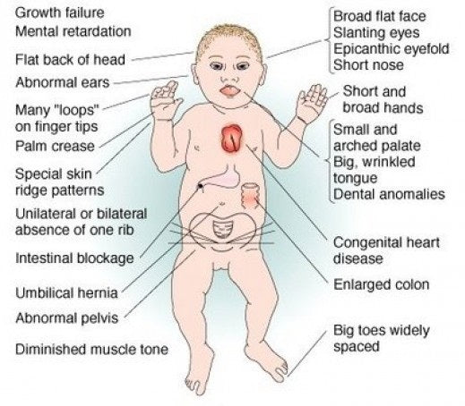
Example: Congenital Hypothyroidism
"cretinism"
Serious condition where a baby is born with an underactive thyroid gland which normally produces thyroid hormone.
Thyroid hormone is vital for growth and brain development
Notes:
The thyroid hormone plays an essential role in energy metabolism, growth, and neurodevelopment.
Specifically, the thyroid hormone acts on neuronal differentiation, synapsis development, and myelination in the prenatal and newborn periods, regulating central nervous system development.
The classic clinical features of CH appear gradually over approximately six weeks, but early signs may appear within the first few weeks of life in more severe cases of CH. The early manifestations include lethargy, hypotonia, large anterior and posterior fontanels, feeding difficulty, prolonged jaundice, poor or hoarse cry, constipation, and hypothermia.
The classic late manifestations of CH usually occur after about six weeks of life. These include coarse facies with depressed nasal bridge, puffy eyelids, large tongue, coarse hair, thick, dry and cold mottled skin, abdominal distension, umbilical hernia, hyporeflexia, bradycardia, hypotension, and anemia.
The respiratory distress may develop due to myxedema of the airway and is characterized by noisy breathing, nasal stuffiness, and intermittent perioral cyanosis

Slide 15
Congenital hypothyroidism
Common!
1 in 3000 – 1 in 4000 (in SA this is approx 250 babies/year)
Vital to diagnose and start treatment within 2 weeks of birth
Ideal to perform NBS on day 2-4 when false readings may be obtained due to maternal effects.
Requires follow-up and repeat testing if screen positive
Treatment simple and cost effective - levothyroxine (L-T4) (~$4)
Untreated/late dx - irreversible neurological deficits (lifelong)
For every $1 spent on screening/treatment - $2.90 averted
Notes:
Does newborn screening save money? The difference between cost-effective and cost-saving interventions. Grosse, Scott D. The Journal of Pediatrics, Volume 146, Issue 2, 168 – 170 Congenital Hypothyroidism - StatPearls - NCBI Bookshelf

Slide 16
Current NBS
USA "uniform screening panel"
35 core conditions (biochemical/genetic screening)
26 secondary conditions (identified unintentionally when screening core)
Definition broadened:
Critical (CHD)
Hearing loss
Head to toe physical examination
Biochemical and/or genetic screening
Improved health outcomes and financial benefits

Slide 17
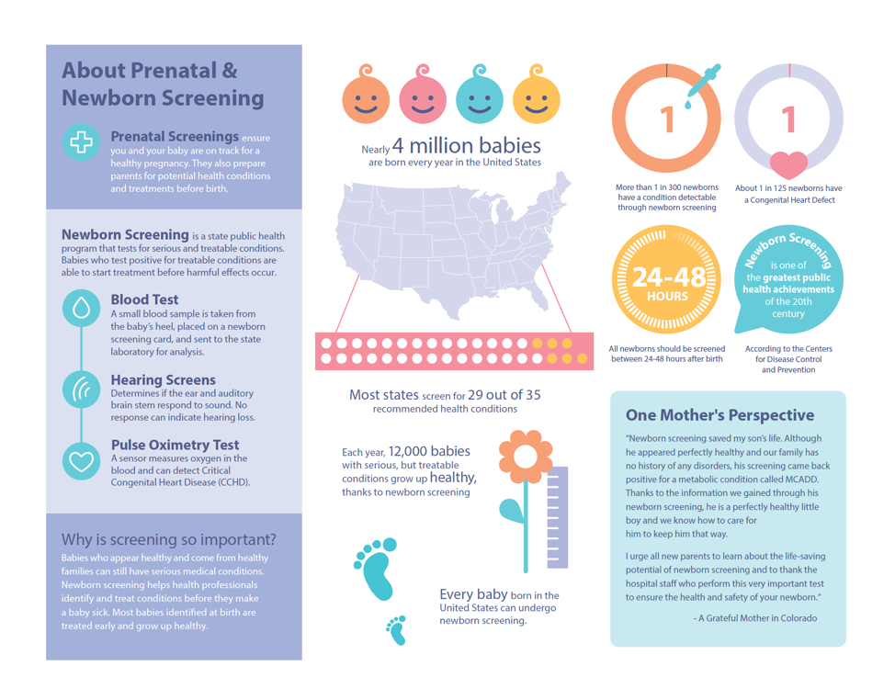
https://babysfirsttest.org/newborn-screening/resource-types/brochure
Notes:
Brochure | Baby's First Test | Newborn Screening | Baby Health

Slide 18
NBS and Role of Genetic Counselling (GC)
Many conditions screened for are "genetic" and require follow-up genetic testing to confirm the diagnosis
Not only is there a possible serious diagnosis in the family but there are also implications for future pregnancies and other family members
Some NBS can reveal "carrier status" in an infant which also requires follow-up
GCs - important source of support and education for parents while also helping families navigate the best medical care for their child after an abnormal screening test result

Slide 19
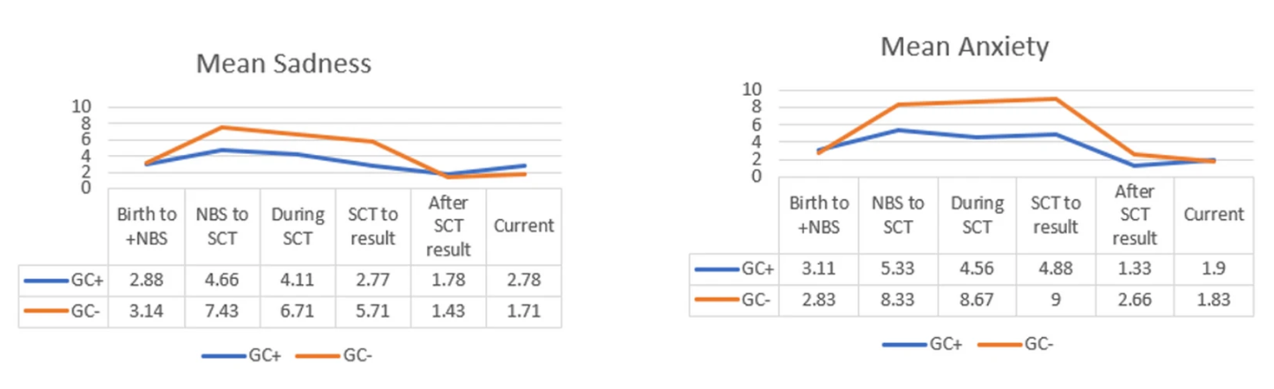
Experiences with NBS for CF and GC
Foil, K., Christon, L., Kerrigan, C. et al. Experiences of cystic fibrosis newborn screening and genetic counseling. J Community Genet 14, 621–626 (2023). https://doi.org/10.1007/s12687-023-00666-8
Notes:
Half of participants indicated they wish the NBS+ result had been delivered by a GC, and others indicated that early access to GC would be helpful. GC engagement earlier in the NBS+ process is likely ideal, and education of pediatricians and direct patient resources may also help meet parental needs.

Slide 20
Real-world experiences
Hricovec, M., Gaviglio, A., Mealwitz, C., Merrill, M., & Goldenberg, A. J. (2025). A Qualitative Study on Parental Experiences with Genetic Counseling After a Positive Newborn Screen for Recently Added Conditions on the Recommended Uniform Screening Panel (RUSP). International Journal of Neonatal Screening, 11(4), 101. https://doi.org/10.3390/ijns11040101
“I think in an ideal world it would be either the specialist or the genetic counselor calling us first, and not even having the pediatrician share that…I know it seems like a very common theme that pediatricians share the news…in my mind, because when you have questions and it’s someone calling you who can’t answer those questions, it’s a little awkward.”
“But then she hands us this folder, and the folder had every single piece of paper that she had talked about…for us to take home to read over. And I can’t tell you how much of a comfort that was for the next couple of days, maybe week.”
“They did do a good explanation of like the pure genetics behind it…And then, I think the education on the likelihood of older brother having it, I think was also really helpful. Because once I heard that it was a only a 25% chance that he would also have it too, [I was] able to breathe a little bit more.”
“They also shared…in that first appointment about some adult patients they had with Pompe, and even just hearing, like real life stuff was really helpful…I remember them saying, we have an…adult patient with Pompe that’s a lawyer… even just that, those pieces again, some kind of anecdotal stuff was really nice.”
“She said she could tell us more about like the options if we wanted to have more kids, and what the odds of a future kid having it would be, and how to handle all of that, and like obviously being like 5 days postpartum, I was not in any place to be thinking about that, but it was good to know that, like she was there as a resource.”
“When we got to the genetic counselor, she was very nice. She was very informative, but she did give us a little bit of false hope because she told us that she had worked in [state] previously when they had just implemented the newborn screening and that there were lots of false positives. especially when the very beginning.”

Slide 21
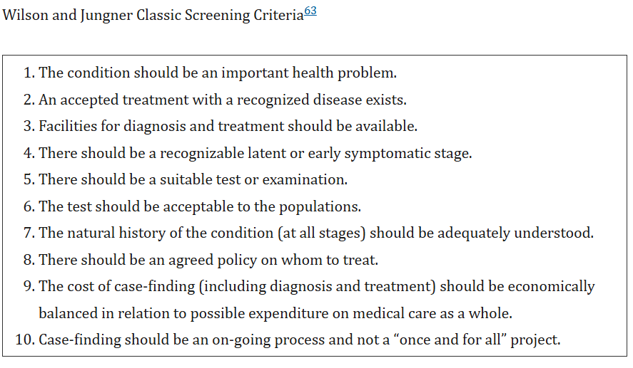
Expansion – Benefit or Burden?
Technology advances have increased no. of conditions
Range
Tranditional disorders with high benefit of early detection e.g. PKU
Unclear benefit – not particularly harmful e.g. short chain acyl-CoA dehydrogenase deficiency
Unclear benefit – no treatment e.g. Niemann-Pick A
Beneficial but treatment carries risk e.g. Krabbe and BMT
Later onset (not newborn) e.g. pompes
Debate if helpful or not?
Should family/society benefits be considered?
Notes:
he development and evolution of newborn screening technologies, coupled with tremendous stakeholder support for the program, has contributed to the breadth of disorders now seen on expanded newborn screening panels. Most panels now include diseases ranging from more traditional disorders that have a high benefit from early detection, such as PKU, to those that have unclear benefits either because they may not be particularly harmful (e.g., short chain acyl-CoA dehydrogenase deficiency) or because there might not be an available treatment (e.g., Type A Niemann-Pick); to those for which screening might be beneficial, but the treatment itself carries a significant risk (e.g., early infantile Krabbe disease treated with bone marrow transplantation) (Table 2). In addition, some states include disorders that may manifest later in life rather than in the newborn period (e.g., some lysosomal storage diseases). These represent unique and unprecedented challenges associated with expanded newborn screening.
Kelly N, Makarem DC, Wasserstein MP. Screening of Newborns for Disorders with High Benefit-Risk Ratios Should Be Mandatory. J Law Med Ethics. 2016 Jun;44(2):231-40. doi: 10.1177/1073110516654133. PMID: 27338599; PMCID: PMC5381153.
Recent additions to screening panels, such as severe combined immune deficiency [Citation19], continue to emphasize the role of prompt identification and intervention for the newborn, yet others less clearly meet established criteria of being amenable to treatment or have been less well characterized with respect to the natural history of the condition, including development from latent to declared disease. As such, a number of recently included, and recently proposed conditions – such as Pompe disease, Fabry disease and Type 1 diabetes [Citation20–25] – have been the subject of debate and evaluation
Nicholls, S. G., Wilson, B. J., Etchegary, H., Brehaut, J. C., Potter, B. K., Hayeems, R., … Carroll, J. C. (2014). Benefits and Burdens of Newborn Screening: Public Understanding and Decision-Making. Personalized Medicine, 11(6), 593–607. https://doi.org/10.2217/pme.14.46

Slide 22
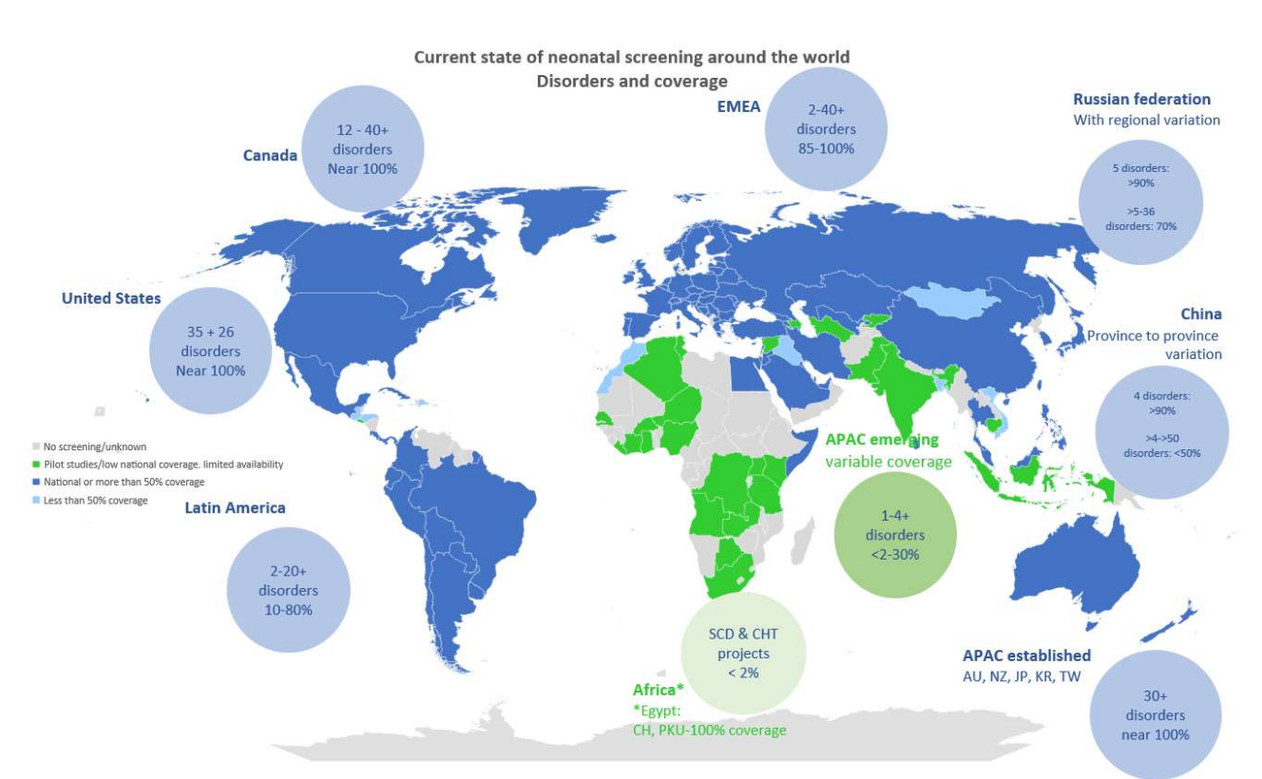
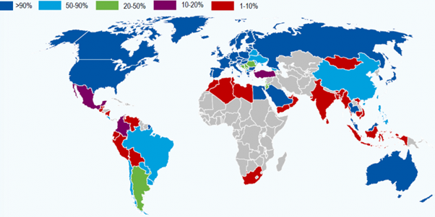
Global experience
https://nextbio.co.za/blog/details/a-case-for-newborn-screening-in-south-africa
https://www.isns-neoscreening.org/wp-content/uploads/2023/09/20230912_BS_Global_map_May2023_update_PS.pdf
Notes:
Microsoft PowerPoint - 20230912_BS Global map May 2023 updated_PS.pptx
A case for newborn screening (FirstScreen) in South Africa A case for newborn screening in South Africa - Next Biosciences > Blog

Slide 23
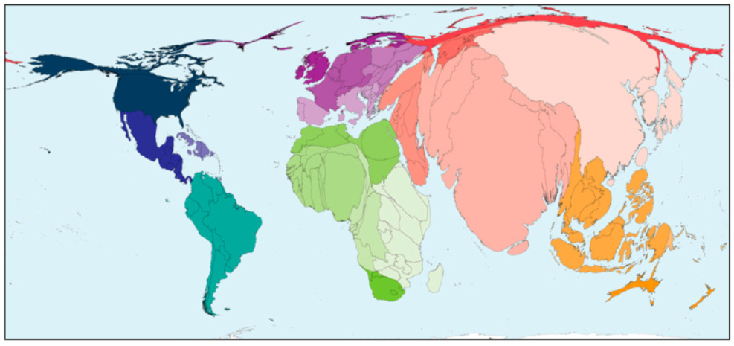
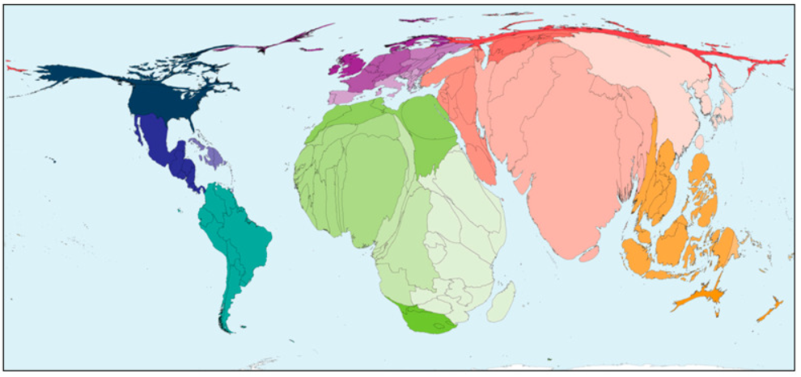
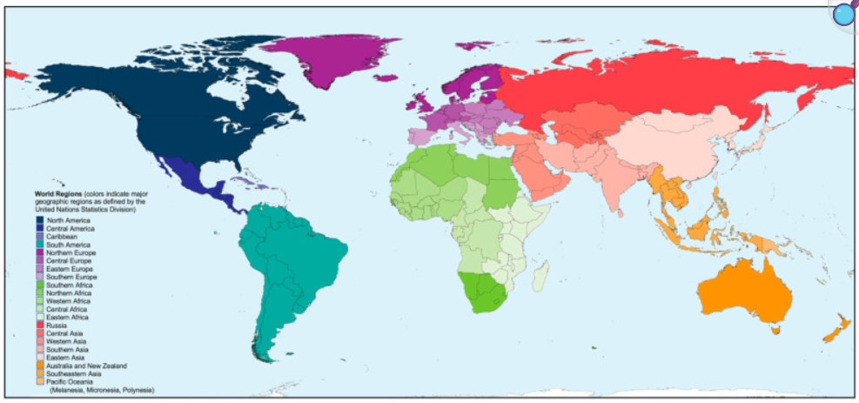
Global experience
In Africa around 30m babies are born each year but newborn screening is very limited, <1m each year
Therrell BL, Padilla CD, Borrajo GJC, Khneisser I, Schielen PCJI, Knight-Madden J, Malherbe HL, Kase M. Current Status of Newborn Bloodspot Screening Worldwide 2024: A Comprehensive Review of Recent Activities (2020-2023). Int J Neonatal Screen. 2024 May 23;10(2):38. doi: 10.3390/ijns10020038. PMID: 38920845; PMCID: PMC11203842.
Notes:
Therrell BL, Padilla CD, Borrajo GJC, Khneisser I, Schielen PCJI, Knight-Madden J, Malherbe HL, Kase M. Current Status of Newborn Bloodspot Screening Worldwide 2024: A Comprehensive Review of Recent Activities (2020-2023). Int J Neonatal Screen. 2024 May 23;10(2):38. doi: 10.3390/ijns10020038. PMID: 38920845; PMCID: PMC11203842.

Slide 24

South African experience

Slide 25
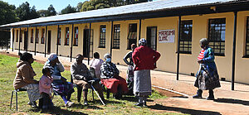

SA HealthCare system
61 million people
12% living with HIV (2022)
State
Majority of the population utilise State health care ~ 84%
Limited resources, understaffed
Private
Self-funded
More healthcare resources
Notes:
Data for 2022 indicates that 12% (n = 7.7 m) of the population were living with HIV, with the highest number of people enrolled in HIV antiretroviral treatment (ART) globally
the HIV/AIDS and TB epidemics of the 1990’s reversed positive epidemiological progress initially achieved
The health system now faces concurrent burdens of communicable and non-communicable diseases (NCD) due to the non-classical epidemiological transition experienced. Limited public resources are predominantly allocated to more easily diagnosed and treated communicable diseases with their perceived higher burden
further
significant reductions may only be achieved by addressing CDs as a priority health issue through comprehensive genetic services

Slide 26
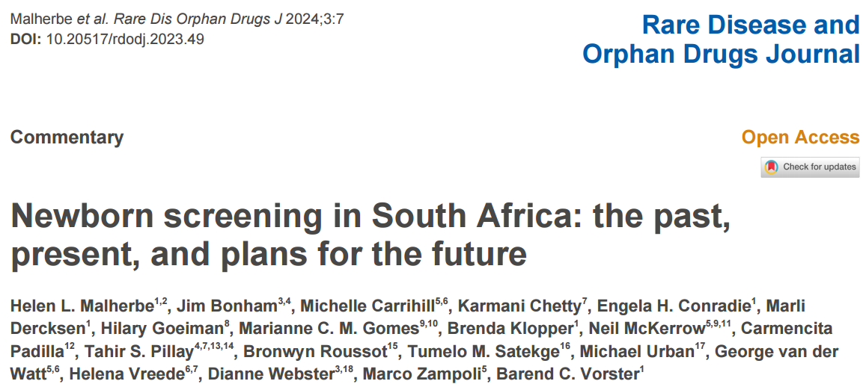
NBS in SA
Extremely limited!
Some CH programs used to exist in 1 province but funding withdrawn despite success
Only available in Private sector at patients expense
22 conditions
(0.5% of annual births)
Notes:
Potentially 12 500 babies with CH over last 50 years –living with preventable, irreversible ID – personal and economic burden

Slide 27
Identified Challenges
Which conditions to include
Early discharge (<6 hours)
Technical challenges
sample collection and
Methodology of NBS based on time of sample collection and sample type
High rate of loss to follow-up
Inadequate resources – financial and human
Lack of accountability
Poor logistics biochemical NBS pathway,
including communicating test results and
accessibility of genetic counselling for patients.
Lack of political will/funding

Slide 28
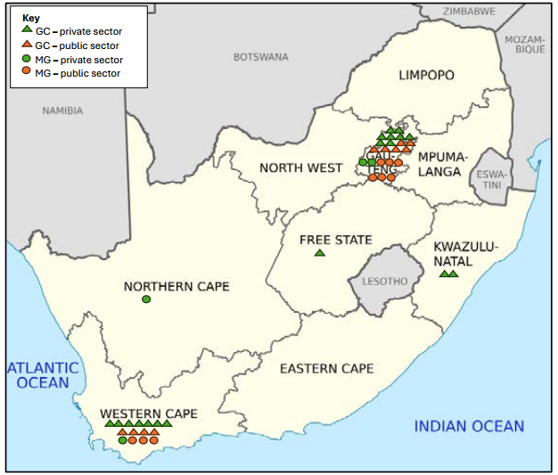
Limited Genetic Services
M. Gomes et al (2024) A Capacity Audit of Medical Geneticists and Genetic Counsellors in South Africa, 2024: A National Crisis. Genes, 15, 1173. https://doi.org/10.3390/genes15091173
Notes:
A total of 54 GC registered with the HPCSA from 1995 to April 2024, of which 26 of (48%) are not practicing in SA.
Five of the nine provinces have no GC.
Practicing MG/GC are unevenly distributed across the country, resulting in inequity both between the public/private sectors and geographically between provinces.
In SA in 2012, genetic services met 10% of the population need [35,47]. Little has changed in the subsequent decade, with continued population growth, growing CD health need, and scarcer resources—despite numerous studies and advocacy efforts highlighting this capacity shortage
1 FTE per 100 000 (recommended ratio)
USA at 80% capacity in 2018
Hoskovec, J.M., Bennett, R.L., Carey, M.E. et al. Projecting the Supply and Demand for Certified Genetic Counselors: a Workforce Study. J Genet Counsel 27, 16–20 (2018). https://doi.org/10.1007/s10897-017-0158-8
A Capacity Audit of Medical Geneticists and Genetic Counsellors in South Africa, 2024: A National Crisis. Marianne C. M. Gomes 1,*,†, Byron J. Gomes 2, Arnold L. Christianson 3,‡, Claude Bailly 4, Neil McKerrow 5,6 and Helen L. Malherbe. Genes 2024, 15, 1173. https://doi.org/10.3390/genes15091173

Slide 29

African experience

Slide 30
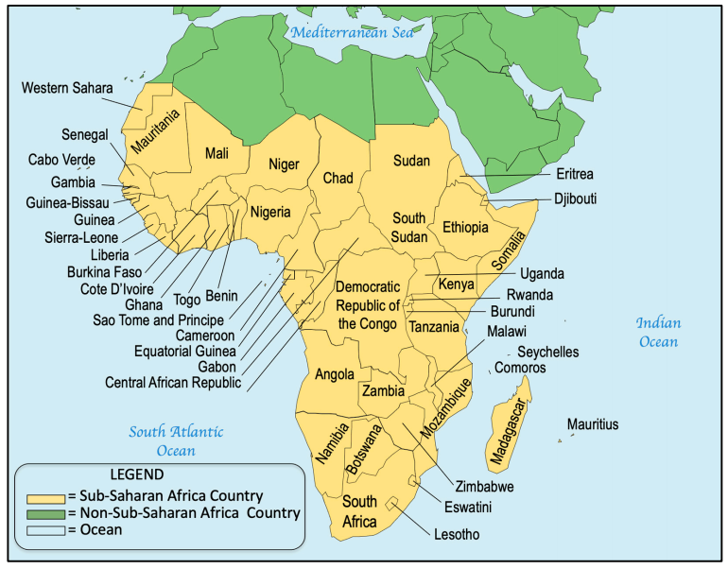
Sub-Saharan Africa
Population - 1.2 billion
41 million births/year
55 countries
25/30 poorest countries in the world are in SSA
45/50 highest birth rates
NBS backseat – prioritisation HIV/AIDs and TB
Infections disease burden decreasing and increasing burden Non-communicable disorders
Therrell BL, Padilla CD, Borrajo GJC, Khneisser I, Schielen PCJI, Knight-Madden J, Malherbe HL, Kase M. Current Status of Newborn Bloodspot Screening Worldwide 2024: A Comprehensive Review of Recent Activities (2020-2023). Int J Neonatal Screen. 2024 May 23;10(2):38. doi: 10.3390/ijns10020038. PMID: 38920845; PMCID: PMC11203842.
Notes:
Newborn screening took a backseat for a long time in Africa as a result of prioritisation of communicable diseases, particularly HIV/AIDS and tuberculosis. The Prevention of Mother to Child Transmission and immunisation programmes have successfully reduced the infectious disease burden on the continent. Recent reports have revealed that there is now an increasing contribution of non-communicable diseases, especially congenital disorders, to infant morbidity and mortality
Satekge T, Okesina A, Anetor J, Erasmus R. The status of newborn screening in Africa: Situation analysis, future plans and call to action. Afr J Lab Med. 2025;14(1), a2973. https://doi.org/10.4102/ajlm.v14i1.2973
Therrell BL, Padilla CD, Borrajo GJC, Khneisser I, Schielen PCJI, Knight-Madden J, Malherbe HL, Kase M. Current Status of Newborn Bloodspot Screening Worldwide 2024: A Comprehensive Review of Recent Activities (2020-2023). Int J Neonatal Screen. 2024 May 23;10(2):38. doi: 10.3390/ijns10020038. PMID: 38920845; PMCID: PMC11203842.

Slide 31
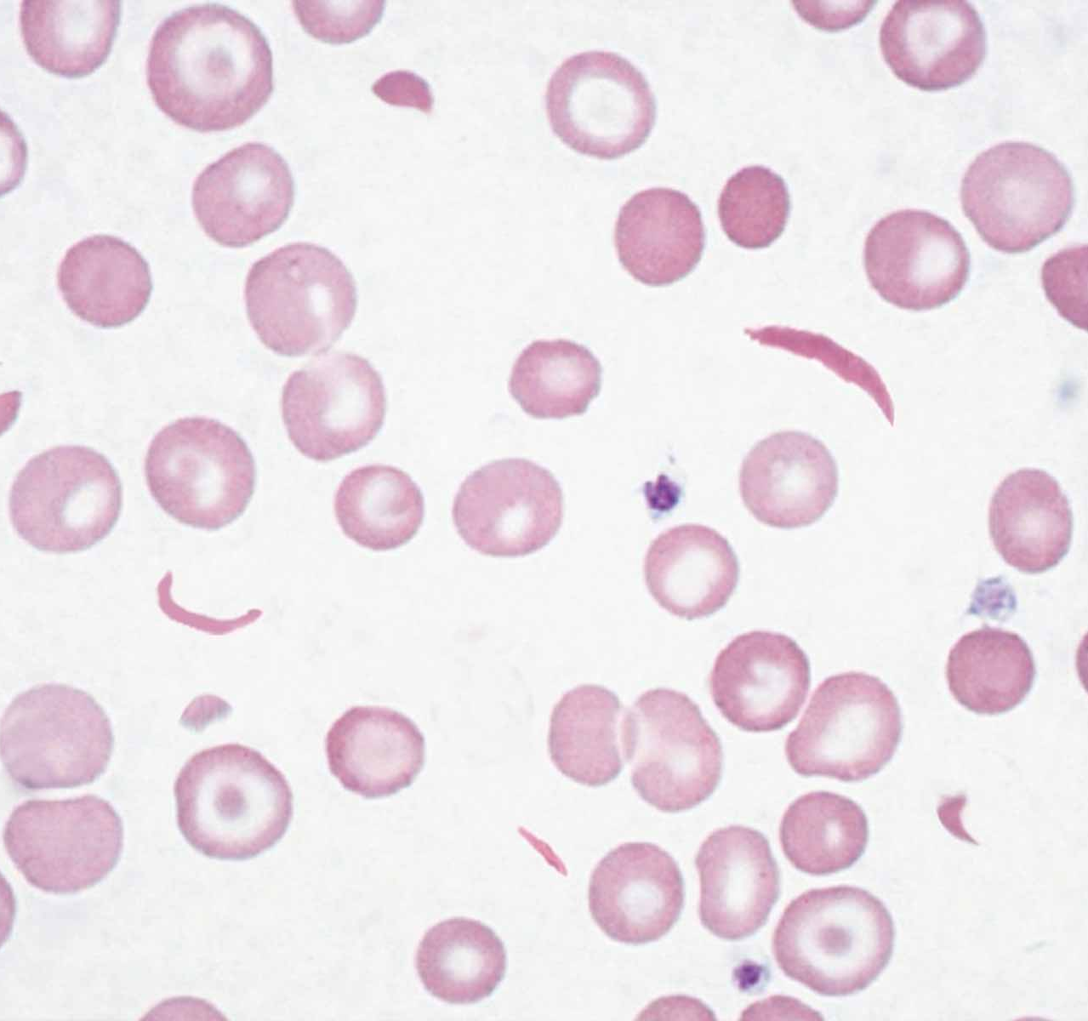
Sickle Cell Disease
Incidence - 400 000/ year
75% in SSA ( ~300 000/year)
50-90% die before 5th birthday
Early detection can greatly improve morbidity and mortality
Initial programmes 1993 – Ghana and Benin
Sustainability limited success
2008 – UN "global public health concern"
Notes:
Each year, approximately 400,000 babies are born with SCD worldwide and more than 75% of these births occur in sub-Saharan Africa (Piel et al. 2013a) where it is estimated that 50 to 90% of affected infants will die before their 5th birthday (Grosse et al. 2011). Fortunately, early diagnosis of SCD coupled with comprehensive care has been demonstrated to be effective in improving newborn survival and related health outcomes
Therrell BL Jr, Lloyd-Puryear MA, Ohene-Frempong K, Ware RE, Padilla CD, Ambrose EE, Barkat A, Ghazal H, Kiyaga C, Mvalo T, Nnodu O, Ouldim K, Rahimy MC, Santos B, Tshilolo L, Yusuf C, Zarbalian G, Watson MS; faculty and speakers at the First Pan African Workshop on Newborn Screening, Rabat, Morocco, June 12-14, 2019. Empowering newborn screening programs in African countries through establishment of an international collaborative effort. J Community Genet. 2020 Jul;11(3):253-268. doi: 10.1007/s12687-020-00463-7. Epub 2020 May 15. PMID: 32415570; PMCID: PMC7295888.

Slide 32
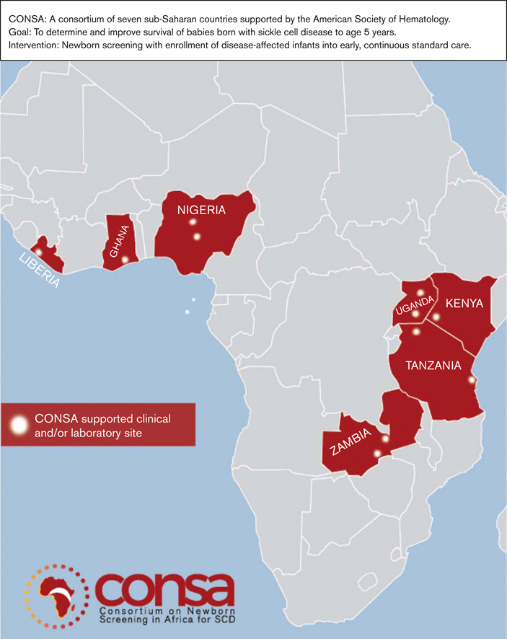
International collaborations
1st Pan African Workshop on Newborn Screening June 2019
150 attendees from 20 countries including 11 African nations
Consortium of Newborn Screening in Africa (CONSA) 2021
Study involving 7 African countries supported by American Society of Hematology and other organisations
Seek to demonstrate the benefits of hemoglobinopathy newborn screening and early clinical interventions for babies diagnosed with SCD
Confirmatory dx, treatment and counselling provided
Last workshop June 2025 – appeal to include CH to SCD screening
Notes:
high incidence of SCD in sub-Saharan Africa and its devastating clinical outcomes, as evidenced by high morbidity and mortality in the region, has largely informed the intervention of the Consortium of Newborn Screening in Africa and other non-governmental organisations, and has also attracted the attention of the WHO
At the last workshop held on 04 June 2025 in Abuja, jointly organised by Revvity and the Newborn Screening Consortium Nigeria, an NBS entity based in Nigeria appealed to the Consortium of Newborn Screening in Africa to add congenital hypothyroidism to SCD screening. The workshop was a side event to the 5th Global Congress on SCD, which was held in Abuja on 03 June 2025–06 June 2025
general consensus that the greatest barrier to the long-term success of NBS programmes resulted from their incomplete adoption into routine health systems

Slide 33
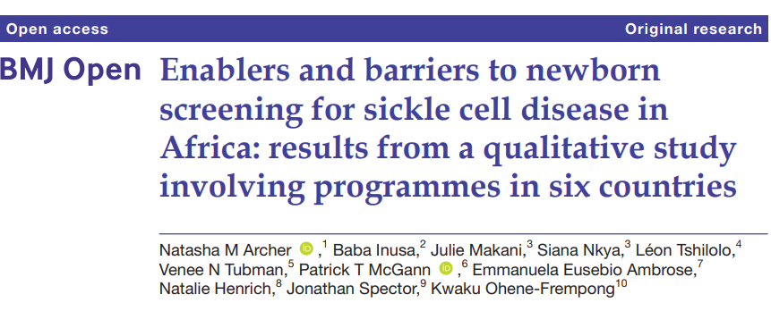
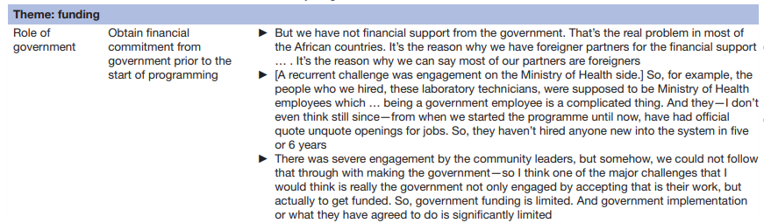
Enablers and Barriers
Programmes for SCD are feasible and can be successfully implemented
BUT feasibility ≠ sustainability
Greatest barrier = incomplete adoption into routine health systems due to lack of political will (funding and governance)
Notes:
A main and crucial finding of this study was confirmation that NBS programmes for SCD are feasible to successfully implement in Africa, as evidenced by the large numbers of babies screened (eg, tens of thousands) and the long duration of screening (eg, more than 25 years) that was demonstrated in some programmes. Nevertheless, a consistent narrative emerged that feasibility did not ensure sustainability
Technical or workflow issues were never the primary challenge; rather, there was general consensus that the greatest barrier to the long-term success of NBS programmes resulted from their incomplete adoption into routine health systems.
This was attributed mostly to inter-related aspects of governance (in particular, government involvement) and funding.
Government commitment was recognised by all interviewees as an essential element of success, and government entities routinely played important roles in the design and implementation of programmes. Even so, in none of the programmes was the government the primary driver behind programme inception and, as a result, several programmes innovatively sought and applied external resources (eg, grants or philanthropy) in order to initiate NBS with the hope that demonstrated success would provide evidence that governments could use to rationalise investing in NBS programmes. While that logic stands to reason, unfortunately, none of the programmes have been fully integrated widely into public health systems despite all six of the programmes having achieved operational success in different ways.
Another finding was the high degree of effort and dedication on the part of teams of SCD clinicians and advocates that was required to establish NBS programmes. Planning routinely took a year or longer before screening started, during which time many team members worked without extra compensation and in addition to an already full workload
Archer NM, Inusa B, Makani J, et al. Enablers and barriers to newborn screening for sickle cell disease in Africa: results from a qualitative study involving programmes in six countries. BMJ Open 2022;12:e057623. doi:10.1136/ bmjopen-2021-057623

Slide 34
How do we address these challenges?

Slide 35
Lessons from the Philippines
Philippines
LMIC
Archipelago of >7600 islands
110 ethnolinguistic groups
Population 110million
1.8million births annually
Pilot project 1996
24 hospitals
5/6 conditions
No funding – small fee for service $9
2000 – 153 hospitals (114 outside main metropole)
How did they succeed?
Initial partnership with Australian lab
Set up own local resources
Technical guidance from University
Administrative orders from DOH
Inclusion Child Health 2025 Plan
Presidential proclamation
2004 – legislature (National screening act)
2006 – covered by national health insurance as a newborn benefit
2015 - ENBS – 28 conditions – initial fee for pay till 2018
7400 facilities – >90% screening
Notes:
Technical guidance from the University of the Philippines Manila, various supporting administrative orders from the Department of Health (DOH), inclusion of NBS in the DOH Child Health 2025 plan, and a Philippine Presidential proclamation in 2003 were some of the key elements contributing to successful adoption of the National Screening Act of 2004 (Republic Act No. 9288), which required that NBS be offered to all newborns [3,5,6]. In 2006, the fee for the 5-condition NBS panel in place at the time was included as a newborn health benefit by national health insurance (PhilHealth). Combined, the law and national insurance significantly improved national NBS coverage
The prevalence of five screening conditions—congenital hypothyroidism (CH), congenital adrenal hyperplasia (CAH), galactosemia (GAL), phenylketonuria (PKU), and homocystinuria (HCY), supported the adoption of NBS across the Philippines [5]. NBS coverage gradually expanded across the country until today, where over 7400 newborn screening facilities (NSFs), i.e., birthing centers, submit NBS screening specimens covering over 90% of all Philippine newborns

Slide 36
What lessons can we learn/ how do we change
Prevention of mother to child transmission (PMCT) programmes
Successful follow-up of newborns
DBS for HIV screening during immunisation schedules
Piggy-back to include NBS for other conditions
Digital applications can be introduced to aid with Follow-up
Need to build local capacity
Need political will/support from local government
Legislation
Affordable methodologies/techniques e.g. paper chromatography
Awareness campaigns and staffing
Notes:
The existing infrastructure and resources of the impactful HIV/AIDS and immunisation programmes should provide the platform to launch and integrate NBS initiatives in African countries. A good example is dried blood spot sampling for HIV screening performed during the immunisation schedules, which can be expanded to screen for other congenital disorders
The success of the NBS is dependent on the programmes being fully incorporated into the routine health system processes, which may be hard to achieve.
The NBS initiatives need to be structured to enable maximal follow-up of the neonates and families for confirmatory testing and initiation of treatment.
Digital applications were introduced in Ghana to conveniently manage the SCD NBS data on the healthcare workers’ mobile phones, which also facilitates follow-ups. It is worth noting that Ghana and Morocco have been successful in sustaining one of the longest running NBS programmes in Africa.^{9,12}
This success has been attributed to the considerable commitment and support from the local government in the building of local capacity.
However, because of a lack of awareness and paucity of sophisticated equipment such as the tandem mass spectrometry in most African states, NBS for IEMs is close to non-existent in Africa, unlike in the developed nations.
An article by Anetor, Orimadegun, and Anetor¹⁴ is insightful in raising awareness of affordable and readily available techniques to pragmatically screen for IEMs in resource-limited settings. Additionally, the dried blood spot should be encouraged, as it can be stored and revisited as the NBS programme expands.
Likewise, point-of-care testing in the forms of paper chromatography and haemoglobin isoform-specific antibodies in a lateral flow platform are cost-effective and user-friendly alternative methods of screening of SCD in remote areas.
We can also draw lessons from other developing countries, such as the Philippines, to gain the encouragement required to implement a sustainable NBS programme. The implementation of universal NBS in Africa will require partnerships and collaborative efforts from key stakeholders to overcome the challenges and for the governments to legislate the NBS policy to combat infant morbidity and mortality on the African continent.
Satekge T, Okesina A, Anetor J, Erasmus R. The status of newborn screening in Africa: Situation analysis, future plans and call to action. Afr J Lab Med. 2025;14(1), a2973. https://doi.org/10.4102/ajlm.v14i1.2973

Slide 37
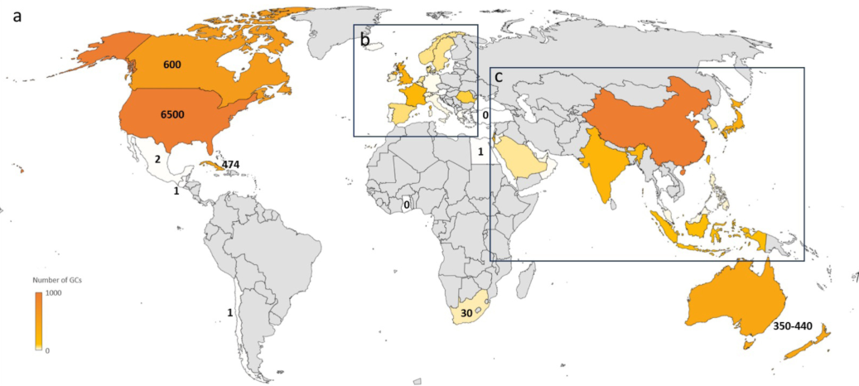
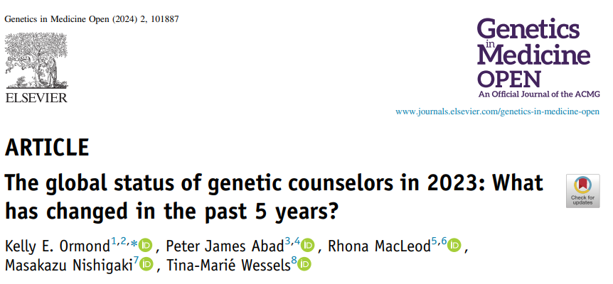
Notes:
Ormond, Kelly E. et al. (2024) The global status of genetic counselors in 2023: What has changed in the past 5 years? Genetics in Medicine Open, Volume 2, 101887

Slide 38

African Genetic Counsellors Association (AGCA)
Inaugural meeting and launch
9 October 2025
https://africangcassociation.org/

Slide 39
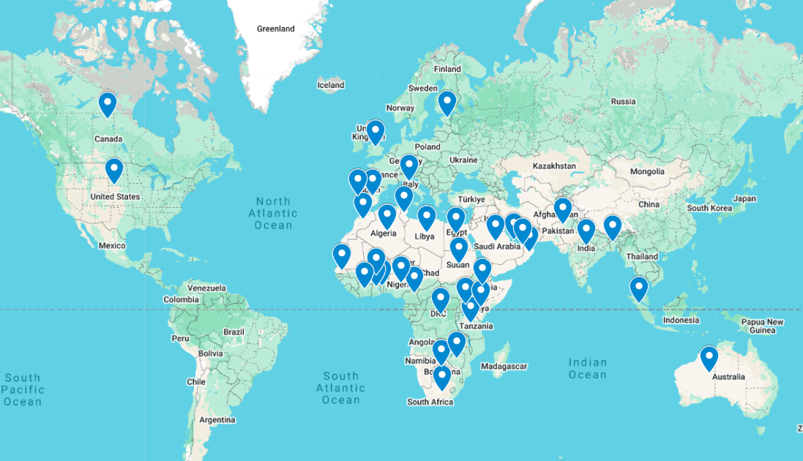
Attendees Map
Notes:
As of end Monday we had 241 registrants from all over the world.
From as far as USA to Australia, Estonia, Europe, middle east as well as Asia.

Slide 40
Mission statement
The African Genetic Counsellors Association is committed to promoting and upholding genetic counselling of international standards.
Through collaboration, education, and advocacy, we aim to raise awareness about the importance of genetic counselling and advocate for the expansion of the field in Africa and the regulation of its practice.
Through this we aim to seamlessly integrate genetic counselling into healthcare systems, ensuring informed decision-making and improved health outcomes for all.
Our goal is to cross borders to link genetic counsellors and likeminded healthcare professionals across Africa to build a resourceful and professional community that will aid in advancing the field to meet the evolving needs of our diverse populations and contributing to the global dialogue on genetics and healthcare.

Slide 41
Objectives
Increase awareness of genetic counselling and genetic counsellors in Africa.
Create relationships amongst all Genetic Counsellors in Africa.
Provide guidance and support structures for healthcare professionals providing genetic counselling services.
Foster active dialogue of relevant topics that impact genetic counselling – human genetics, genetic testing, bioethics, funding.
Explore methods to overcome barriers that hinder genetic counselling services in Africa.
Perform ongoing research on important topics in the field of genetic counselling.
Advocate for policy changes that support the integration, accessibility and creation of genetic counsellors in Africa.
Perform high-level advocacy for the recognition, regulation and funding of genetic counsellors in Africa
Provide training opportunities and support for capacity building in the field of genetic counselling, including the training of other healthcare providers.
Advocate for patients.
Strive towards the development of qualified genetic counsellors in Africa.

Slide 42
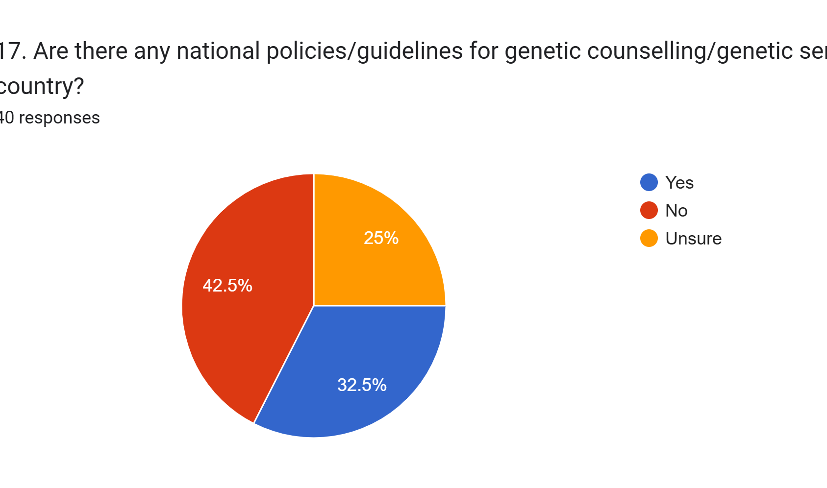
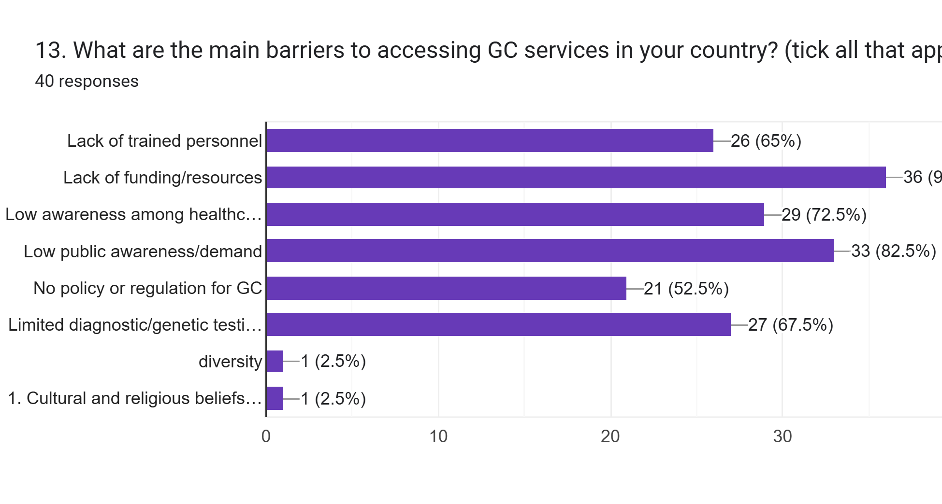

Slide 43
Thank you

Slide 44
References
Does newborn screening save money? The difference between cost-effective and cost-saving interventions. Grosse, Scott D. The Journal of Pediatrics, Volume 146, Issue 2, 168 - 170
Congenital Hypothyroidism - StatPearls - NCBI Bookshelf
Foil, K., Christon, L., Kerrigan, C. et al. Experiences of cystic fibrosis newbornscreening and genetic counseling. J Community Genet 14, 621–626 (2023).https://doi.org/10.1007/s12687-023-00666-8
Hricovec, M., Gaviglio, A., Mealwitz, C., Merrill, M., & Goldenberg, A. J. (2025). A QualitativeStudy on Parental Experiences with Genetic Counseling After a Positive Newborn Screen forRecently Added Conditions on the Recommended Uniform Screening Panel(RUSP). International Journal of Neonatal Screening, 11(4), 101.https://doi.org/10.3390/ijns11040101
Kelly N, Makarem DC, Wasserstein MP. Screening of Newborns for Disorders with High Benefit-Risk Ratios Should Be Mandatory. J Law Med Ethics. 2016 Jun;44(2):231-40. doi: 10.1177/1073110516654133. PMID: 27338599; PMCID: PMC5381153.
Nicholls, S. G., Wilson, B. J., Etchegary, H., Brehaut, J. C., Potter, B. K., Hayeems, R., … Carroll, J. C. (2014). Benefits and Burdens of Newborn Screening: Public Understanding and Decision-Making. Personalized Medicine, 11(6), 593–607. https://doi.org/10.2217/pme.14.46
Malherbe HL, Bonham J, Carrihill M, Chetty K, Conradie EH, Dercksen M, Goeiman H, Gomes MCM, Klopper B, McKerrow N, Padilla C, Pillay TS, Roussot B, Satekge TM, Urban M, van derWatt G, Vreede H, Webster D, Zampoli M, Vorster BC. Newborn screening in South Africa: the past, present, and plans for the future. Rare Dis Orphan Drugs J. 2024;3:7. http://dx.doi.org/10.20517/rdodj.2023.49
A Capacity Audit of Medical Geneticists and Genetic Counsellors in South Africa, 2024: A National Crisis. Marianne C. M. Gomes 1,*,†, Byron J. Gomes 2, Arnold L. Christianson 3,‡, Claude Bailly 4, Neil McKerrow 5,6 and Helen L. Malherbe. Genes 2024, 15, 1173. https://doi.org/10.3390/genes15091173
Hoskovec, J.M., Bennett, R.L., Carey, M.E. et al. Projecting the Supply and Demand for Certified Genetic Counselors: a Workforce Study. J Genet Counsel 27, 16–20 (2018). https://doi.org/10.1007/s10897-017-0158-8
a2973. https://doi.org/10.4102/ajlm.v14i1.2973
Therrell BL, Padilla CD, Borrajo GJC, Khneisser I, Schielen PCJI, Knight-Madden J, Malherbe HL, Kase M. Current Status of Newborn Bloodspot Screening Worldwide 2024: A Comprehensive Review of Recent Activities (2020-2023). Int J Neonatal Screen. 2024 May 23;10(2):38. doi: 10.3390/ijns10020038. PMID: 38920845; PMCID: PMC11203842.
Therrell BL Jr, Lloyd-Puryear MA, Ohene-Frempong K, Ware RE, Padilla CD, Ambrose EE, Barkat A, Ghazal H, Kiyaga C, Mvalo T, Nnodu O, Ouldim K, Rahimy MC, Santos B, Tshilolo L, Yusuf C, Zarbalian G, Watson MS; faculty and speakers at the First Pan African Workshop on Newborn Screening, Rabat, Morocco, June 12-14, 2019. Empowering newborn screening programs in African countries through establishment of an international collaborative effort. J Community Genet. 2020 Jul;11(3):253-268. doi: 10.1007/s12687-020-00463-7. Epub 2020 May 15. PMID: 32415570; PMCID: PMC7295888.
Green NS, Zapfel A, Nnodu OE, Franklin P, Tubman VN, Chirande L, et al. The consortium on newborn screening in Africa for sickle cell disease: study rationale and methodology. Blood Adv. 2022;6(24):6187–97. pmid:36264096
Satekge T, Okesina A, Anetor J, Erasmus R. The status of newborn screening in Africa: Situation analysis, future plans and call to action. Afr J Lab Med. 2025;14(1),
Archer NM, Inusa B, Makani J, et al. Enablers and barriers to newborn screening for sickle cell disease in Africa: results from a qualitative study involving programmes in six countries. BMJ Open 2022;12:e057623. doi:10.1136/ bmjopen-2021-057623
Padilla CD, Therrell BL Jr, Alcausin MMLB, Chiong MAD, Abacan MAR, Reyes MEL, Jomento CM, Dizon-Escoreal MTT, Canlas MAE, Abadingo ME, Posecion JEWC, Abarquez CG, Andal AP, Elizaga ALG, Halili-Mendoza BC, Otayza MPVK, Millington DS. Successful Implementation of Expanded Newborn Screening in the Philippines Using Tandem Mass Spectrometry. Int J Neonatal Screen. 2022 Jan 19;8(1):8. doi: 10.3390/ijns8010008. PMID: 35225931; PMCID: PMC8883932.
Padilla CD, Therrell BL Jr, Alcausin MMLB, de Castro RC Jr, Gepte MBP, Reyes MEL, Jomento CM, Suarez RCN, Maceda EBG, Abarquez CG, Posecion JEWC, Andal AP, Elizaga ALG, Halili-Mendoza BC, Otayza MPVK, Hoppe CC. Successful Implementation of Newborn Screening for Hemoglobin Disorders in the Philippines. Int J Neonatal Screen. 2021 Jun 17;7(2):30. doi: 10.3390/ijns7020030. PMID: 34204320; PMCID: PMC8293152.
Ormond, Kelly E. et al. (2024) The global status of genetic counselors in 2023: What has changed in the past 5 years? Genetics in Medicine Open, Volume 2, 101887

