Slide 1
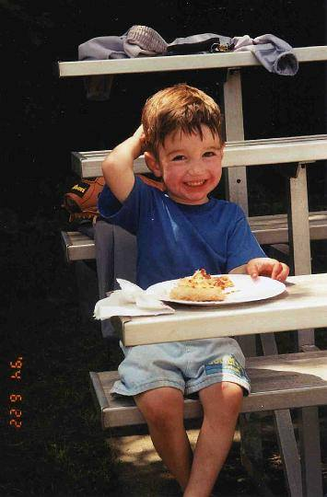

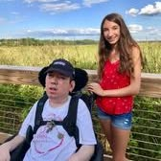

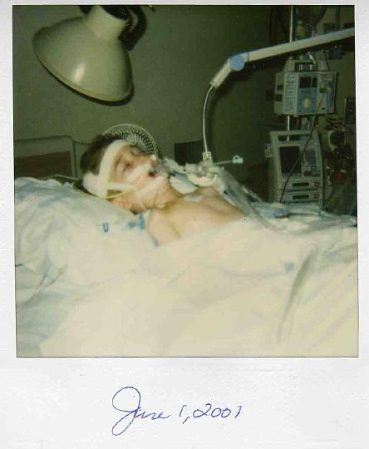

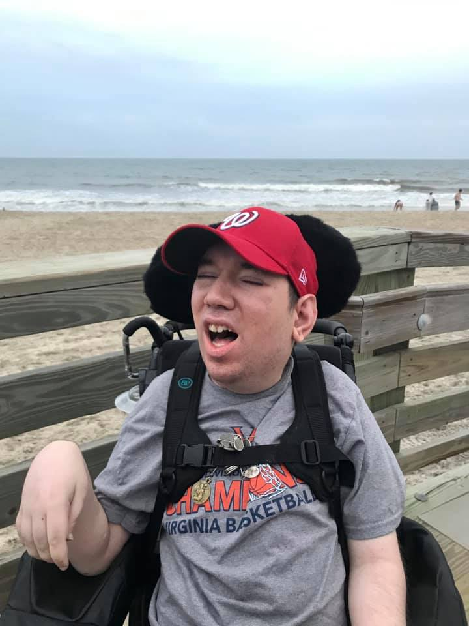
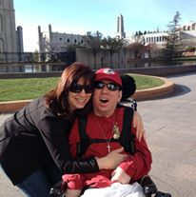
Newborn Screening… a Lifelong Impact

Slide 2
Newborn Screening Matters
•Newborn Screening has been described as one of the greatest public health initiatives giving newborns a healthy start in life.
•Great strides have been made over the years nationally and internationally.
•The HHS Committee created to address NBS and establish the Recommended Screening Panel (RUSP) was pivotal in helping all states to expand their screening programs.
•HHS Committee disbanding in April has been a critical threat to the future of NBS progress.
•NBS has improved globally, but has far to go. Accomplishments have been made. Give Pakistan example and how Stephen’s story has impacted thanks to Brad and others sharing.
•NBS may be initiated in a public, private, or academic healthcare setting, but sustainability of the system requires intersection with, and support of, the public health system as stated in “Current Status of Newborn Bloodspot Screening Worldwide 2024: A Comprehensive Review of Recent Activities” (2020-2023)

Slide 3
Jana Monaco
Rare Action Network, Volunteer Virginia Ambassador
Organic Acidemia, Advocacy Liaison
Jana.Monaco@rareaction.org
Newborn Screening News Story
https://wjla.com/news/local/newborn-screenings-hhs-us-health-human-services-baby-diseases-tests-birth-metachromatic-leukodystrophy-mld-duchenne-muscular-dystrophy-dnd-recommended-uniform-screening-panel-trump-cuts?trk=feed-detail_main-feed-card_feed-article-content&fbclid=IwY2xjawNh-mpleHRuA2FlbQIxMQABHq2mk6E3BEwfCB9sNIQgdKhwsh4EgbEXsxtdIGID7XSbO8stpp_jaC_oX0Tt_aem_jwnOoQTHIZup-OT-JH10-g
Thank you!

