Slide 1
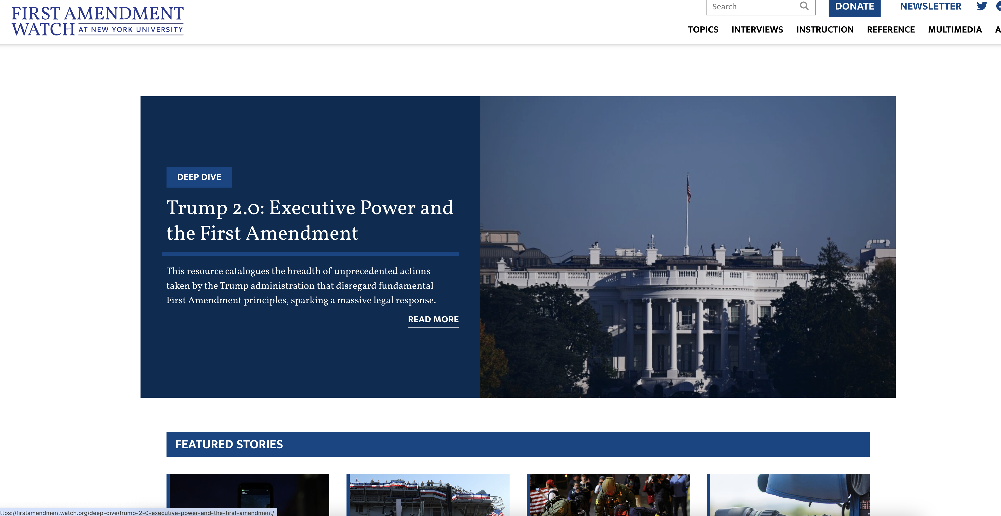

Slide 2

Recording the Police and Other Government Officials
Stephen D. Solomon, Marjorie Deane Professor of Journalism; Founding Editor, NYU’s First Amendment Watch; author of Revolutionary Dissent: How the Founding Generation Created the Freedom of Speech
Notes:
Or change title to match conference title

Slide 3
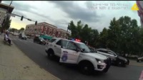
Susan Greene and the Denver PD

Slide 4
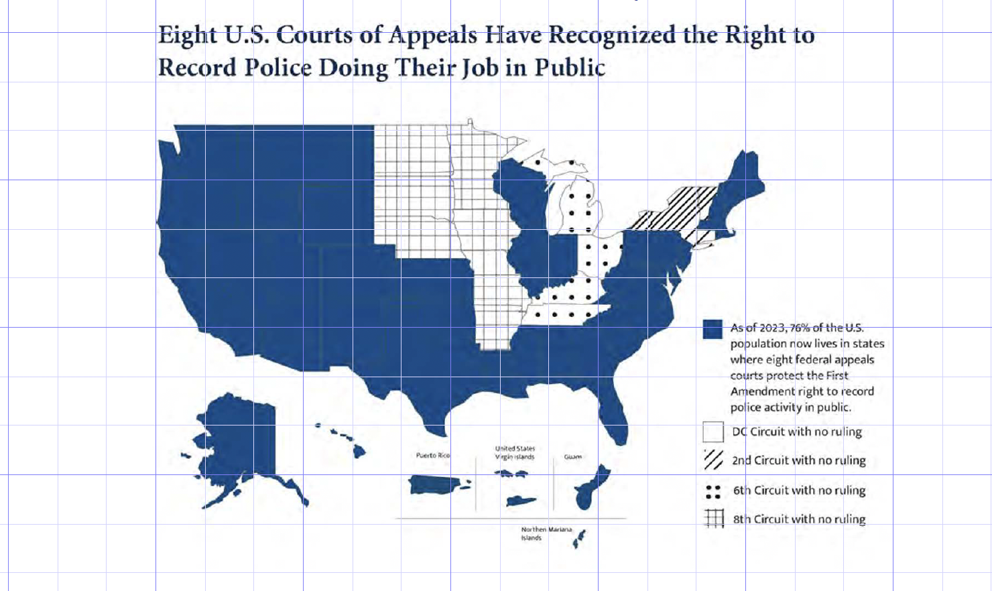
Recording Police: First Amendment Protections

Slide 5
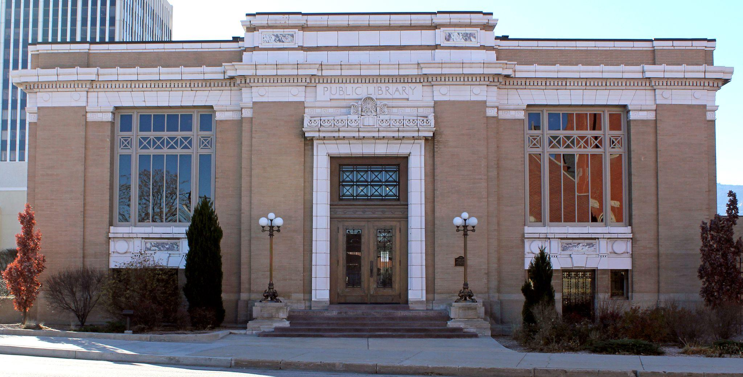
What Constitutes a Public Forum?

Slide 6
Traditional Public Forums
Areas such as streets, sidewalks, and parks that have a history of dedication to political speech.
Public officials may not discriminate against people using a public forum based on their viewpoint, but can impose reasonable regulations relating to the time, place and manner of speech.

Slide 7
 | Traditional Public Forum | Limited/Designated Public Forum | Nonpublic Forum
Examples | Streets, sidewalks and parks that have a history of dedication to political speech | Government property that has been opened up for expressive activities | Government-owned properties such as jails, airport terminals, and military bases.
Level of scrutiny | Strict scrutiny (must meet a compelling state interest and must be narrowly tailored to achieve that interest) | Strict scrutiny (must meet a compelling state interest and must be narrowly tailored to achieve that interest) | Rational basis (regulations imposed by the government must be merely reasonable–not compelling–and must not discriminate based on viewpoint)

Slide 8
Public Forum: Streets “immemorially held in trust”
“Wherever the title of streets and parks may rest, they have immemorially been held in trust for the use of the public and, time out of mind, have been used for purposes of assembly, communicating thoughts between citizens, and discussing public questions. Such use of the streets and public places has, from ancient times, been a part of the privileges, immunities, rights, and liberties of citizens.”
Hague v. C.I.O. (1939)

Slide 9
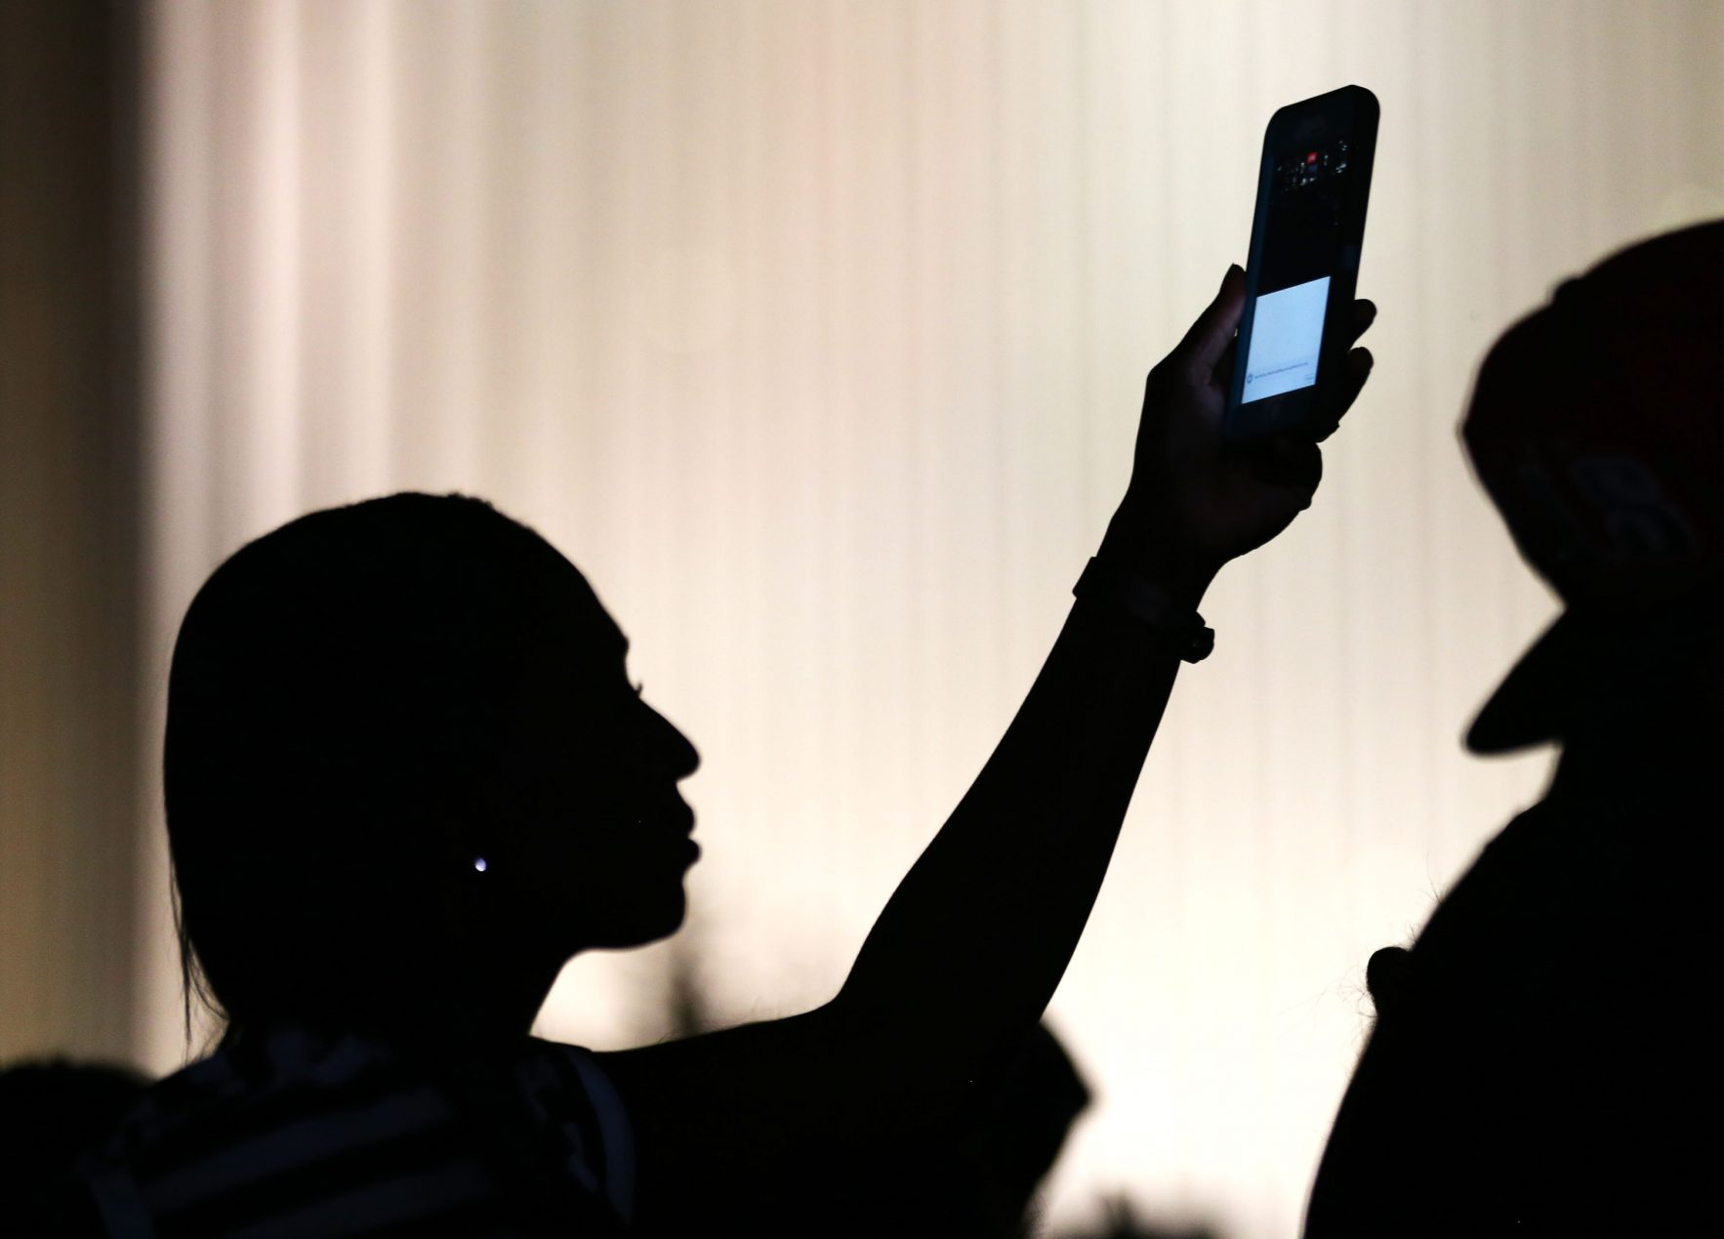
Reasons for First Amendment Protection

Slide 10
Protects Stock of Information from Which Public May Draw:
As the Supreme Court has observed, “the First Amendment goes beyond protection of the press and the self-expression of individuals to prohibit government from limiting the stock of information from which members of the public may draw.” First Nat'l Bank v. Bellotti, 435 U.S. 765, 783, 98 S.Ct. 1407, 55 L.Ed.2d 707 (1978)
Glik v. Cunniffe, 1st Circuit, 2011

Slide 11
Promotes Free Discussion of Government Affairs
“There is practically universal agreement that a major purpose of the First Amendment was to protect the free discussion of governmental affairs.”
Mills v. Alabama (1966)

Slide 12
Core First Amendment Interest in Aiding Citizens Uncover Abuses and Misconduct:
Ensuring the public's right to gather information about their officials not only aids in the uncovering of abuses, but also may have a salutary effect on the functioning of government more generally, see Press-Enter. Co. v. Superior Court, 478 U.S. 1, 8, 106 S.Ct. 2735, 92 L.Ed.2d 1 (1986) (noting that "many governmental processes operate best under public scrutiny").

Slide 13
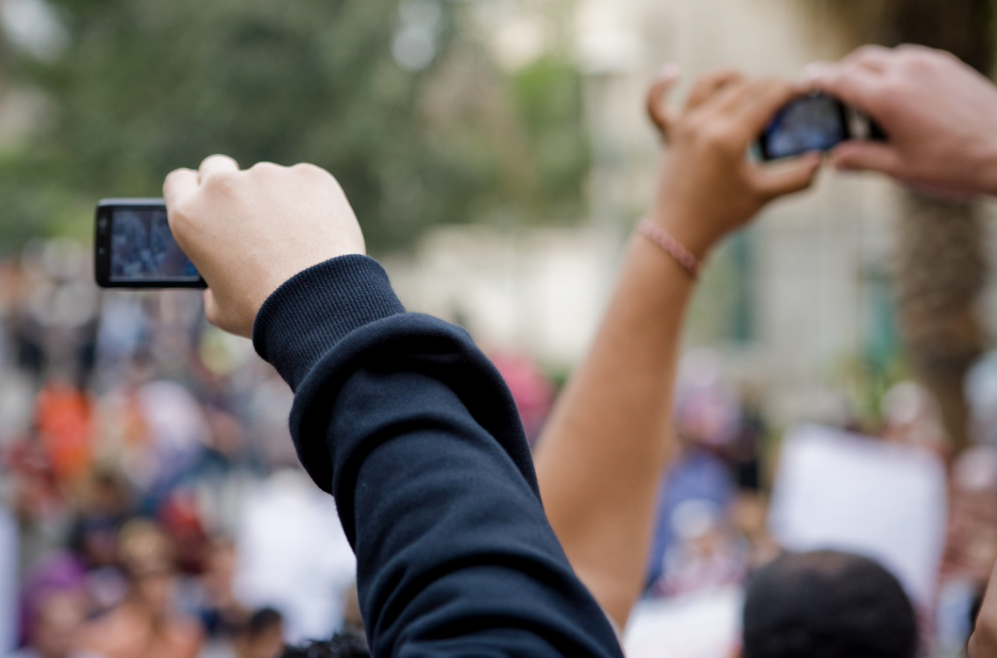
Creation of Content:
The Picasso Problem
Isn’t recording an action? How is video recording a form of speech?
Hossam el-Hamalawy, Flickr

Slide 14
The Picasso Problem
Courts recognize that the recording of video and audio is closely intertwined with the eventual dissemination of the information. Use of recording technology enables protected speech to occur, and thus the First Amendment must shield both.

Slide 15
There is No Fixed First Amendment Line Between the Act of Creating Speech and the Speech Itself:
“The process of expression through a medium has never been thought so distinct from the expression itself that we could disaggregate Picasso from his brushes and canvas, or that we could value Beethoven without the benefit of strings and woodwinds. In other words, we have never seriously questioned that the processes of writing words down on paper, painting a picture, and playing an instrument are purely expressive activities entitled to full First Amendment protection.”
Anderson v. City of Hermosa Beach (9th Cir. 2010)

Slide 16
Do Bystanders Have the Same Rights as Journalists?

Slide 17
The Lonely Pamphleteer
The Supreme Court has recognized that “liberty of the press is the right of the lonely pamphleteer who uses carbon paper or a mimeograph just as much as of the large metropolitan publisher who utilizes the latest photocomposition methods.” It is a "fundamental personal right" which "is not confined to newspapers and periodicals. It necessarily embraces pamphlets and leaflets. . . . The press in its historic connotation comprehends every sort of publication which affords a vehicle of information and opinion."
Lovell v. Griffin, 303 U. S. 444, 450, 452 (1938)

Slide 18
Advances in Technology Make Distinctions Between Journalists and Bystanders Difficult to Draw
“The proliferation of electronic devices with video-recording capability means that many of our images of current events come from bystanders with a ready cell phone or digital camera rather than a traditional film crew, and news stories are now just as likely to be broken by a blogger at her computer as a reporter at a major newspaper. Such developments make clear why the news-gathering protections of the First Amendment cannot turn on professional credentials or status.”
Glik v. Cunniffe, 1st Circuit, 2011

Slide 19
Time, Place, and Manner Regulations

Slide 20
Three-Prong Test
To survive constitutional scrutiny, time, place, and manner restrictions must satisfy a three-prong test:
The regulation must be content neutral.
It must be narrowly tailored to serve a significant governmental interest.
It must leave open ample alternative channels for communicating the speaker’s message.

Slide 21
Time, Place, and Manner Regulations
What actions by a videographer might violate reasonable time, place, and manner regulations?

Slide 22
Time, Place, and Manner Regulations
“It goes without saying that the police may take all reasonable steps to maintain safety and control, secure crime scenes and accident sites, and protect the integrity and confidentiality of investigations. While an officer surely cannot issue a ‘move on’ order to a person because he is recording, the police may order bystanders to disperse for reasons related to public safety and order and other legitimate law-enforcement needs.”
ACLU v. Alvarez (7th Cir. 2012)

Slide 23
Actions That May Violate Time, Place, and Manner Regulations
Direct interference with police activity, such as standing in the way of police, witnesses, emergency responders, etc.
Actions that affect the safety of officers, witnesses, victims, third parties.
Blocking traffic.
Blocking building entrances.
Hindering movement of pedestrians.
Entering a marked-off crime scene.

Slide 24
Wiretapping Statutes
Federal appeals courts have ruled that recording police in the line of duty does not violate eavesdropping and wiretapping laws.
The state’s interest in protecting private conversations “is not implicated when police officers are performing their duties in public places and engaging in public communications audible to persons who witness the events.”
ACLU v. Alvarez, 7th Circuit, 2012

Slide 25
Verbal Criticism of Police Officers
“The First Amendment protects a significant amount of verbal criticism and challenge directed at police officers.”
The freedom of individuals to verbally oppose or challenge police action without thereby risking arrest is one of the principle characteristics by which we distinguish a free nation from a police state.”
City of Houston v. Hill (1987)

Slide 26
Case Studies

Slide 27
The Case of Susan Greene and the Denver Police
Was she engaged in a traditional public forum?
Did police officers apply reasonable time, place and manner restrictions? If so, what were their considerations?
Notes:
Should we delete since we open with this?

Slide 28
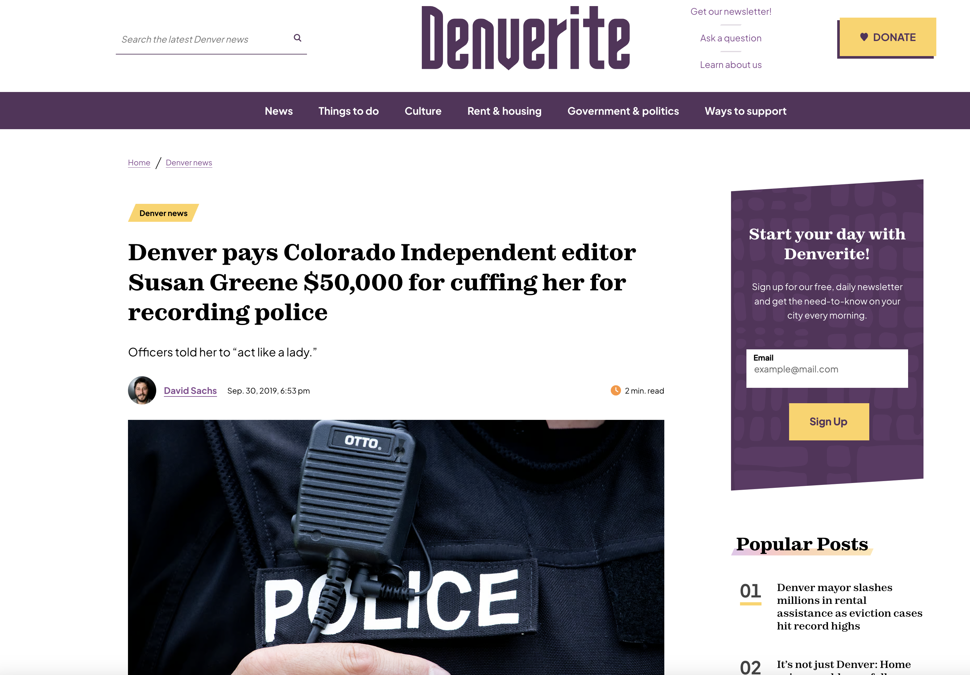

Slide 29
Fields v. Philadelphia (U.S. Third Circuit, 2017)
“Defendants offer nothing to justify their actions. Fields took a photograph across the street from where the police were breaking up a party. Geraci moved to a vantage point where she could record a protestor’s arrest, but did so without getting in the officers’ way. If a person’s recording interferes with police activity, that activity might not be protected. For instance, recording a police conversation with a confidential informant may interfere with an investigation and put a life at stake. But here there are no countervailing concerns.”

Slide 30
The Plight of Simon Glik
A judicial law clerk, Glik was walking through Boston Commons, a public park, when he saw several officers treating an African-American man harshly.
Glik took out his cell phone and recorded the incident.
The officers did not like this and ended up arresting Glik.
After the charges were dropped, Glik filed a civil rights lawsuit.

Slide 31
Glik v. Cunniffe (U.S. First Circuit, 2011
“Gathering information about government officials in a form that can readily be disseminated to others serves a cardinal First Amendment interest in protecting and promoting the free discussion of governmental affairs.”

Slide 32
Glik v. Cunniffe (U.S First Circuit, 2011)
The First Circuit emphasized the peaceful nature of Glik’s conduct and the fact that he did not interfere with the officers’ exercise of their duties.

Slide 33
Glik v. Cunniffe (U.S. First Circuit, 2011)
“Glik filmed the defendant police officers in the Boston Common, the oldest city park in the United States and the apotheosis of a public forum. In such traditional public spaces, the rights of the state to limit the exercise of First Amendment activity are "sharply circumscribed." Perry Educ. Ass'n v. Perry Local Educators' Ass'n, 460 U.S. 37, 45 (1983). Moreover, as in Iacobucci, the complaint indicates that Glik "filmed [the officers] from a comfortable remove" and "neither spoke to nor molested them in any way" (except in directly responding to the officers when they addressed him). 193 F.3d at 25. Such peaceful recording of an arrest in a public space that does not interfere with the police officers' performance of their duties is not reasonably subject to limitation.”

Slide 34
The Case of Kevin Ray Bradley
On Jan. 25, 2018, Kevin Ray Bradley entered the lobby of the Williamsport Bureau Police Department and started filming with his cell phone. In the lobby was a sign that read: “Recording, taping, photographing strictly prohibited.”
Bradley, however, insisted that he had a right to film police officers in their own lobby.

Slide 35
Bradley (continued)
McGee, a police corporal, asked Bradley several times to stop filming, but he did not comply. When McGee attempted to take the phone, Bradley pulled away. Several officers assisted McGee and took Bradley into custody, arresting him for the offense of defiant trespass.
A court sentenced him to a year of probation. His conviction was affirmed on appeal.

Slide 36
Commonwealth of Pennsylvania v. Bradley (Superior Court of Pennsylvania, 2020)
“Among other things, the no-filming condition ensures the integrity of police investigations and activity,” the court wrote. “The condition applies only to the Lobby and the interior of the police station, and not to areas outside of the police station, such as steps or entrances.”

Slide 37
Bradley (continued)
The Pennsylvania court said that the no-filming rule in the lobby was important to protect confidential information that the police might talk about, protect confidential informants, protect the identity of undercover police officers, and protect the privacy of crime victims.
The court reasoned that the no-filming condition was a reasonable time, place, and manner restriction on speech.

