Slide 1

AI in Business, Small Business and Local Journalism Balaji Padmanabhan Associate Dean for Strategic Initiatives Director, Center for AI in Business Dean’s Professor of Decision, Operations & Information Technologies Robert H. Smith School of Business University of Maryland bpadmana@umd.edu

Slide 2


Slide 3
Magic is a bad metaphor for Artificial Intelligence!
Or is it?

Slide 4
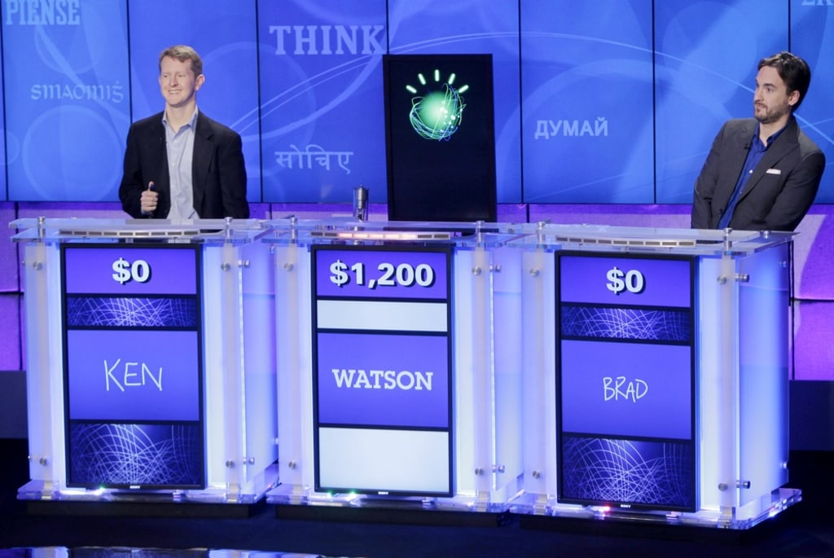

Slide 5
Today’s AI (and Magic)
Can do some amazing things because of brilliant engineering ”under the hood” that makes it seem like magic!

Slide 6
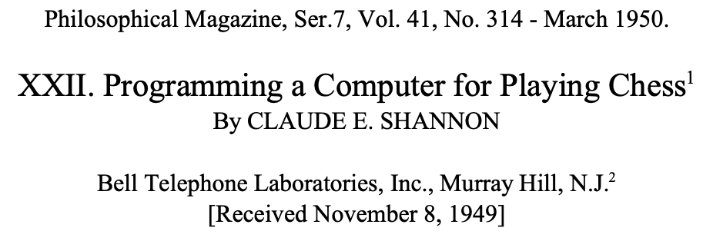
Demonstrating Intelligence: Then

Slide 7
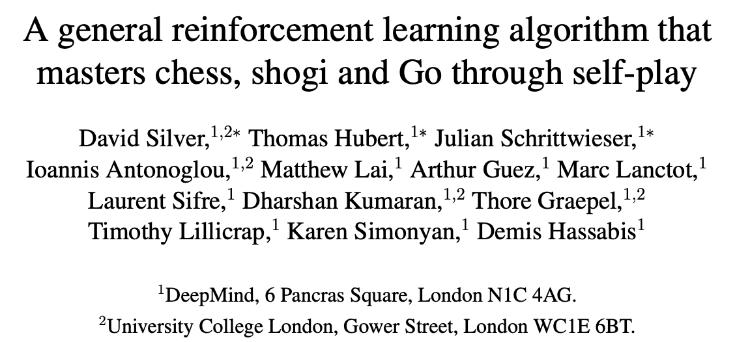
Demonstrating Intelligence: Now

Slide 8
AI: Then and Now
Use-cases look eerily similar, but under the hood it’s night and day
Learning from pre-programmed logic
VS
Learning from continuous, massive data and new learning paradigms

Slide 9
Four Questions that Drove Modern AI
Everything in AI is a number. How do we represent anything as a number?
The concept of “embeddings” learned from news data first by Google
Learning requires lots of “input – output” pairs of information. How do we generate this?
Google translate and the United Nations
Learning also requires “ignoring”, or equivalently, knowing what is important and what is not. How do we train machines to do this?
Google’s ”Attention is All you Need’ paper in 2017
Learning also requires “feedback” – how do we learn from feedback?
Google DeepMind’s work in Reinforcement Learning and AlphaGo

Slide 10
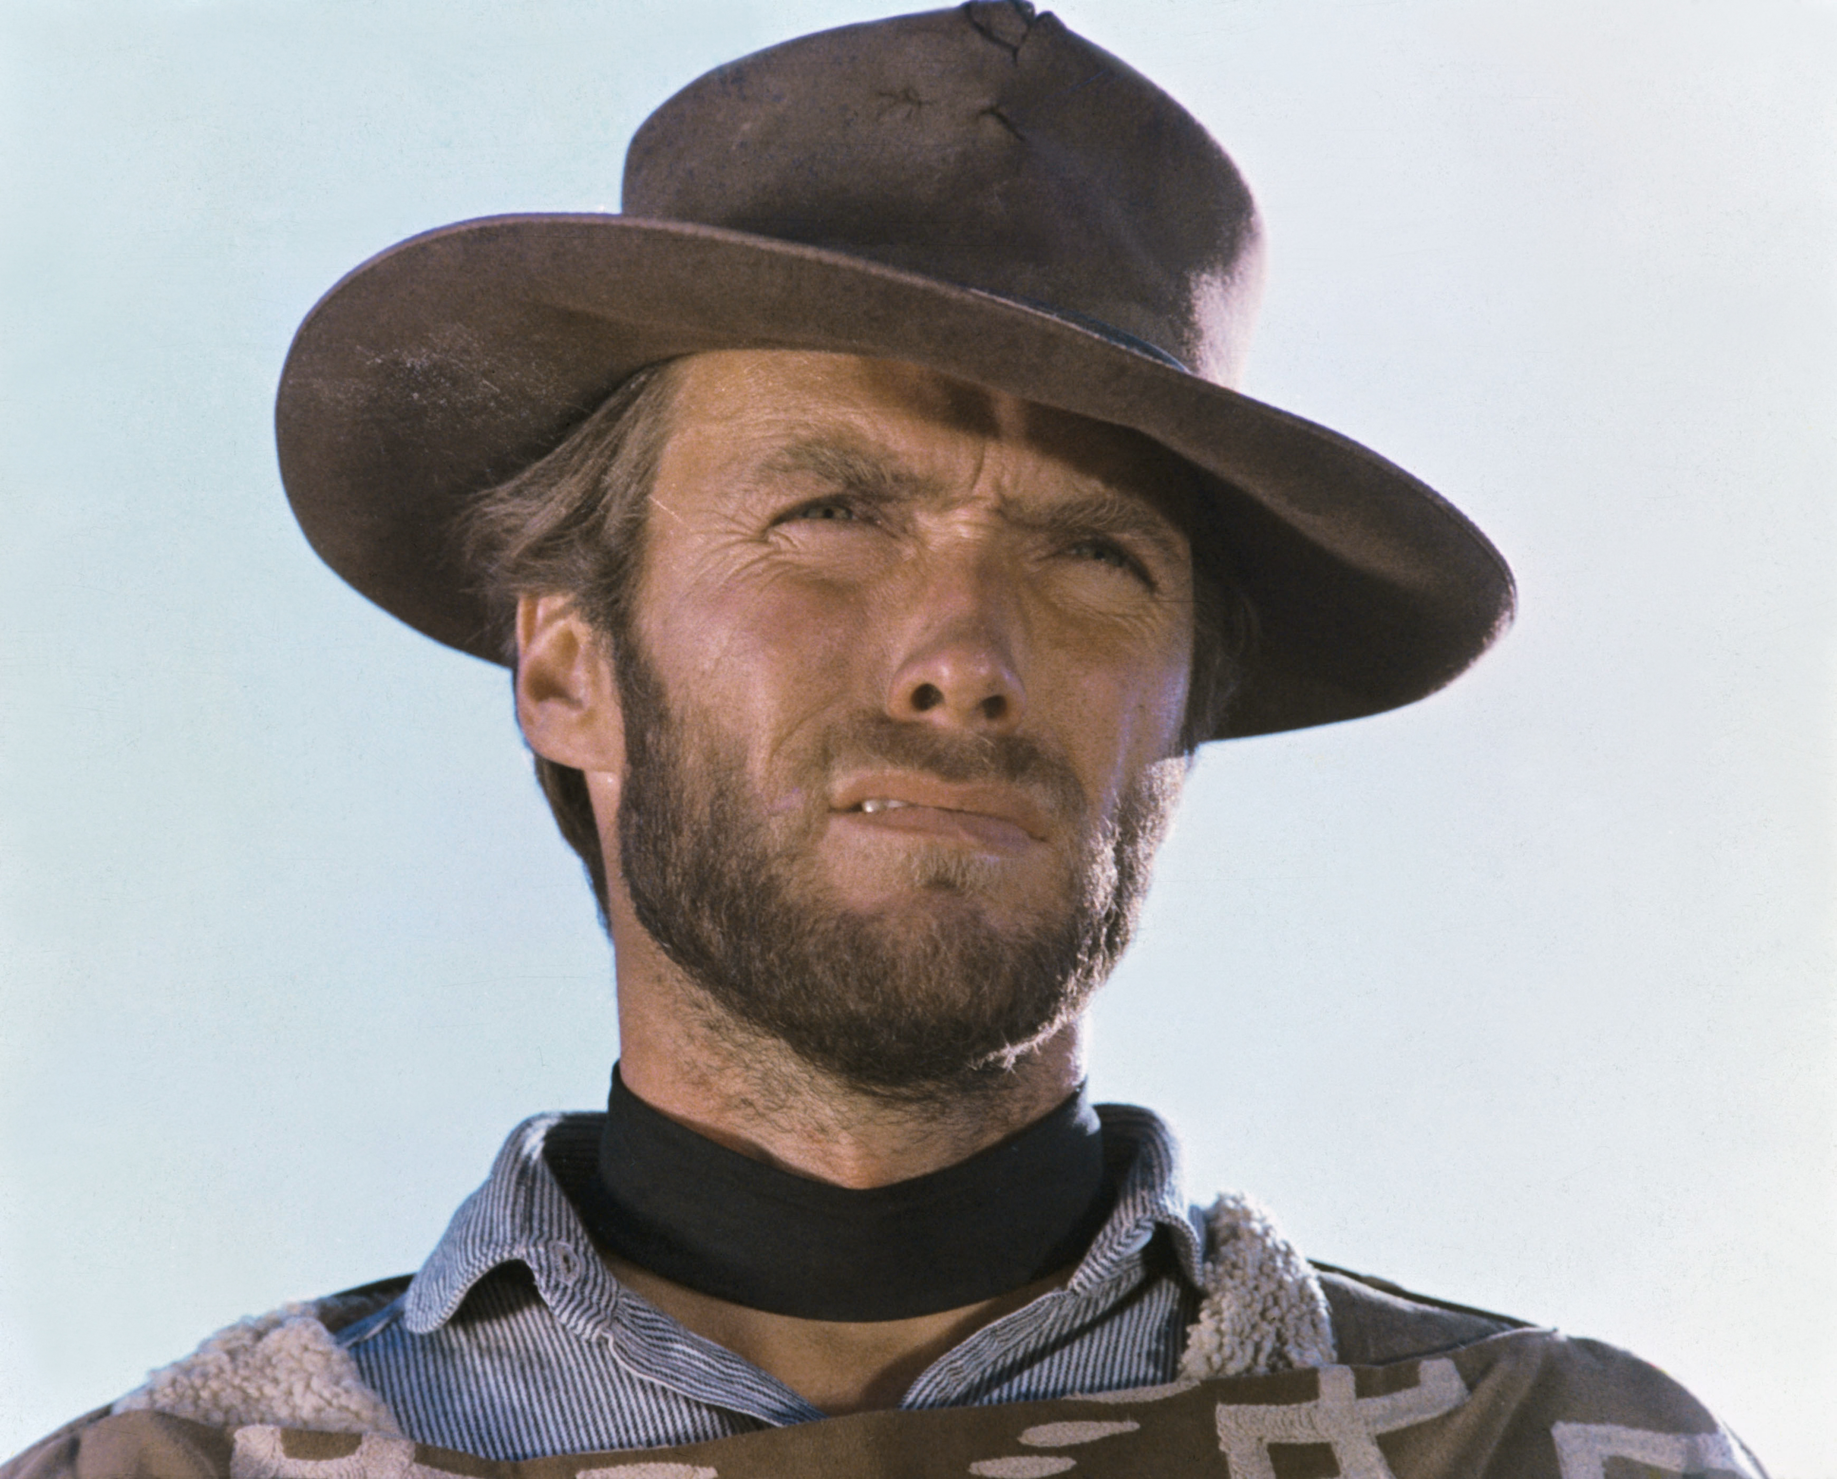
Today’s AI: The Good, The Bad and The Ugly

Slide 11
AI & Humans: Some Thoughts on Two Broad Issues
“AI will be better than humans at most tasks and will replace humans”
Predictive Models are good when the future is like the past
“Edge cases”…
How are today’s AI systems evaluated?
Use-cases don’t reflect on-the-ground business scenarios
AI makes mistakes, even if on average it is better and faster
Humans make mistakes too but…
As long as you have less-than-perfect AI on our tasks we will likely move to augmented scnarios

Slide 12
AI & Humans: Some Thoughts on Two Broad Issues
“Each of us will have our own “superpower in our pockets” in the near future”
This is what we should plan for (and equip our people with!)
What kind of superpowers should we give whom and how?
Finance: Personalized wealth-management recommendations for wealth management advisors
Starting drafts of analyst reports for investment banking analysts
Human Resources: Performance review template with plusses and minuses populated from data
Marketing: Instant, highly targeted and appealing marketing materials
Operations: Daily supply chain reports with recommendations on actions to take
Information Technology: Starting software engineering code base to automate a laborious processes
Accounting: Creating balance sheets and auditing financial filings
Healthcare: Monitoring patient health and alert physicians to take actions

Slide 13
Small Business Use Cases for Generative AI
Talking to customers (AI chatbots)
Checking compliance with (regulatory) requirements
Backoffice support (processing invoices, summarizing management of massive paper trails)
Creating Social Media Campaigns
Creating Apps and Websites with No-Code Solutions
Creating entirely new AI-Human workflows through “Agentic AI” systems

Slide 14
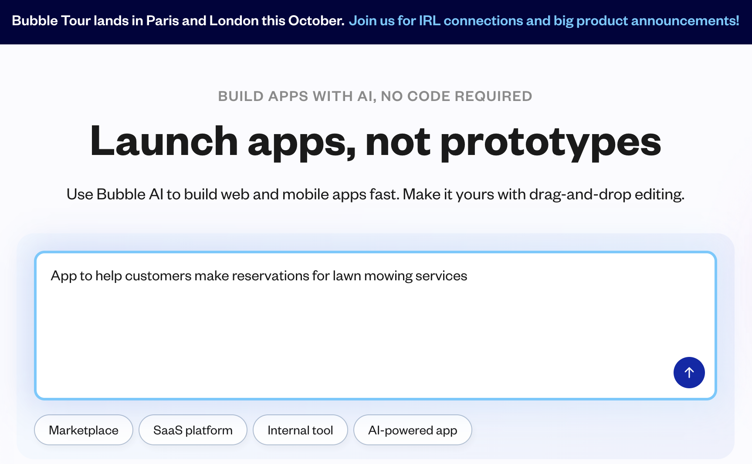
Use “Bubble” to Create Niche Apps

Slide 15
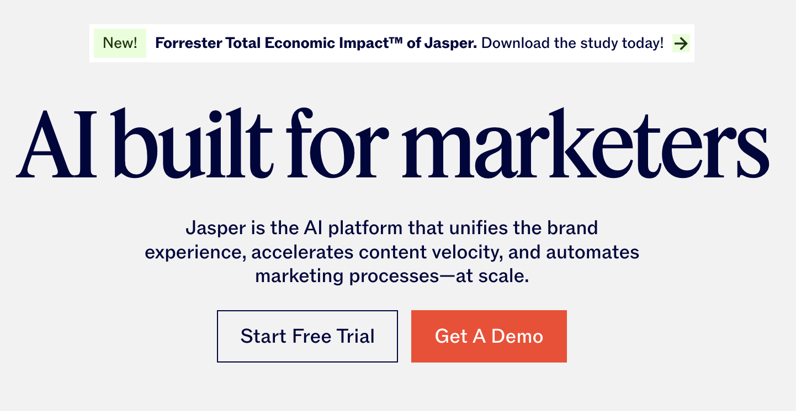
Create Social Media Content with “Jasper”

Slide 16
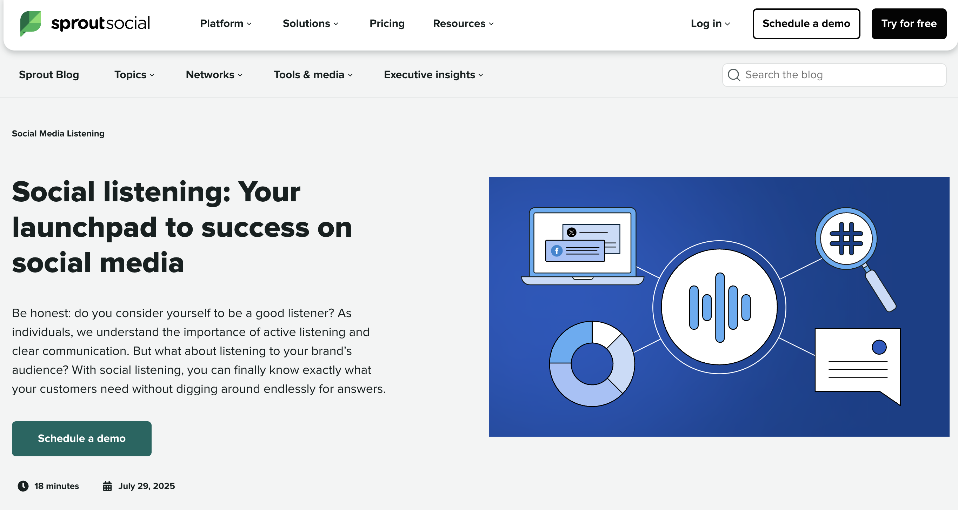
Listen and Respond in Social Media with Sprout

Slide 17
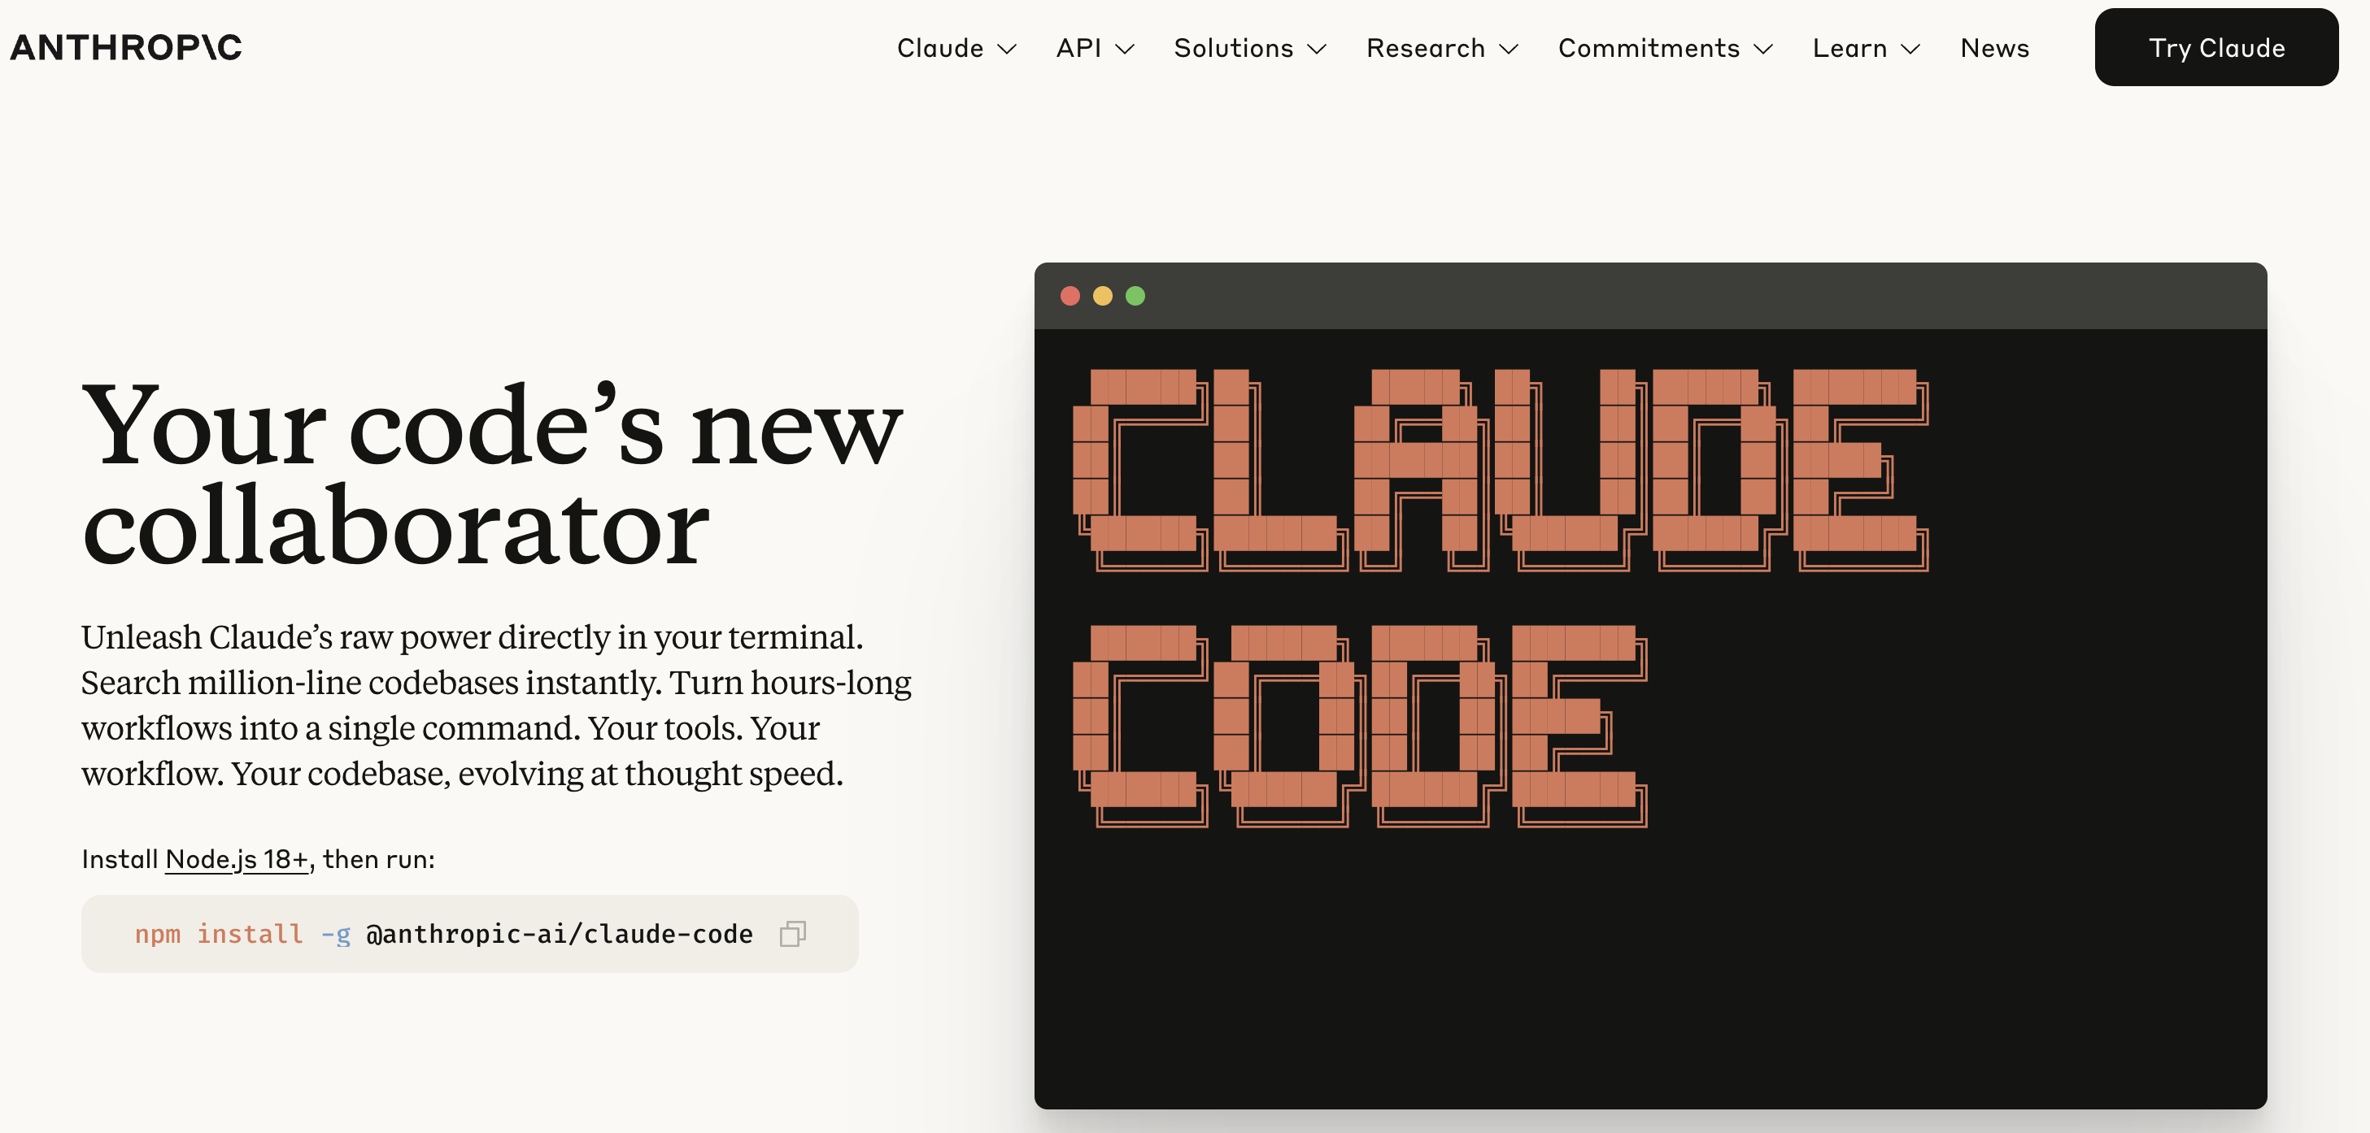
Build your own agents with tools from the frontier model firms

Slide 18
Disclaimer: None of those are “endorsements”, just examples…

Slide 19
AI and Small Businesses
Background
Small businesses drive 40% of U.S. GDP and create 70% of net new jobs since 2019
10+ trillion dollars in economic activity
Challenges: access to capital, inflation, competition, industry consolidation
The Case for AI
Technology is a key driver of productivity & innovation
60% of small businesses believe AI can help
Current hurdles: lack of talent, high costs, limited vendor support
Our Experience
AI for Small Business initiative in Prince George’s County, MD

Slide 20
Our Workshops, Free AI Course Offerings and Vision
Two year workshops in partnership with PGEDC (example offering and video)
https://www.pgcedc.com/aismallbiz
Free Coursera course to anyone in the world
https://www.coursera.org/learn/ai-empowerment-for-small-businesses
Our (Free) AI & Career Empowerment Course
https://www.rhsmith.umd.edu/programs/executive-education/learning-opportunities-individuals/free-online-certificate-artificial-intelligence-and-career-empowerment
Over 30K in the course, launched May 1, 2025

Slide 21
Our Vision: AI and Small Businesses
Partnering with Maryland SBDC, PGEDC and other stakeholders in Maryland
Build a one-stop digital platform for AI solutions tailored to small business
Offer AI tools: chatbots, image processing, call/email handling, monitoring systems
Provide free online education and expert guidance
Ensure equitable access to AI benefits across the small business ecosystem

Slide 22
Thank you! bpadmana@umd.edu

