Slide 1
How to Dig into Nonprofits
Dave Fahrenthold | National Press Foundation | 9.16.2025

Slide 2

Why is the nonprofit beat so much fun?
Lots of money
Lots of power
Lots of transparency
BUT…..
Very little regulation or enforcement

Slide 3
Nonprofit basics

Slide 4



There are more than 30 types of tax-exempt nonprofit. Some are weird.

Slide 5

Not all nonprofits are charities!
Charities are a subset of nonprofits, called 501(c)(3) organizations, that are dedicated entirely to the public good.
Along with churches, they can offer tax-deductible donations
There are two sub-types of 501(c)(3), with different rules:
Public charities, which help the world directly.
Private foundations, which mainly donate to other charities.

Slide 6
The rest are non-charitable nonprofits
These groups have more freedom, but their donors don’t get tax deductions
501(c)(4)s or “dark money” groups. Can spent 49 percent of their time on politics.
527s. Can spend *all* of their time on politics. Often scams.
Trade associations.
Sports leagues, like the NCAA and PGA Tour.
Credit unions.
Somehow, two casinos in Iowa.

Slide 7


Who regulates nonprofits?
Nationally, the IRS
In 38 states, state officials provide a second layer of regulation

Slide 8

But nobody regulates them very well
DO NOT assume that a charity is trustworthy just because it once received IRS or state approval.
Regulators don’t look very hard at the beginning, and barely look at all after that.
So even obvious frauds can get by them.

Slide 9
Starting a nonprofit story, step by step

Slide 10

Begin here:
The IRS form 990
Like the deep sea, you can study it for years and still not comprehend its true depth and beauty.
Find them with ProPublica’s Nonprofit Explorer tool.

Slide 11
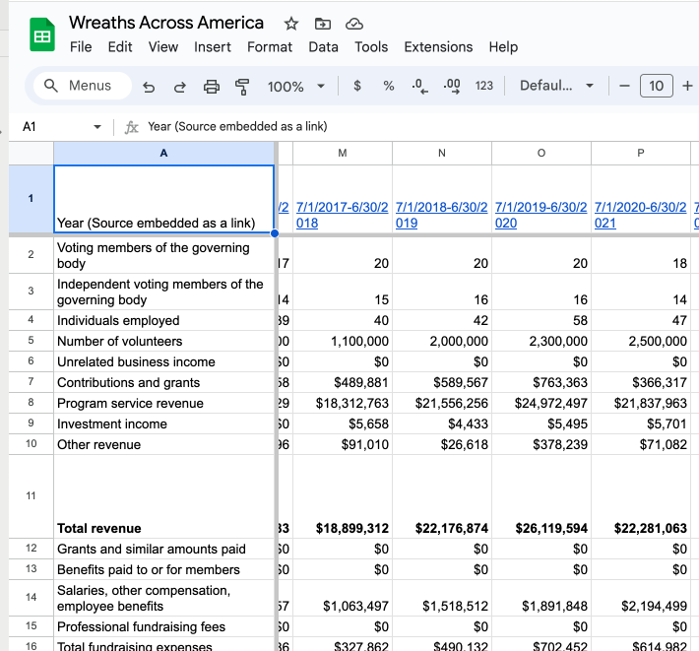
Step One: Catalog the nonprofit’s finances
Is its income growing or shrinking?
What are its largest expenses?
Does its spending match its stated mission?
Look at the attached schedules too. Does the group list any payments to insiders on Schedule L?

Slide 12
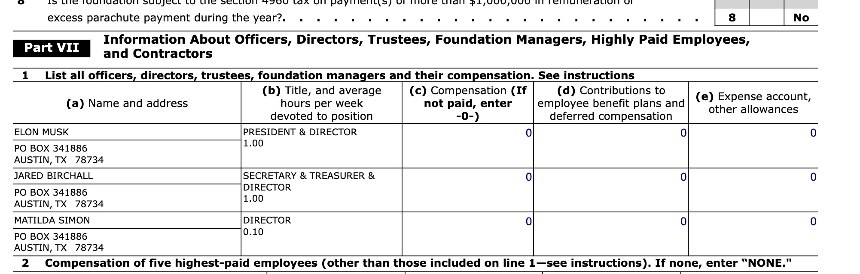
Step Two: Catalog the group’s officers and board members
These will be your targets and possible sources

Slide 13
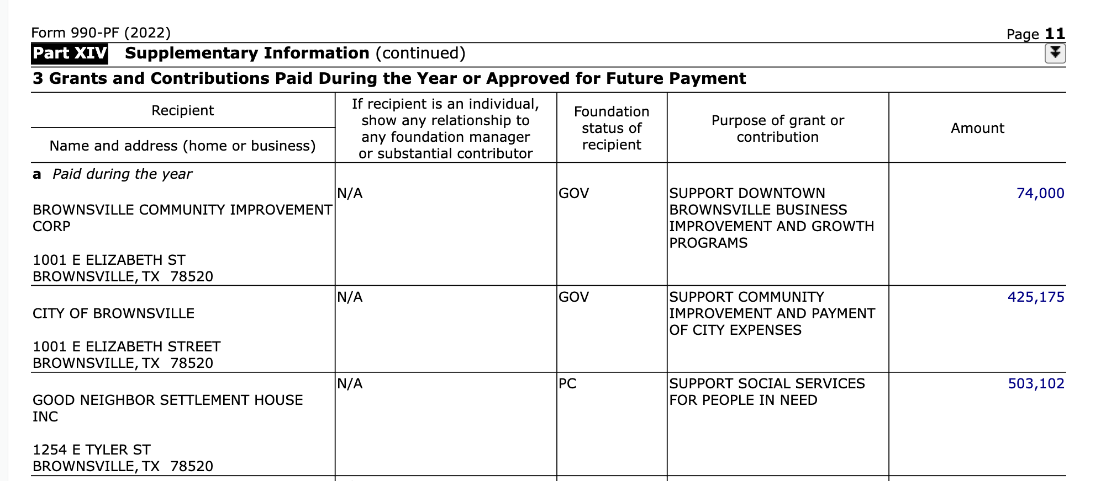
Step 3: Catalog outgoing donations
Who did this group support and why?
How did its giving change over time?

Slide 14
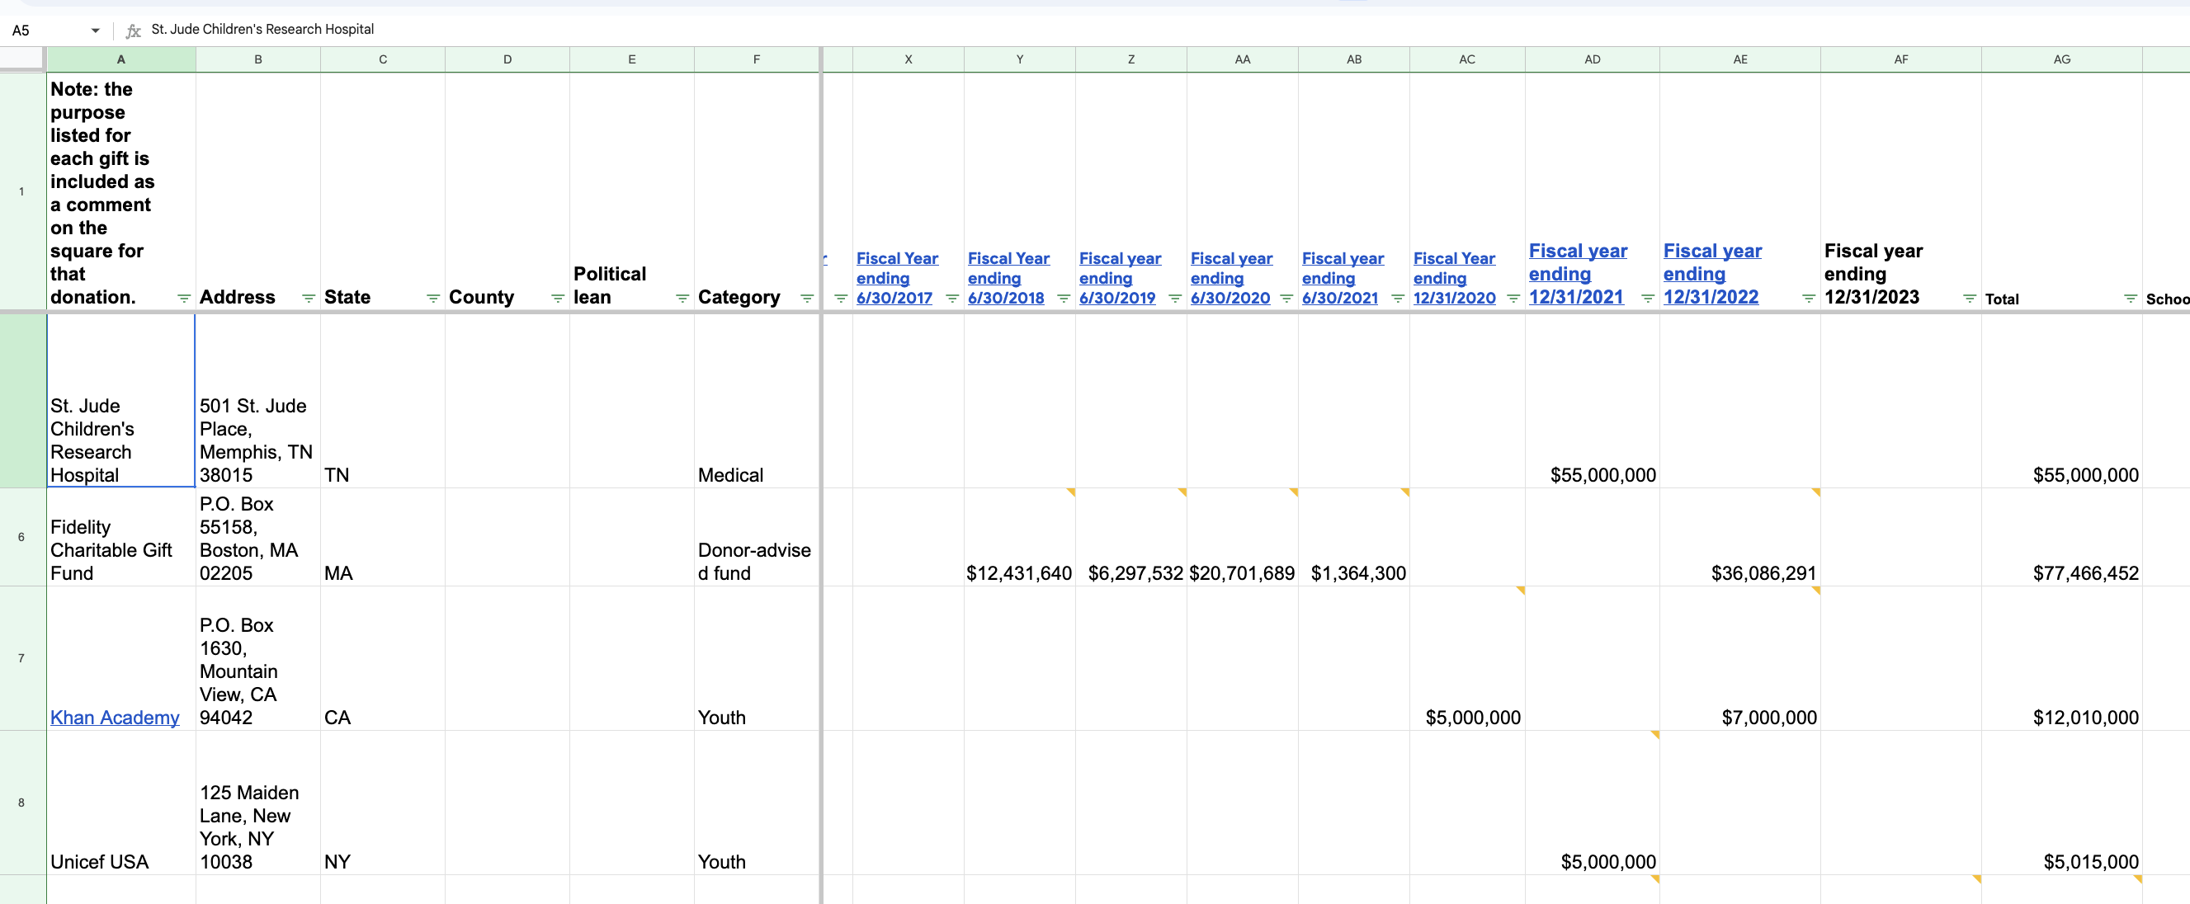
Here’s what Step 3 looks like when it’s done
This is my spreadsheet of the Musk Foundation’s outgoing donations

Slide 15
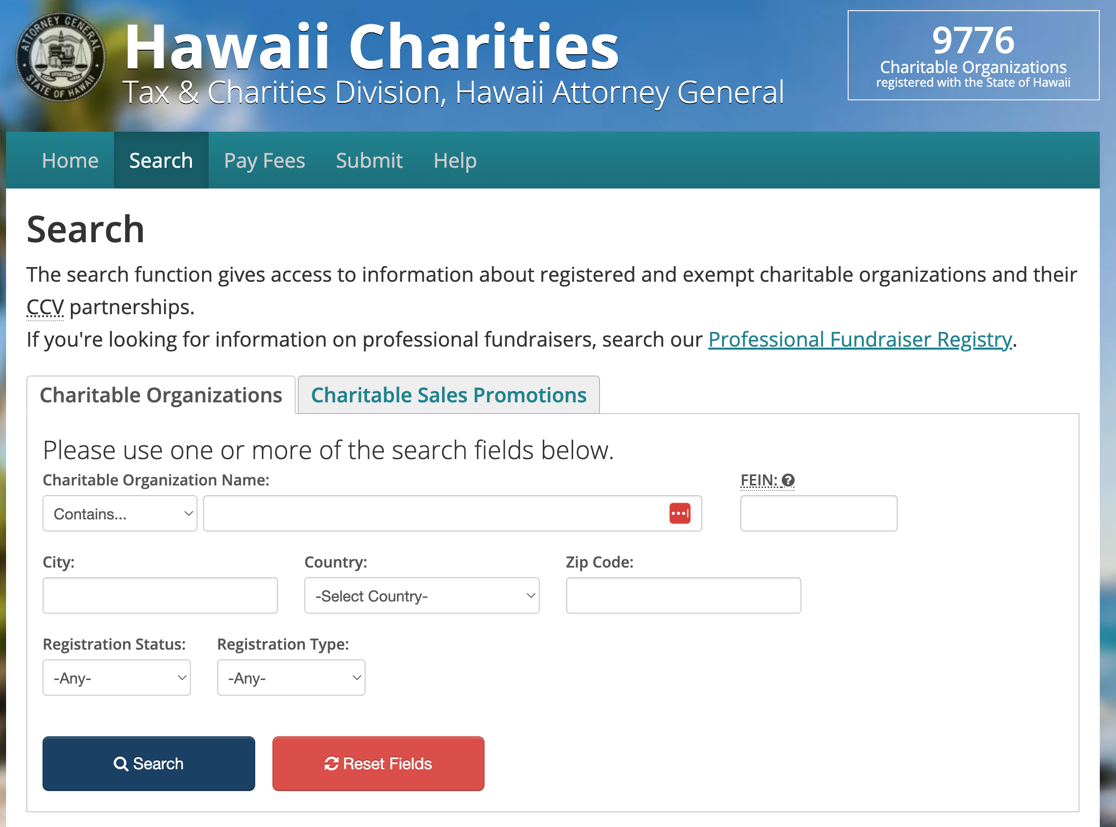
Step 4: Check State charity registers
Seven states require even more detailed filings than the IRS Form 990. They are CA, FL, HI, MA, NC, NM and NY.
Even charities based in other states must file these forms, if they fundraise in the seven states.

Slide 16
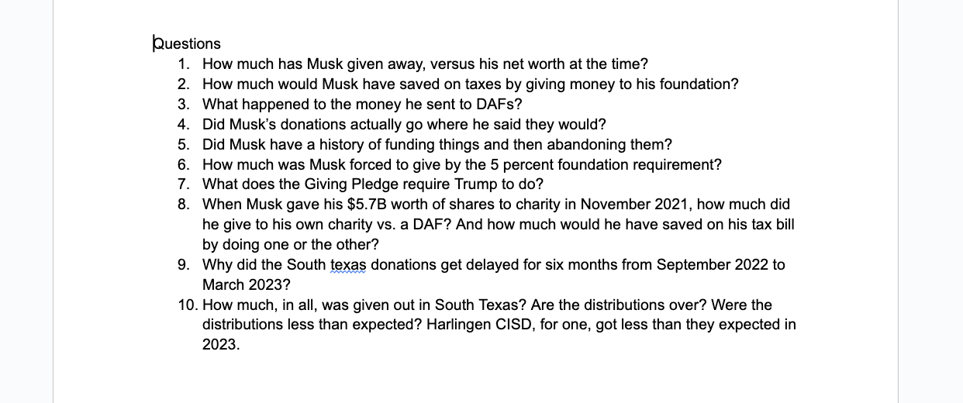
Step 5: What questions did these documents raise?
Jot these down as you go through the Forms 990 and state filings. What was odd, unexpected or unexplained?
This is your roadmap for the next phase of reporting

Slide 17
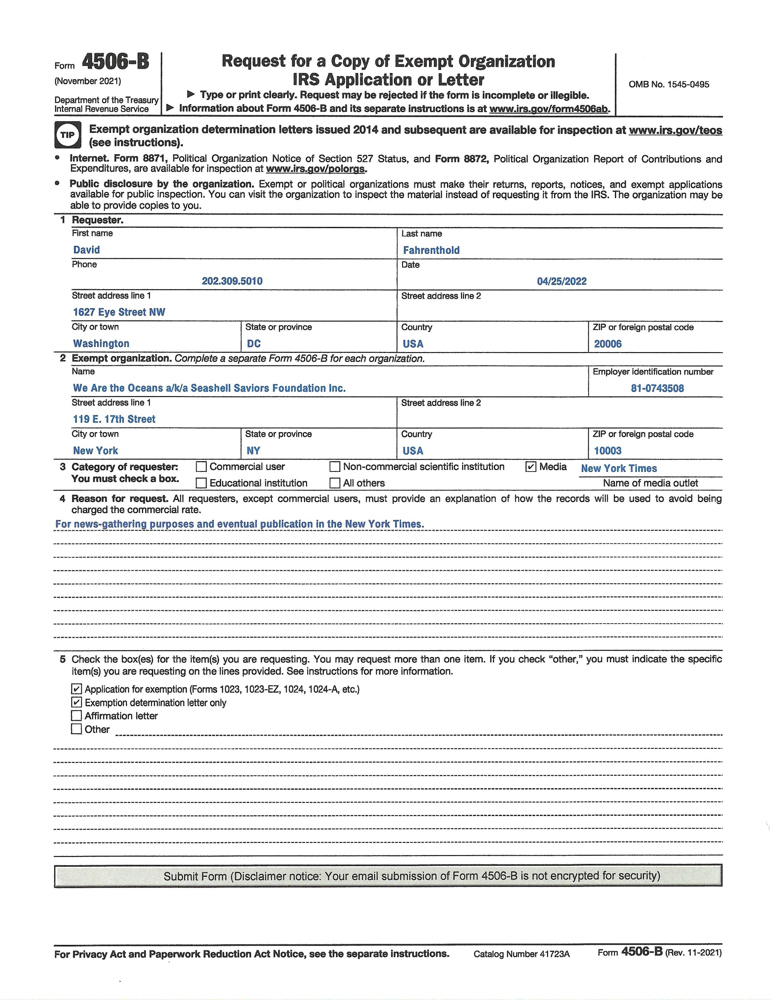
Step 6: You can FOIA the nonprofit’s application for tax exemption
The procedure..
1. Fill out and email IRS form 4506B.
2. Hear nothing back.
3. Despair.
4. Get a package in the mail from the IRS.

Slide 18

Do nonprofits have to reveal their donors publicly?
Private foundations do.
Everybody else does not.
But there are resources that can help, sometimes.

Slide 19
Resources that can help, sometimes.
CauseIQ and Candid. These are tools (paid subscription required) that allow you to look up any nonprofit’s donations from other nonprofits.
The IRS. If you use a special FOIA called Form 4506b, they will send you a group’s initial application for tax exemption. Comes slowly, but it’s often a gold mine, and can include information on initial donors.
The nonprofit itself. If you request their most recent 990s, they have to provide them. Sometimes they forget, and send you forms with donor information unredacted. Always worth a try.

Slide 20
Let me know how I can help!
I’m still learning this beat myself, and I’d love to help answer questions and help solve problems.
Email me anytime at daf@nytimes.com

