Slide 1


Trumponomics Impact on Asia and the World
Trinh Nguyen – Senior Economist, Emerging Asia – trinh.nguyen@natixis.com

Slide 2

Table of contents
01
Tariffs are here to stay, the only certainty from rising uncertainty, dragging down growth
02
Silver lining is thirst for diversification makes rest of world attractive; policy response to be stimulative
03
Geopolitical risks lead to higher defense spending/imports, hunt for havens (e.g., govies, gold)
04
Risks
05
Key Natixis Research Forecasts

Slide 3
Tariffs are here to stay, the only certainty from rising uncertainty, dragging down growth
1

Slide 4
Where Does Trump Tariffs/Tax Power Come From?
Reciprocal Tariffs/Fentanyl; 25% on Mexico and Canada
Sectoral Tariffs
Country-Focused Tariffs
International Emergency Economics Power Act (IEEPA passed in 1977) the president to regulate international commerce after declaring a national emergency.
Section 232 Tariffs: Trade Expansion Act of 1962 (19 U.S.C. §1862) authorizes the Secretary of Commerce to conduct comprehensive investigations to determine the effects of imports of any article on the national security of the United States.
Section 301 of the Tariff Act of 1930 allows the Office of the U.S. Trade Representative (“USTR”) to pursue unilateral trade retaliation against countries that impose unfair trade barriers against the United States
Balance of Payment/Discrimination
Section 122 of the Trade Act of 1974, the president can impose tariffs of up to 15% or quotas on all imports for up to 150 days to address balance-of-payments deficits. Extending tariffs beyond 150 days requires Congressional approval.
Section 238 of the Tariff Act of 1930, the president can impose new or additional duties on imports from a foreign country of up to 50% or exclude its products from importation if the foreign country imposes unreasonable charges or discriminates against US commerce. These duties take effect 30 days after the proclamation and do not explicitly require consultation with any department.
Court of international Trade Ruled IEEPA invalid as not appropriate
Trump appealed
US Court of Appeals for the Federal Circuit ruled that tariffs remain in place during appeal
Cased expected to reach the Supreme Court

Slide 5
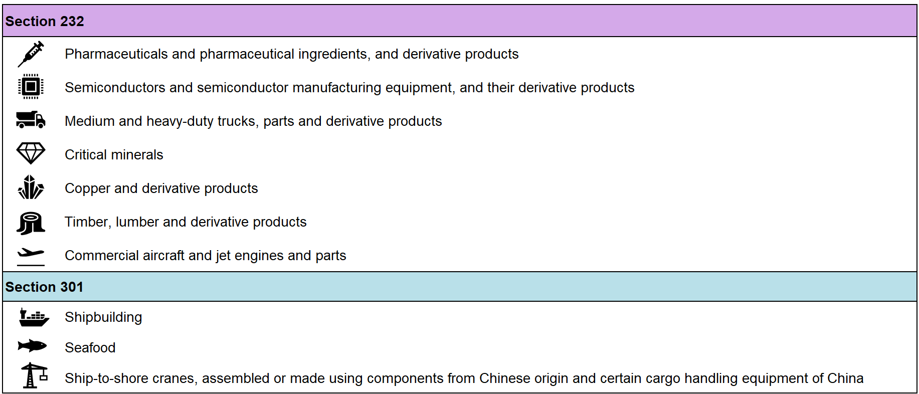
The upcoming tariffs targeting products will bring more pain to the world
Pending List of Tariffs Targeting Specific Products
Source: Natixis, Federal Register, The White House

Slide 6
US: Growth to slowdown as tariffs and uncertainty bite
Vastly increased policy uncertainty combined with decreasing business optimism should hinder fixed investment. President Trump’s immigration and trade policies have presented large and immediate risks to the outlook for consumption which have required us to markedly downgrade our forecasts for 2025 growth.
2.8%
2024 GDP Growth
1.1%
2025 GDP Growth
Source: Natixis, Haver

Slide 7
US: The Fed is torn between softening growth & tariffs
The last Summary of Economic Projections revised up the FOMC’s inflation expectations, with the median committee member raising their core PCE projection up from 2.5% to 2.8%. We would expect this to continue to be increased in each SEP, reminiscent of the 2021 FOMC cycle.
2.8%
Q4/Q4 Core PCE 2024
3.7%
Q4/Q4 Core PCE 2025
Note: Median FOMC Core PCE Inflation Projections are , 2.8% in ‘25, 2.2% in ‘26.
Source: Natixis, Bloomberg

Slide 8
US: Treasury Issuance and Net Purchases
Increased Treasury supply was remarkably well received in 2024, in no small part due to increased demand from money market funds and foreign buyers. With foreign holdings of US Treasury Securities shrinking since October 2024, demand will have to be supported domestically.
MMFs have been an integral purchaser of US Treasuries…
…and bills have increased as a share of marketable debt.
Source: Natixis, Haver
Source: Natixis, Haver

Slide 9
US: But Rate Cuts are Coming
With job growth and economic activity slowing but still solid, but the outlook increasingly negative on growth and inflation, the Fed is likely to take a more ‘wait-and-see’ approach going forward. The Fed will make sure any tariff induced rise in inflation is not persistent before it resumes the cutting cycle due to slowing growth and rising unemployment.
3.75%
Federal Funds Rate Upper Bound
End ‘25
3.00%
FFR Upper Bound
End ‘26
Source: Natixis, Bloomberg

Slide 10
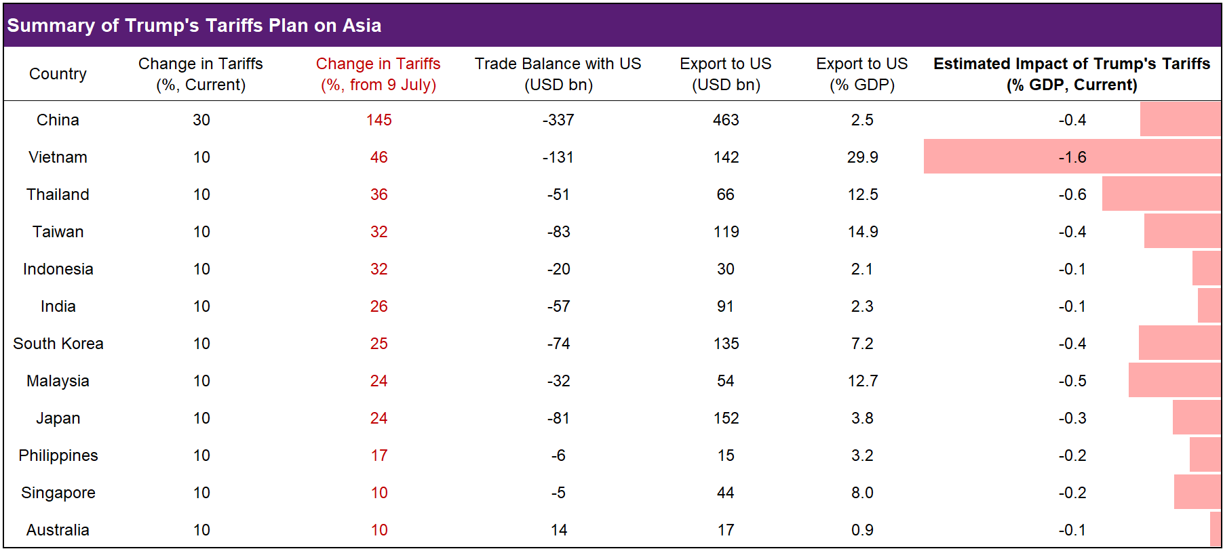
For Asia, tariffs are big headwinds for big traders
Source: Natixis, UN Comtrade
N.B. Data is based on goods trade data in 2024. Estimated impact of reciprocal tariffs is calculated under the assumption of short-term elasticity of demand = 0.8. We exclude products including semiconductor, pharmaceutical, energy products, etc., which are exempted from the current tariffs plan, to calculate the net impact of the reciprocal tariffs.

Slide 11
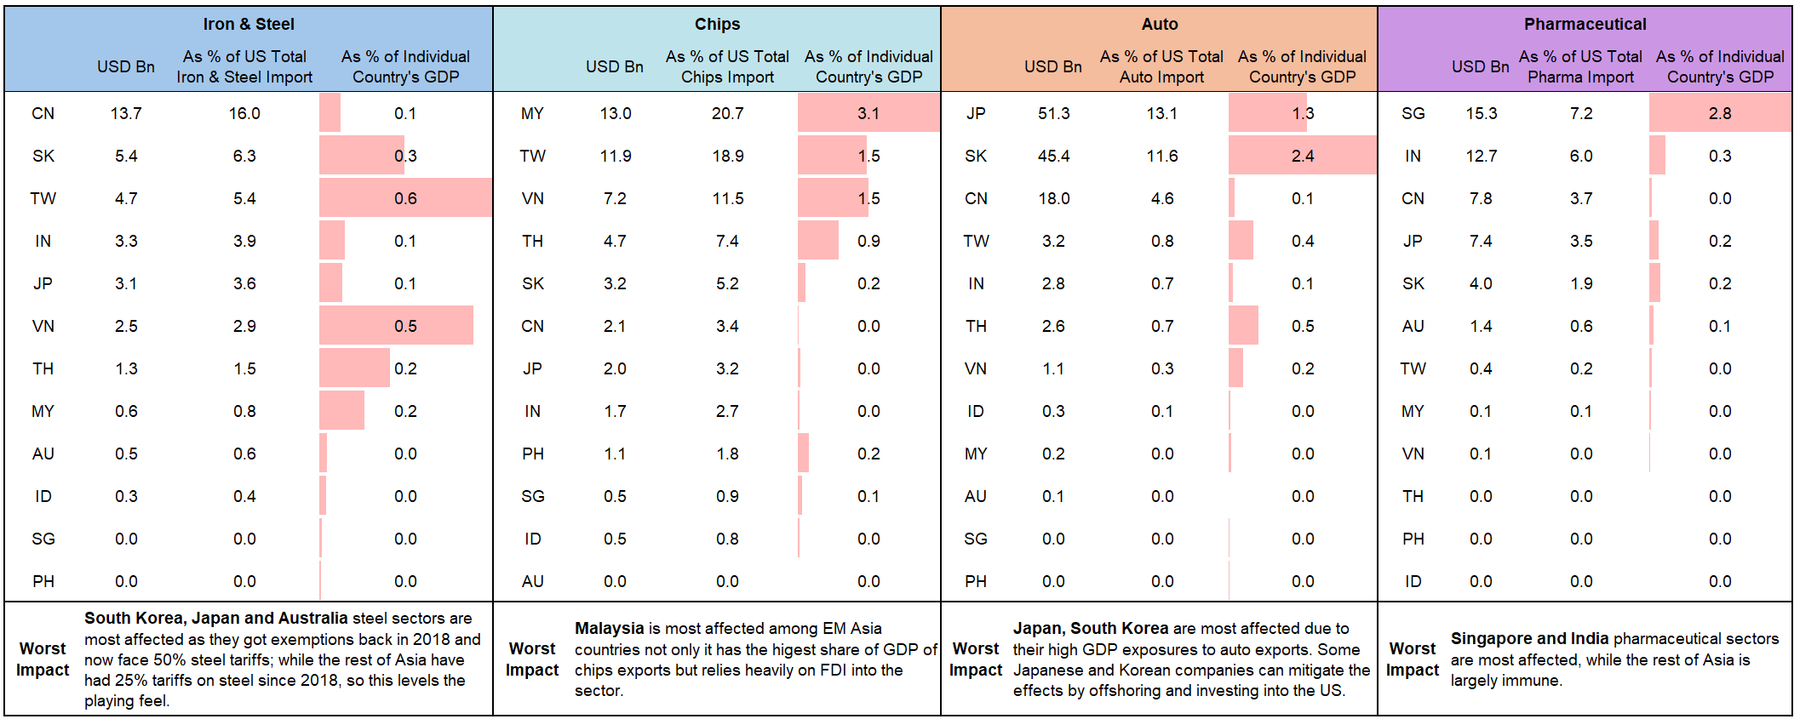
What are the Asia countries most effected by Trump’s tariff on targeted sectors?
US Product Imports by Countries
Source: Natixis, UN Comtrade
N.B. Data is based on goods trade data in 2024. Product classification is based on HS system. US has Free Trade Agreement with Australia, South Korea and Singapore. During Trump’s first presidency, he imposed 25% and 10% tariffs on steel and aluminum, respectively. Under Biden, exemptions were granted to US major trade partners. Among Asia countries, South Korea has tariff-rate quotas for steel and Australia has exemptions for steel and aluminum within a specified export volumes. For other countries, the 25% tariffs on steel and 10% on aluminum were already in place. On 4 June 2025, Trump doubled the tariffs on steel to 50% from the previous 25%.

Slide 12
In developed Asia, Japan, South Korea, and Taiwan are particularly exposed to the US demand for electronics and industrial goods, such as automobile and parts
Asia: Input-output Table of Goods Exported to the US by Market and Sector
(% of Total of Respective Market, 2023)
 | VN | TW | KR | TH | MY | JP | SG | IN | PH | CN | ID | NZ | AU | HK
Transports* | 21 | 36 | 32 | 14 |  | 32 | 14 | 23 |  | 20
Machinery |  | 20 | 17 |  |  | 20 |  | 25 |  | 13
Rubber & plastics | 27 | 5 | 6 | 31 | 10 | 8 |  | 21 |  | 9 | 31
Wood | 21 |  |  | 5 | 10 |  |  |  |  | 13 | 24 | 21
Electrical & optical* | 21 | 15 | 20 |  | 16 | 11 | 5 | 32 |  | 8
Chemicals |  | 10 | 12 | 5 |  | 12 | 8 | 18 |  | 11 | 7 |  | 22
Pulp and paper | 34 | 15 | 23 |  |  | 6 | 4 | 12 |  | 15 | 4 |  | 10
Materials | 26 | 21 | 19 | 16 |  | 13 |  | 20 |  | 7
Metals* | 22 | 24 | 17 | 15 |  | 6 |  | 14 |  | 6 |  |  | 6
Agriculture | 8 | 29 |  | 10 |  |  |  | 8 |  | 4 | 17
Food & beverages | 8 | 9 |  | 5 | 3 | 8 |  | 8 | 19 | 3 | 7 | 9 | 15
Leather & footwear | 20 |  |  |  |  |  |  | 3 |  | 5 | 3
Energy |  |  | 8 |  |  |  |  | 7 |  | 2
Textiles | 25 | 6 | 7 |  |  | 7 |  | 7 |  | 1
N.B. To rule out the outliers with minimal values, we exclude the country data points below 5% of the maximum of each industry.
* Some products from these sectors may be exempted, such as autos, semiconductors, and steel and aluminum. However, they may be subject to sectoral tariffs.
Source: Natixis, Asian Development Bank

Slide 13
Reciprocal Tariff: Sectoral exemptions help alleviate the pain but how long?

Slide 14
Vietnam is the biggest victim of its own success but for Japanese exporters, especially auto, it’s painful even macro impact less so

Slide 15
If trade balance is a benchmark, can buying American products work?
Reciprocal tariffs are going to bite if not negotiated down but how?

Slide 16
Asia: EM Asia ex China to benefit from easing of financial conditions but not all will benefit as China reflation policies will be targeted and China will export more to EM Asia

Slide 17
China will trade with narrower scope so more Chinese goods flood markets
Trade deficit with China widened – hard to compete with cheap prices & higher quality products

Slide 18
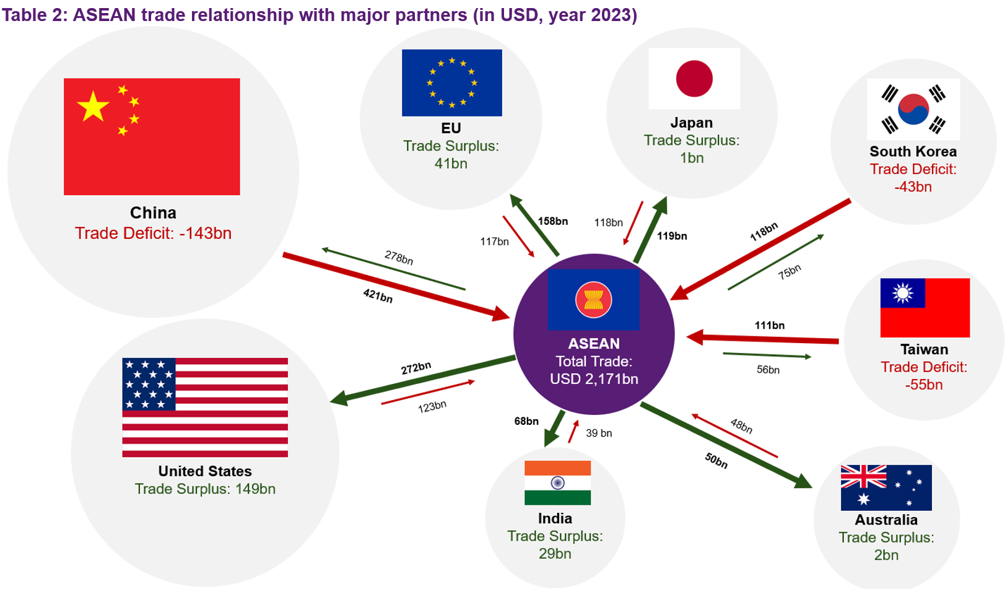
More regionalization - deep regionalization at work and tariffs will further it
ASEAN trade relationship with major partners (in USD, year 2023)
Source: Natixis, UN Comtrade
N.B. Goods trade data for ASEAN countries is only up to 2023.

Slide 19
Tariffs are not just targeting trade but investment flows
Global investment reshuffled from China to EM Asia and Asia was just hammered; Asia will need to negotiate as many trade deals as possible

Slide 20
Thirst for diversification makes Asia attractive; policy response to be stimulative
2

Slide 21
Asia: Fiscal policy will be more accommodative
Especially if monetary is more limited; that said, appetite for aggressive easing is limited given fiscal consolidation goals

Slide 22
Monetary conditions are very right in Asia, especially real rates, rate cuts have been front-loaded

Slide 23
Asia: Rate cuts are falling very gently, mainly because they never went up that much, a softer dollar has helped with front loading of cuts

Slide 24
Too much allocation in US assets
Diversification is key but where and how? Slowly rather than rapidly

Slide 25
Asia: EM Asia ex China to benefit from easing of financial conditions
Diversification has pushed inflows
ASEAN-6 (rhs)

Slide 26
A lot of room for Asian allocation to grow, especially EM Asia

Slide 27
Can the USD lose its reserve Currency Status?
Looking at the key features needed to become a reserve currency, the USD will remain dominant but with a decreasing share
the size of the domestic economy
the importance of the economy in international trade
the size, depth, and openness of financial markets
the convertibility of the currency / liquidity of assets
the use of the currency as a currency peg
domestic macroeconomic policies.
Credit quality of assets
Gold reserves and as share of total FX reserves

Slide 28
Diversification out of China-centric supply chains will help EM Asia; Foreign ownership of US assets already peaked

Slide 29
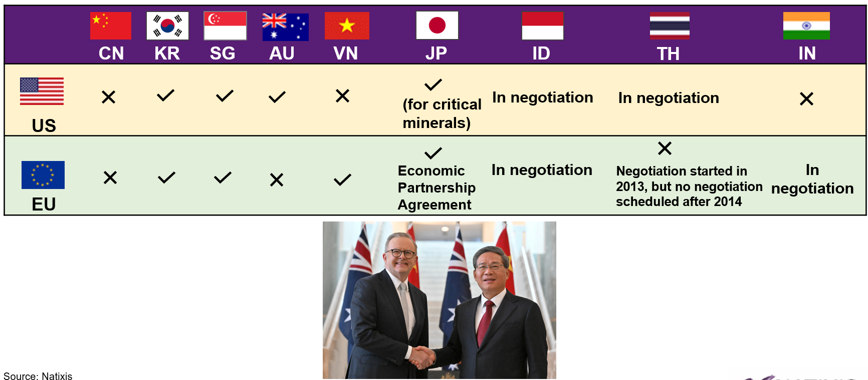

Trade liberalization: Free trade agreement between friendly/neural countries

Slide 30
Geopolitical risks lead to higher defense, hunt for havens (e.g., govies, gold)
3

Slide 31
China spending on defense rising & US retreating from world; This means that regional demand for security rises just to make up for the gap

Slide 32
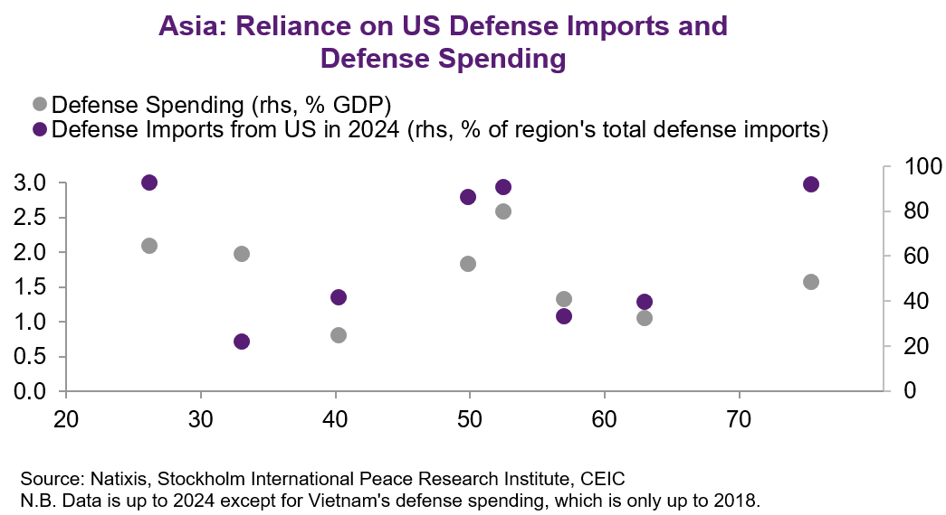
Defense spending will rise, diversification out of US defense too
South Korea
Taiwan
Indonesia
Philippines
Vietnam
Australia
Japan
Thailand
237
Gross Debt to GDP (%, Year 2024)

Slide 33
Ranking of Asia economies self-sufficient in defense; exporters and importers
Rank | Country | Procurement of Major Arms | Arms Company Sales | Uncrewed Maritime Vehicles | Self Reliance Score
1 | China | 105 | 200 | 25 | 330
2 | Japan | 92 | 28 | 11 | 131
3 | South Korea | 63 | 20 | 9 | 92
4 | India | 63 | 21 | 8 | 91
5 | Taiwan | 70 | 8 | 6 | 84
6 | Australia | 52 | 9 | 6 | 67
7 | Singapore | 31 | 8 | 7 | 46
8 | Pakistan | 38 | 2 | 0 | 40
9 | Indonesia | 31 | 0 | 0 | 31
10 | Malaysia | 21 | 0 | 0 | 21
11 | Thailand | 3 | 0 | 6 | 9
Less self-reliant
Source: Natixis, Stockholm International Peace Research Institute
N.B. Vietnam is not included in the ranking due to a lack of data.

Slide 34
Asia: EM Asia has a lower debt stock

Slide 35
Risks
4

Slide 36
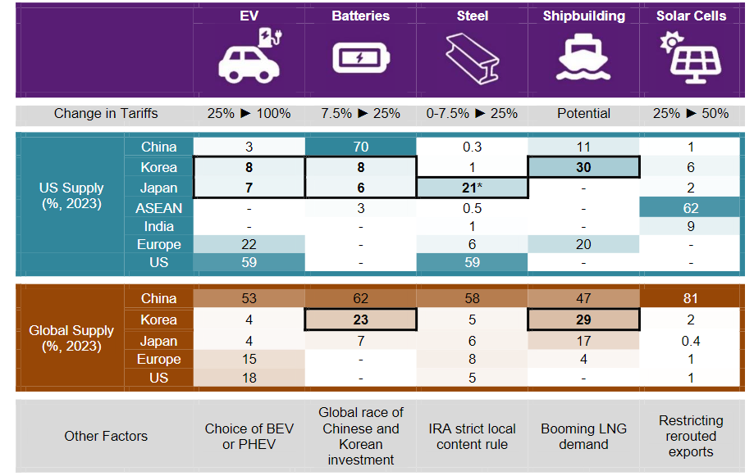
Weakened global order – less cooperation & more disruption
Protectionism is the vogue word not globalization.
N.B. EV market share is estimated based on US EV sales. Battery supply and shipbuilding are based on US imports due to low domestic production. Steel supply is calculated from local production on a corporate level by the country of origin and international trade data. Solar cell supply based on imports. *Assuming Nippon Steel successfully acquires US Steel.
Source: Natixis, UN Comtrade, MarkLines, UNCTAD, eworldship.com, Clarksons, Global Energy Monitor

Slide 37
Climate Change / Rising Food Prices: Very inflationary and volatile
Stagflation lurks; That said, conclusions of Ukraine War would bring better food supply

Slide 38









Natixis infrastructure gap index shows a wide gap currently and even more so if we account for the population increase in the future.
Poor infrastructure is still a big hurdle for India, the good news is they have been putting infrastructure front and center of the policy agenda
Infrastructure Gap Rankings
Overall
Rail
Road
Air
Fixed
Broadband
Overall
1
2
3
Source: Natixis

Slide 39
Demand for energy in Asia has risen fast & will accelerate
Why? Higher income = higher demand for AC/Cars/electronic goods & industrialization needs energy; Vietnam and India have been the fastest

Slide 40
Key Natixis Research Forecasts
5

Slide 41
Asia: Forecasts
GDP growth (% change yoy) | 2015 | 2016 | 2017 | 2018 | 2019 | 2020 | 2021 | 2022 | 2023 | 2024f | 2025f | 2026f
Australia | 2.3 | 2.7 | 2.4 | 2.9 | 1.9 | -2.4 | 5.0 | 3.7 | 2.0 | 1.0 | 1.6 | 2.0
Mainland China | 7.0 | 6.8 | 6.9 | 6.7 | 6.0 | 2.2 | 8.1 | 3.0 | 5.2 | 4.8 | 4.2 | 4.0
Hong Kong | 2.4 | 2.2 | 3.8 | 2.8 | -1.7 | -6.5 | 6.3 | -3.5 | 3.2 | 2.4 | 2.0 | 2.2
India | 7.5 | 9.0 | 6.1 | 7.3 | 4.6 | -6.0 | 9.4 | 6.5 | 7.7 | 6.5 | 6.1 | 6.0
Indonesia | 4.9 | 5.0 | 5.1 | 5.2 | 5.0 | -2.1 | 3.7 | 5.3 | 5.0 | 5.0 | 4.8 | 4.7
Japan | 1.6 | 0.8 | 1.7 | 0.7 | -0.4 | -4.7 | 1.8 | 1.1 | 1.7 | 0.1 | 0.8 | 0.6
Malaysia | 5.1 | 4.5 | 5.7 | 4.7 | 4.3 | -5.6 | 3.1 | 8.7 | 3.7 | 5.1 | 4.6 | 4.5
Philippines | 6.1 | 6.9 | 6.7 | 6.3 | 6.1 | -9.5 | 5.7 | 7.6 | 5.5 | 5.7 | 5.8 | 5.7
Singapore | 3.0 | 3.3 | 4.5 | 3.4 | 0.9 | -4.1 | 7.9 | 3.7 | 1.1 | 4.3 | 2.5 | 2.5
South Korea | 2.8 | 3.0 | 3.2 | 2.9 | 2.2 | -0.7 | 4.1 | 2.6 | 1.4 | 2.1 | 1.3 | 1.5
Taiwan | 1.5 | 2.2 | 3.3 | 2.8 | 3.1 | 3.4 | 6.6 | 2.4 | 1.3 | 4.3 | 2.8 | 2.4
Thailand | 3.1 | 3.4 | 4.2 | 4.2 | 2.2 | -6.2 | 1.5 | 2.6 | 1.9 | 2.7 | 2.2 | 2.0
Vietnam | 6.7 | 6.2 | 6.8 | 7.1 | 7.0 | 2.9 | 2.6 | 8.0 | 5.1 | 7.1 | 6.5 | 6.2
N.B. As of 4 June 2025.
Source: Natixis, Bloomberg

Slide 42
Asia: Forecasts
Inflation (CPI %, yoy, avg) | 2015 | 2016 | 2017 | 2018 | 2019 | 2020 | 2021 | 2022e | 2023 | 2024 | 2025f | 2026f
Australia | 1.5 | 1.3 | 1.9 | 1.9 | 1.6 | 0.9 | 2.9 | 6.6 | 5.6 | 3.2 | 2.6 | 2.7
Mainland China | 1.4 | 2.0 | 1.6 | 2.1 | 2.9 | 2.5 | 0.9 | 2.0 | 0.2 | 0.2 | 0.2 | 1.5
Hong Kong | 3.0 | 2.4 | 1.5 | 2.4 | 2.9 | 0.3 | 1.6 | 1.9 | 2.1 | 1.8 | 2.0 | 1.9
India | 4.9 | 5.0 | 3.3 | 4.0 | 3.7 | 6.6 | 5.1 | 6.7 | 5.6 | 4.6 | 4.5 | 4.3
Indonesia | 6.4 | 3.5 | 3.8 | 3.2 | 2.8 | 2.0 | 1.6 | 4.2 | 3.7 | 2.3 | 2.0 | 2.5
Japan | 0.8 | -0.1 | 0.5 | 1.0 | 0.5 | 0.0 | -0.3 | 2.5 | 3.3 | 2.4 | 2.1 | 1.7
Malaysia | 2.1 | 2.1 | 3.8 | 1.0 | 0.7 | -1.1 | 2.5 | 3.4 | 2.5 | 1.9 | 2.5 | 2.3
Philippines | 0.7 | 1.3 | 2.9 | 5.2 | 2.4 | 2.4 | 3.9 | 5.8 | 6.0 | 3.2 | 2.8 | 3.3
Singapore | -0.5 | -0.5 | 0.6 | 0.4 | 0.6 | -0.2 | 2.3 | 6.1 | 4.8 | 2.4 | 2.3 | 2.2
South Korea | 0.7 | 1.0 | 2.0 | 1.5 | 0.4 | 0.5 | 2.5 | 5.1 | 3.6 | 2.3 | 2.0 | 1.8
Taiwan | -0.3 | 1.4 | 0.6 | 1.4 | 0.6 | -0.2 | 2.0 | 3.0 | 2.5 | 2.1 | 1.9 | 1.8
Thailand | -0.9 | 0.2 | 0.7 | 1.1 | 0.7 | -0.8 | 1.2 | 6.1 | 1.3 | 0.4 | 1.3 | 1.5
Vietnam | 0.6 | 2.7 | 3.5 | 3.5 | 2.8 | 3.2 | 1.8 | 3.2 | 3.3 | 3.6 | 3.5 | 3.5
N.B. As of 4 June 2025.
Source: Natixis, Bloomberg

Slide 43
Asia: Forecasts
Interest rate (%, e.o.p) | 2015 | 2016 | 2017 | 2018 | 2019 | 2020 | 2021 | 2022 | 2023 | 2024f | 2025f | 2026f
Australia | 2.00 | 1.50 | 1.50 | 1.50 | 0.75 | 0.10 | 0.10 | 3.10 | 4.35 | 4.35 | 3.35 | 3.35
Mainland China | 3.09 | 3.27 | 4.91 | 3.35 | 3.02 | 2.76 | 2.50 | 2.42 | 2.53 | 1.70 | 1.20 | 1.00
Hong Kong | 0.75 | 1.00 | 1.75 | 2.75 | 2.49 | 0.50 | 0.50 | 4.75 | 5.75 | 4.75 | 4.00 | 3.25
India | 6.75 | 6.25 | 6.00 | 6.50 | 5.15 | 4.00 | 4.00 | 6.25 | 6.50 | 6.50 | 5.50 | 5.00
Indonesia | 7.50 | 4.75 | 4.25 | 6.00 | 5.00 | 3.75 | 3.50 | 5.50 | 6.00 | 6.00 | 4.50 | 4.50
Japan | 0.00 | -0.10 | -0.10 | -0.10 | -0.10 | -0.10 | -0.10 | -0.10 | -0.10 | 0.25 | 0.75 | 0.75
Malaysia | 3.04 | 3.00 | 2.91 | 3.18 | 3.00 | 1.75 | 1.75 | 2.75 | 3.00 | 3.00 | 2.50 | 2.00
Philippines | 4.00 | 3.00 | 3.00 | 4.75 | 4.00 | 2.00 | 2.00 | 5.50 | 6.50 | 5.75 | 4.50 | 4.00
Singapore | 1.19 | 0.97 | 1.50 | 1.89 | 1.77 | 0.41 | 0.44 | 4.00 | 4.06 | 3.30 | 2.10 | 1.60
South Korea | 1.50 | 1.25 | 1.50 | 1.75 | 1.25 | 0.50 | 1.00 | 3.25 | 3.50 | 3.00 | 2.00 | 2.00
Taiwan | 1.625 | 1.375 | 1.375 | 1.375 | 1.375 | 1.125 | 1.125 | 1.750 | 1.88 | 2.000 | 1.875 | 1.750
Thailand | 1.50 | 1.50 | 1.50 | 1.75 | 1.25 | 0.50 | 0.50 | 1.25 | 2.50 | 2.25 | 1.50 | 1.00
Vietnam | 6.50 | 6.50 | 6.25 | 6.25 | 6.00 | 4.00 | 4.00 | 6.00 | 4.50 | 4.50 | 3.00 | 2.50
N.B. As of 4 June 2025.
Source: Natixis, Bloomberg

Slide 44
G10: FX Forecasts
G10 | 4-Apr | 3 mth | 6 mth | 9 mth | 12 mth | 15 mth | 18 mth
DXY | 99.21 | 97.5 | 96.1 | 95.4 | 94.7 | 94.4 | 95.0
EURUSD | 1.14 | 1.16 | 1.18 | 1.19 | 1.20 | 1.20 | 1.19
USDJPY | 144.23 | 140 | 138 | 138 | 136 | 135 | 135
EURJPY | 164.18 | 162 | 163 | 164 | 163 | 162 | 161
USDCAD | 1.37 | 1.37 | 1.36 | 1.35 | 1.35 | 1.34 | 1.34
AUDUSD | 0.65 | 0.65 | 0.66 | 0.68 | 0.68 | 0.67 | 0.67
NZDUSD | 0.60 | 0.61 | 0.62 | 0.64 | 0.64 | 0.63 | 0.63
GBPUSD | 1.35 | 1.36 | 1.37 | 1.38 | 1.39 | 1.40 | 1.40
EURGBP | 0.84 | 0.85 | 0.86 | 0.86 | 0.86 | 0.86 | 0.85
USDCHF | 0.82 | 0.81 | 0.80 | 0.80 | 0.80 | 0.80 | 0.82
EURCHF | 0.94 | 0.94 | 0.94 | 0.95 | 0.96 | 0.96 | 0.97
EURSEK | 10.94 | 10.90 | 10.85 | 10.80 | 10.80 | 10.75 | 10.75
USDSEK | 9.61 | 9.40 | 9.19 | 9.08 | 9.00 | 8.96 | 9.03
EURNOK | 11.51 | 11.60 | 11.50 | 11.50 | 11.40 | 11.25 | 11.25
USDNOK | 10.11 | 10.00 | 9.75 | 9.66 | 9.50 | 9.38 | 9.45
N.B. As of 4 June 2025.
Source: Natixis, Bloomberg

Slide 45
Asia: FX Forecasts
Asia | 4-June | 3 mth | 6 mth | 9 mth | 12 mth | 15 mth | 18 mth
USDCNH | 7.19 | 7.24 | 7.16 | 7.11 | 7.09 | 7.09 | 7.04
USDCNY | 7.19 | 7.25 | 7.17 | 7.12 | 7.10 | 7.10 | 7.05
USDIDR | 16,295 | 16,200 | 16,150 | 16,150 | 16,100 | 16,100 | 16,000
USDINR | 85.91 | 85.00 | 84.80 | 84.60 | 84.50 | 84.30 | 84.20
USDKRW | 1,366 | 1,370 | 1,365 | 1,350 | 1,340 | 1,340 | 1,330
USDMYR | 4.25 | 4.22 | 4.20 | 4.18 | 4.14 | 4.12 | 4.10
USDPHP | 55.79 | 55.30 | 55.20 | 55.15 | 55.10 | 55.00 | 55.00
USDSGD | 1.29 | 1.28 | 1.28 | 1.27 | 1.27 | 1.26 | 1.26
USDTHB | 32.71 | 32.50 | 32.40 | 32.20 | 32.00 | 31.80 | 31.60
USDTWD | 29.99 | 29.70 | 29.50 | 29.40 | 29.30 | 29.30 | 29.20
N.B. As of 4 June 2025.
Source: Natixis, Bloomberg

Slide 46
Natixis CIB Research Teams
Head of CIB Research
Jean-François Robin
+33 1 58 55 13 09
jean-francois.robin@natixis.com
Solutions
Real Assets / Enr
Macro & Financial Institutions
Asia
Head of Market Research
Head of Cross-Asset strategies
Head of Real Asset Research
Head of Macro & Financial Institutions Research
Chief Economist Asia Pacific
Cyril Regnat
+33 1 58 55 82 20
cyril.regnat@natixis.com
Florent Pochon
+33 1 58 55 32 81
florent.pochon@natixis.com
Thibaut Cuilliere
+33 1 58 55 05 06
thibaut.cuilliere@natixis.com
Nathalie Dezeure
+33 1 58 55 99 93
nathalie.dezeure@natixis.com
Alicia Garcia Herrero
+852 3900 8680
alicia.garciaherrero@natixis.com
Forex
Energy Transition & Commodities
Head of Europe Macro Research
Japan, Pacific
Emerging Asia
Nordine Naam
+33 1 58 55 14 95
nordine.naam@natixis.com
Celine Clari
+33 1 58 55 82 50
celine.clari@natixis.com
Bernard Dahdah
Base & Precious Metals
+44 20 321 691 31
bernard.dahdah@natixis.com
Joel Hancock
Oil, Natural Gas
+44 20 321 696 48
joel.hancock@natixis.com
Dirk Schumacher
+49 699 7153 354
dirk.schumacher@natixis.com
Kohei Iwahara
+813 4519 2141
kohei.iwahara@natixis.com
Trinh Nguyen
+852 3900 8726
trinh.nguyen@natixis.com
Rates strategist
Infrastructure, Green & Hybrids
Healthcare
CEEMEA
Real Estate
Asia Pacific, Thematic research
Benoit Gerard
+33 1 58 55 44 86
benoit.gerard@natixis.com
Theophile Legrand
+33 1 58 55 44 14
theophile.legrand@natixis.com
Ivan Pavlovic
+33 1 58 55 17 04
ivan.pavlovic@natixis.com
Fanny Meindre, Phd
+33 1 58 55 28 62
fanny.meindre@natixis.com
Inna Mufteeva, CFA
+33 1 58 55 52 04
inna.mufteeva@natixis.com
Sylwia Hubar
+33 1 58 55 35 59
sylwia.hubar@natixis.com
Gary Ng
+852 3915 1242
gary.ng@natixis.com
Haoxin Mu
+852 3900 8067
haoxin.mu@natixis.com
Rates Derivatives Strategist
Invest. Strategies & Cross Asset
Infrastruc. & Natural Resources
Transportation & Mobility
Spain, Portugal, Greece, Eurozone
Covered Bonds
Greater China
Eya Chammakhi
+33 1 58 55 26 05
eya.chammakhi@natixis.com
Emilie Tetard
+33 1 58 19 98 15
emilie.tetard@natixis.com
Benoit Maynard
+33 1 58 55 05 11
benoit.maynard@natixis.com
Valentin Mory
+33 1 58 55 04 98
valentin.mory@natixis.com
Jesus Castillo
+33 1 58 55 99 90
jesus.castillo@natixis.com
Jennifer Levy
+33 1 58 55 05 81
jennifer.levy@natixis.com
Jianwei Xu
+852 3900 8034
jianwei.xu@natixis.com
Real Estate
Financial Institutions
Americas
Thierry Cherel
+33 1 58 55 14 68
thierry.cherel@natixis.com
Roméo YOMBO-NGUITONGO
romeo.yombo-nguitongo@natixis.com
Bouchra Rhajbal
+33 1 58 55 79 93
bouchra.rhajbal@natixis.com
Samy Lakhdari
+33 1 58 55 24 45
samy.lakhdari@natixis.com
Chief Economist Americas
Benito Berber
+1 212 698 3044
benito.berber@natixis.com
Tech & Data Specialist
Stress Test / Modelisation
Micaella Feldstein
+33 1 58 55 05 29
micaella.feldstein@natixis.com
Eric Benoist
+44 20 32 16 93 97
eric.benoist@natixis.com
Patricia Florez Cabra
+33 1 58 55 62 71
patricia.florezcabra@natixis.com
Head US Economist
Economist
Christopher Hodge
+1 212 891 6109
christopher.hodge@natixis.com
Jonathan Pingle
+1 212 891 1932
jonathan.pingle@natixis.com
High Yield
Serge Herve NDOUMBE SAME
sergeherve.same@natixis.com

Slide 47
General Disclaimer
General Disclaimer
Reference prices are based on closing prices.
The information contained in this publication and any attachment thereto is exclusively intended for a client base consisting of professionals and qualified investors. This document and any attachment thereto are strictly confidential and cannot be divulgated to a third party without the prior written consent of Natixis. If you are not the intended recipient of this document and/or the attachments, please delete them and immediately notify the sender. Distribution, possession or delivery of this document in, to or from certain jurisdictions may be restricted or prohibited by law. Recipients of this document are required to inform themselves of and comply with all such restrictions or prohibitions. Neither Natixis, nor any of its affiliates, directors, employees, agents or advisers or any other person accepts any liability to any person in relation to the distribution, possession or delivery of this document in, to or from any jurisdiction.
This document is considered as marketing communication within the meaning of the AMF General Regulation. It has not been developed in accordance with legal requirements designed to promote the independence of investment research and its author(s) is/are not subject to any prohibition on dealing in the relevant financial instrument ahead of the dissemination of the marketing communication. The investments mentioned in this documentation may not be suitable for all types of investors.
This document and all attachments are communicated to each recipient for information purposes only and do not constitute a personalized investment recommendation. They are intended for general distribution and the products or services described herein do not take into account any specific investment objective, financial situation or particular need of any recipient. This document and any attachment thereto shall not be construed as an offer nor a solicitation for any purchase, sale or subscription. Under no circumstances should this document be considered as an official confirmation of a transaction to any person or entity and no undertaking is given that the transaction will be entered into under the terms and conditions set out herein or under any other terms and conditions. This document and any attachment thereto are based on public information and shall not be used nor considered as an undertaking from Natixis. All undertakings require the formal approval of Natixis according to its prevailing internal procedures.
This document and any attachment thereto are based on public information and shall not be used nor considered as an undertaking from Natixis. All undertakings require the formal approval of Natixis according to its prevailing internal procedures.
Under no circumstances should this document be considered as an official confirmation of a transaction to any person or entity and no undertaking is given that the transaction will be entered into under the terms and conditions set out herein or under any other terms and conditions.
The information contained in this document may include results of analyses from a quantitative model, which represent potential future events that may or may not be realized, and is not a complete analysis of every material fact representing any product. Information may be changed or may be withdrawn by Natixis at any time without notice. More generally, no responsibility is accepted by Natixis, nor any of its holding companies, subsidiaries, associated undertakings or controlling persons, nor any of their respective directors, officers, partners, employees, agents, representatives or advisers as to or in relation to the characteristics of this information. The statements, assumptions and forecasts contained in this documentation and any attachment thereto reflect the judgment of its author, unless otherwise specified, and do not reflect the judgment of any other person or of Natixis.
Natixis shall not be liable for any financial loss or any decision taken on the basis of the information disclosed in this presentation and Natixis does not provide any advice, including in case of investment services.
In any event, you should request for any internal and/or external advice that you consider necessary or desirable to obtain, including from any financial, legal, tax or accounting adviser, or any other specialist, in order to verify in particular that the transaction described in this material complies with your objectives and constraints and to obtain an independent valuation of the transaction, its risk factors and rewards.
It should be noted that, in the context of its activities, Natixis may have positions in financial instruments and in the issuer concerned by the recommendations or opinions provided in this document or any attachment thereto.
Natixis can be remunerated for underwriting services, investment services, advice services and any other investment service provision or banking activity and any other service related to financial instruments of the company or the companies mentioned in this document.
In this case, references made to conflicts of interests that Natixis and its affiliates may experience, with respect to the issuer(s) mentioned in this document are available on the website of the Research by clicking on the following link: Specific disclaimers.

Slide 48
Natixis Corporate & Investment Banking
is the global arm of Groupe BPCE

