Slide 1
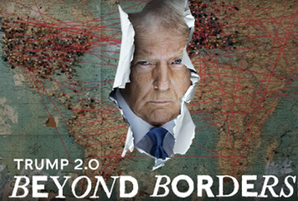


Trump 2.0 Beyond Borders
Steven R. Okun
June 23, 2025
Steve Okun 20/09/2020

Slide 2
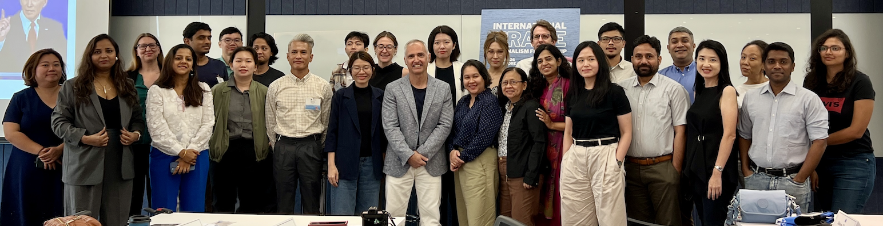
June 24, 2024
Steve Okun 20/09/2020

Slide 3
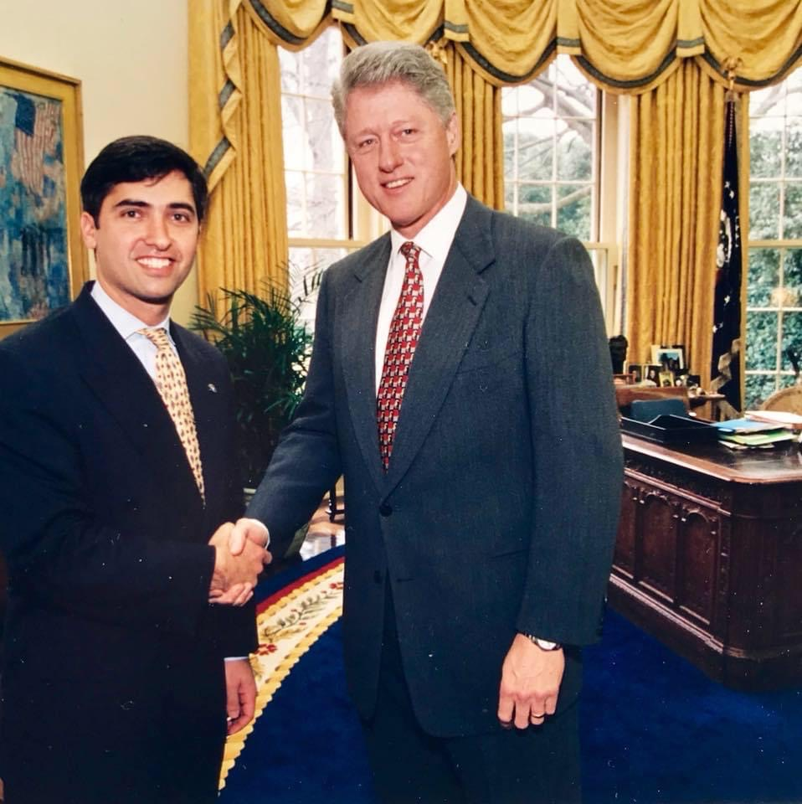
About Steven Okun
Served in Clinton Admin
Singapore Since 2003
CEO, APAC Advisors
Created KKR & UPS Asia PA
Former Chair, AmCham SG
Former Chair, AAP
Head of External Affairs, AAIP

Slide 4

December 2023

Slide 5
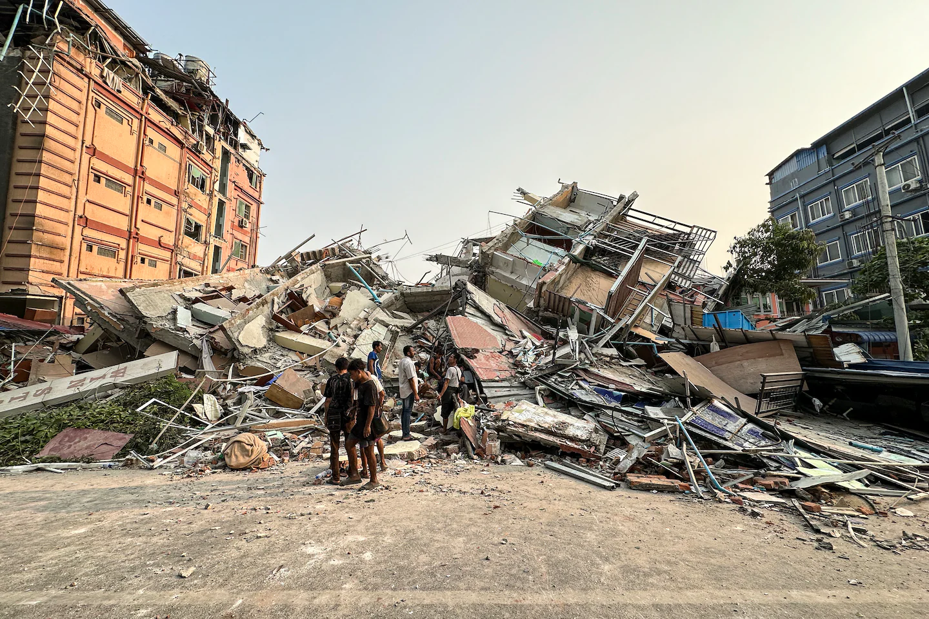
June 2025 . . . Not All of Asia Yet

Slide 6
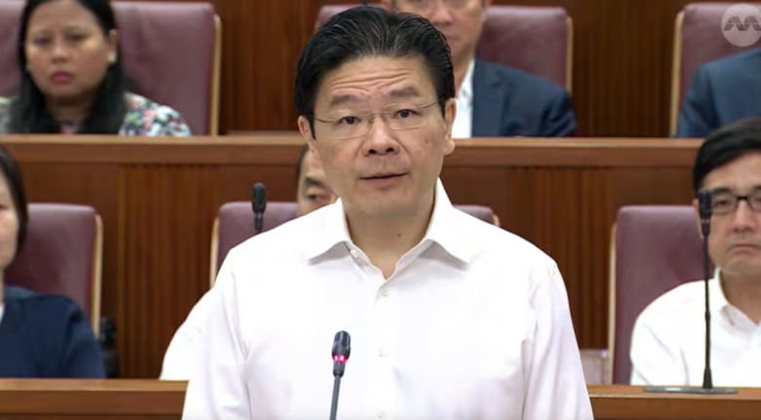
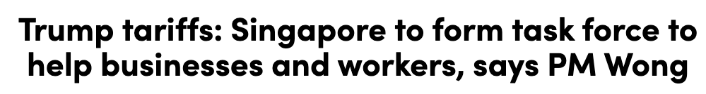
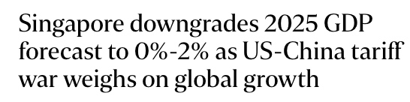
Singapore Braces for Impact
Export Sectors Hit from Declining External Demand
Jobs and Wages Under Pressure, Rising Retrenchment Risks
Business Confidence Drops, Delayed Investments
Recession Risk Rising

Slide 7
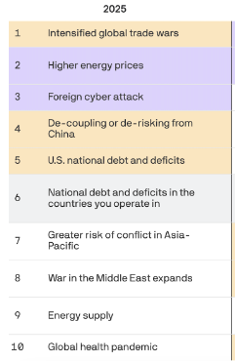
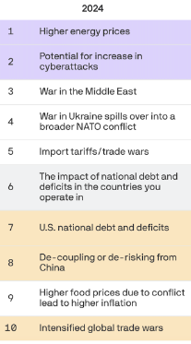

Top Geopolitical Risks Shift Under Trump
Drop
Drop
New
New
Drop
New
Source: https://www.axios.com/2025/01/15/trump-ceos-debt-trade-tariff; The Conference Board

Slide 8
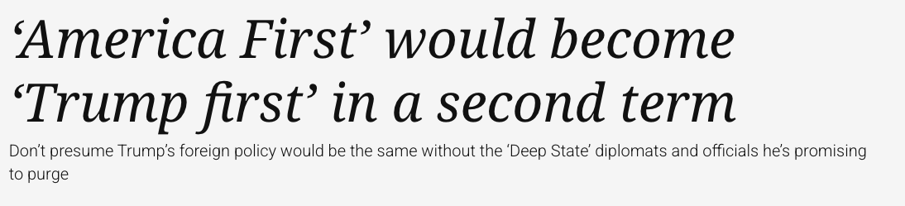
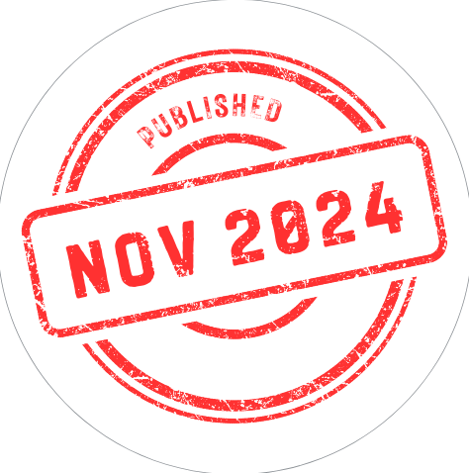
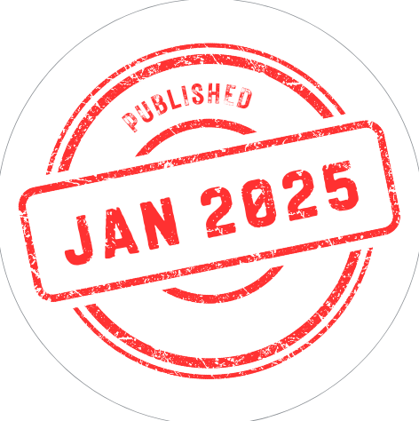
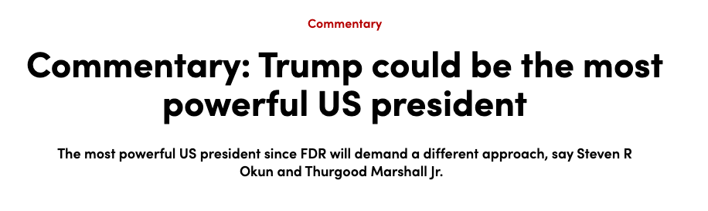
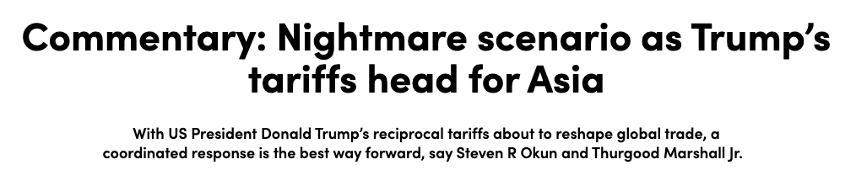

Trump: Believe Him

Slide 9
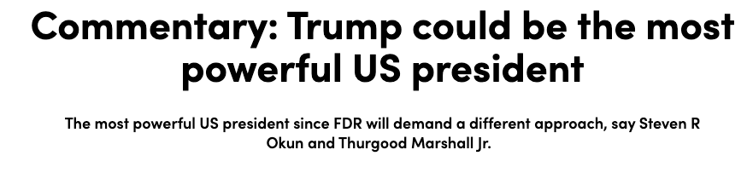
The Last Guardrail / TACO
During his first term, before COVID-19 crushed the economy, Trump bragged about the gains in the US stock market as a sign of his success. Trump will again keep score of the Dow Jones Industrial Average, S&P 500 and NASDAQ, regardless of whether that shows the true health of the economy.
Governments and businesses need to present evidence of how policies will boost the economy or conversely show that Trump’s agenda will hit the stock markets or increase inflation.
Economics and investments, not geopolitics and alliances, drive the returning president.
Source: https://www.channelnewsasia.com/commentary/donald-trump-jan-20-inauguration-us-president-second-term-foreign-policy-asia-trade-tariffs-4862391
Steve Okun 20/09/2020

Slide 10
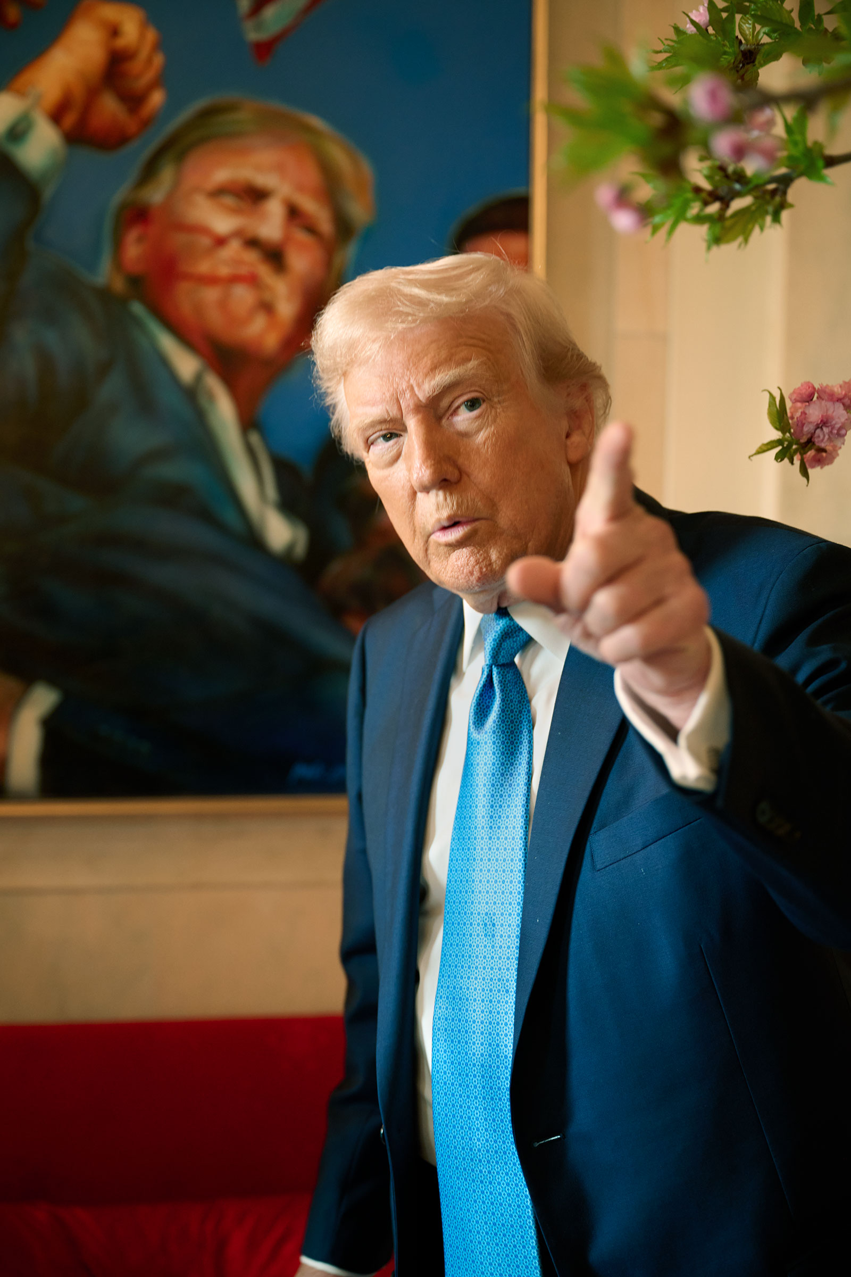
I Own The Store
“It’s a giant, beautiful store, and everybody wants to go shopping there . . .
And on behalf of the American people, I own the store, and I set prices, and I’ll say, if you want to shop here, this is what you have to pay.”
Steve Okun 20/09/2020
Source: https://www.washingtonpost.com/politics/2025/05/18/trump-economy-tariffs-taxes-trade/

Slide 11
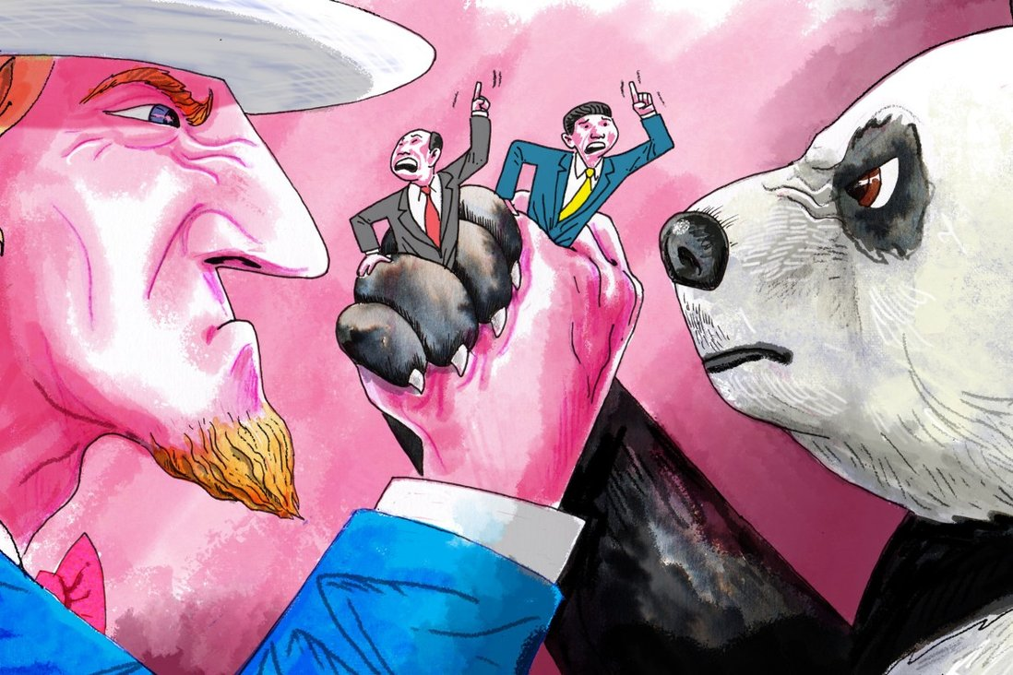
US-China Drives the Region
Steve Okun 20/09/2020

Slide 12
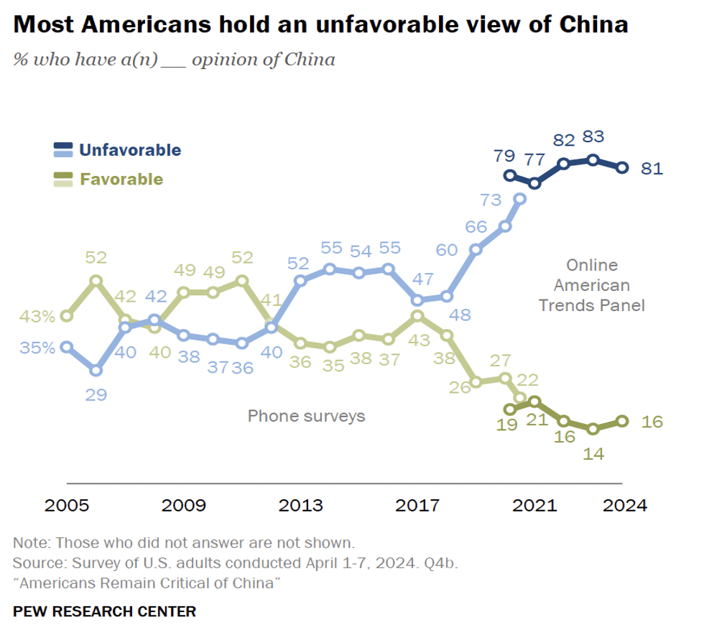
US Bipartisan Agreement on China

Slide 13
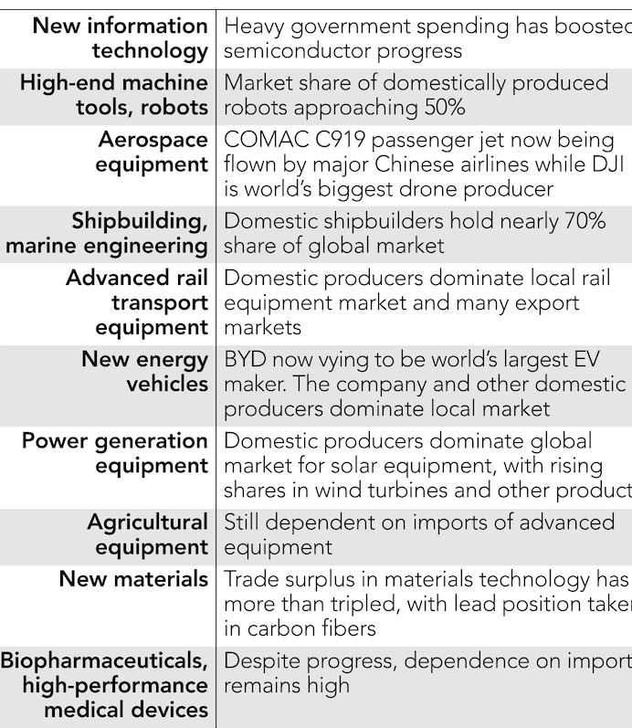
A Starting Point: Made in China 2025
Source: https://asia.nikkei.com/Spotlight/Policy-Asia/For-Xi-Jinping-Made-in-China-2025-has-been-worth-every-penny

Slide 14
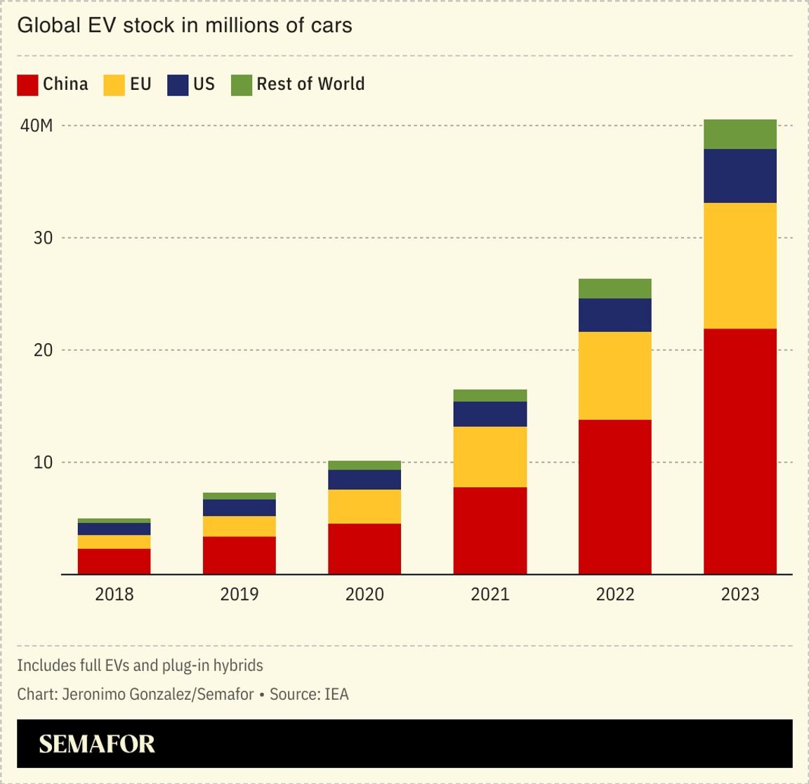
Made in China 2025 Worked

Slide 15
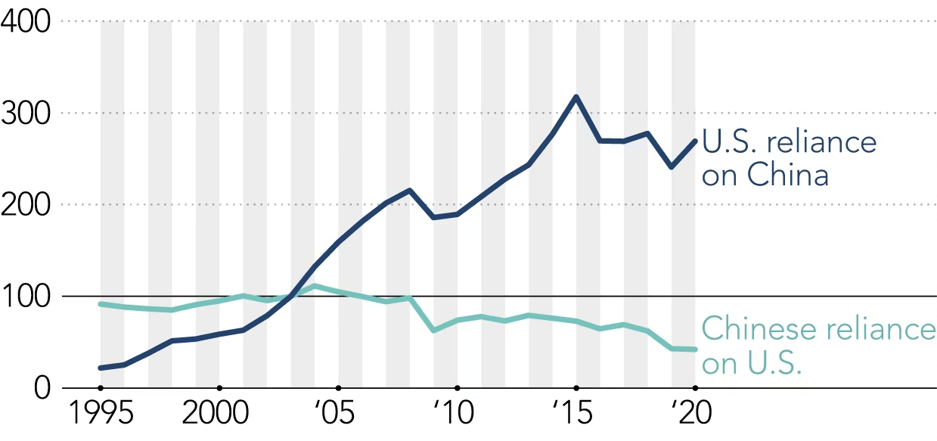
Made in China / Dual Circulation Worked
Share of Manufacturing Input Sourcing (indexed to 2003)
Source: OECD

Slide 16
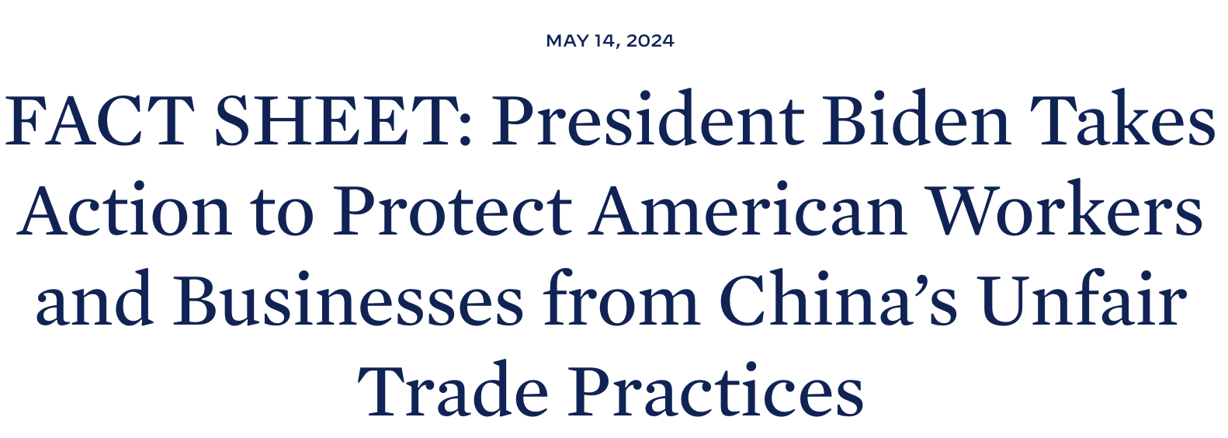
US Shift From Engage and Accommodate
China threatens American businesses and workers.
China uses unfair, non-market practices.
Forced technology transfers and intellectual property theft have contributed to its control of 70-90% of global production for the critical inputs necessary for our technologies, infrastructure, energy, and health care

Slide 17
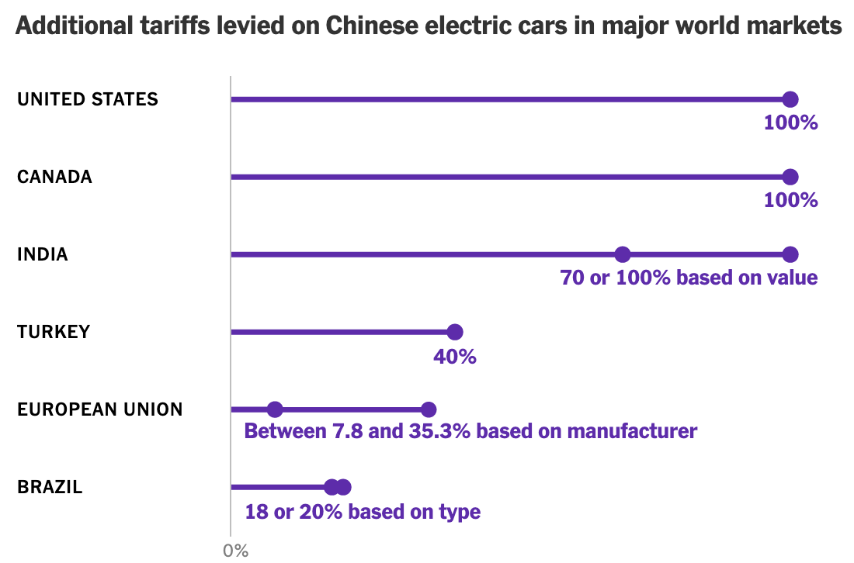
The World Responds to China
Governments are concerned because the auto industry plays a big role in national security, producing tanks, armored personnel carriers, freight trucks and other vehicles.

Slide 18
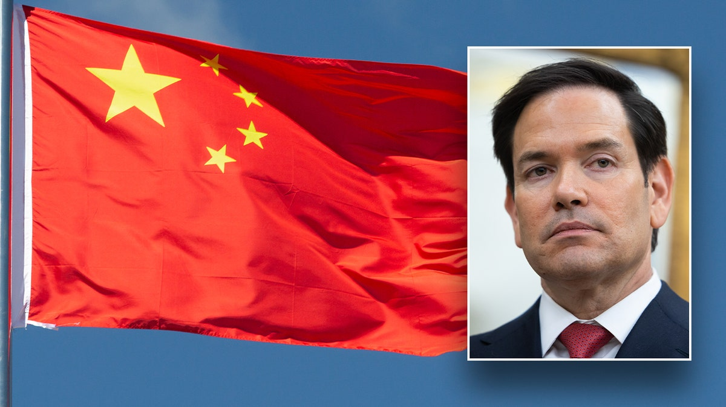
US-China: Three Scenarios
“Most advanced adversary America has ever faced”
If we stay on the road that we're on right now, in less than 10 years, virtually everything that matters to us in life will depend on whether China will allow us to have it or not.
Status Quo Plus – Small Yard Gets Bigger, Higher Fence
Strategic Decoupling – Further Limits on Trade and Investment with PRC
Decoupling – Limits on Trade and Investment with PRC to Greatest Extent Possible

Slide 19
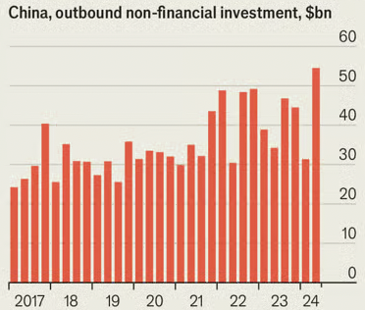
China +1 Increasingly Chinese
Source: The Economist

Slide 20
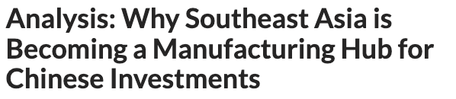
SEA A Magnet Post-Tariffs
Southeast Asia is becoming a magnet for Chinese companies wanting to relocate their mid-to-upstream supply chain to avoid US’ stricter tariff policies.
China’s investment in the region is accelerating, particularly among the electronics, automotive and renewable energy sectors.
Source: https://www.caixinglobal.com/2025-01-08/analysis-why-southeast-asia-is-becoming-a-manufacturing-hub-for-chinese-investments-102276740.html

Slide 21
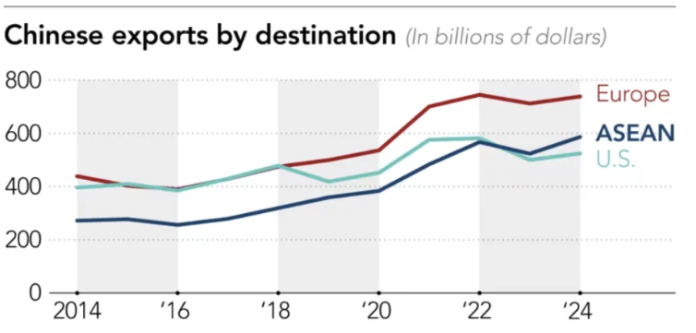
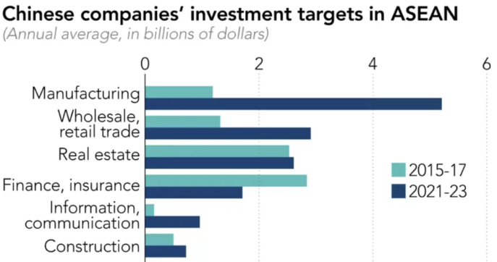
US Trade War Focuses PRC Business on SEA
Source: https://asia.nikkei.com/Spotlight/ASEAN-Money/Trump-tariffs-shine-spotlight-on-Chinese-targeting-Southeast-Asian-consumers

Slide 22
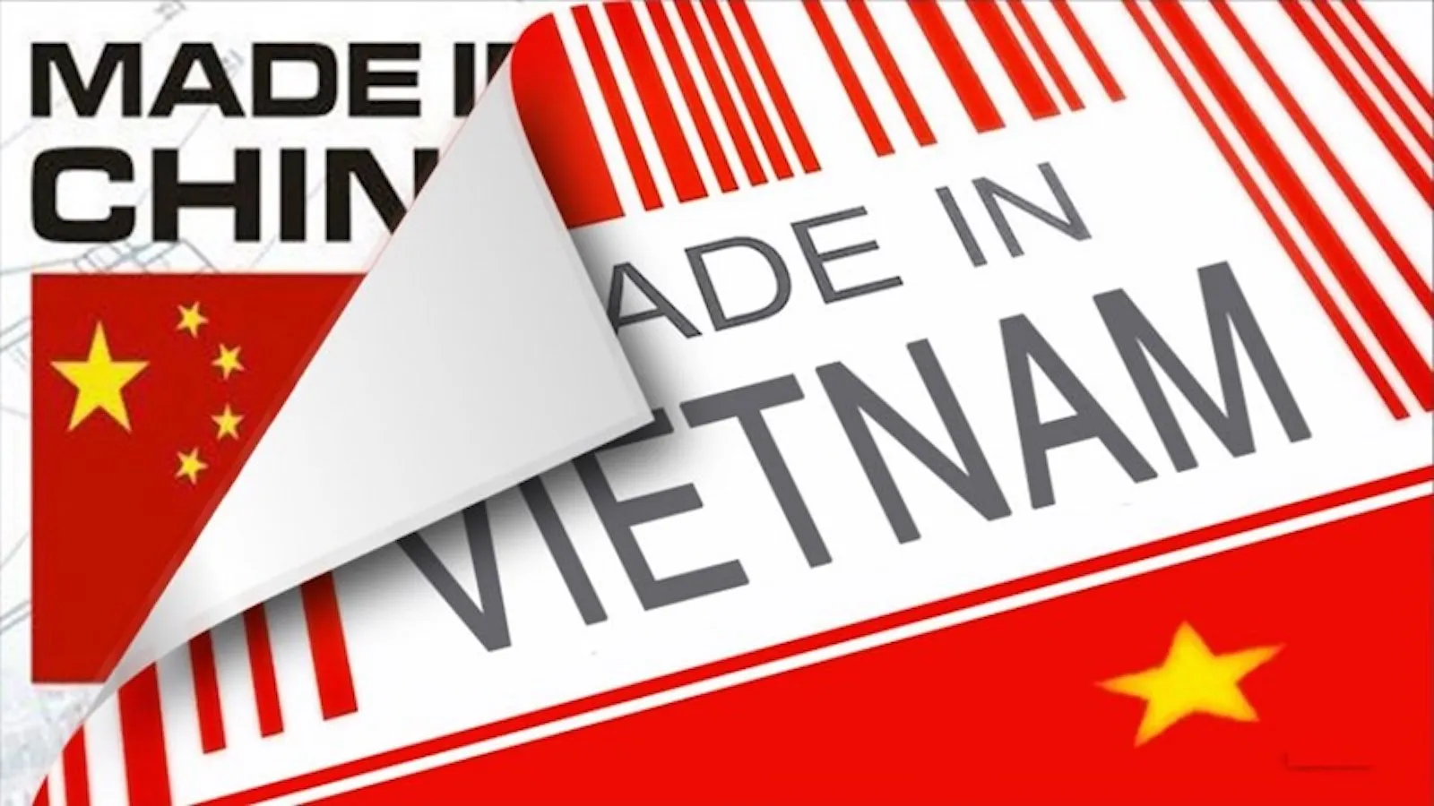
This Won’t Work When National Security And Trade Collide
Supply Chains: China +1
Tariffs: China +1
Investment Restrictions: China + 1

Slide 23
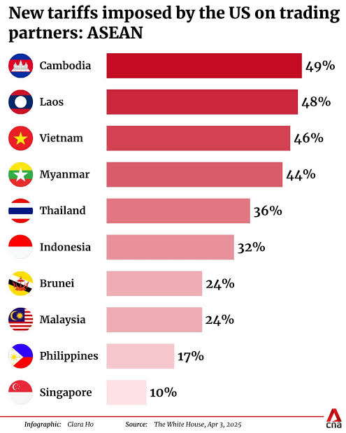
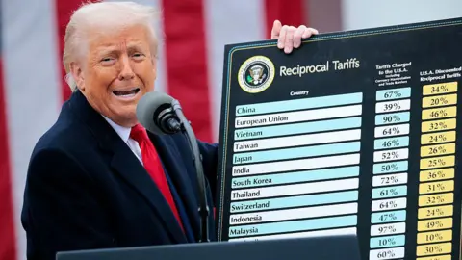
Liberation Day Tariffs on SE Asia

Slide 24

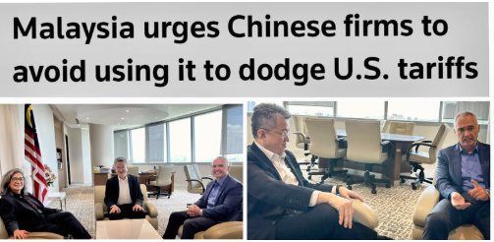
Changing Definition of Tariff Circumvention
“Section 301 may need to be modified to prevent third-country workarounds by extending the effect of the measures to imports from Chinese headquartered companies or adjusting the rule of origin for goods.”
Source: https://www.reuters.com/markets/malaysia-urges-chinese-firms-avoid-using-it-dodge-us-tariffs-2024-12-02/; Dep Trade Min Liew Chin Tong

Slide 25
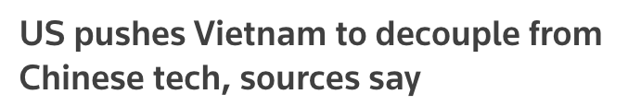
Strategic Decoupling in Action
To avoid 46% tariffs which could significantly limit access for Vietnam-made goods to their main market and upend the Communist-run country's export-oriented growth model:
Vietnam has been asked "to reduce its dependency on Chinese high-tech. That is part of the restructuring of supply chains and would in turn reduce U.S. dependency on Chinese components."
The ultimate objective is to speed up U.S. decoupling from Chinese high-tech while increasing Vietnam's industrial capacity, citing VR devices as an example of Vietnam-assembled products that are too dependent on Chinese technology.
Source: https://www.reuters.com/world/china/us-pushes-vietnam-decouple-chinese-tech-sources-say-2025-06-16/#

Slide 26
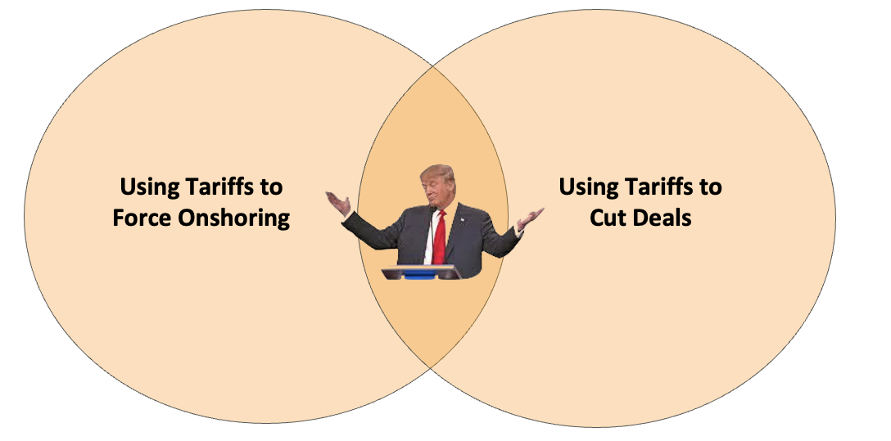
Can Tariffs Accomplish Both?
Is and possible for “US for US" and “US for World”

Slide 27

Non-Tariff Barriers Significant Issue
Licensing, Testing, and Certification Requirements
Restrictions on Business Scope and Market Access
Legal and Regulatory Burdens on Imports
Payment Risk and Delays
Digital Services and IP Protection
Movement of People
Restrictions on Movement of Capital
Transferring money out of Vietnam is complex, costly, and time-consuming.
Requirements go beyond AML and appear to function as informal capital controls.
Customs often apply the Harmonized System codes that carry the highest tariff regardless of actual product description or classification. Importers are required to pay the higher duty, creating financial strain.
US Industrial Base Needs to Export – Need to Reduce NTBs

Slide 28
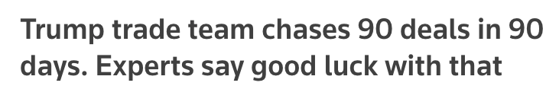
Post July 9: Business and Investors Need Certainty
Totally
Arbitrary
Rules
Countries Need Predictability
Relative Tariff Rate-MFN
Will Section 232 Apply Post-Agreement
Strategic Protectionism Needs to be Narrow (”Pharma”)
Reasonable Timelines
Dispute Settlement Process / Expectation of Stability
Inspiring
Frustration
Fear
Two Blind Spots:
US Has No Strategic Empathy
PRC Has More Leverage Over Them Than Us

Slide 29
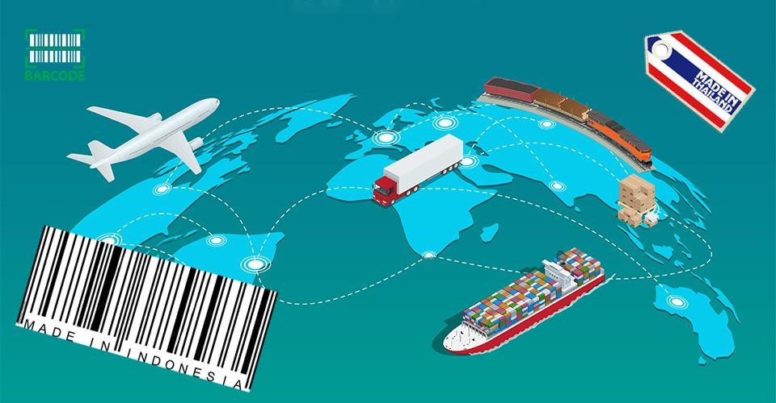
Questions Businesses Need to be Asking
What is your exposure to China?
What is your supply chain’s exposure to China?
Can you find workarounds?
Bundling of Invoices
Separation of IP
Can you find alternate markets?
Will you be getting new competitors?

Slide 30
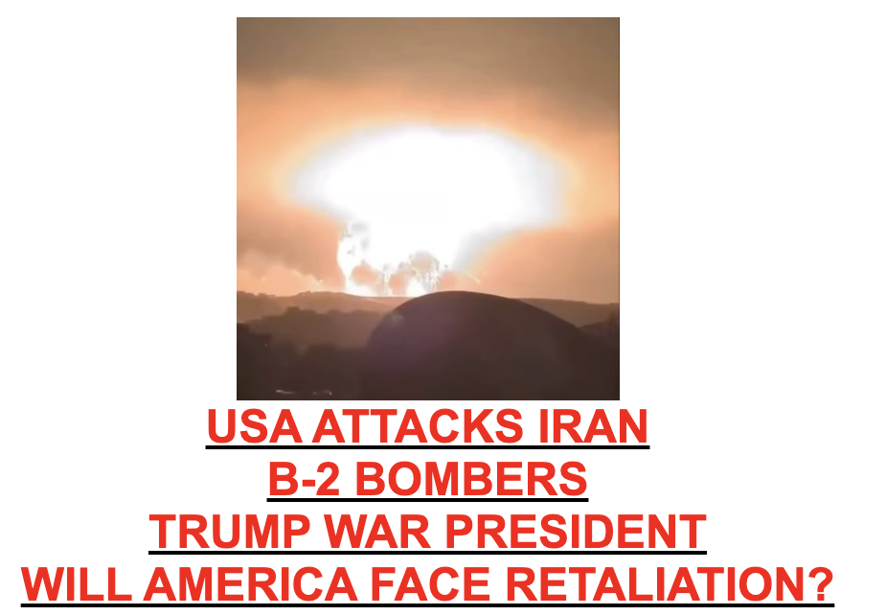
US-Iran / Israel-Iran
Source: Drudge Report

Slide 31
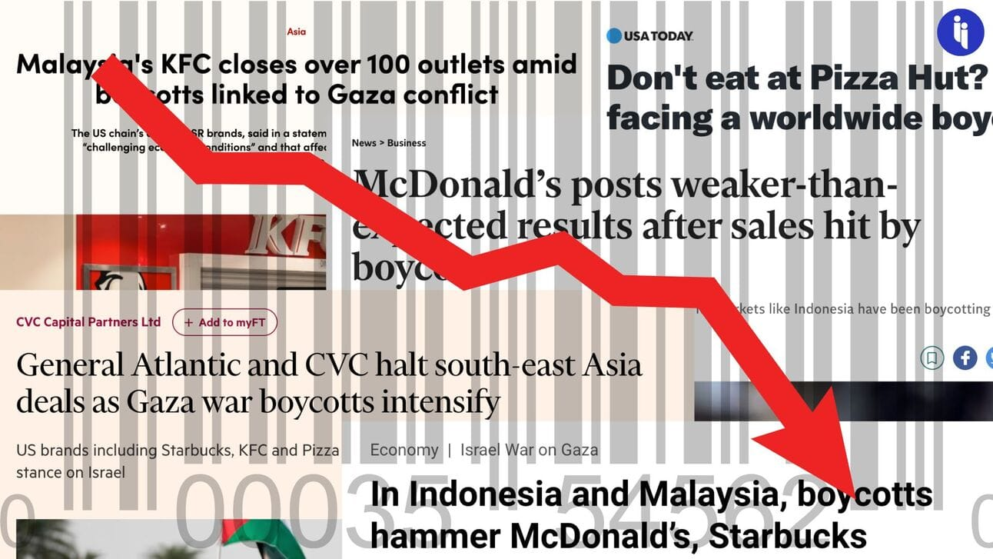
Impact of Israel-Gaza in SE Asia

Slide 32

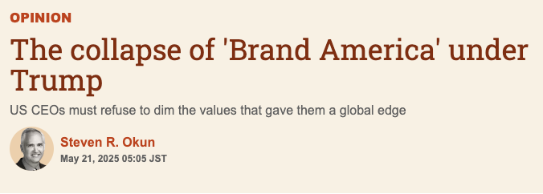
Broader Impact on US Business
Brand America was always about purpose, never perfection, and about standing up for that intention. Lose that and you lose your access, customers and employees.

Slide 33
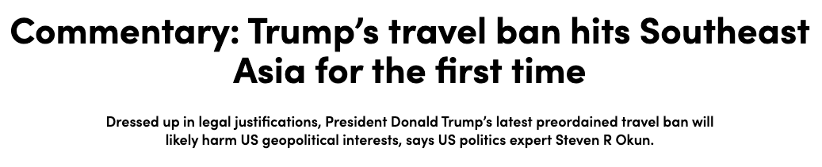
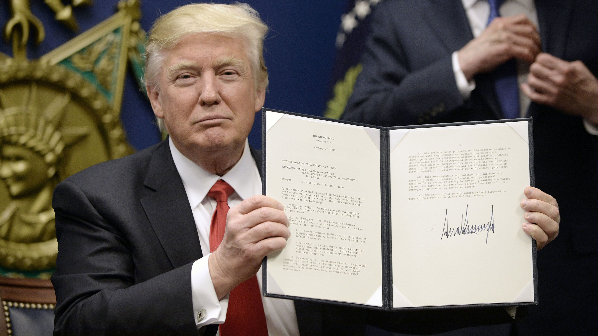
Nightmare Scenario Now Base Case
Global Tariff War
Protectionism the new norm
Unravelling of the International Trading System
WTO sidelined
Sanctions + Tariffs = Tools of National Security
Customs Disruptions Enforcement delays, stricter checks, supply chain chokepoints.
Strategic Alliances Are Reordering

Slide 34
APAC Advisors Contact Information
Steven Okun
steven.okun@apacadvisors.com
+65 9173 8923
Noemie Viterale
noemie.viterale@apacadvisors.com
+65 8571 3201
Steve Okun 20/09/2020

Slide 35
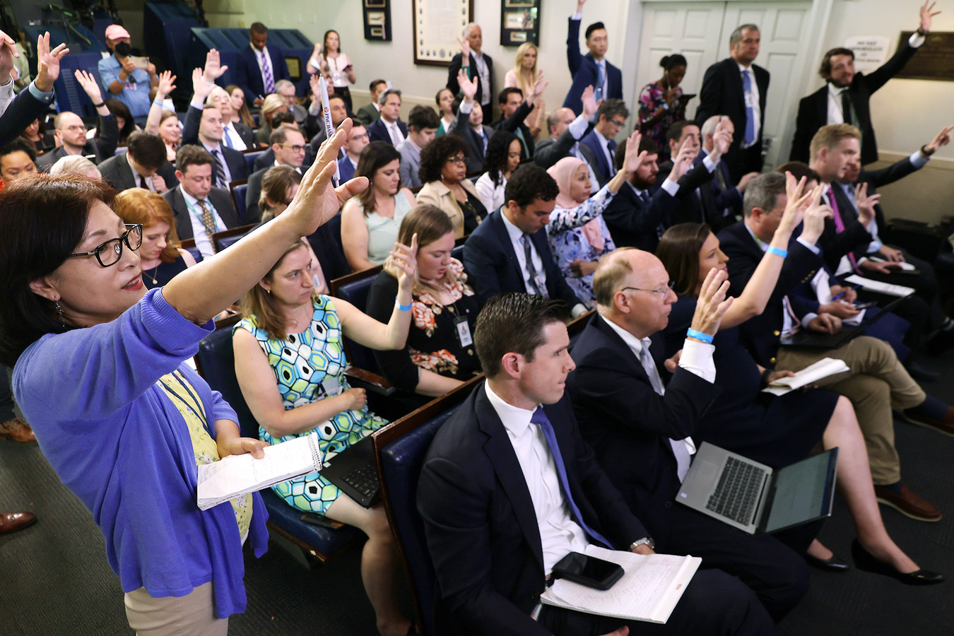
Q+A

