Slide 1


Coalition for Digital Prosperity for Asia (DPA)
Shared prosperity for Asia, by Asia
November 2024

Slide 2

About Us
Who We Are
Our Mission
The Digital Prosperity for Asia (DPA) Coalition represents digital startups across the Asia-Pacific, helping them better navigate the fast-moving landscape of digital regulation and make their voices heard to government policymakers.
We seek to strengthen awareness of key policy issues among digital SMEs and startups and create a platform for them to share their perspectives with regional policymakers.

Slide 3























































































Our Members and Partners
Our members hail from
Cambodia, India, Indonesia, Japan, Malaysia, Singapore, South Korea, Taiwan, Thailand, and Vietnam.
Partners

Slide 4
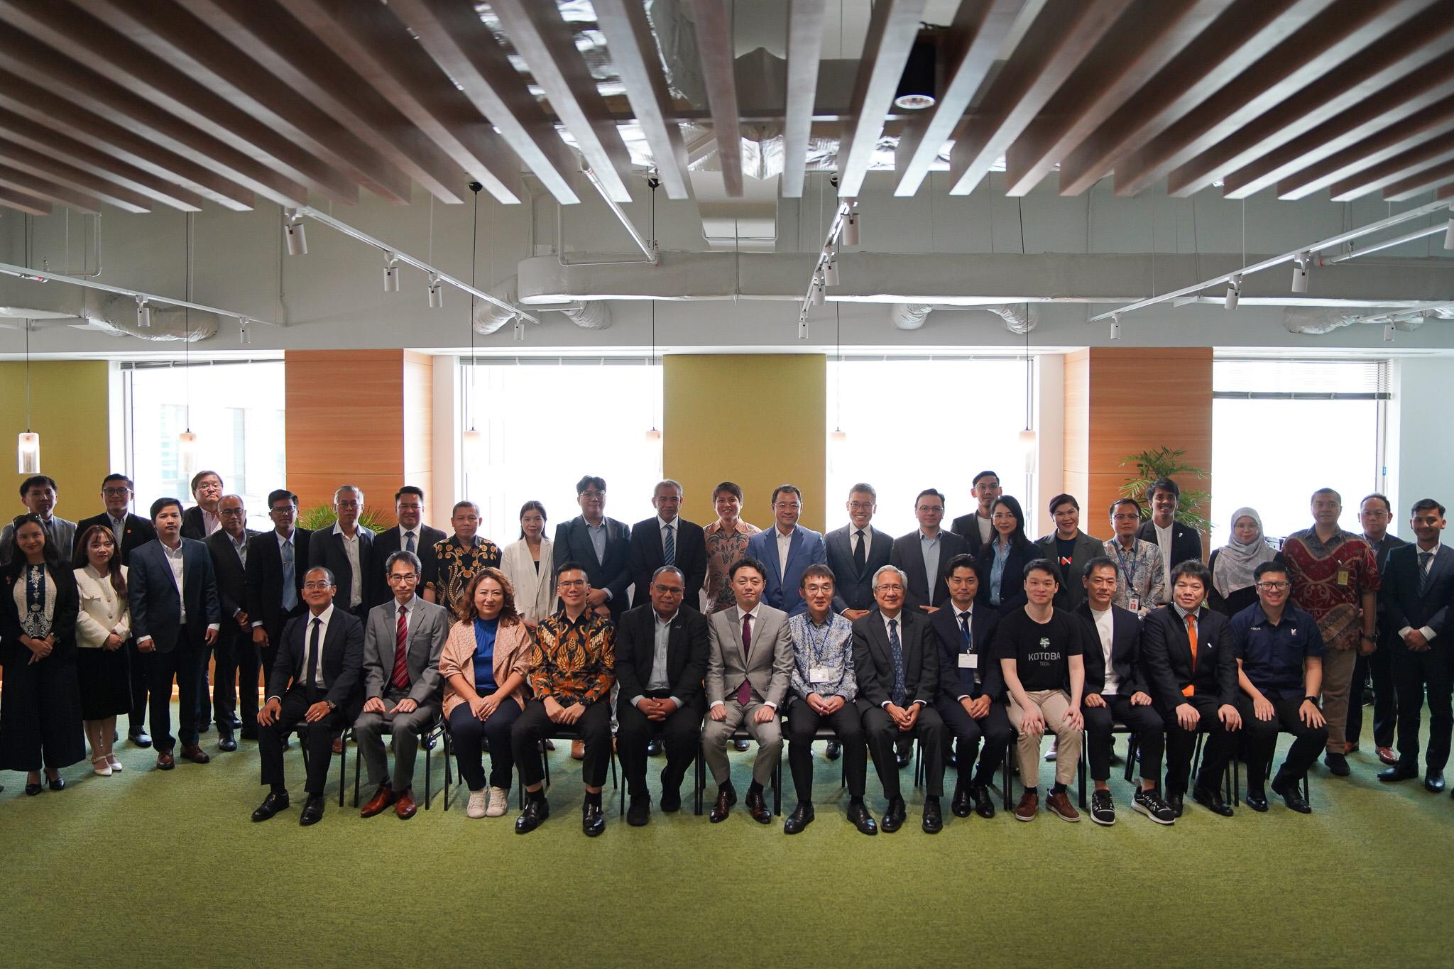


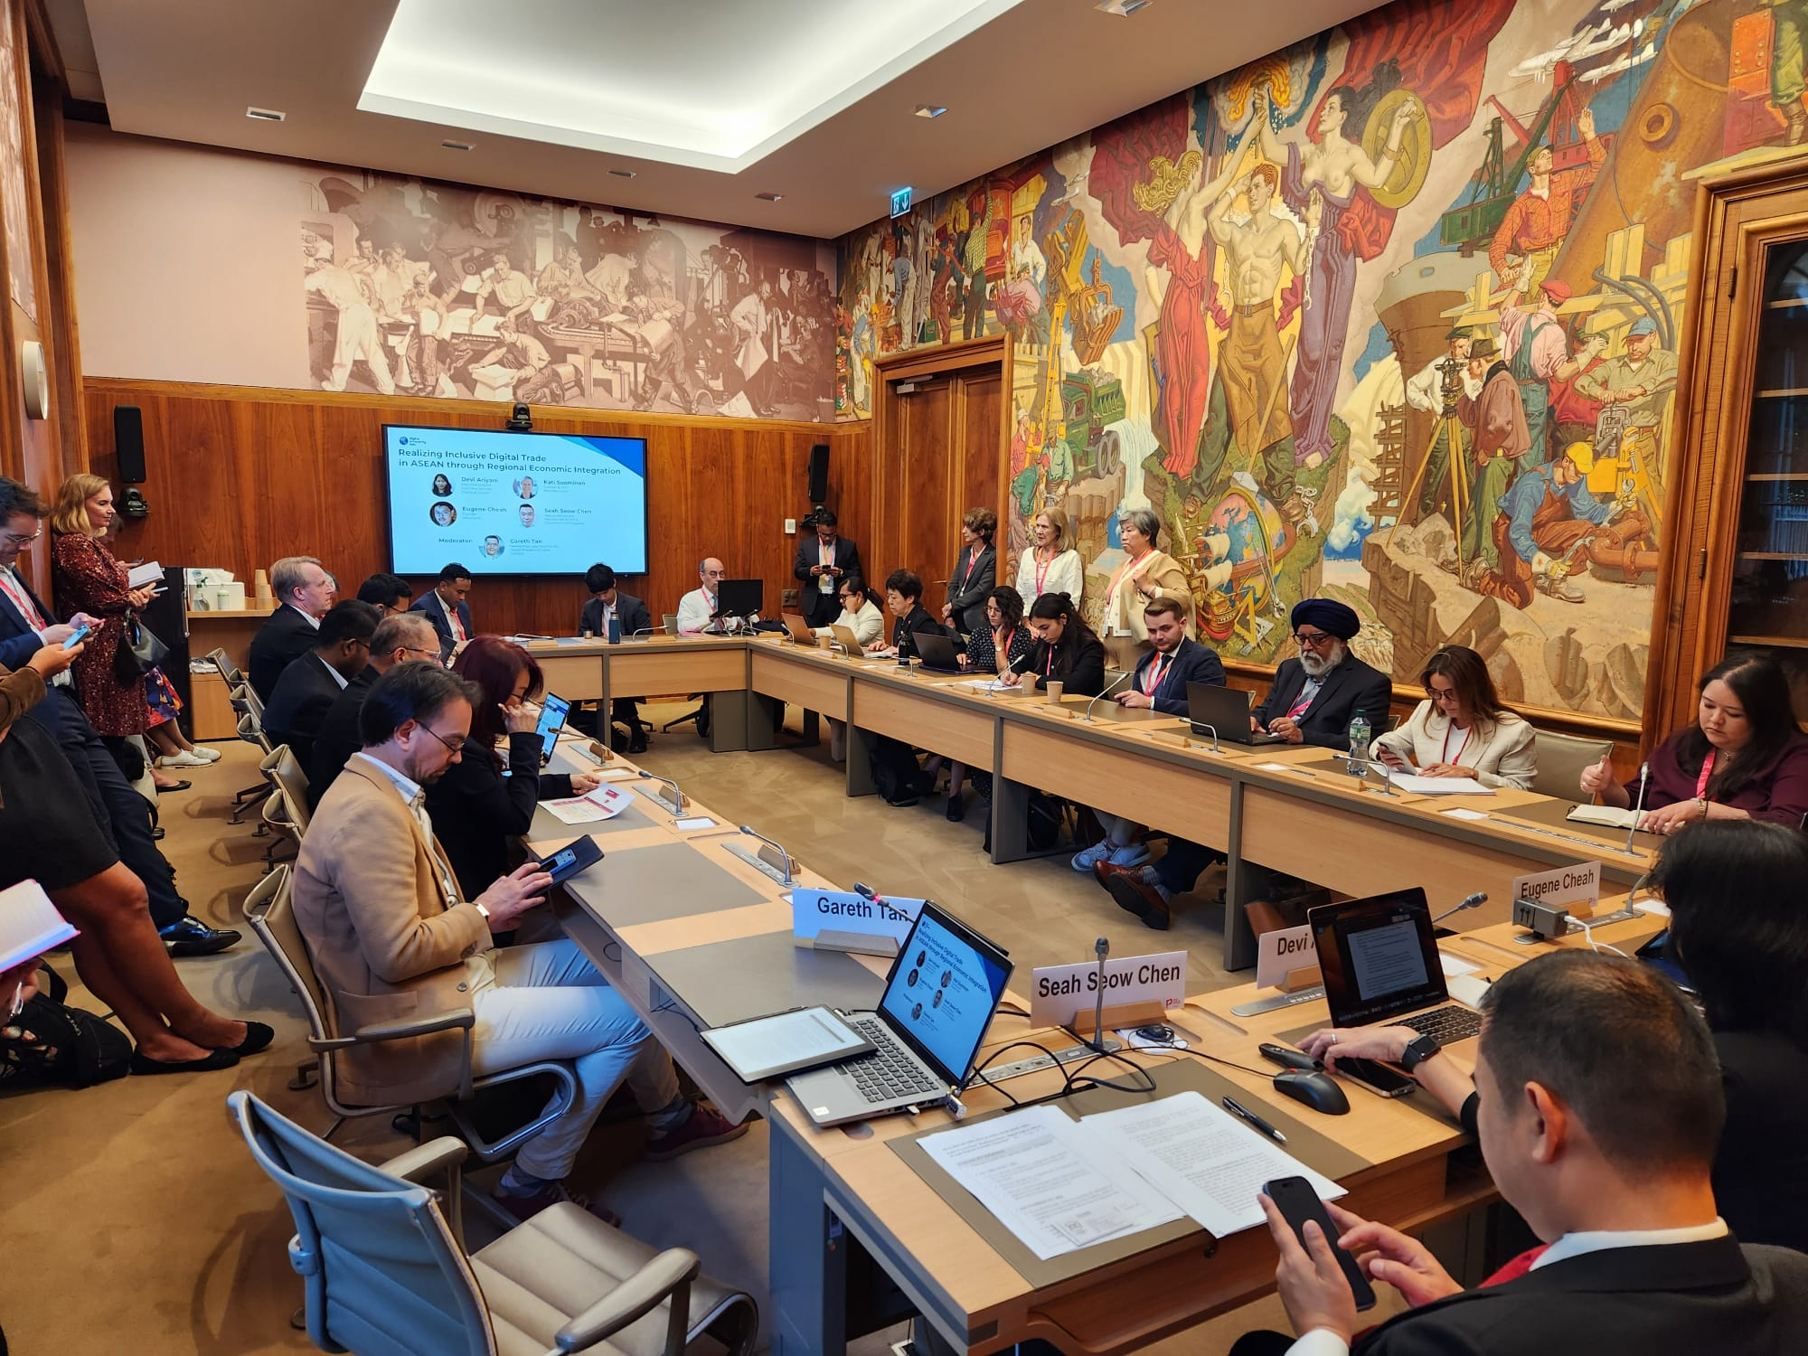
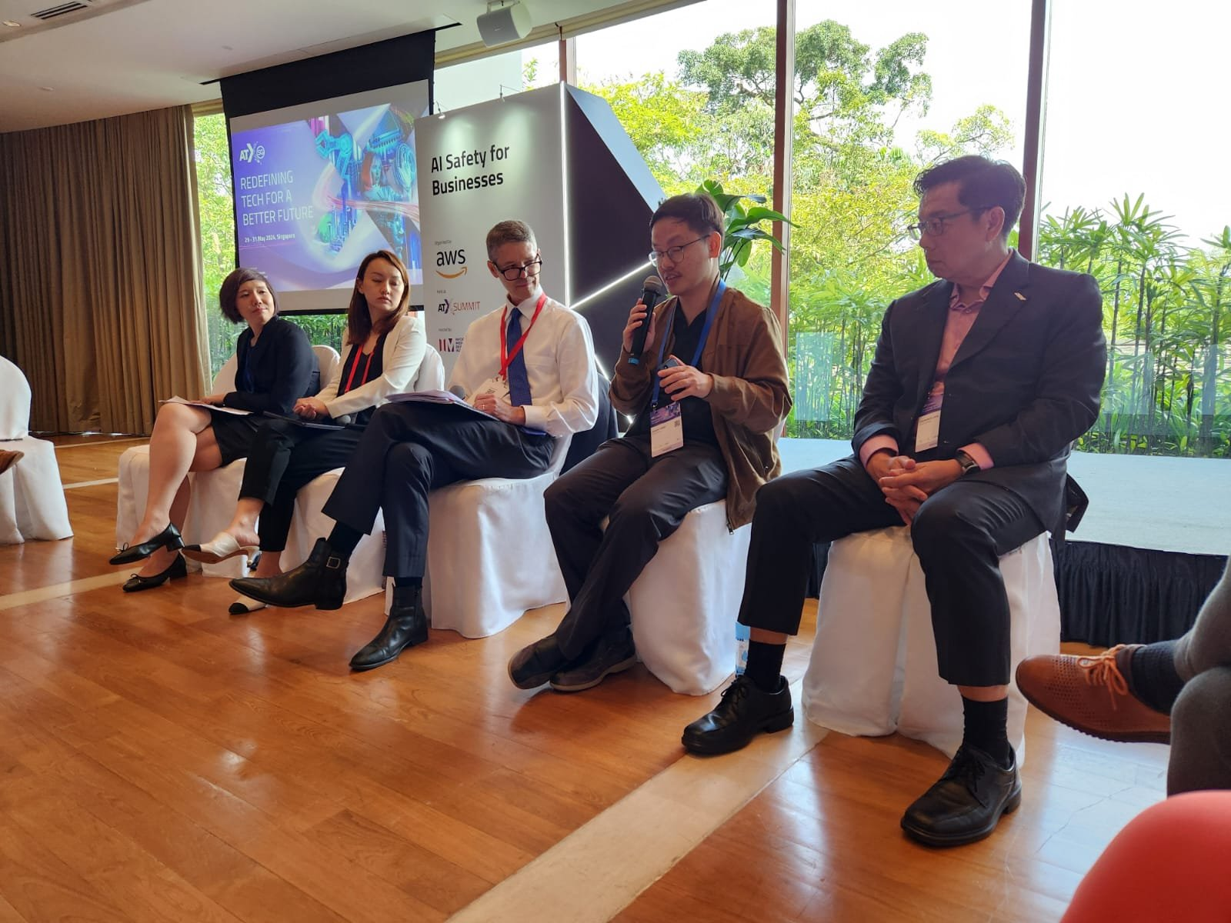
Our Advocacy
APEC Senior Officials’ Meeting 2
MAY 2025
DPA was invited to provide perspectives on how best to support AI adoption among women at the APEC Group on Services’ APEC Services Competitiveness Roadmap Dialogue.
Second ERIA Start-up Dialogue
APR 2025
The DPA participated in a start-up dialogue and contributed perspectives on the state of the start-up funding ecosystem in Southeast Asia, and the challenges member companies faced.
Ministry of Trade (Indonesia) Roundtable
MAR 2025
The DPA secretariat in Indonesia participated in a roundtable convened by Indonesia’s Ministry of Trade to discuss the impact of customs regulations on digital goods and services.
Korea National Assembly AI Seminar
NOV 2024
The DPA secretariat in Korea presented an in-depth interview conducted with market research firm Embrain on the perspectives of startups regarding the evolving role of digital regulation in Korea’s AI industry development.
DPA + iTNT Tech Munnetram Tamil Nadu
NOV 2024
DPA organized an event that brought together thought leaders, innovators, and policymakers from Tamil Nadu’s IT and Public Health Departments to discuss the future of digital transformation in Tamil Nadu.
AI x ADB Panel on AI and Economic Growth
OCT 2024
The DPA secretariat was represented on a panel on AI and Economic Growth hosted by the Asian Development Bank, alongside panelists from the Tech for Good Institute, Boston Consulting Group, and Columbia University.
WTO Public Forum 2024
SEP 2024
The DPA hosted a panel at the WTO Public Forum 2023 in Geneva, Switzerland, addressing the impact of regional trade agreements in ASEAN on developments at the WTO and vice versa.
IMDA Asia Tech x Singapore Summit AI Safety Panel
MAY 2024
DPA member Eugene Cheah of Recursal.AI provided perspectives on AI safety for startups in the Asia-Pacific region. alongside the Singapore Government’s AI Verify Foundation and AI SG.

Slide 5
Trends in Digital Trade
H2 2025
The World Trade Organization and the e-Commerce Moratorium
ASEAN and the Digital Economy Framework Agreement (DEFA)
Other Trends

Slide 6
The World Trade Organization and the e-Commerce Moratorium
The WTO and the growth of Digital Trade
The WTO was created in 1994 with the conclusion of the Uruguay Round negotiations of the General Agreement on Tariffs and Trade framework.
The WTO precedes the explosive growth of the Internet, and widespread access to digitally-delivered goods and services.
Rules at the WTO like the General Agreement on Trade in Services (GATS) touches on data, but has somewhat unclear applications on new technologies like the Cloud.
The WTO has played a key role in enabling the growth of the tech industry and the adoption of technology by reducing tariffs in IT products.
ITA facilitated the growth of digital trade by enabling the spread of the physical goods making up its hardware layer—but does not touch digital trade directly.
The Information Technology Agreement (ITA)
The Information Technology Agreement (ITA) is a Plurilateral agreement eliminating tariffs on vital ICT products signed in 1996.
ITA-2, adopted in 2015, saw ITA expand to include 50 more countries and 201 additional product categories.
ITA and ITA-2 may have reduced computer and semiconductor import prices by 66% between 1996 and 2016 for participating countries.

Slide 7
The World Trade Organization and the e-Commerce Moratorium
What is the e-Commerce Moratorium?
The Moratorium on Customs Duties on Electronic Transmissions was introduced in 1998 and prohibits WTO members from imposing customs duties or tariffs on “electronic transmissions”.
The Moratorium is not a permanent agreement and has been renewed at every Ministerial Conference (MC) of the WTO since 1998—most recently being renewed until 2026 at MC13 in the United Arab Emirates last year.
What is an Electronic Transmission?
The definition of “Electronic Transmission” is intentionally imprecise and covers any transmission of information by electronic means across borders, vitally including data transfers and all forms of digitally-delivered goods and services.
Anything from movies streamed online, to video games that exist entirely in digital form, to data moving from a data center to a customer’s mobile phone, is taken to be covered by this definition.

Slide 8
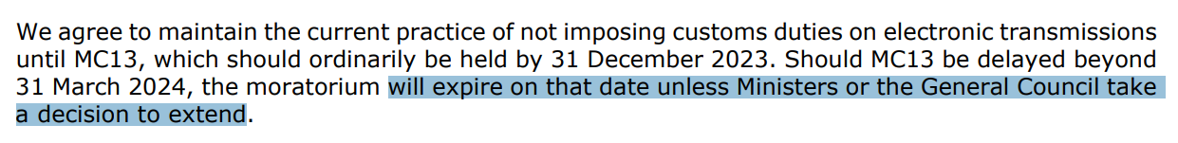
The World Trade Organization and the e-Commerce Moratorium
What’s the fuss this year?
As the Digital Economy has grown, developing countries have become increasingly territorial about data, which they view as a key strategic resource.
Some developing countries, including India, Indonesia, and South Africa, have called for the Moratorium to expire as they feel it would allow them to more directly access the economic value of the data they generate.
Pointed Language
2019
2022
2024
As the WTO operates on consensus, a decision to extend the Moratorium must be unanimous, meaning that even one dissenting country would lead to its expiry.

Slide 9
The World Trade Organization and the e-Commerce Moratorium
Why is the e-Commerce Moratorium important?
The Moratorium is the only multilateral agreement directly addressing digital trade at the WTO.
It forms the basis of modern digital trade and electronic commerce and provides certainty to businesses large and small that digital services purchased or provided can be accessed absent of additional costs or administrative burdens.
Why not put tariffs on digital trade?
A common formulation is that all digital goods are services, which are infamously difficult to track, quantify, and therefore tariff.
Countries already control services imports through market access mechanisms and capture value on digital goods and services by charging VAT or GST, which are much simpler to implement.
Worrying Signs
Indonesia: Indonesia introduced Ministry of Finance Regulation No.190 (04/2022), which establishes procedural rules for import declarations on ‘intangible goods’.
United States: U.S. President Donald Trump suggested imposing a 100% tariff on foreign-made movies, which are services that are broadly consumed online.
Customs duties on digital trade would add duplicative cost and introduce significant administrative burdens for small businesses.
Notes:
Most governments around the world acknowledge the sheer bureaucratic nightmare it would be to impose tariffs on services, and there is a general agreement that no efforts will be made to mobilize any sort of meaningful tariff on services. Governments can control services through market access mechanisms, like China does in restricting the import of movies, or by withholding national treatment to foreign service providers, or unevenly recognize certification or qualifications—like Singapore does with Law Degrees from all but a select number of Law schools overseas, for example.

Slide 10
The World Trade Organization and the e-Commerce Moratorium
What are countries in the region doing about this?
Countries like Singapore, Japan, and Australia are playing a significant role in advancing discussions on digital trade, including on the moratorium.
A key component of this work is the Joint Statement Initiative on E-Commerce.
What is a Joint Statement Initiative (JSI)?
JSIs are working groups that include like-minded WTO members, which aim to expand and advance discussions on specific trade-related topics, like E-Commerce, investment facilitation, or the issues faced by MSMEs.
The JSI on E-Commerce
The Joint Statement Initiative on E-Commerce is a working group of 91 WTO members accounting for over 90% of global trade conducting exploratory discussions on aspects of digital trade.
In July 2024, the JSI concluded negotiations on an Agreement on Electronic Commerce, agreed upon by a majority of JSI participants.
The stabilized text includes an Article on Customs Duties on Electronic Transmissions which implements a permanent moratorium with a five-year review clause.
The JSI co-convenors and participants have since moved on to exploratory discussions in adoption and implementation of the agreement, but full adoption by the WTO would rely on agreement by all other WTO members.
Notes:
Most governments around the world acknowledge the sheer bureaucratic nightmare it would be to impose tariffs on services, and there is a general agreement that no efforts will be made to mobilize any sort of meaningful tariff on services. Governments can control services through market access mechanisms, like China does in restricting the import of movies, or by withholding national treatment to foreign service providers, or unevenly recognize certification or qualifications—like Singapore does with Law Degrees from all but a select number of Law schools overseas, for example.

Slide 11
ASEAN and the Digital Economy Framework Agreement (DEFA)
What is the Digital Economy Framework Agreement (DEFA)?
DEFA is the world’s first binding regional digital economy agreement, aiming to unlock ASEAN’s economic potential by clearing barriers to digital trade.
What is going to be covered by DEFA?
No draft has been released, but DEFA is currently assumed to be modelled on articles and chapters similar to what some ASEAN Member-States (AMS) have already signed on to in other deals, like the Comprehensive and Progressive Trans-Pacific Partnership and the Regional Comprehensive Economic Partnership.
Expected areas of focus and contention include cross-border data flows, source code protections, and non-discriminatory treatment for businesses from other AMS.
One somewhat controversial discussed element is an intra-ASEAN Moratorium on Customs Duties on Electronic Transmissions.
Why should I be paying attention to DEFA?
DEFA has the potential to strengthen the value proposition of ASEAN as a unified economic bloc and give it greater leverage in negotiations with larger trade partners.
ASEAN and various ministers of AMS have publicly declared that DEFA negotiations will conclude by 2025, indicating some level of completion by year’s end.
There has been anticipation on this, as current ASEAN Chair Malaysia is viewed as being highly motivated to push DEFA forward.
Notes:
Most governments around the world acknowledge the sheer bureaucratic nightmare it would be to impose tariffs on services, and there is a general agreement that no efforts will be made to mobilize any sort of meaningful tariff on services. Governments can control services through market access mechanisms, like China does in restricting the import of movies, or by withholding national treatment to foreign service providers, or unevenly recognize certification or qualifications—like Singapore does with Law Degrees from all but a select number of Law schools overseas, for example.

Slide 12
ASEAN and the Digital Economy Framework Agreement (DEFA)
What are the concerns regarding DEFA?
DEFA’s impending conclusion in 2025 is a double-edged sword—political capital has been invested into announcing it will conclude which means there is significant pressure on ASEAN to achieve some result this year.
As DEFA would be binding on AMS signatories, ASEAN’s consensus-based model makes coming to an agreement on contentious issues challenging, which could lead to compromises that reduce the impact of the final agreement.
What are the most recent developments with DEFA?
As of June 2025, DEFA is understood to still not have hit 50% completion, raising concerns that it will be a sprint to the finish line—though there remains a strong commitment to concluding negotiations this year.
Recent indications suggest that ASEAN will aim to achieve consensus on substantial text by 2025, leaving detailed negotiations and implementation discussions to 2026.
What differentiated approaches could ASEAN take?
Phased Approach: AMS at different stages of digital development could be granted different schedules to acceding to DEFA—similar to how the ASEAN Trade in Goods Agreement allowed CMLV countries a different implementation timeline.
ASEAN Minus X Approach: If agreement cannot be reached, DEFA may become a framework, with a-la-carte voluntary accession to the agreement or even individual chapters for some AMS.
Notes:
Most governments around the world acknowledge the sheer bureaucratic nightmare it would be to impose tariffs on services, and there is a general agreement that no efforts will be made to mobilize any sort of meaningful tariff on services. Governments can control services through market access mechanisms, like China does in restricting the import of movies, or by withholding national treatment to foreign service providers, or unevenly recognize certification or qualifications—like Singapore does with Law Degrees from all but a select number of Law schools overseas, for example.

Slide 13
Other Trends – The Future of the Brussels Effect
What is the Brussels Effect?
The Brussels Effect refers to the European Union’s reliance on the incentive of access to Europe’s large and developed consumer market to compel international regulatory standardization aligned to major EU regulation.
Recent Developments at Home
Following the publication of the Draghi report on EU competitiveness, developed by former Italian Prime Minister and European Central Bank Chair Mario Draghi, the EU has committed to reviewing elements of its regulation that may be stifling innovation and economic growth.
Repercussions in the Asia-Pacific
Concerns in this region regarding the enforceability of regulation based on EU frameworks, and compliance burdens imposed on small businesses, has called into question the suitability of relying on EU models as one-size-fits-all approaches.
Approaches to AI regulation across the region have notably diverged significantly from the EU’s approach, as governments like Japan, Singapore, and Taiwan have introduced regulations focused on industry promotion that avoid EU-style risk classification frameworks entirely.
Indicative of a further shift in regional regulatory posture on digital issues that could also extend to momentum on digital trade regulations broadly as well.
Notes:
Most governments around the world acknowledge the sheer bureaucratic nightmare it would be to impose tariffs on services, and there is a general agreement that no efforts will be made to mobilize any sort of meaningful tariff on services. Governments can control services through market access mechanisms, like China does in restricting the import of movies, or by withholding national treatment to foreign service providers, or unevenly recognize certification or qualifications—like Singapore does with Law Degrees from all but a select number of Law schools overseas, for example.

