Slide 1

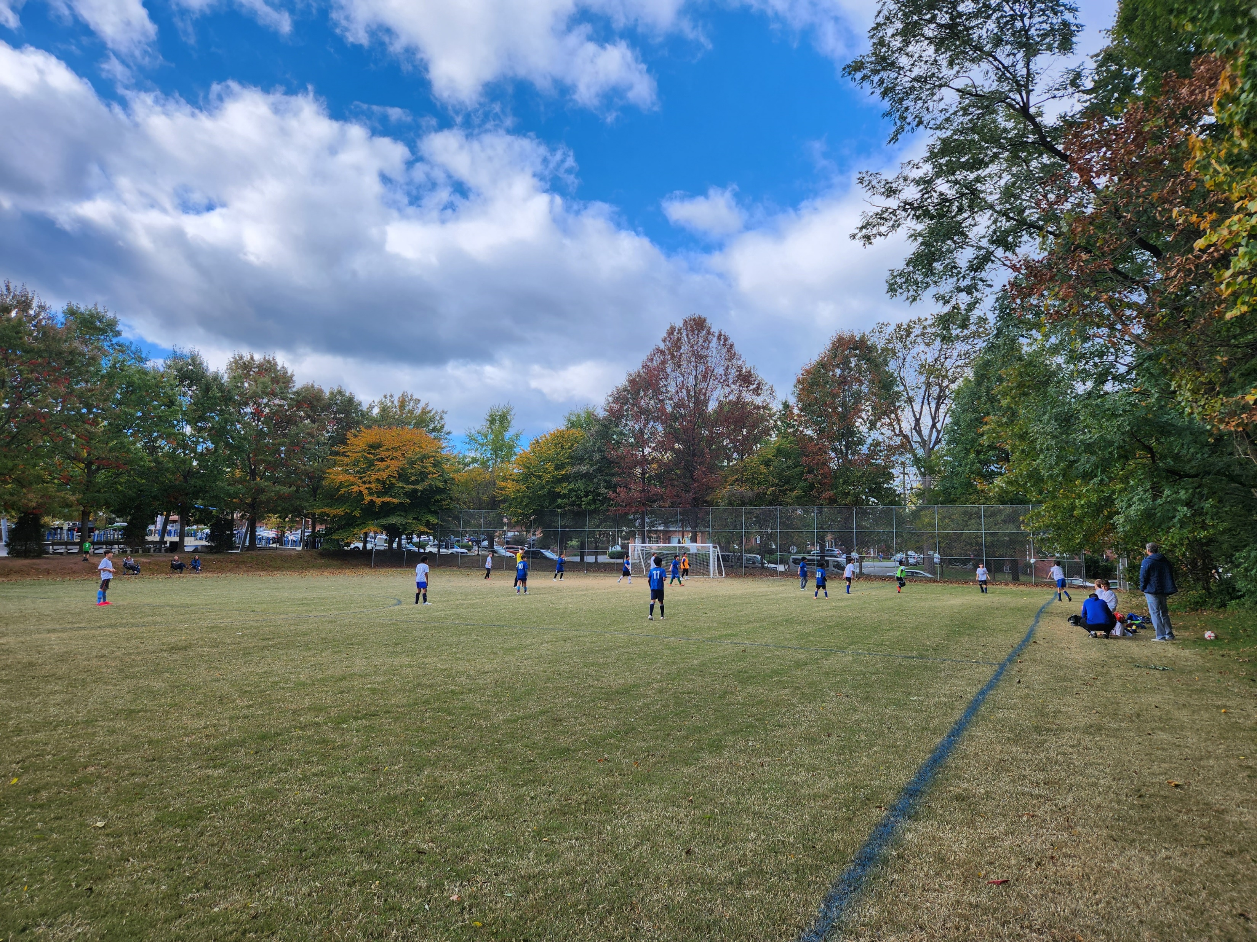
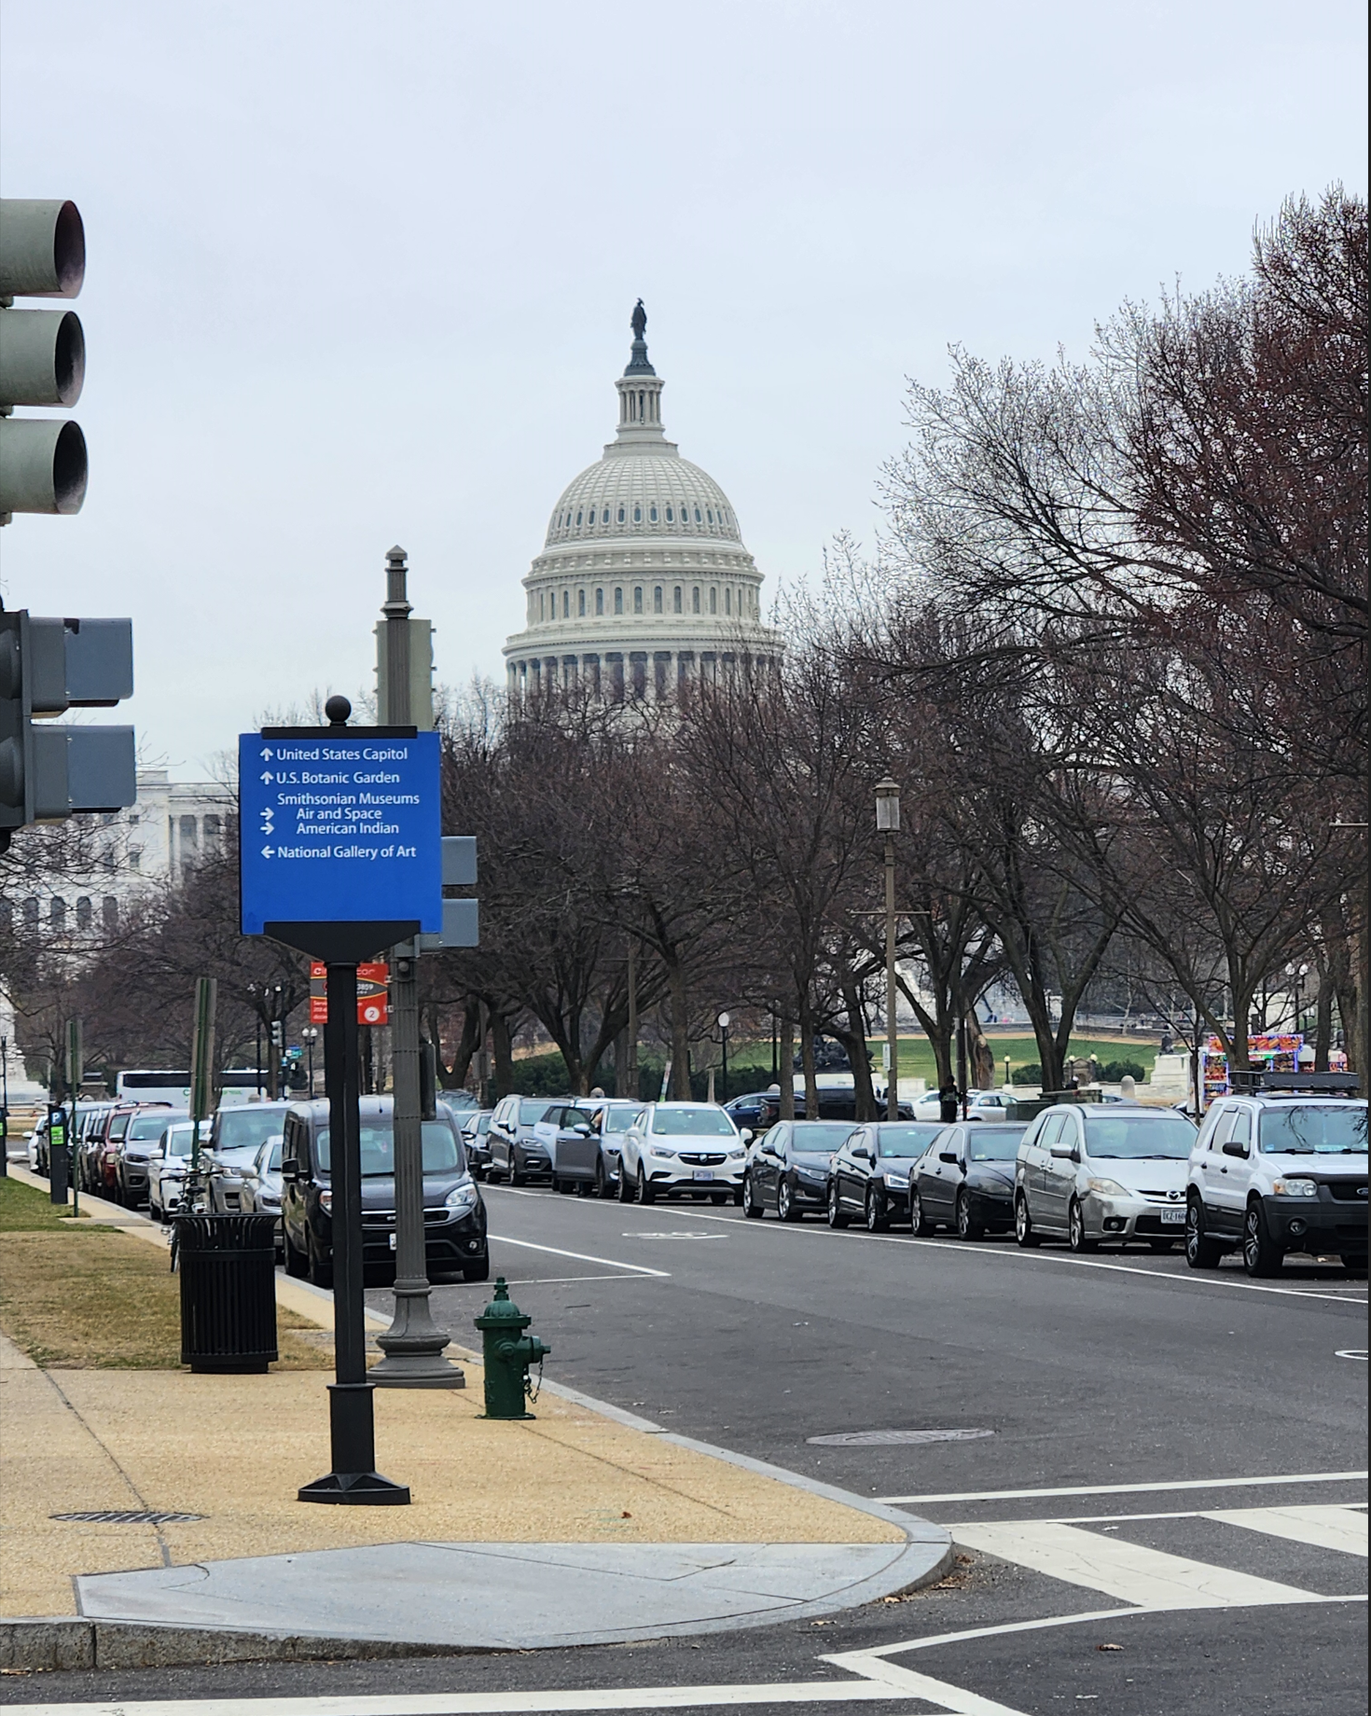


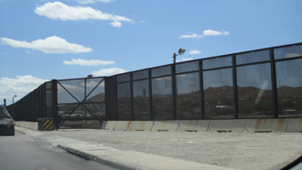

Immigration Status, Work, and Mental Health &
Considerations when writing about immigration
Ernesto Castañeda, PhD
Director, Center for Latin American & Latino Studies
& The Immigration Lab
Professor, American University
@drernestocast.bsky.social‬

Slide 2
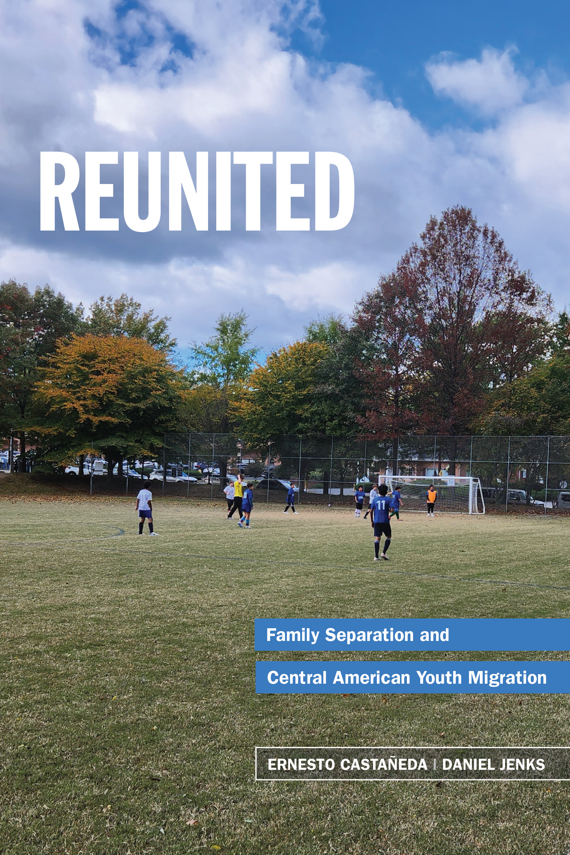
Case Study – Un-accompanied Minors in DC

Slide 3
Family Separation < - - > Family Reunification
Recent arrivals < - - > Established families
Legal exclusion < - - > Social inclusion
(border, papers) (labor market, schools, cities)

Slide 4
Data Collection
We carried out 122 interviews in total.
Household Interviews
  Immigrant youth (n = 58)
  Sponsors (n = 41)
School System, Local Government, and NGO Staff Interviews (n = 23)
Immigrant children are a hard-to-reach population.
Recruitment through service providers, non-profits, schools, lawyers.
Locations
  DC
  Maryland (Montgomery and Prince George’s Counties)
  Virginia (Fairfax County)
Notes:
-Here’s a bit more about our data collection: because we were engaging a hard to reach population we used snowball sampling through social services providers, nonprofits, schools, and law offices – we carried out 122 interviews in total, 58 with immigrant youth, 41 with their sponsors, and 23 with school, government, and NGO staff who could speak to the experiences of these children and teens, as well as give background into things like school registration and community contexts of reception.

Slide 5
Descriptive statistics among immigrant minors in the DC metropolitan area (N = 58)
 | n
Average age
At time of Arrival | 58 | 14
At time of Interview | 58 | 16
Gender | 58
Male | 31 | 53.45%
Female | 26 | 44.83%
Non- Binary | 1 | 1.72%
U.S. Legal citizenship status at Time of Arrival | 58
Documented | 9 | 15.52%
Undocumented/Asylum seekers | 49 | 84.48%
Country of Origin | 58
El Salvador | 37 | 63.79%
Honduras | 16 | 27.59%
Guatemala | 5 | 8.627%
Notes:
Here are the demographics of our sample. If there’s any questions about that we can talk about them at the end.

Slide 6
Reasons for migration: Gang violence, extortion, and recruitment, as well as higher educational and economic goals.
Many witness or experience potentially traumatic events before and during their migration.
Many respondents had not seen their parents since they were very young.
Transnational families and physical family separation because of restrictive immigration laws.

Slide 7
Vos (Alexander, 17 at migration, El Salvador)
“I treat her like a friend because she tells us: ‘ I know, I understand, because you all have grown up with my mother and from night to day you won’t say mom, or something…you all care more for my mom than me. And I know I have to understand but little by little you will get used to me,’ she says. ‘Yes’, I say, ‘but remember we have spent a great amount of time with my grandma, we never forgot you but we have spent more time with my grandma.’ She understands, that’s the thing.”
“Yo la trato como a una amiga, porque ella muy bien nos dice a nosotros: "yo se, los entiendo, porque ustedes se han crecido con mi mama y de la noche a la manana no me van a decir mama, o algo... Ustedes quieren mas a mi mama que a mi" nos dice." Y yo se que tengo que entender, pero poco a poco se van a ir ambientando conmigo," dice ella. "Si", le digo yo, "pero recorda que hemos pasado bastante tiempo con mi abuela, nunca nos olvidamos de vos pero hemos pasado mas tiempo con mi abuela. Me entiende, asi es la cosa”
Notes:
Here’s something on the topic of family reuinifcation that I thought was important to include because this is a language conference – Alexander, who was 17 when he migrated, explained that he calls his mom by “vos” instead of “mom”. He said: *read quote*. So this is an example of how family reunification is a challenging thing, it’s a process that takes time. But in the end it’s worth it.

Slide 8
Diana, (13 at migration, El Salvador on school:
“At first, I did not want to go out. I was afraid of people who I thought did not speak Spanish. I don’t know, I thought they would say go, you aren’t from here, things like that. … But after the first day I went to school, I made friends and then I didn’t even want there to be a weekend. I only wanted to be in school. … And although some classes/subjects were difficult for me, like math, because let me tell you, in El Salvador, they barely had taught me how to add. I didn’t know how to multiply, I didn’t know how to divide, I didn’t know anything! I only knew how to read, but I didn’t read very well. And here they [even] taught me in Spanish. They are teaching me how to read better. And I am interested in school here. They have a lot of programs to help us, for the students at our school.”
Notes:
And here’s a quote from Diana, who was 13 when she migrated, about her experience in school in Montgomery County, Maryland:

Slide 9
Challenges & Solutions in School Systems
Challenges
Language barriers
SIFE
History of trauma (affects non-school as well)
Cultural changes in schools
Solutions
ESOL programming
Newcomer programs
Trauma-informed counseling
Hiring new staff, creating new administrative pathways
Notes:
The last section I have here is the schooling context – there are definitely challenges for school systems when it comes to making a welcoming and effective educational environment for these children and teens – and they also serve as places where they can really engage with the U.S., with the language, culture, etc. First you have language barriers, many newcomer students only speak Spanish or an indigenous language. There is also this acronym, SIFE, which stands for “students with interrupted formal education:, in carlos’ case above, he couldn’t go to school because he was worried about getting stopped by the gnags on the way. So he may not have been in school for a year, or for six months, or for a year he only went a handful of days - Many times in schools, too, we don’t know what the quality of education was. There’s also the history of trauma that a lot of these kids bring with them ()FROM, and finally, some schools have seen their student population go from majority African-American to majority immigrant Hispanic in a number of years, which necessitates a different range of services and capabilities.
To work through these challenges, there are a number of things that schools have been doing: there is ESOL programming but schools also have to be equipped to hire staff and social workers who are bilinguial and trained in working with immigrant populations and students with a history of traumatic experiences. Some schools have ”newcomer programs”, where they do an expedited type of, let’s get everyone up to speed, at the same level, work on our English, and then get everybody into the school or into the next thing, whether it be trade school, the work force, 2-year or 4-year colleges.
Schools are are a really interesting context of reception to me, and there are a lot of innovative things that schools in the region are doing, so please ask questions about that if you have them.

Slide 10
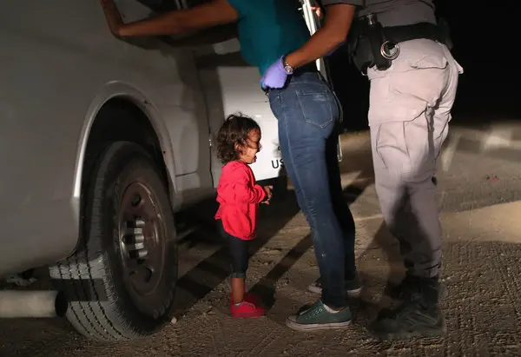
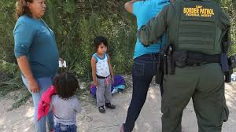
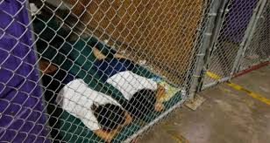
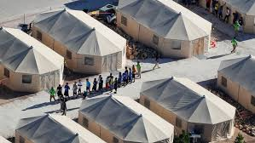
Forced Family Separations

Slide 11
Consequences of Family Separation
Due to Immigrant Enforcement
Parental humiliation of parents by authorities in front of small children, creates a sense of insecurity and anxiety on the short- and long-term.
Children feel separation as parental abandonment resulting in reduced self-esteem and self-efficacy.
Migration as trauma, PTSD, toxic stress.

Slide 12
Consequences of Family Separation
Due to Immigrant Enforcement
Parental humiliation of parents by authorities in front of small children creates a sense of insecurity and anxiety in the short- and long-term.
Children feel separation as parental abandonment, resulting in reduced self-esteem and self-efficacy.
A climate of mass deportations can create anxiety, PTSD, and toxic stress.

Slide 13
In a US and global context with:
BUT this is not new,
unique, or unprecedented…
limited legal migration for working class people;
limited guest-worker programs;
almost non-existent family visas for low wage jobs;
family reunification happening after a lag of many years or even decades:
FAMILY SEPATION AMONG IMMIGRANTS IS PERVASIVE!

Slide 14

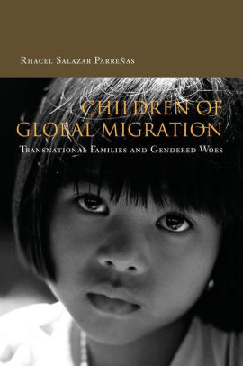
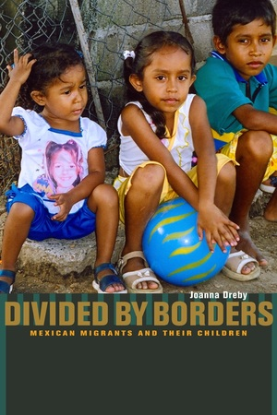
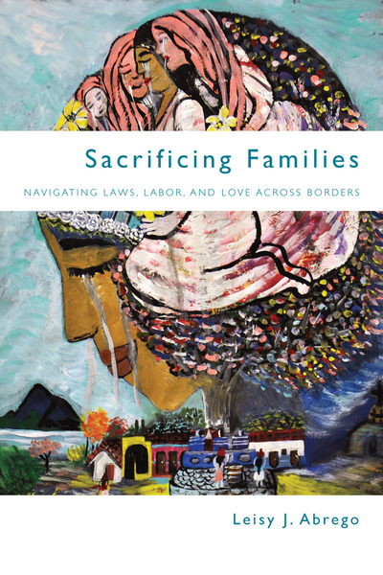

Work on family separation, transnational families, immigrant families
Decades of work on the topic in the social sciences (Abrego 2009, Burawoy 1976, Dreby 2007, Hondagneu-Sotelo 1994, Hondagneu-Sotelo and Avila 1997, Kibria 1993, Oliveira 2018, Parreñas 2005, Waters 2010)

Slide 15
Transnational Households
By Transnational Household we mean a nuclear or extended family divided across locations where income is combined (Castañeda and Buck 2011)
Captures both the economic and familial dimensions of social life
Transnational Households raise the issue of the division of labor across countries across life cycle.
  E.g., childbearing and nurturing in A; working cycle in B; retirement back in A.
Distorted population demographics (children, elderly, gender imbalances, and few local people of working age)
“Tele-parenting” (Castañeda and Buck 2011).

Slide 16
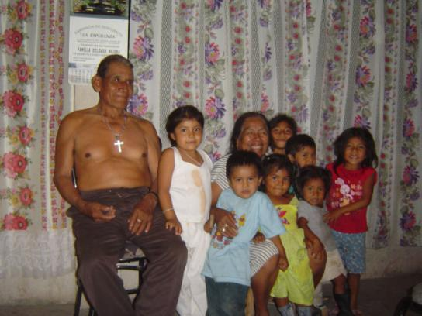

Slide 17
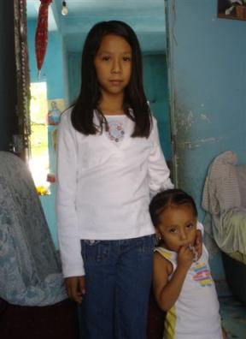
Accelerated Adulthood

Slide 18
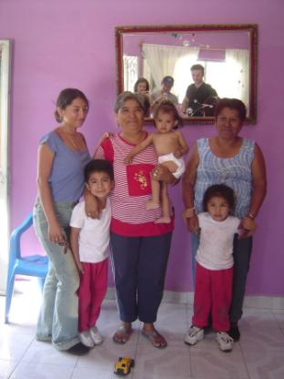
Gendered Caregiving
-
Intergenerational conflict
Photos © Ernesto Castañeda

Slide 19
The Children Left Behind
Artico (2003) explores the experiences, perceptions and memories of Latino adolescents and young adults reunited with their biological parents after prolonged separation during childhood because of piecemeal immigration patterns. Some reported:
  Feeling that the loss could never be repaired
  Feeling distant or disconnected from others; doubt about their own ability to feel love for others.

Slide 20
The Effects of Family Separation
PYSCHOLOGICAL
Separation anxiety
Continued grief
Abandonment
  (Castañeda and Buck, Remittances, Transnational Parenting, and the Children Left Behind: Economic and Psychological Implications 2011).
ECONOMIC
Culture of migration
Lower likelihood of enrolling in higher education despite the increased income
  (Castañeda Living in Limbo 2013)

Slide 21
Remittances come at a cost
We should keep in mind that:
  Remittances keep families dispersed across state borders,
  And the social structure created by remittance economies has impacts on the prospects for economic development, and future families.
We should be careful not to extrapolate developmental potentials from remittance flows at the national level,
and recognize the social costs brought about by family separation

Slide 22
Solution: laws that allow for regularization & family reunification

Slide 23
Immigrant youth in the dmv
Suffering and enjoying like everyone else.
  Underfunded schools.
  Existing but limited green spaces, recreational, and public parks.

Slide 24
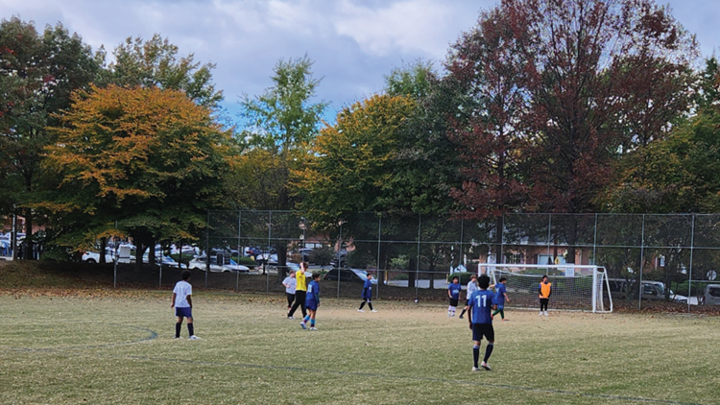

Slide 25
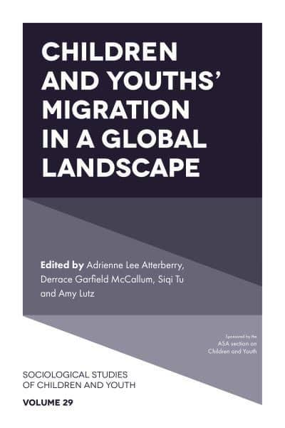
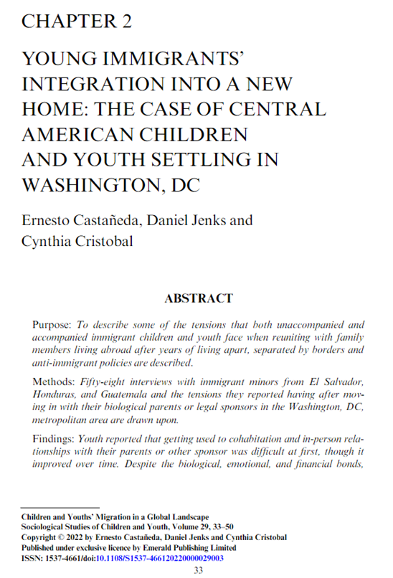

Slide 26
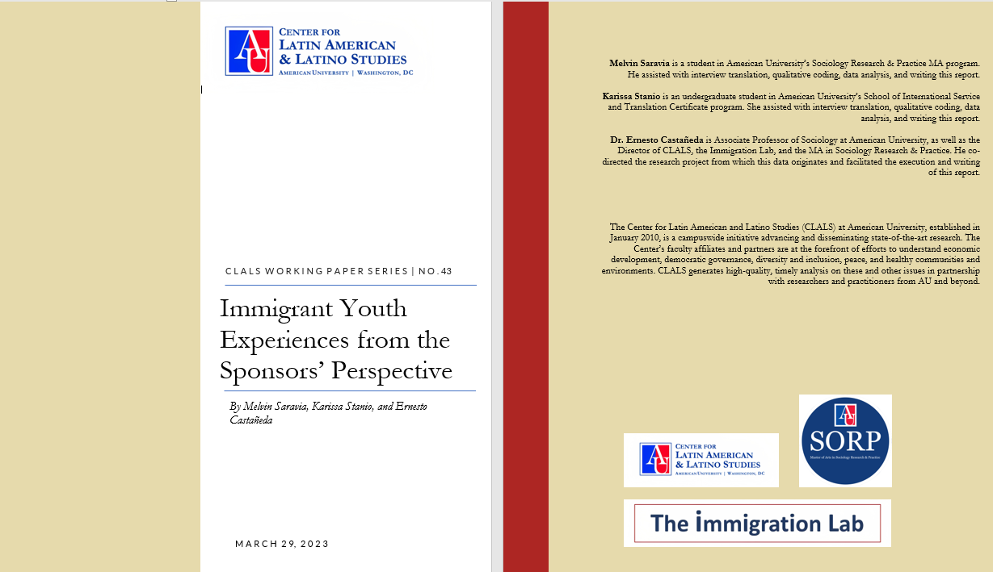

Slide 27
Common assumption about immigration
There are many widespread misconceptions regarding immigration
Members of the public may think that they are experts
Therefore, the importance of being reflexive when covering immigration
We must be conscious of possible misunderstandings and malicious misrepresentations of facts presented.

Slide 28
Pluses
In 2025, there is clear interest in the topic.
So, the issue is not in covering the topic and reporting on policy changes, but in the storytelling and framing of “the problem.”

Slide 29
Examples

Slide 30
Draft of academic paper reviewed
Protracted global conflicts during the past decade have led to repeated major refugee crises in Europe.
During the height of the Syrian refugee crisis at the end of 2015, Europe hosted around 2.3 million people requesting asylum [1].
Today, the ongoing war in Ukraine has resulted in the largest refugee surge in Europe since World War II, with more than 7.4 million seeking refuge across Europe [2].
Do repeated refugee crises threaten to exhaust solidarity or do Europeans welcome Ukrainians over other refugees [3, 4]?

Slide 31
After review
Protracted global conflicts during the past decade have led to repeated major humanitarian protection crises in Europe.
During the height of the Syrian refugee crisis at the end of 2015, Europe hosted around 2.3 million people requesting asylum [1].
Today, the ongoing war in Ukraine has resulted in one of the largest humanitarian emergencies in Europe since World War II, with more than eight million Ukrainians seeking refuge across Europe [2].
Do repeated humanitarian crises threaten to exhaust solidarity or do Europeans welcome Ukrainians over other refugees [3, 4]?

Slide 32
Background
More than 40 million people today are refugees, asylum-seekers, or other internationally displaced “migrants in need of protection” (MNP) (UNHCR 2021).
Relative to other migrants and non-migrants, MNP exhibit higher burdens of mental health issues …
Nevertheless, most scholarship on MNP mental health is cross-sectional, leaving open questions about their mental health volatility.

Slide 33
The migratory context in Chile is of high interest. There has been an increase in international immigrants in the last decade [1–3], mainly from the rest of Latin America [4–6]. Migration is especially relevant in Chile because foreign nationals increased from 2% to 7.6% of the total population of the country between 2002 and 2021, mainly due to the arrival of Venezuelan, Colombian, and Haitian immigrants [7].
Recently, a sharp increase in illegal crossings in the northern part of the country has increased conflict and negative attitudes toward immigrants. There have been attacks by the Chilean population on immigrants who are in precarious situations and are living on public roads [8], which has a negative impact not only on foreigners’ lives but on social cohesion as well [9,10].
Thus, there is a complex scenario in part because migration is a recent cultural phenomenon where non-Chilean nationals are signified as outsiders regardless of their legal status or nationality [11,12].
Furthermore, it has fueled situations where migrants’ rights are neglected and they are not treated as equals by the Chilean society [13].

Slide 34
Causation
Reasons for why academics write like this

Slide 35
Migration scholars are sometimes called to rarify migration and talk about the uniqueness of their work.
Research proposals must underline their uniqueness and unprecedented approach.
In previous decades, migration researchers had to make a case about the importance of migration to be published in generalist disciplinary journals.
While many academics have journal editors and other academics in mind when they frame their research questions and write introductions, discussions, and conclusions, it is essential to also have in mind a more general public, journalists, and policymakers who may not call on them directly but read their work to inform public policy.
It is of the utmost importance to avoid sensationalist frameworks and cliches about supposed refugee crises, record numbers, foreign “invasions,” historical demographic changes, “great replacements,” and other tropes popularized by the right.

Slide 36
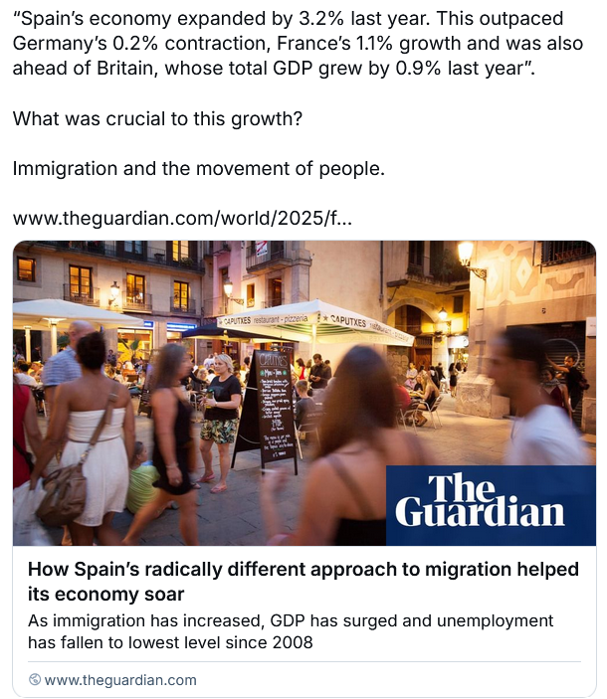
Good example
Let data speak.

Slide 37
Bad way to end article
It was a glimpse of the delicate balancing act required of governments, said Rafael Doménech, the head of economic analysis at Spain-based bank BBVA.
Spain’s relative openness to migration “is certainly an advantage and it’s an opportunity, but it has to be managed well”, said Doménech. “If not, it can lead to major imbalances and tensions that can turn into social unrest or foment populism,” he said. He cited the country’s housing crisis as a potential flashpoint.
He cautioned that it was too soon to draw any sweeping lessons from Spain, a country where migrants had gone from making up less than 2% of the population in 1998, to more than 15% in two decades. “It remains to be seen how this will play out,” said Doménech, who pointed to countries such as Denmark, where the far right had successfully turned migration into a polarising talking point after years of relative openness.
“I think we’re just getting started here,” he said. “It would be good to have this conversation in five or 10 years from now, so that we can evaluate how well Spain has done.”
https://www.theguardian.com/world/2025/feb/18/how-spains-radically-different-approach-to-migration-helped-its-economy-soar

Slide 38
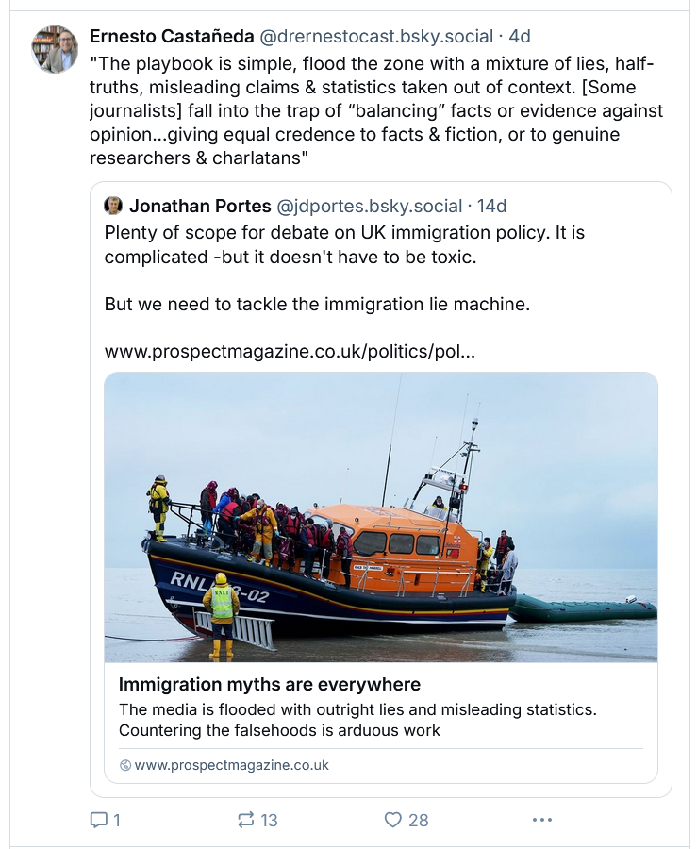
https://www.prospectmagazine.co.uk/politics/policy/immigration/69229/immigration-myths-are-everywhere
"The playbook is simple, flood the zone with a mixture of lies, half-truths, misleading claims & statistics taken out of context. [Some journalists] fall into the trap of “balancing” facts or evidence against opinion...giving equal credence to facts & fiction, or to genuine researchers & charlatans"

Slide 39
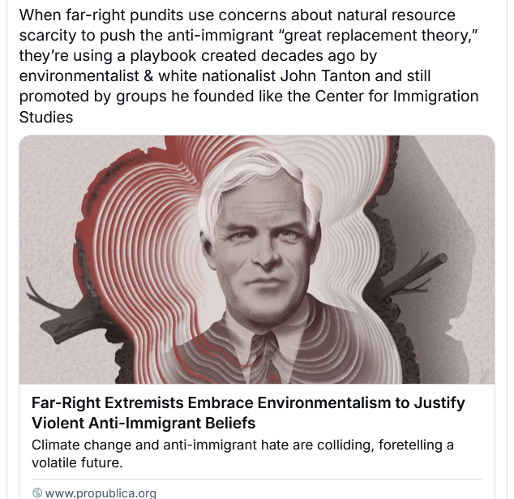
Anti-immigrant lobby
“When far-right pundits push the anti-immigrant “great replacement theory,” they’re using a playbook created decades ago by environmentalist & white nationalist John Tanton and still promoted by groups he founded like the Center for Immigration Studies” by Abrahm Lustgarten
https://www.propublica.org/article/john-tanton-far-right-extremism-environmentalism-climate-change

Slide 40

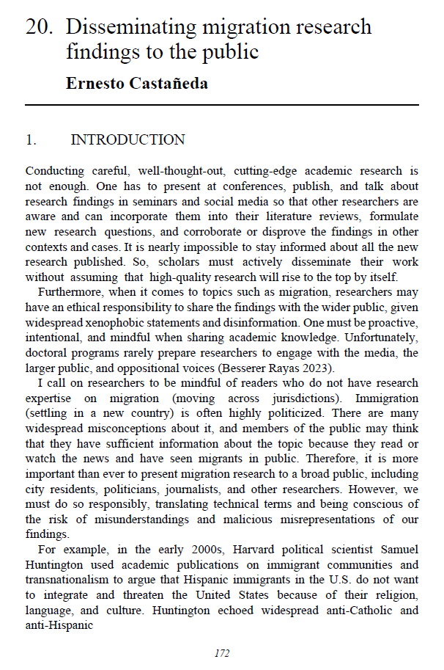
Some takeaways from the chapter

Slide 41
• Do not start a paper with a description of the size of the immigration, minority, or religious population. Neither with possible growth in the future, these things are contingent, and research on any population is important no matter how small.
• Do not speak about “record numbers” of migrants or asylum seekers. When discussing immigrant absolute numbers, also include their percentage out of the total population of a place and, if possible, how that compares to other times in the last 150 years. What will transpire is a certain continuity in inflows amidst changes in national origins. Citizens may be observing new people in public places, but immigration is not a new phenomenon.
•Avoid the use of the term “era” or in times of “_____.” Eras come from geology and mean something much different and long-term than how social scientists have been using the term in recent years. Avoid this in the title. If you insist on using this terminology, then you should specify when this “time” or “era” began and when it ended or what would make it change into a new era.

Slide 42
Do not use the term “nation,” which denotes a supposed shared racial and cultural origin. Instead, use country, state or even better, the name of a specific territory and city, or metropolitan area. It does not need to coincide with political and administrative borders.
Employ the running definition of a citizen as that of any person living in a city rather than a state-sanctioned dweller.
There is no need to connect international migration to globalization, new communication technologies, or new forms of transportation. These are tired and anachronistic statements that have become unquestioned truisms.

Slide 43
Similarly, transnationalism and remittances in themselves should not be the basis for new empirical research and case studies. Remittances are not new, and while they may aggregate into very large amounts, they most often represent a portion of personal income used to cover family expenses, in this case, when close family members live in other countries. Here what should stand out is not that parents provide for their children but what Jenks and I call “structural family separation,” i.e. in current working-class immigration regimes treat immigrants as individual workers rather than as family members.

Slide 44
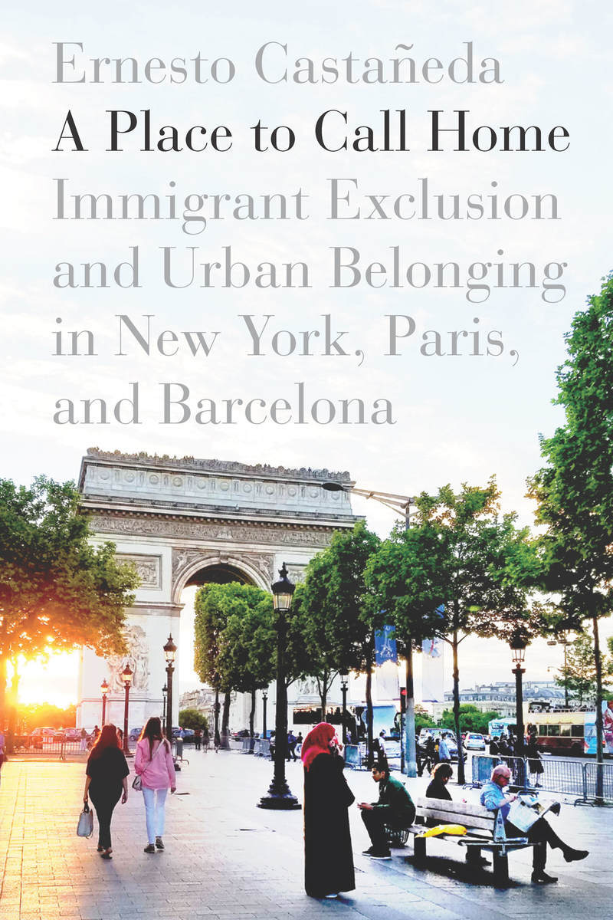
Similarly, in the twentieth century, we should no longer talk about assimilation (forced homogeneity at the expense of cultural diversity) but instead about all residents of a place feeling a similar sense of belonging in an intercultural context.

Slide 45
Apolitical?
Research that assumes or has as its goal a world without refugees, asylum seekers, or undocumented migrants, or one where every move must be sanctioned and pre-approved by origin, transit, and destination states should say that and justify why that should be the case in reality. The opposite has been the case for a long time.

Slide 46
Do not include statements and hypotheses of purportedly dangerous, exotic, or disruptive immigrant behavior along with statements from politicians.
Sometimes, engaging politicians’ statements and media coverage is useful and necessary, as in discourse analyses. But if the project is about immigrants’ experiences or other subjects, it could be superfluous and even counterproductive. The decision is up to the author, but it should be a conscious one.
One should read one’s own articles and papers before publication, looking for statements with which xenophobes could agree with but that are not backed by the results, and possibly remove them.

Slide 47
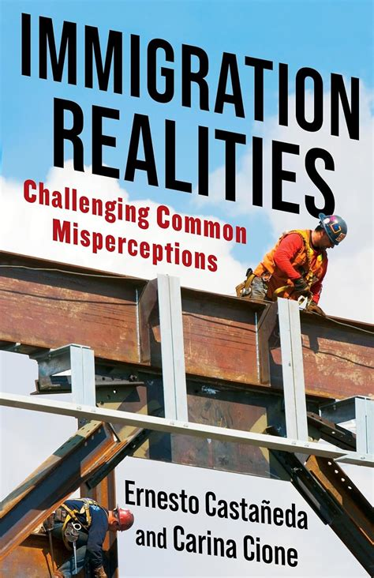
Immigration Myths and Realities
1. The border is safe.
2. Border walls do not work.
3. Immigrants are less likely to commit crimes than the US-born.
4. Immigrants want to learn the local language.
5. Immigrants are less likely to depend on welfare programs than the native-born poor.
6. Remittances are not a drain on the local economy, and it would be difficult to tax them.
7. The current refugee crisis is not without precedent, and it is manageable.
8. Immigrants are not responsible for manufacturing jobs moving abroad.
9. Brexit will not in-and-of-itself reduce immigration to the U.K.
10. There are successful immigrant integration practices in cities across the globe.

Slide 48
Thank you very much!
Questions?
ernesto@american.edu
Ernesto Castañeda, PhD
Director, Center for Latin American & Latino Studies
& The Immigration Lab
Professor, American University
@drernestocast.bsky.social‬

Slide 49
For academics

Slide 50
Pluses
In 2023, immigration academic and policy research is an established area with a large number of practitioners and readers.
New case studies are always useful in building a collective empirical database.
Comparative studies are especially useful in showing how the context of immigrant reception affects the immigrants’ feeling of belonging, and how local policies and practices make immigrants feel at home and responsible for the new places they live in.
Scholars put a lot of time and care into describing their methodology and presenting their empirical findings. The peer review process is quick to point out issues on this regard.
So, for me the issue is not in the methods or empirics but in our story telling and framing of “the problem.”

Slide 51
Even careful innovative empirical papers often start with problematic introductory paragraphs, and the abstract and the first paragraph are as much as many readers will read or remember.

