Slide 1
Making Sense of Scientific Studies in Workplace Mental Health Reporting
TORI ESPENSEN, PHD
May 22, 2025

Slide 2

How to use studies
You don’t have to report a whole story on a single study
Look to studies for evidence you can insert into broader stories
Use new studies as a news peg to cover bigger phenomena
Focus on trends and patterns
Demonstrate the scientific process

Slide 3

How to read a paper
Start with the abstract
Move to the introduction
Skip to the discussion
Go back up to the methods
Read the results
Don’t forget the acknowledgements

Slide 4

Is there a story here?
Does the type of study support the findings?
How many subjects were there?
How were participants selected?
Is the difference statistically significant?
Is the difference practically significant?

Slide 5

It’s dangerous to go alone! Talk to an expert
Is the methodology sound?
Are the conclusions supported by the data?
What limitations or caveats should I keep in mind?
What’s next for this research?
Will this finding stand the test of time?

Slide 6

Quick tips
Don’t use causal language if the study isn’t causal
A study can’t “prove” anything
True breakthroughs are rare
Include important caveats
Check your understanding
Ask for a fact check or follow up

Slide 7

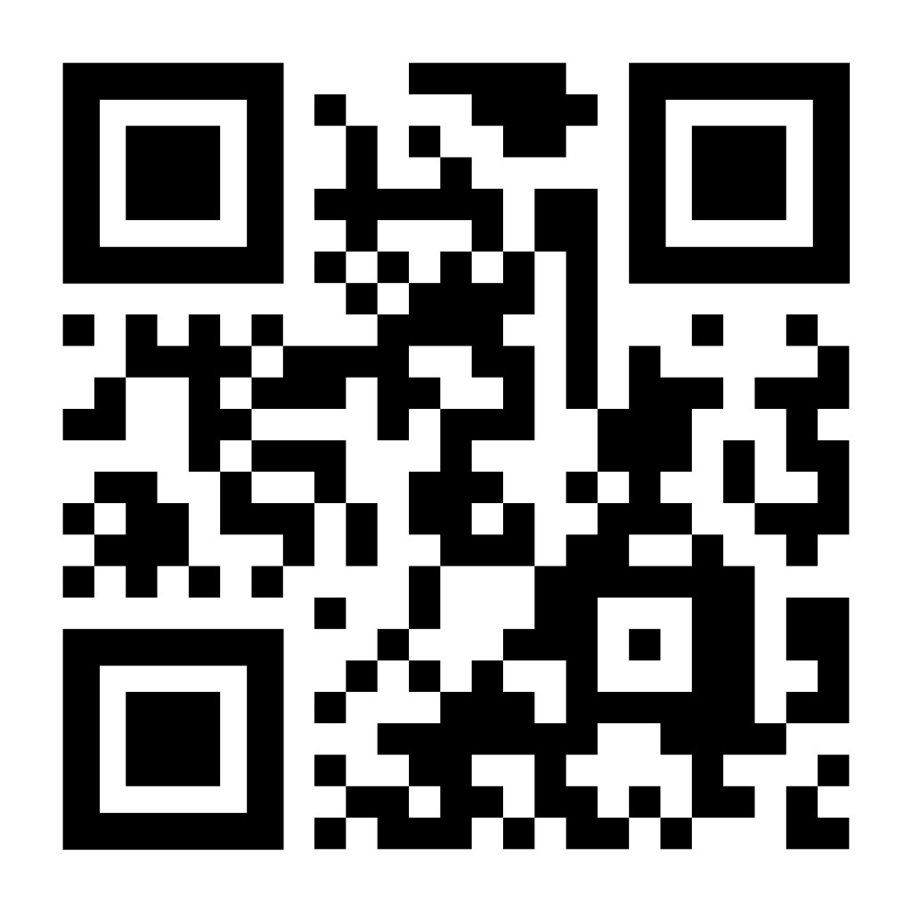

Thank you!
@RealSciLine
tespensen@aaas.org
Scan for science reporting tip sheets!

