Slide 1
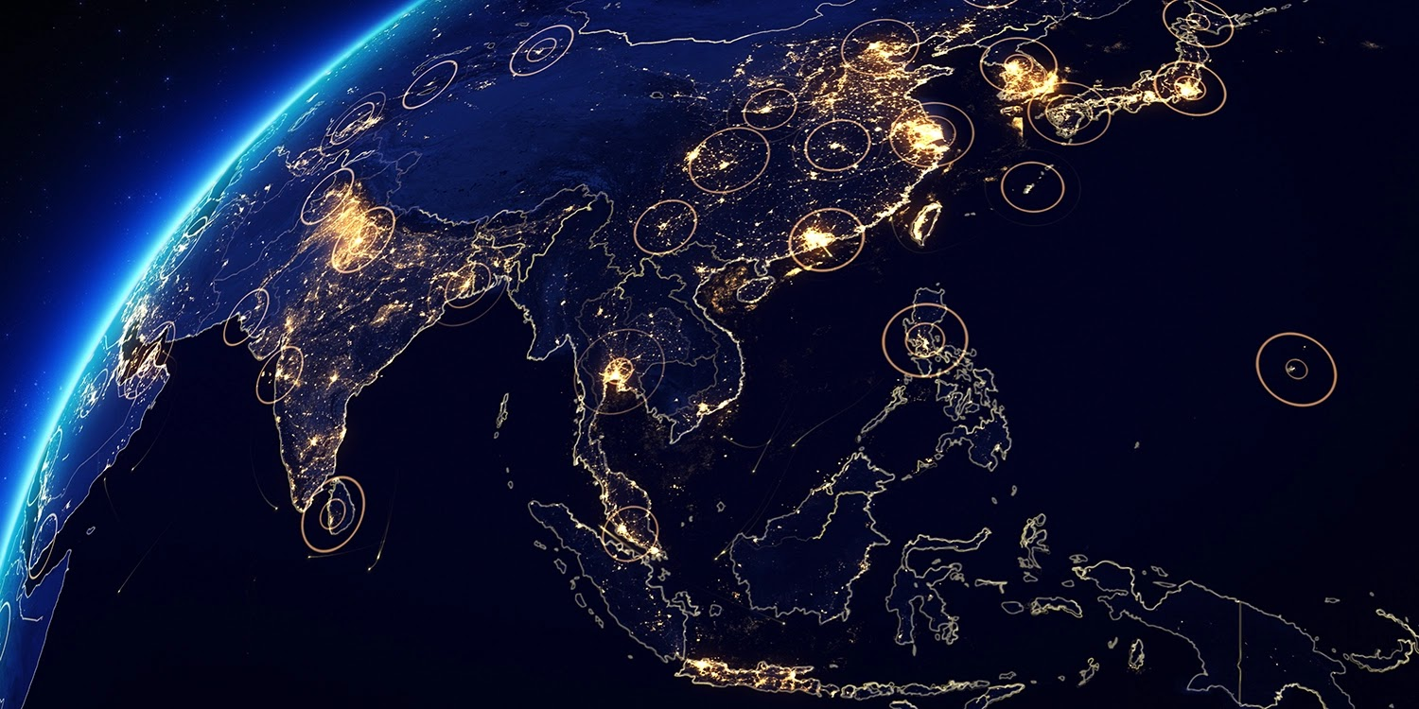
NAVIGATING THE NEW WORLD ORDER
What’s next for globalisation?
2025 International Trade Journalism Fellowship
National Press Foundation / Hinrich Foundation Office
Singapore, June 2025
Presented by
Andrew Staples, PhD.
Principal
GeoPol Asia

Slide 2
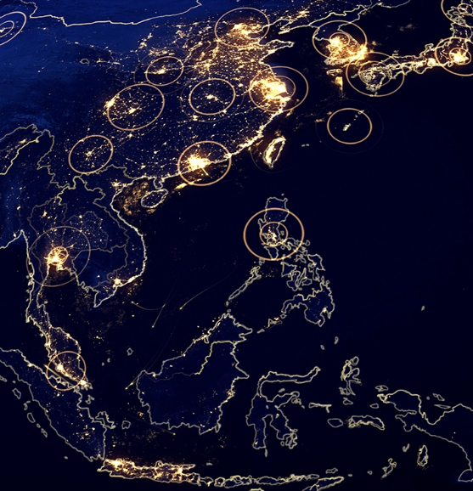


Andrew Staples, PhD.
Founder and Principal
GeoPol Asia
Principal affiliations:
Advisory Board Member, The Hinrich Foundation
Associate Fellow, Geoeconomics & Strategy, International Institute for Strategic Studies
Senior Advisor, Geopolitics, Vriens & Partners
Senior Advisor, Emerging Markets Intelligence & Research (EMIR)
Forum Chair (Singapore), IMA Asia
Previous posts
Editorial Director & Head of Asia, Economist Impact, The Economist Group (2021-24)
Director of Research & Outreach, The Hinrich Foundation (2020-21)
Editorial Director, The Economist Corporate Network, The Economist Group (2013-20)
Associate Professor, Doshisha Graduate School of Business, Kyoto, Japan (2009-13)
Associate Professor, Kansai Gaidai University, Osaka, Japan (2006-09)
Lecturer, Japanese Business and Economics, The University of Sheffield, UK (2002-06)
Research areas
Foreign direct investment, geopolitics, geoeconomics, international political economy, international business, strategy, Japan, Asia.

Slide 3
Agenda
Some context
Terms of reference
Globalisation
The emerging world order and ‘new’ globalisation
From global context to regional dynamics
to regional
Focus on the Indo-Pacific
Implications for trade
Looking ahead

Slide 4
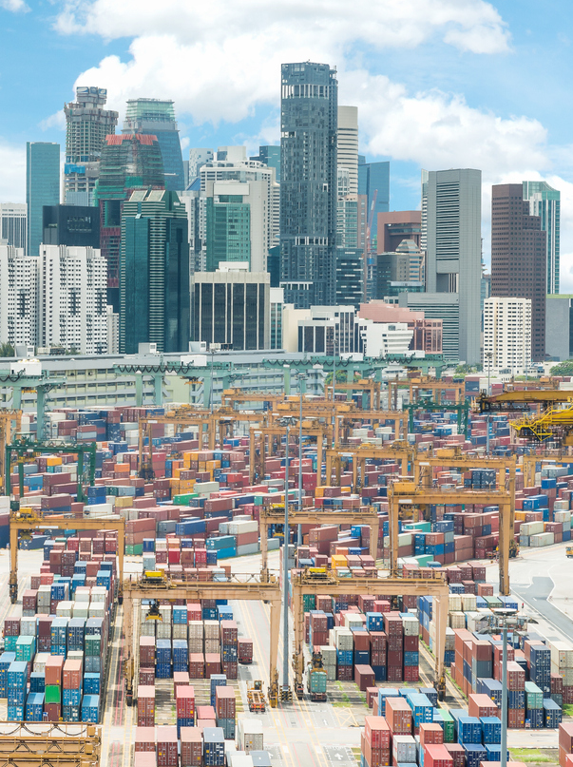
The emerging new world order and ‘new’ globlaisation

Slide 5
Terms of reference:
GLOBALISATION
GEOPOLITICS
POWER
GEOECONOMICS

Slide 6
Globalisation, in a specific historical context, has been underpinned by core economic, political and geopolitical assumptions …

Slide 7
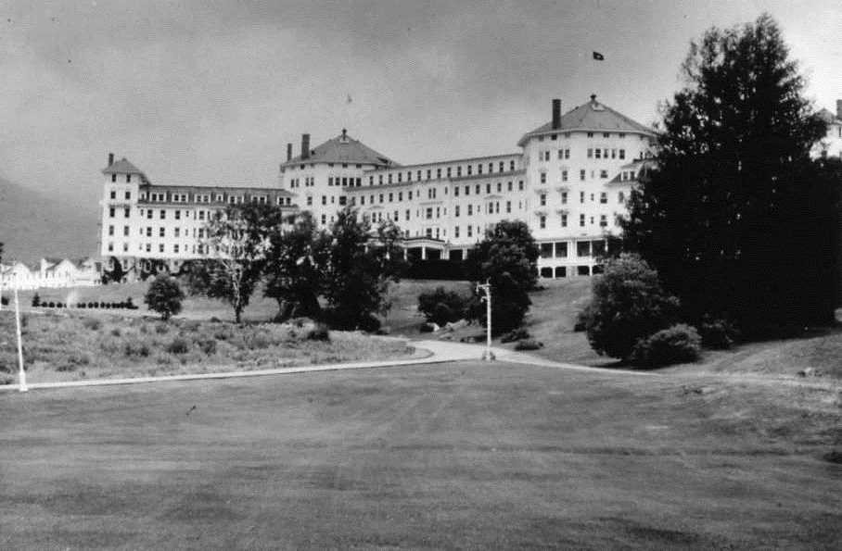
Globalisation, in a specific historical context, has been underpinned by core economic, political and geopolitical assumptions …
Post-war Pax Americana
Collapse of the Soviet Union

Slide 8
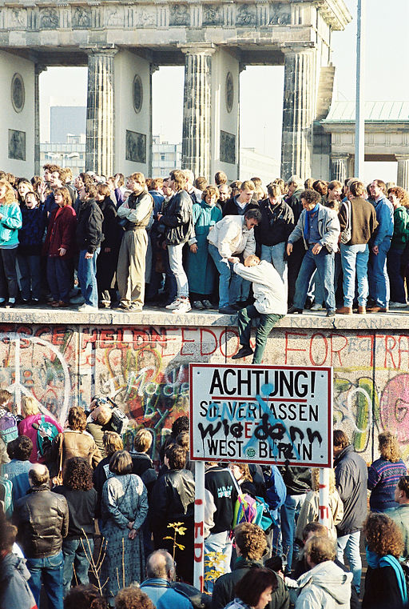
Globalisation, in a specific historical context, has been underpinned by core economic, political and geopolitical assumptions …
Post-war Pax Americana
Collapse of the Soviet Union

Slide 9
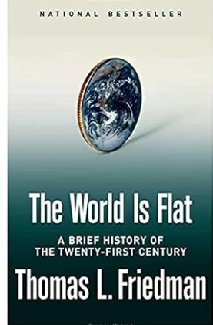
Globalisation, in a specific historical context, has been underpinned by core economic, political and geopolitical assumptions …
Post-war Pax Americana
Collapse of the Soviet Union
Comparative advantage & free trade
Liberalisation & market reforms
Global supply chains - efficiency over resilience

Slide 10

Globalisation, in a specific historical context, has been underpinned by core economic, political and geopolitical assumptions …
Post-war Pax Americana
Collapse of the Soviet Union
Comparative advantage & free trade
Liberalisation & market reforms
Global supply chains - efficiency over resilience
Multilateralism
Peace & democracy through economic interdependence

Slide 11

Globalisation, in a specific historical context, has been underpinned by core economic, political and geopolitical assumptions …
Post-war Pax Americana
Collapse of the Soviet Union
Comparative advantage & free trade
Liberalisation & market reforms
Global supply chains - efficiency over resilience
Multilateralism
Peace & democracy through economic interdependence
US-led global order
Globalisation over nationalism

Slide 12
…but these assumptions are now breaking down due to:

Slide 13
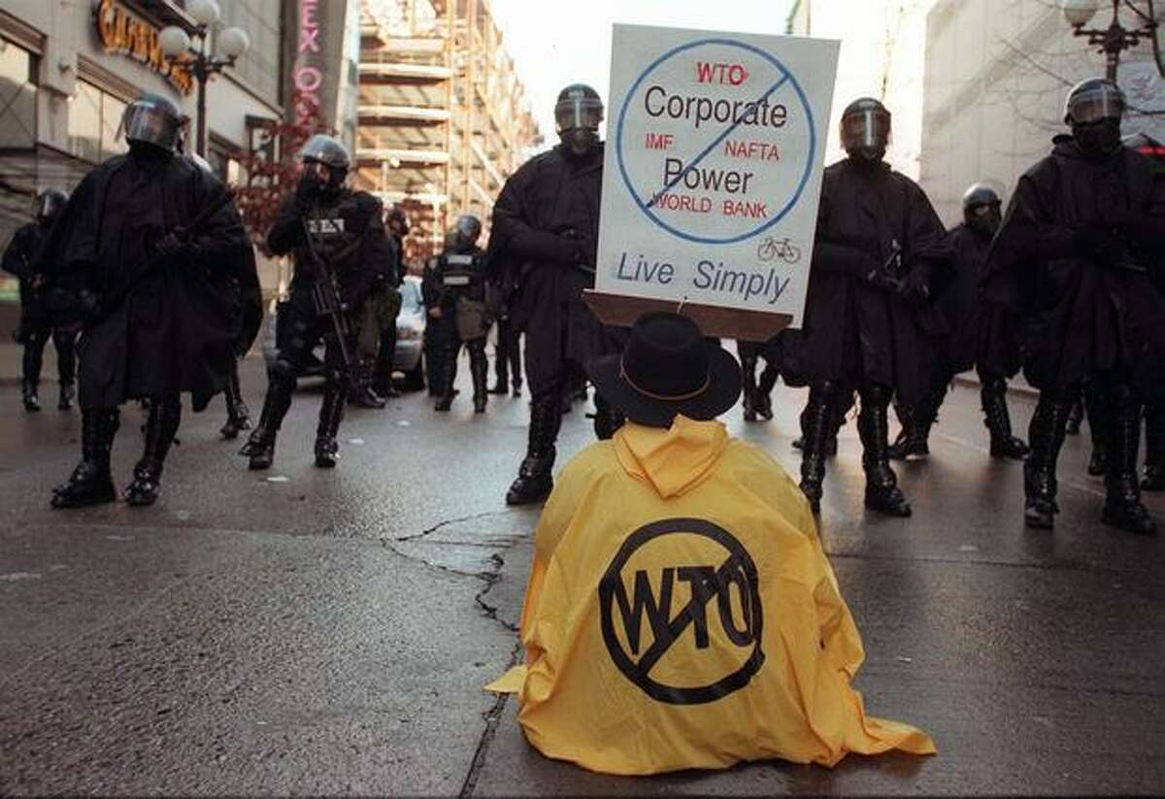
…but these assumptions are now breaking down due to:
Inequality, populism and discontent
Climate change

Slide 14
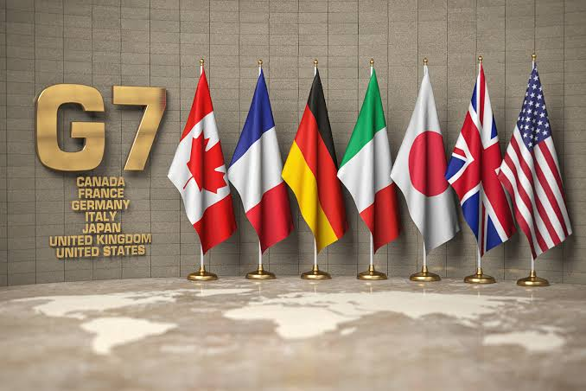
…but these assumptions are now breaking down due to:
Inequality, populism and discontent
Climate change
State capitalism and the rise of the global south

Slide 15
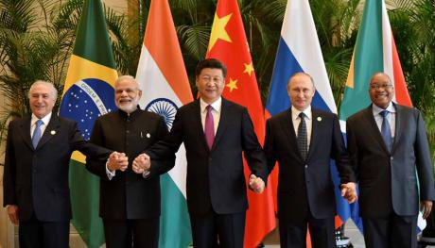
…but these assumptions are now breaking down due to:
Inequality, populism and discontent
Climate change
State capitalism and the rise of the global south

Slide 16
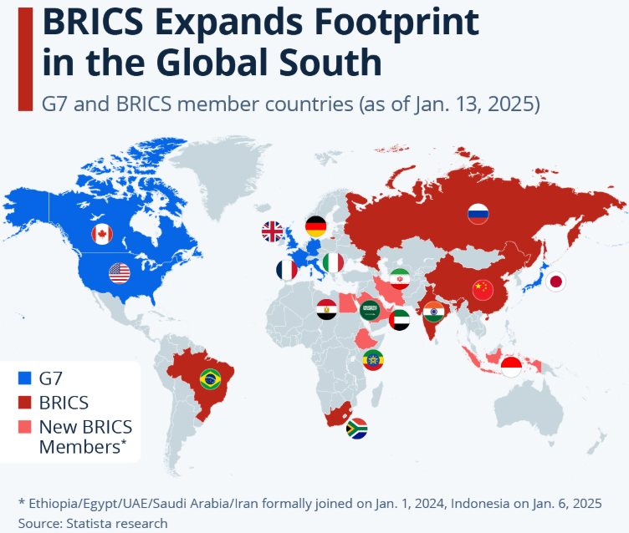
Who gets to write the ‘rules of the road’?

Slide 17
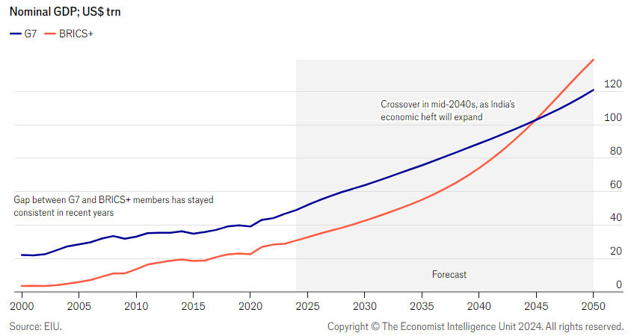
Rising global weight of emerging economies will strain geopolitics

Slide 18
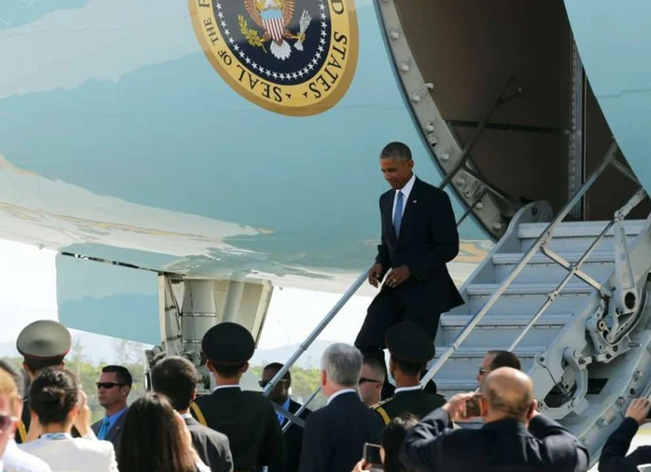
…but these assumptions are now breaking down due to:
Inequality, populism and discontent
Climate change
State capitalism and the rise of the global south
US - China tensions

Slide 19
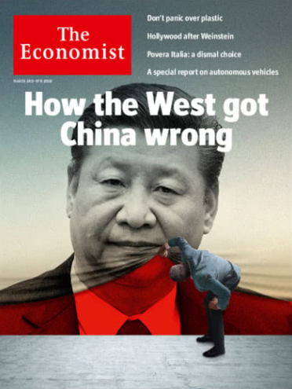
…but these assumptions are now breaking down due to:
Inequality, populism and discontent
Climate change
State capitalism and the rise of the global south
US - China tensions

Slide 20
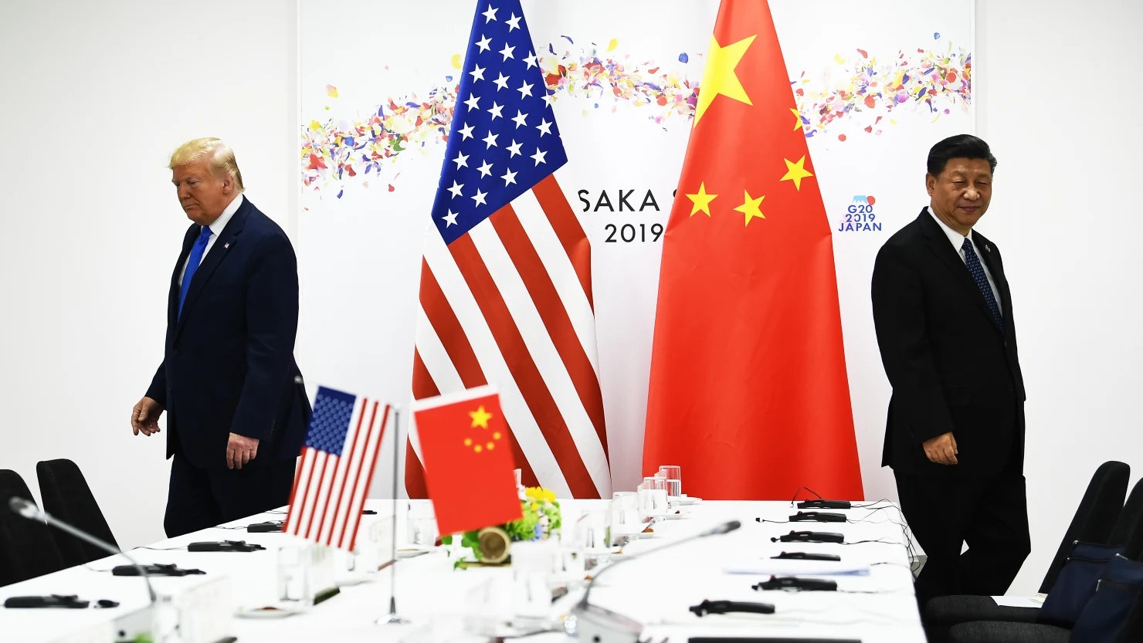
…but these assumptions are now breaking down due to:
Inequality, populism and discontent
Climate change
State capitalism and the rise of the global south
US - China tensions

Slide 21
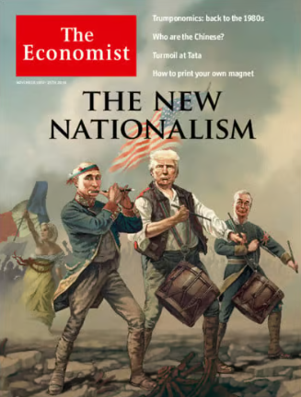
…but these assumptions are now breaking down due to:
Inequality, populism and discontent
Climate change
State capitalism and the rise of the global south
US - China tensions
The new nationalism

Slide 22
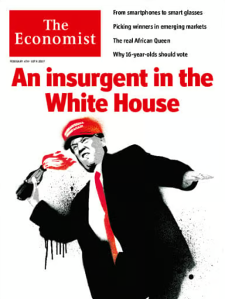
…but these assumptions are now breaking down due to:
Inequality, populism and discontent
Climate change
State capitalism and the rise of the global south
US - China tensions
The new nationalism
The second Trump presidency

Slide 23
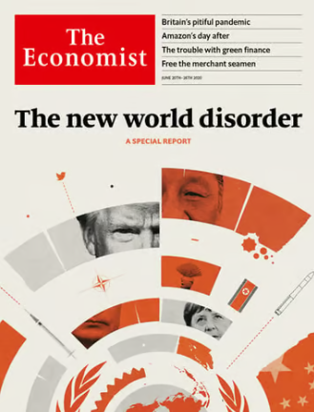
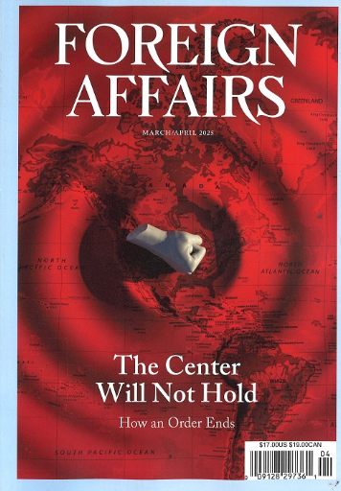
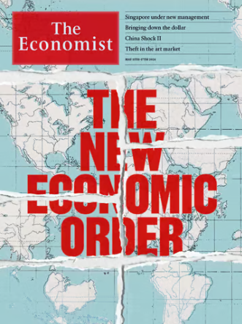
Taken together, this suggests the emergence of a new world order.

Slide 24
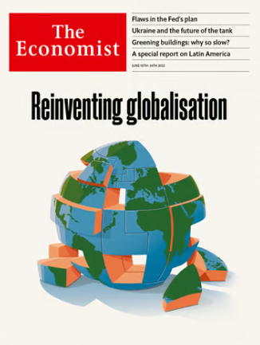
Taken together, this suggests the emergence of a new world order. What are the features or contours of this new phase of globalisation?

Slide 25
Taken together, this suggests the emergence of a new world order. What are the features or contours of this new phase of globalisation?
Geopolitical - a transition to a multipolar world⏐a new cold world⏐‘pre-war’

Slide 26
Taken together, this suggests the emergence of a new world order. What are the features or contours of this new phase of globalisation?
Geopolitical - a transition to a multipolar world⏐a new cold world⏐‘pre-war’
Geoeconomic - economic security⏐economic coercion⏐ ‘new’ industrial policy

Slide 27
Taken together, this suggests the emergence of a new world order. What are the features or contours of this new phase of globalisation?
Geopolitical - a transition to a multipolar world⏐a new cold world⏐‘pre-war’
Geoeconomic - economic security⏐economic coercion⏐ ‘new’ industrial policy
Political - the retreat of democracy⏐ authoritarian and hybrid regimes ⏐ erosion of rules/norms

Slide 28
Taken together, this suggests the emergence of a new world order. What are the features or contours of this new phase of globalisation?
Geopolitical - a transition to a multipolar world⏐a new cold world⏐‘pre-war’
Geoeconomic - economic security⏐economic coercion⏐ ‘new’ industrial policy
Political - the retreat of democracy⏐ authoritarian and hybrid regimes ⏐ erosion of rules/norms
Security - heightened tensions ⏐ nuclear proliferation ⏐ risk of proxy wars ++

Slide 29
Taken together, this suggests the emergence of a new world order. What are the features or contours of this new phase of globalisation?
Geopolitical - a transition to a multipolar world⏐a new cold world⏐‘pre-war’
Geoeconomic - economic security⏐economic coercion⏐ ‘new’ industrial policy
Political - the retreat of democracy⏐ authoritarian and hybrid regimes ⏐ erosion of rules/norms
Security - heightened tensions ⏐ nuclear proliferation ⏐ risk of proxy wars ++
Economic - fragmented globalisation⏐competing economic blocs ⏐ slower growth

Slide 30
Taken together, this suggests the emergence of a new world order. What are the features or contours of this new phase of globalisation?
Geopolitical - a transition to a multipolar world⏐a new cold world⏐‘pre-war’
Geoeconomic - economic security⏐economic coercion⏐ ‘new’ industrial policy
Political - the retreat of democracy⏐ authoritarian and hybrid regimes ⏐ erosion of rules/norms
Security - heightened tensions ⏐ nuclear proliferation ⏐ risk of proxy wars ++
Economic - fragmented globalisation⏐competing economic blocs ⏐ slower growth
Technological - techno nationalism ⏐bifurcation ⏐ parallel worlds

Slide 31
Globalisation has been underpinned by core economic, political and geopolitical assumptions….
GLOBALISATION & the GLOBAL ORDER
1945/1990 - 2008
FEATURES
End of the Cold War
US-led world order
Market economies
Multilateralism
Trade liberalisation
Market access
Security through economic interdependence
Growth in global trade and FDI
Global value chains
Efficiency over resilience

Slide 32
Globalisation has been underpinned by core economic, political and geopolitical assumptions….which are now breaking down.
GLOBALISATION & the GLOBAL ORDER
1945/1990 - 2008
FEATURES
End of the Cold War
US-led world order
Market economies
Multilateralism
Trade liberalisation
Market access
Security through economic interdependence
Growth in global trade and FDI
Global value chains
Efficiency over resilience
‘NEW’ GLOBALISATION & THE EMERGING WORLD ORDER
2008 -
FEATURES
Multipolarity
Alternative modes of capitalism
Competing visions of social and economic organisation
Nationalism
Populism
National security = economic security‘
New’ industrial policy
Politicisation of business
Trade friction
Derisking, decoupling
Technology bifurcation
Fragmented globalisation
Slower growth

Slide 33
From global context to regional dynamics
Focus on the Indo-Pacific
Indo-Pacific dynamics: TECHNOLOGY

Slide 34
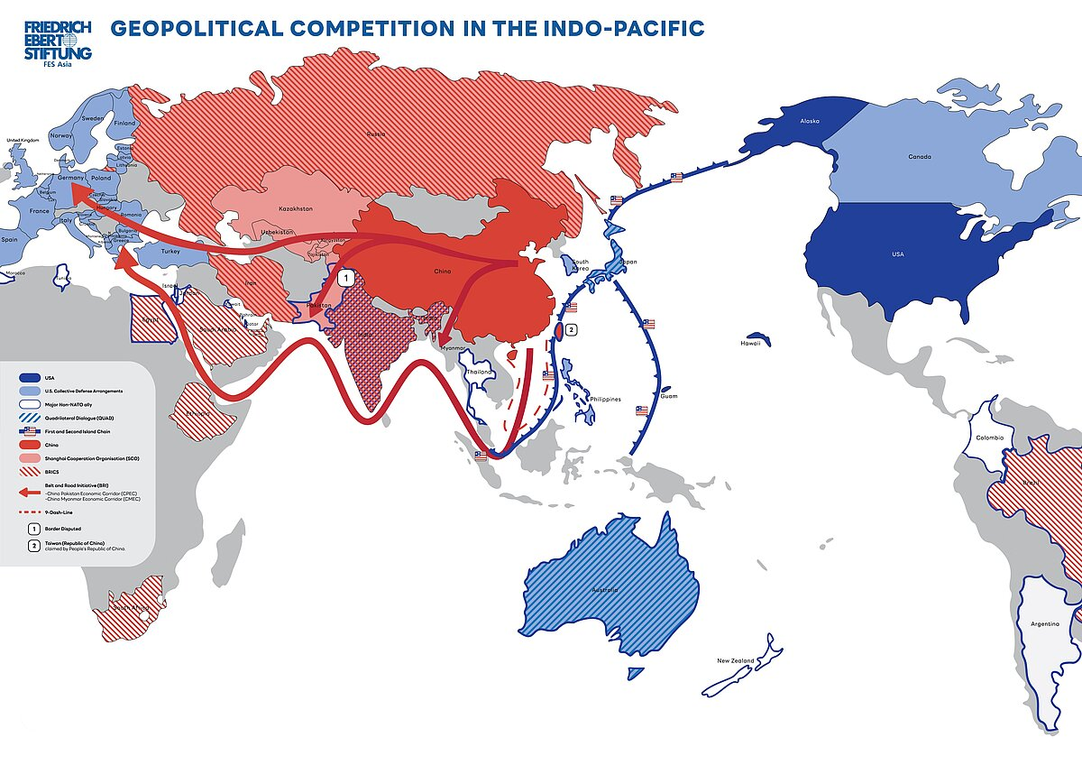
Indo-Pacific dynamics: GEOPOLITICS
Concepts
From Asia-Pacific to Indo-Pacific
Eurasia
Overlays
Politics
Economics (trade/FDI)
Agreements & frameworks
Stage of development
Connectivity
Security
International relations
Spheres of influence

Slide 35
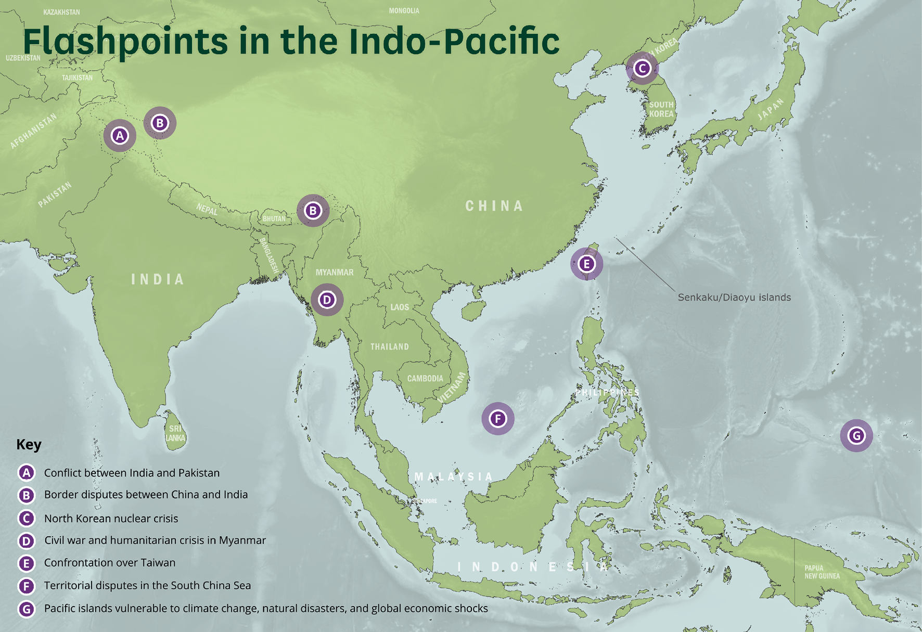
Indo-Pacific dynamics: SECURITY
Core actors
China
US
North Korea
Taiwan
Japan
South Korea
Philippines
India
Russia
Core dynamics
US-China (restrainer vs prioritiser debate)
US-JP/SK/PH/AUS
Taiwan
North Korea
India-China
Territorial disputes
AUKUS
Greyzone activities
Source: Defence Committee, UK Parliament, 2004.

Slide 36
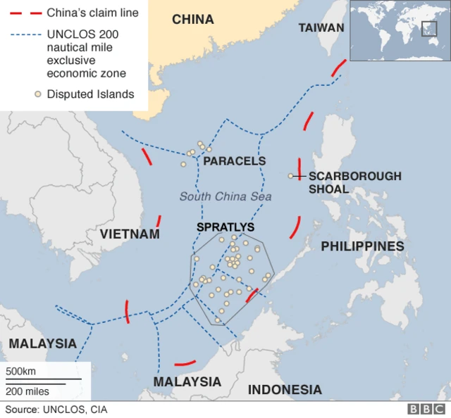
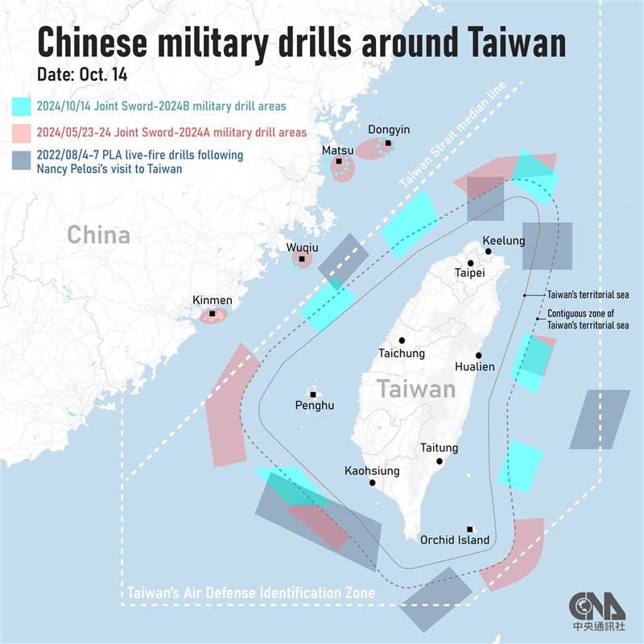
Indo-Pacific dynamics: SECURITY

Slide 37
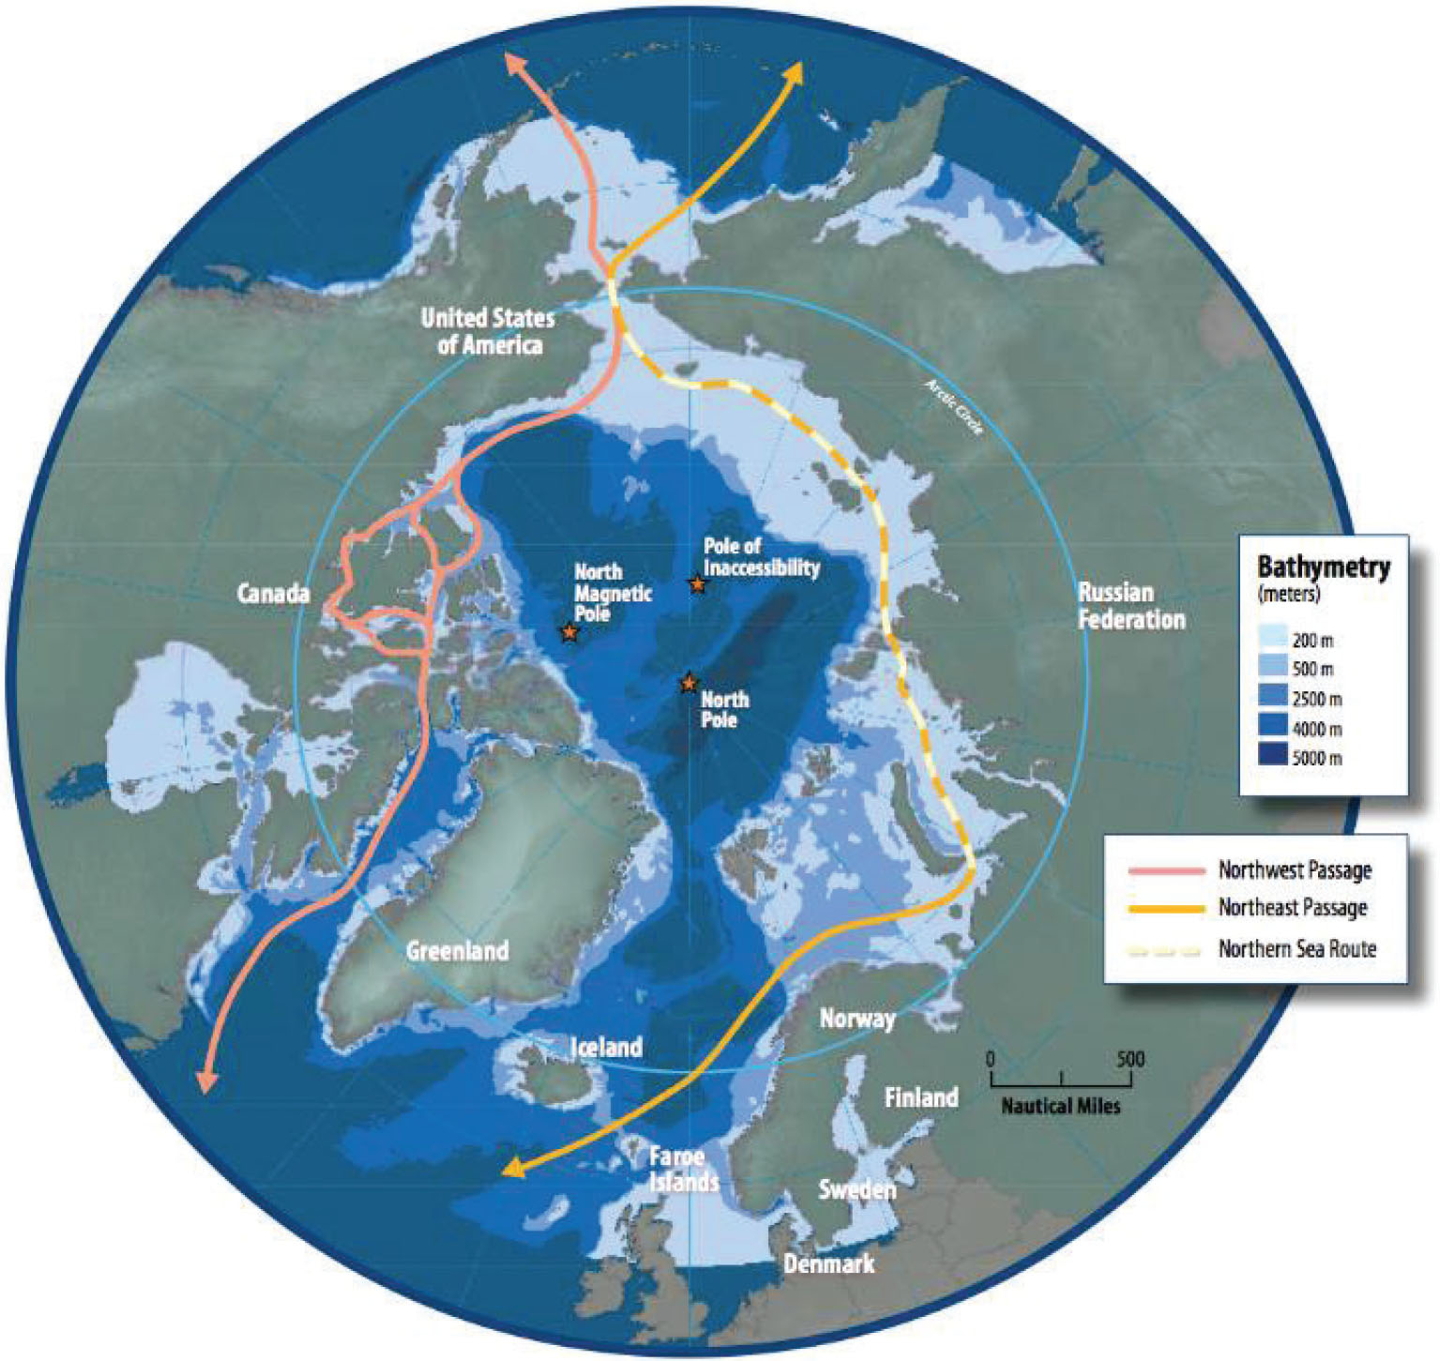
Indo-Pacific dynamics: Great power competition in the North

Slide 38
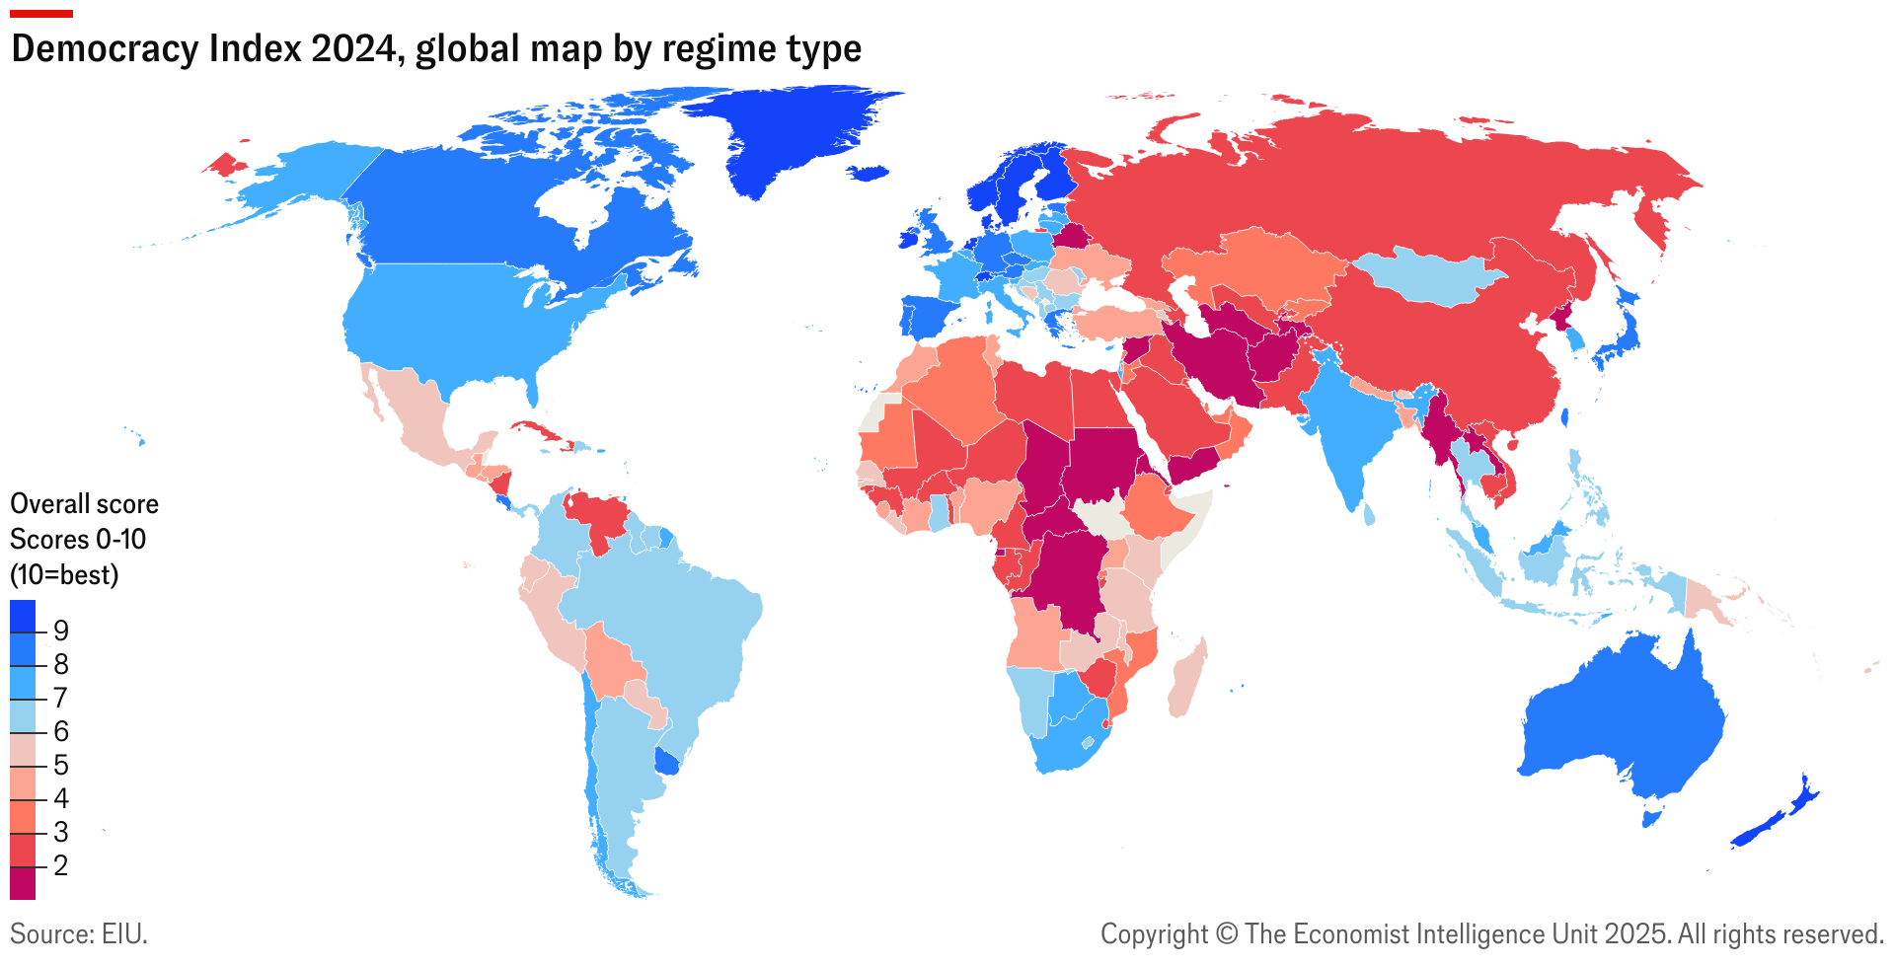
Indo-Pacific dynamics: POLITICAL
Source: EIU Democracy Index, 2024

Slide 39
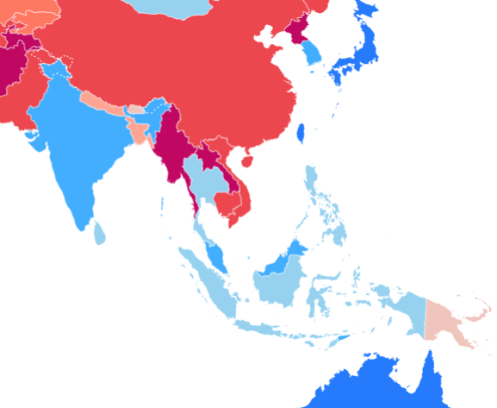
Indo-Pacific dynamics: POLITICAL
Asia is home to some of the world’s most vibrant democracies but in recent years there has been a gradual drift away from representative democracy
Dynastic politics and democratic backsliding in Southeast Asia
South Korea’s democracy wobbles
‘When elephants fight, the grass gets trampled’
‘Bamboo diplomacy’ vs. hard choices
Typhoons vs. climate change
Source: EIU Democracy Index, 2024

Slide 40

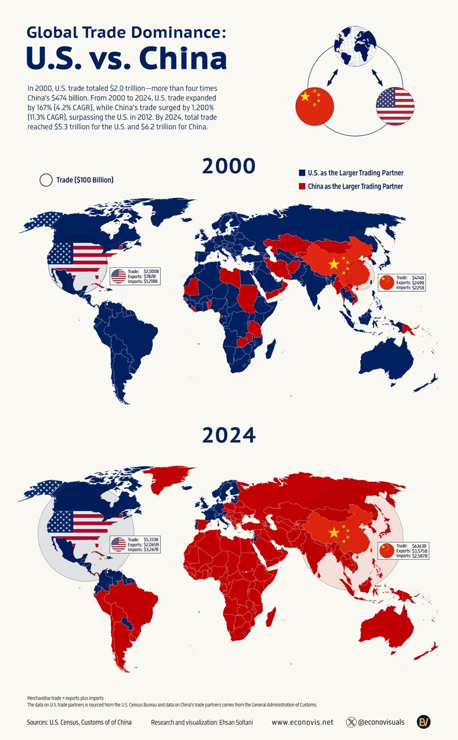
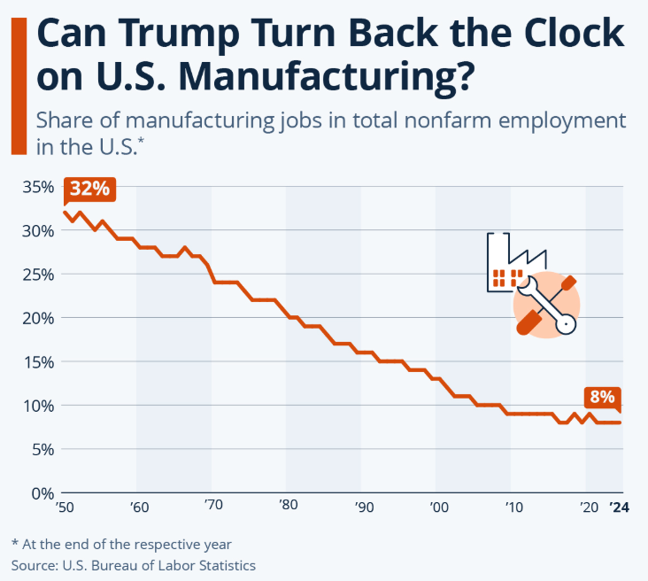
Indo-Pacific dynamics: GEOECONOMICS & TRADE

Slide 41
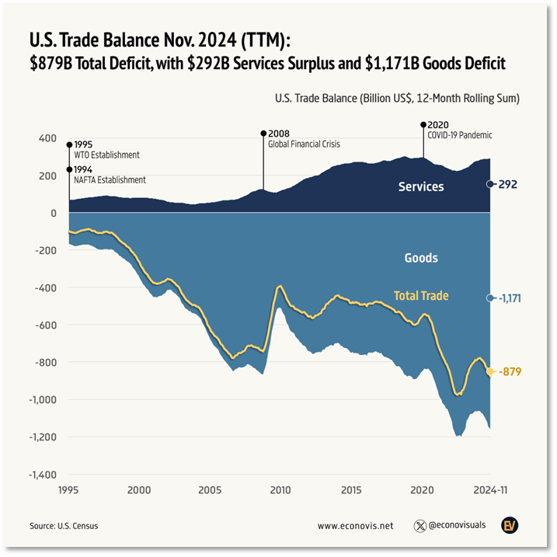
Indo-Pacific dynamics: GEOECONOMICS & TRADE

Slide 42
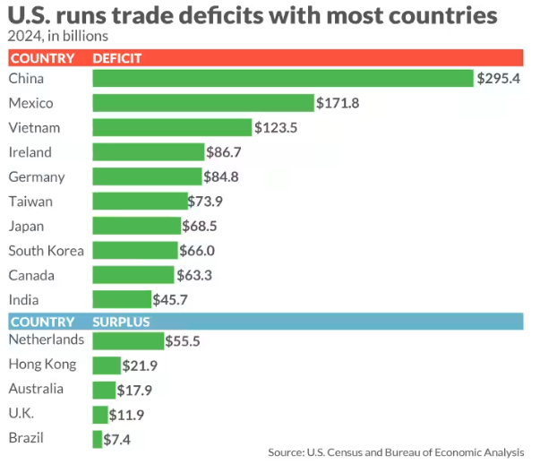
Indo-Pacific dynamics: GEOECONOMICS & TRADE

Slide 43
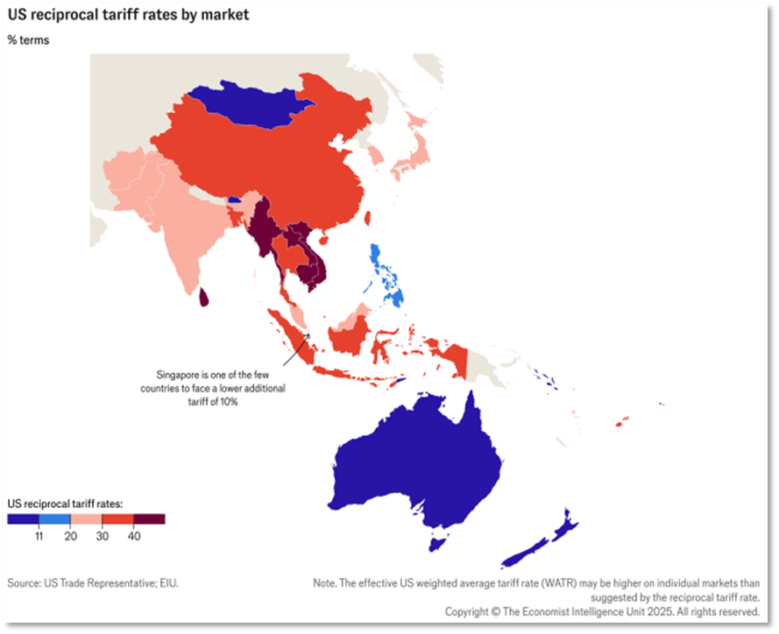
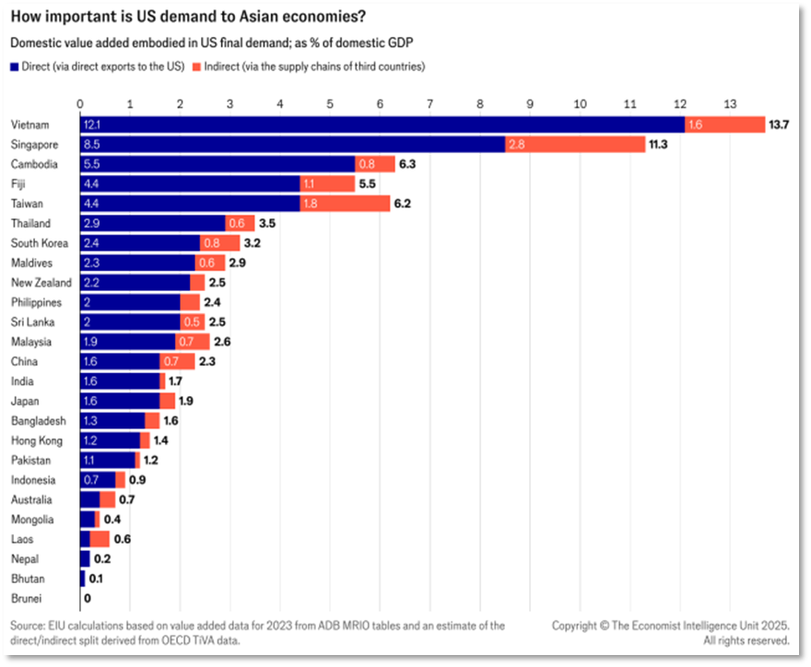
Indo-Pacific dynamics: GEOECONOMICS & TRADE

Slide 44
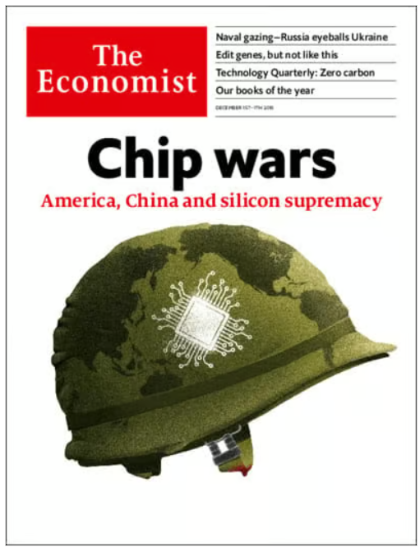
Indo-Pacific dynamics: TECHNOLOGY
Technology—and who controls it—is at the core of US-China tensions
Techno-nationalism is an increasingly dominant approach in governance that links a nation’s technological capabilities and self-sufficiency to its state security, economic prosperity, and social stability.
It is a response to a new era of global systemic competition between differing ideologies of economic development.

Slide 45
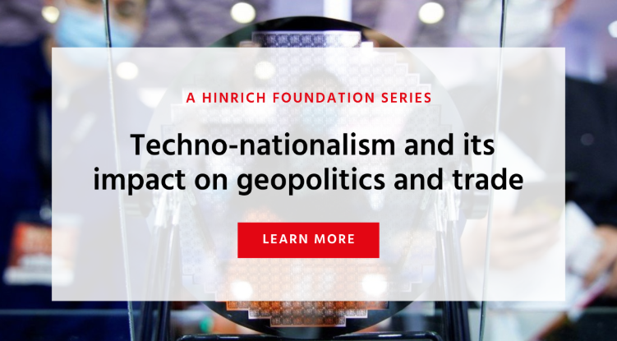
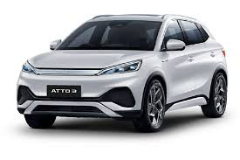
Indo-Pacific dynamics: TECHNOLOGY
Tech bifurcation
Strategic and policy drivers - National security concerns⏐industrial policy & techno-nationalism⏐
decoupling & derisking
Semiconductors - Export controls⏐self-sufficiency⏐
production diversification
Divergent ecosystems - Hardware & infrastructure⏐
Operating Systems & Software ⏐AI & Data Governance

Slide 46
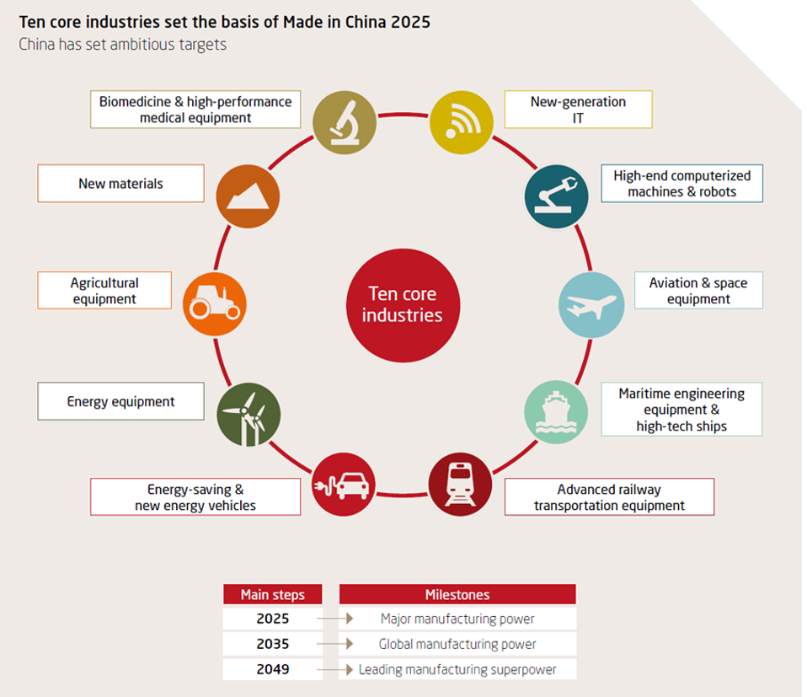


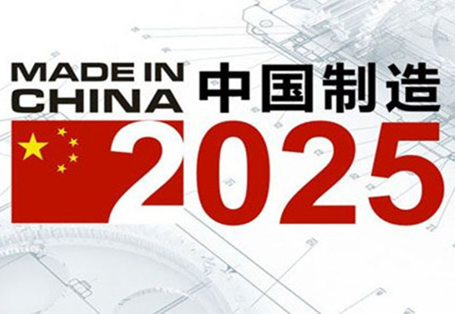
Indo-Pacific dynamics: TECHNOLOGY

Slide 47
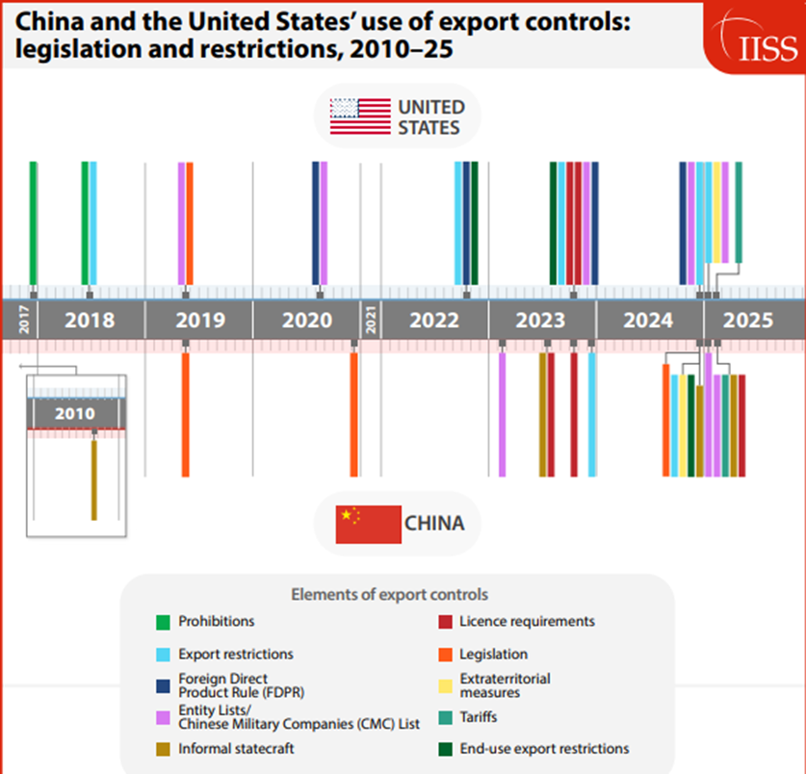
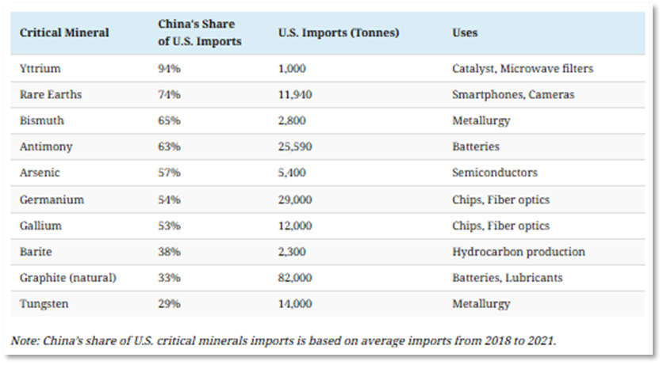
Indo-Pacific dynamics: TECHNOLOGY
China has a chokehold on critical minerals – crucial inputs for technology and defence
US dependency is unsustainable
April 15 Executive Order- US “launching an investigation into the national security risks posed by U.S. reliance on imported processed critical minerals and their derivative products.” Report in 180 days.

Slide 48
Implications for trade
Looking ahead
Indo-Pacific dynamics: TECHNOLOGY

Slide 49



Slide 50
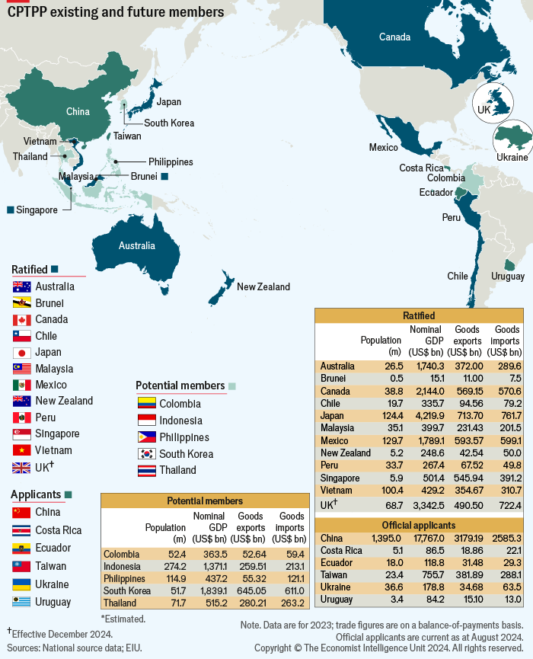
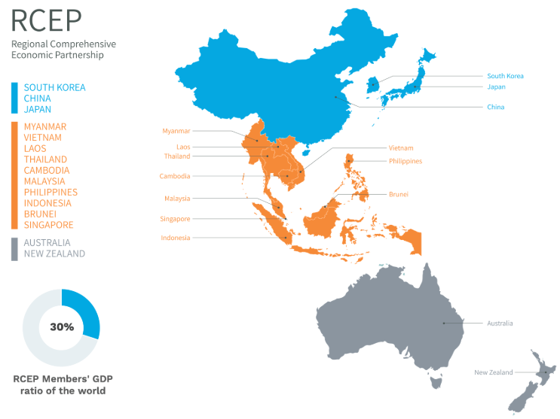
Trade connectivity

Slide 51
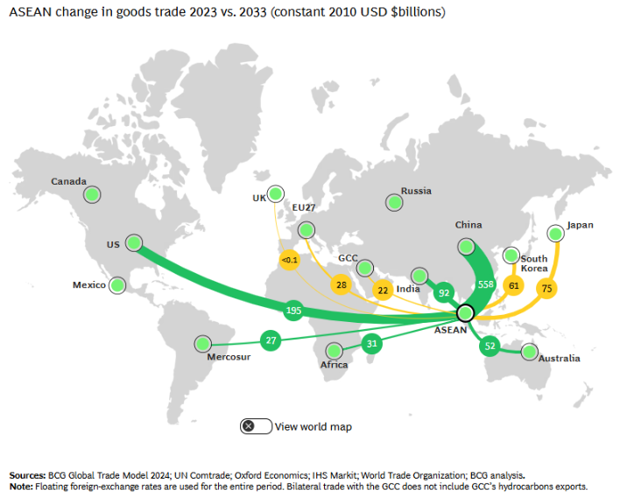
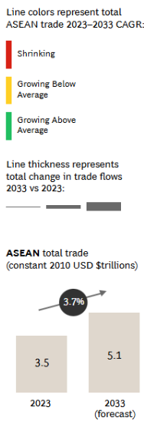
Changing trade patterns: ASEAN is well hedged, EU an opportunity

Slide 52
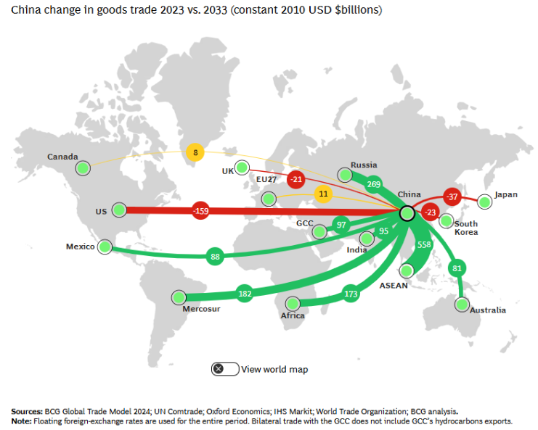
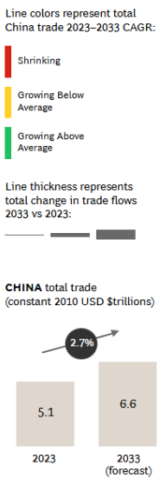
Changing trade patterns: China pivots to RoW

Slide 53
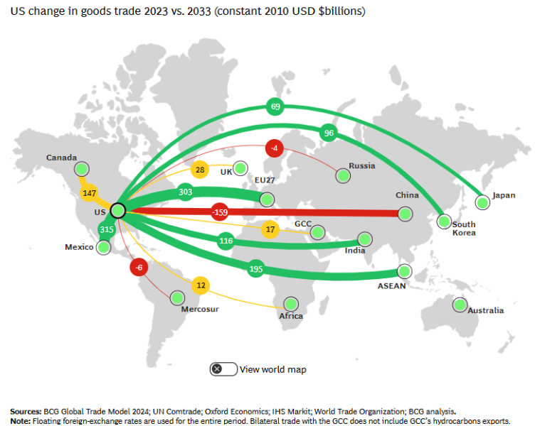
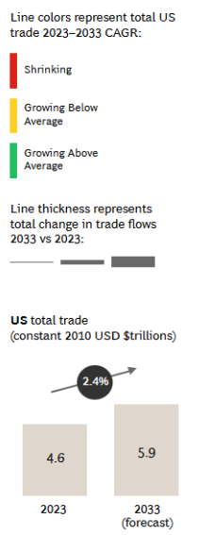
Changing trade patterns: Fortress US?

Slide 54

Navigating uncertainty
Manage risk, capture opportunity
A new world order is emerging informed by new assumptions and norms. Uncertainty and risks are high
Navigating geopolitics is not just about risk
The region is economically dynamic, contributing perhaps 60% of global GDP growth and is home to 60%+ of the global population
The US-China relationship remains crucial but multipolarity means that ‘middle’ powers are becoming increasingly important
Supply chain restructuring (risk/resilience/economic security) is accelerating creating both challenges and opportunities

Slide 55
Navigating uncertainty
Control what you can
The emerging new world order has implications for everyone - countries, regional blocs (EU/ASEAN), companies, organisations and individuals
Filter out the noise and focus on the signals. Beyond the news cycle, consider the structural dynamics shaping the global economy
Engage in building competing yet plausible scenarios for your business and sector- pose the ‘what if?’ questions
Doing so builds geopolitical mind muscle
Be curious! Talk to clients/experts/government

Slide 56

Thank you for your attention
Andrew Staples, PhD.
andrewstaples@geopolasia.com
geopolasia.com

