Slide 1
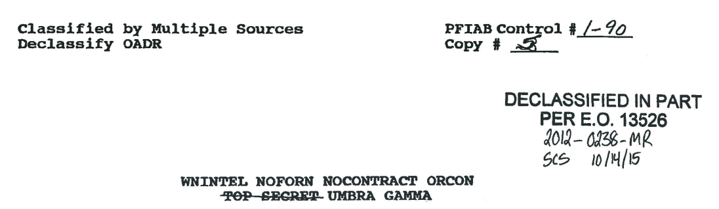
Tactical and Practical
Public Records Advice Nate Jones
The Washington Post

Slide 2

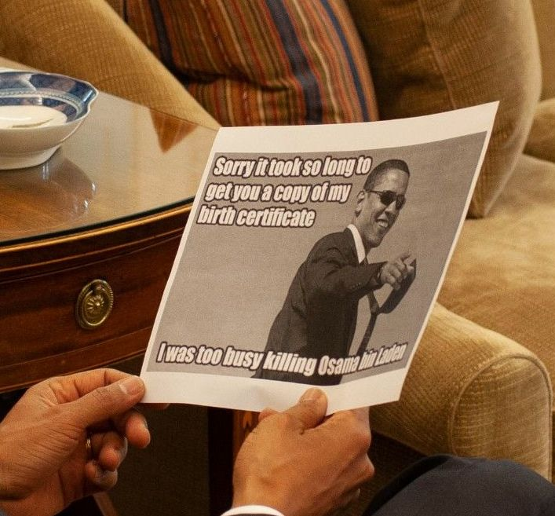
Photograph of President Obama at the President’s Daily Briefing May 2, 2011. Via FOIA to Obama Presidential Library.

Slide 3
FOIA Pointers:
Find where to file. Find the law.
Target your FOIAs.
Emails.
Appeal!
Litigation

Slide 4
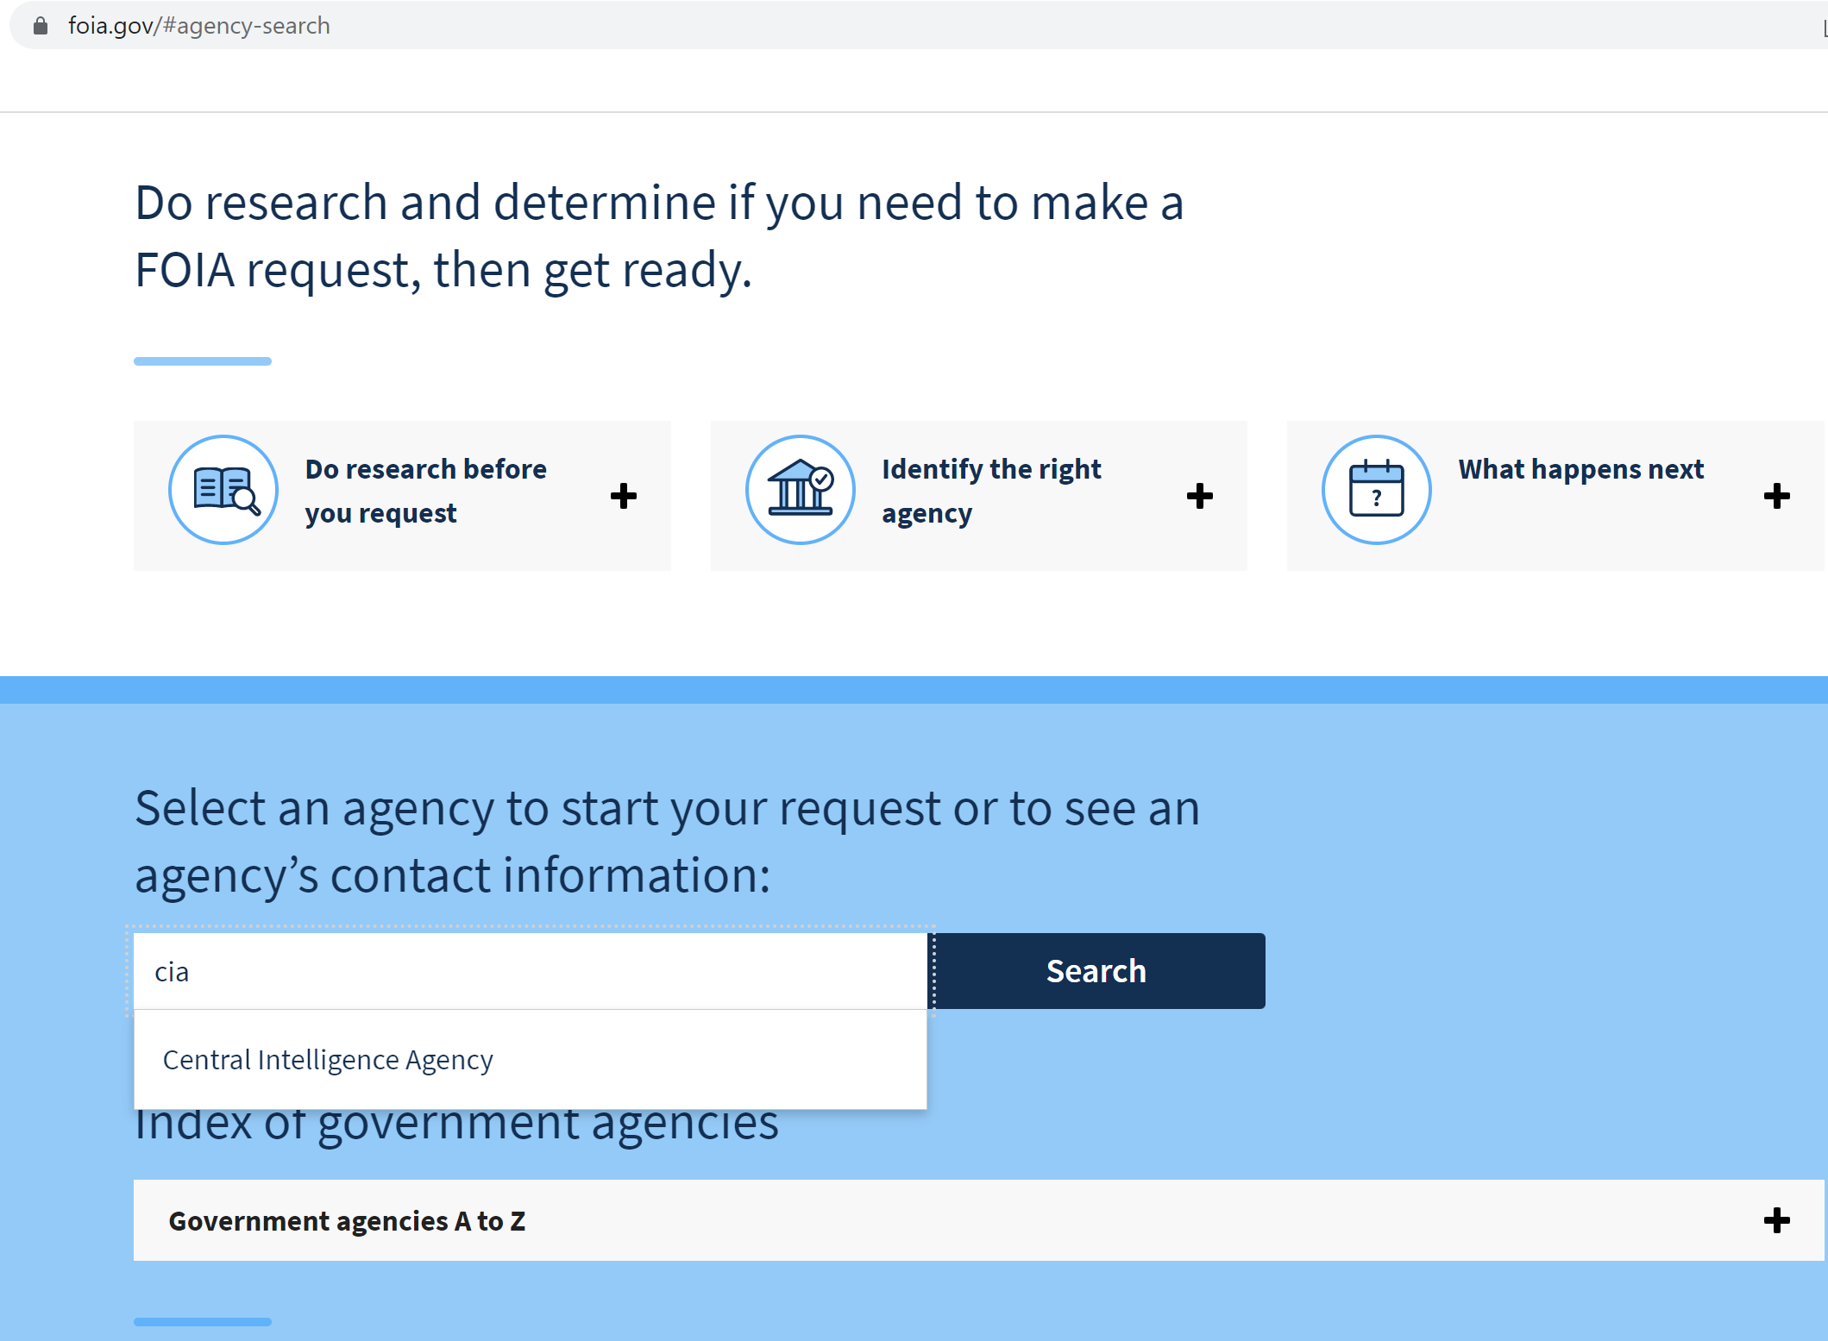
1. Find where to file. Find the law.
For Federal agencies: FOIA.gov

Slide 5
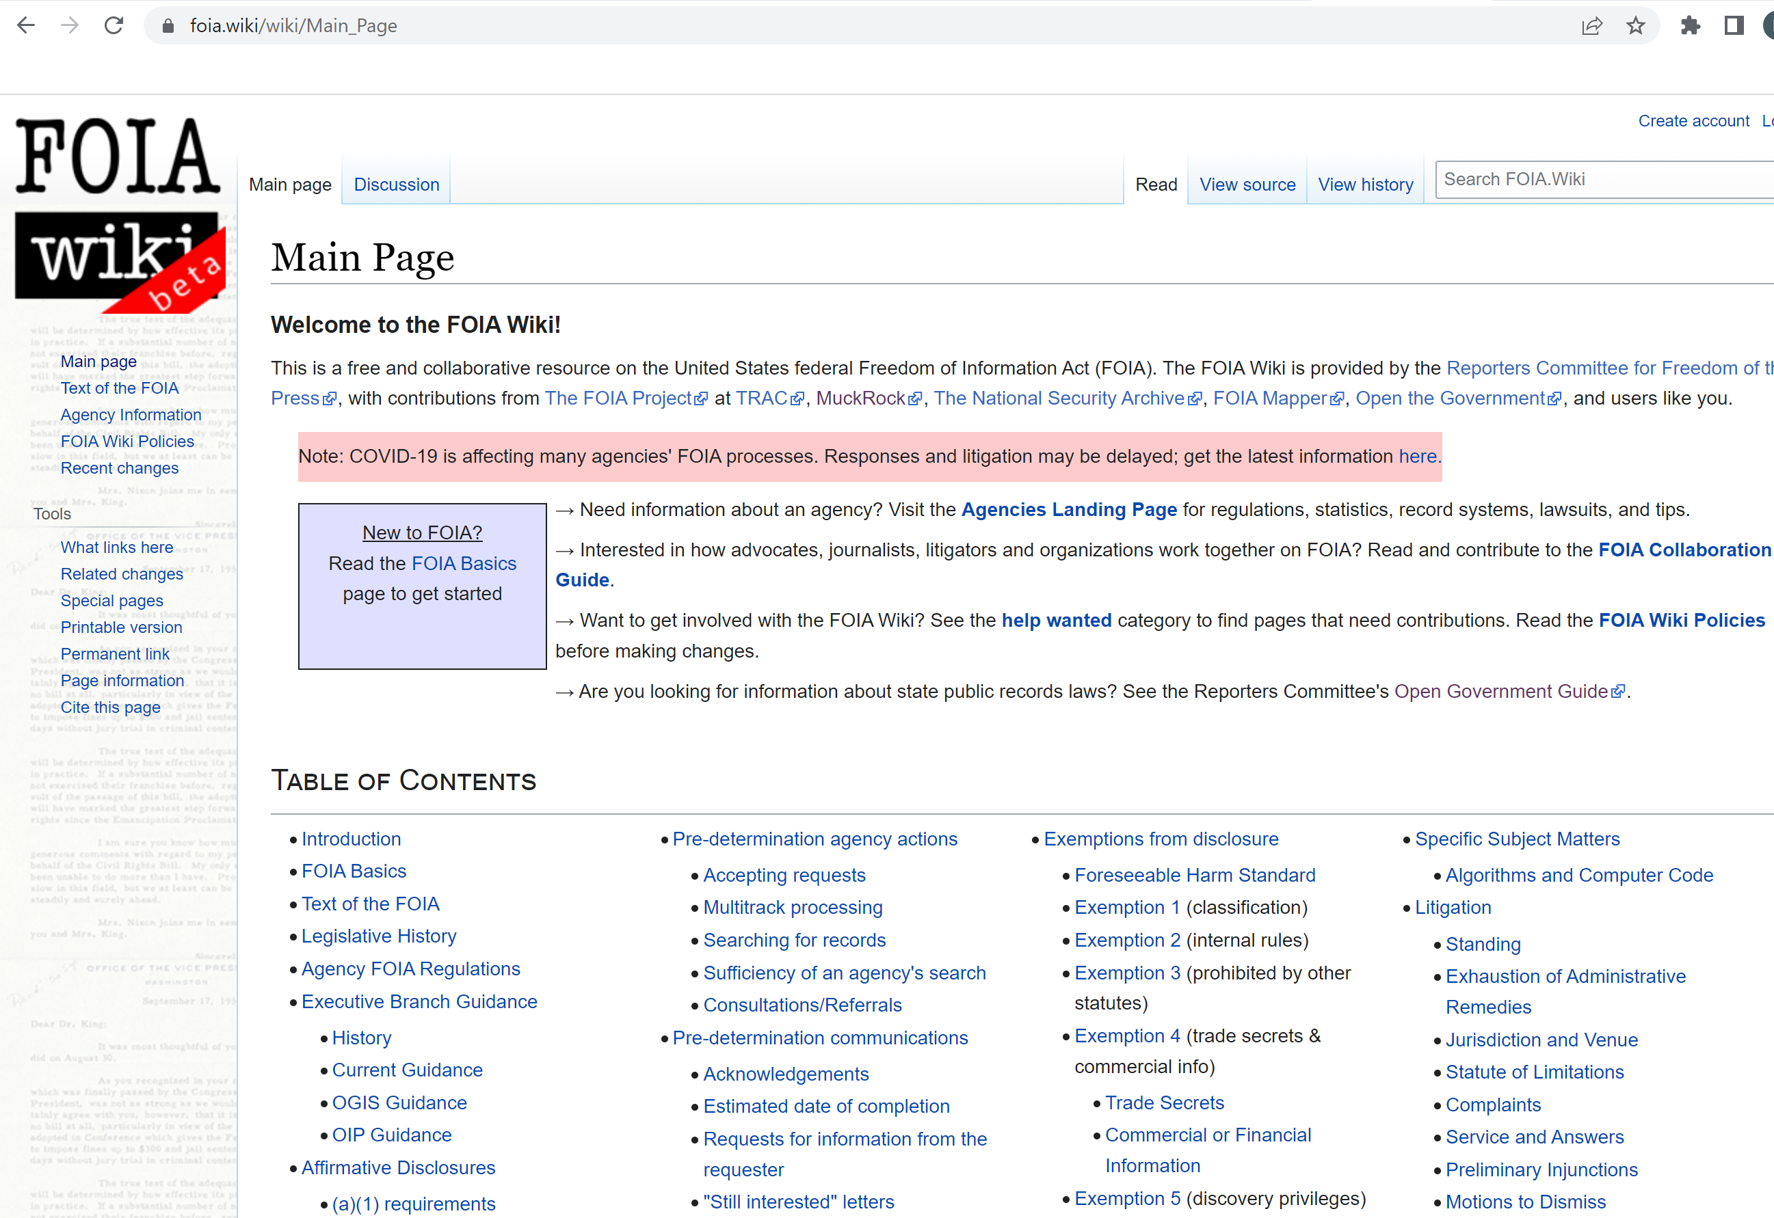
For Federal law: FOIA.wiki

Slide 6
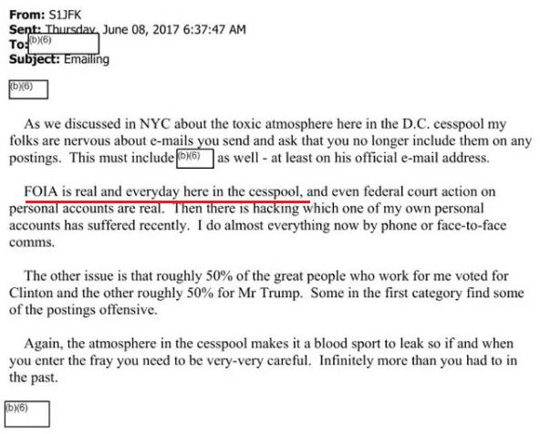
“FOIA is real and everyday here in the cesspool” –Former WH Chief of Staff John Kelly
Source: Via Jason Leopold Buzzfeed FOIA request to DHS

Slide 7
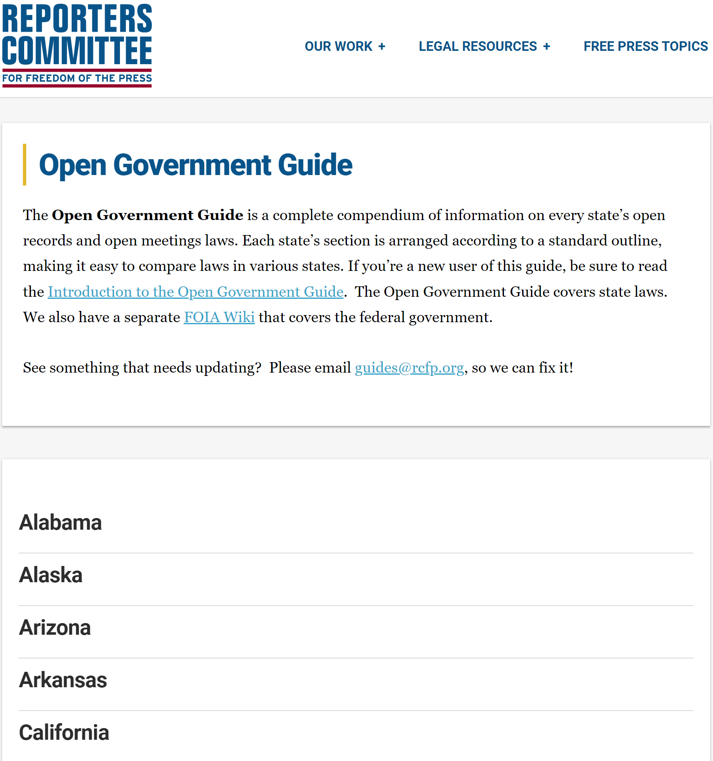
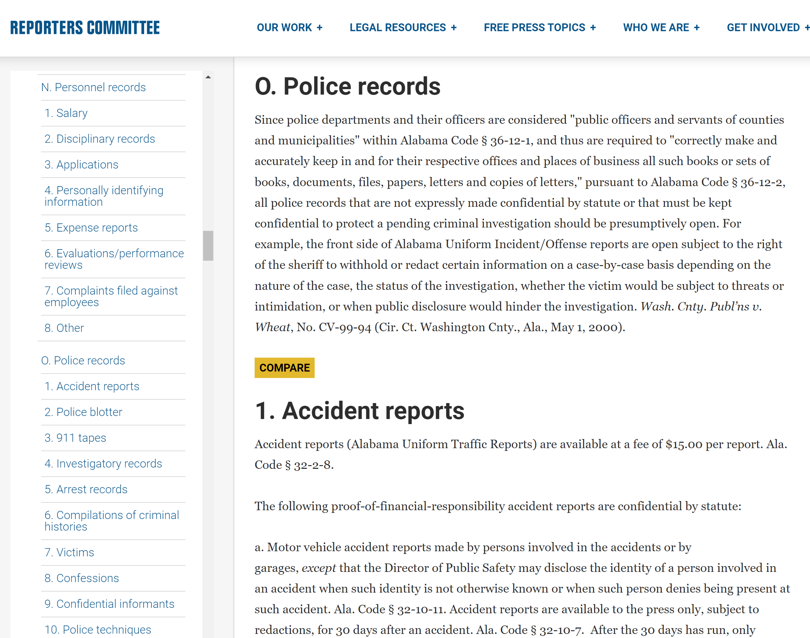
For state law: Reporters Committee for Freedom of the Press Open Government Guide

Slide 8
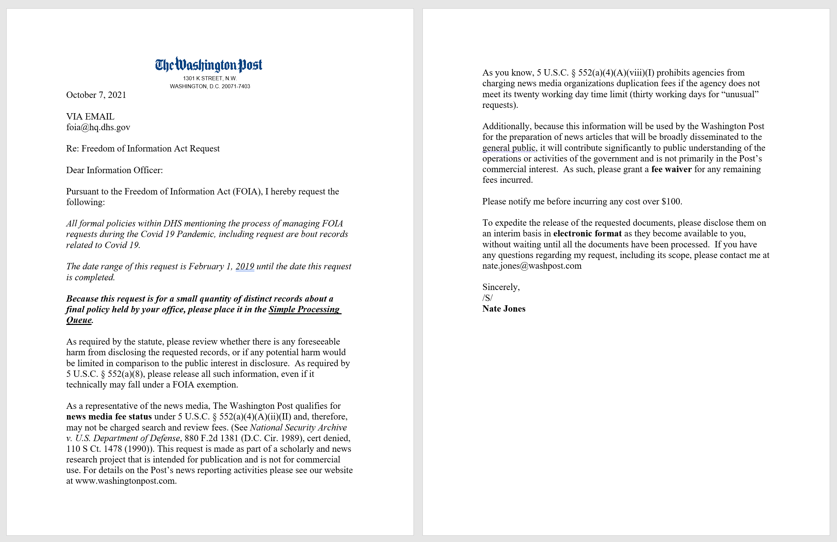
A “typical”
Federal FOIA request

Slide 9
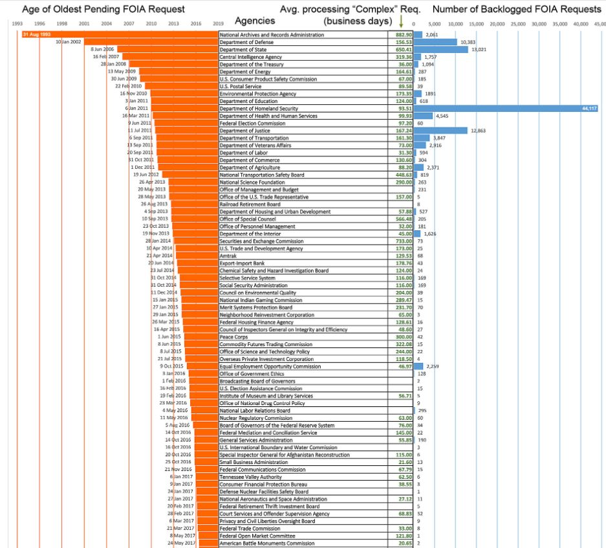
Think Strategically.
FOIA where others aren’t.
Source: National Security Archive
2018 FOIA Audit nsarchive.org

Slide 10
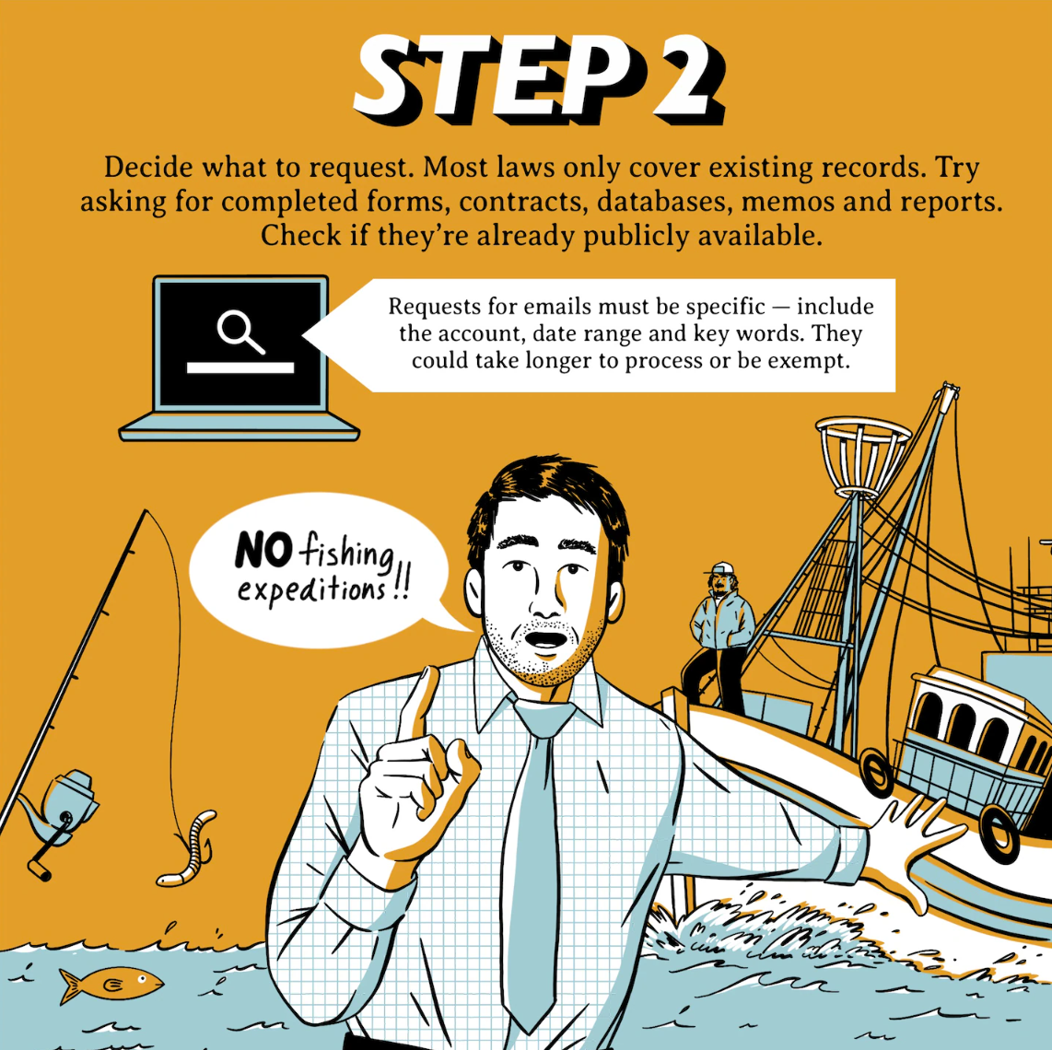
2. Target your Requests*
Ideas:
Records released to others.
Records cited in footnotes.
Records reported to Congress/used in testimony.
Records used in briefings.
IG investigations/sup. dox
Databases
Contracts
Schedules
Emails

Slide 11
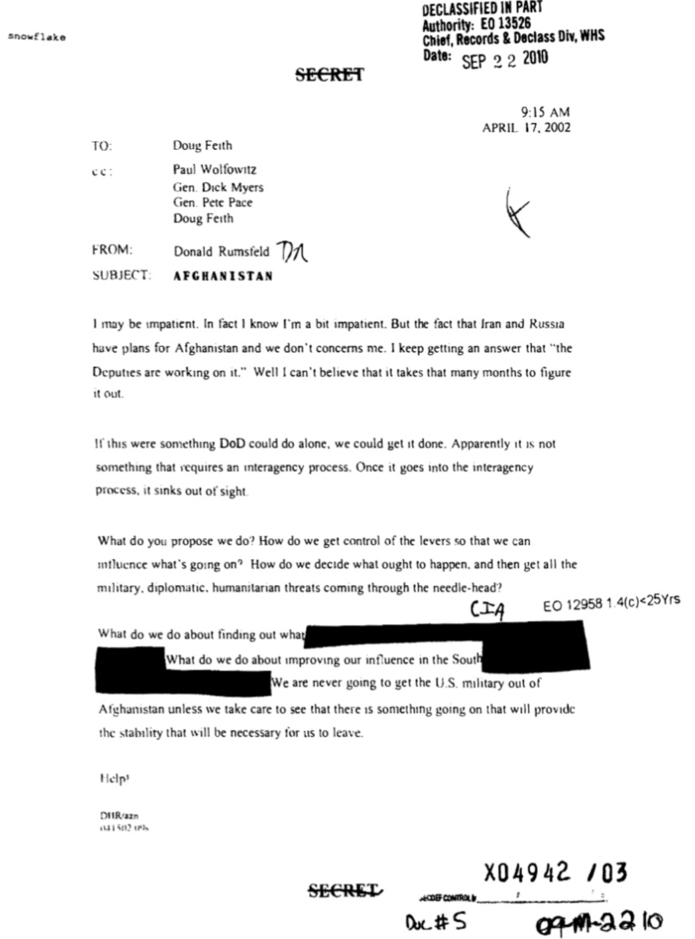
“We are never going to get the U.S. military out of Afghanistan unless we take care to see there is something going on that will provide the stability that will be necessary for us to leave. Help!” -Donald Rumsfeld, 2002.
Source: Afghanistan Papers

Slide 12
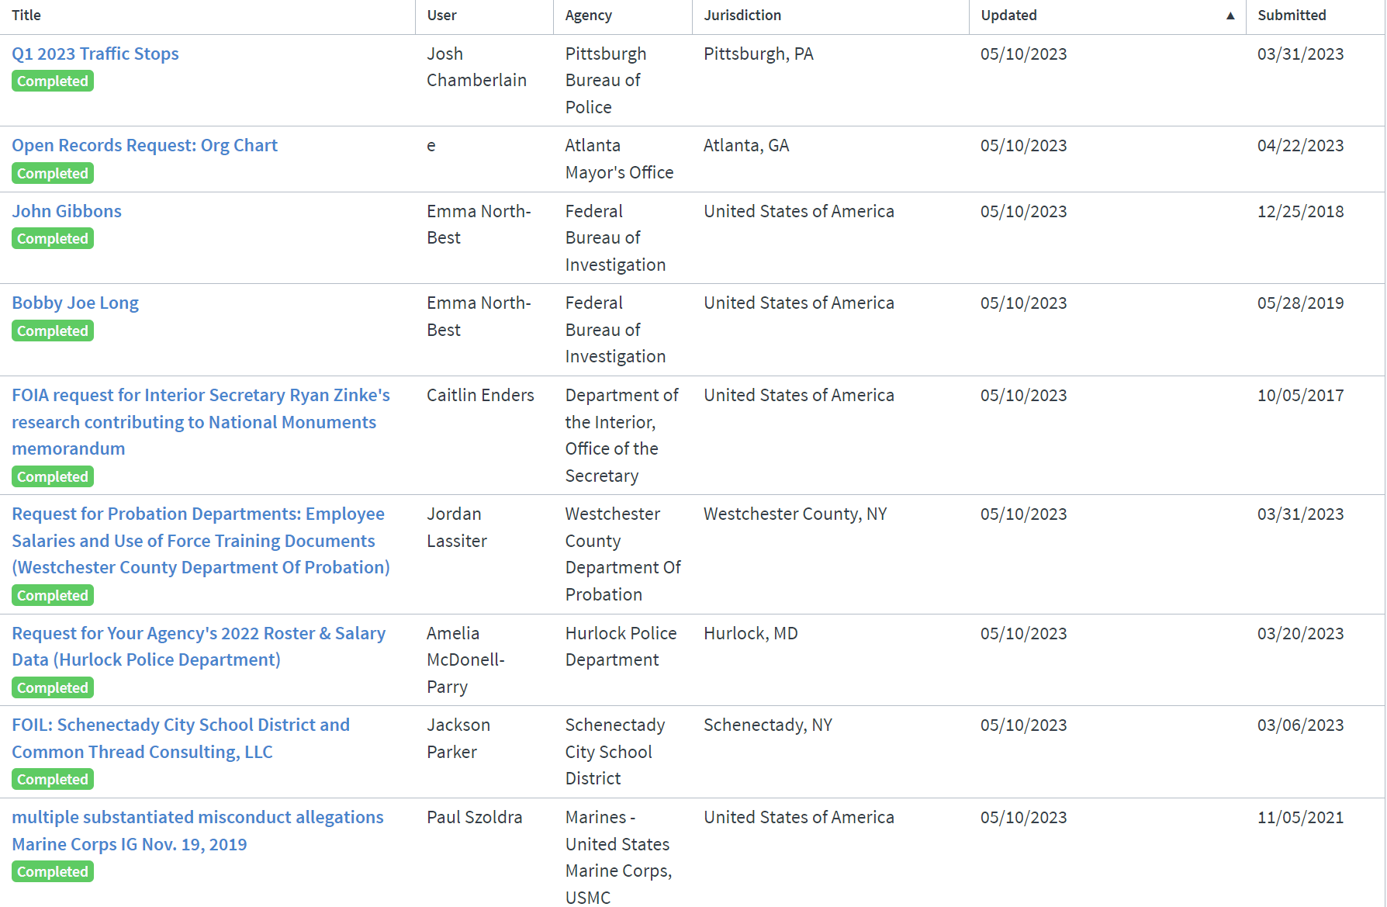
Brainstorming spots:
Agency reading
Rooms
2.Muckrock →
“Browse All Requests”
3. Government Attic
for FOIA logs

Slide 13
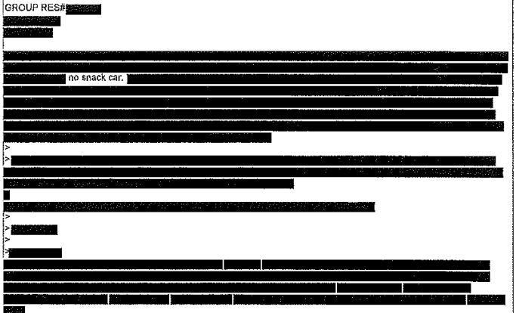
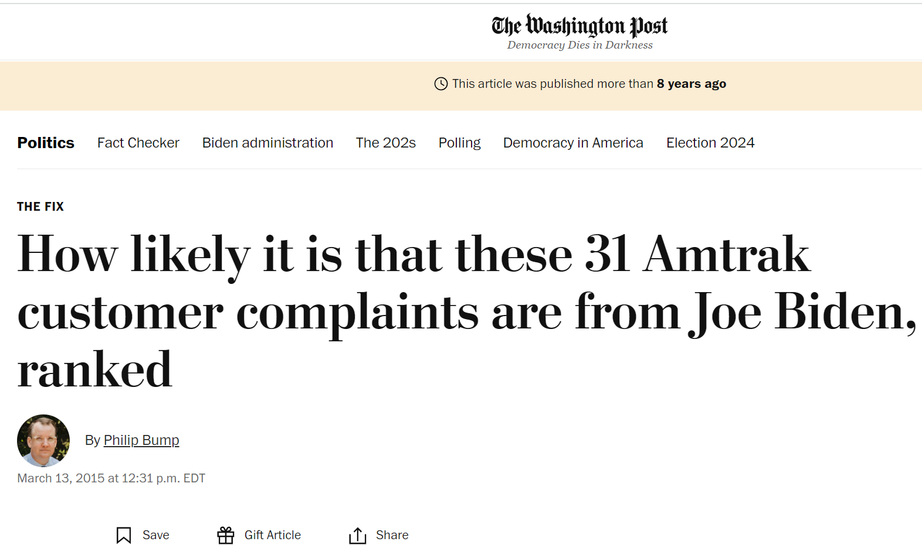
Make your requests as specific as possible.
Make sure agency acknowledges.
Tracking: Excel Works.
Put yourself in the shoes of the records processor.
Proactive > reactive.
The more you file, the more dox you’ll get. Plant acorns.
News Media Fee Status > Fee Waiver

Slide 14
3. EMAILS
All emails sent from email account X to email account Y from date X to date Y mentioning the terms X Y and Z.
“All emails sent to or from the account of John Smith from September 1, 2022 to September 3, 2022.”
All emails sent to or from the email account of John Smith mentioning the term “Blizzard” from September 1, 2021 to September 1, 2022.
Think how you would search your own email (probably Microsoft Outlook.)

Slide 15
Potential additional language:
“Please omit all news articles or summaries of news articles.”
“In an effort to accommodate your office and reduce the number of potentially responsive records to be produced, I request only communications sent by [email addresses X Y and or Z]. However, I am still requesting that complete email chains be produced. This means, for example, that any response to an email containing one of the listed key terms and the initial received message are responsive to this request and should be produced.”

Slide 16
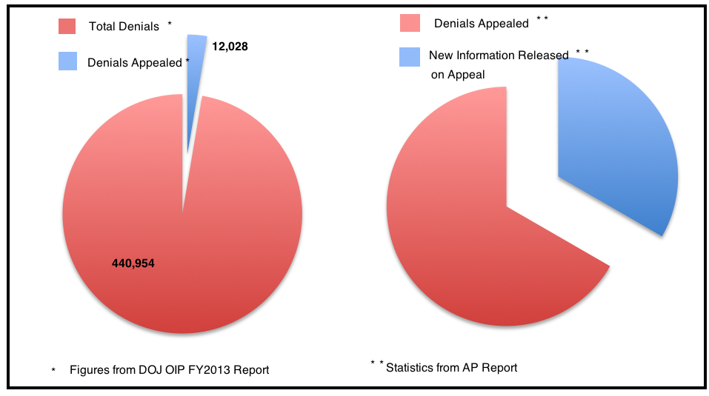
4. Appeal!

Slide 17
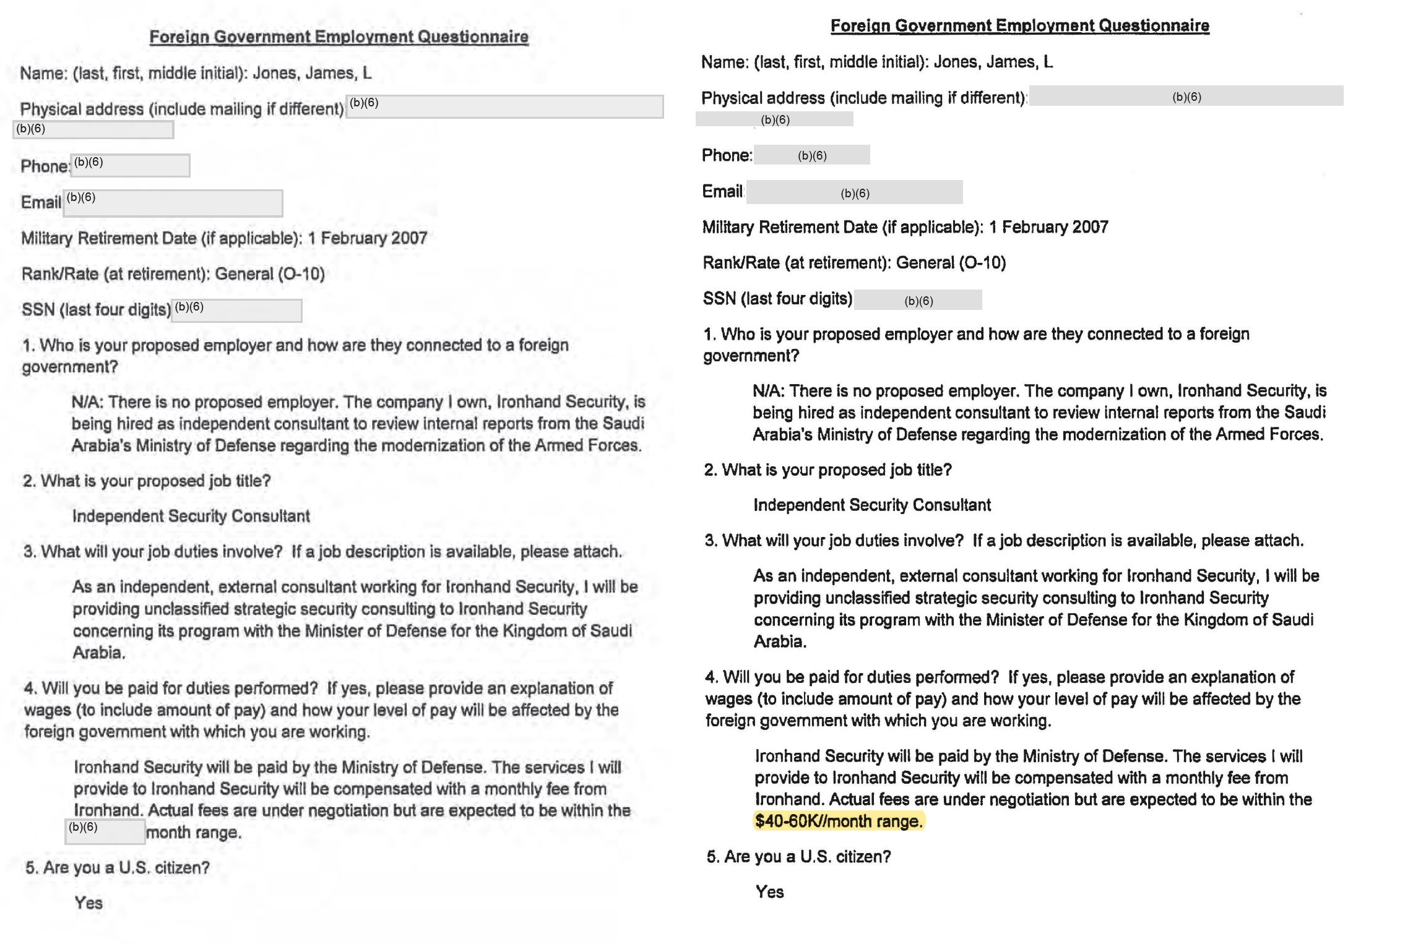

Slide 18
At the federal level, you can appeal any “adverse determination:”
(For states: check the RCFP Open Government Guide.)
Denials/Redactions
“No Records Responses”
Fee Determinations
Denial of Expedited Processing
Publicize Denials (What are they hiding?!)

Slide 19
5. Consider Litigation
Federal FOIA Tracks
Expedited | Simple | Complex | Appeal | Lawsuit
✓ ✓ ✗ Varies 4 Months+

Slide 20
Litigation Considerations
Factors The Post Considers before suing:
1. Is the law on your side?
2. Is it an issue of delay (if so suing often best solution).
3. Will the records still be newsworthy when you win (usually records start coming out ~4 months)?
4. Federal FOIA (and many states) have “fee shifting”
provisions which mean if the requester wins there is a
good chance the government has to pay.

Slide 21
FOIA Pointers:
Find where to file. Find the law.
Target your FOIAs.
Emails.
Always appeal.
Litigation

Slide 22
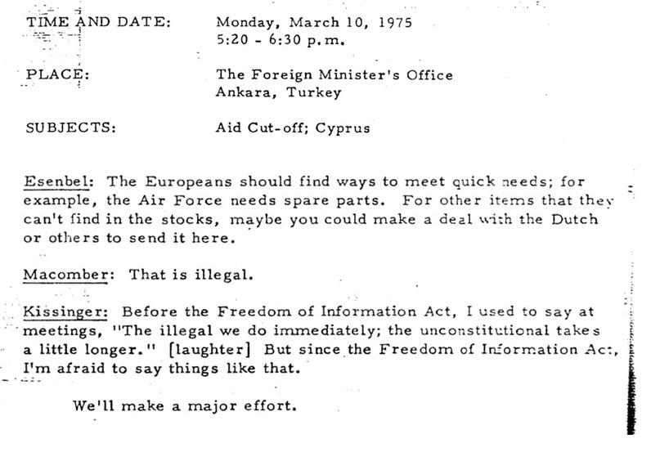
Questions?

Slide 23
Nate.jones@washpost.com
@FOIANate

