Slide 1
NORMAL NEVER RETURNED
The long-term impact of the pandemic on front line workers
Nidhi Tewari, LCSW; CEO Work Well, Live Well

Slide 2
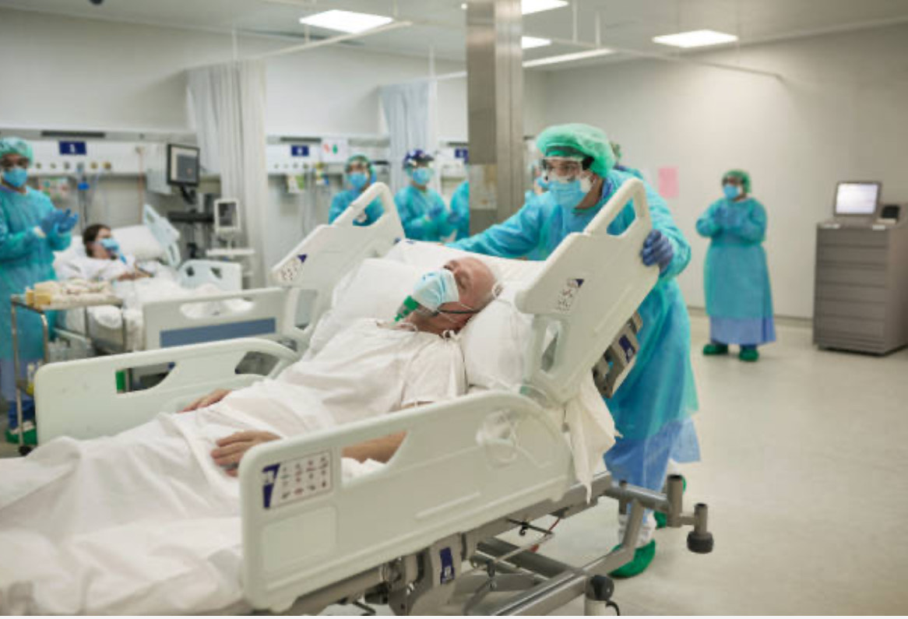

MARCH 2020

Slide 3


RETURN TO NORMAL
2022

Slide 4
THE PANDEMIC ENDED IN THE GREAT REPRESSION
Nidhi Tewari, LCSW

Slide 5
NPR Interview with Frontliners

Slide 6
72% of mental health care workers reported increased client severity since the pandemic.
(National Council for Mental Wellbeing).
Nidhi Tewari, LCSW

Slide 7
MENTAL HEALTH CARE WORKERS WERE THE FORGOTTEN FRONTLINERS
Nidhi Tewari, LCSW

Slide 8
BURNOUT
STOLE THE SPOTLIGHT FROM
MORAL INJURY
Nidhi Tewari, LCSW

Slide 9
MORAL INJURY
WHEN SOMEONE ENGAGES IN,
FAILS TO PREVENT,
OR WITNESSES ACTS THAT CONFLICT WITH THEIR VALUES AND BELIEFS
Nidhi Tewari, LCSW

Slide 10
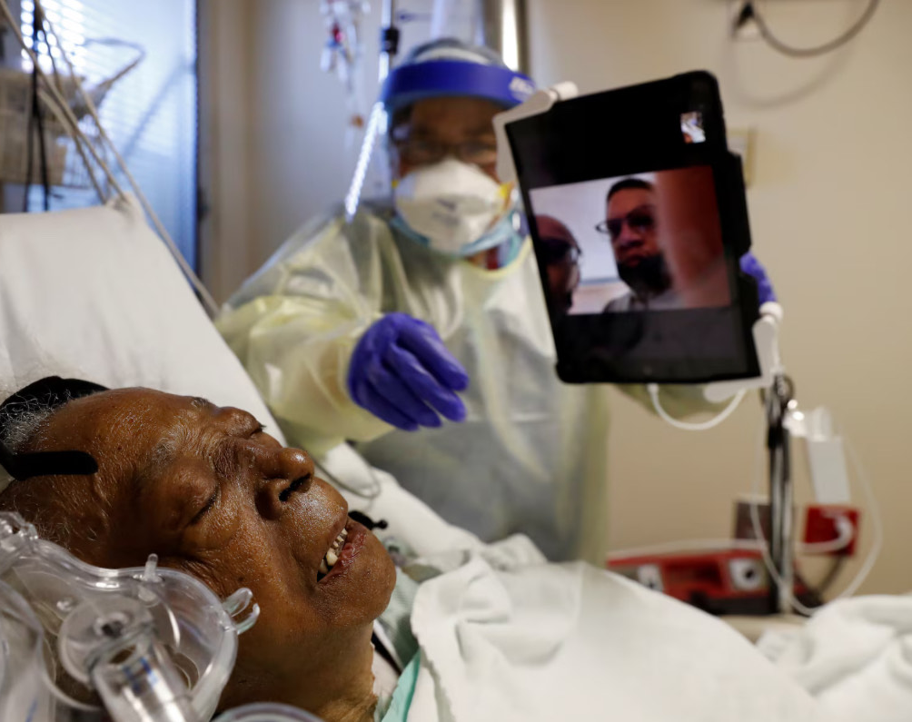
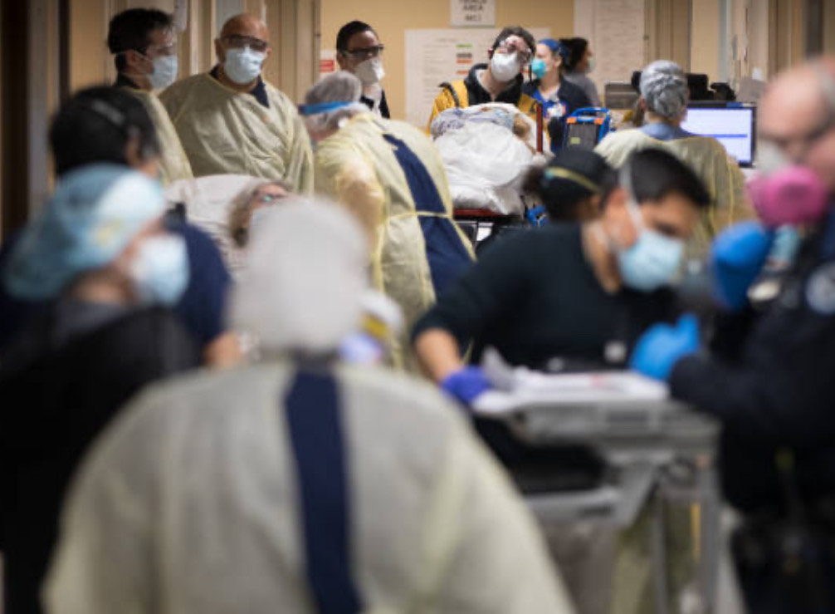
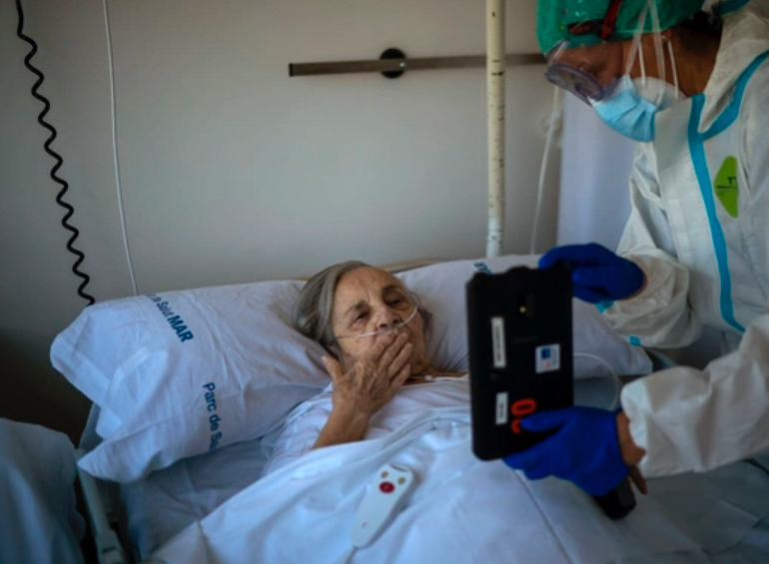

Slide 11
MORAL INJURY LEADS TO PTSD, ANXIETY, DEPRESSION
IN A 2023 STUDY, 55.3% OF HEALTHCARE WORKERS REPORTED EXPERIENCING PTSD-LIKE SYMPTOMS
(Syracuse University)
Nidhi Tewari, LCSW

Slide 12

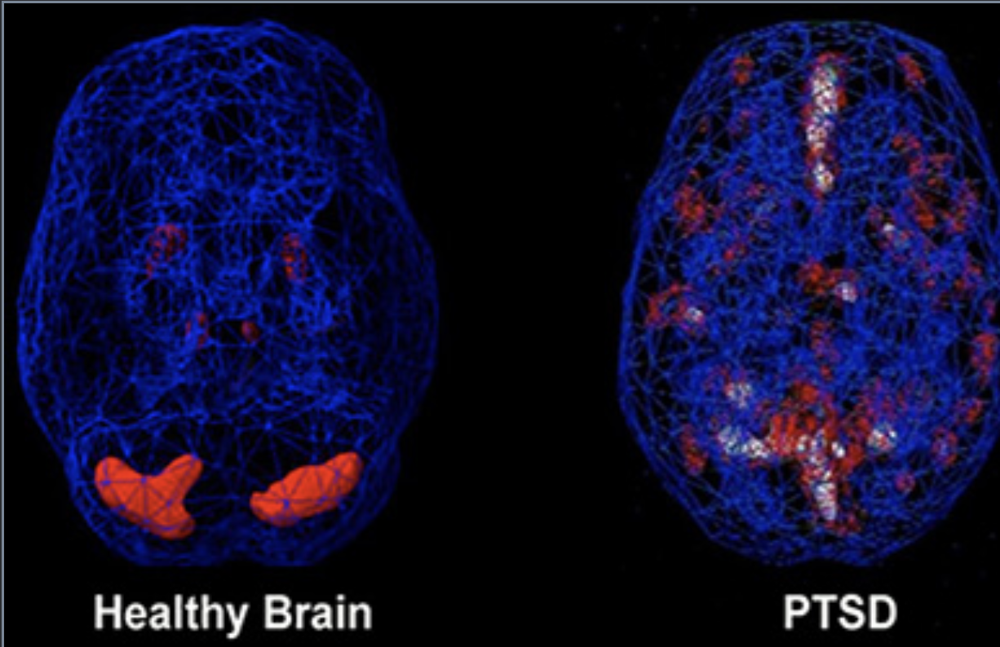
THE IMPACT OF TRAUMA
Trauma causes changes in the brain
Dissociation (zoning out)
Difficulties with focus
Memory challenges
People Pleasing
Hypervigilence
Hypoarousal
Nidhi Tewari, LCSW

Slide 13
YOU CAN LOVE YOUR JOB AND STILL EXPERIENCE MORAL INJURY AND BURNOUT
Nidhi Tewari, LCSW

Slide 14
HEALTHCARE WORKERS ARE OFTEN UNABLE TO SEEK HELP
Nidhi Tewari, LCSW

Slide 15
A 2024 MERCER REPORT PREDICTS A NATIONAL HEALTHCARE WORKER SHORTAGE OF 100,000 BY 2028
Nidhi Tewari, LCSW

Slide 16
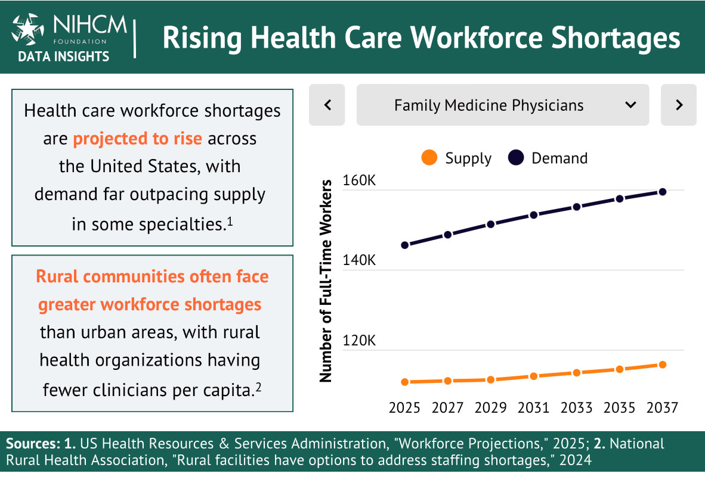

Slide 17
93% of mental health care workers have experienced burnout.
48% of mental health care workers have considered other employment options
Nidhi Tewari, LCSW

Slide 18
WORK CULTURE IS A KEY REASON FOR THE SHORTAGE
Nidhi Tewari, LCSW

Slide 19

1 IN 5 GEN-Z HEALTHCARE WORKERS MAY LEAVE THE INDUSTRY
Nidhi Tewari, LCSW

Slide 20
83% of Gen-Z frontline employees report burnout.
Out of 27 industries, healthcare ranked last for employee satisfaction with pay and work culture.
Toxic work culture, micromanagement, hierarchical structures, and lack of leadership support are contributors (Forbes, 2024).
Nidhi Tewari, LCSW

Slide 21
WHAT WAS ONCE CONSIDERED ABNORMAL HAS BECOME NORMALIZED
Nidhi Tewari, LCSW

Slide 22
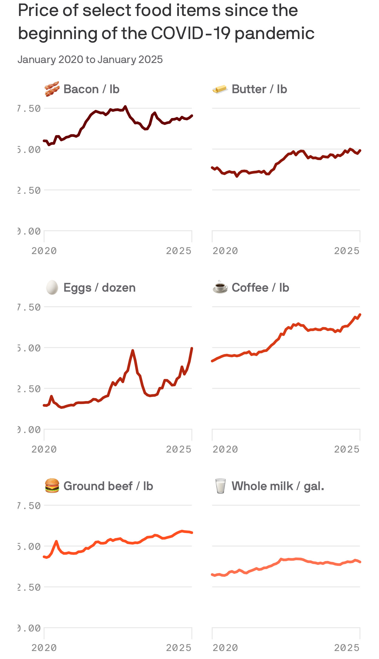
Axios, 2025
Supply chain disruption
and demand eruption

Slide 23
THE FACTORS THAT DROVE UP THE PRICE OF GROCERIES ARE NO LONGER THERE, BUT HIGH PRICES STILL REMAINED.
THE FACTORS THAT CAUSED STRESS DURING THE PANDEMIC ARE NO LONGER THERE, BUT THE STRESS STILL REMAINED.
Nidhi Tewari, LCSW

Slide 24
“We became heroes but they’ve already forgotten us.”
Southern Italy’s medical workers
Nidhi Tewari, LCSW

Slide 25


NIDHI TEWARI, LCSW
Keynote SPEAKER, WORKPLACE CONSULTANT, AND MENTAL HEALTH EXPERT
Book with Penguin Random House (April 2026):
Working Well: How to Build a Happier, Healthier Workplace Through the Science of Attunement

