Slide 1
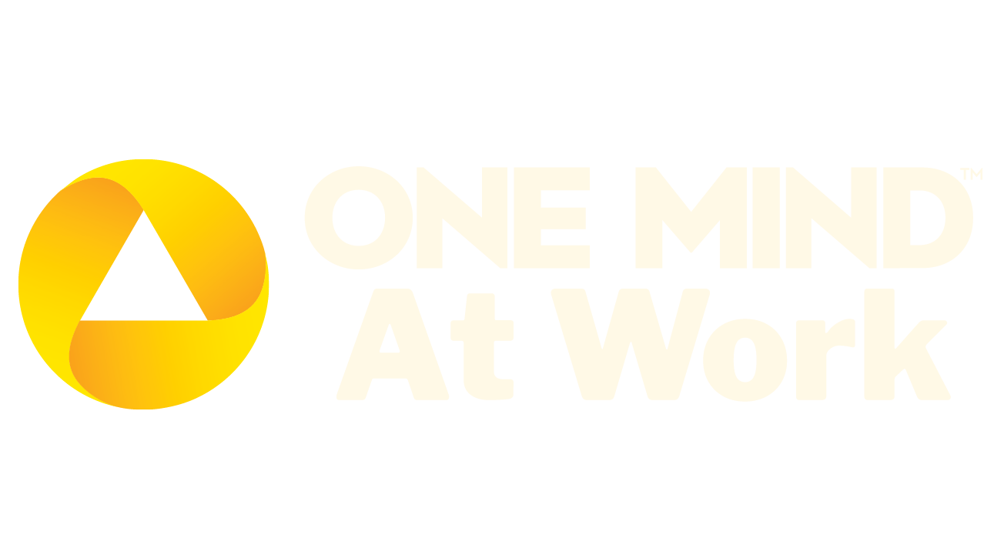
Building the Future of Workplace Mental Health

Slide 2

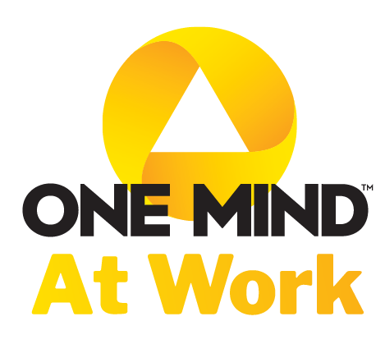
One Mind at Work is a non-profit organization leading a global movement to improve workplace mental health.
We drive measurable impact on workforce mental health, leading to better outcomes for individuals and organizations, by translating science into workplace best practices.

Slide 3
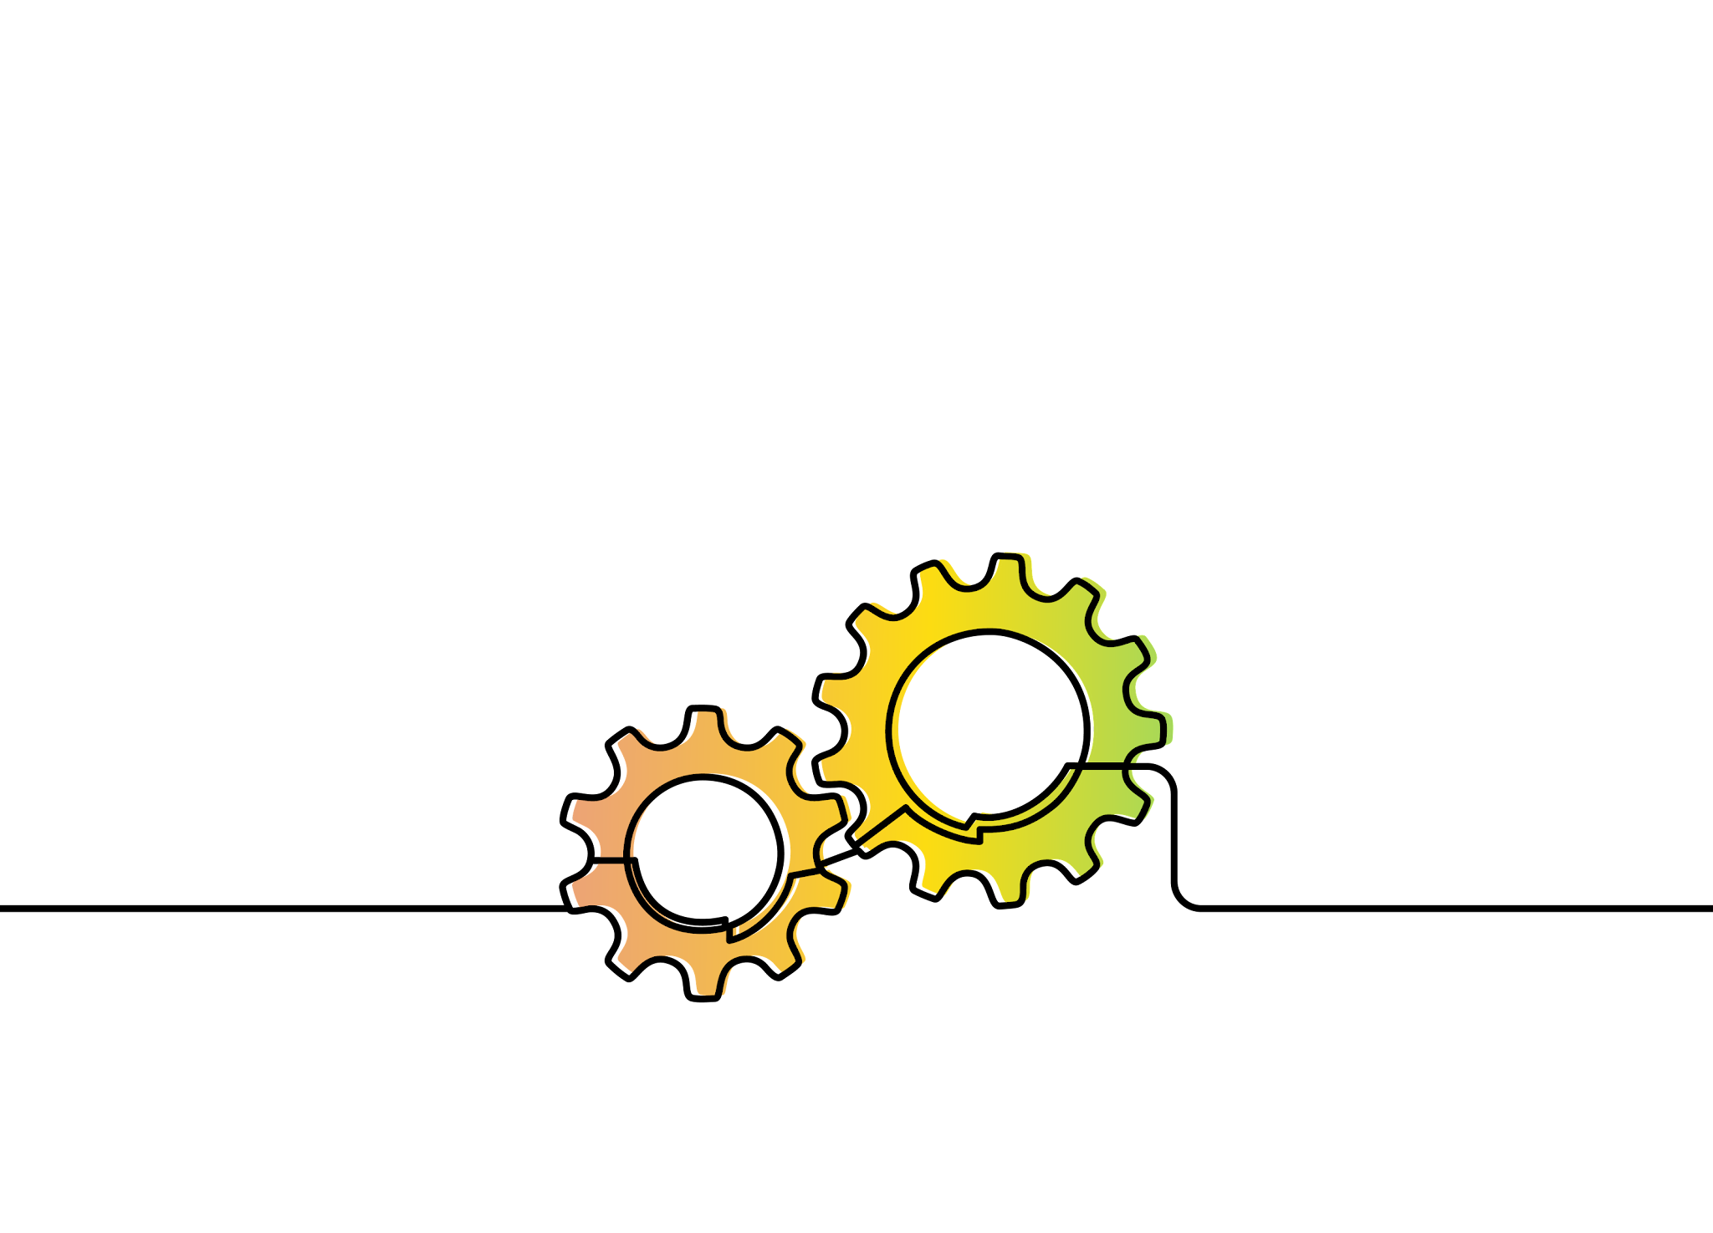
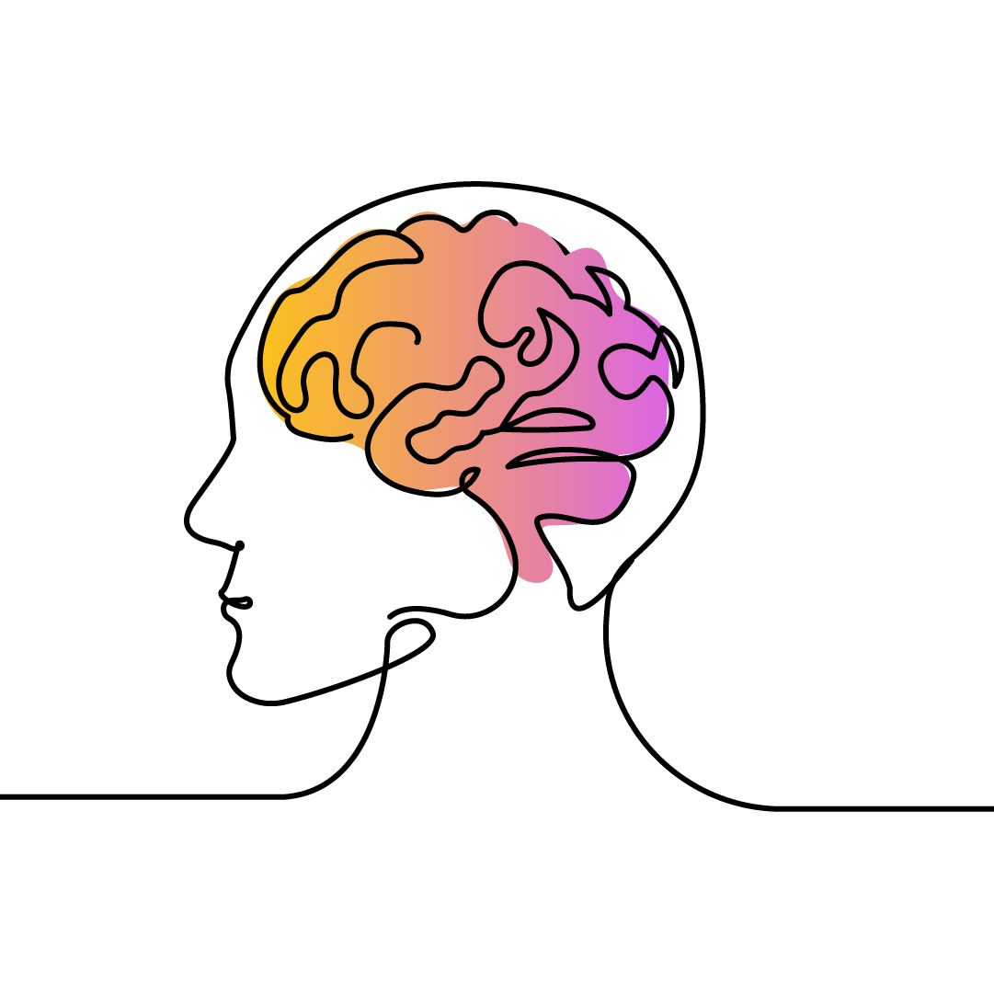
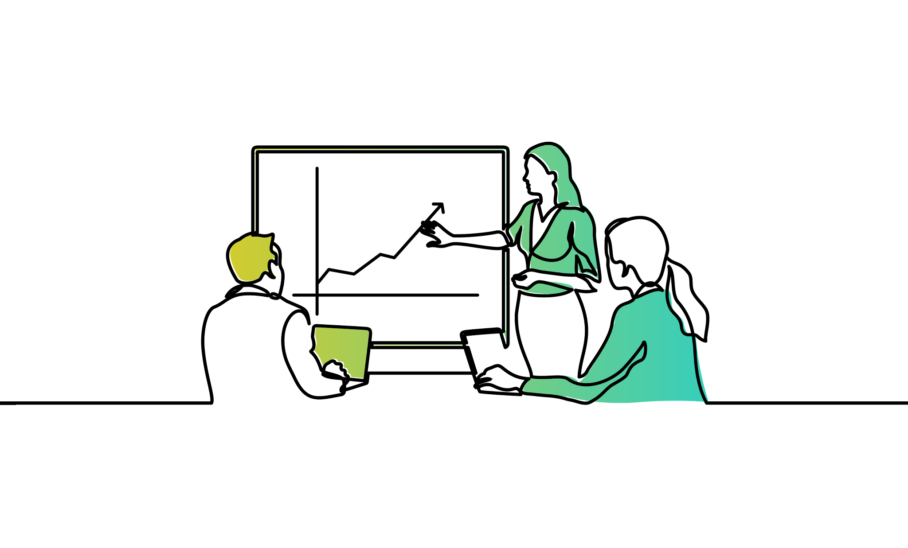

With science as our cornerstone, we empower organizational leaders to improve their mental health and well-being programs, policies, and practices that so people and organizations can flourish.
EXPERTISE
Access to our science and content experts.
Consultation and review in building effective strategies and plans for rapid improvement.
EDUCATION
Science-based, practical workshops and webinars that will have real impact on your work.
Annual convening that brings new science, networking opportunities and sharing of best practices.
MEASUREMENT
Capacity to measure what you are doing, benchmark, and determine whether programs are having impact over time.
Priority setting for how you can improve the work you are doing.
COMMUNITY
A community of organizational leaders committed to creating thriving, high-performing, and healthier workplaces.
Networks getting things done.

Slide 4
The Global Workforce is Struggling
Mental health trends are heading in the wrong direction.
15%
59%
87%
US$1trillion
workers report experiencing negative mental health impacts²
working-age adults have a mental health condition¹
of employees believe employer actions would help their
mental health³
annual cost to the global economy to untreated mental health conditions²
WHO, 2021. Mental Health Atlas 2020. Geneva: World Health Organization.
APA, 2021. APA’s 2021 Work and Well-being Survey.
Chisholm, D., Sweeny, K., Sheehan, P., Rasmussen, B., Smit, F., Cuijpers, P. & Saxena, S. 2016. Scaling-up treatment of depression and anxiety: a global return on investment analysis. Lancet Psychiatry, 3, 415-24.

Slide 5
Mental Health Predicts
Workforce Engagement
3 Rs: Recruitment, Retention, Reputation
Voluntary Turnover
Overall Health Care Costs
Disability
Performance
Productivity
Net Promoter Score

Slide 6


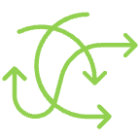
The Current Environment:
Overfocus on Worker Mental Health
Proliferation of Ad Hoc Point Solutions
Absence of Guidance for Business Leaders on what Works

Slide 7


Proprietary and Confidential.
Notes:
Employee data is like this garden. It’s clear the crops are not thriving, but it’s not clear why. could be too much water, could be beetles, could be not enough nitrogen in the soil, etc. Same is true in the workplace

Slide 8
We need a systems approach within the workplace to have real impact on mental health.

Slide 9
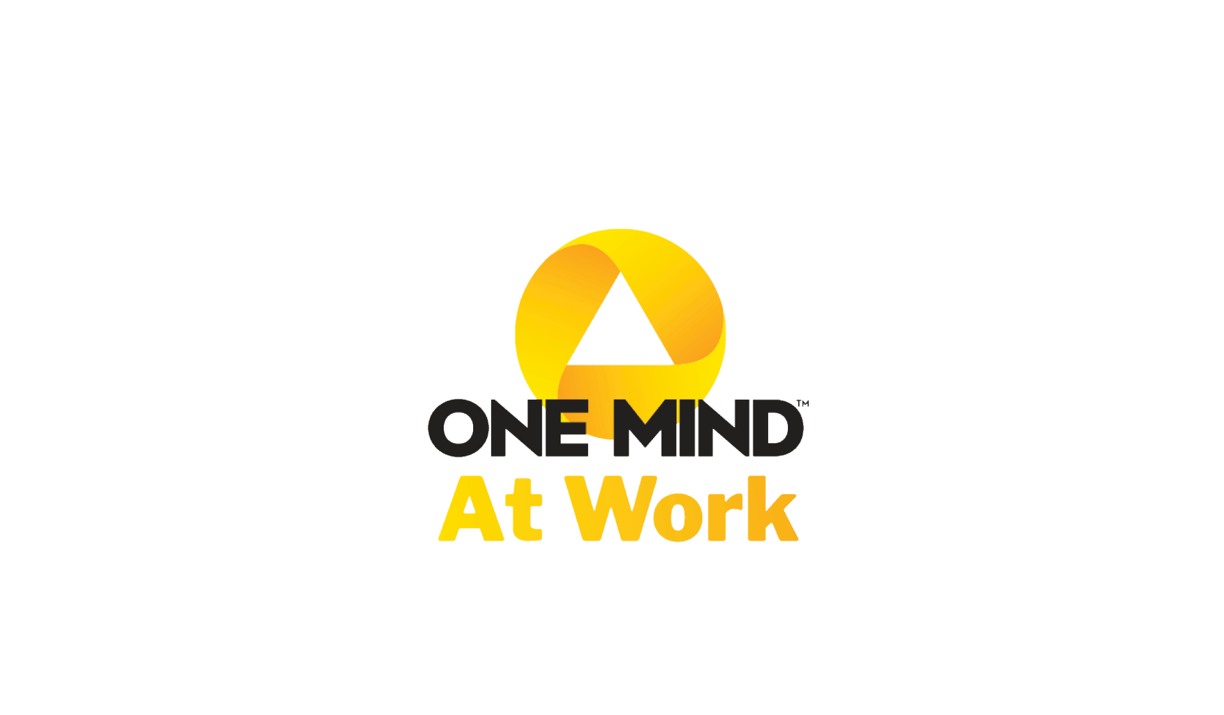
Insights from the Mental Health
at Work Index

Slide 10


3 Ps Framework
Protection of mental health by eliminating psychosocial hazards and minimizing risks that can negatively affect workers.
Protect
Promotion of psychological well-being by developing the positive aspects of work as well as worker strengths and positive capacities.
Promote
Provision of access to information, resources, and services that enable corrective organizational actions to address workforce mental health needs regardless of their cause.
Provide

Slide 11

Mental Health at Work IndexTM Categories
Organizational Culture and Impact
Training Specific to Mental Health
Workforce Involvement and Engagement
Mental Health Resources and Benefits
Mental Health Strategy
Work Design and Environment
Related Employment Practices
Measuring, Monitoring, and Reporting
Leadership
Communication

Slide 12
What Exactly Is the Index?
It is the first of its kind leadership tool to measure and improve workplace mental health strategies and compare results against other employers.
Self-Assessment
Benchmark & Target Scores
Advice Library
Customized Report & Expert Review
Evidence-based, data-driven approach to measuring an organization’s mental health programs
Immediately usable data, including the organization’s maturity score, a target score, a benchmark score, and a red flag score
Algorithm-driven to provide recommendations and resources – and prioritizes where to start
Guidance for strategic organizational improvement
Notes:
The Mental Health at Work Index is the first-of-its-kind comprehensive, standardized assessment of organizational programs supporting workforce mental health.
The Mental Health at Work Index was developed to extend the capacity of leaders committed to making a meaningful and sustainable impact on their employees’ mental health. Built on a foundation of science and best practice, the Mental Health at Work Index is unique in its ability to support organizational leaders in the assessment of their mental health programs and practices and develop data-driven solutions. By engaging with the Index, organizations are given the tools to establish a baseline for their mental health programs and services, identify areas that will accelerate the impact of their existing efforts, and access evidence-based content and guidance to support more strategic and efficient use of resources for improved outcomes.
The Mental Health at Work Index addresses a critical gap in an increasingly noisy space by focusing on the practices and policies within an organization that leaders can directly control.

Slide 13
Key Findings from the Mental Health at Work IndexTM
91
2.5M+
Organizations
Workers
< $1M – $350B+
Annual revenue
Mental Health at Work Index

Slide 14
Index Benchmarks
Target
Benchmark
Mental Health Strategy
Leadership
Organizational Culture and Impact
Workforce Involvement and Engagement
Work Design and Environment
Communication
Training Specific to Mental Health
Mental Health Resources and Benefits
Related Employment Practices
Measuring, Monitoring, and Reporting
5
4.7
4
4.3
4.3
4.0
4.0
4.0
4.1
4.0
3.8
3.8
3
3.2
3.1
2.5
2.8
2.4
2.5
2.3
2
2.1
2.0
2.0
1
Mental Health at Work Index

Slide 15
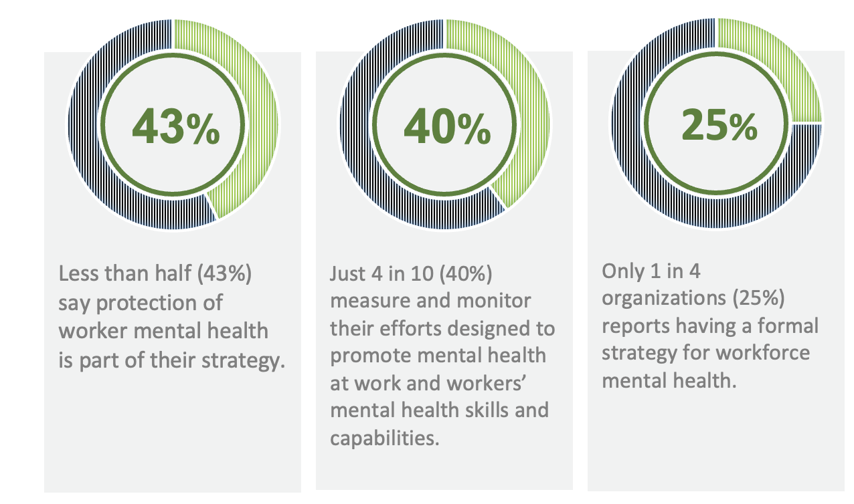
What We Are Learning
Companies are expending significant sums to provide mental health care, but most do not have a comprehensive mental health strategy. Employers need to focus on system solutions that support workers across the continuum of mental health needs.

Slide 16
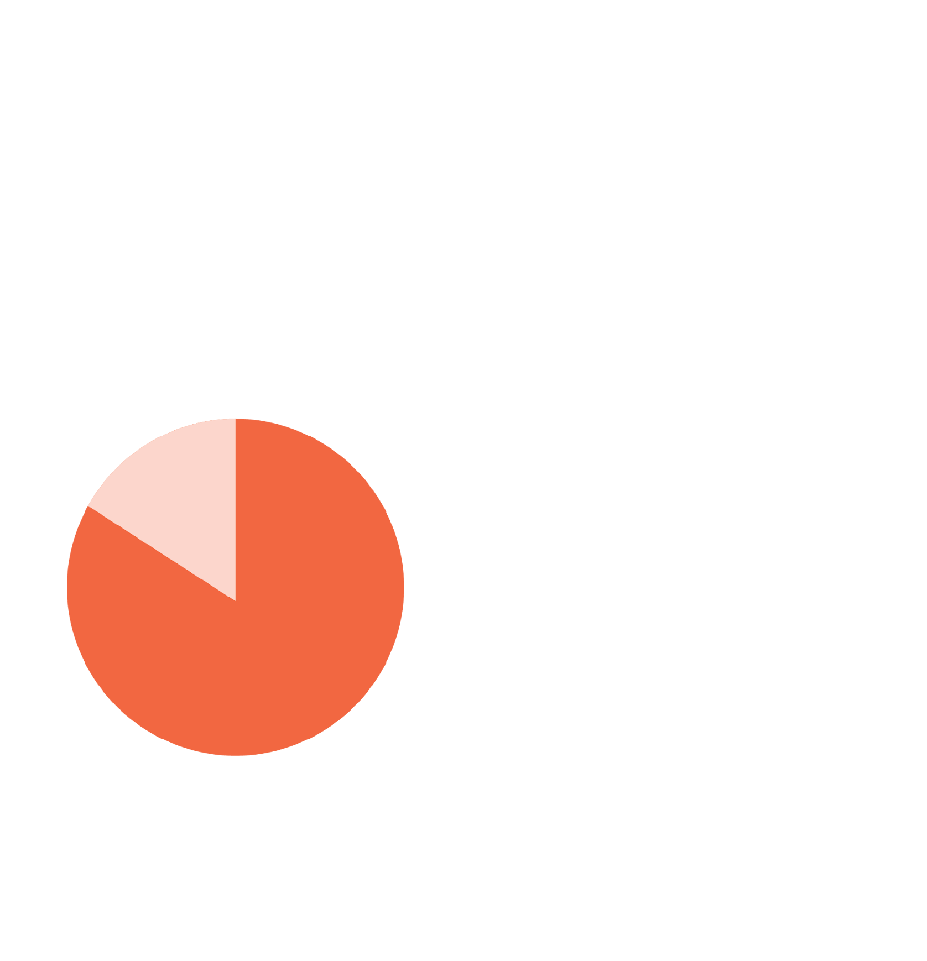

KEY FINDINGS
Leadership support for mental health is getting stuck in the C-suite
86%
6 in 10
Of organizations have at least one executive with oversight of, or involvement in, their workforce mental health strategy
Senior leaders have established mental health at work as a priority(60%)
57% publicly acknowledge the link between mental health and performance and 62% regularly communicate with workers about mental health

Slide 17
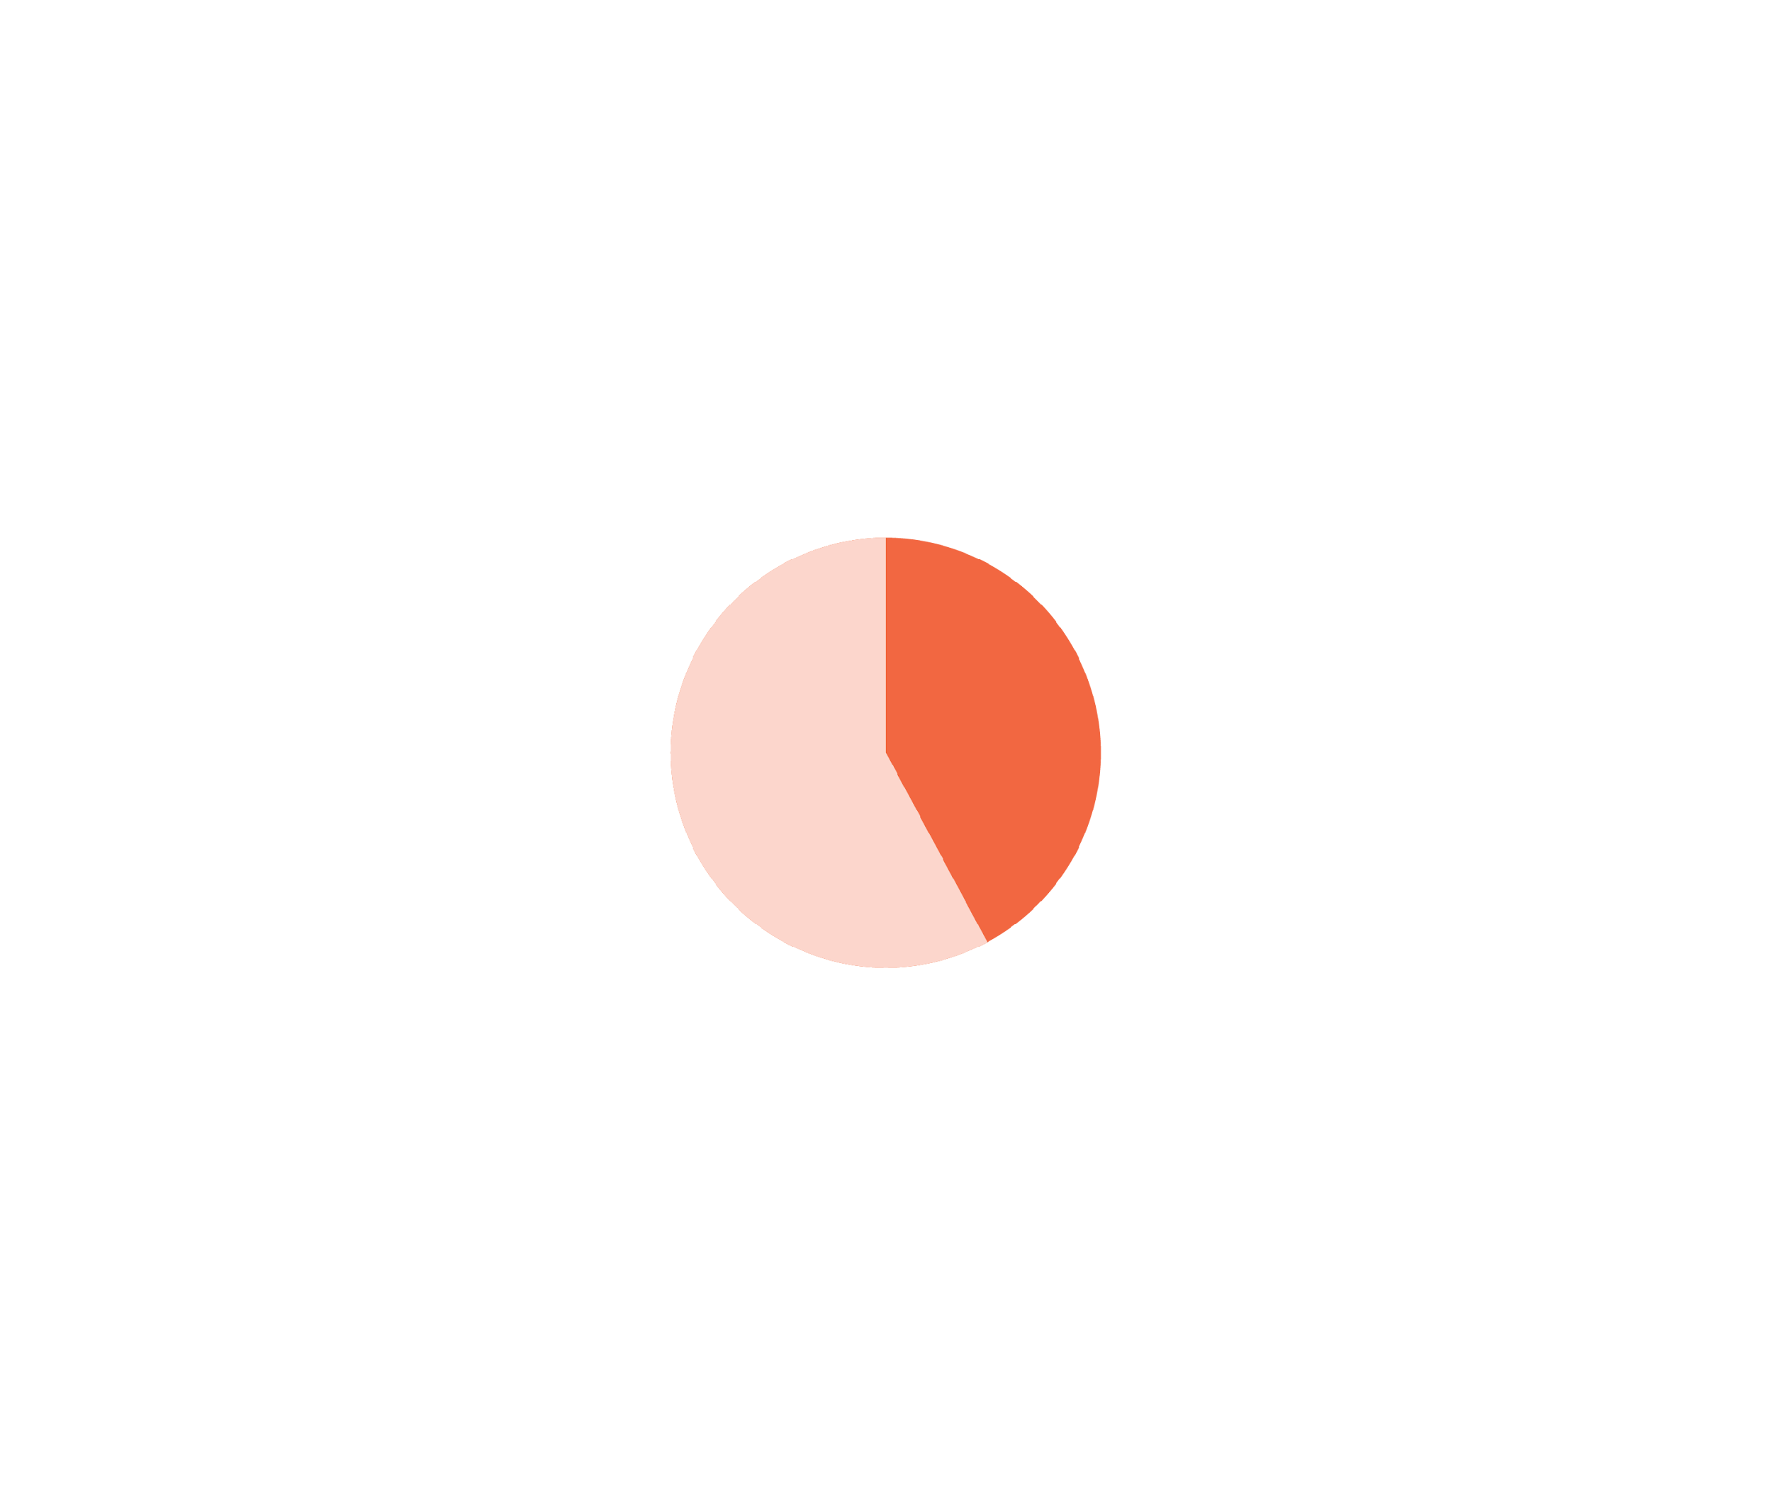


KEY FINDINGS
Leadership support for mental health is getting stuck in the C-suite
41%
Set a good example for others by consistently modeling positive mental health behaviors
The Business Case
Organizations with senior leaders who actively support workforce mental health reported less than half the voluntary turnover of those where leadership support was lacking (7% vs. 15%).
1 in 4
Hold their direct reports accountable for advancing and supporting mental health in their respective operating units
7

Slide 18
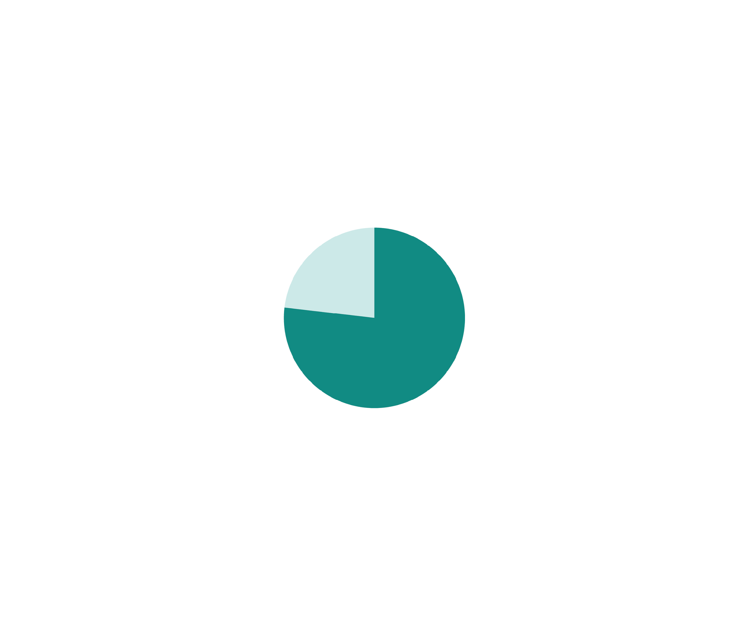
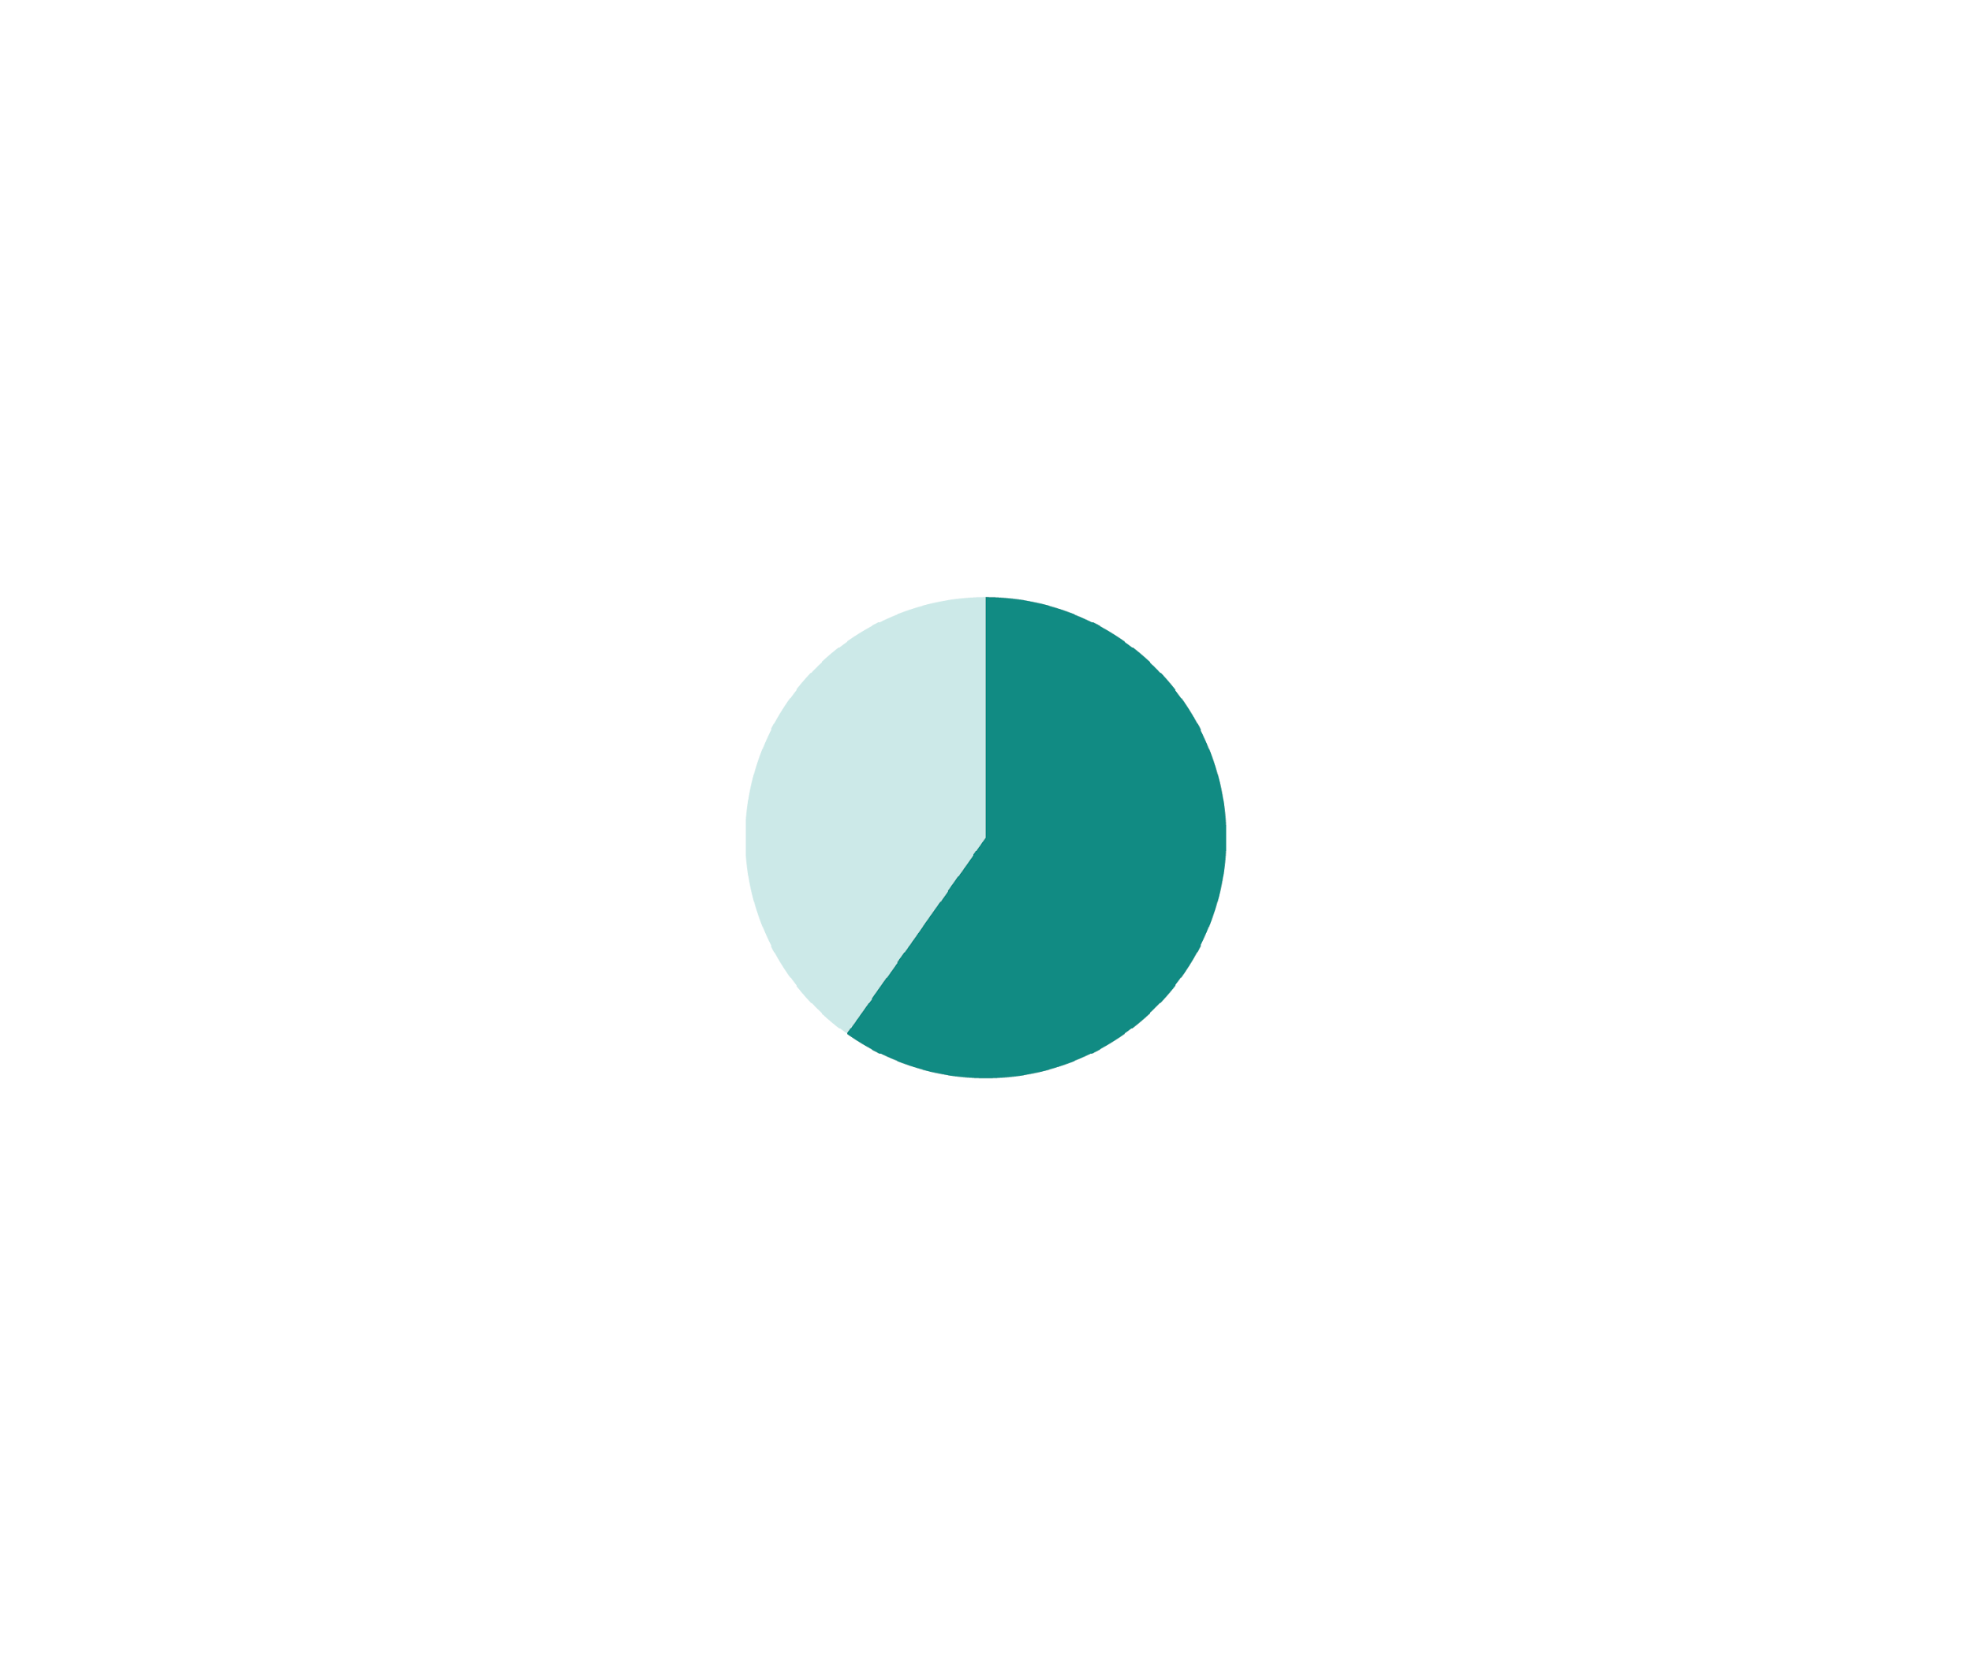

KEY FINDINGS
Managers are key to meaningful mental health programs
77%
63%
of managers encourage employees to use available benefits and resources.
of organizations report that managers allow work time for participation in mental health activities.
Fewer than 1 in 3
organizations report that managers make mental health efforts personally meaningful to their teams.

Slide 19
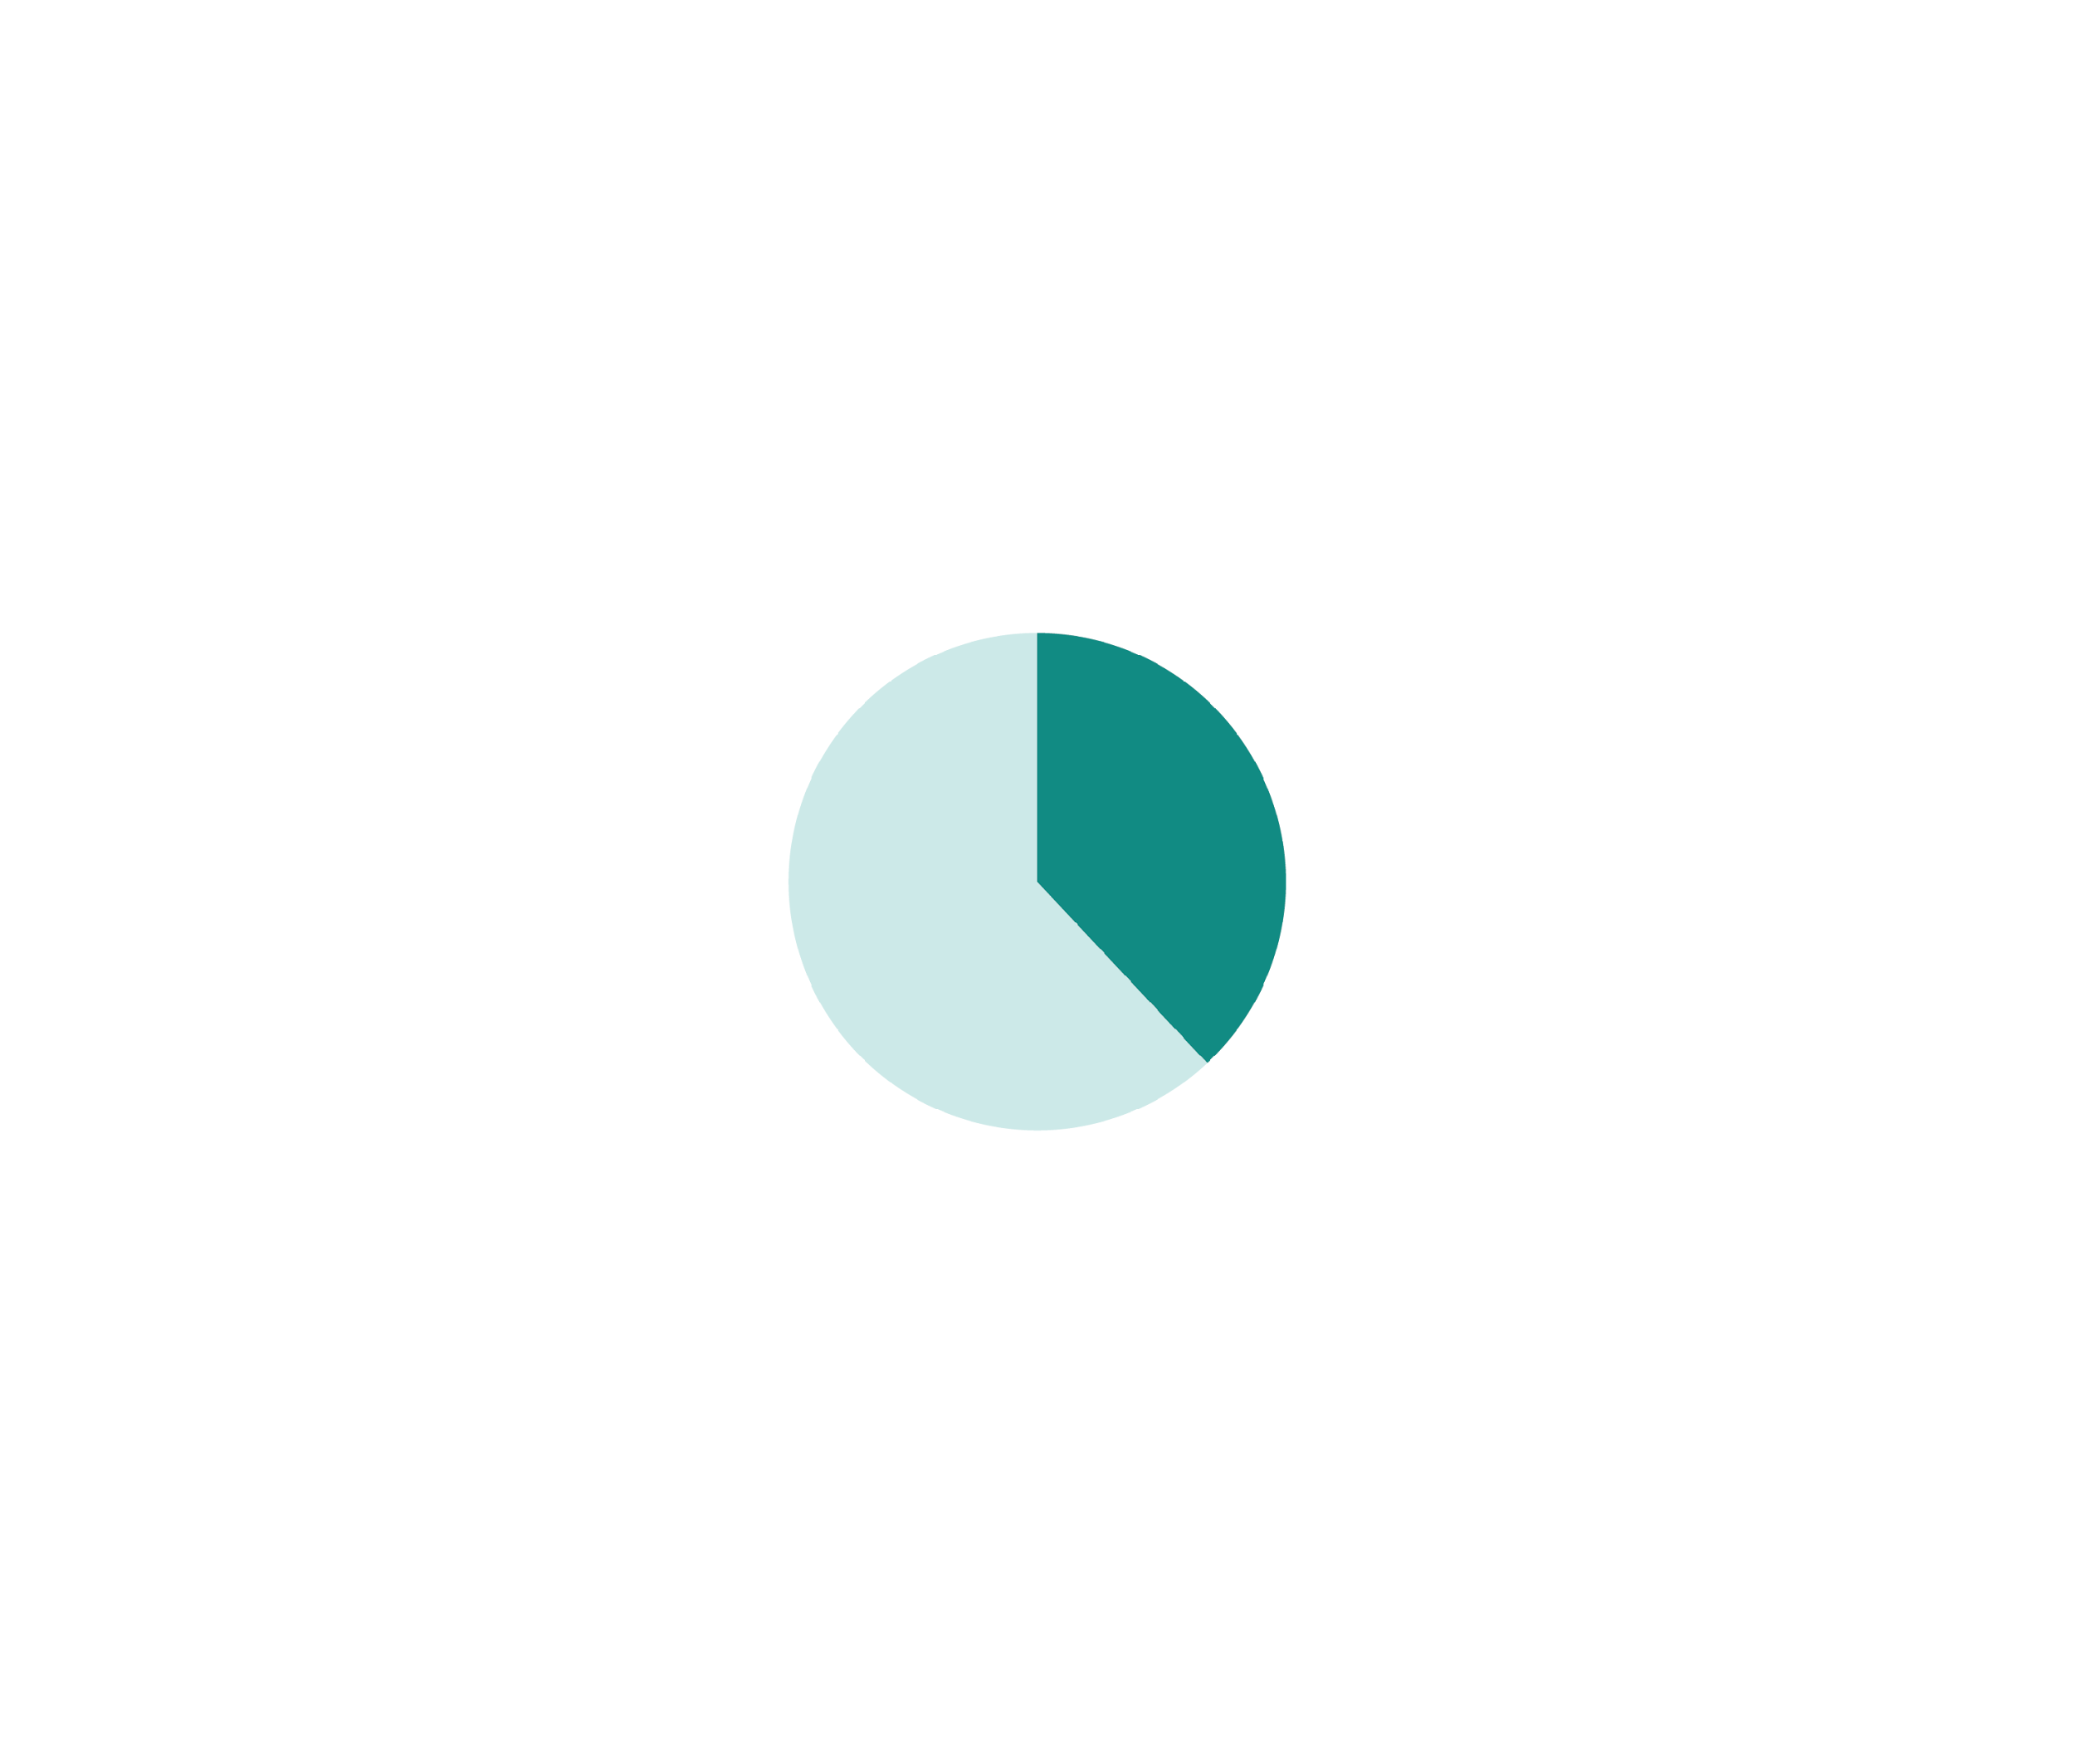
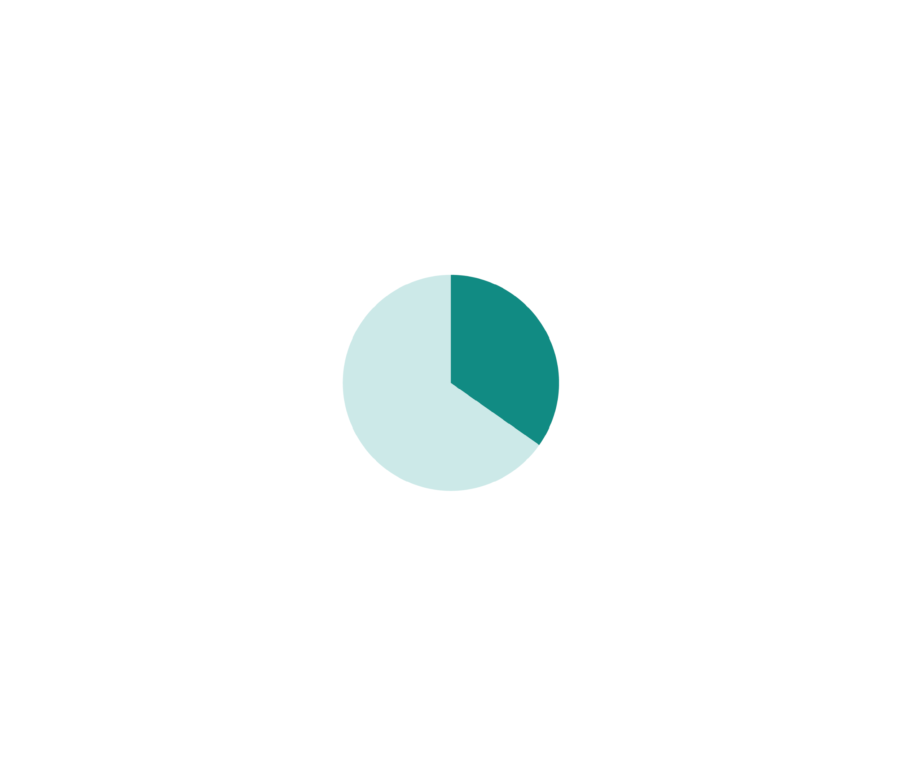

KEY FINDINGS
Managers are key to meaningful mental health programs
33%
of managers seek feedback from direct reports.
The Business Case
75% of organizations with comprehensive manager support for workforce mental health saw employee satisfaction ratings rise last year—more than double the rate of those without management support (33%).
31%
tailor practices to the specific needs of their department.
32%
recognize employee participation in the organization’s mental health initiatives.
7

Slide 20
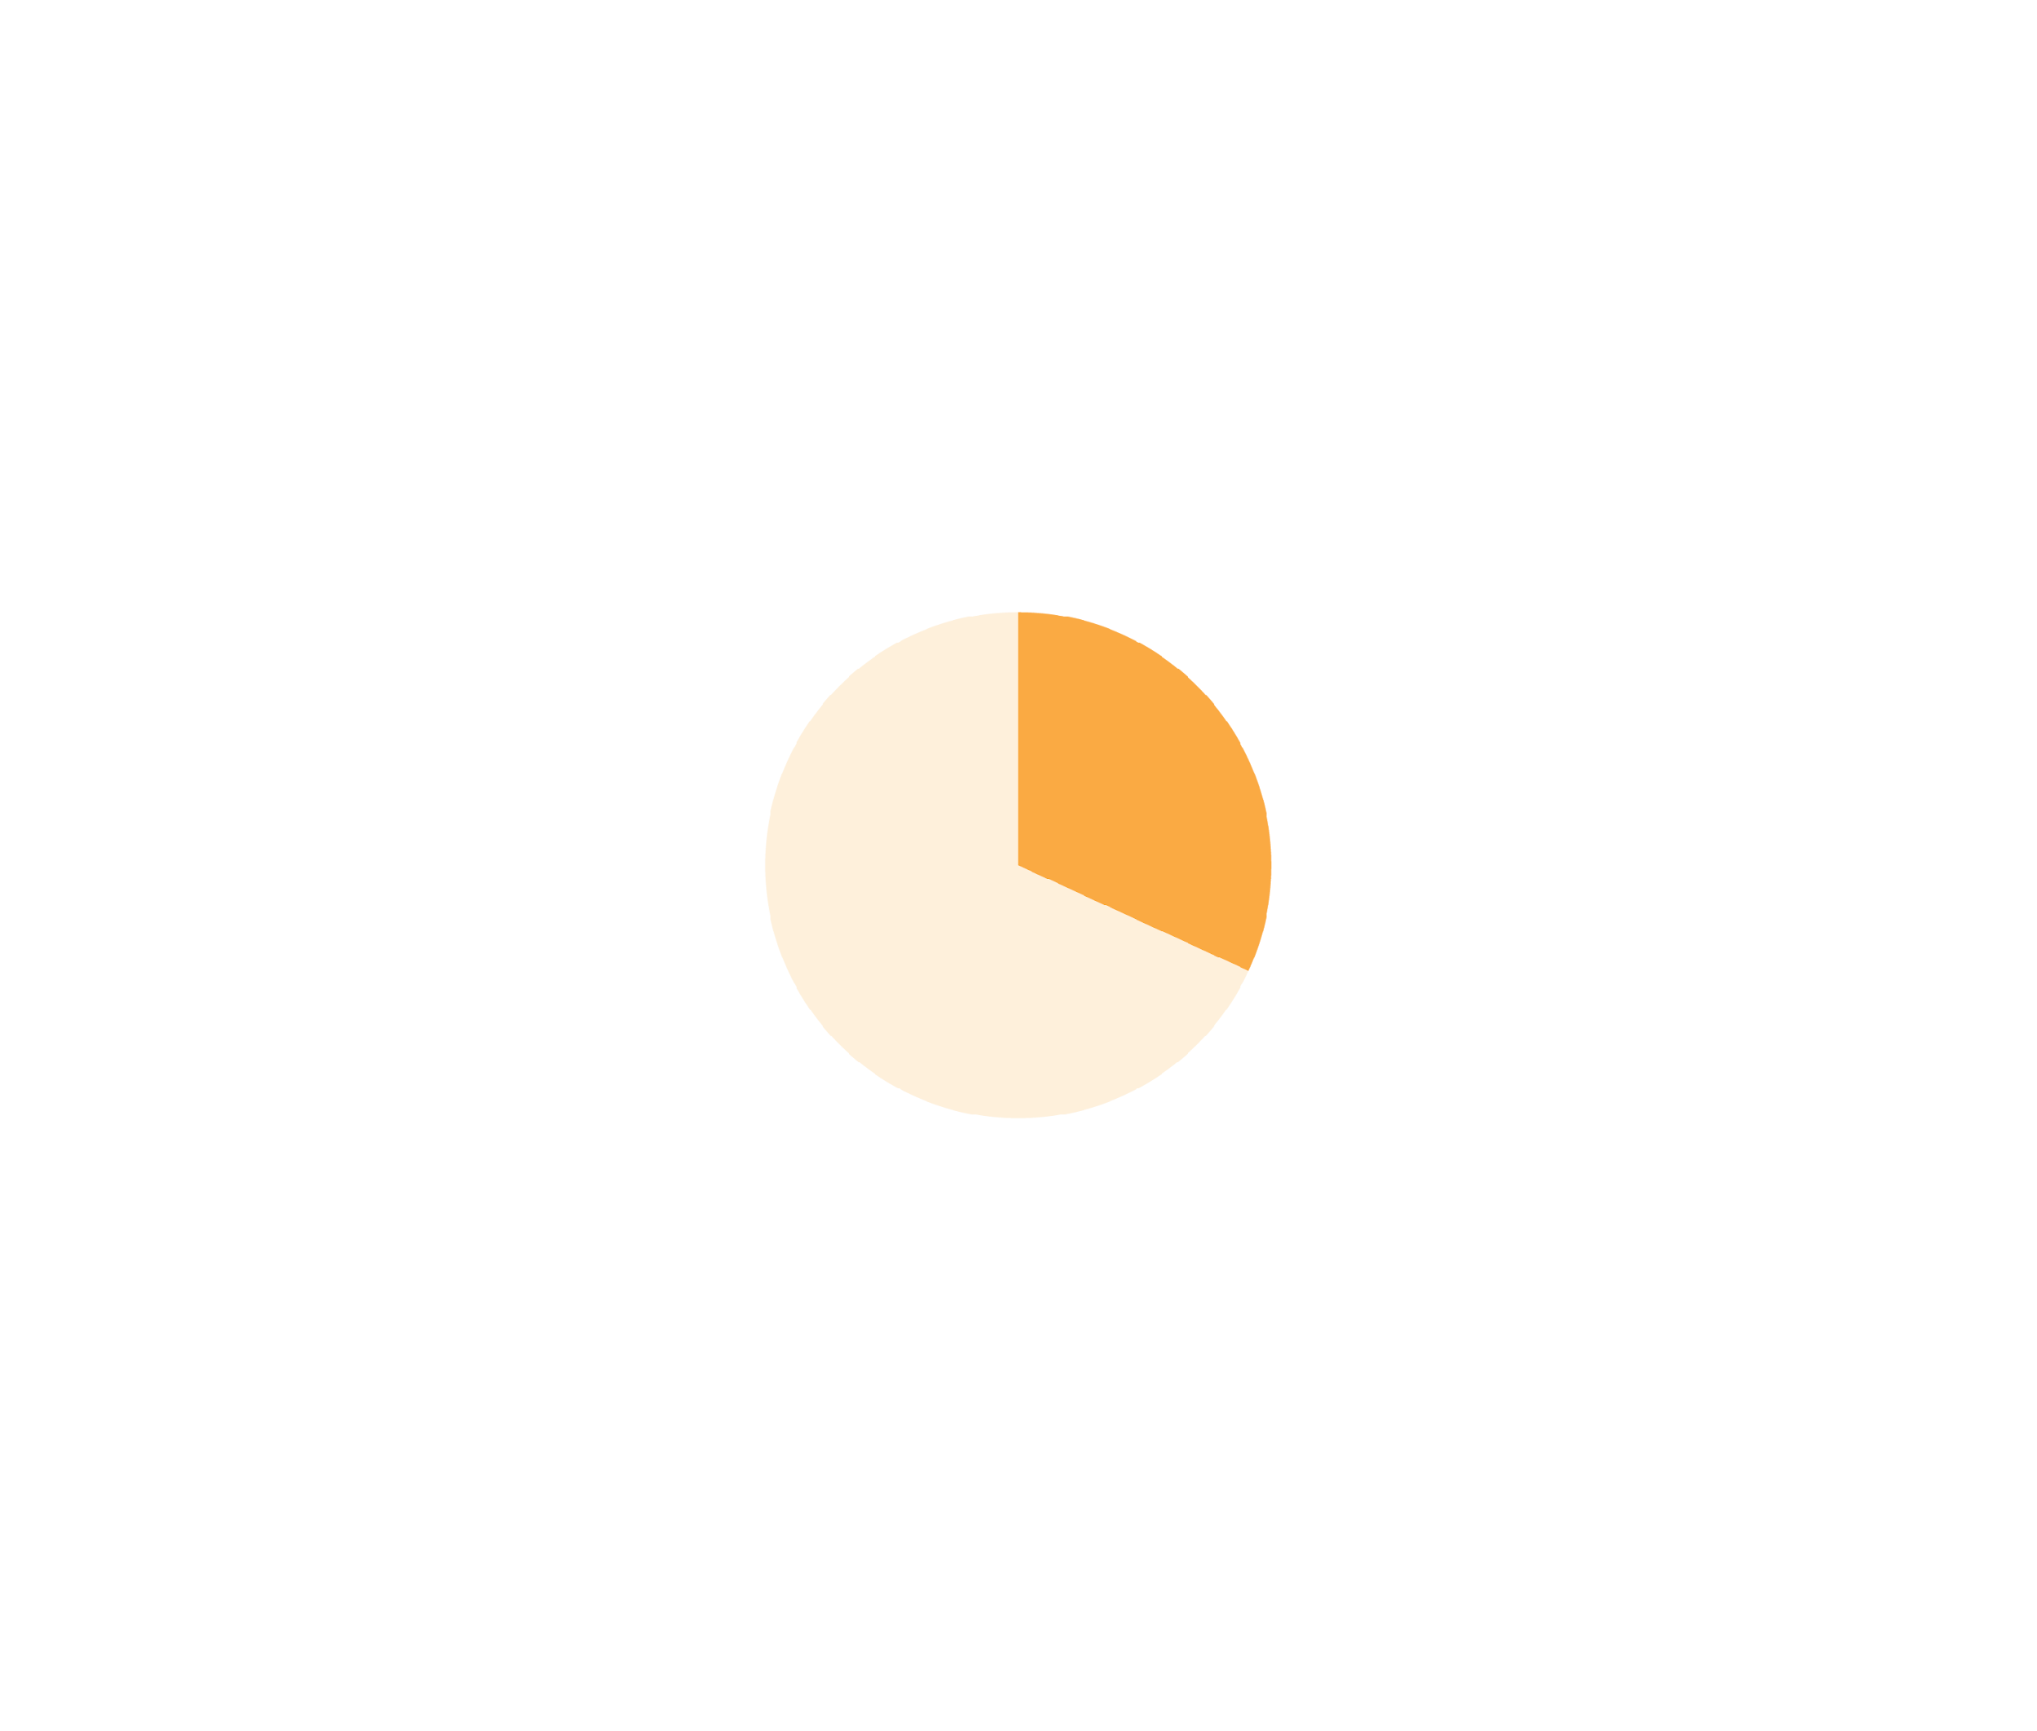

KEY FINDINGS
Most boards overlook workforce mental health as a strategic priority
1 in 10
30%
organizations formally define the board’s role in their mental health strategy.
share mental health program outcomes at the board level.

Slide 21

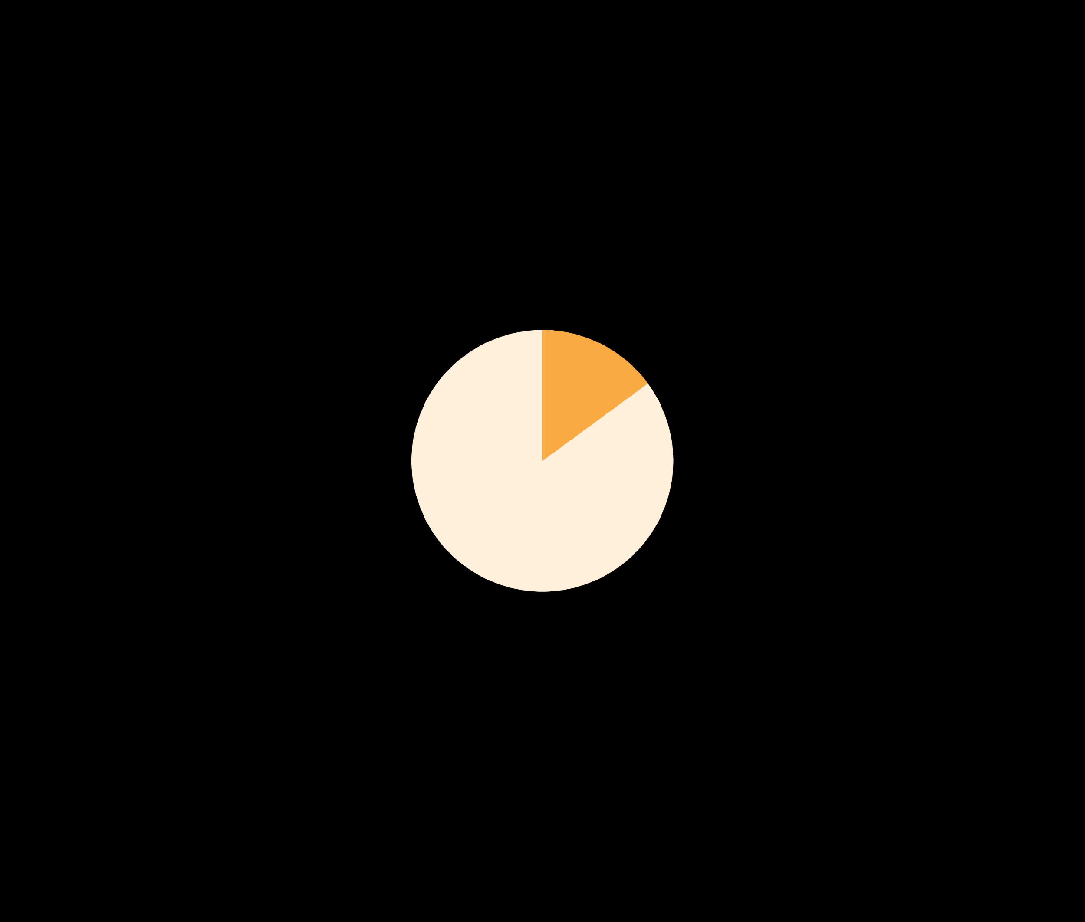
KEY FINDINGS
Most boards overlook workforce mental health as a strategic priority
41%
of employers say the board is supportive when leadership raises these issues.
The Business Case
Organizations where the board actively supports mental health efforts score 70% higher in overall program maturity on the Mental Health at Work Index. Governance engagement in workforce mental health is critical to building effective, high-impact programs.
15%
report that the board is actively engaged—routinely monitoring mental health metrics and advancing organizational priorities.
7

Slide 22
kathy.pike@onemind.org
https://kathypikephd.com/

