Slide 1
Job Uncertainty & Mental Health
NPF Covering Workplace Mental Health Fellowship
DR. JASON WANG
May 22, 2025

Slide 2
Dr. Jason Wang
Inflection Points Therapy
DC Private Practice Psychotherapist
Specialty (one of): Career-Focused Therapy
  NOT career counseling or career coaching
  Topics include: meaning in work, work-life balance, insight into career-related emotions and thoughts, and coping with job stress
Notes:
I’m Dr. Jason Wang, a psychotherapist in private practice here in DC. The name of my practice is Inflection Points Therapy, which captures pretty well my general approach to therapy and the type of client who I tend to work with - people who are at transition points in their life or career who want to be thoughtful and intentional as they enter a new stage of their lives, whether that means trying to work through issues that might be holding them back, or thinking through how to live their life differently moving forward, etc.
One of my clinical specialties is career-focused therapy. It’s important to note that career-focused therapy is NOT career counseling or career coaching. I want to clarify that this is still psychotherapy first and foremost, but with a focus on career-related issues. So examples of topics that we talk about include meaning in work, work-life balance, insight into career-related emotions and thoughts, and coping with job stress.
So that’s the clinical side of my work that informs my understanding of Workplace Mental Health

Slide 3
Vocational Psychology
My research subspecialty
Industrial/Organizational (I/O) Psychology
  (work-related psychology from the perspective of the organization)
Vocational Psychology
  (work-related psychology from the perspective of the individual worker)
  my research: career self-management & coping with unemployment
Notes:
On the research side of things, I’m trained as a vocational psychologist, and I’m still actively participating in career-related research.
Just to take a second to explain Vocational Psychology - I’m assuming most of you have never heard of Vocational Psyc (if you have heard of it, raise your hand). But you’ve probably heard of Industrial-Organization Psyc (aka I/O Psyc) (if you’ve heard of I/O Psyc, raise your hand).
So there is a decent amount of overlap between I/O Psyc and Vocational Psyc, but the main difference is that Industrial/Organizational (I/O) Psychology is work-related psychology from the perspective of the organization, whereas Vocational Psychology is work-related psychology from the perspective of the individual worker)
So what that means is that I/O psychology is interested in, for example, how companies can recruit, train, and develop employees in an optimal way; or how they can optimize organizational performance.
Whereas Vocational psychology is interested in how individuals choose a career, or is interested in the career development of individuals across their lifespan.
As another way of thinking about this, one of my major research interests is in how individuals psychologically cope with unemployment. That topic falls squarely in the domain of Voc Psyc, and not I/O Psyc, because Voc Psyc wants to understand the psychology of individual workers across their working lives, and a period of unemployment is becoming increasingly a normative event in the working lives of many workers. It is a topic that isn’t really found in the I/O literature because I/O Psyc is from the point of view of the organization or industry - an unemployed worker is not a part of a work organization and not actively working in their industry anymore, and thus psychological coping with unemployment falls outside of their interests.
I mention this because my general sense is that I/O Psyc gets a lot more funding and gets a lot more attention because of its organizational perspective. I want to advocate for more journalistic coverage of work-related mental health research that doesn’t get as much funding or attention, such as psychological coping with unemployment.

Slide 4
Uncertainty
Definitions (Massazza et al, 2023)
A state where details of the situation are ambiguous, complex, unpredictable, or probabilistic; when information is unavailable or inconsistent; and when people feel insecure in their own state of knowledge or the state of knowledge in general (Brashers, 2001)
A state characterized by lack of control (Afifi et al., 2014), by an incapacity to foresee future outcomes (Penrod, 2007), by entropy and disorder (Hirsh et al., 2012) or by the inability to determine the meaning of an event (Mishel, 1988).

Slide 5
Uncertainty & Mental Health
A Scoping Review (Massazza et al, 2023)
A review of peer-reviewed articles examining the relationship between uncertainty and mental health
101 quantitative studies (2000 - 2018)
59% medicine/nursing (e.g. patients facing illness uncertainty)

Slide 6
Uncertainty & Mental Health
A Scoping Review (Massazza et al, 2023)
In 79% of studies: higher levels of uncertainty associated with worse mental health outcomes (e.g. depression, anxiety, distress, PTSD, and stress)
In 15% of studies: mixed findings
In 6% of studies: non-significant relationship

Slide 7
Uncertainty & Mental Health
A Scoping Review (Massazza et al, 2023)
“the existing literature has overwhelmingly focused on characterising and quantifying the link between uncertainty and mental health rather than on exploring how to address this link in practice”

Slide 8
Uncertainty & Mental Health
A Theoretical Mechanism (Anderson et al, 2019)
We constantly think about possible future events - mentally simulating (i.e. imagining) them
Benefits: helps us plan for the future, test out alternative responses, and cope with stressful situations
In uncertain situations, mental simulation of possible outcomes is a plausible adaptive strategy

Slide 9
Uncertainty & Mental Health
A Theoretical Mechanism (Anderson et al, 2019)
In uncertain situations where the outcome might be (+) or (-), more weight is implicitly given to the potential (-) outcome
We have a general attentional bias toward the (-), meaning we prioritize (-) information. Likely an evolutionarily adaptive response: the cost of missing a (-) threat may be much greater than the cost of missing a (+) reward. So we focus on potential (-) outcomes

Slide 10
Uncertainty & Mental Health
A Theoretical Mechanism (Anderson et al, 2019)
When the cost of missing a potential threat is high, it can be advantageous to treat any ambiguous stimuli as a threat (a “zero miss” strategy), causing us to assume the worse
So we tend to deal with uncertain situations by fixating on mental simulations of the (-) outcomes that could happen, which is what negatively affects our mental health

Slide 11
Uncertainty & Mental Health
A Theoretical Mechanism (Anderson et al, 2019)
This theory explains why the link between uncertainty and mental health is typically (more uncertainty → worse mental health), but also explains how sometimes the link can be (more uncertainty → better mental health)
A theory posited in 2019 – to my knowledge, no known empirical studies have tested it!

Slide 12
Job Insecurity / Uncertainty
Definitions (Sverke et al, 2002)
Expectations about continuity in a job situation (Davy et al., 1997)
Concern about the future permanence of the job (van Vuuren & Klandermans, 1990)
Perception of a potential threat to continuity in his or her current job (Heaney, et al., 1994)

Slide 13
Job Insecurity
Conceptual Clarity (Sverke et al, 2002)
It is NOT the same as Job Loss (in which there is no uncertainty)
  Note: anticipation of a stressful event represents an equally important, or perhaps even greater, source of anxiety than the actual event (Lazarus & Folkman, 1984)
  Job loss allows the deployment of coping strategies

Slide 14
Job Insecurity
Conceptual Clarity (Sverke et al, 2002)
It is a subjective perception (2 employees in the same situation can experience different degrees of job insecurity)
It is characterized by fear of involuntary job loss
Generally not referring to uncertainty about a feature/facet of a job (e.g return to office mandate)

Slide 15
Job Insecurity
Conceptual Clarity (Shoss, 2017)
Encompasses both secure job → insecure job, & jobs that are insecure from the beginning (i.e. precarious work, jobs with selective retention processes)
  Is the link between job uncertainty and mental health different with precarious work vs. decent work?
  How does the perception of job uncertainty (i.e. a threat of job loss) overlap with sense of control over the situation?
Notes:
Precarious work: is work that is unstable and insecure in the continuity and quantity of work, restricts the power of workers to advocate for change, and does not provide protections from workplace abuses and unsafe working conditions (e.g., Kalleberg, 2009; Tompa, Scott-Marshall, Dolinschi, Trevithick, & Bhattacharyya, 2007). A hallmark of precarious work is uncertainty related to the work itself (e.g., people might lose their jobs) but also uncertainty about the ability to cope with unexpected consequences due to lack of social power and access to resources (e.g., Bosmans, Hardonk, De Cuyper, & Vanroelen, 2016). For example, people with relative privilege, power, and access to resources may have uncertainty in their work (e.g., contract work) but have the ability to sufficiently deal with unexpected changes. (Allan et al, 2021)

Slide 16
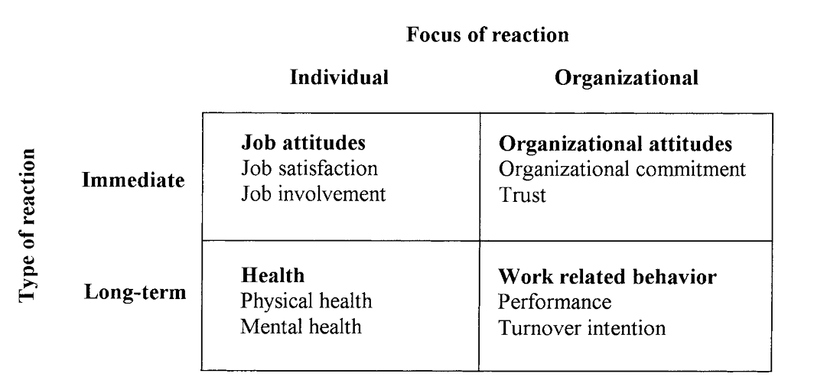
Job Insecurity
Conceptual Outcome Categories
(Sverke et al, 2002)

Slide 17
Job Insecurity
Meta-Analysis Results (Immediate, Individual)
(Sverke et al, 2002; Cheng & Chan, 2008; Jiang & Lavaysse, 2018; Lastad et al, 2025)
Job Satisfaction (Moderate-Strong, negative relationship)
  Supervisor Satisfaction (Strong, negative relationship)
  Promotion Satisfaction (Strong, negative relationship)
Job Involvement (Weak-Moderate, negative relationship)
Knowledge Hiding (Moderate, positive relationship)
Notes:
Promotion satisfaction: satisfaction an employee experiences when they achieve or make progress toward goals centered on growth, advancement, and accomplishments.
Job involvement: by the degree to which you psychologically identify with your work, i.e., how much importance you place on your work; how emotionally invested you are in your work; pride in your work
knowledge hiding as a mechanism through which employees try to protect their jobs by maintaining their unique knowledge, thereby making themselves indispensable (Shoss et al. 2023). Knowledge hiding is defined as ‘the intentional attempt to withhold or conceal knowledge that has been requested by another individual’ (Connelly et al., 2012, p. 67).

Slide 18
Job Insecurity
Meta-Analysis Results (Immediate, Organizational)
(Sverke et al, 2002; Cheng & Chan, 2008; Jiang & Lavaysse, 2018; Lastad et al, 2025)
Organizational Commitment (Moderate, negative relationship)
Trust (Strong, negative relationship)
  Trust in Organization (Strong, negative relationship)
  Trust in Management (Strong, negative relationship)
Notes:
Organizational commitment: how emotionally invested, aligned, and loyal an employee is to the organization

Slide 19
Job Insecurity
Meta-Analysis Results (Long-Term, Individual)
(Sverke et al, 2002; Cheng & Chan, 2008; Jiang & Lavaysse, 2018; Lastad et al, 2025)
Physical Health (Weak-Moderate, negative relationship)
Mental Health (Moderate, negative relationship)
Career Satisfaction (Strong, negative relationship)
Cynicism (Strong, positive relationship)
Positive Affectivity (Moderate, negative relationship)
Notes:
Career satisfaction: an individual's overall contentment with their career progression, achievements, and experiences over time
Positive affectivity: individual’s tendency to experience positive emotions and moods across time and situations
Cynicism refers to a general distrust or skepticism towards people, institutions, and the motives behind their actions

Slide 20
Job Insecurity & Health
Longitudinal Studies Review (57 studies)
(De Witte et al, 2015)
“The results show strong evidence for normal causation, in which job insecurity influences both psychological well-being and somatic health over time”

Slide 21
Job Insecurity & Health
Mechanism
(Vander Elst et al, 2014)
Evidence for Psychological Contract Breach (employees’ expectations regarding a fair exchange between loyalty and effort by the employee, and job security and rewards by the employer) as the explanatory mechanism
  Job insecurity may imply a violation of the employer’s obligations → perception of a unidirectional breach of the psychological contract

Slide 22
Job Insecurity
Meta-Analysis Results (Long-Term, Organizational)
(Sverke et al, 2002; Cheng & Chan, 2008; Jiang & Lavaysse, 2018; Lastad et al, 2025)
Performance (Weak-Moderate, negative relationship; No sig rel.)
Turnover Intention (Moderate, negative relationship)
Distributive Justice (Strong, negative relationship)
Notes:
Turnover intention: intention to leave their current job/organization
Distributive justice refers to employees’ perceptions of the fairness of outcome distributions in the workplace — such as pay, promotions, rewards, and workload. It concerns whether people feel they are receiving a fair share relative to their contributions or compared to others.

Slide 23
Job Insecurity
Moderators
What factors change the relationship between job insecurity and mental health?
In other words, moderators tell us when, for whom, or under what conditions the relationship between job insecurity and mental health is stronger or weaker

Slide 24
Job Insecurity
Moderators (Job Insecurity & Mental Health)
Work Centrality (Jiang & Lavaysse, 2018)
  the importance one attaches to one’s work
Performance Based Self-Esteem (Blom et al, 2015)
  the tendency to demonstrate, prove, & earn self-worth through achievements
Notes:
We use work centrality to represent the importance of work. Work centrality is the extent to which individuals believe that their work plays an important role in their life, irrespective of their current job (Bagger & Li, 2012; Hirschfeld & Feild, 2000; Paullay, Alliger, & Stone-Romero, 1994). People who consider work as a central life interest attach great importance to their work. In other words, individuals who are high in work centrality perceive the work role to be an important and a core part of their lives; work is something to be engaged in for its own sake (Hirschfeld & Feild, 2000).
When people attach a lot of importance to their work (high work centrality), and they also feel insecure about their job, they tend to have worse mental health than those who attach less importance to their work and feel the same level of job insecurity
When people based their self-esteem in a performance-based way, and they also feel insecure about their job, they tend to have worse mental health then those who don’t based their self-esteem on achievements and feel the same level of job insecurity

Slide 25
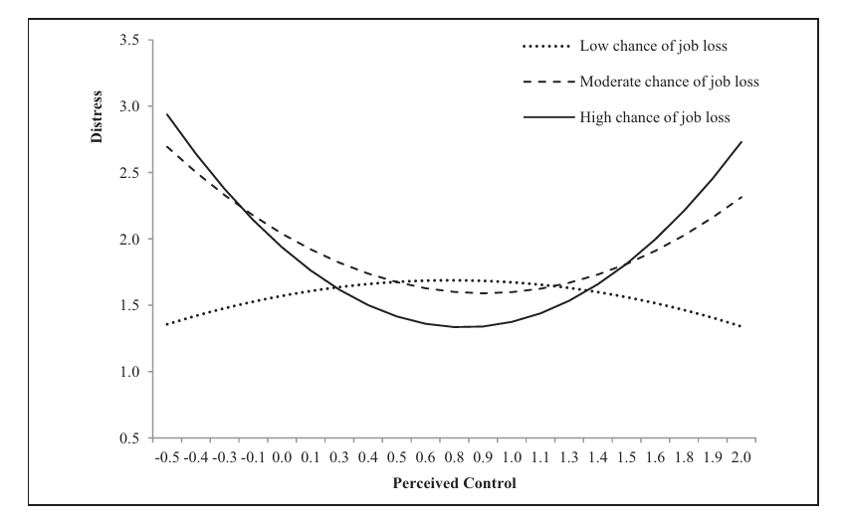
Job Insecurity
Moderators (Job Insecurity & Mental Health)
Perceived Control (Glavin & Schieman, 2014)
  Belief that events & outcomes in one’s life are the result of one’s own actions
Notes:
Individuals with a high sense of personal control perceive that the events and out comes in their lives are a result of their own actions rather than the consequence of chance or outside forces (Pearlin and Schooler 1978).
Individuals who have strong beliefs about personal control tend to view stressful events as excep tional occurrences that can be dealt with and avoided in the future. In contrast, those with low perceived control may consider these events as normative and unavoidable (Mirowsky and Ross 2003).
Beliefs about personal control are advantageous beyond their interpretative influence; they also encourage proactive behaviors and problem-solving strategies that are designed to cope with and resolve undesirable experiences (Menaghan 1983).
increases in perceived control initially buffer the negative consequences of job insecurity among insecure workers. This is consistent with an established finding that personal agency acts as a coping resource. However, higher perceived con trol is ineffectual for reducing the stress of insecure work experiences. This may be because beliefs about control are most useful when one is actually able to achieve desired outcomes. Resolving the threat of a layoff is an outcome that is often beyond the control of most individuals—particularly during eco nomic downturns like the recent Ameri can Great Recession.
Statements that measure the level that individuals claim control over good outcomes include: (1) ‘‘I am responsible for my own successes,’’ and (2) ‘‘I can do just about anything I really set my mind to.’’ Items that mea sure claims of control over bad outcomes include: (3) ‘‘My misfortunes are the result of mistakes I have made,’’ and (4) ‘‘I am responsible for my failures.’’ Items that assess the extent that individuals deny control over good outcomes are: (5) ‘‘The really good things that happen to me are mostly luck’’ and (6) ‘‘There’s no sense planning a lot—if something good is going to happen it will.’’ The last two statements measure the denial of control over bad outcomes: (7) ‘‘Most of my prob lems are due to bad breaks’’ and (8) ‘‘I have little control over the bad things that happen to me.’’

Slide 26
Job Insecurity
Moderators (Job Insecurity & Mental Health)
Perceived Employability (Canzio, 2024)
  workers’ assessment of their chances of finding a similar job
  Moderates relationship b/w risk of job loss & MH
  Does NOT moderate relationship b/w fear of job loss & MH
Notes:
The variable (perceived) employability was assessed with the question ‘If you lost your job, how easy would it be for you to find a com parable job?’. The possible responses were: with great difficulty, mostly with difficulty, mostly easily, and very easily.

Slide 27
Job Insecurity
Moderators (Job Insecurity & Mental Health)
Age (Cheng & Chan, 2008)
  Stronger effect on MH for older employees (also physical health)
  Stronger effect on turnover intention for younger employees
Economic Climate (Lam et al, 2014)
  2006 vs. 2010
Notes:
The relationship between job insecurity and turnover was more profound among younger employees (rc = .36) than older employees (rc = .26). The effect of job insecurity on psychological health was stronger among older employees (rc = −.32) than younger employees (rc = −.24), and that on physical health was also stronger among older employees (rc = −.30) than younger employees (rc = −.19).
Older employees who feel insecure about their jobs tend to have worse mental health & physical health than younger employees who feel the same level of job insecurity
We find respondents with higher levels of job insecurity in 2010 reported lower levels of happiness compared to those similarly insecure in 2006.
Employees during more turbulent economic times who feel insecure about their jobs tend to have worse mental health than employees during less turbulent economic times

Slide 28
Job Insecurity
Moderators (Job Insecurity & Other Outcomes)
Organizational Tenure (Cheng & Chan, 2008)
  Shorter tenure vs. longer tenure
  Moderates relationship b/w Job Insecurity & Turnover Intention
Notes:
For workers who have worked less years at their organization who feel insecure about their job, they tend to be more likely to intend to leave their company than workers who’ve worked more years at their organizations who feel the same level of job insecurity
The positive association between job insecurity and turnover intention was stronger among employees with shorter tenure than those with longer tenure

Slide 29
Job Insecurity
Moderators (Job Insecurity & Other Outcomes)
Occupational Status (Sverke et al, 2002)
  Blue collar vs. White collar
  Moderates relationship b/w Job Insecurity & Turnover Intention
  Moderates relationship b/w Job Insecurity & Work Performance
Strength of Welfare System (Sverke et al, 2019)
  Moderates relationship b/w Job Insecurity & Work Performance
Notes:
For blue collar workers who feel insecure about their job, they tend to be more likely to intend to leave their company, and their job performance tends to suffer more than white collar works who feel the same level of job insecurity
In countries that have an extensive welfare system, employees are better protected if they become unemployed or if their job is at risk
For workers from countries with stronger welfare systems, they tend to be less likely to intend to leave their company and less likely to have their work performance suffer than workers from countries that have weaker welfare systems who are feeling the same level of job insecurity.
The results of the moderator analyses focusing on union density were not in line with Hypothesis 5, which predicted that the associations between job insecurity and employee performance would be weaker in countries characterized by higher union density. More specifically, the finding that there were no di erences between countries with high, medium, and low union densities as concerns the associations of job insecurity with contextual performance and counterproductive work behavior is contrary to the assumption that union membership may bu er against negative consequences of job insecurity

Slide 30
Job Insecurity
Coping
Very limited research literature, and muddled categories of “problem-focused coping” vs. “emotion-focused coping” / “avoidance-focused coping” → Richter et al (2013); Giunchi et al (2019)
Best to look at exploratory qualitative research; also limited
Notes:
Problem Solving 1. Problem solving 2. Seeking social support 3. Cognitive restructuring 4. Active distraction 5. Humor
Emotional Expression 6. Emotional expression 7. Rumination 8. Other-blame 9. Self-blame
Emotional Avoidance 10. Cognitive distraction 11. Passive resignation 12. Emotional containment
Richter et al (2013)
Giunchi et al (2019) – some support for workers who feel insecure about their job and use more PFC tend to have worse health than those who feel insecure about their job and use less PFC

Slide 31
Job Insecurity
Coping
(Astarlioglu et al, 2011)
Proactive action: organizational citizenship behavior & job search behavior
Personal variables: building self-esteem, focusing on internal locus of control, & cultivating optimism
Notes:
OCB: behaviors that go beyond formal obligations for effective functioning of organizations (voluntarily helping colleagues, putting in extra effort, being extra courteous and positive, etc)

Slide 32
Job Insecurity
Coping – My Clinical Perspective
Awareness of your reaction to job insecurity (Helplessness & giving up? Hyper-control & planning?)
Don’t catastrophize, and don’t engage in all-or-nothing thinking re: perceived control
Learning to tolerate uncertainty (instead of chasing certainty)
Notes:
Uncertainty tolerance: UT appears positively related to adaptability and adaptive readiness (Shamionov, 2017), and more specifically with the ability to cope constructively with chance events (Kim et al., 2016). Persons with greater tolerance for ambiguity may also be more likely to engage in pro-social risk-taking behaviors (Vives and Feldman Hall, 2018).

Slide 33
Job Insecurity
Coping – My Clinical Perspective
Cultivating adaptability self-efficacy (COVID)
Recognize that the idea of Job Security is an illusion
Find community & support
Do not ignore it

Slide 34
Thank You! Questions?
Website: inflectionpointstherapy.com
Email: jason@inflectionpointstherapy.com

