Slide 1
Covering Immigration!
Tandy Lau / New York Amsterdam News

Slide 2
Nice meeting you!

Slide 3

Background on covering immigration in NYC last 2-3 years

Slide 4
2. Reporting on immigration for a historically non-white audience
Why do perceived legacy media consumers/traditionally white American audiences read immigration stories?
-Concerns about crime?
-Sympathy/empathy?
-Confirmation bias on opposition party’s stance?
-Xenophobia?
-Friends/family/community?

Slide 5
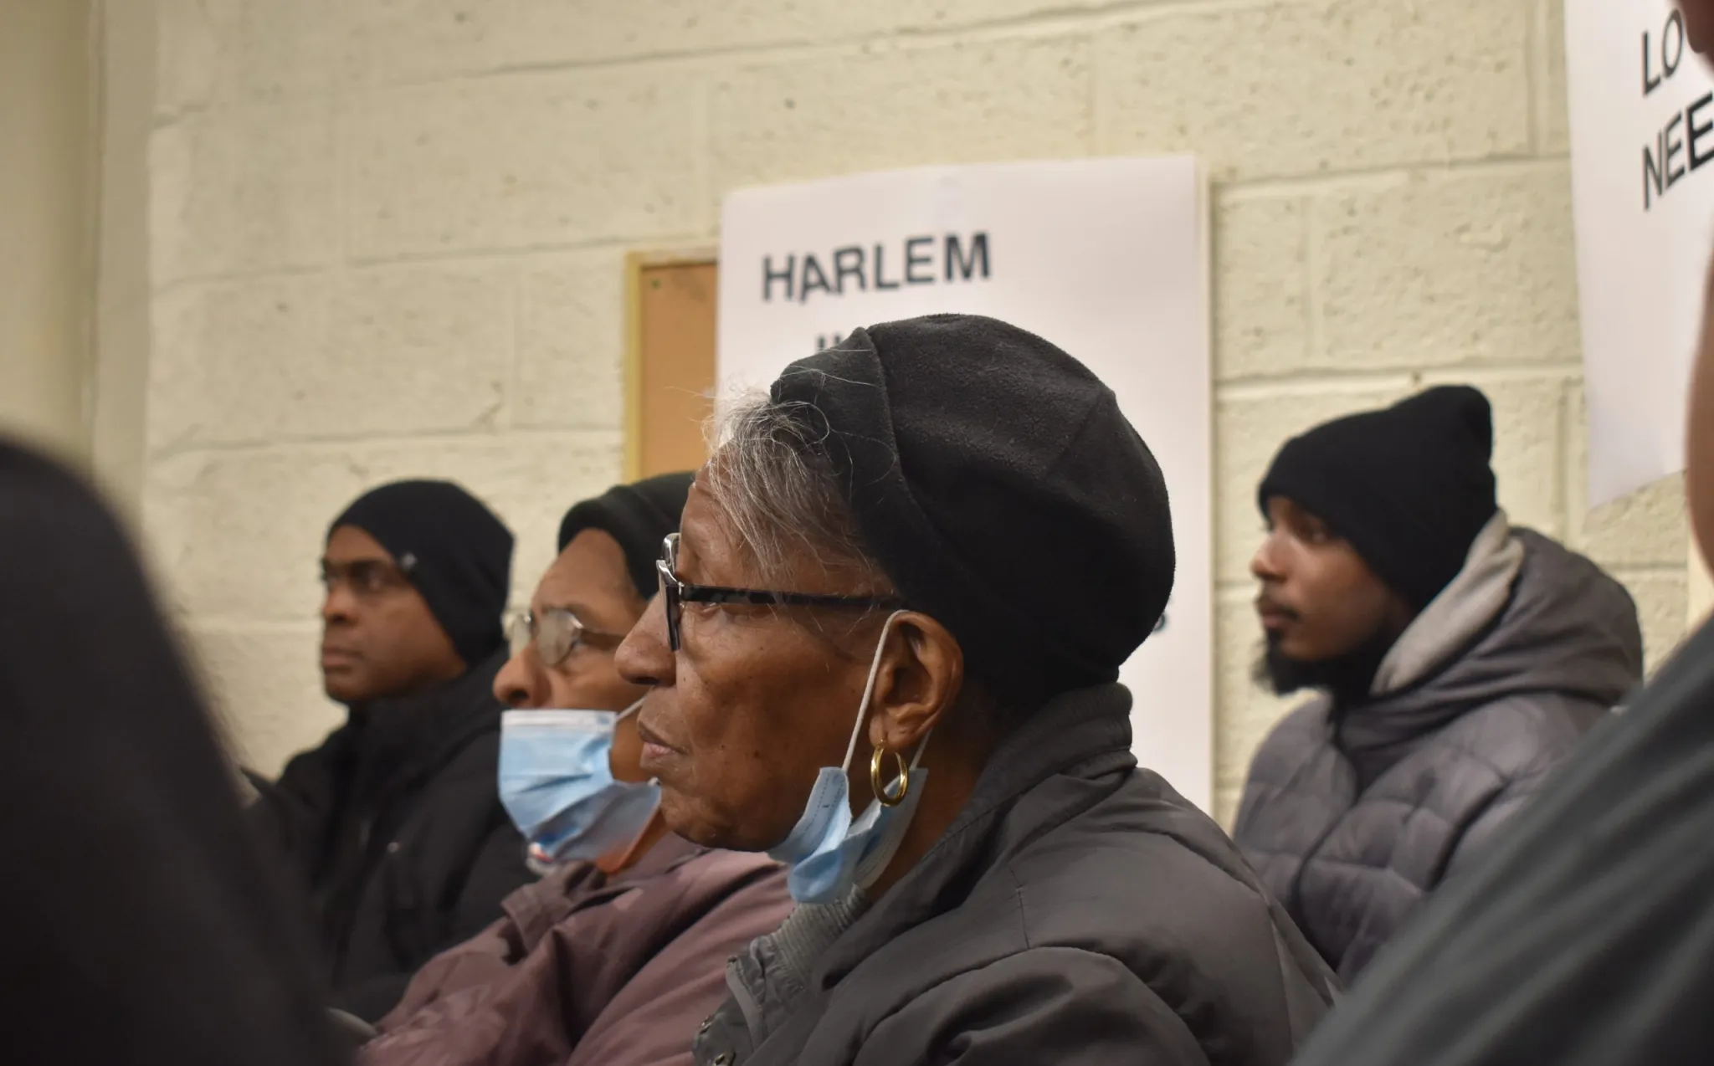
3. Covering other communities of color when they oppose immigration

Slide 6
4. What does diverse newsroom look like for immigration coverage?

Slide 7

5. Discussion/thoughts?

