Slide 1
DOJ OIG 101
The history of Inspectors General and the mission, jurisdiction, authorities, and accomplishments of the Department of Justice Office of the Inspector General

Slide 2
History of Inspectors General
The Inspector General Act of 1978 (IG Act) was enacted as part of a wave of good government and civil service reforms. It established Offices of Inspector General in 12 federal agencies (The Departments of Agriculture, Commerce, Housing and Urban Development, Interior, Labor, and Transportation, and the Community Services Administration, the Environmental Protection Agency, the General Services Administration, the National Aeronautics and Space Administration, the Small Business Administration, and the Veterans Administration).
Their purpose was to conduct audits and investigations of agency programs to promote economy, efficiency, and effectiveness and to detect fraud and abuse in programs and operations. The Inspectors General served under the general supervision of the agency head. Yet, by statute, IGs had a dual and independent reporting relationship to the agency head and to the Congress.
In 1988, 45 additional Offices of Inspector General were established, including at the Department of Justice.
Since 1988, Congress has continued to establish new Inspectors General when it saw a need. Today, there are 75 Inspectors General.
Virtual Exhibit: 40 Years of Inspectors General

Slide 3
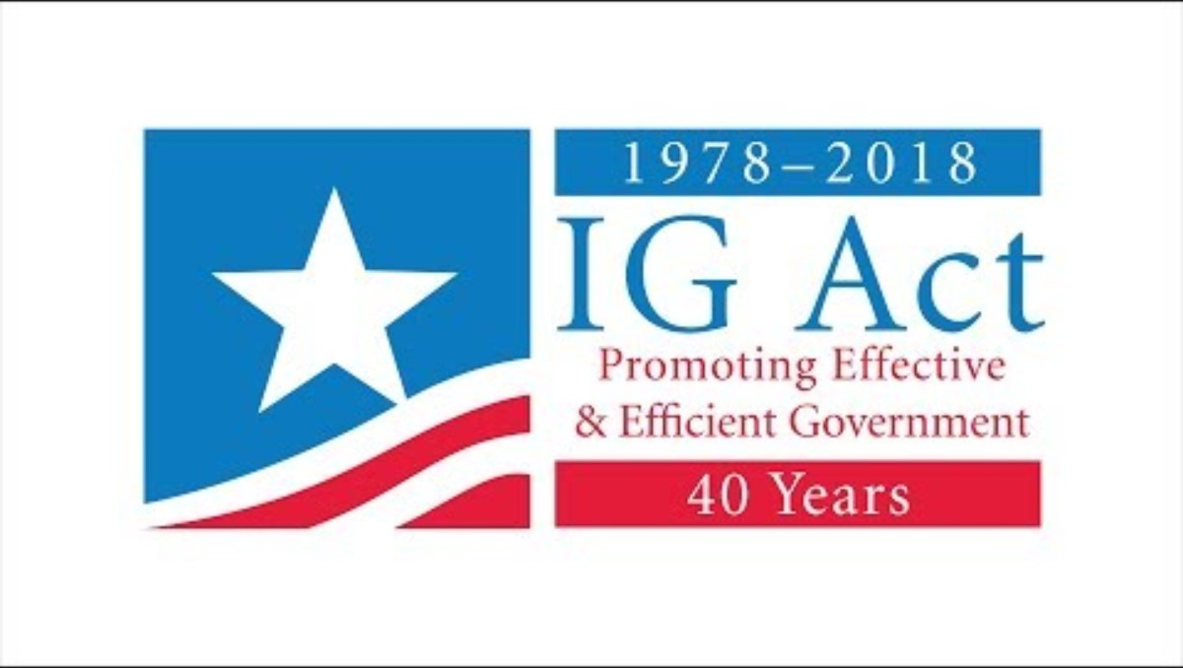
Video: Building on 40 Years of Excellence in Independent Oversight

Slide 4
What do Inspectors General Do?
Independent oversight
Issue public reports
  Management and operations of programs
  Impact of agency policies
  Financial management
  Almost 30,000 reports on Oversight.Gov from all federal Inspectors General
Make recommendations and publicly report on implementation status
Conduct criminal, civil, and administrative investigations
Annually report on Top Management and Performance Challenges
Semiannually report to Congress on OIG activities
Whistleblower protection and retaliation investigations

Slide 5
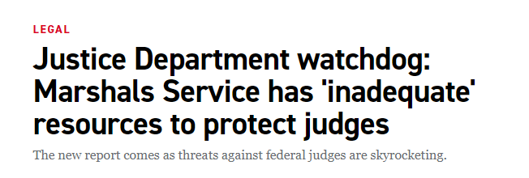
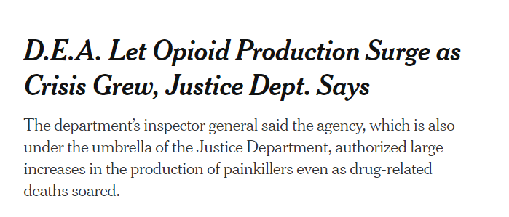
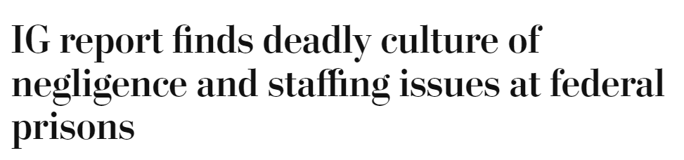
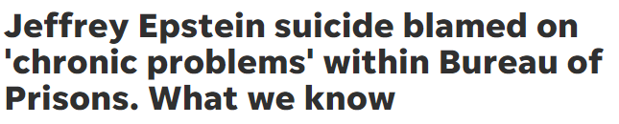

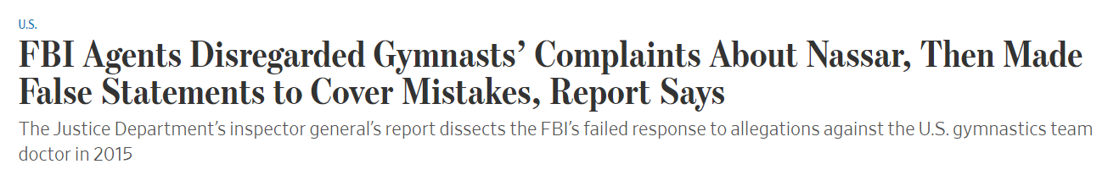
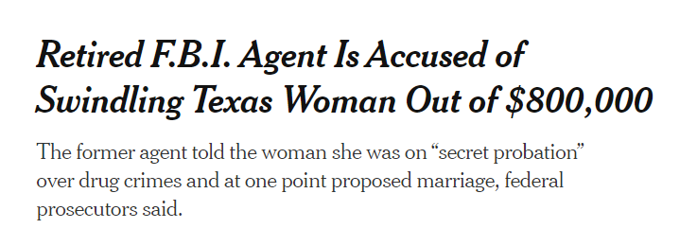
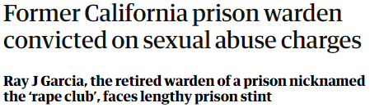
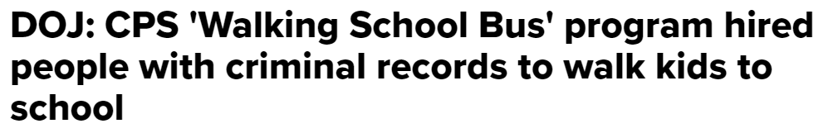
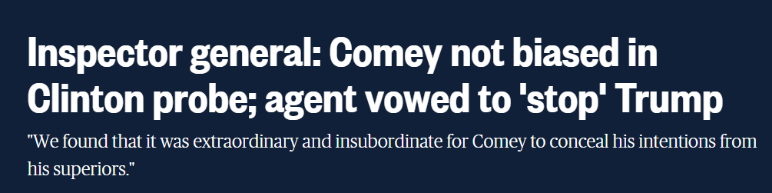
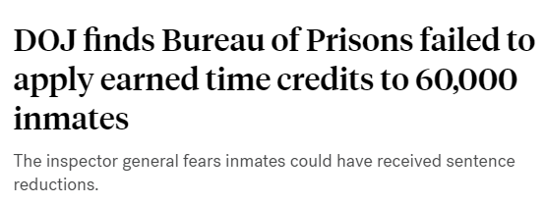

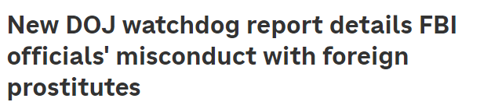
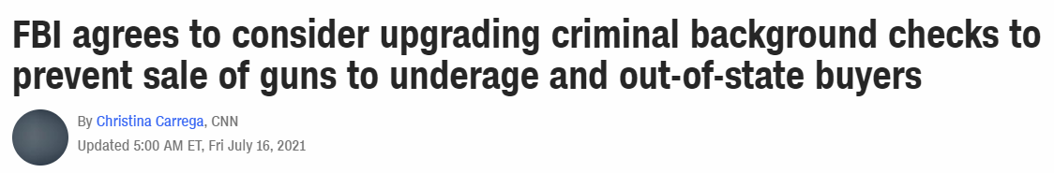
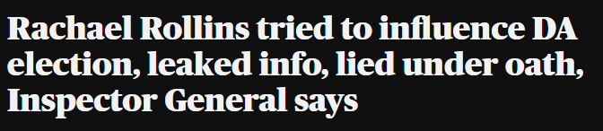
What do Inspectors General Do?

Slide 6
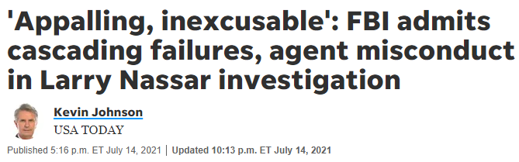
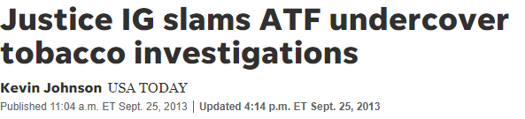
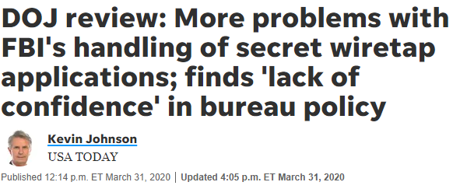
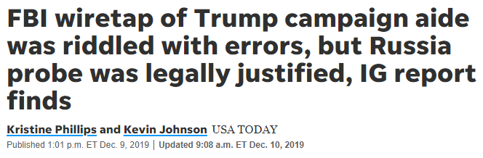
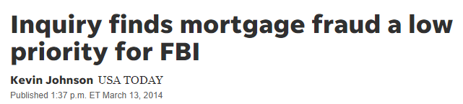
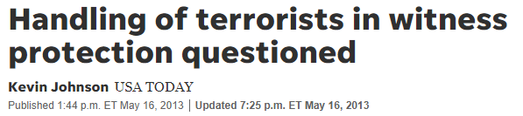
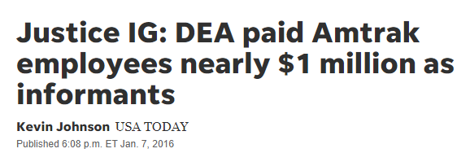
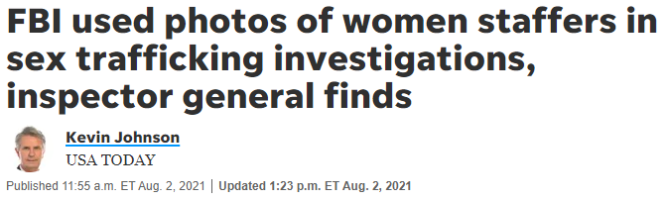
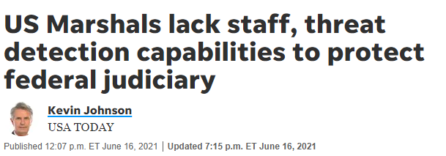
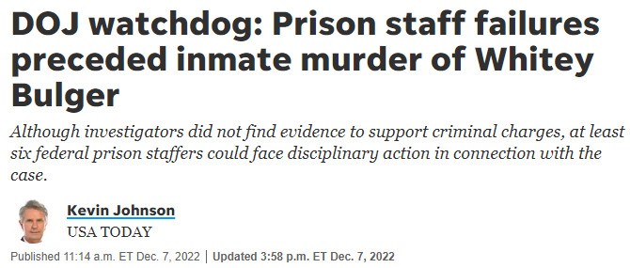
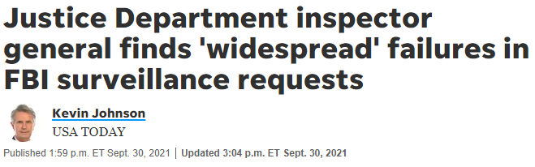
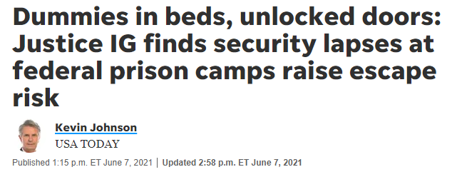
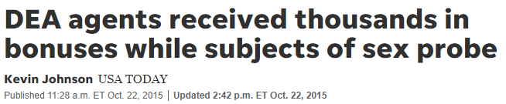
What do Inspectors General Do?

Slide 7
Bedrock Principles for Inspectors General
Non-partisan
Independent from agency
Transparency and public reporting
Accountable to Congress and Administration
Access to all agency records

Slide 8
Limitations of Inspectors General
OIGs make recommendations and findings of employee misconduct, but the authorities to implement recommendations and impose employee discipline lie with the agency
OIGs only have the authority to oversee the agencies in which they reside
OIGs may compel testimony from current agency employees during administrative reviews and investigations, but most OIGs do not have the authority to compel or subpoena testimony from former DOJ employees, including those who retire or resign
Limitation for the DOJ OIG
DOJ OIG does not have the authority to investigate allegations of DOJ attorneys where the allegations relate to the exercise of the authority of an attorney to investigate, litigate, or provide legal advice. Those allegations are handled by DOJ Office of Professional Responsibility

Slide 9
DOJ OIG Mission, Vision, Values
Mission
Promoting the rule of law through objective, independent oversight of the Department of Justice.
Vision
To set the standard for innovative, transformative oversight.
Values
Integrity
Independence
Excellence
Transparency
Respect
Agility
Strategic Plan FY 2024-26

Slide 10
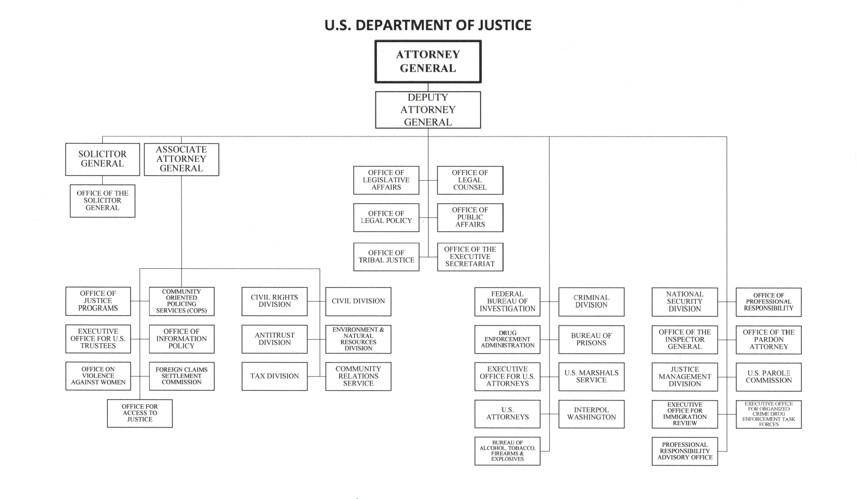

Slide 11
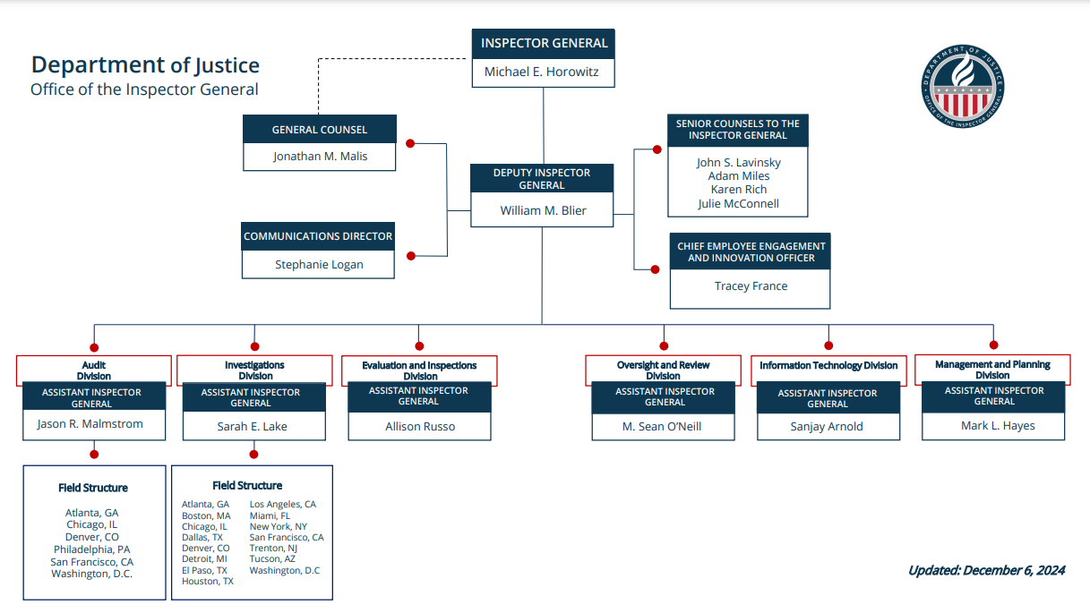

Slide 12
DOJ OIG Workforce
530+ employees across the country
Professions:
  Auditor
  Program Analyst
  Criminal Investigator
  Attorney
  Data Analyst
  Mission Support
    Communications
    Finance
    Administrative
    Training and Development

Slide 13
Resources for Journalists
Reports
Criminal and Civil Cases
Findings of Misconduct
Ongoing Work
FOIA Reading Room
Top Management and Performance Challenges
Open Recommendations
Email Alerts
Other OIG public affairs points of contact
All OIG reports on Oversight.gov

