Slide 1
Health/Science Reporting
NPF Widening the Pipeline Fellowship
December 9, 2024
Aneri Pattani

Slide 2
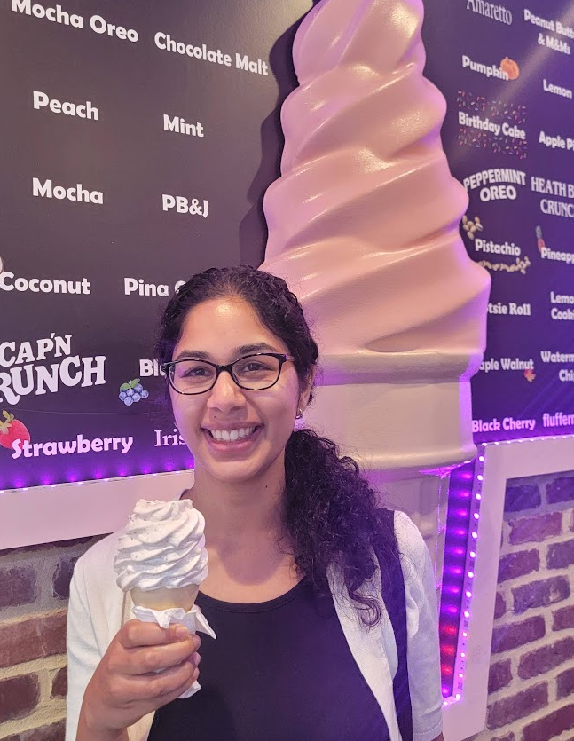
Hi, I’m Aneri Pattani
KFF Health News national correspondent
Johns Hopkins masters in public graduate
National Press Foundation Paul Miller fellow 2024
Ice cream enthusiast

Slide 3
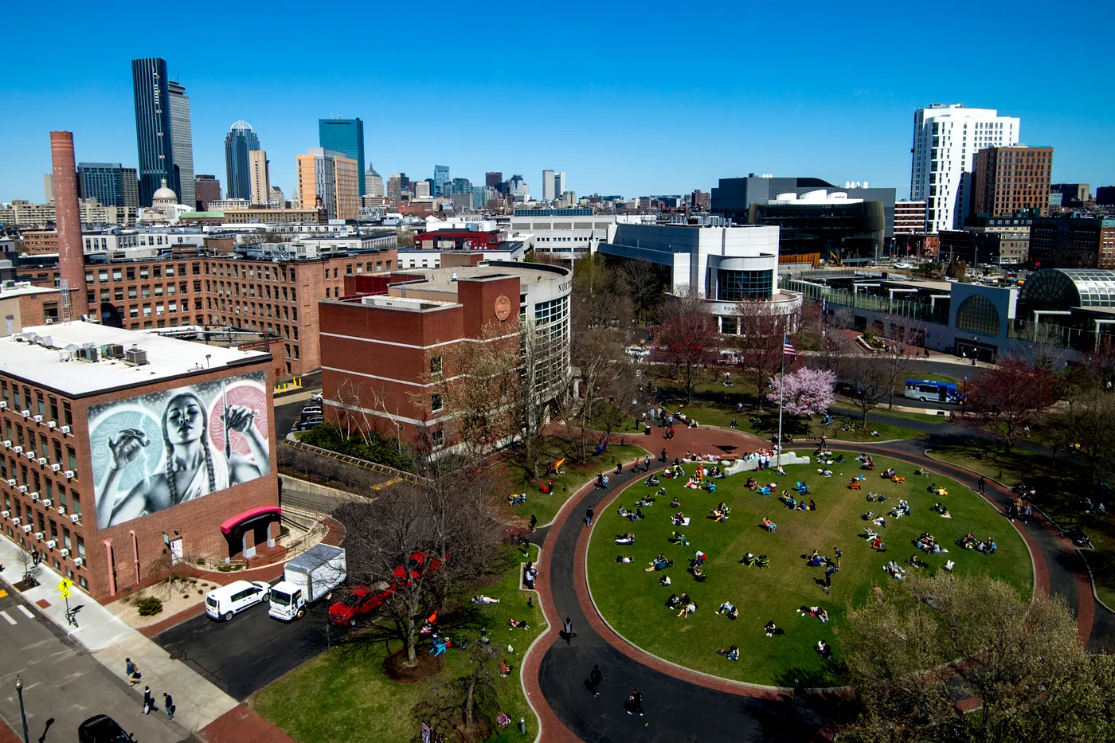
My Journalism Journey

Slide 4




Co-ops & Internships
Local Features
(print)
Politics & Policy (digital)
Crime & Breaking News (print)
Business
(TV & digital)

Slide 5

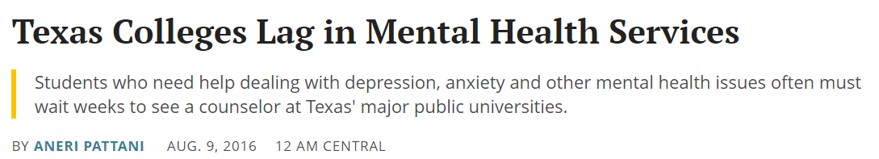
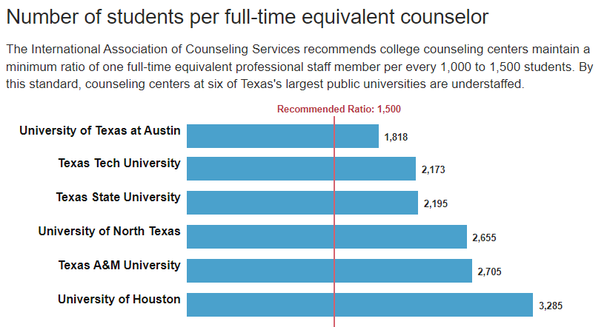
https://www.texastribune.org/2016/08/09/texas-universities-struggle-fund-mental-health-ser/

Slide 6




Health Journalism
College mental health, postpartum depression, racial disparities in health
Global health, scientific study stories
Lead exposure for kids, disability services
State health department, Covid response, oversight of addiction treatment

Slide 7

Mental Health
Addiction
Suicide
Public health

Slide 8
A Few Clips

Slide 9
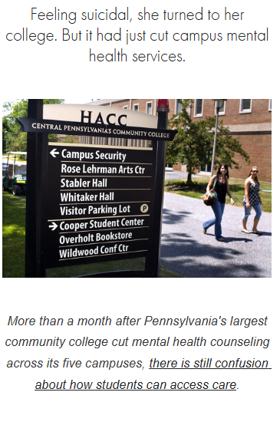
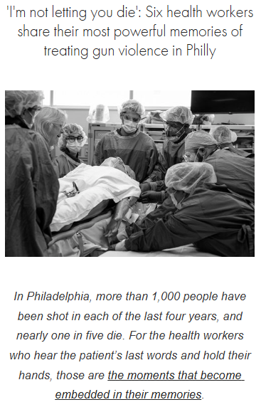
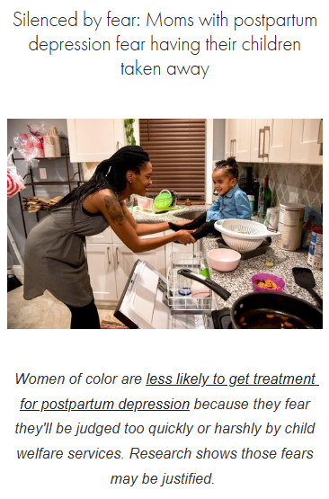

Slide 10
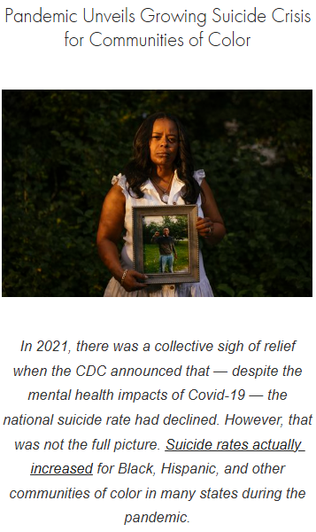
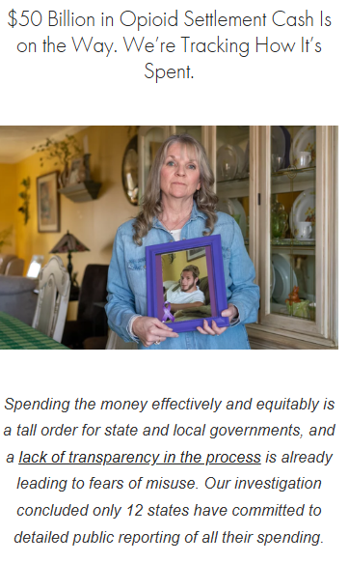

Slide 11
Tips for Health/Science Reporting
Health story ideas are all around you. Crazy bills. Insurance questions from family/friends. Dirty water/air in your neighborhood.
You don’t have to be a health report to cover health. Mental health shows up in education. Addiction shows up in courts/crime. Vaccines, reproductive health, and more comes up in politics.
Break the system down into small pieces. Focus on one person’s bill. Investigate lead in the water at one school. Scrutinize ethics violations at one hospital.
Don’t be intimidated. You CAN understand science/medicine. It just takes patience and practice. And there are resources to help: The Open Notebook, Association of Health Care Journalists, etc.
Don’t be scared to ask dumb questions. That’s literally the job. Always ask: “What do people often get wrong? What’s easy to misconstrue?”
Making mistakes is also part of the job. It sucks, but we all do it. Sometimes during the reporting process. Sometimes in the published product. We learn from it and do better next time.
Remember, health is human. There are great data stories, investigations, scientific advances, policies, and more to cover. But at the end of the day, this topic matters because it affects people.

Slide 12
Questions?
health/science reporting
finding a beat
navigating editors/newsrooms
different newsrooms (print vs. digital vs. audio)
ice cream flavor debates & recommendations!
Aneri Pattani | anerip@kff.org | @aneripattani

