Slide 1
Why Podcast?

Slide 2
A lot of uncertainty
Oversaturated market
Are you a celebrity?
AI?

Slide 3
No but really…

Slide 4
Anyone can do it! (sort of)
Very accessible medium
All you need is a phone
Audience!
Great way to connect
Great way to grow/expand audience
Growth!
About $25 billion industry (source: PBS 2024)
20 years, hundreds of millions of listeners
Influence
2024 election

Slide 5
What Makes a Good Podcast?

Slide 6

The guest (your foundation)
Has a good story (universal principle)
Creativity (this is art!)
Authenticity (in my opinion)

Slide 7
How To Dive In?

Slide 8
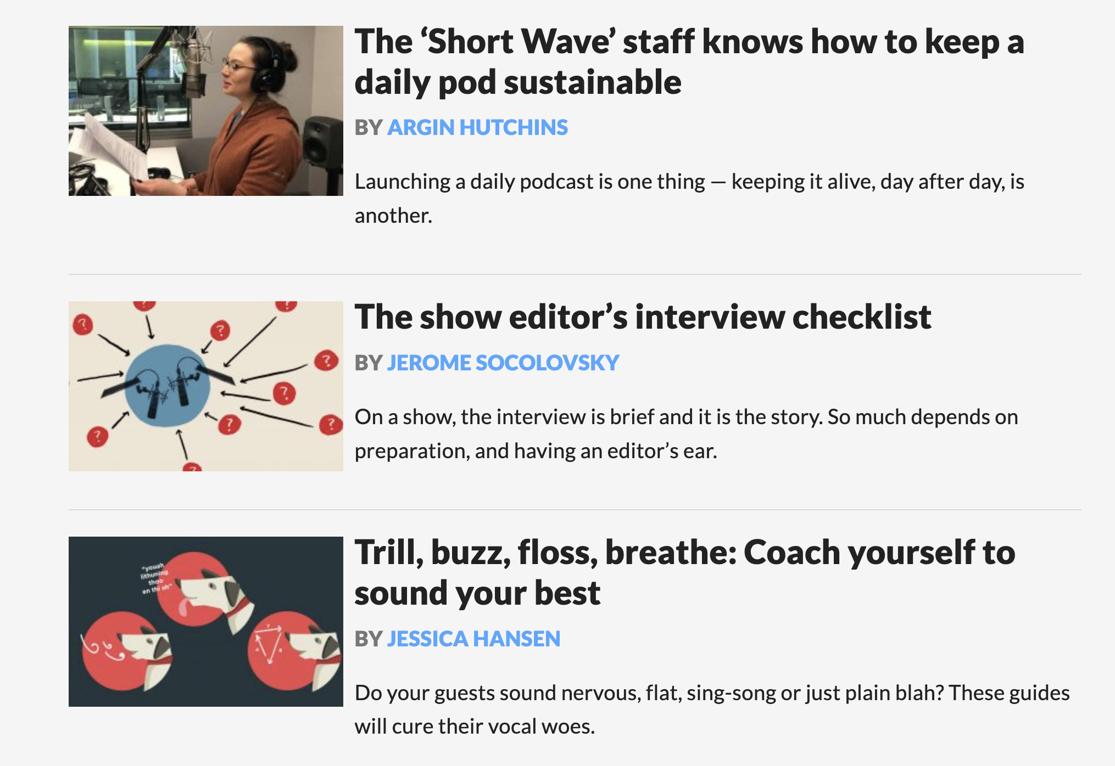
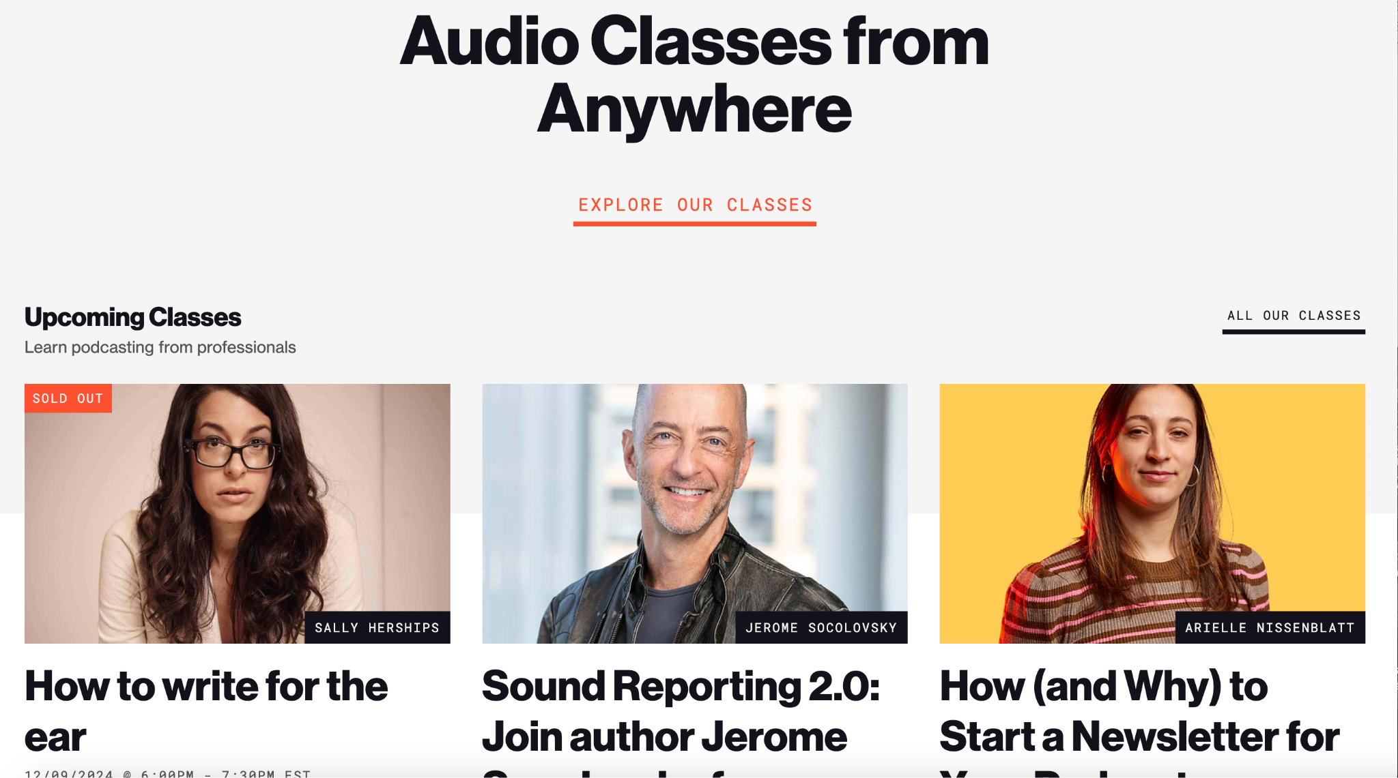
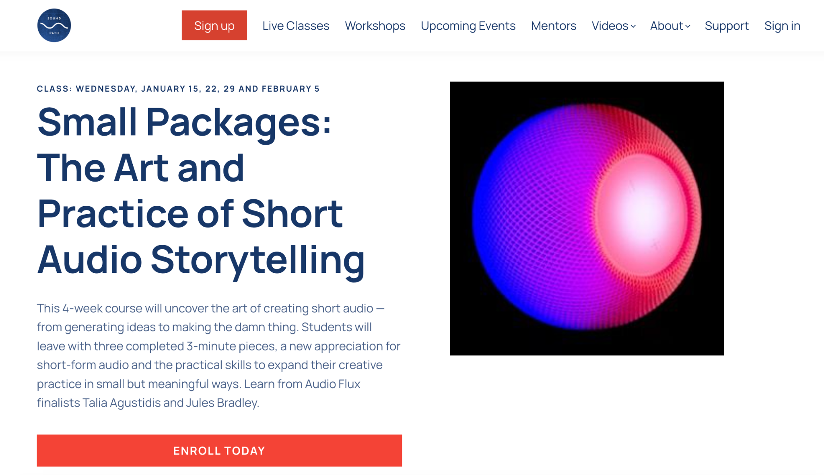
Learn the craft
Free:
NPR Training [training.npr.org]
Paid:
Radio Boot Camp (webinars)
Association of Independents in Radio (live classes, webinars, mentorship)

Slide 9
Learn your voice
What is your goal?
Find ways to put your work out there
Connect with other podcaster

