Slide 1

Adjusting the Lens
on Journalism’s Future
E. Samantha Cheng
Executive Producer, Heritage Series, LLC
Monday, December 9, 2024
National Press Club
© Heritage Series

Slide 2
A Little Bit About Me…
Born in New York City
Immigrant parents from China
    Father a paper son
    Mother a war bride
Fifth child in a family of six children
Third daughter
© Heritage Series

Slide 3
Grew up living between Beechhurst and Chinatown
Attended New York City Public Schools:
  PS 193, JHS 194, Bayside
  High, CUNY-Hunter & Baruch College
  majored in Business/Accounting
© Heritage Series

Slide 4
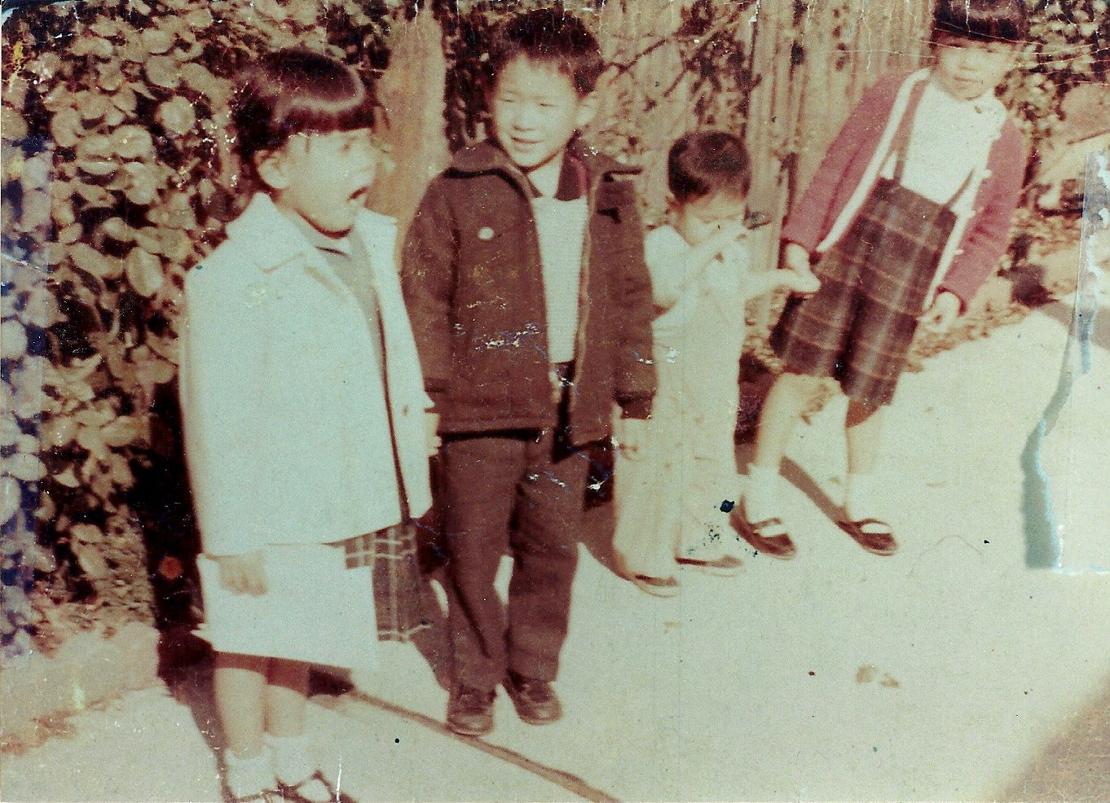
First Producing Gig
© Heritage Series

Slide 5
Skillsets
    Ability to lead
    Commanding voice
    Command of language as a
        speaker and writer
    Organizational skills
    Research skills
    Tenacious
© Heritage Series

Slide 6
Early Career
    Paid Intern – BBC London
    Production Associate and
    Assistant to Executive Producer
    Tulchin Productions & Centrex Studios
    Clients included: Revlon, Borghese
    Estee Lauder, Proctor &Gamble
    Producer – What’s On, Live
© Heritage Series

Slide 7
Shifts in Broadcast News
    1980 – CNN debuts 24-hour programming
    1985 - Capital Cities purchased
  ABC Television Company for 3.5 billion dollars
    1987 – FCC abolished fairness doctrine
    TV News became a “profit center”
© Heritage Series

Slide 8
Left Network TV News in 1992
Established Television Production Services, Inc. (TPS)
    Independent broadcast television production company
    Supported Broadcast News operations worldwide and broadcast equipment manufacturers
© Heritage Series

Slide 9
Developed and created independent productions and programs
    Used new technologies, i.e., optical disc media: CDs and DVDs for dissemination
Developed partnerships to create long and short form programs
© Heritage Series

Slide 10
2000 started Heritage Series, LLC to create and develop independent and educational programs:
    Public Service Campaigns, Oral History Shorts for streaming, Short and Long form documentaries, OTO Specials and documentary series
© Heritage Series

Slide 11
Insights for new journalists
    Be Confident - If you believe in yourself others will believe in you
    Be fluid and flexible
    FACT CHECK, FACT CHECK, FACT CHECK
    Learn and understand processes
    Stay current on new technologies and methods for story delivery
© Heritage Series

Slide 12
Any Questions?
Contact:
e.samantha.cheng@gmail.com
Re: National Press Club Foundation
© Heritage Series

