Slide 1
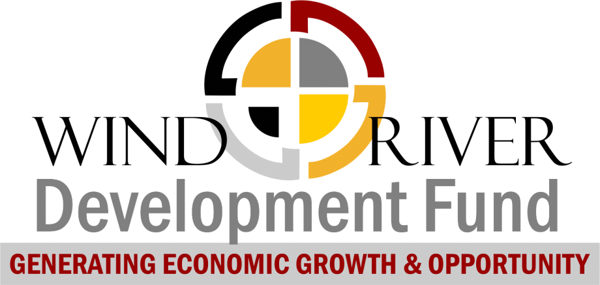
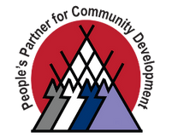
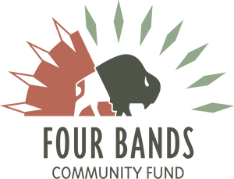


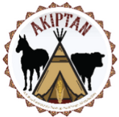
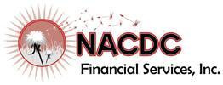

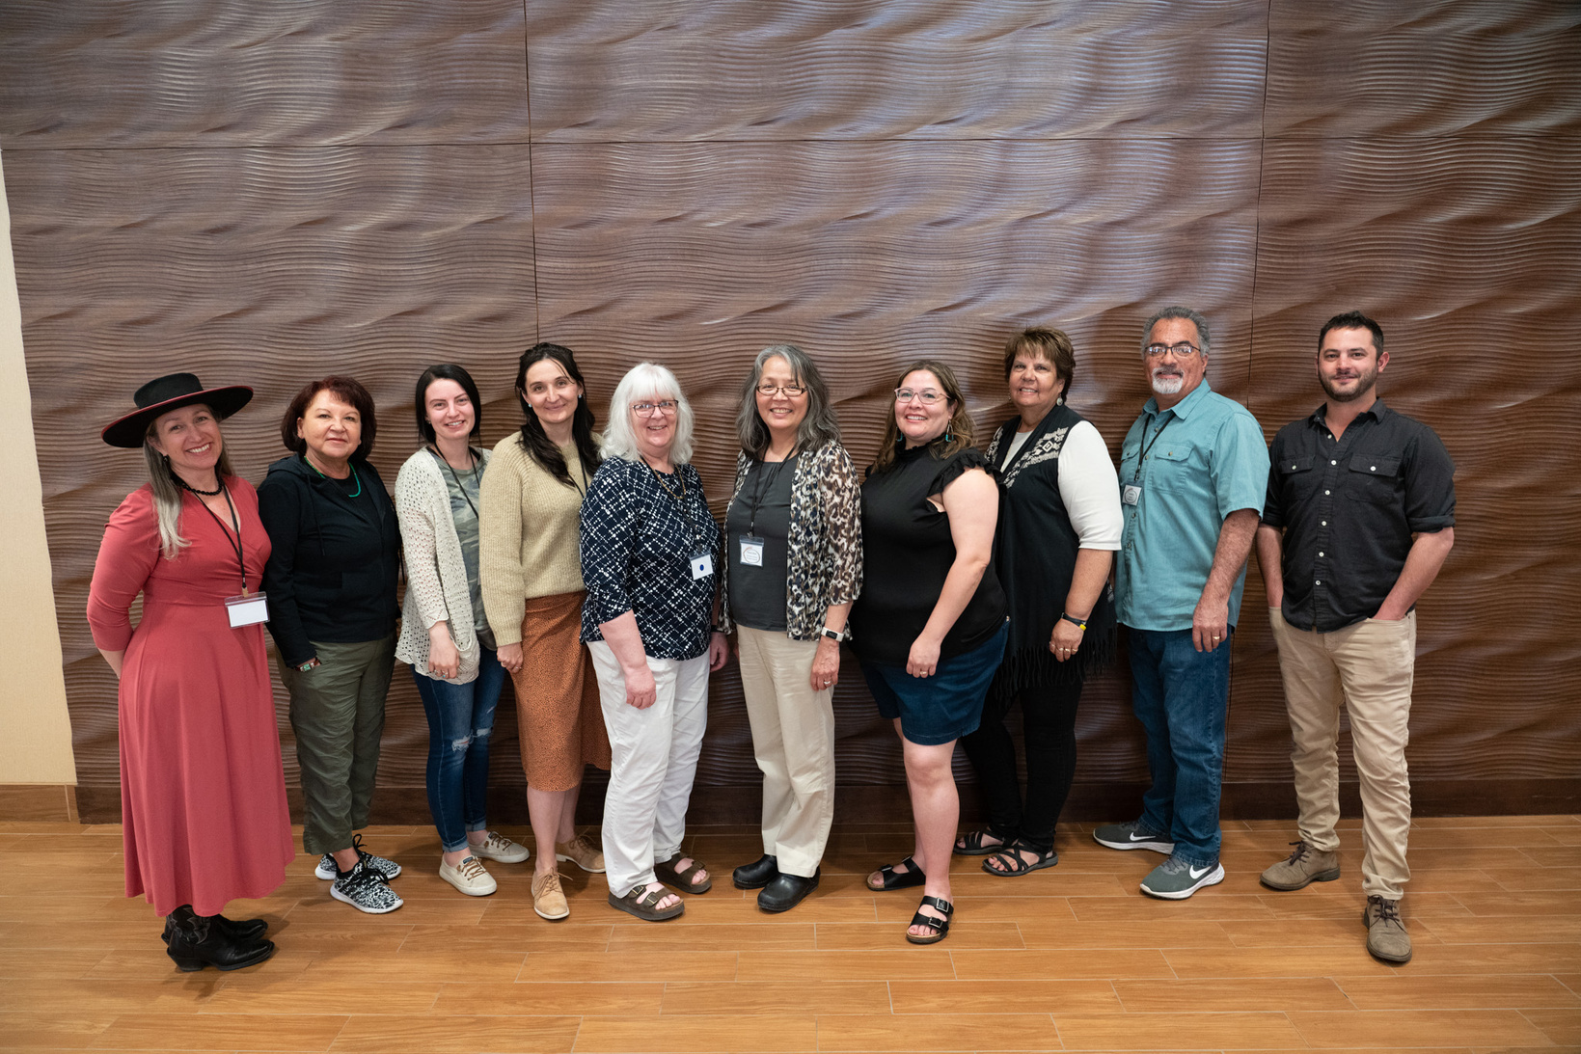
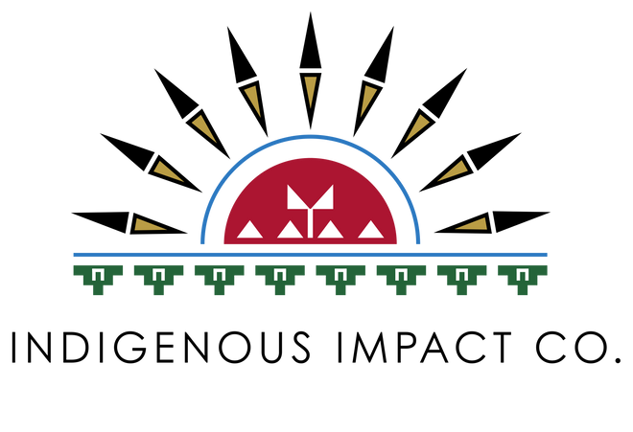
NACDC, Financial Services
Angie Main, Executive Director
Dispelling Myths about Risks in Native Markets
A project of Mountain | Plains Regional Native CDFI Coalition
September 2024
supported and compiled by
Indigenous Impact Co.
1

Slide 2
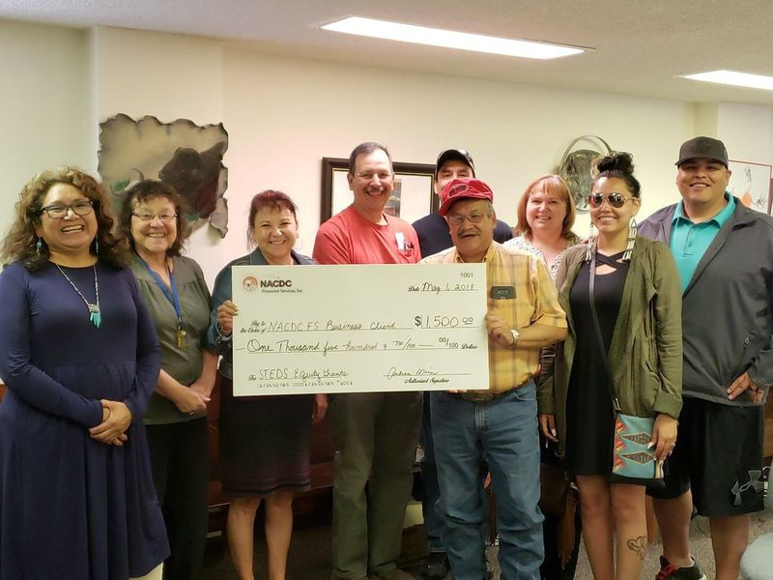
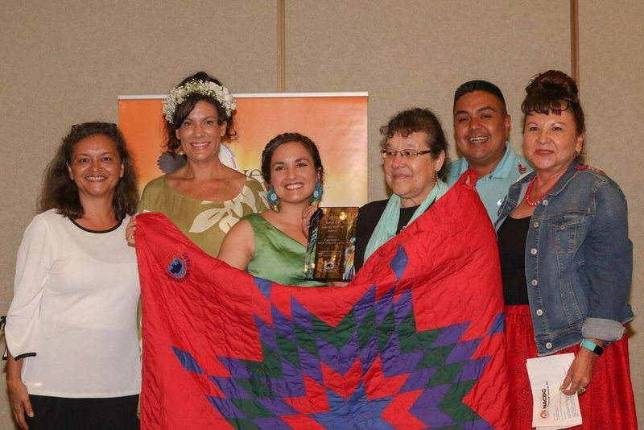
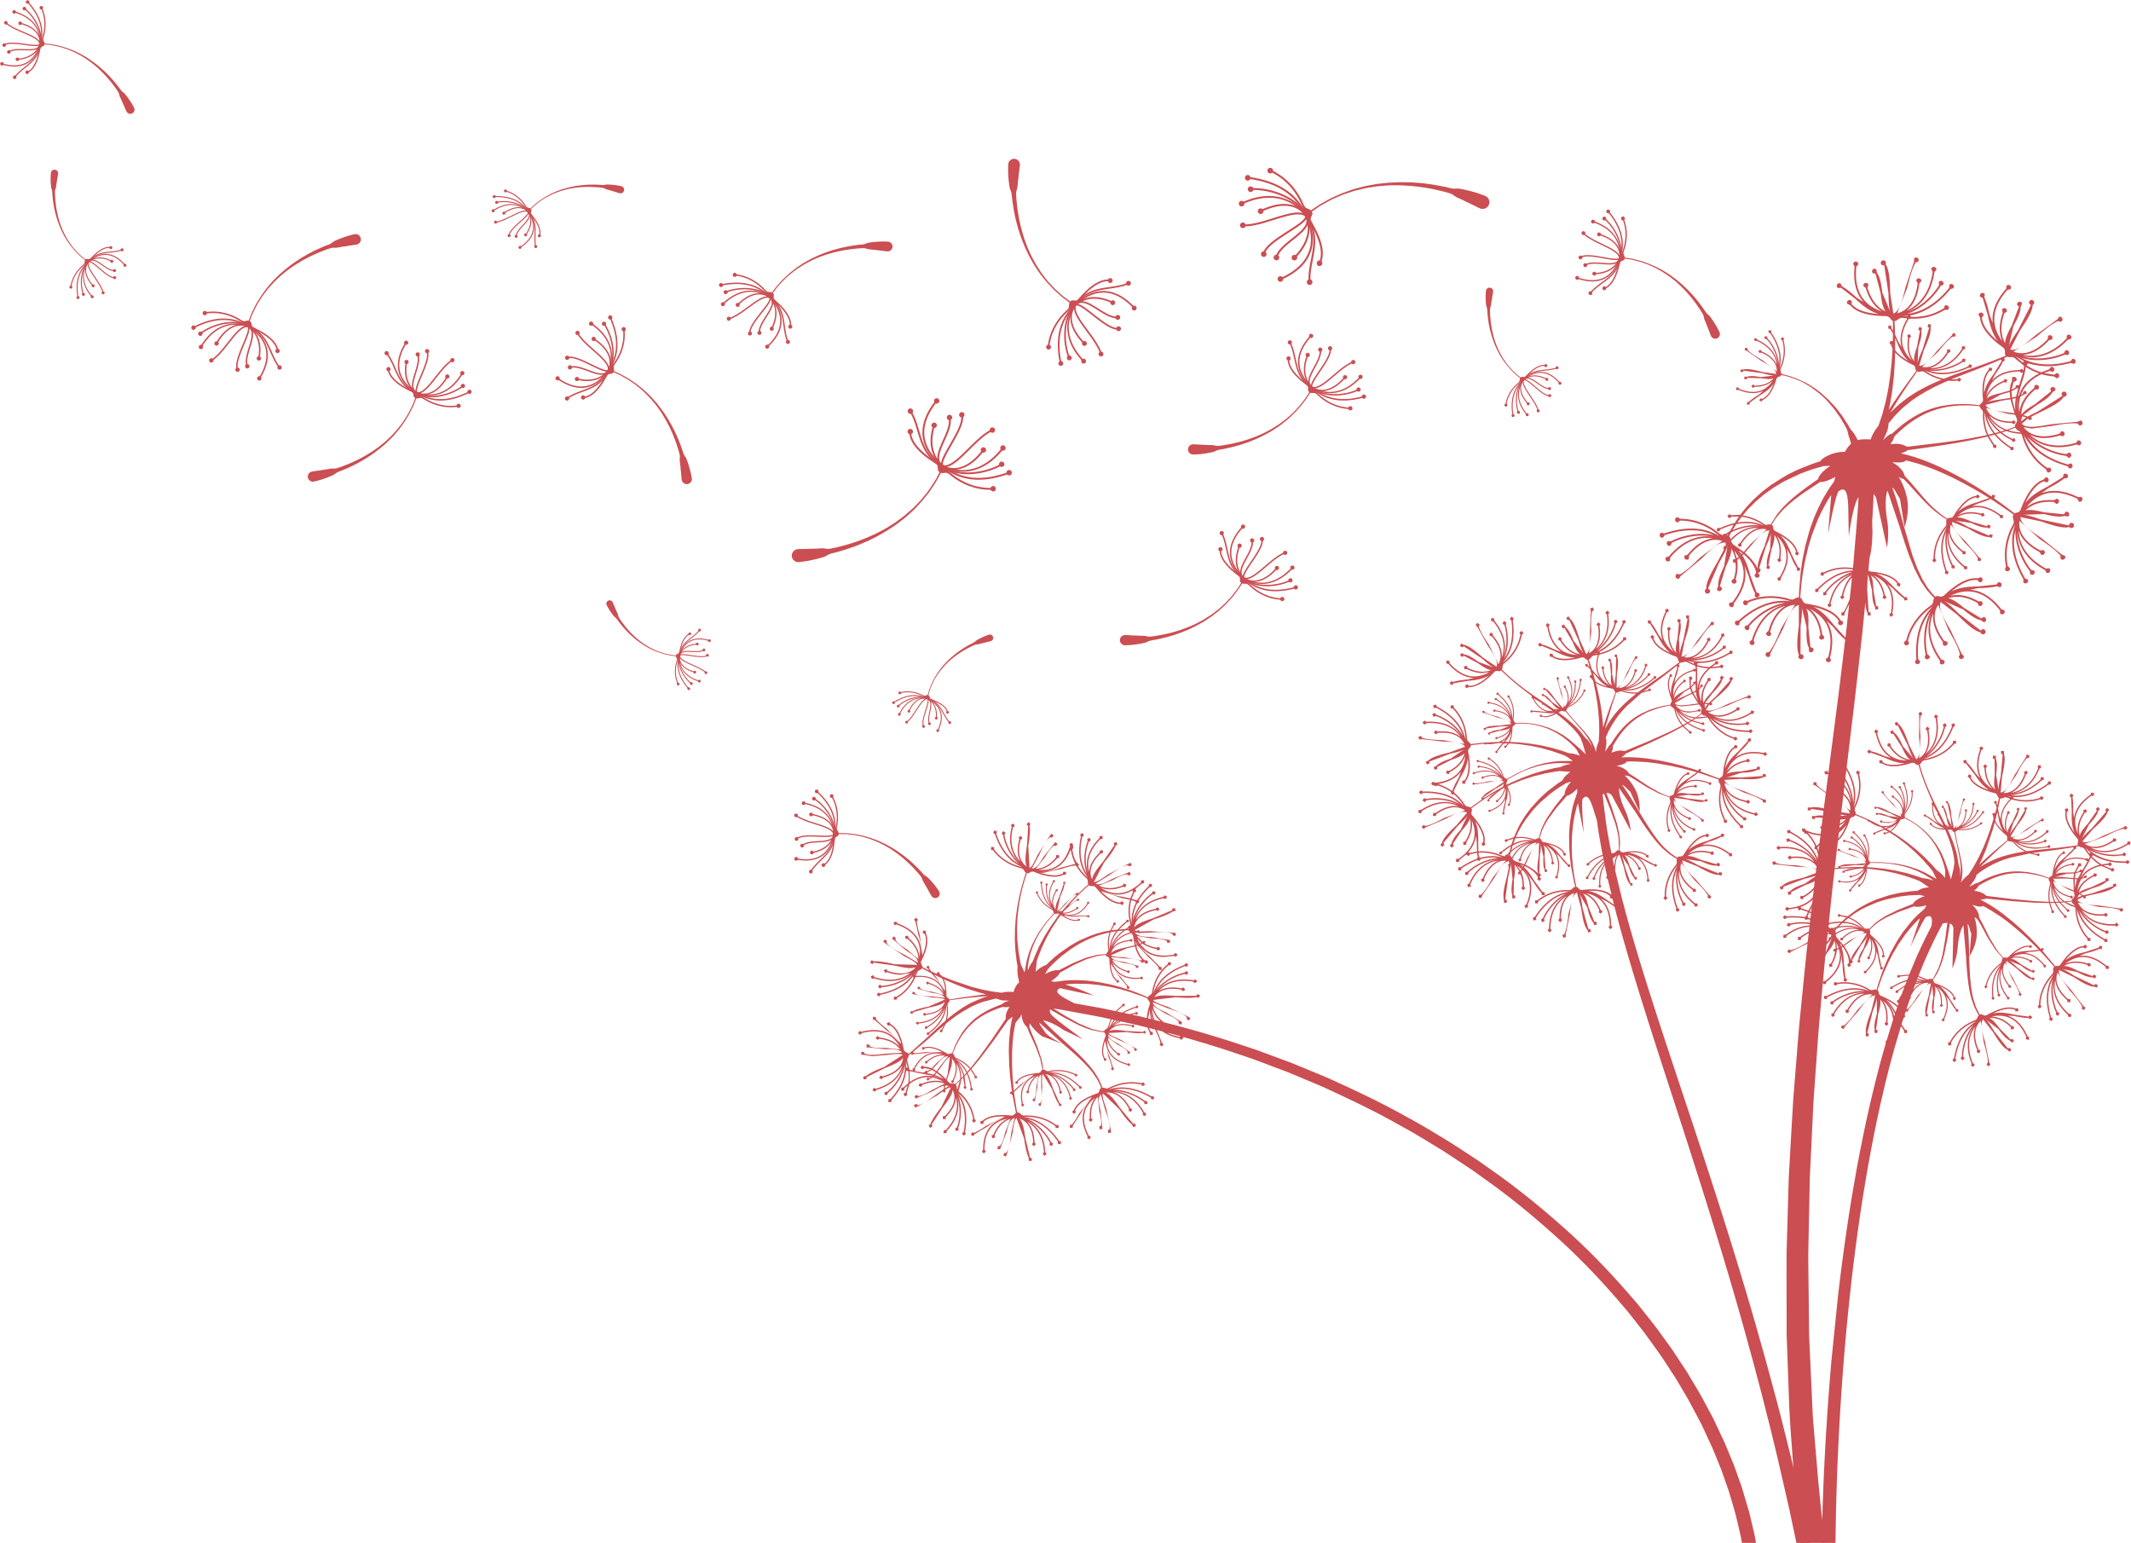
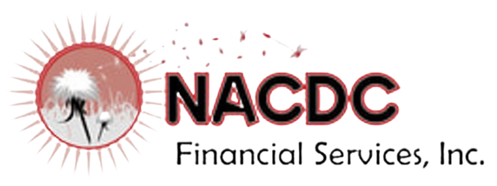
Overview | NACDC Financial Services, Inc.
Our mission is to provide alternative financing opportunity for Native American Entrepreneurs and small businesses in communities on and near Indian Reservations in Montana
Founded in 2010
Loan Products |
small dollar
consumer
business
agriculture
artist line of credit
home loans
Developing the work force | Grown from 3 staff to 15 since founding
Capital Deployed | 23 million since founding
2

Slide 3
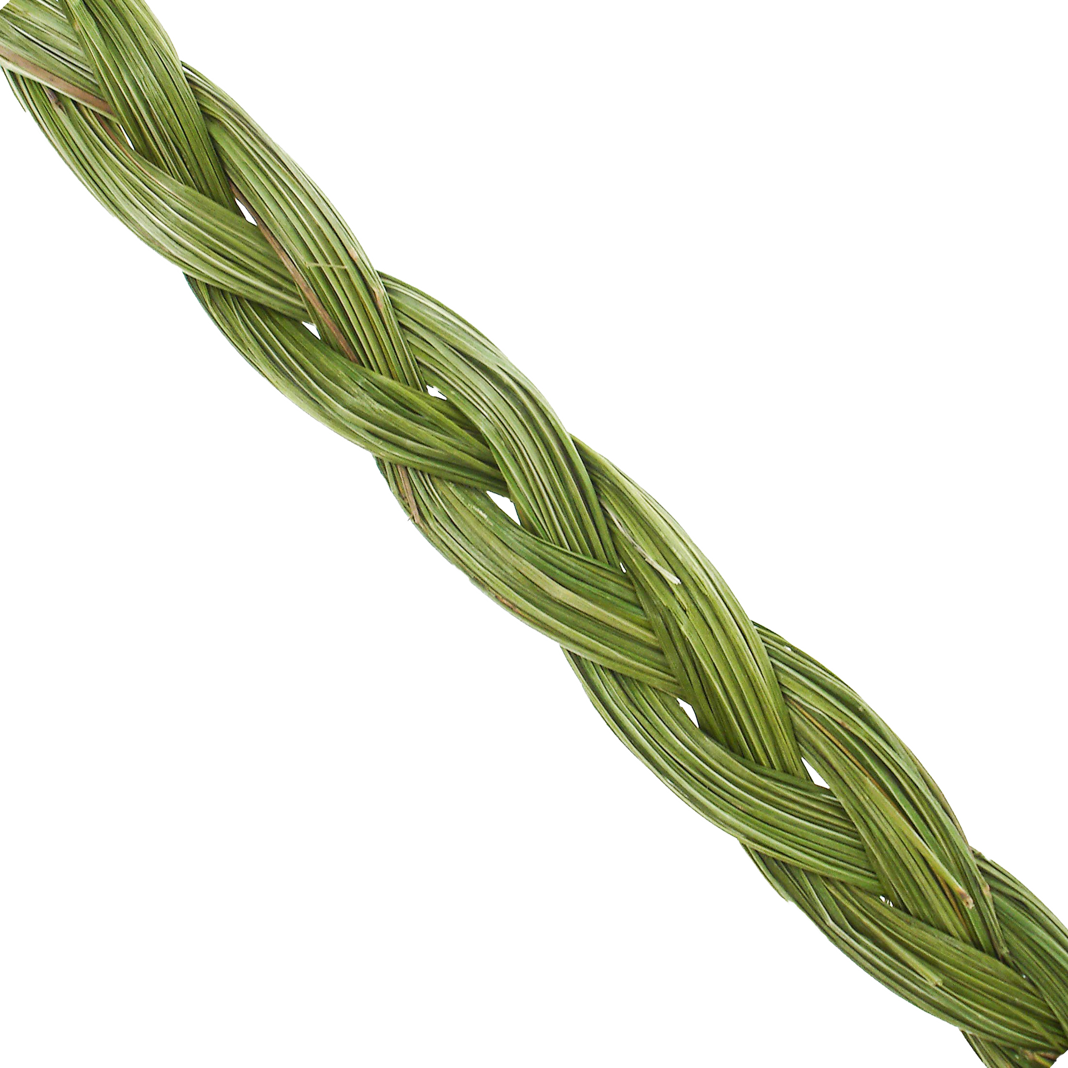
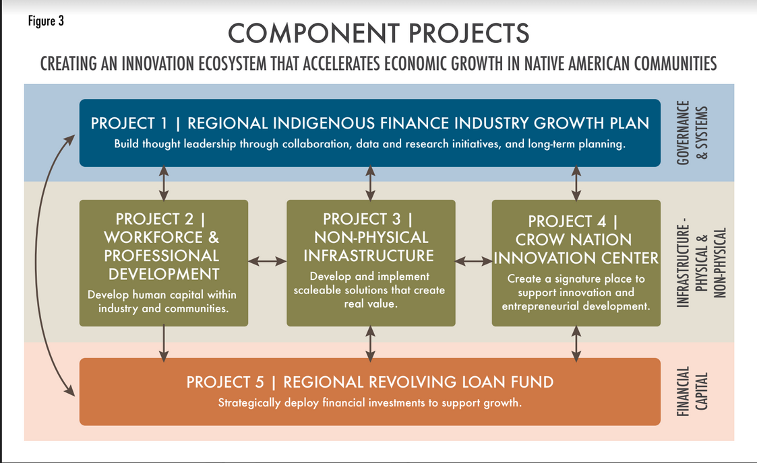
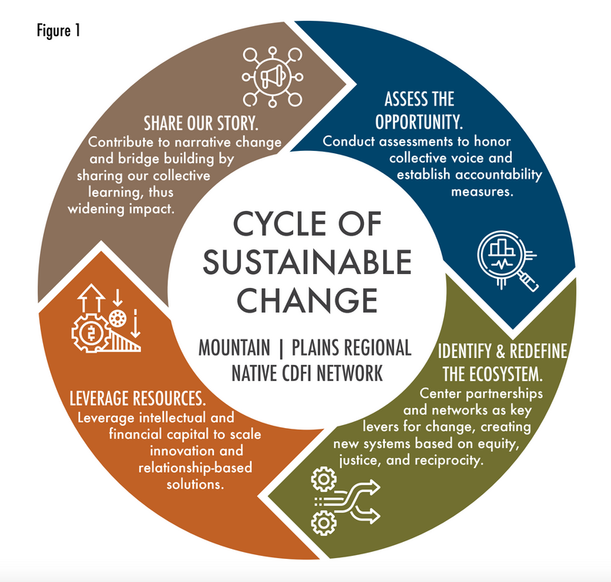
Mountain | Plains Regional Native CDFI Overview
Founded: February 2020
Members: 9 Native CDFIs + 1 CDC
Target Market: MT, WY, SD, ND
Leadership: 8/10 Executive Directors are Native Women
Capital | 23 unique investments from private philanthropy, impact investors, and government
Largest Capital Source: 2022 EDA Build Back Better Regional Challenge Awardee
Purpose | to fortify the Mountain | Plains Indigenous Finance Industry
Why| To re-establish traditional, vibrant trade routes
Strategy| Amplify Strength | Unify Action | Sustain Generations
3
Notes:
In 2022, the Coalition was one of 21 awardees out of 576 applicants for a Build Back Better Regional Challenge Grant.
At the time, this award marked the single largest investment into the Native CDFI industry. We were awarded $45M, which was triple the amount that treasury invests annually into Native CDFIs, who previously was the largest source of capital.

Slide 4
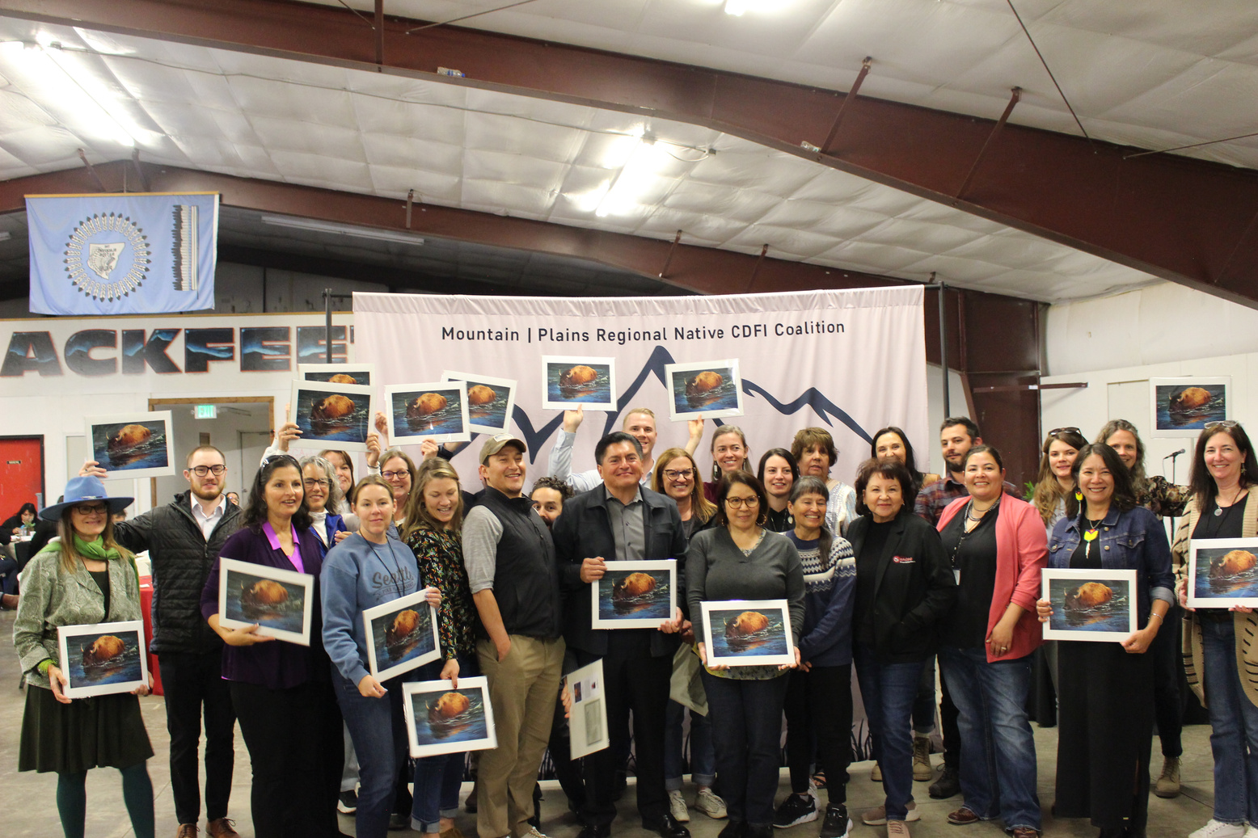
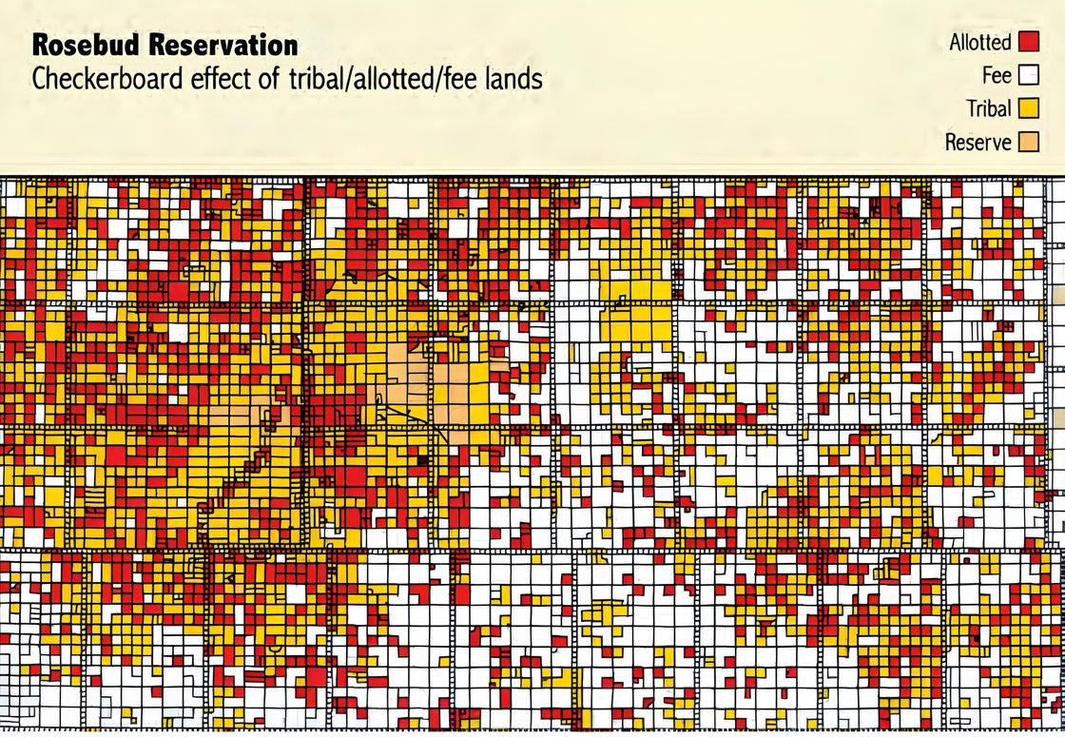
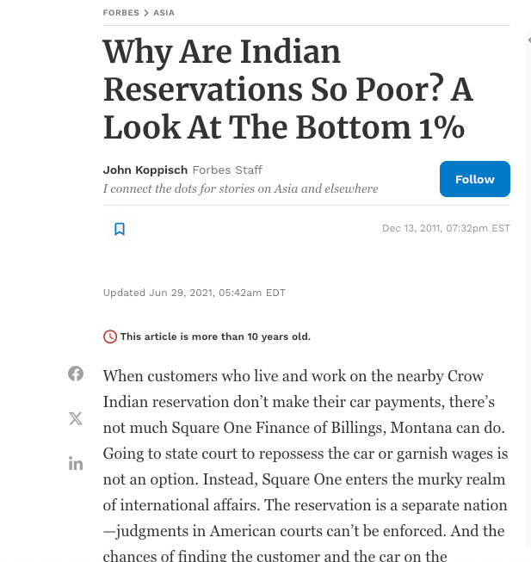
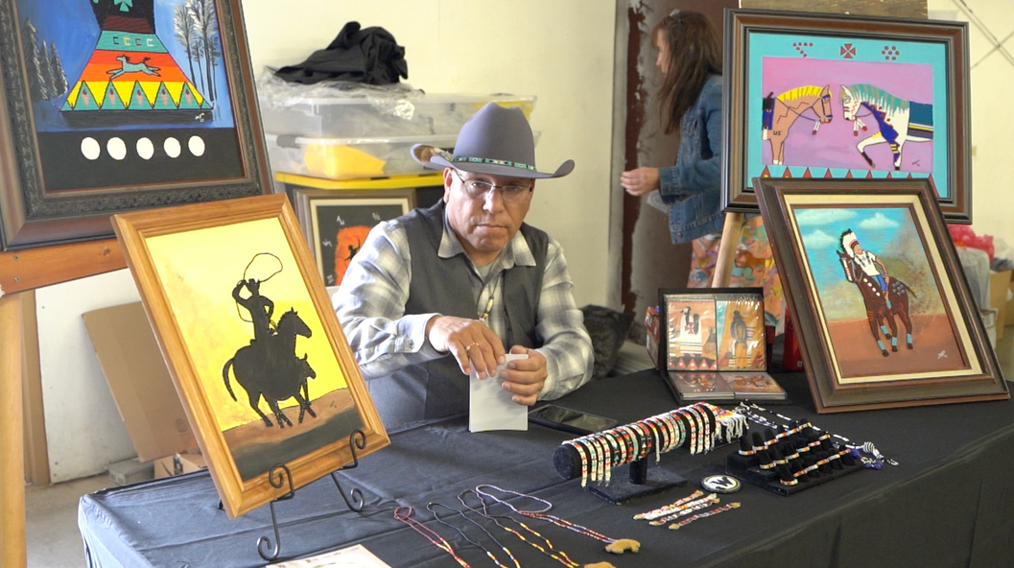
Myth of Risk in Native Markets
Myth
vs
Reality
Story telling from a deficit lense highlights and perpetuates the myth of disparity and struggling, inadvertently diminishing perception of investment opportunity.
Lack of knowledge around Indian trust lands justify ongoing red-lining and also fuel these myths.
Native CDFIs have low default rates, have pipeline of good deals in need of investment and are actively growing local economies. Native CDFI’s are the experts of their markets.
Red Lining - refusing financial services because potential clients live in an area deemed to be a poor financial risk.
4
Notes:
There is a perception that Indian Country is high risk. One of the causes is the way the media talks about Indigenous communities, framing them in deficit and poverty.
Secondly, there is a tendency to blame poverty on people in poverty as opposed to acknowledging intentionally designed, extractive systems of colonial capitalism. Native communities, like many communities of color, were by designed, intentionally left out of finance systems that build assets and create access to capital.
The reality is that indigenous communities are not high risk for those who know how to navigate them.
Native CDFI's are proof of this. Native CDFI's in the Mountain | Plains region have an average of a 2% default rate, have so many deals in the pipeline that they can't fund them all, and are experts in their markets.

Slide 5
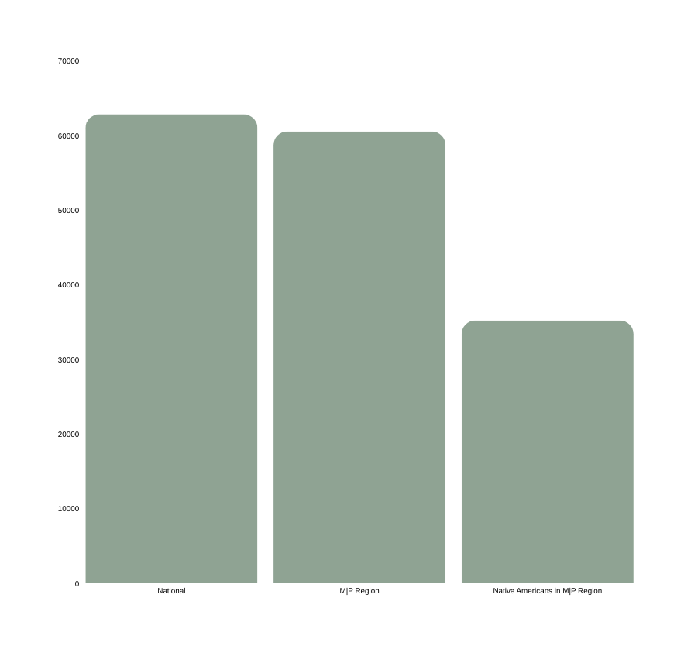
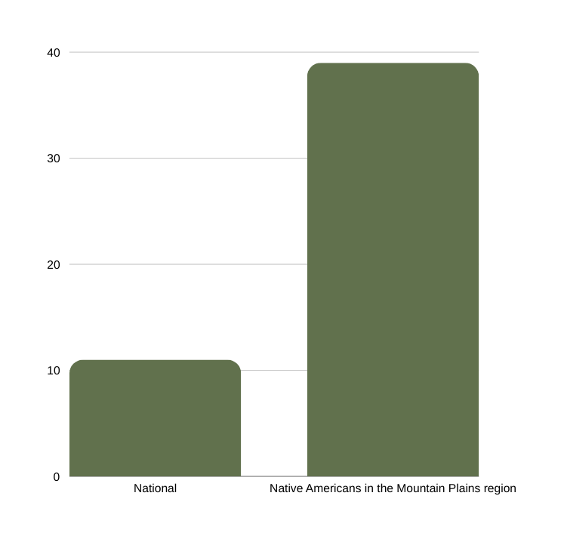


A Broken System | Native Communities Have Been Left Behind
By design, mainstream economic systems oppress & exclude Native communities.
75,000
National
Mountain Plains Region
Racial Wealth Gap
Household Wealth
Native Americans in Mountain Plains Region
White
Native
50,000
39%
25,000
$62,843
$60,547
11%
$1.00
$0.08
$35,214
Native Americans in
the M|P Region
0
National
National
M|P Region
Native Americans in M|P Region
Percentage of Communities Living in Poverty
Median Household Income
5
Notes:
These myths have real consequences.
Western finance institutions have abandoned Indigenous communities.
Without awareness and intention to work at a systems change level, inaction continues to contribute to systemic poverty along racial lines.

Slide 6
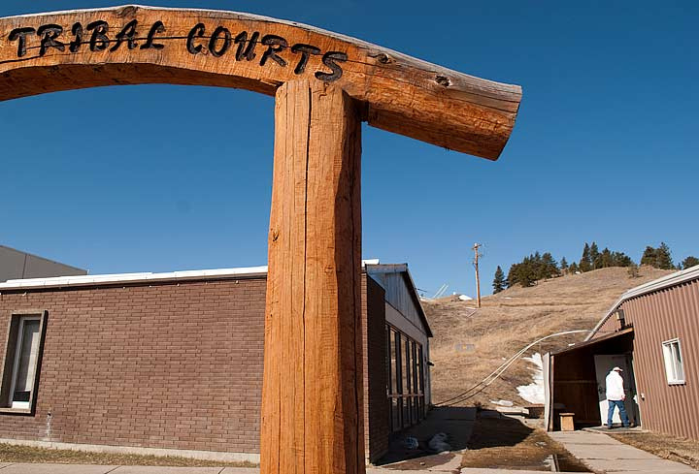
Percieved Risk | Recourse
Sovereign Immunity: Tribal nations are sovereign entities, meaning we have the authority to govern ourselves and our legal systems. Lenders fear that if a loan goes into default, they won’t be able to pursue legal action in tribal court or state courts due to this immunity.
Jurisdictional Differences: Tribal courts operate independently from state and federal courts. Non-Indigenous investors may not trust that tribal courts will be unbiased or enforce contracts in a way they are familiar with.
Unique Uniform Commercial Codes by Tribe (UCC): Many tribes have their own versions of commercial codes, but these might differ from the UCC adopted by most states. This can lead to concerns about the predictability and enforceability of contracts, particularly in matters related to bankruptcy or collateral recovery.
6
Notes:
False assumptions of risk mitigation perpetuates myths. These myths become barriers to capital investment into Native markets.
While Native CDFIs invest deeply into relationships as key risk mitigators, dominant culture institutions see recourse as a primary tool for risk mitigation.
Tribal jurisdiction is a unique category of American law. As most lenders aren't required to understand Indian law, myths can be legally leveraged to justify modern day red-lining.

Slide 7
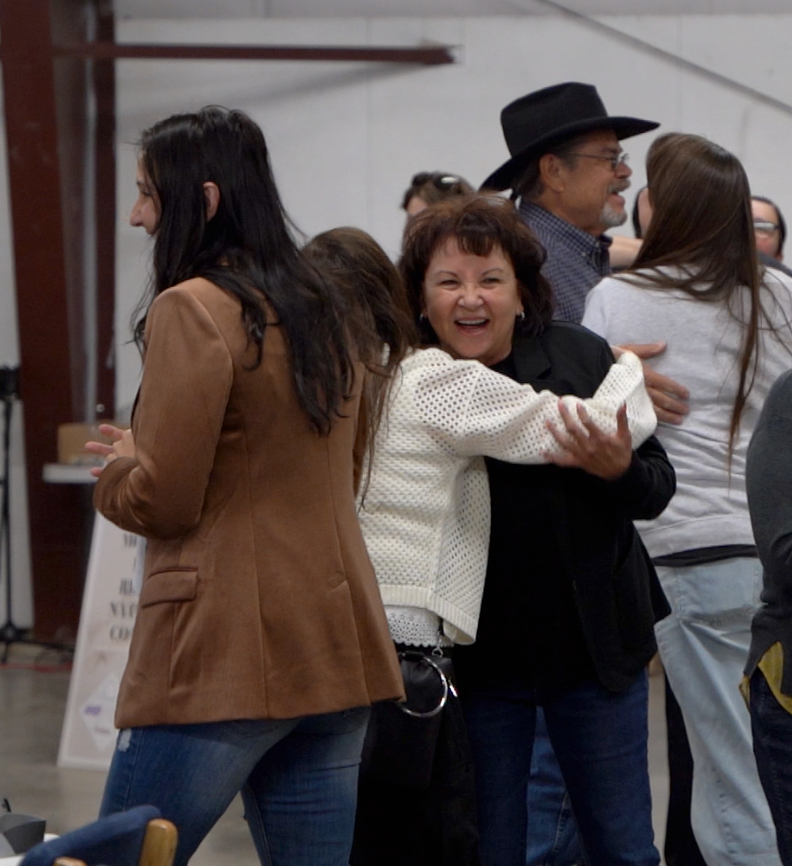
Native CDFIs | Experts in Relationships & Growing Native Markets
Native CDFIs invest in relationship as a mitigator of risk. Because we share the same communities with our borrowers, there is immediate accountability. When you run into each other when shopping for groceries or attending a ball game, there is more opportunity to touch base and pivot and problem solve together before default ever happens.
In the rare event of default, Native CDFIs have strong systems in place to work within the court systems. In our region, the current default rate is 2.22%, an indicator of strong systems of repayment balanced with accepting appropriate risk in systemically underserved markets.
Native CDFIs have been working within our legal systems since 1985 and know how to successfully navigate our own court systems. We know the timeline is often slow and the process requires knowing the right point of contact.
7
Notes:
In contrast, Native CDFIs are experts in tribal jurisdiction. The industry has invested over 40 years fine tuning risk mitigation systems well before a tribal court ever needs to be involved.
Our consistent solution: leverage social capital. We invest in client relationships to problem solve long before a loan gets to default. We know our neighbors who work within the tribal courts to know who can move cases forward. We have relationships with our local BIA to process mortgages on trust land.
The result is a near 0% default rate.

Slide 8
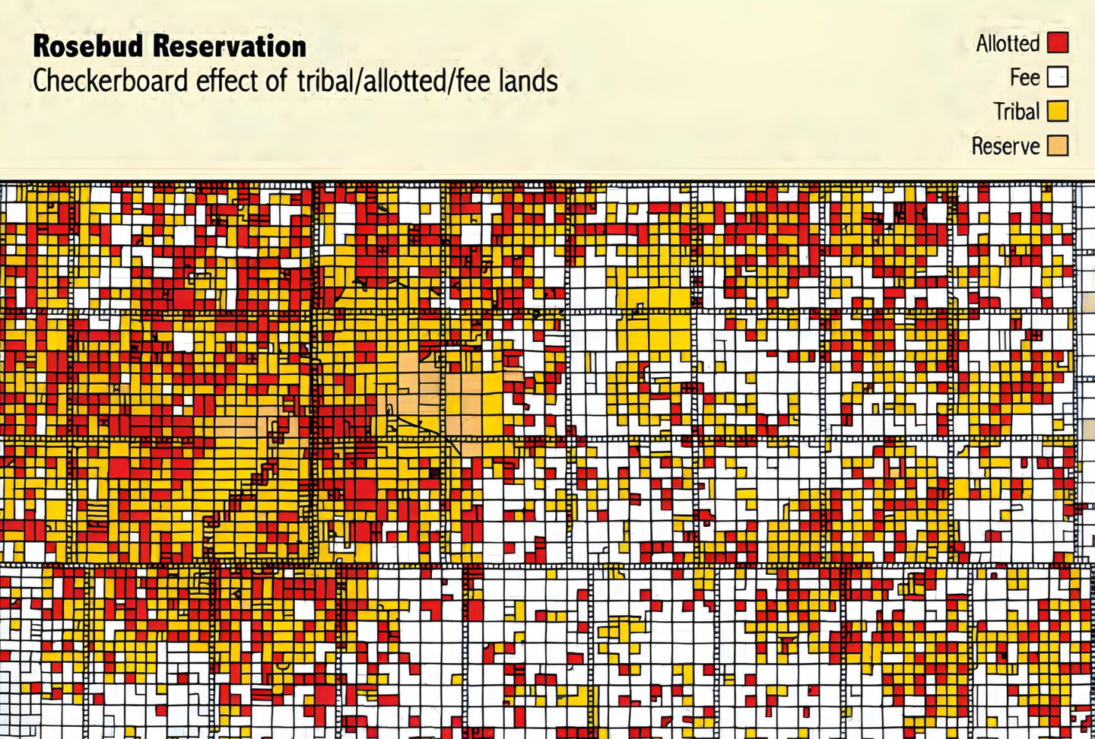
Perceived Risk | Trust Land
Collateral: Trust land cannot be sold, transferred, or encumbered without federal approval. Lenders fear they cannot foreclose on or seize trust land as collateral in case of defaults.
Restricted Transfer and Use: Any sale, lease, or mortgage must be approved by the U.S. Department of the Interior.
Limited Commercial Use: Trust land is designated for tribes or individual members, which can limit its use. Commercial development often requires special approvals, making the process more complex than with privately owned land, adding to lenders' concerns about generating revenue.
“The risk is not as great as non-reservation people would view it. We [Native CDFIs] know you can use trust land as collateral." (Charitina Fritzler, Plenty Doors Community Development Corporation)
8
Notes:
Trust land is a category of land ownership unique to Native Americans.
To uniformly have banks determine that trust land can't be collateralized is modern day red-lining.
It is determining that our greatest asset, our land, and what defines us as a people -we are "of" the land" is stripped of all value.
This myth that trust land can't be collateralized or has restricted use is a significant barrier to access to capital.
Like these other myths, it is 100% false.

Slide 9
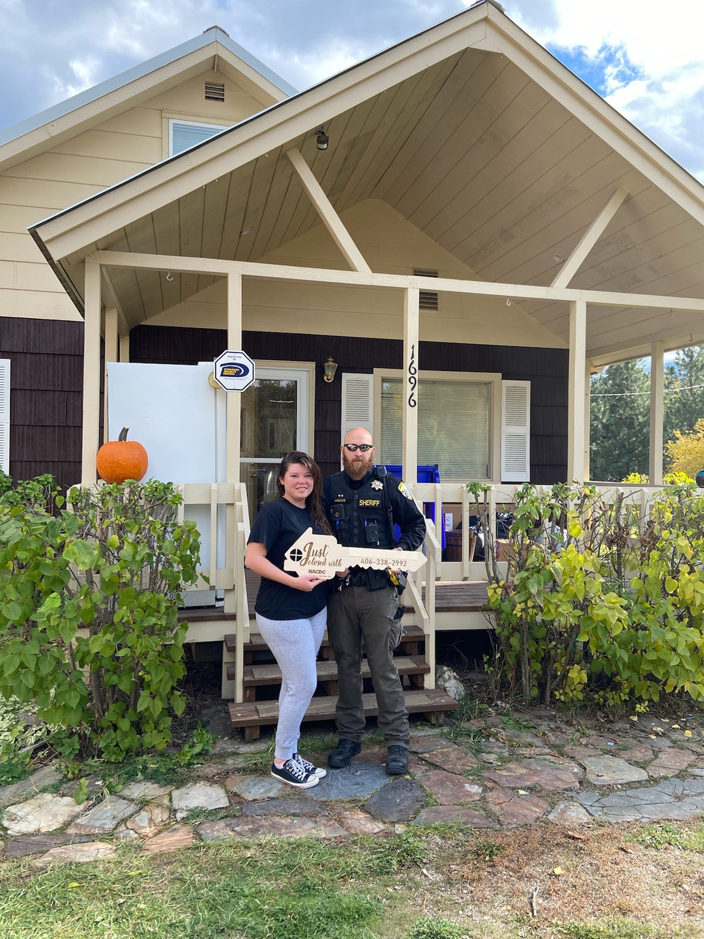
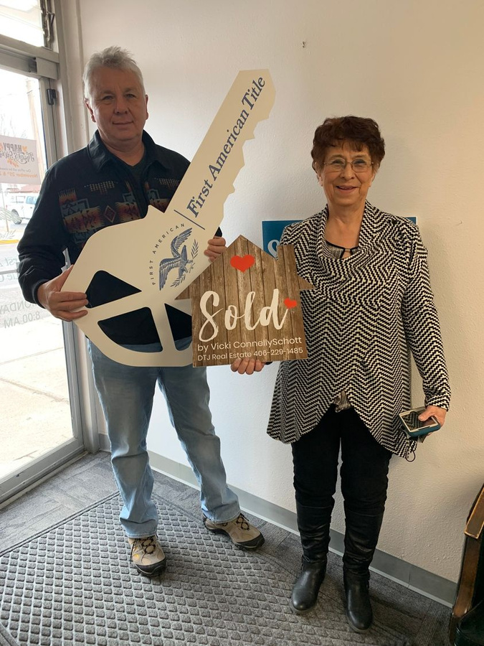
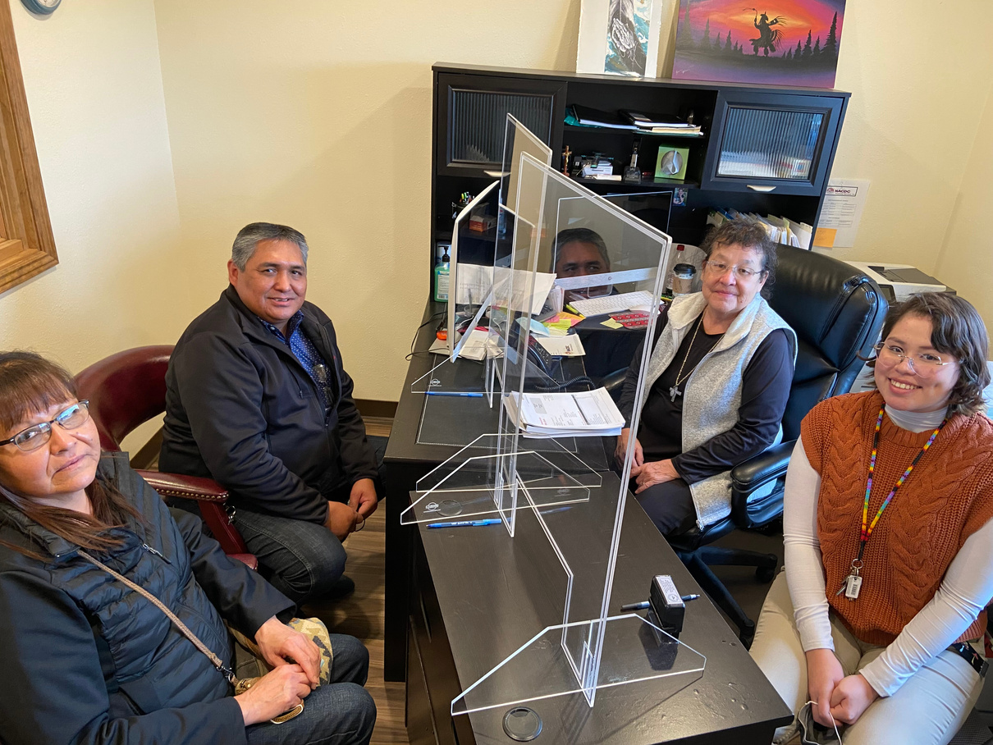
Reality | Native CDFIs are Reclaiming Native Lands as the Assets They Are
Two of our larger and more established CDFIs in the Coalition have normalized leveraging trust land to build home ownership. NACDC, Financial Services, Inc. (MT) and Four Bands Community Fund (SD) are national leaders strengthening local systems to mortgage successfully on trust land. Both leaders work with their local BIA land offices to build the BIA capacity to leverage trust land.
NACDC Financial Services, Inc
76 mortgages
$6,971,940.25 portfolio
Four Bands Community Fund
78 mortgages
$7,984,479.57 portfolio
9
Notes:
The reality is Native CDFI's have been successfully leveraging trust land since their inception. One of the ways we've done this is through home mortgages. Two national leaders with strong track records are ourselves, NACDC Financial Services, and Four Bands Community Fund in SD.

Slide 10
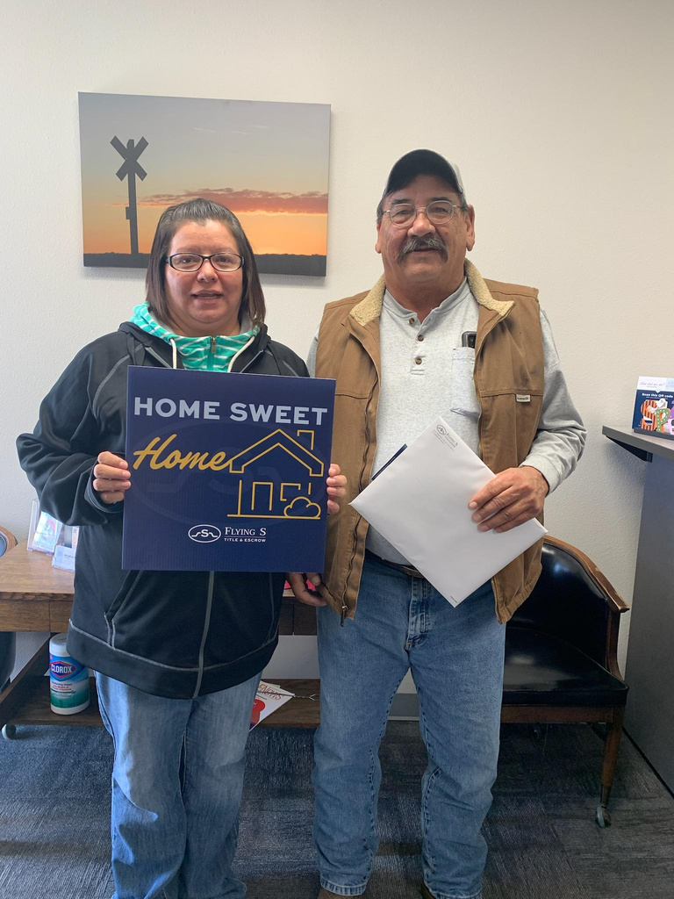
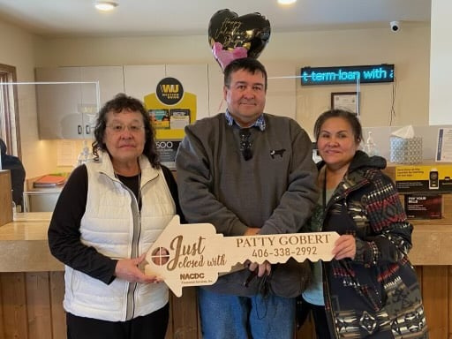
Myth Busting in Action at NACDC Financial Services Inc.
“When you make an investment into NACDC Financial Services Inc., you not only invest in an organization, you invest in a community, because you're funding when it comes into our organization it goes back out into a business.”
-Angie Main, NACDCFS Inc
Mortgages
NACDC Financial Services Inc.’s home lending increased from just over $2 million in 2021 to $6.9 in 2024!
10

Slide 11
“We see our communities as whole resourceful human beings, and we [Native CDFIs] are institutions that guide them towards solutions. We don’t use the word “risk” in our work. We use ‘how do we get to yes’”.
-Lakota Vogel, Four Bands Community Fund
“We all know each other and that creates a system of accountability. The risk is not as great as off reservation people think.”
-Charitina Fritzler - Plenty Doors Community Development Corporation
The Mountain | Plains Coalition is Changing this Narrative
“There is a path. There is a solution that works directly against this myth that “oh, it’s hard, we should just walk away”. No! that’s not an acceptable answer.”
-Bill Stoddard, 45 North Partners
“We know our land. We know our family. We know our history. We work on a one-on-one basis. Our default rates prove how successful Native CDFIs are.”
-Sharon Small, Peoples Partners for Community Development
11
Notes:
While the myth about risk is pervasive, the Mountain | Plains Coalition is changing this narrative, and they've started with their own partners and members.
Here are words from leaders in our ecosystem.

Slide 12
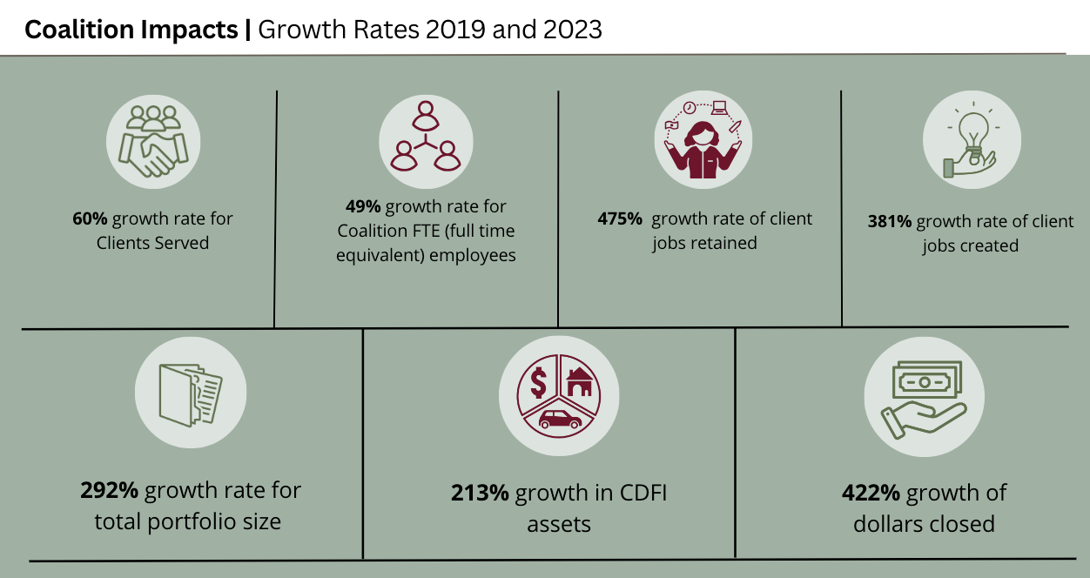
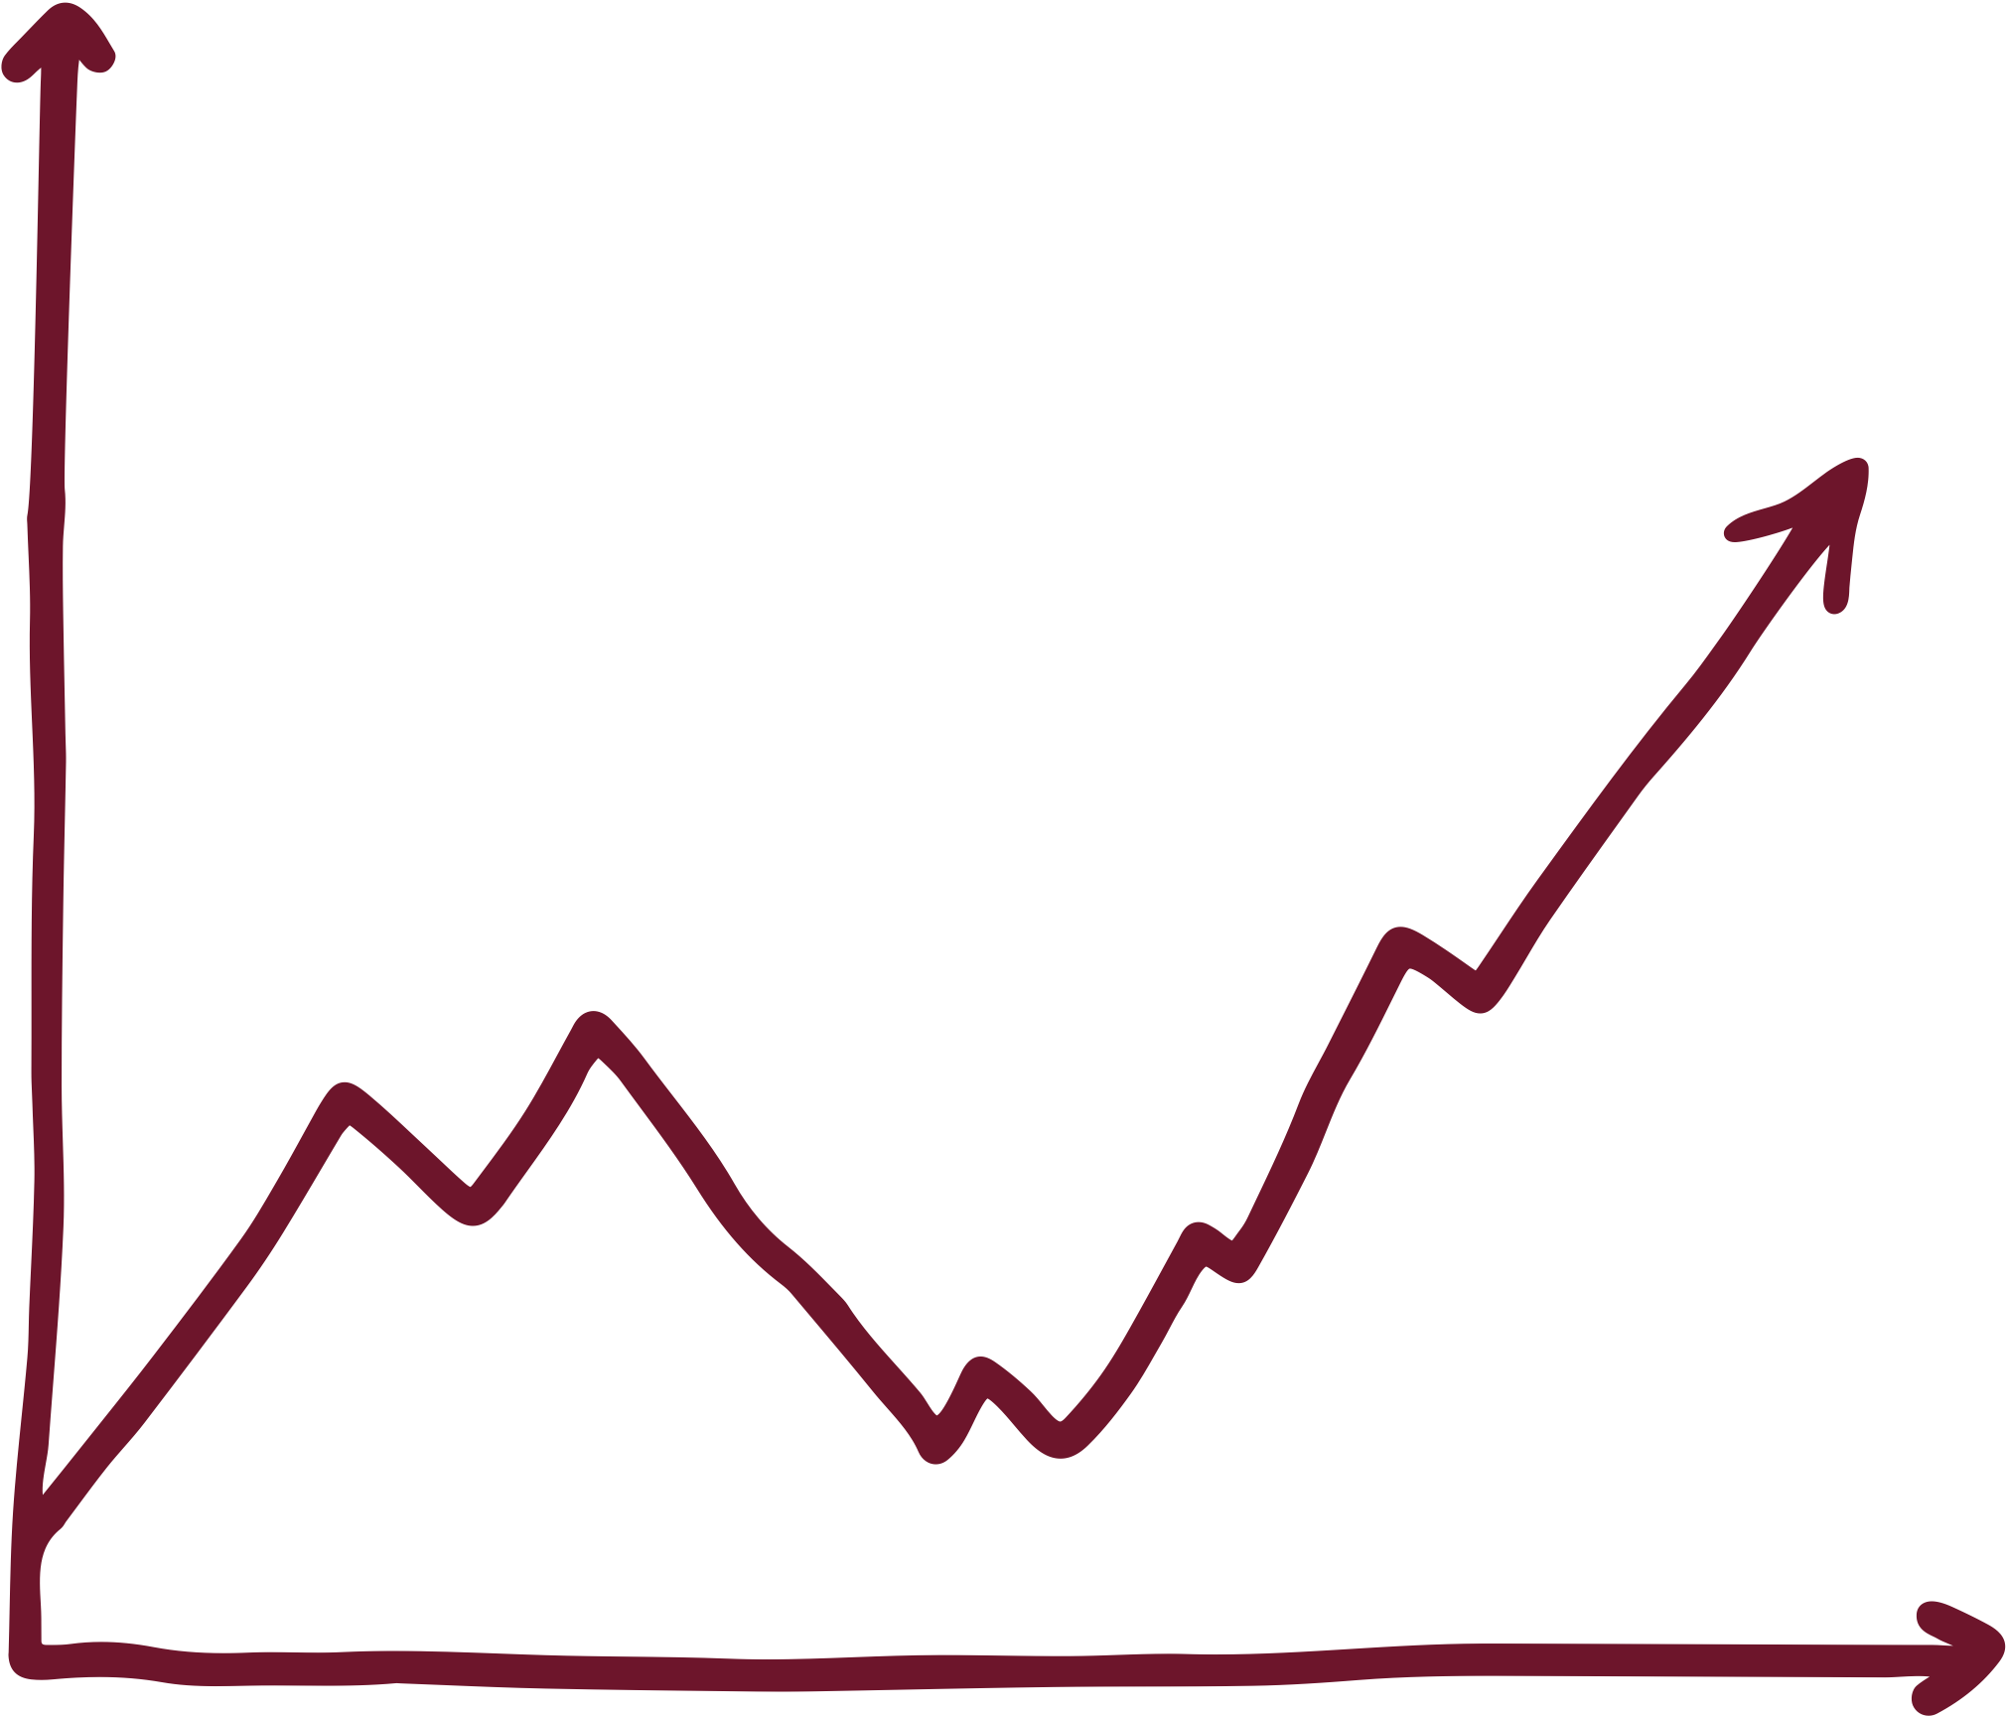



2% average default rate ranging from 0% to 5%
$22.1M closed
2% average default rate ranging from 0% to 5%
$53.1M total portfolio size as of 12/31/23
$84.1M in CDFI assets as of 12/31/23
12
Notes:
The impacts of this narrative change work and the innovation and dedication of the Mountain | Plains coalition cannot be disputed.
With only growing our own internal workforce by 17% in the last four years, we have doubled, tripled, and nearly quadrupled some of our key indicators of wealth creation and access to capital.

Slide 13
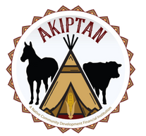
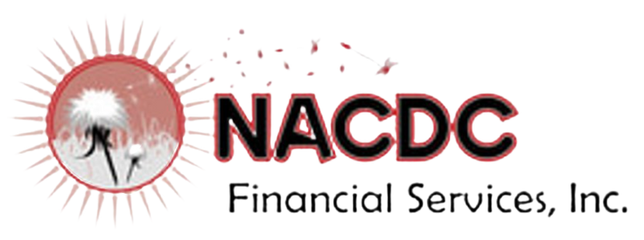


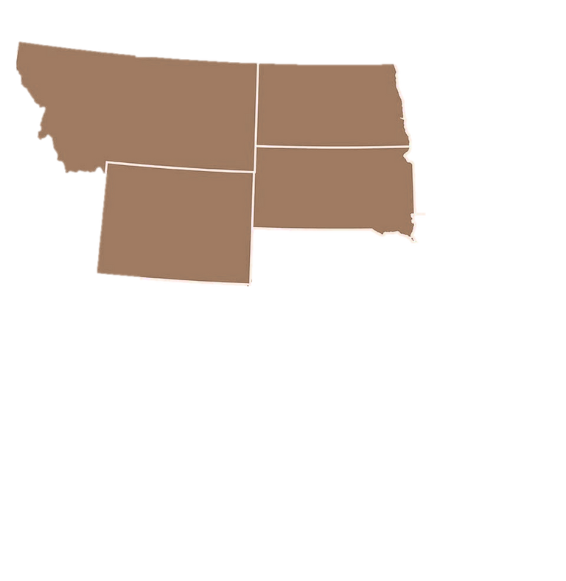







Mountain Plains Regional Native CDFI Coalition
Montana
Wyoming
Browing, MT
Fort Washakie, WY
NACDC Financial Services, Inc.
Angie Main
angiem@3rivers.net
Wind River Development FundPaul Huberty
paul@wrdf.org
MONTANA
NORTH DAKOTA
South Dakota
Hays, MT
Eagle Butte, SD
Montana Native Growth Fund
Kerry Shabi
kerry@nativegrowth.org
Four Bands Community Fund
Lakota Vogel
lakota@fourbands.org
Billings, MT
SOUTH DAKOTA
Speaker
Angie Main
Executive Director
NACDC Financial Services Inc.
(angiem@3rivers.net)
Native American Development Corporation
Sue Taylor
staylor@nadc-nabn.org
Eagle Butte, SD
WYOMING
Akiptan, Inc.
Skya Ducheneaux
skya@akiptan.org
Crow Agency, MT
Other
Plenty Doors CDC
Charlene Johnson
Cfjohnson@plentydoorscdc.onmicrosoft.com
Mountain Plains CDC
Eric Swack
eric@mountainplainscdc.org
Lame Deer, MT
The People's Partners for Community Development
Sharon Small
sksmall@hotmail.com
Compiled by Indigenous Impact Co.
Regional Economic Competitiveness Officer, Mountain | Plains Regional Native CDFI Coalition
Jael Kampfe, President, (jael@indigenousimpact.co)
Naatosi Fish, Marketing and Communications Manager, (naatosi@indigenousimpact.co)
Laraya Johnson, Operations Project Manager, (laraya@indigenousimpact.co)
13

