Slide 1
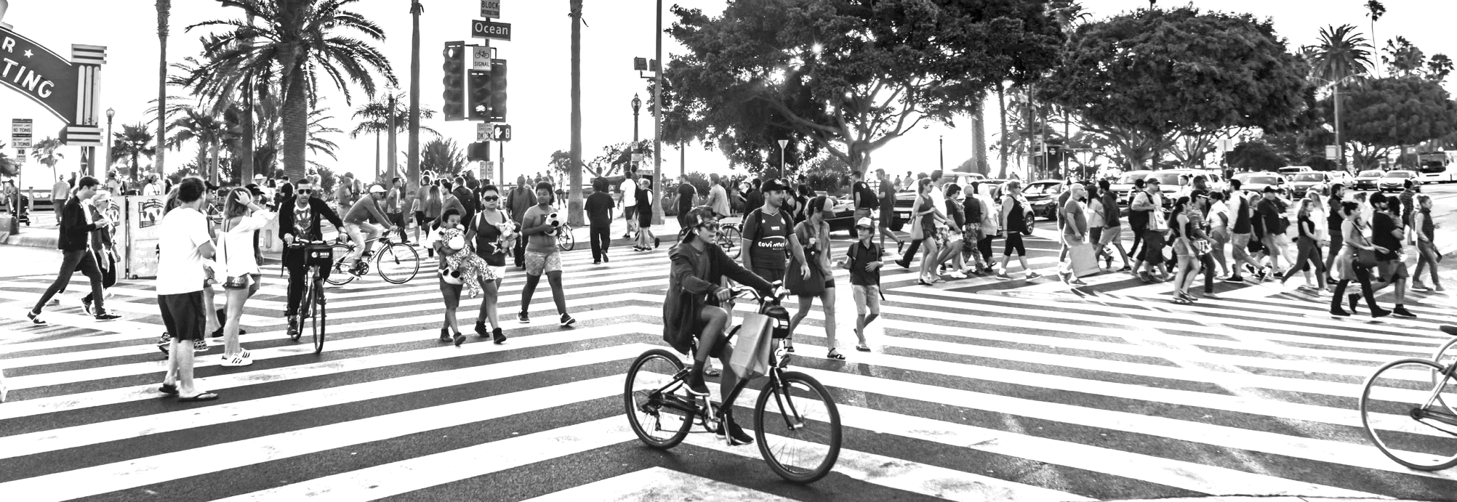

Public health in big cities
Chrissie Juliano, MPP, Executive Director
juliano@bigcitieshealth.org
bigcitieshealth.org

Slide 2
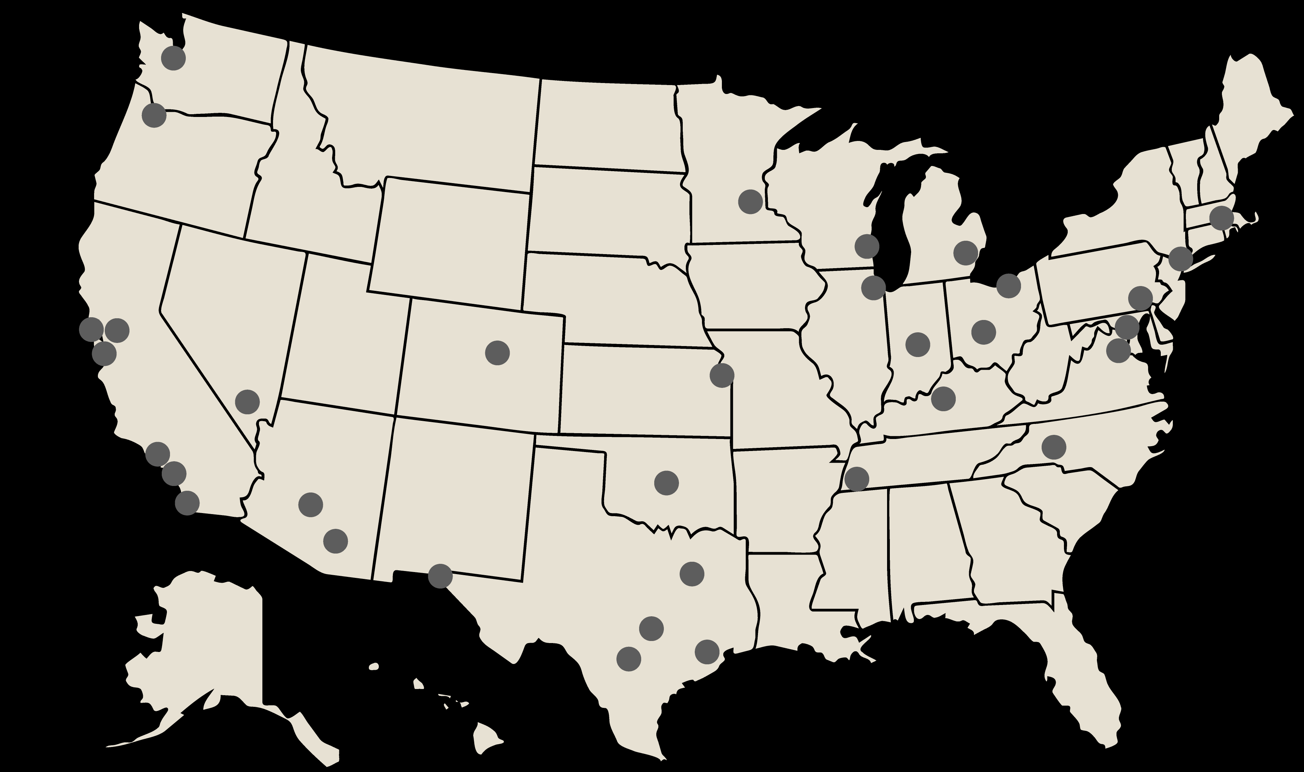
Member HDs serve 61M+ People
Austin
Baltimore
Boston
Charlotte (Mecklenburg Co)
Chicago
Cleveland
Columbus
Dallas (Co)
Denver
Detroit
El Paso
Houston
Indianapolis (Marion Co)
Kansas City
Las Vegas (Southern NV Health Dist)
Long Beach
Los Angeles (Co)
Louisville
Memphis (Shelby Co)
Milwaukee
Minneapolis
New York City
Oakland (Alameda Co)
Oklahoma City (OKC–Co)
Philadelphia
Phoenix (Maricopa Co)
Portland (Multnomah Co)
San Antonio
San Diego (Co)
San Francisco
San Jose (Santa Clara Co)
Seattle (and King Co)
Tucson (Pima Co)
Washington, DC
MORE INFO: bigcitieshealth.org/members

Slide 3
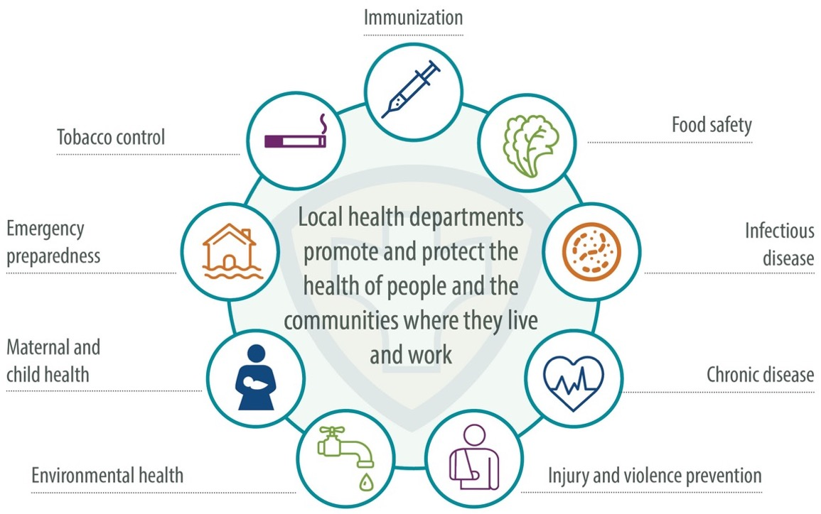
What public health is
…science of protecting and improving the health of people and their communities by promoting healthy lifestyles, researching disease and injury prevention, and detecting and responding to infectious diseases… health of entire populations
GRAPHIC: naccho.org/about
DEFINITION SOURCE: cdcfoundation.org/what-public-health

Slide 4
Governmental public health
Public health laboratories
Federal agencies
(CDC, FDA, HRSA, etc.)
The public health ecosystem
State & territorial health departments
Tribal health departments & authorities
Local health departments
Plus….
Health systems
Community-based organizations (CBOs)
Cross sector stakeholders and partners

Slide 5
Urban Health Agenda
a shared, actionable vision for transforming urban health
prioritizes health equity – that is, maximizing opportunities for health for everyone, especially those who have historically had the fewest social structures supporting that
envisions city-wide ecosystems in which all government sectors take action to improve health in cities and beyond
calls for investing in policies and practices that promote health – e.g., affordable housing, livable wages, earned leave
MORE INFO: bigcitieshealth.org/urban-health-agenda

Slide 6
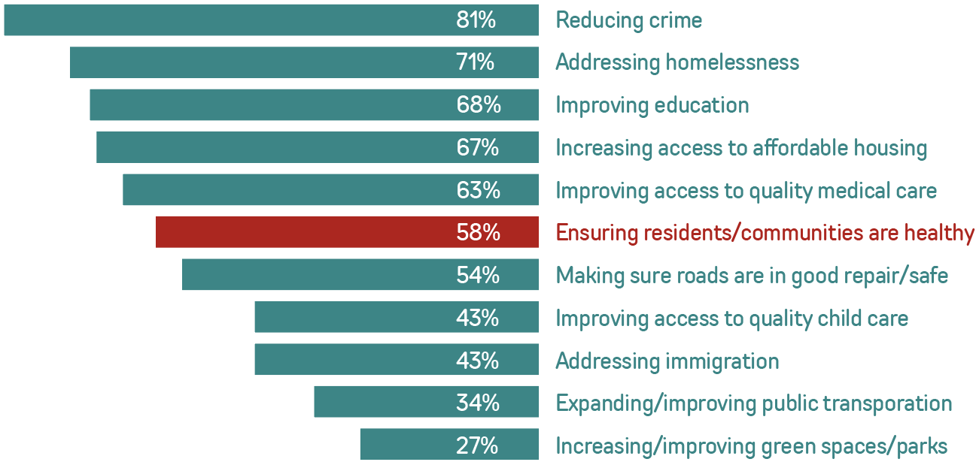
Comms research
Talking about public health & structural racism
FULL REPORT: bit.ly/bchc-comms-study

Slide 7
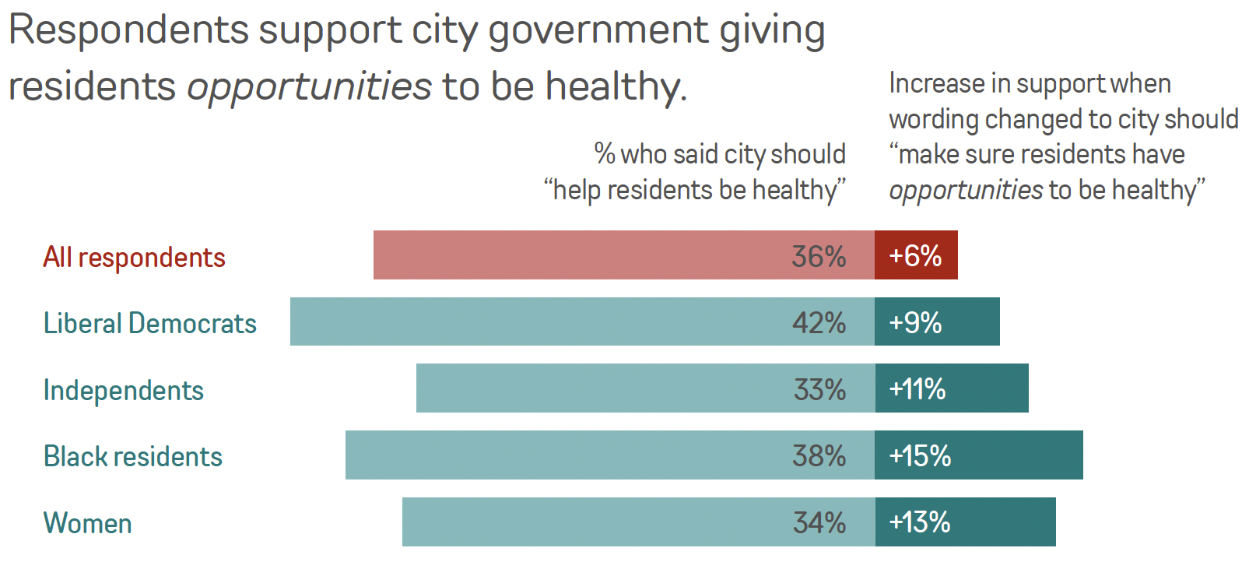
Comms research
Talking about public health & structural racism
FULL REPORT: bit.ly/bchc-comms-study

Slide 8
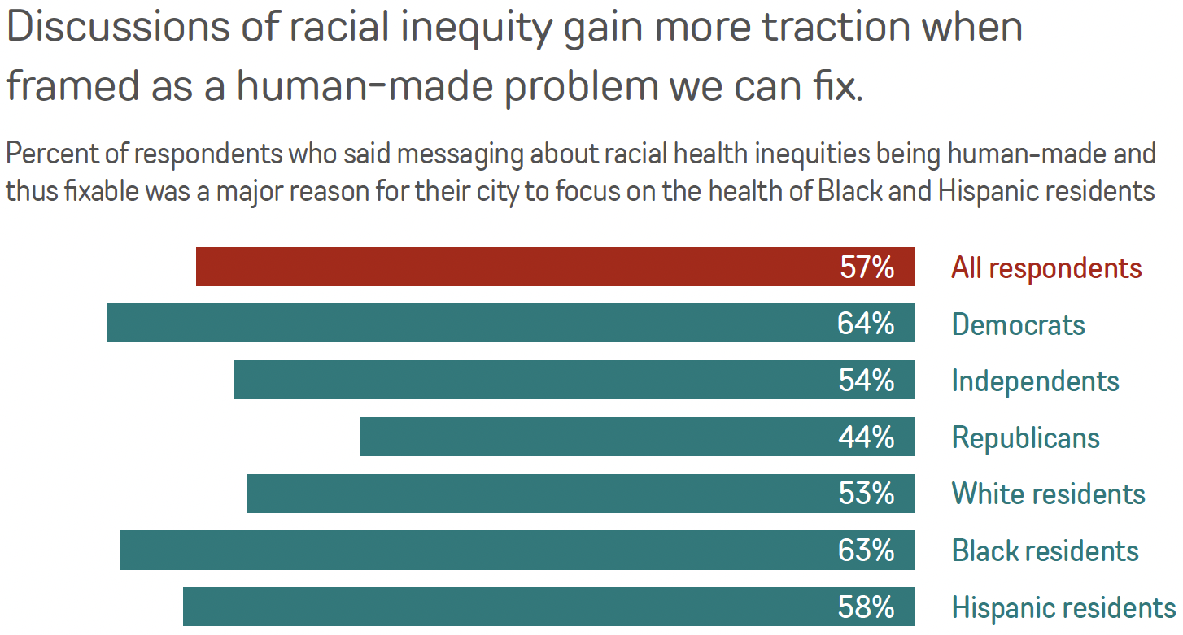
Comms research
Talking about public health & structural racism
FULL REPORT: bit.ly/bchc-comms-study

Slide 9
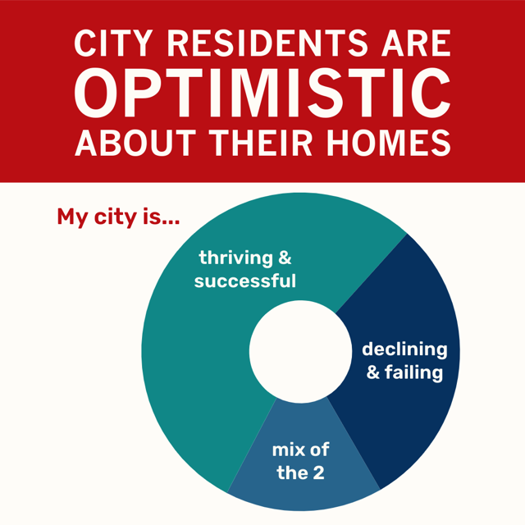
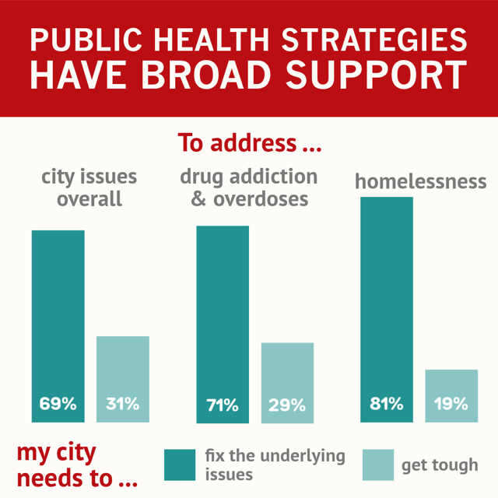
Comms research
Talking about public health approaches to drug use, homelessness
FULL REPORT: bigcitieshealth.org/harm-reduction-messaging

Slide 10
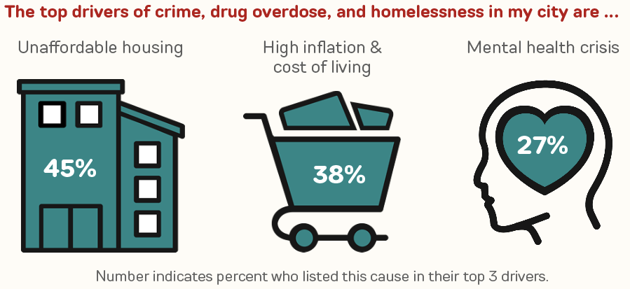
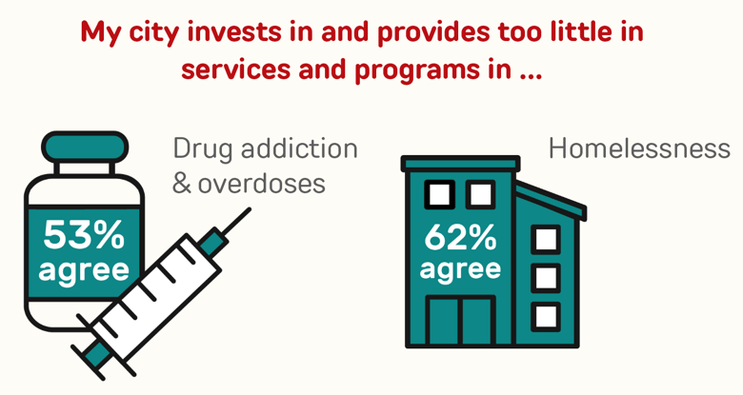
Comms research
Talking about public health approaches to drug use, homelessness
FULL REPORT: bigcitieshealth.org/harm-reduction-messaging

Slide 11
Which statement do you agree with more?
61%
“The public health approach treats people who use drugs as people, rather than as criminals. We cannot always control the people we love and know use drugs, but this approach reduces the chances that they will die if they do.”
Comms research
Talking about public health approaches to drug use, homelessness
39%
“A public health approach is not a long-term solution for addressing drug overdose deaths in cities. Because it does not require people to get treatment for addiction, it enables people who use drugs like heroin, fentanyl, or meth to continue using drugs even after overdosing.”
FULL REPORT: bigcitieshealth.org/harm-reduction-messaging

Slide 12
BCHC resources for reporters
Contact BCHC anytime you need a big-picture view of how health is changing in big cities (infectious disease, substance use, tobacco, violence, heat-related illness, etc.).
Contact Elizabeth Green, BCHC Communications Director (egreen@bigcitieshealth.org), to discuss ideas, request information, and/or schedule interviews with BCHC experts and big city health commissioners.
How we can tell important stories together…
Trends and inequities in health outcomes in our member cities on our data platform at https://www.bigcitieshealth.org/city-data/
Evidence (data and anecdotal) that harm reduction works to prevent ODs and save lives
How big city health departments work to address gaps and inequities in our health system, such as vaccinating un-/under-insured
How big city health departments work with new arrivals to the U.S.: protecting their community’s health needs while also supporting the health and well-being of people who have been through a traumatic experience

Slide 13
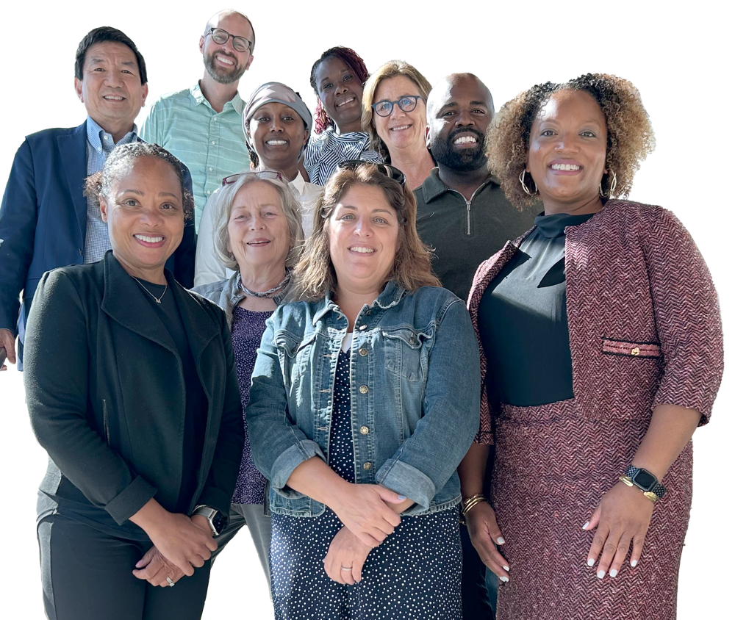



Contact/follow us
Chrissie Juliano juliano@bigcitieshealth.org
Media requests Elizabeth Green egreen@bigcitieshealth.org
bigcitieshealth.org
@bigcitieshealth
PHOTO: BCHC's 2024–25 Board, which includes the health commissioners from Charlotte, Cleveland, Columbus, Dallas, Kansas City, Memphis, San Jose, and Seattle.

