Slide 1

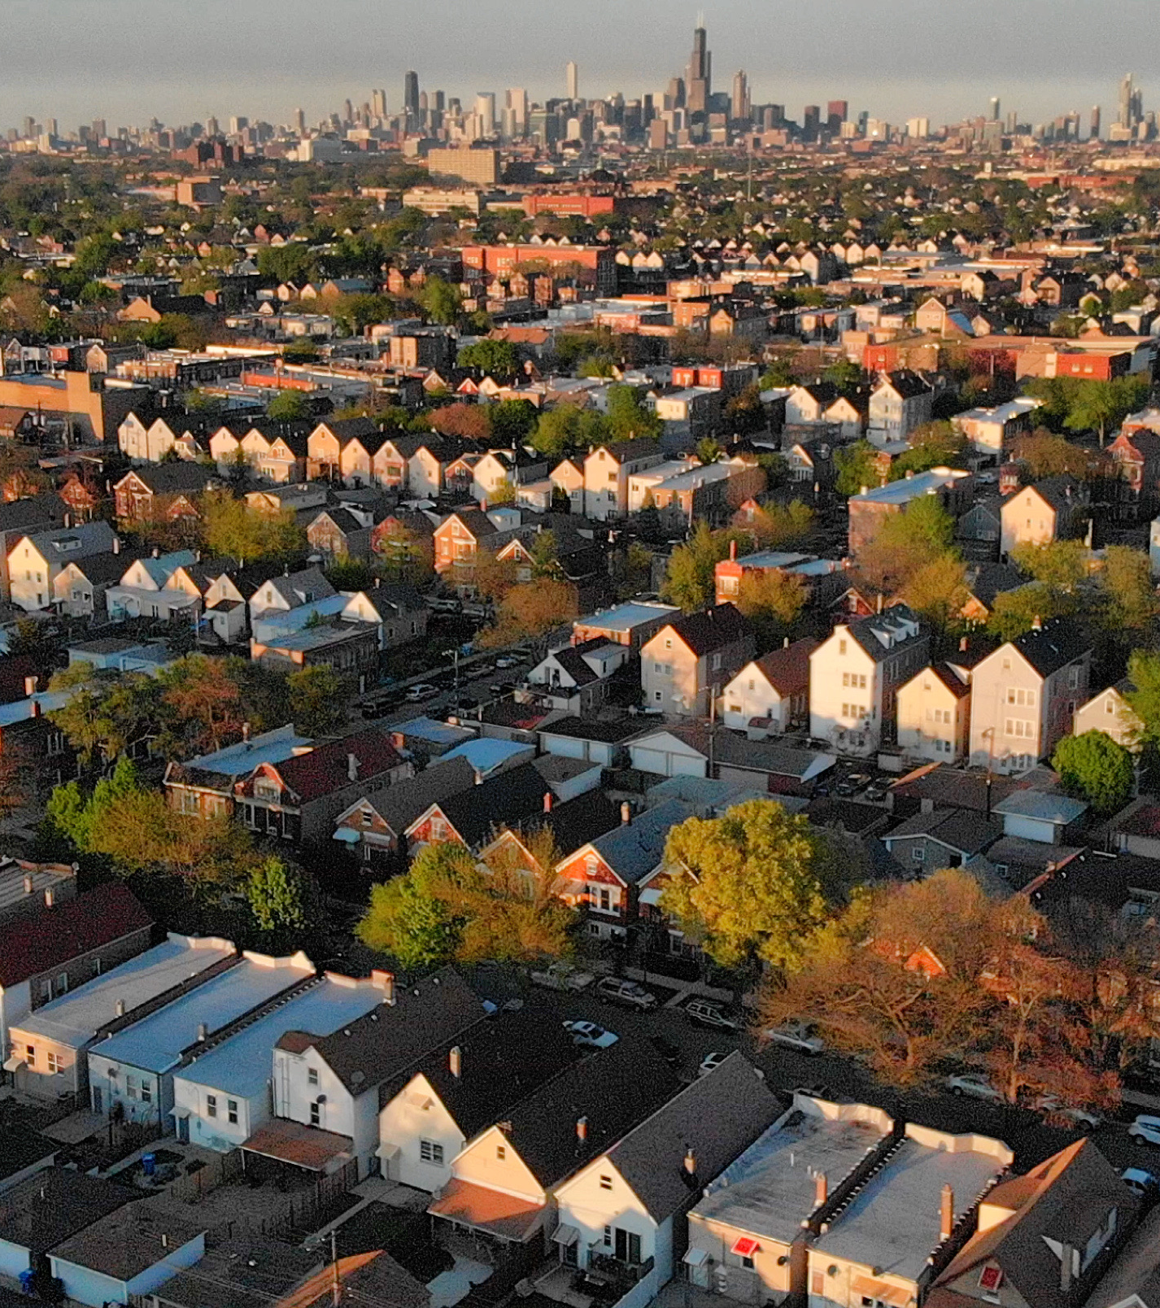

About West Side United
National Press Foundation
October 8, 2024

Slide 2
The Challenge
BELMONT
CRAGIN
79.7
68
82
74.7
80.0
vs
AUSTIN
HUMBOLDT PARK
WEST TOWN
70.1
68.5
67.7
76.3
East Garfield Park
Loop
WEST GARFIELD PARK
EAST GARFIELD PARK
NEAR WEST SIDE
Average life expectancy on Chicago’s West Side is up to 14 years less than the Loop A white baby born today in the affluent West Loop neighborhood is likely to live to age 82. A Black baby born just seven miles away in East Garfield Park is likely to live just 68 years old.
NORTH LAWNDALE
68.1
LOWER WEST SIDE
80.2
SOUTH LAWNDALE
80.5

Slide 3







Our Mission & Governance
Eliminate the life expectancy gap between the Loop and the West Side
by addressing the social determinants of health.
Key Facts
6-hospital partnership
$5M annual budget with 14 full-time employees
Community advisory board (17 members from West Side)
Board comprised of 6 hospital reps and 6 community reps
Rush as fiscal sponsor, transitioning to 501 C3 by early 2025.

Slide 4
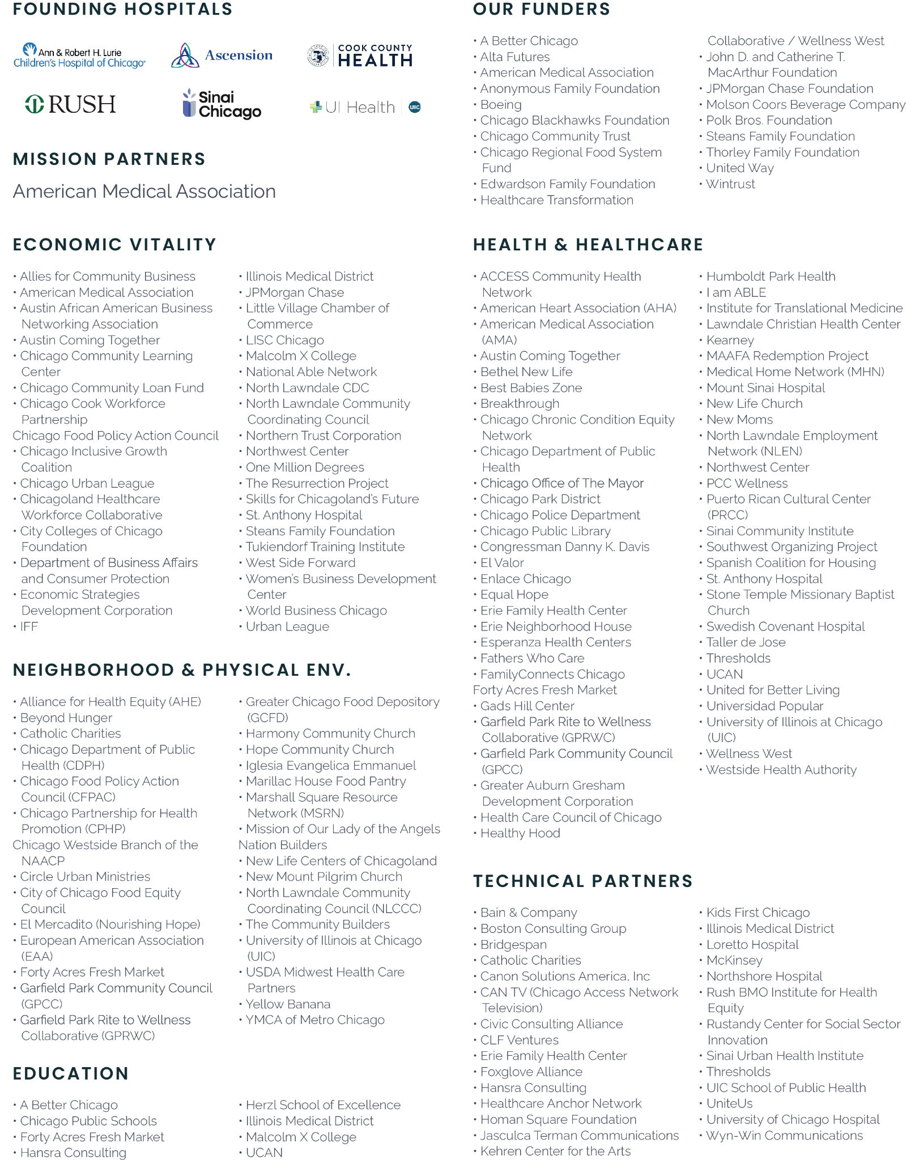

Our Partners.
Notes:
Ayesha

Slide 5
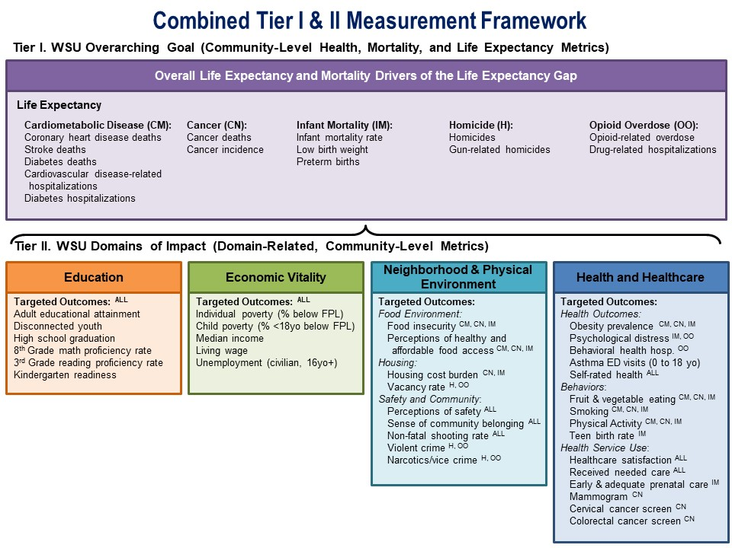
WSU Metrics Framework
In 2019, partner researchers and the Chicago Department of Public Health conducted an analysis of the life expectancy gap and identified the primary drivers.
This group also created a framework of social determinants of health that could likely influence the drivers.
Our impact areas are the following: Education, Economic Vitality, Neighborhood and Physical Environment, and Health and Healthcare.
Notes:
Crosscutting:
WSU conducted various listening tours with community members in 2017. We tried to ensure that our quantitative metrics complemented this qualitative feedback from community members themselves, which has also been a key element of the exiting initiatives that WSU is pursuing currently.
“Is this metric applicable across WSU Community Areas? Is it more pertinent in some communities versus others?”
Changeability:
“How feasible is it for WSU and its partners to solve the problem/improve the metric by 2030?”
We tried to be mindful of the areas where WSU is already pursuing initiatives and change. The group tried to remain mindful of those things that WSU could actually change. For example, we know that clean air is incredibly important to the health and the physical environment. But, based on listening tours and current momentum in WSU, we did not see this as an area of direct WSU focus. Therefore, you do not see metrics related to clean air here. That is not to say that WSU would not support local efforts related to environmental justice – they may just not be directly driven by WSU.
Impact:
“If we move this metric, will it impact the pathway to other outcomes and impact measures we have further downstream? If we move this metric, how great of an effect would it have?”
Repeatability:
We additionally had to consider metrics that are already being collected with the intent to continue to collect them at the community and population levels.
Sensitivity:
“Will changes in this metric truly reflect that there are underlying community changes taking place? Is this truly measuring what we want it to?”
Lastly, we tried to stick with metrics that are movable and change over time – and that are sensitive to interventions.
Understandability:
“Is this metric easily understood and broadly acceptable to stakeholders and community members themselves?”

Slide 6
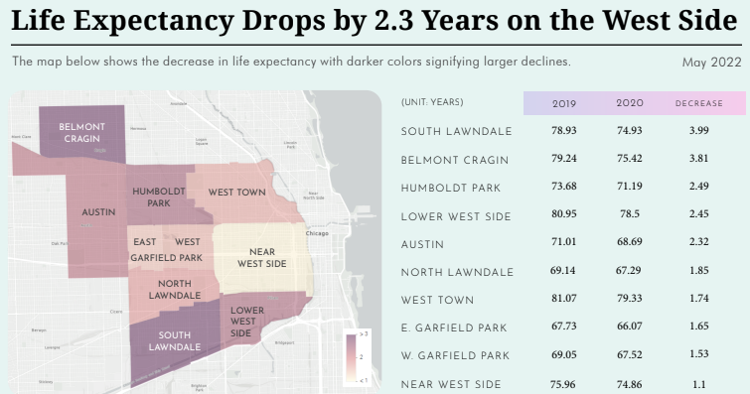
COVID Uncovered Disparities in Latino Communities
In life expectancy data from 2019 to 2020
Every neighborhood experienced a decrease
Declines were worse in predominantly Latino neighborhoods
The gap itself between the West Side and the loop did not change (14 years)
Preliminary data on 2021 and 2022 life expectancy also showed declines.
The COVID-19 pandemic serves as a stark proof point of the devastation health disparities can cause. Nationally, Black Americans were three times more likely to die from COVID-19 compared to whites in the U.S. as of November 2020.
.

Slide 7
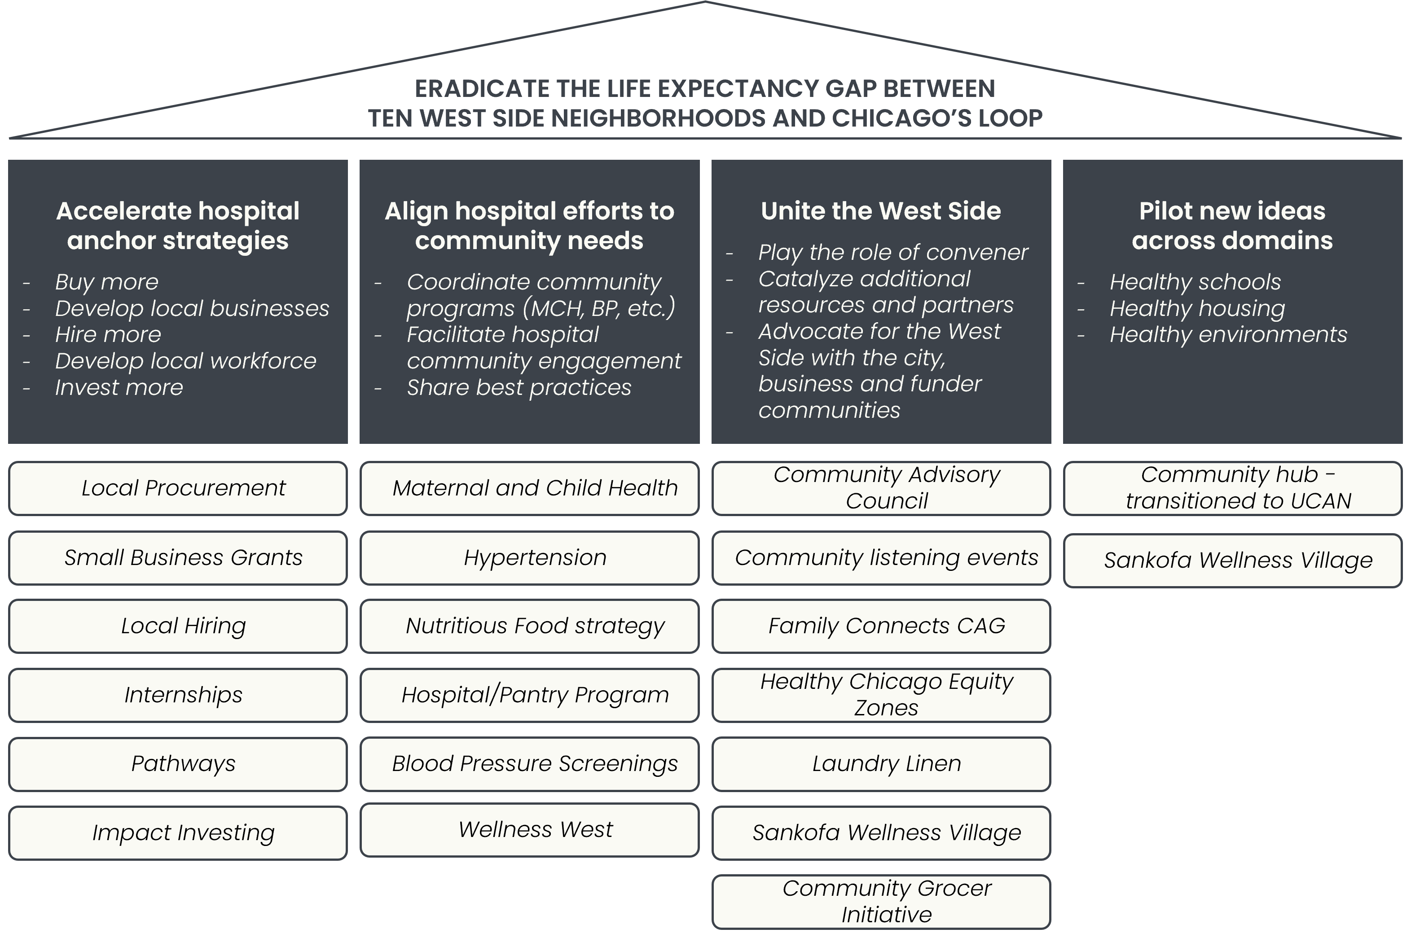
WSU Strategies & Programs
AMBITION
What we’ll achieve
STRATEGIES
What we’ll do
CURRENT INITIATIVES
How existing work fits in

Slide 8
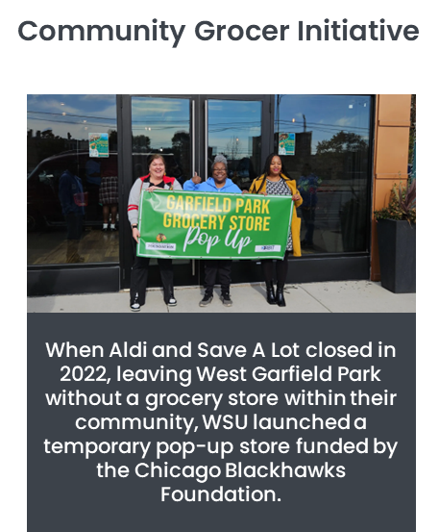

Impact to Date across domains
Galvanized Resources in a time of crisis
Created a national model for health equity metrics and evaluation
In Chicago, Black Americans accounted for 70 of the first 100 recorded COVID deaths, despite making up only 30% of the city’s population.
Former Mayor Lori Lightfood called on West Side United to administer $5 million from the Oprah Winfrey Charitable Foundation for the Live Healthy Chicago initiative, a unique collaborative spanning 20 majority Black and Brown target communities on Chicago’s West and South Sides.
.

Slide 9
WSU Anchor Mission Accomplishments
2018-2023
IMPACT INVESTING
$16.3M
CUMULATIVE
INVESTMENTS SINCE 2017
635
LOANS
LOCAL PROCUREMENT
LOCAL HIRING
$220M+
LOCAL SPEND
0.70%
% AVG WS SPEND
6662
WS HIRES
14.2%
% WS HIRES
EMPLOYEE PROFESSIONAL PATHWAYS
SMALL BUSINESS GRANT POOL
278
PARTICIPANTS
4
TYPES OF PATHWAYS PROGRAMS
$1.9M+
DISTRIBUTED IN GRANTS
95%
GRANTEES ARE FROM UNDER REPRESENTED DEMOGRAPHICS
Notes:
Eve
Accomplishments: WSU Anchor Mission activities mobilize hospitals’ economic resources to improve opportunities on the West Side. We have a local hiring and workforce development program, a small business accelerator, which includes a $10k grant, a local procurement initiative, and a social impact investing group.
GAP:
Our long term goal is to decrease unemployment and increase median income across the West Side and we still have a long way to go. We know these initiatives need to grow and to expand beyond the hospitals for greater economic impact.
ASK:
Support us by spreading the word about our events when we have hiring fairs and small business events or even partner together for these events. If you are connected to other workforce development or business development initiatives, let us know or make an introduction. Also, we ask you to support legislation that facilitates business growth for West Side businesses, like the Small Business Truth in Lending Act, which I know many of you are already sponsors of.

Slide 10
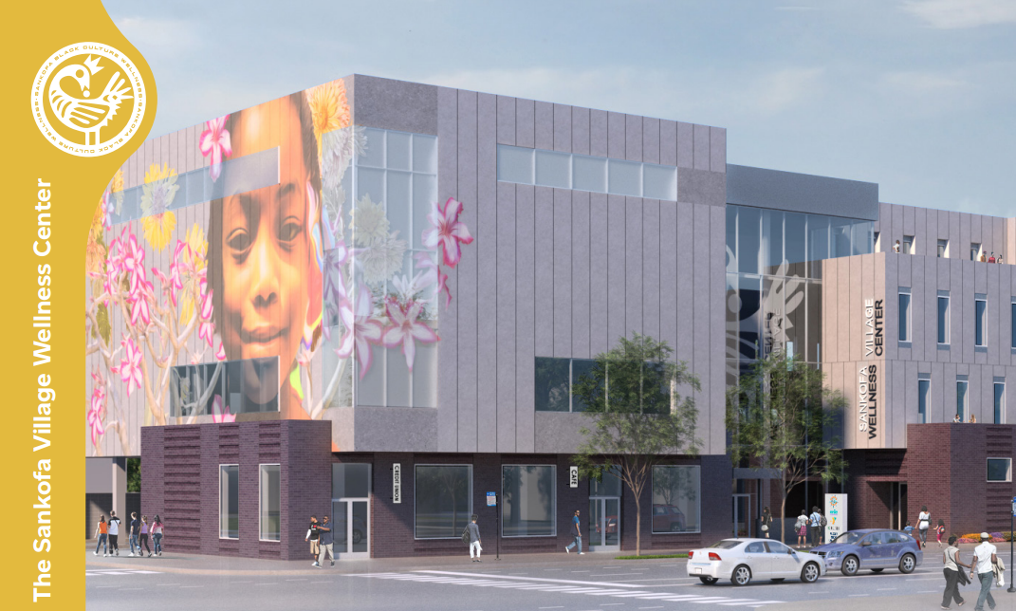
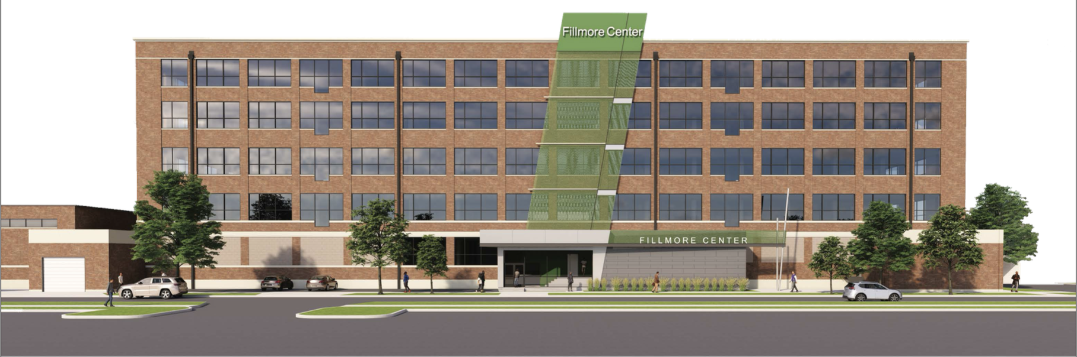
Catalytic Investments.
Sankofa Wellness Village
Fillmore Center & Linen Service
$50M+
DEVELOPMENT
Wellness Center, Small Business Incubator, Arts Center, And Community Grocer
Community Asset & Ownership
Future Office For WSU
In partnership with Steans Family Foundation
$40M Anchor economic hub in North Lawndale with significant quality jobs
Creating a laundry facility to support the Chicago healthcare system
Liaising with prospective hospital clients, Rush confirmed
Notes:
Eve
Accomplishment(s): WSU has been a convener, setting the tables and bringing together the right partners for several large-scale Catalytic Investments, including Sankofa Wellness Village in West Garfield Park and the Fillmore Center & Linen Service in North Lawndale. Both sites serve as small business incubators, will create jobs and employ WS residents, and provide resources and assets to WS residents. The Fillmore Center and Linen Service is having its ribbon cutting on June 26th! And Sankofa Wellness Village will open in 2025.
GAP: These are examples of large-scale investments in just two neighborhoods. All of our neighborhoods need the type of infrastructure and assets like these. There has been 60 years of disinvestment on the West Side and countering will take so much more.
ASK:
Share the opening of both sites to your communities and networks, promote North Lawndale and West Garfield Park residents to utilize services and assets in both sites, and strengthen procurement and workforce partnerships with sustained support as roll off takes place. We’d like to work together when there are opportunities for future investments. Particularly, to build on our skill set of engaging community members and bringing their vision to partners and funders. We will also send you the invitation to the ribbon cutting on the 26th.

Slide 11
Resources
The following materials will help acquaint you with WSU’s journey advancing health and economic vitality - and illustrate the impacts of WSU’s strategy to date:
2023 WSU Community Impact Report: Highlights WSU’s community impact and program updates
Article: The Anchor Strategy– A Place-Based Business Approach for Health Equity: Discusses Rush University Medical Center’s journey implementing the anchor strategy, its contributions to the development of West Side United, and initial community impacts of West Side United
WSU-AMA Partnership: Highlights AMA’s partnership with WSU and the value of social impact investing
MIT Sloan School of Management Review Article: “How Corporate Clout Helps Communities Thrive”
WSU Impact Investing Data: Overview of WSU’s impact investing outcomes through the end of 2023

