Slide 1

Equitable Community Development in New Orleans
A Vietnamese community’s journey

Slide 2
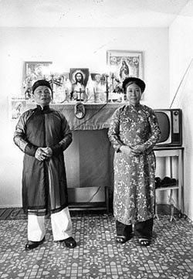
History of Vietnamese Americans in Louisiana
Photo by Mark Sindler, 1978

Slide 3
Vietnamese Migration
1954: North Vietnamese fled to South Vietnam; many were Catholic
End of Vietnam War on April 30, 1975
1975-1995: Vietnamese boat people
Approximately 800,000 fled by sea; between 200,000 - 400,000 died or have gone missing
Malaysia, Philippines, Indonesia
Resettlement in Hong Kong, USA, Switzerland, France, and more

Slide 4
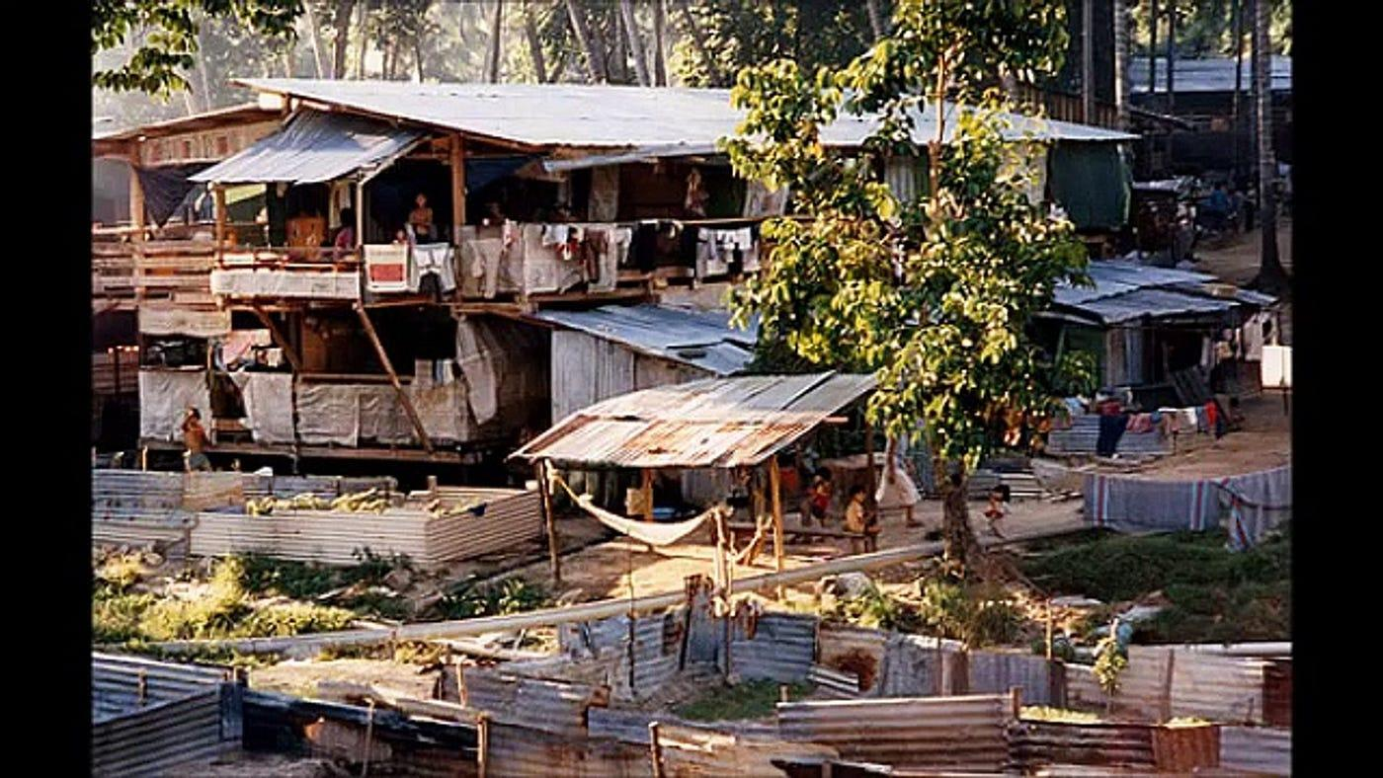

Slide 5
Vietnamese in New Orleans
Vietnamese in New Orleans
Archbishop Hannan and Fort Chaffee, Arkansas
100 families to New Orleans East and 100 families to Algiers
By 1979, 10,000 Vietnamese refugees settled in New Orleans
As of 2024, approximately 30,000 Vietnamese Americans in Greater New Orleans area

Slide 6
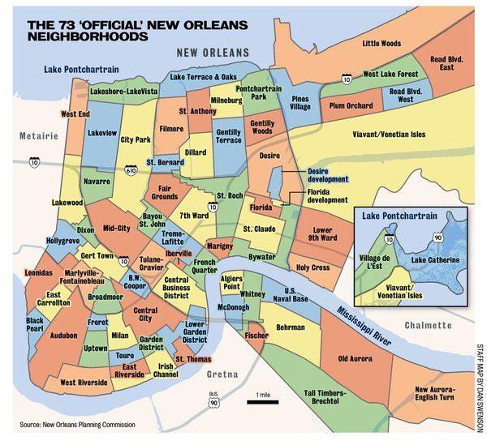
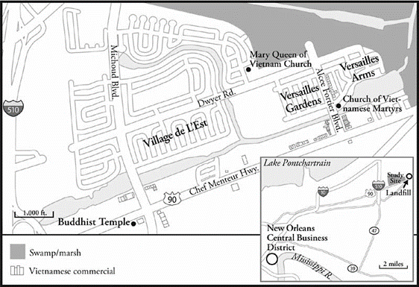

Slide 7
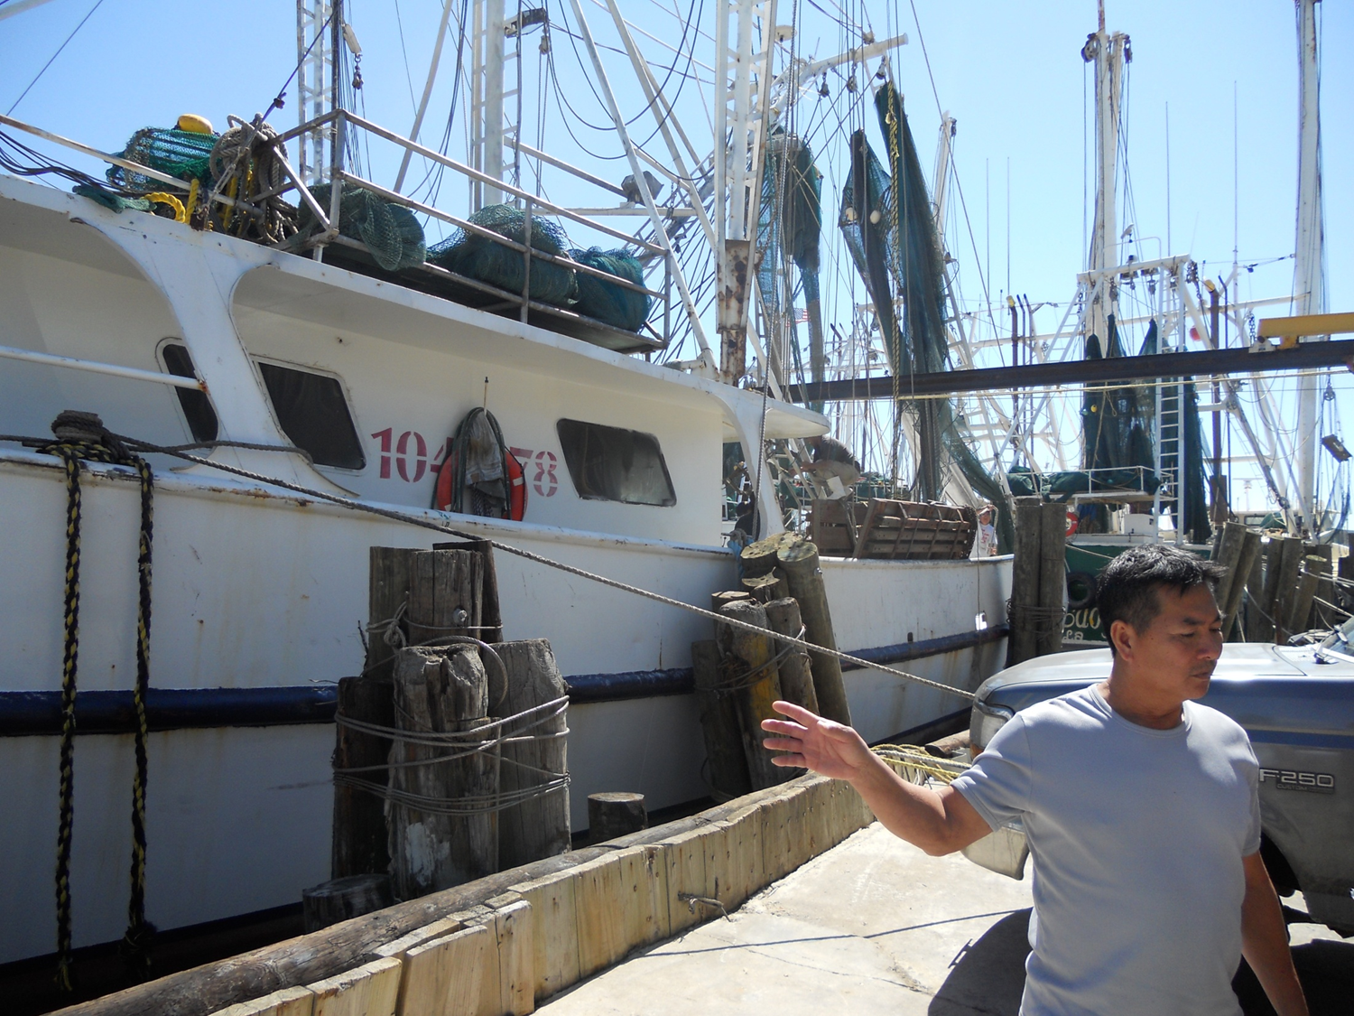
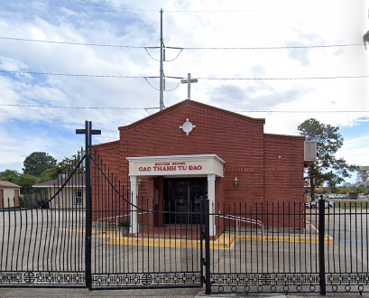
Why New Orleans?
Tropical climate
Thriving coastal fishing industry
Deep Catholic influence

Slide 8
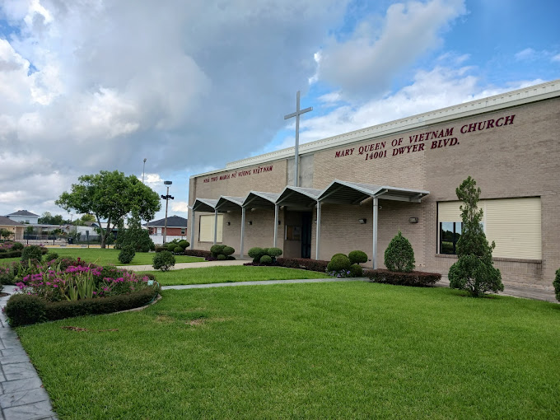
Mary Queen of Vietnam Parish was established in 1983, the first in the nation for a Vietnamese congregation.
Church completed in 1986.

Slide 9
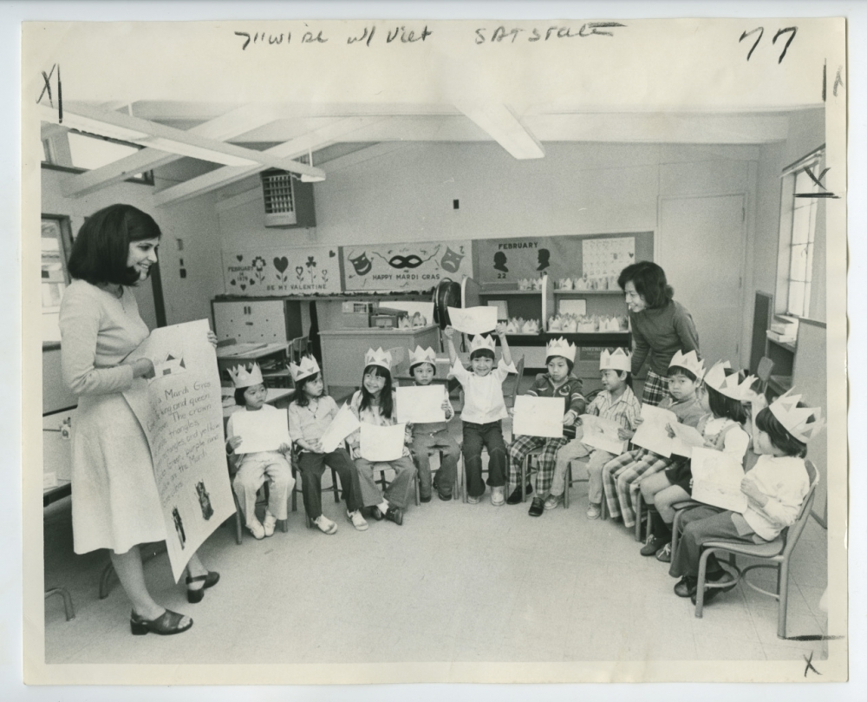

Slide 10
Climate Justice and Community Development Efforts

Slide 11
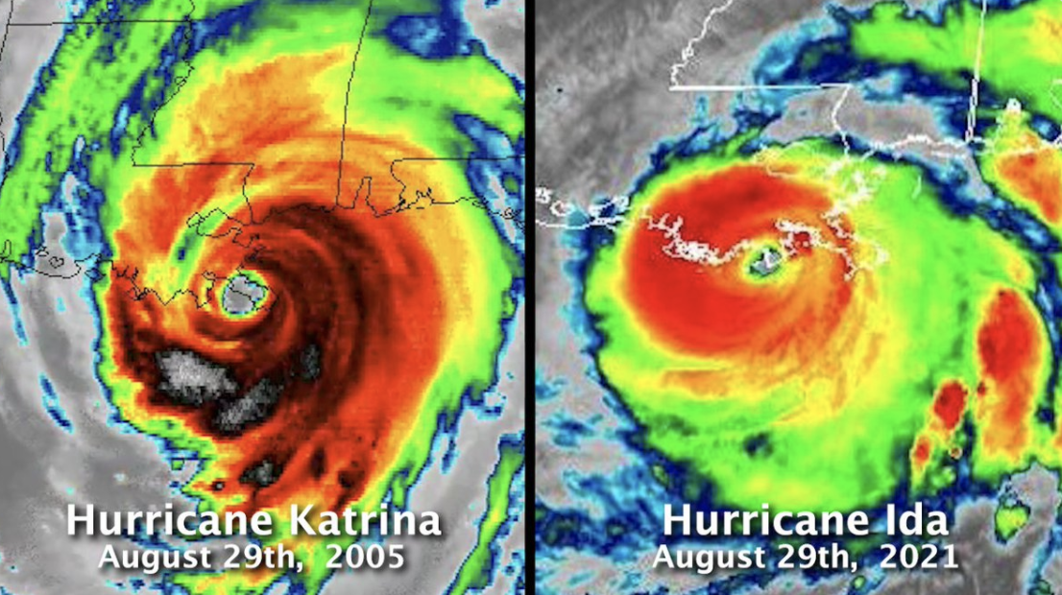
Notes:
This is 2021. This is where WE are AT.

Slide 12
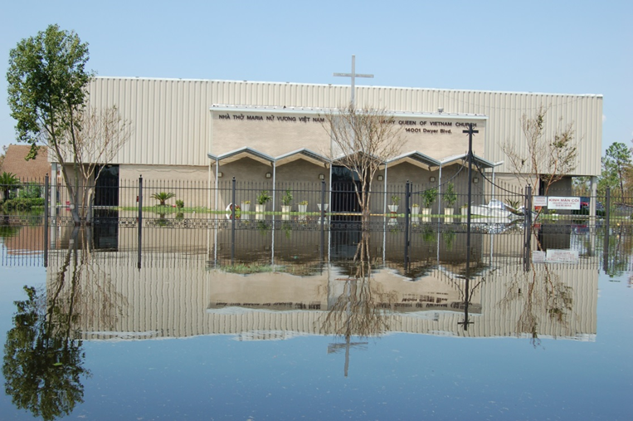
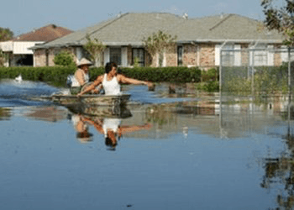
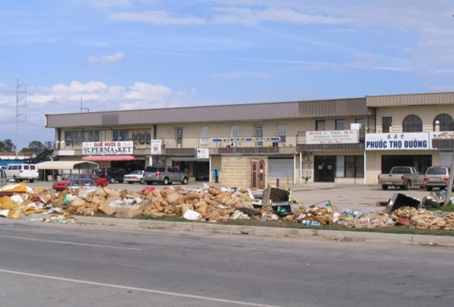

Slide 13
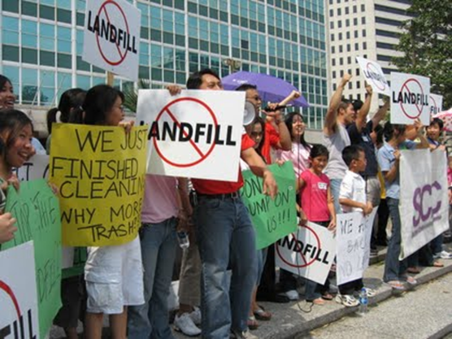

Slide 14

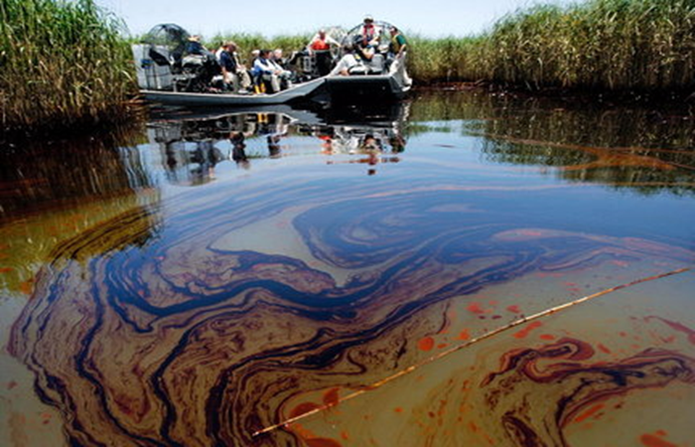
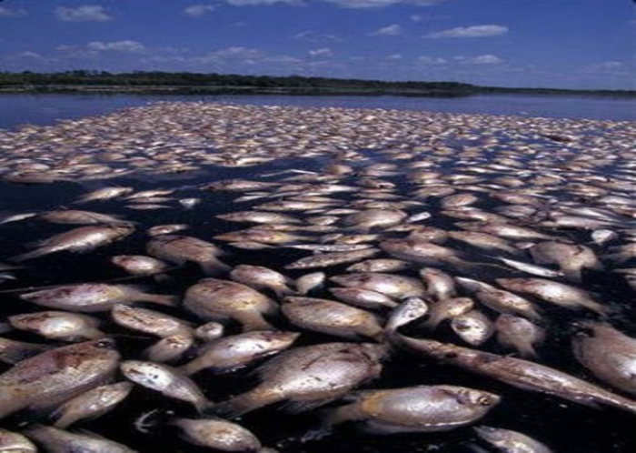
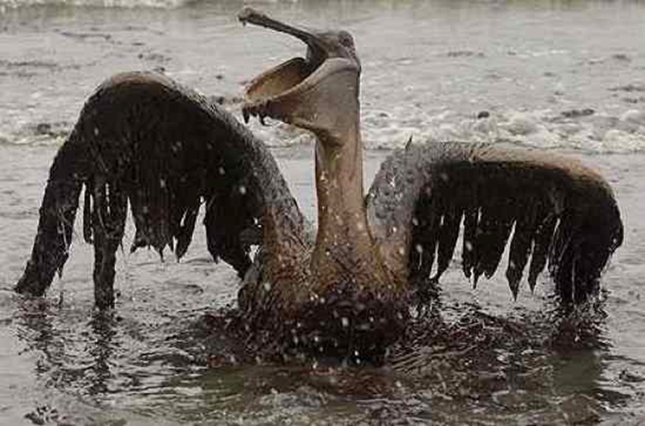

Slide 15

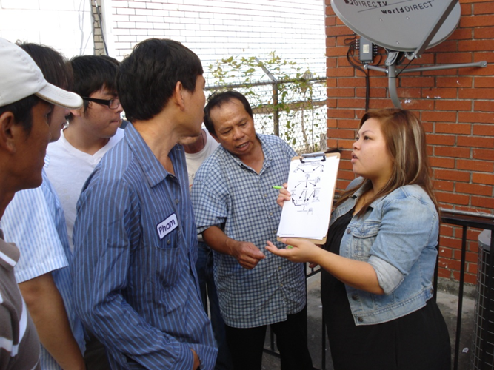
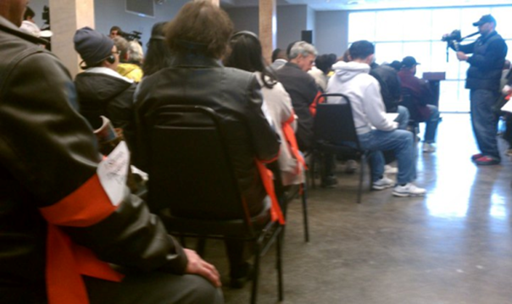
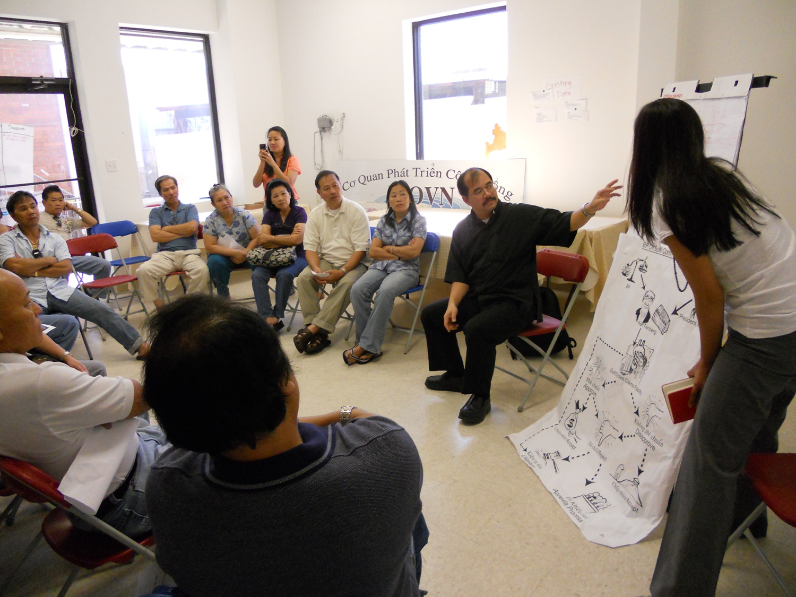

Slide 16
Continued Challenges
Redevelopment efforts are scarce post-Hurricane Katrina
Lack of disinvestment
Fishing industry heavily impacted by imports
Stronger storms due to climate change
Failing infrastructure

Slide 17
Overview of Organization
Sông Community Development Corporation was created in 2021 to further community development efforts
Mission is rooted in the Vietnamese American experience and pursues the full liberation of BIPOC communities across all intersectional identities to improve their quality of life
Work spans environment, health, climate, food, housing, workforce as well as the culture and arts

Slide 18
Current Priorities
Equitable Community Development to build vibrant communities with a focus on revitalizing disinvested communities; VEGGI Farmers Coop; Hung Dao land trust; affordable senior housing; green infrastructure
Community Programs and Services to connect ecosystems to streamline immediate assistance and provide ongoing services to vulnerable families such as disaster preparedness and response; youth mental health; ongoing community dialogue/conversations
Policy and Advocacy to identify critical issues that resonate with our community and allies that are informed by learnings from our services and programs as well as community-driven planning; food justice supply chains; environmental and climate justice/resilience; coastal advocacy

Slide 19
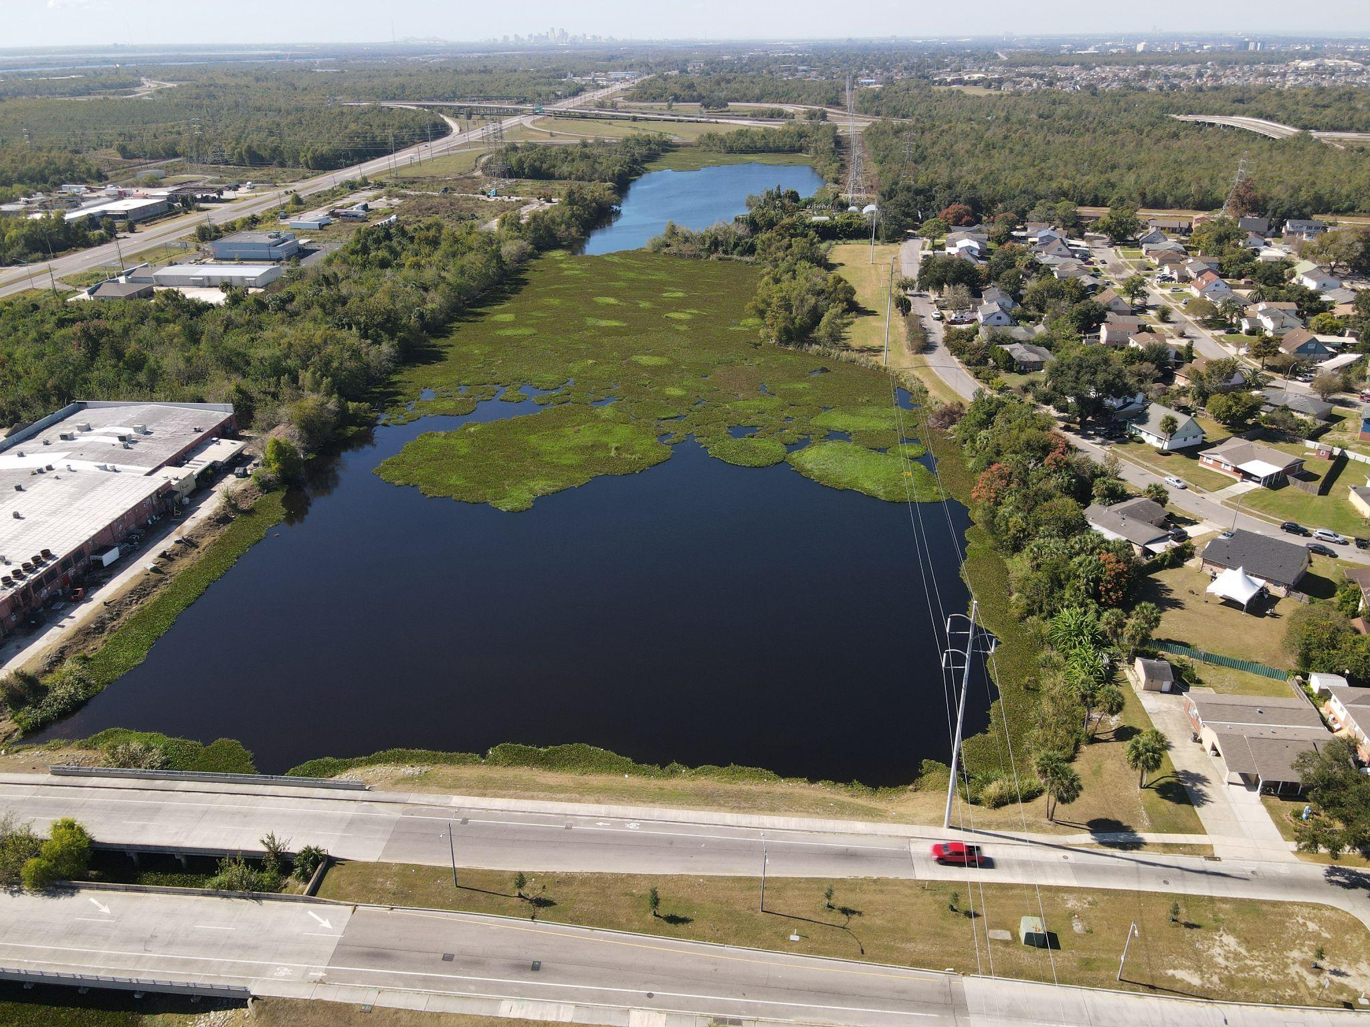
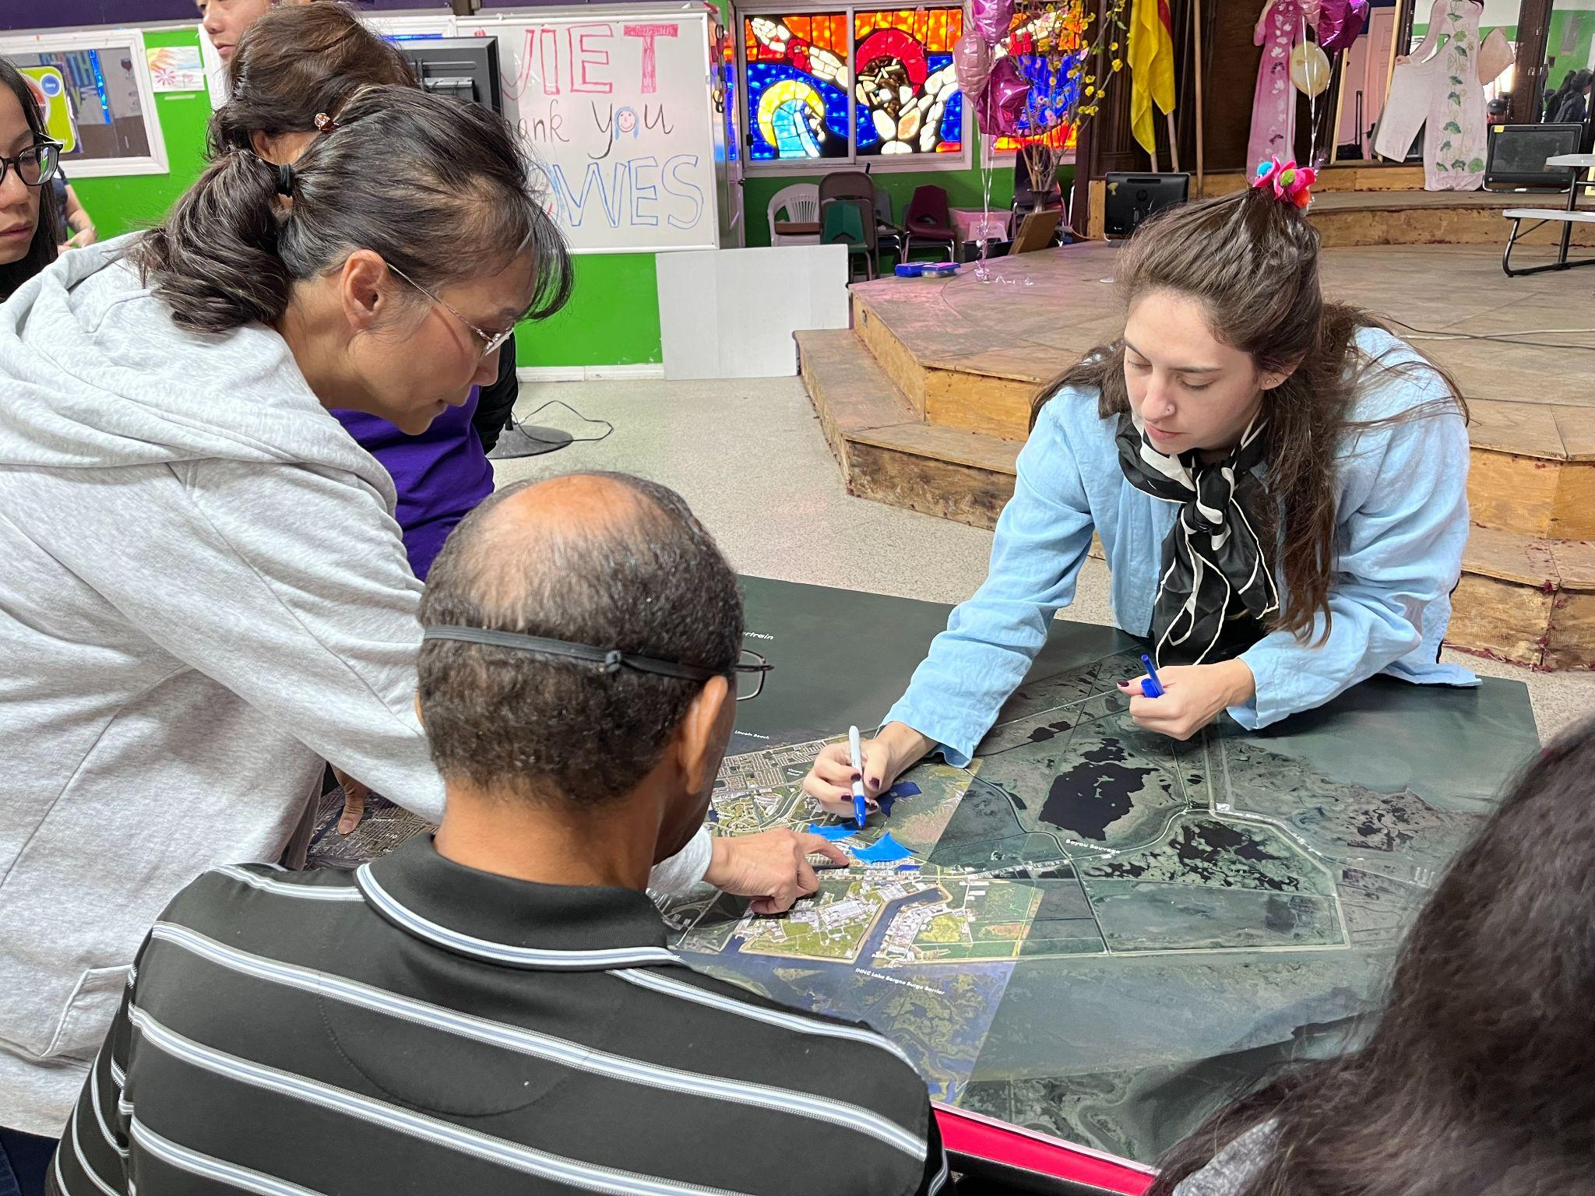
Program Highlight: Waters By-YOU
A collaborative effort to develop community-based solutions for issues such as flooding and subsidence, pollution, environmental health, access to water, and quality of life in New Orleans East
Goals
Create a community water plan for New Orleans East.
Reimagine communities’ relationship to water.
Design and implement green infrastructure.

Slide 20
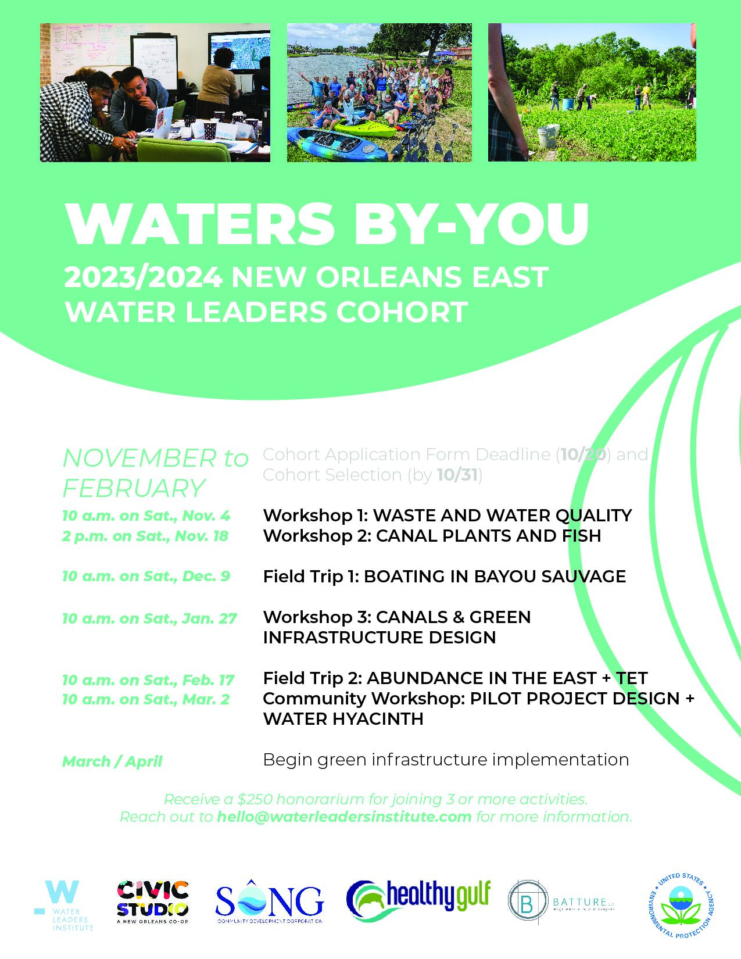
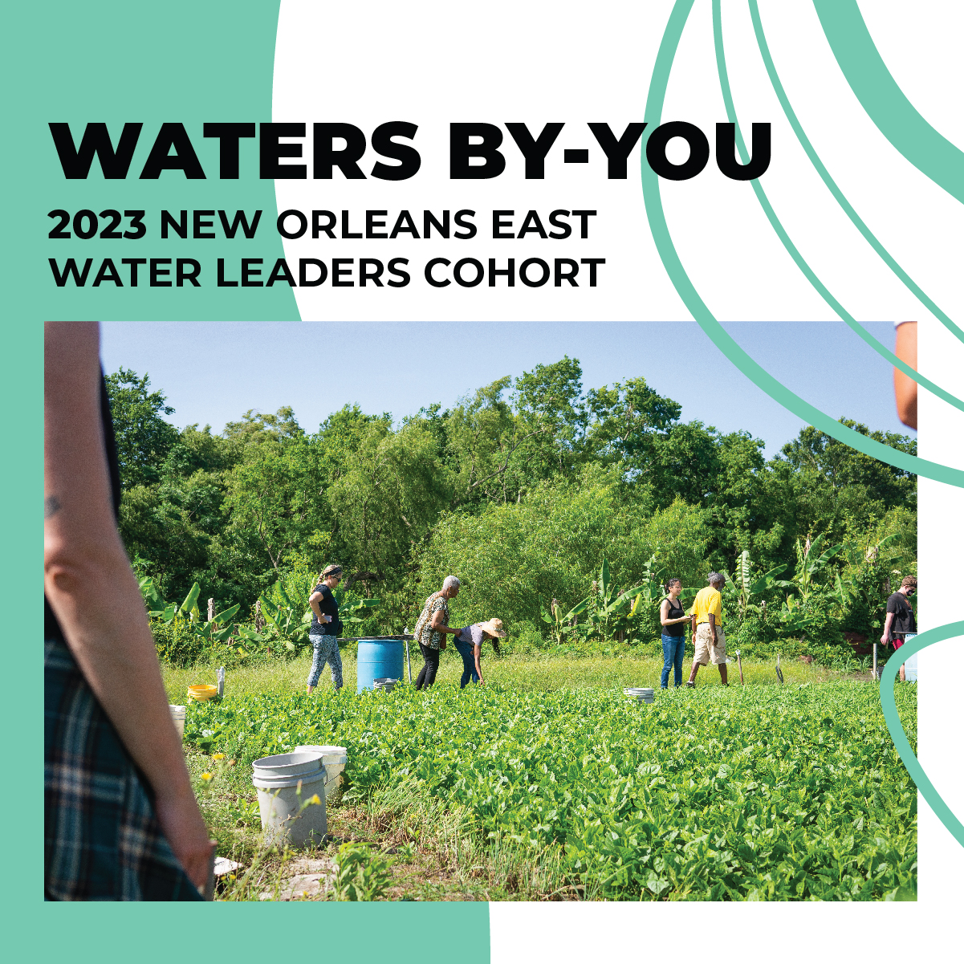

Slide 21
2023-2024 Water Leaders Cohort
6 month training opportunity for New Orleans East residents as part of the Waters By-YOU program
Site visits and hands-on workshops to build shared language, skills, and knowledge around the work of reimagining relationship to water (build community knowledge and capacity)
Cohort members receive a $250 honorarium if they take part in at least 3 of the cohort activities.
15- 20 participants with representation from across ethnic backgrounds, ages, gender and sexuality

Slide 22
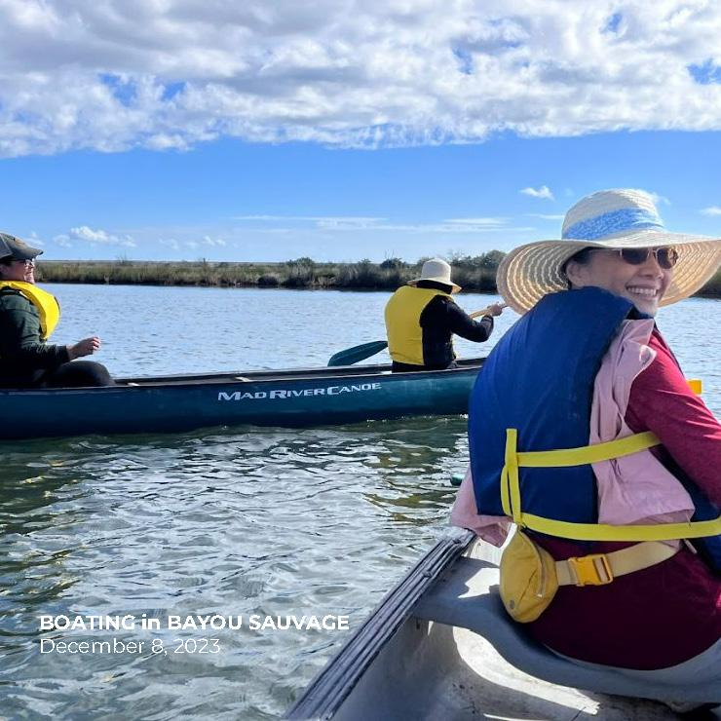
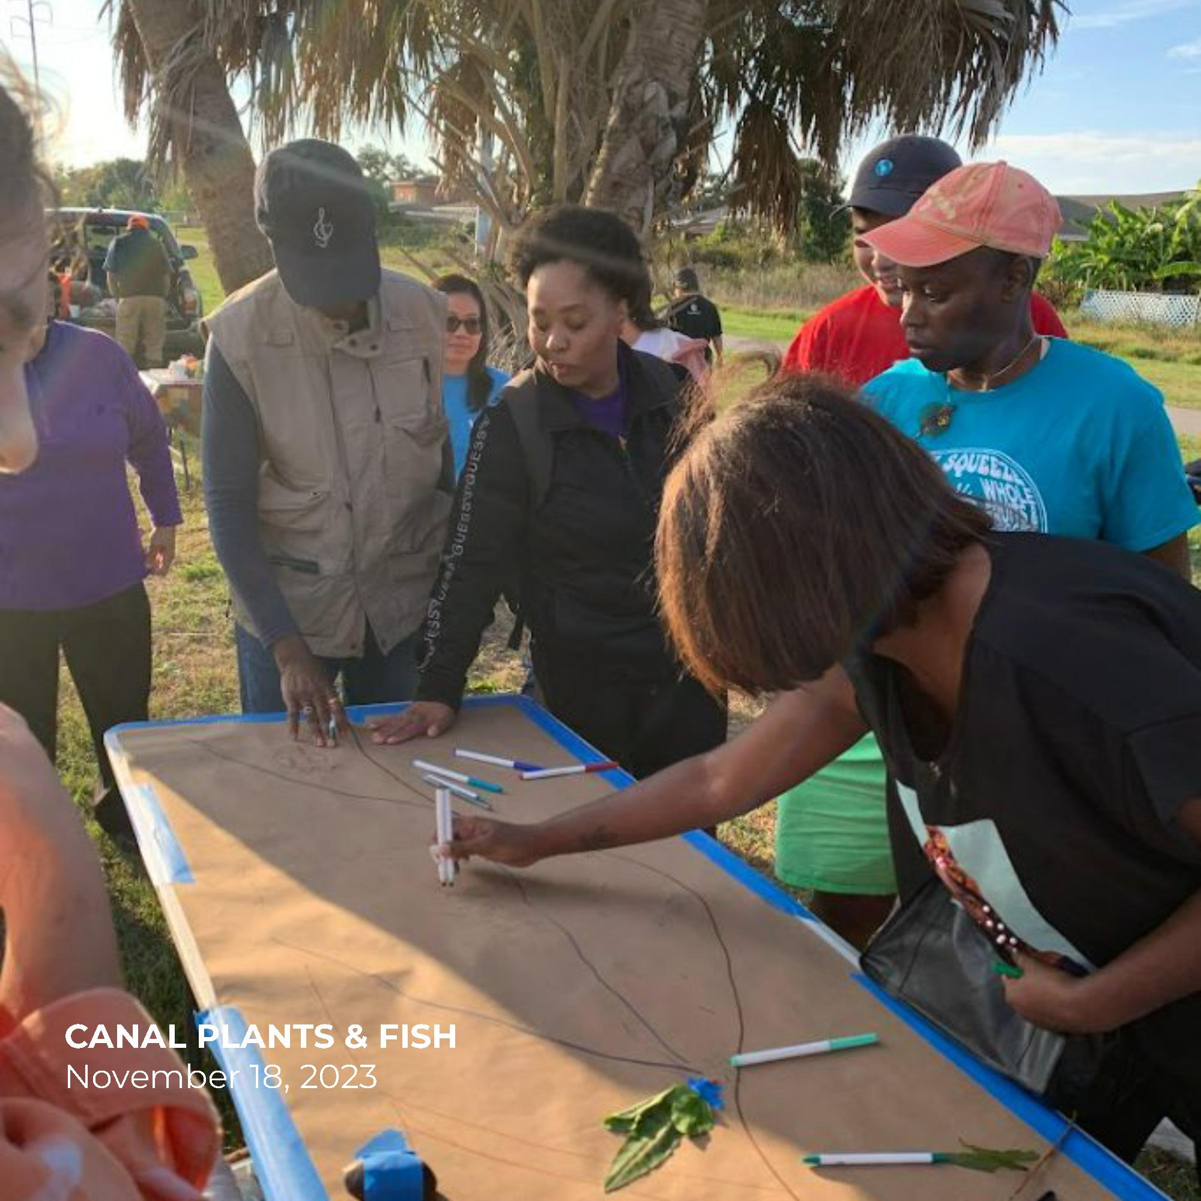

Slide 23
Outreach and Communications Strategy
Work with community leaders and organizations to spread knowledge about program
Ensure language access is a priority
Lay groundwork for workshops by emphasizing personal connections to issues:
  Story circles and field trips
  Work on reimagining on people’s relationship to water
Participant incentives
Multiple outreach channels: email; social media from multiple partner organizations
Limited cohort space prioritized those who live in New Orleans East

Slide 24
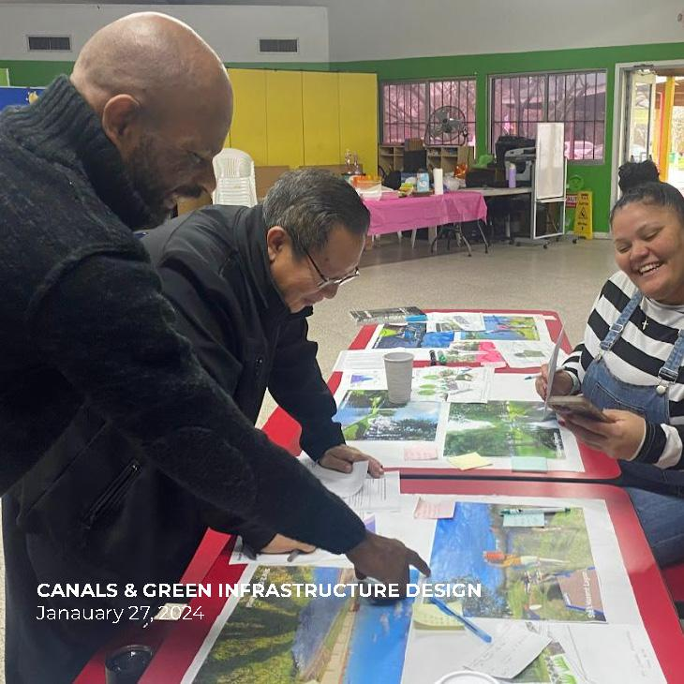
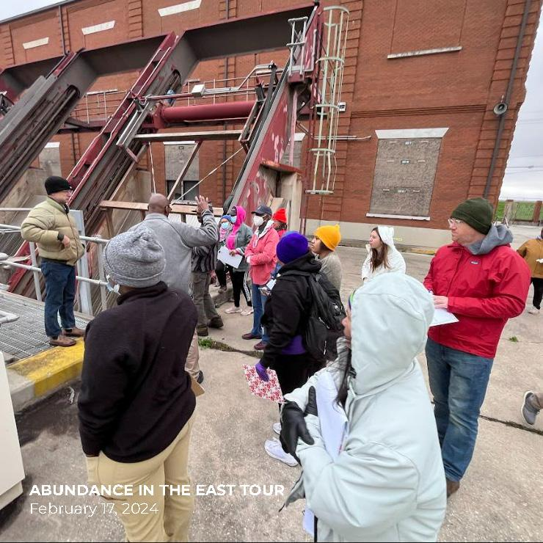

Slide 25
Next Steps/Future Opportunities
Implement a pilot green infrastructure project in New Orleans East
Specific ask to replicate Water Leaders Cohort in Algiers for the Resilient Algiers Project
Ongoing communication with cohort (added to Water Leaders Google Group, potential newsletter, exit surveys)
Furthering development of New Orleans East Water Plan

Slide 26
Lessons Learned in Environment and Climate Work
Importance of community-driven processes
Increase capacity of residents for engagement and buy-in
Pay them as what you’d pay consultants/experts
Emphasize personal connections to issues
Need to move both community and decision-makers (especially those in legal, finance, etc.)

Slide 27
Recommendations
Connect with and amplify voices of minority communities that have historically been left out of mainstream media; minority communities are disproportionately affected by climate and environment issues
Investigate how public policies are failing minority communities in disaster preparedness, recovery, or mitigation efforts; example: subsidies to fossil fuel and lack of support for renewable energy
Be a champion in governance and hold decision makers accountable

