Slide 1
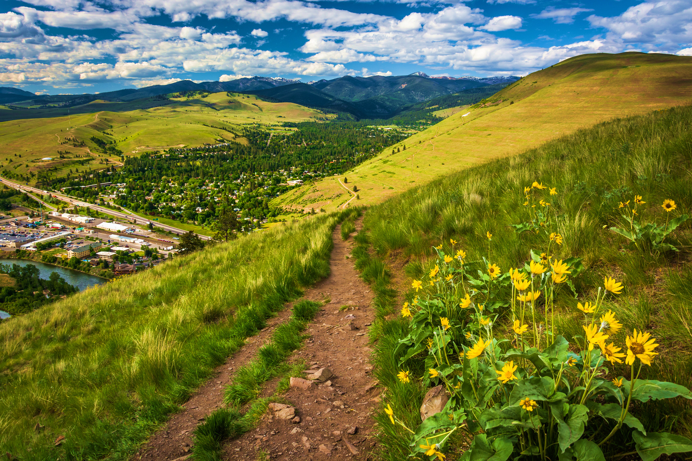

Partnering on Equitable Community Development:
How Collaboration Fuels Change
October 10, 2024

Slide 2

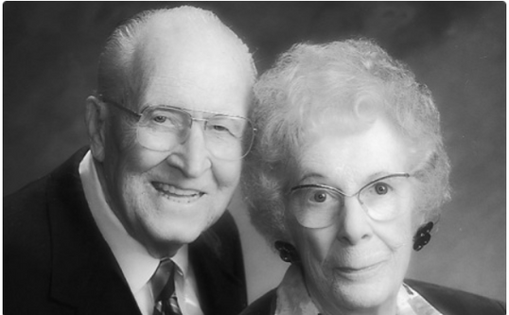
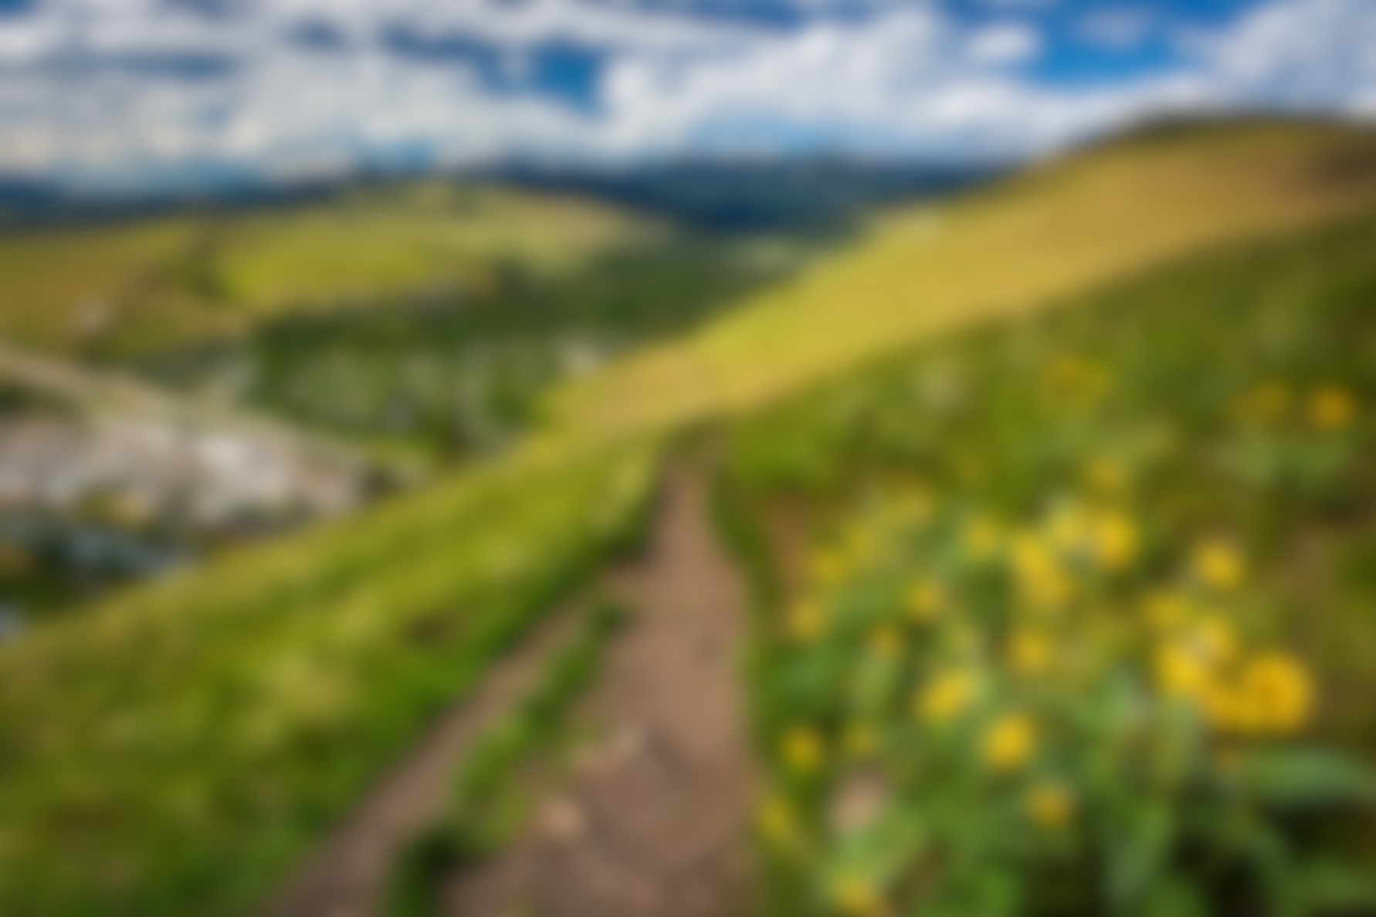
Founded 1931 by two local philanthropists
“Community Chest” model for approximately 80 years
Workplace campaigns: 95% of funding
1980s: began cultivating individual annual givers (mostly $500+)
Funds granted annually to 20+ unaligned nonprofits
very little collaboration
very little prevention focus

Slide 3

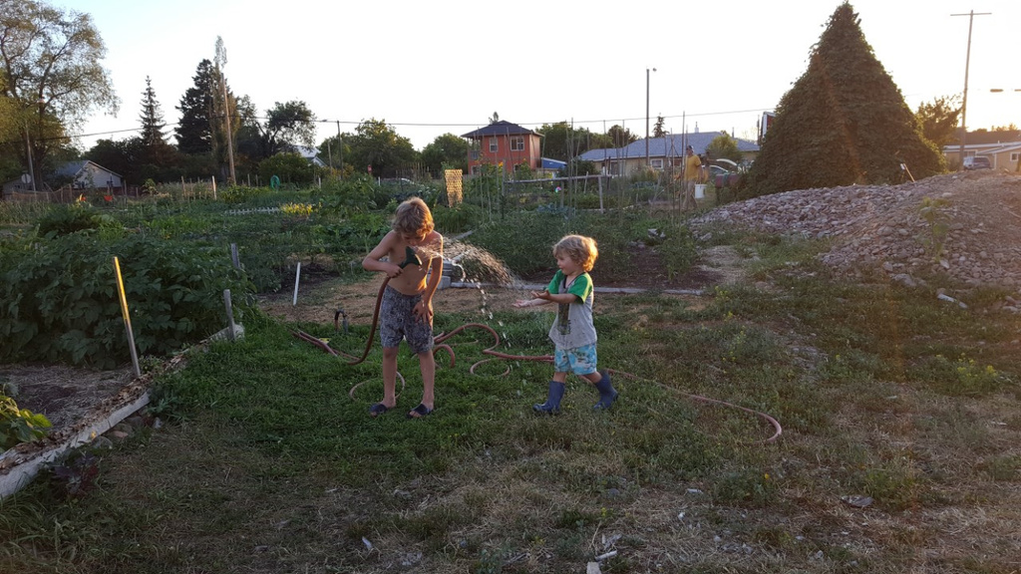
“Collective Impact”
Model introduced/implemented 2009-13
What is Collective Impact?
“A network of community members, organizations, and institutions who advance equity by learning together, aligning, and integrating their actions to achieve population and systems-level change.”
CollectiveImpactForum.org

Slide 4

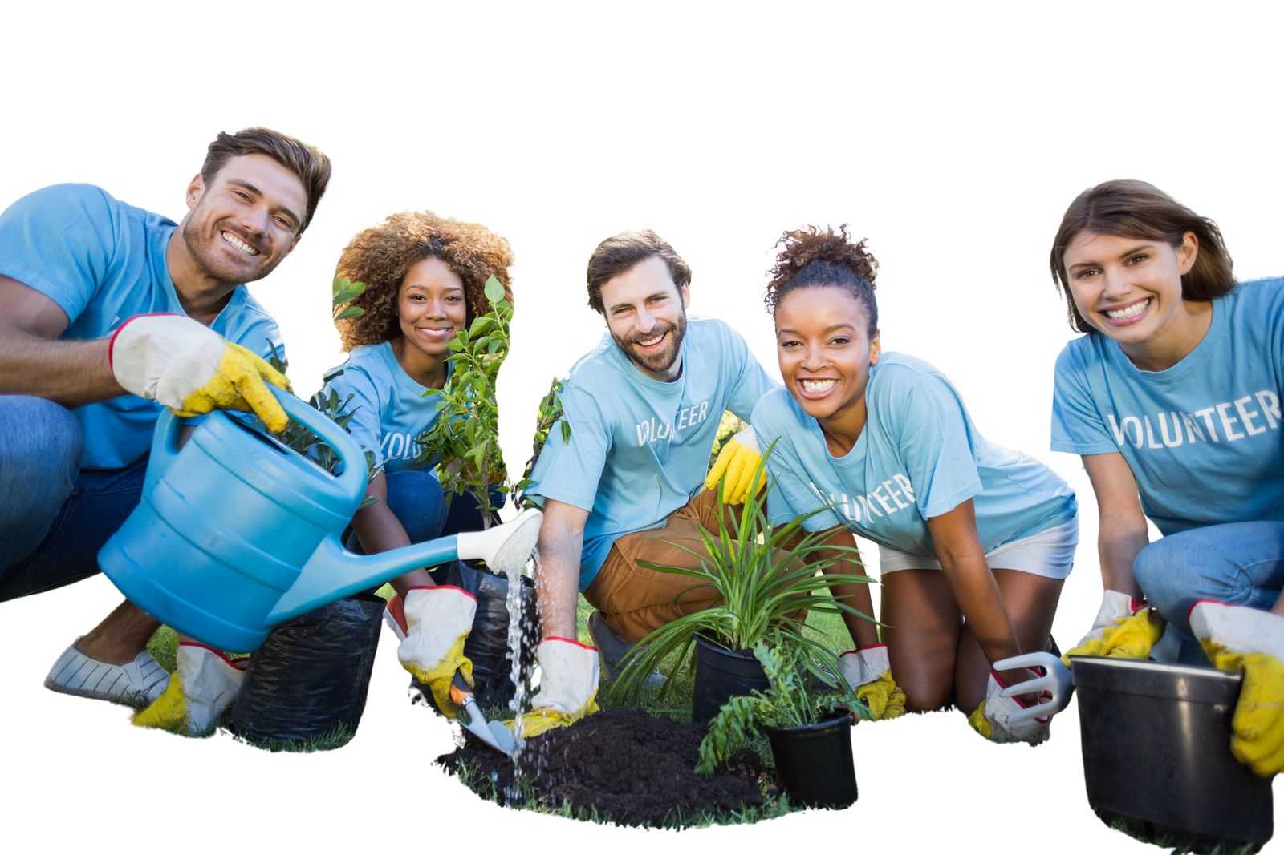
2012-Present
UWMC is the nexus of community-wide collaborations focused on education, financial stability, health, and community resilience. Our superpower is bringing people and resources together to solve complex problems.

Slide 5
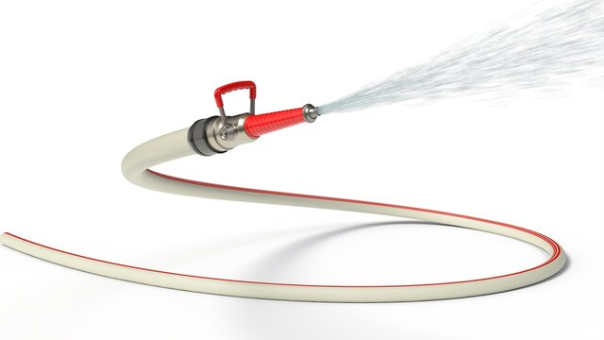
WHY did we make the shift?
Change wasn’t happening fast enough.
Increasing rates of suicide, homelessness, obesity, hunger, kids failing to graduate HS
We were using a garden hose to fight problems that required a fire hose.

Slide 6



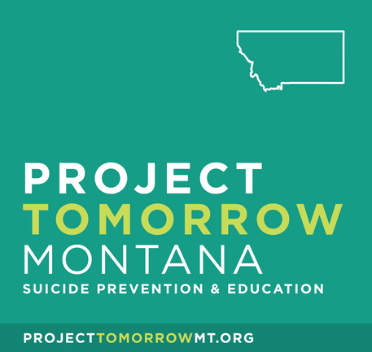
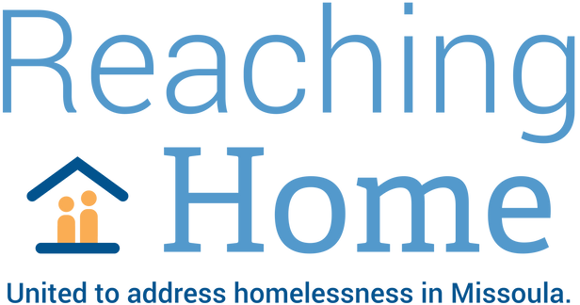






Slide 7

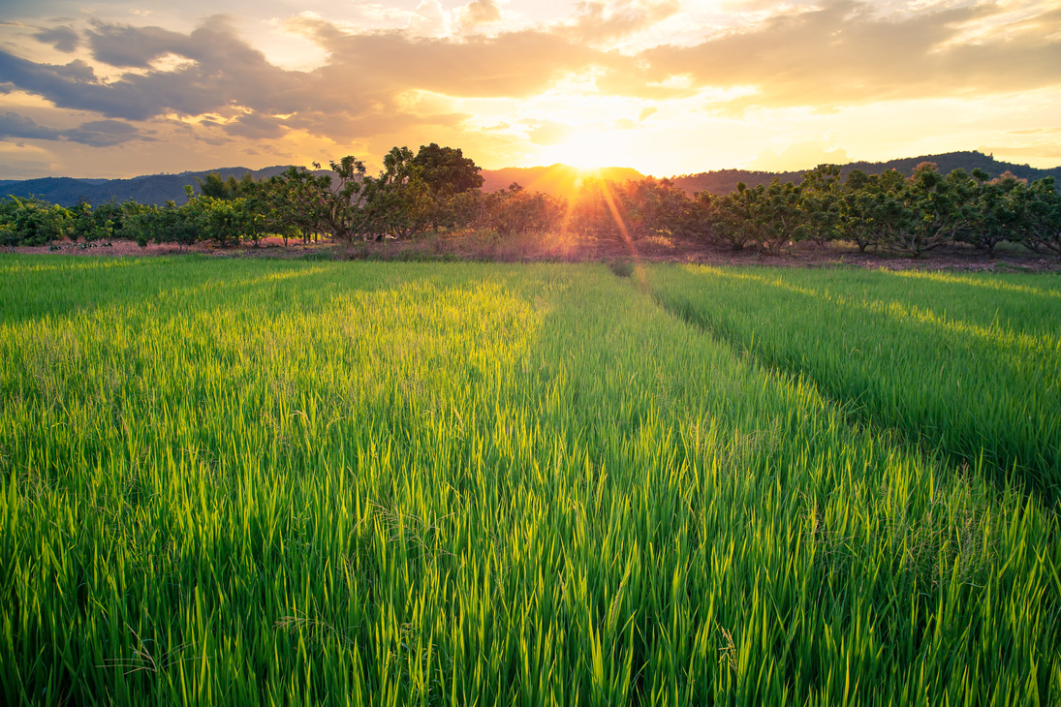
Goal: Make homelessness in Missoula rare, brief, one-time only
Temporary Safe Outdoor Space
Housing Solutions Fund: flexible $; fast response
Public and policy maker education, Point In Time count, continuous improvement training for providers; thought partner for providers/policymakers

Slide 8

Zero to Five Missoula County
Goal: Ensuring that young kids and families have the services/support they need so that kids arrive at kindergarten ready to succeed in school and life
Kindergarten Entry Assessment (year 6) Just 43% of Missoula kids enter kindergarten “fully ready.”
Early Learning Fellows (year 3)
Parent Leadership Training Institute (year 3)
Missoula Child Care Advantage – opened March 2024
Dolly Parton’s Imagination Library
Backpacks
Legislative advocacy

Slide 9
Project Tomorrow Montana
A partnership with Missoula Public Health
Goal: Reduce the number of suicides and suicide attempts by promoting and increasing awareness, prevention, intervention, and recovery
Training 1,000+ Missoulians
Distributing 1,000+ gun locks
Bringing 988 call center to Missoula
Normalizing and promoting help-seeking
From 2022-24 YTD, suicide in Missoula County declined steadily over three consecutive years.

Slide 10
A partnership with Missoula Public Health
Goal: Mobilize projects and partnerships that build healthy kids and residents of all ages - no matter where they live, work, play or learn
Midday Move: trained volunteers engage kids in active play on school playgrounds during lunchtime at three Title I elementary schools. Teacher satisfaction: 100%

Slide 11
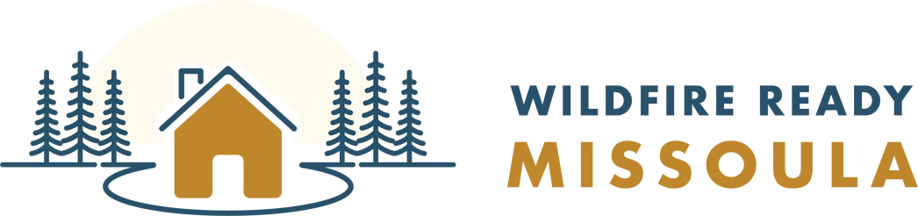
Wildfire Ready Missoula
A partnership with Missoula County
Goal: Reduce wildfire risk and catastrophic property losses on private land in the wildland-urban interface throughout Missoula County
Support establishment of Missoula County Wildfire Program
Increase awareness and outreach
Complete contracted work

Slide 12

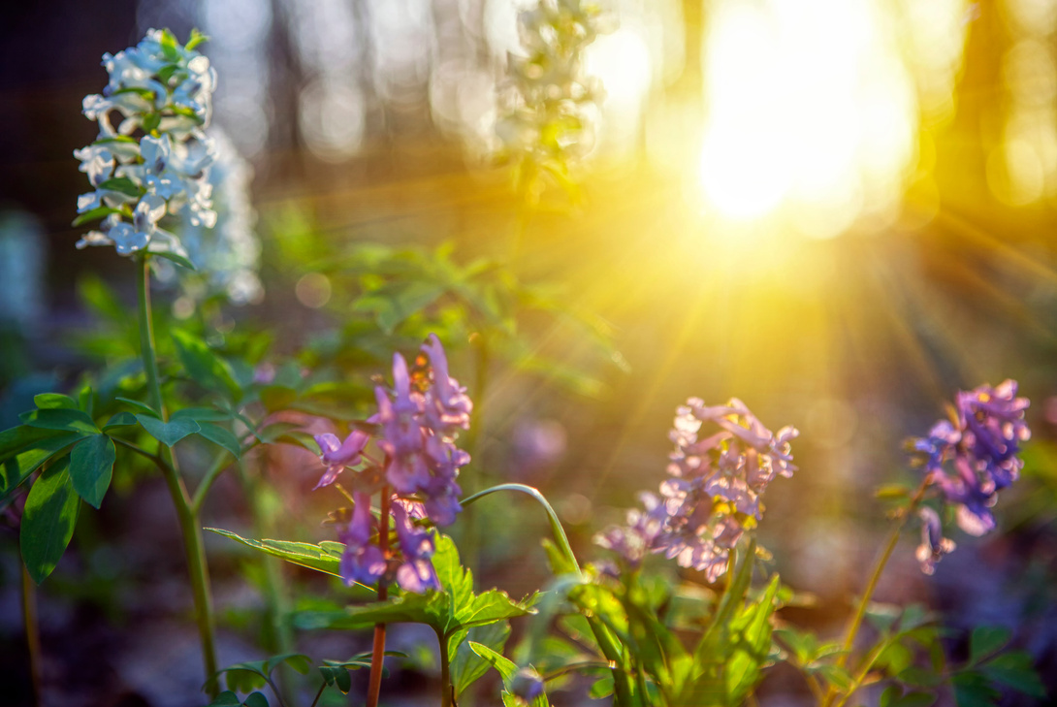

Missoula Nonprofit Center
100+ diverse members
Goal: Strengthening the local nonprofit sector through training, information-sharing, and networking

Slide 13
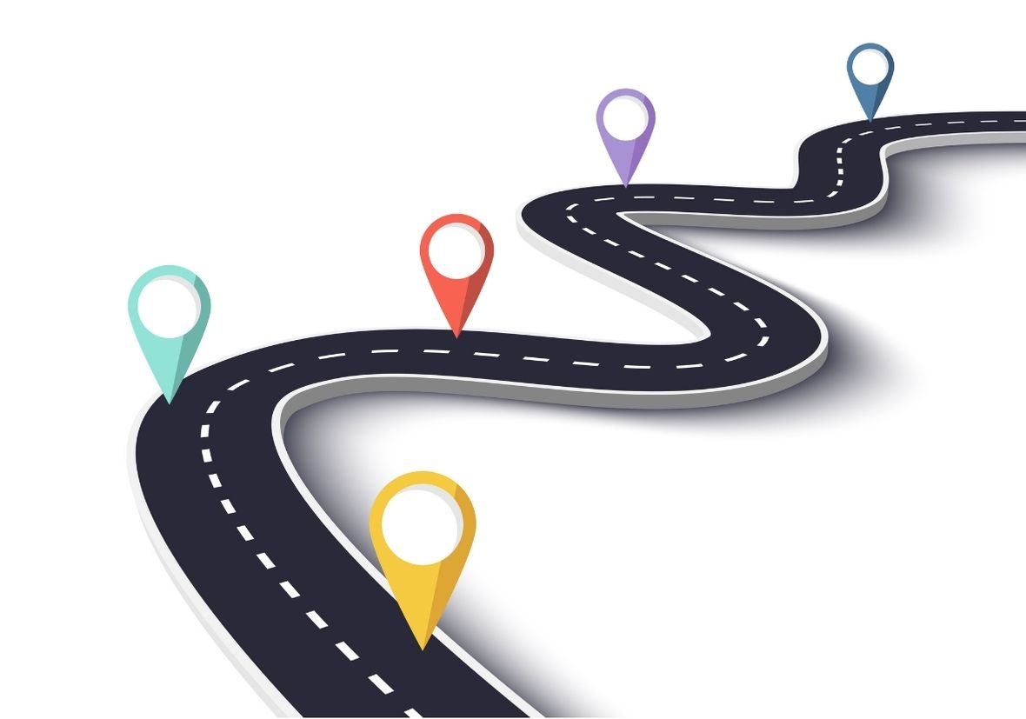

Creating a JEDI “roadmap” for Missoula
A community-wide Action Plan to guide Missoula in fostering a more resilient, welcoming, and supportive community for all.
identify/address inequities
provide resources and educational opportunities
define measures by which we will track progress

Slide 14

Thriving United Way framework
United Way Worldwide bran refresh Oct. 2024-`2027
We are an Early Adopter: launch late Oct. 2024 transition through Dec. 2025
Branded House instead of House of Brands

Slide 15
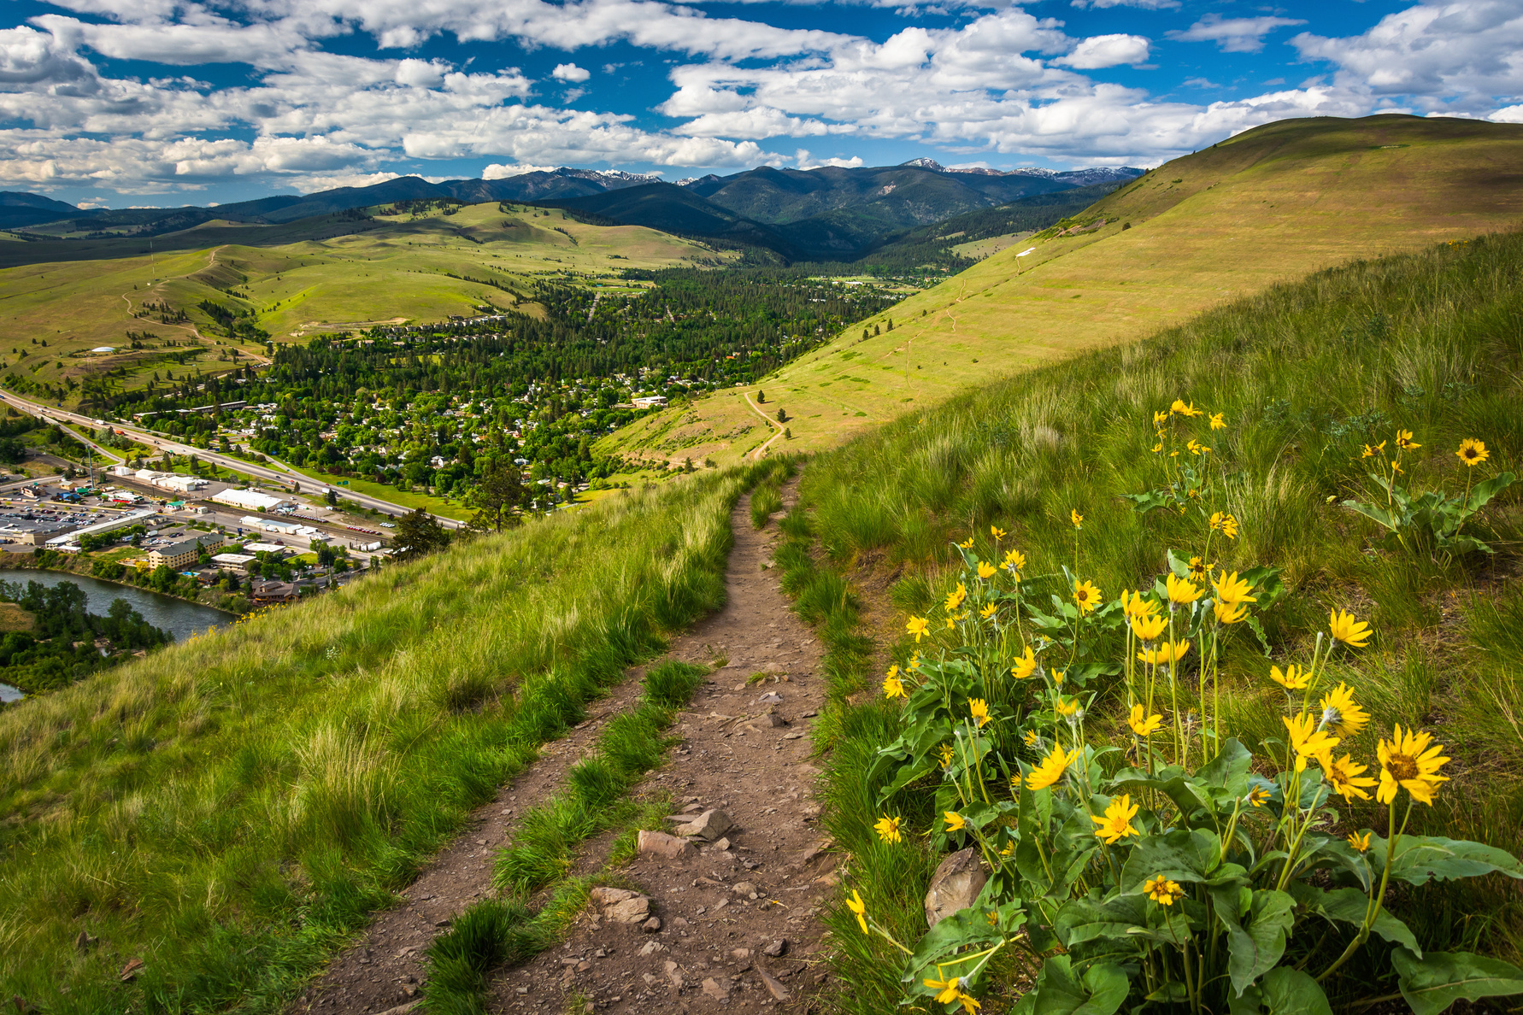
Challenges
Fundraising: Matching money with the mission
Public awareness and understanding – good, insightful reporting helps!

Slide 16
OPPORTUNITIES - STRENGTHS
Community trust
“Nimbleness”
Strong partnerships with the public sector
Thriving United Way
Engaged board of directors, staff, volunteers

Slide 17
Questions to consider asking after leaving Missoula
Are there collective impact efforts in your community working on housing, health, child care, equity? How are they doing?
How much land that is zoned for housing in your community is affordable by local residents?
What’s your sidewalk map look like? Your kindergarten- readiness stats?
Elderly people and youth aging out of foster care are the fastest-growing homeless demographics nationally -- what’s the story in your community?
Are health equity/Social Determinants of Health embedded in local development efforts?
Is YOUR United Way “thriving”?

Slide 18
What I wish local reporters would do and not do
DO
cover prevention efforts (not as “sexy”)
focus as much on solutions as on problems
listen to voices of those most affected by public policies
DON’T
talk about “the homeless”
focus on numbers served; DO focus on lives changed and conditions improved

Slide 19
Why is covering equitable development so critical?
When people have access to the news they need, they’re more likely to vote, access public resources, and advocate for change. [Equitable journalism seeks] to ensure all communities see their needs, concerns, and dreams reflected in a vibrant and diverse public square. Through this flow of information, people can use their power to build an inclusive multiracial democracy.
The Democracy Fund’s Equitable Journalism Project
www.democracyfund.org

Slide 20
t
Thank you!!!

