Slide 1


Missoula Child Care Advantage:
Building collaborative solutions to a collective problem

Slide 2
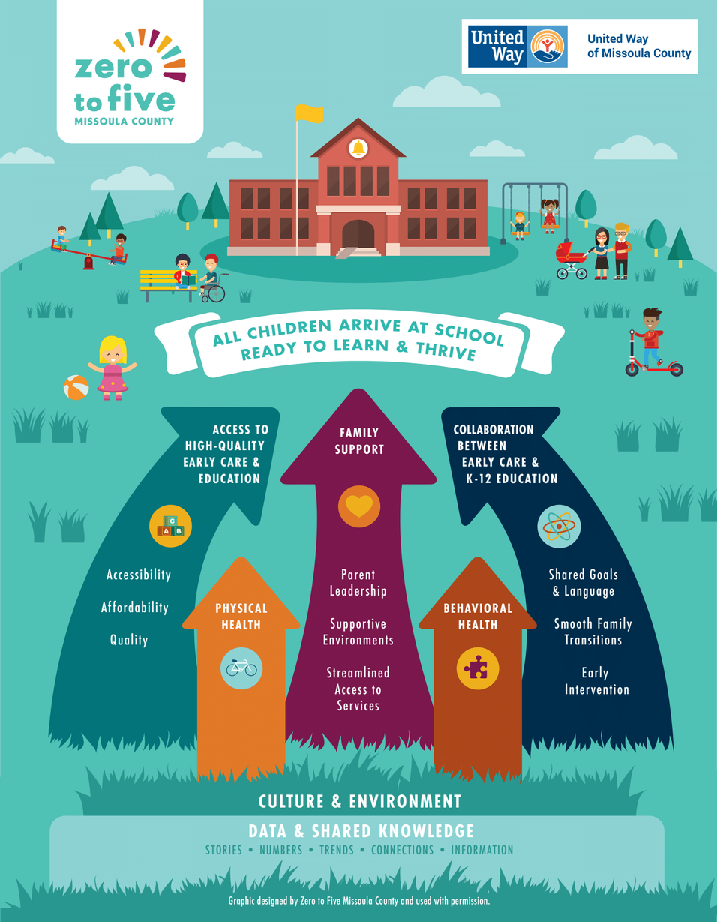
Zero to Five aims to ensure that all children in Missoula County are ready to thrive in school and beyond.
We do this by:
  Building a better-informed, better connected early childhood system
  Equipping parents to be effective advocates for children
  Increasing families’ access to high quality early care and education

Slide 3
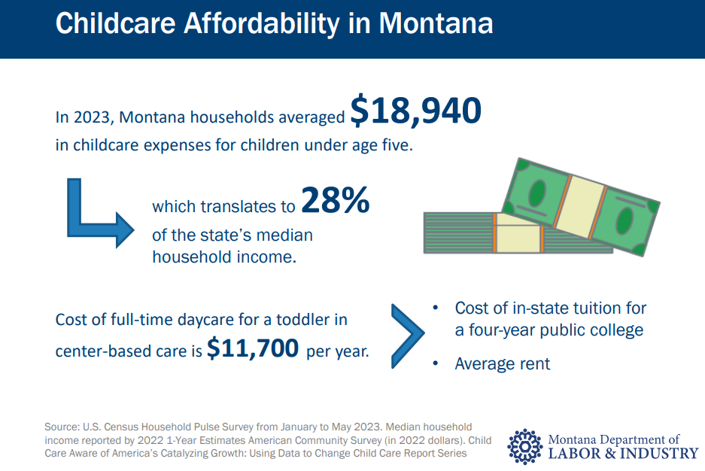
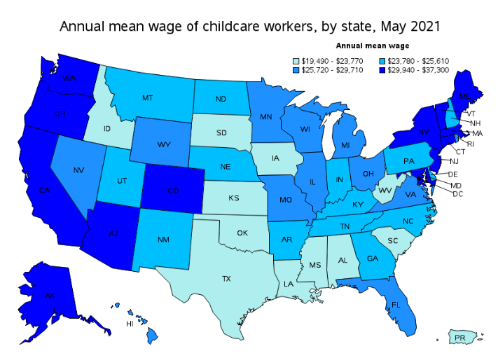
We know that child care necessary but it is also...
Scarce
Challenging
Expensive
Poorly Paid
Source: Child Care Aware
Struggling

Slide 4
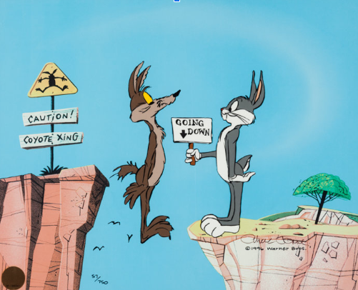
Child care is...
a broken business model
Child care is an essential “product” that we need to be of high quality.
This product costs more to produce than parents can afford to pay.

Slide 5


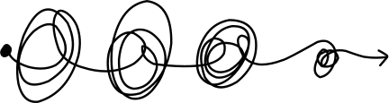
Origins
Families
Partner
Organizations
School District
Local
government
Business community
Providers
Child Care Innovation and Infrastructure Grantee

Slide 6




Objectives
Short term:
New child care slots
  Infant/toddler
  Extended hours
Sustainable contributions:
Engage multiple sectors not typically involved in child care solutions
Long term:
Stabilization of the child care sector
Our project: Missoula Child Care Advantage

Slide 7



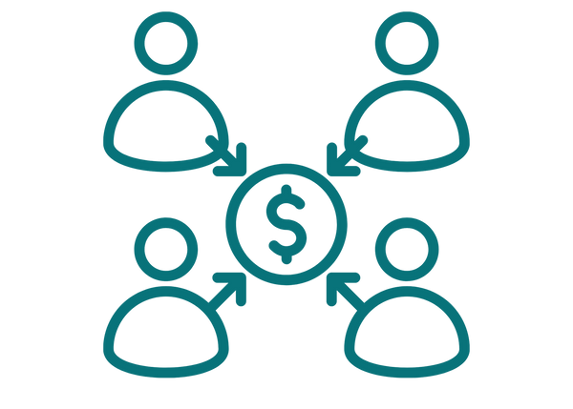

What is MCCA
Shared Services
Network of Providers
Public Private Partnership
Business Membership

Slide 8



1
Shared Services
Shared Services Currently Offered by MCCA:
  Payroll
  Child Care Management Software
  Waitlist services
  Telehealth
  Substitute Service
MCCA is a network of independent child care businesses that utilize shared services to…
Increase quality of childcare
Expand enrollment and revenues
Increase stability of childcare and expand capacity of childcare

Slide 9


2
Business Membership
Local employers purchase business memberships in the MCCA network on behalf of their employees.
  Business membership designation gives staff of member businesses preferred waitlist status for faster access to care
  Business membership fees cover the cost of shared services, therefore, shared services are free for providers

Slide 10



3
Public Private Partnership
PPP

Slide 11
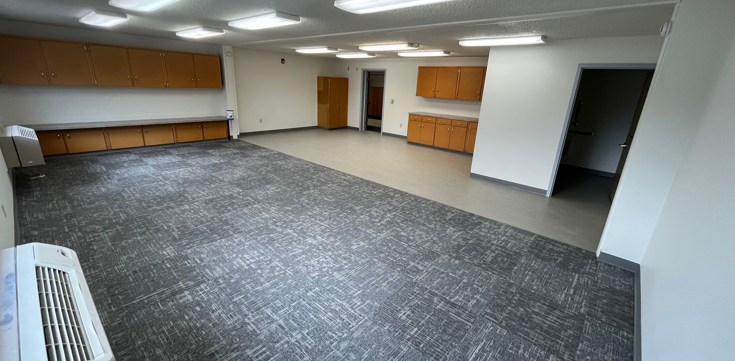
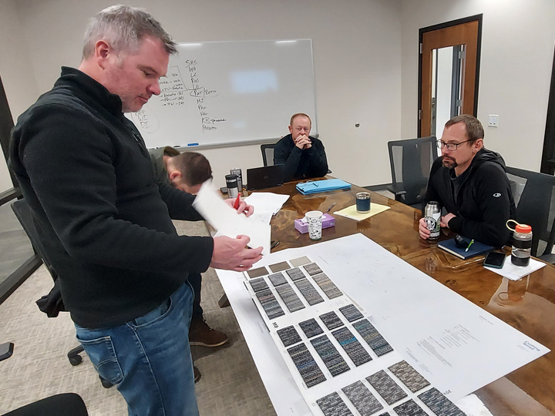
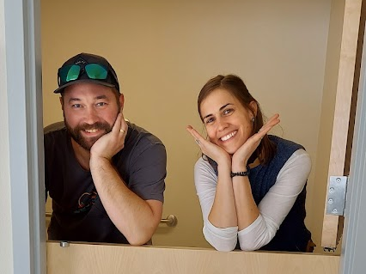
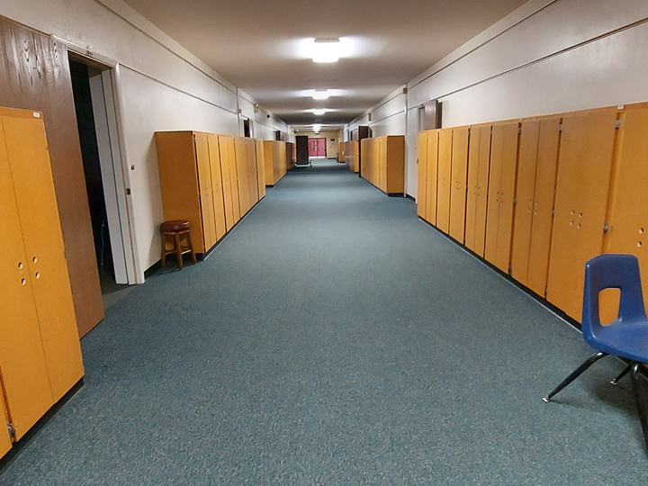
Pilot Site
The MCCA model is being piloted with 6 independent child care businesses co-located in an unused public school building. Each room was recently remodeled with new flooring, paint, a bathroom, and appliances.
Missoula County Public Schools has committed to an affordable lease for the portion of the building used by MCCA.
Providers pay $900/month for rent and utilities.

Slide 12
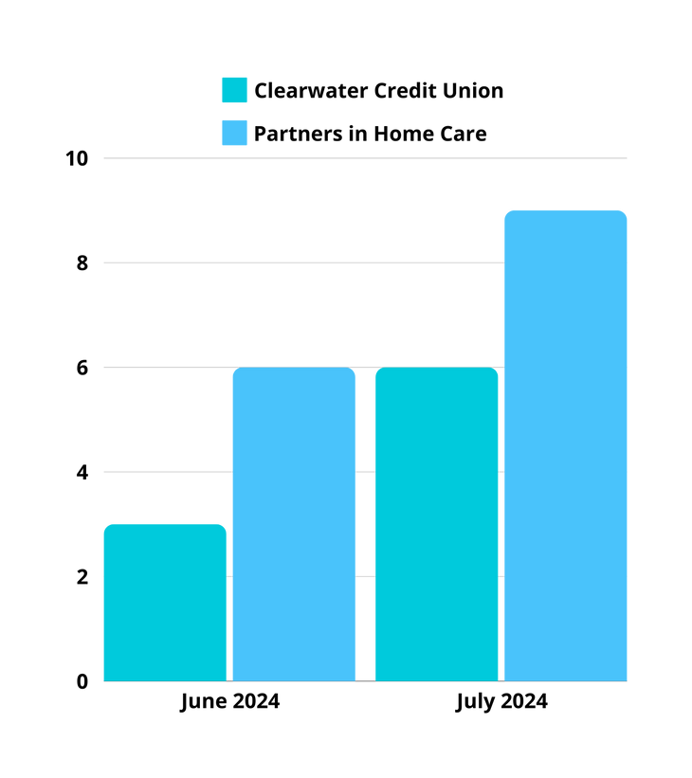

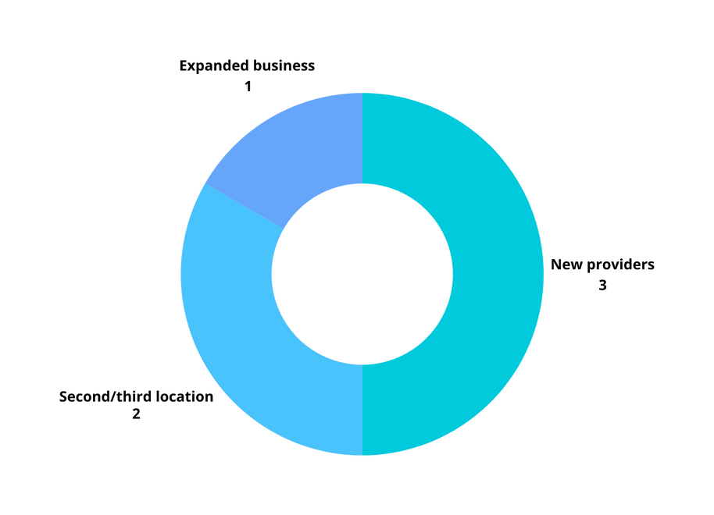




How is it going...
Participating Providers
6 Child Care Businesses
Serve infants & toddlers
Extended hours
Accept Best Beginnings
Business Membership Growth

Slide 13


MCCA Roadmap
Expansion
Scaling
Additional Shared Services
More providers
Evaluation
Strategic Planning
More business members

Slide 14












Project Partners

Slide 15



Thank you!
Sally Henkel
Missoula Child Care Advantage Coordinator
Sally@missoulaunitedway.org
www.missoulachildcareadvantage.com

