Slide 1


Slide 2


Slide 3
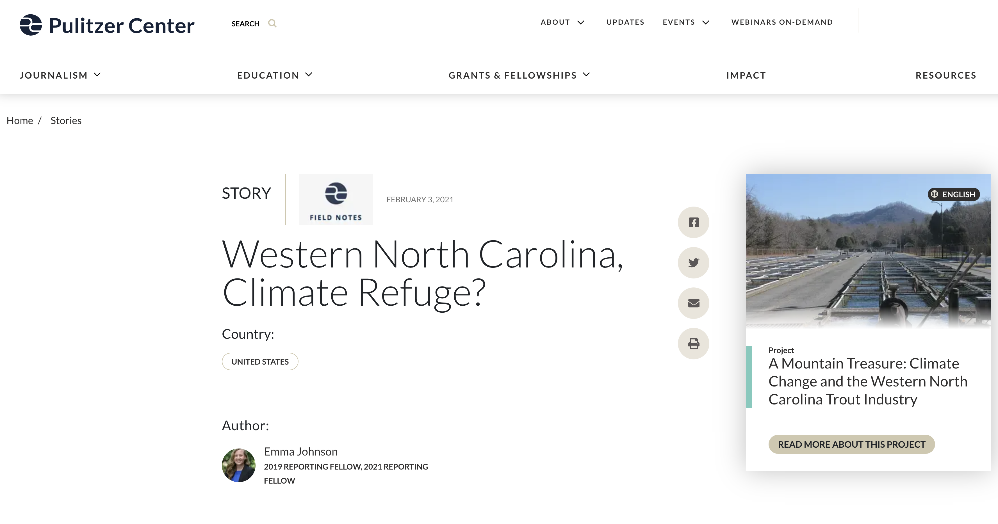

Slide 4
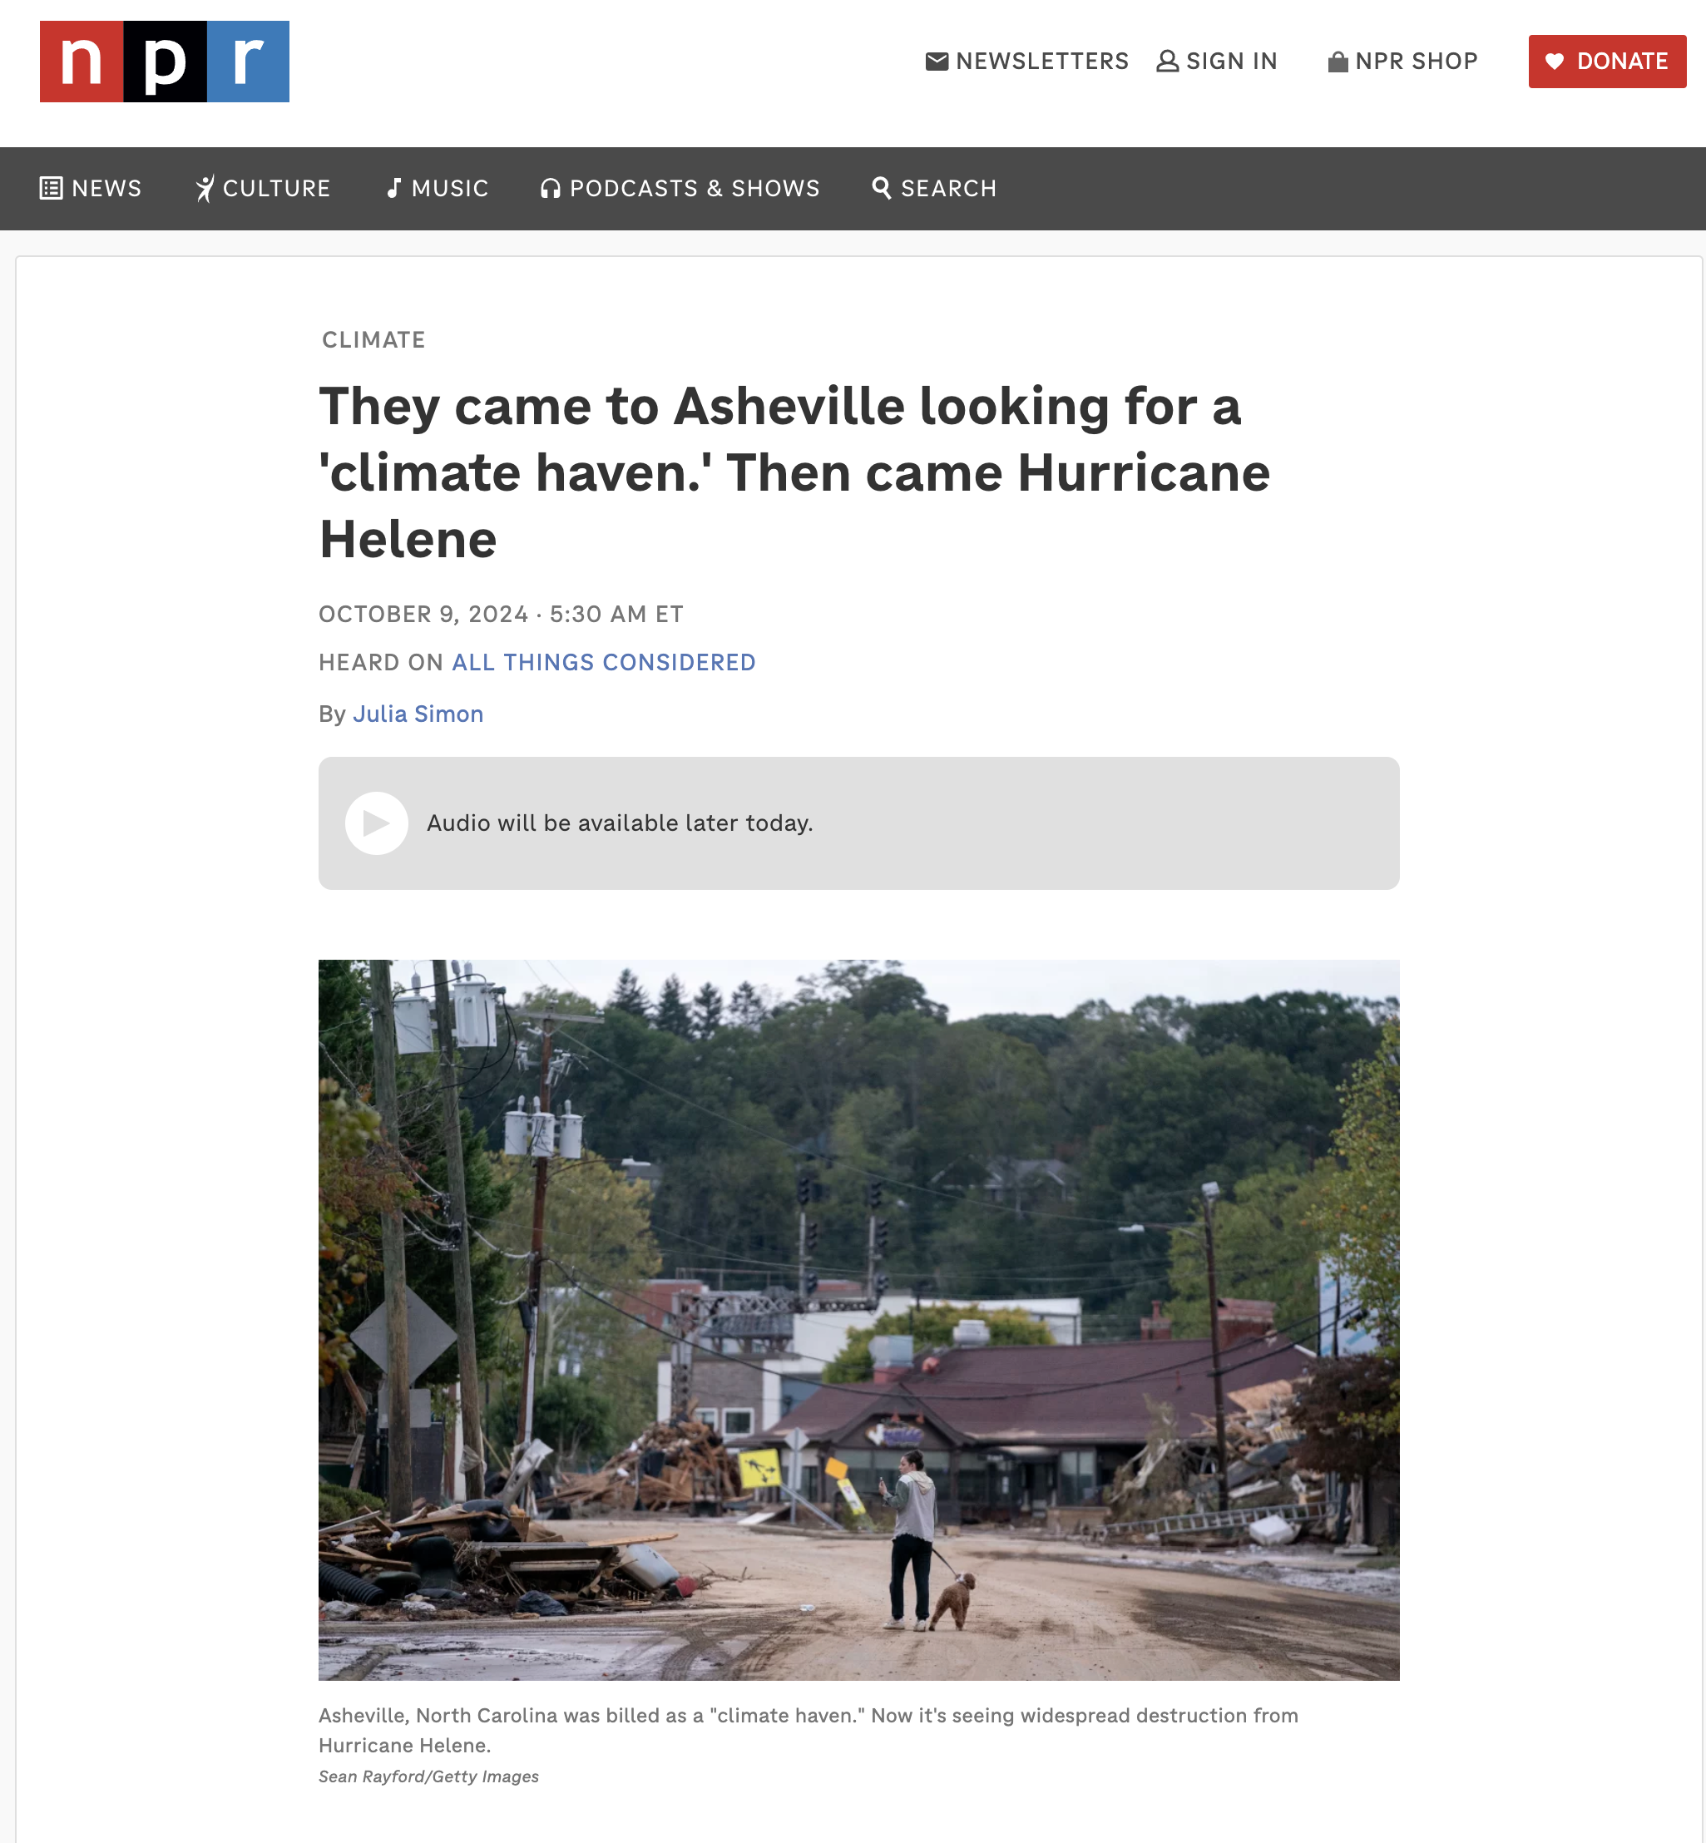

Slide 5
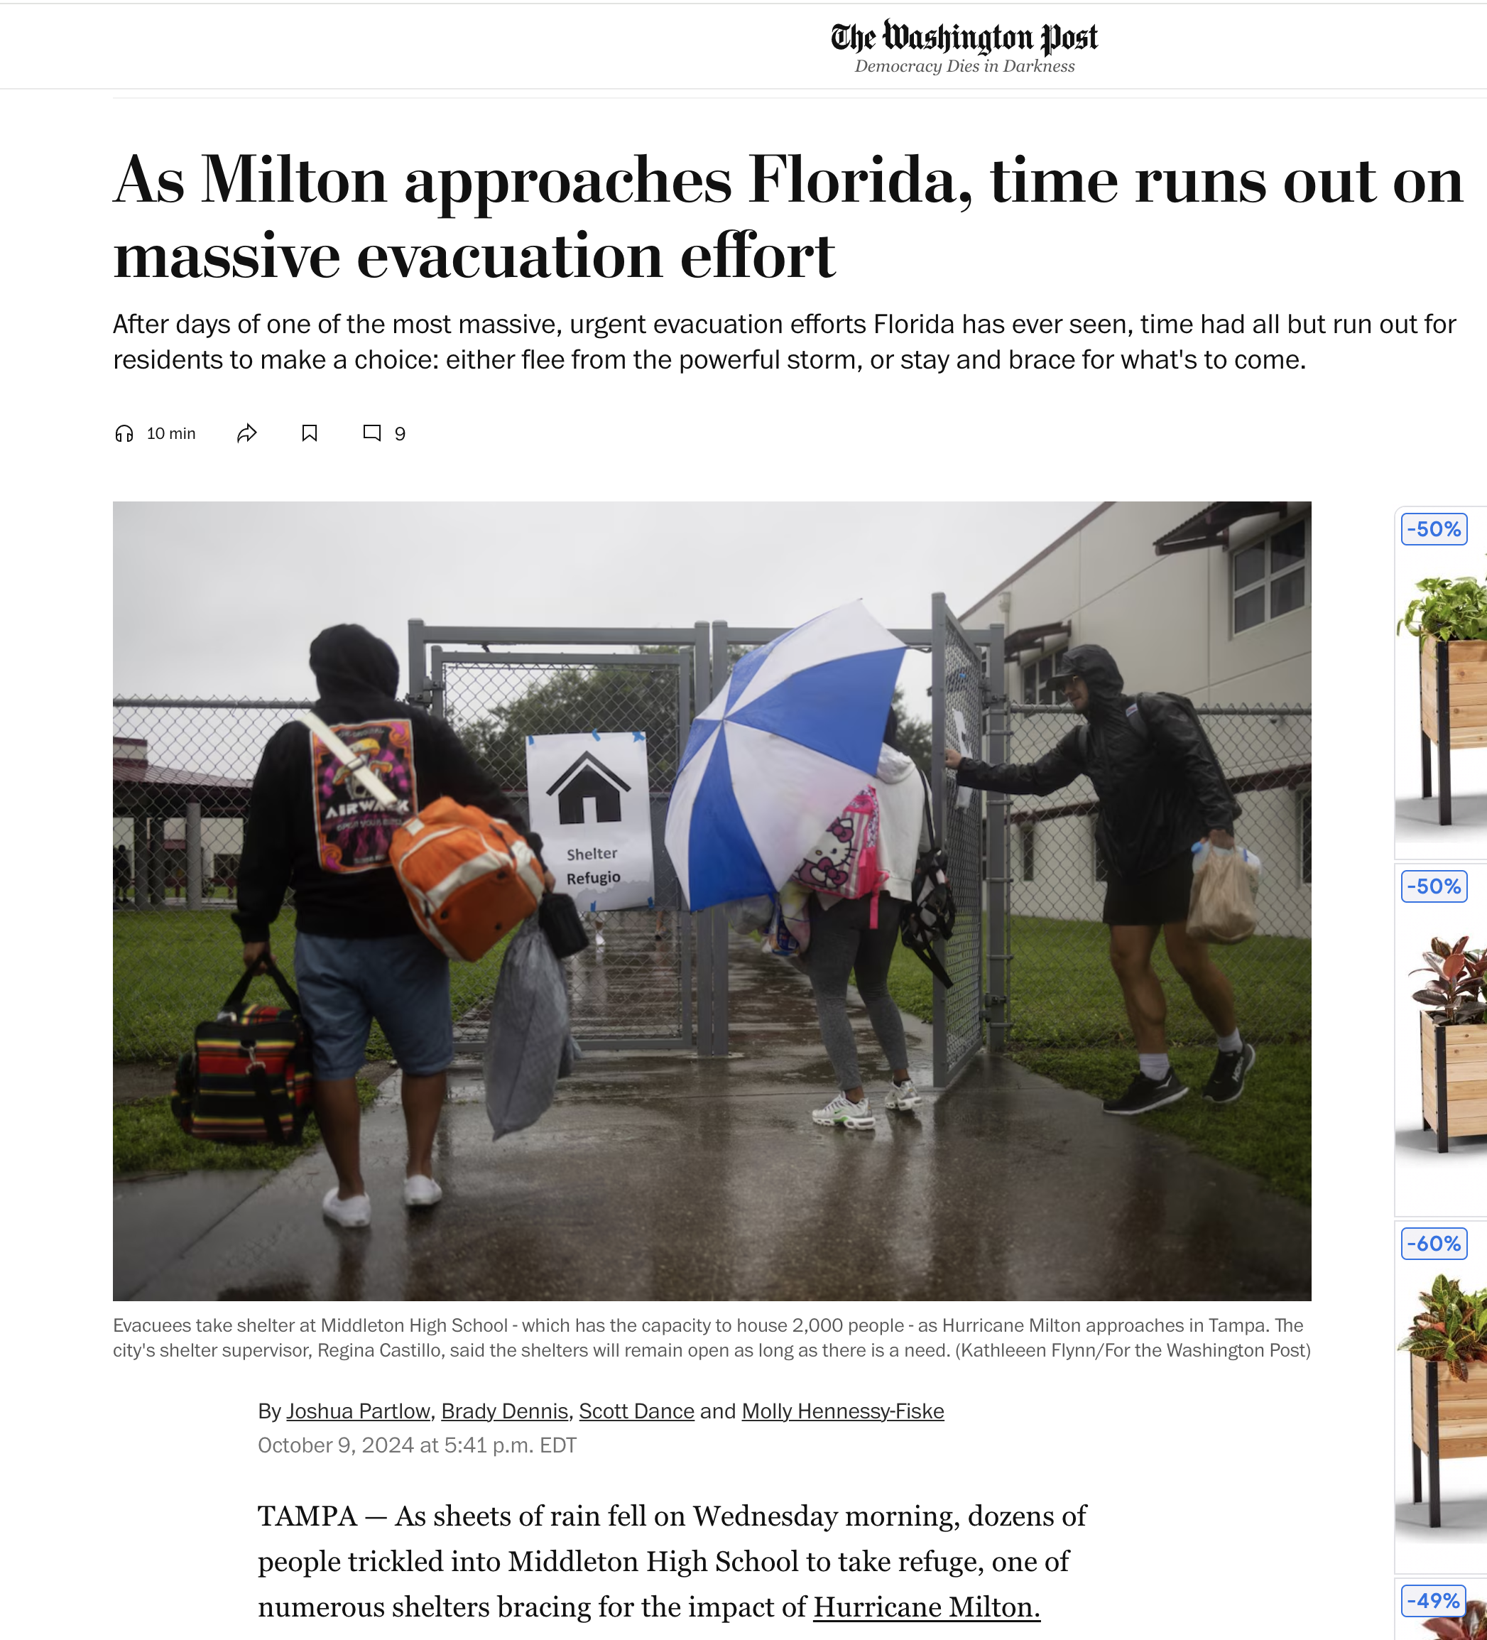
Notes:
Climate makes people move
George H.W. Bush included climate change in the U.S. Military's strategic planning in 1991

Slide 6
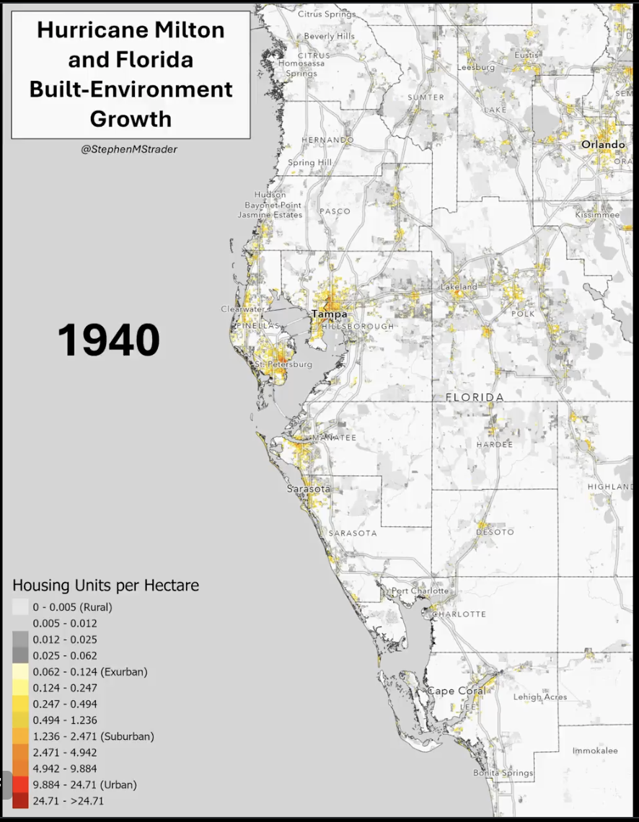

Slide 7
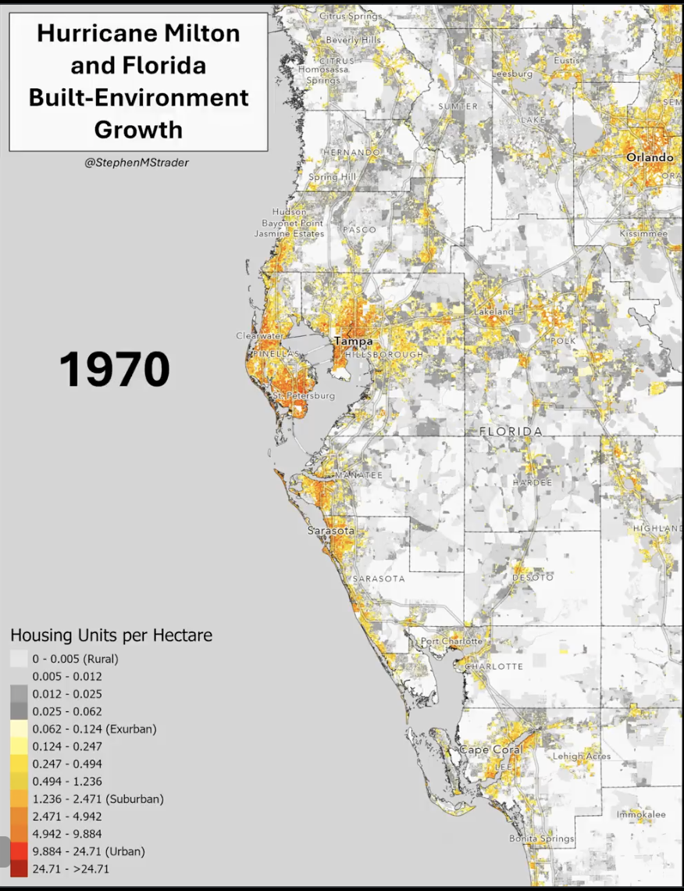

Slide 8
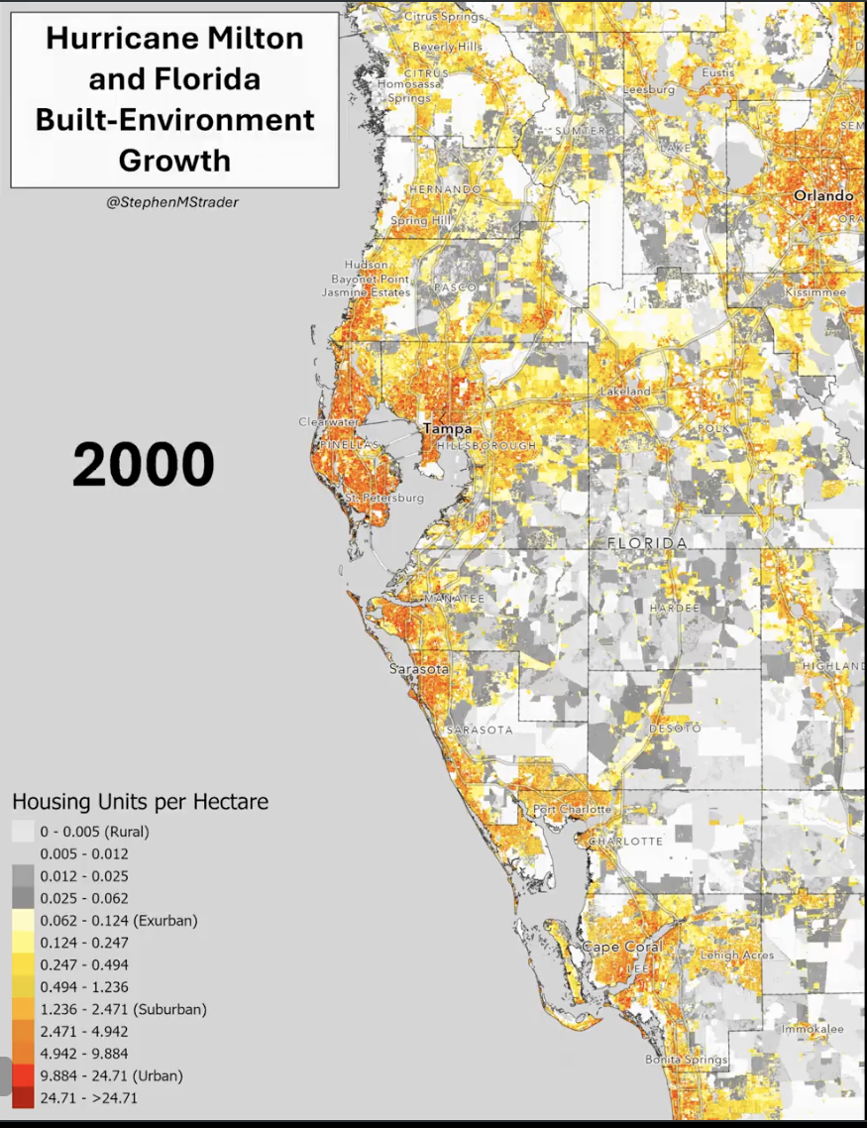

Slide 9
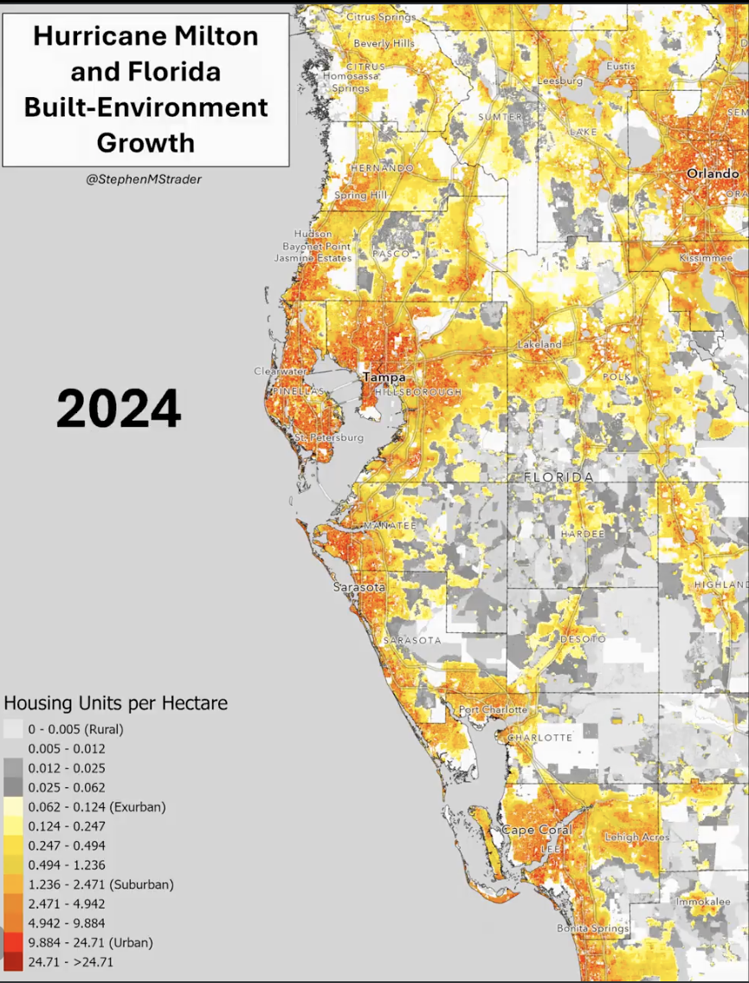

Slide 10

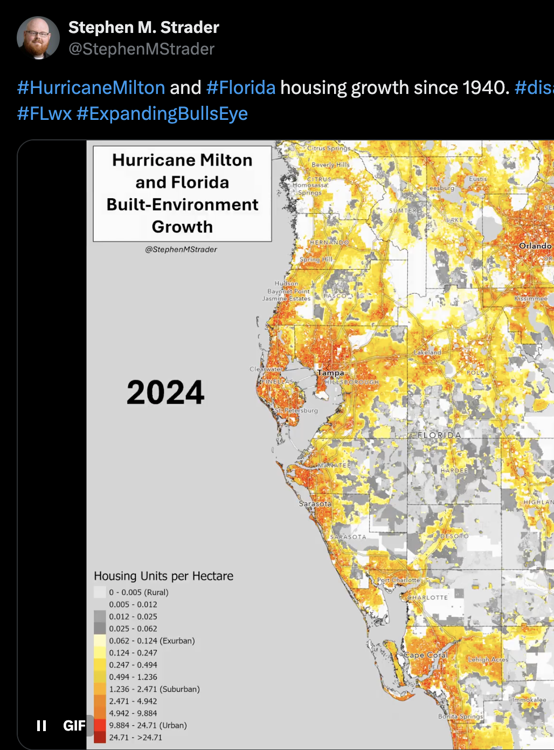

Slide 11
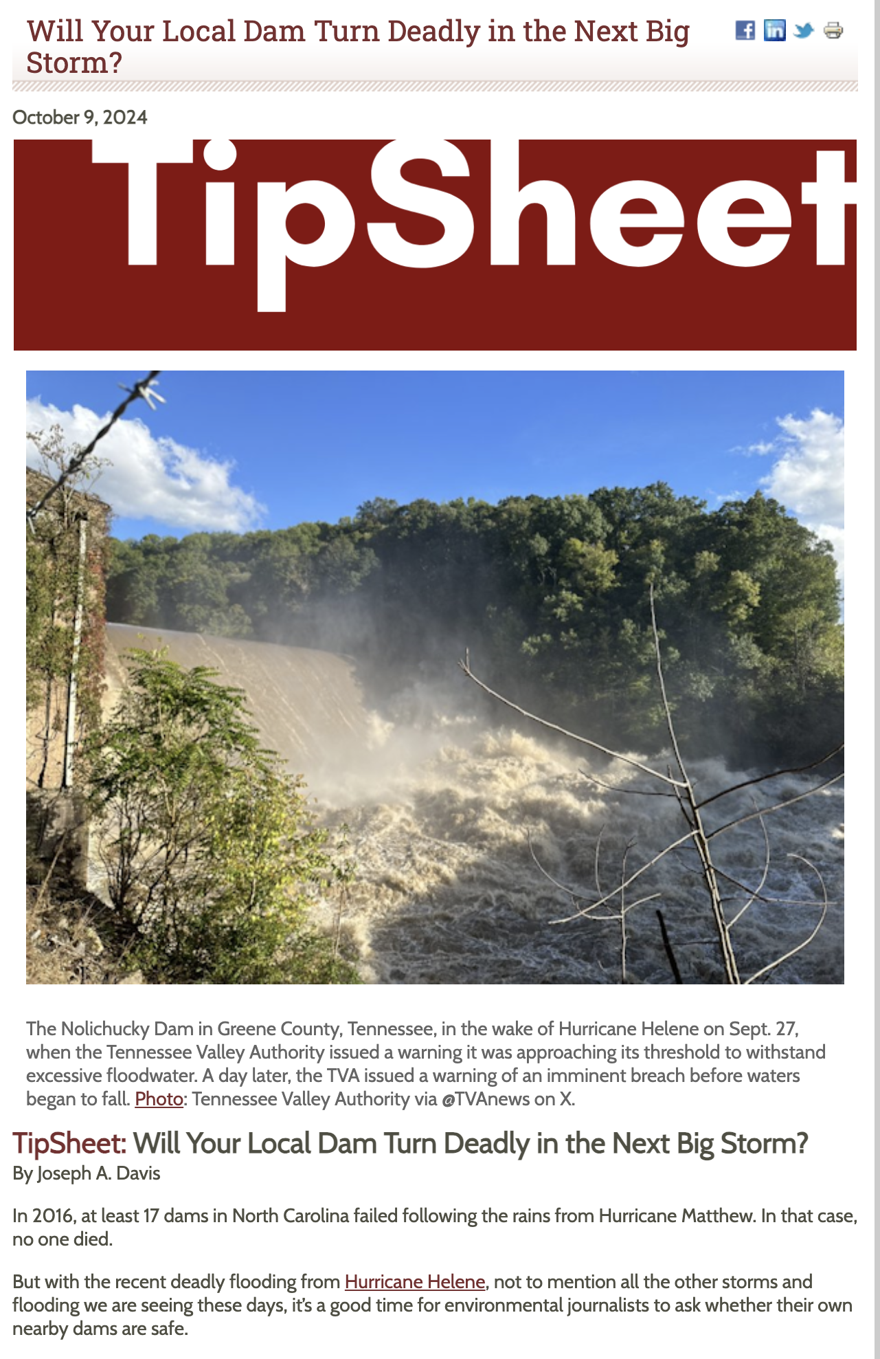
Notes:
Floodplains
Irrigation systems - St. Mary siphon to Milk River cost Montana Hi-Line entire growing season
Toxic deposits
Insurance

Slide 12
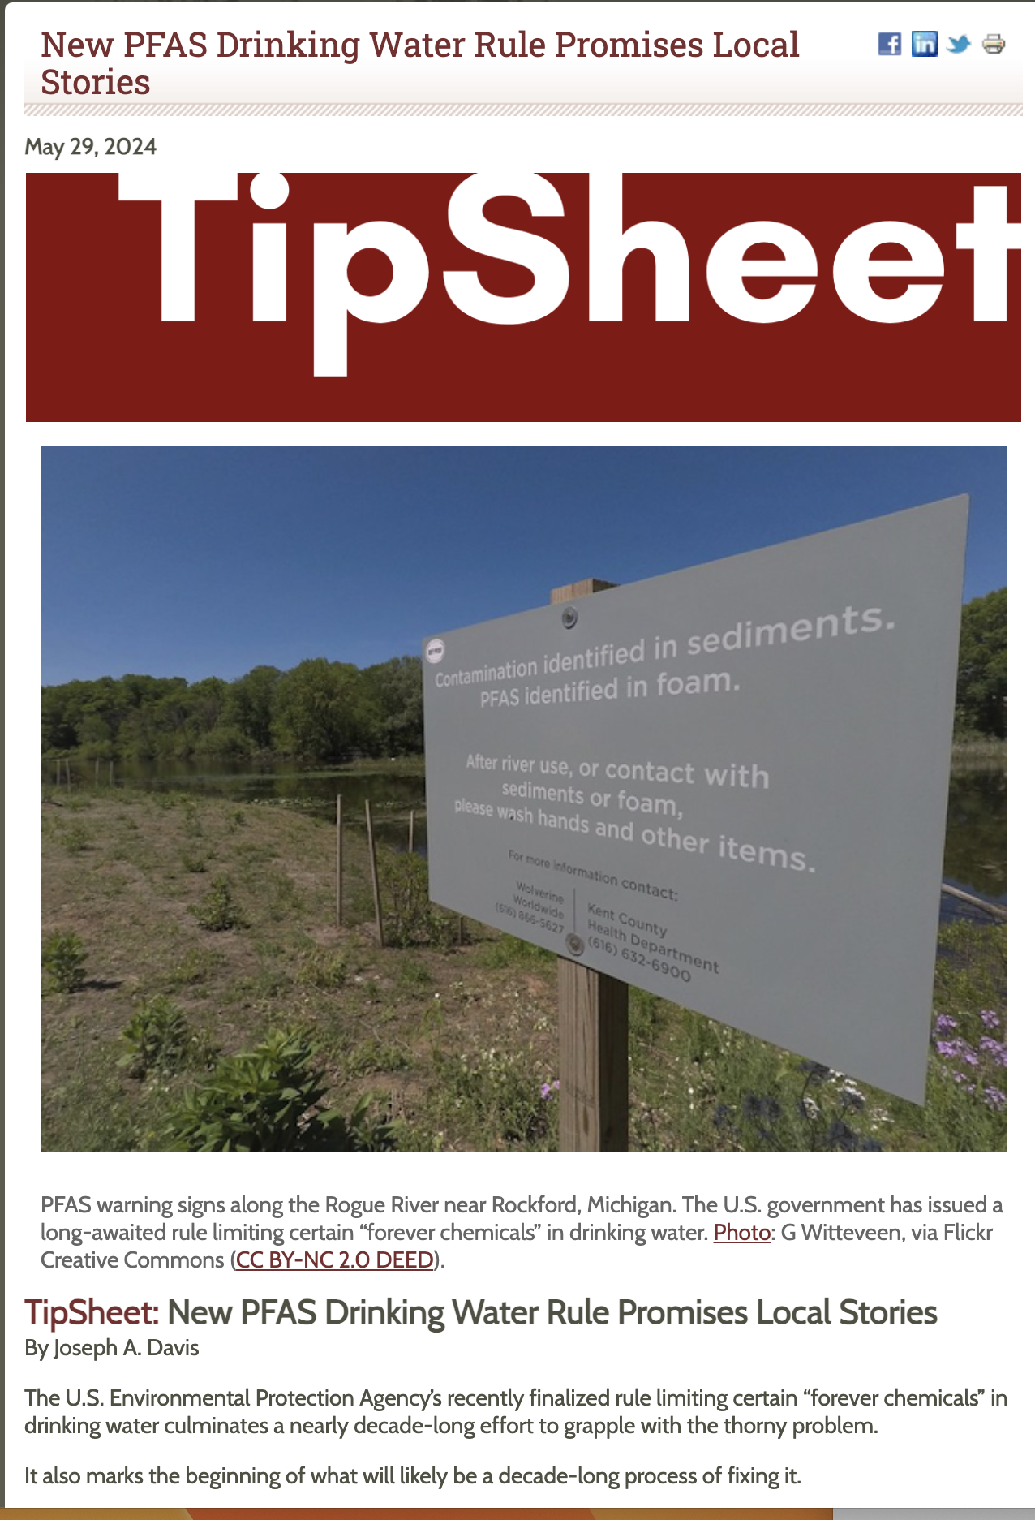
Notes:
PFAS filters into aquifers
Heavily used around military bases
Raincoats on deep discount

Slide 13

Notes:
Attribution science can support clilmate inflluence claims almost in real time
Milton was powered by unprecedented heat in Gulf of Mexico water - direct link to climate change
Wildfire recovery - places won't grow back because trees don't have enough moisture

Slide 14
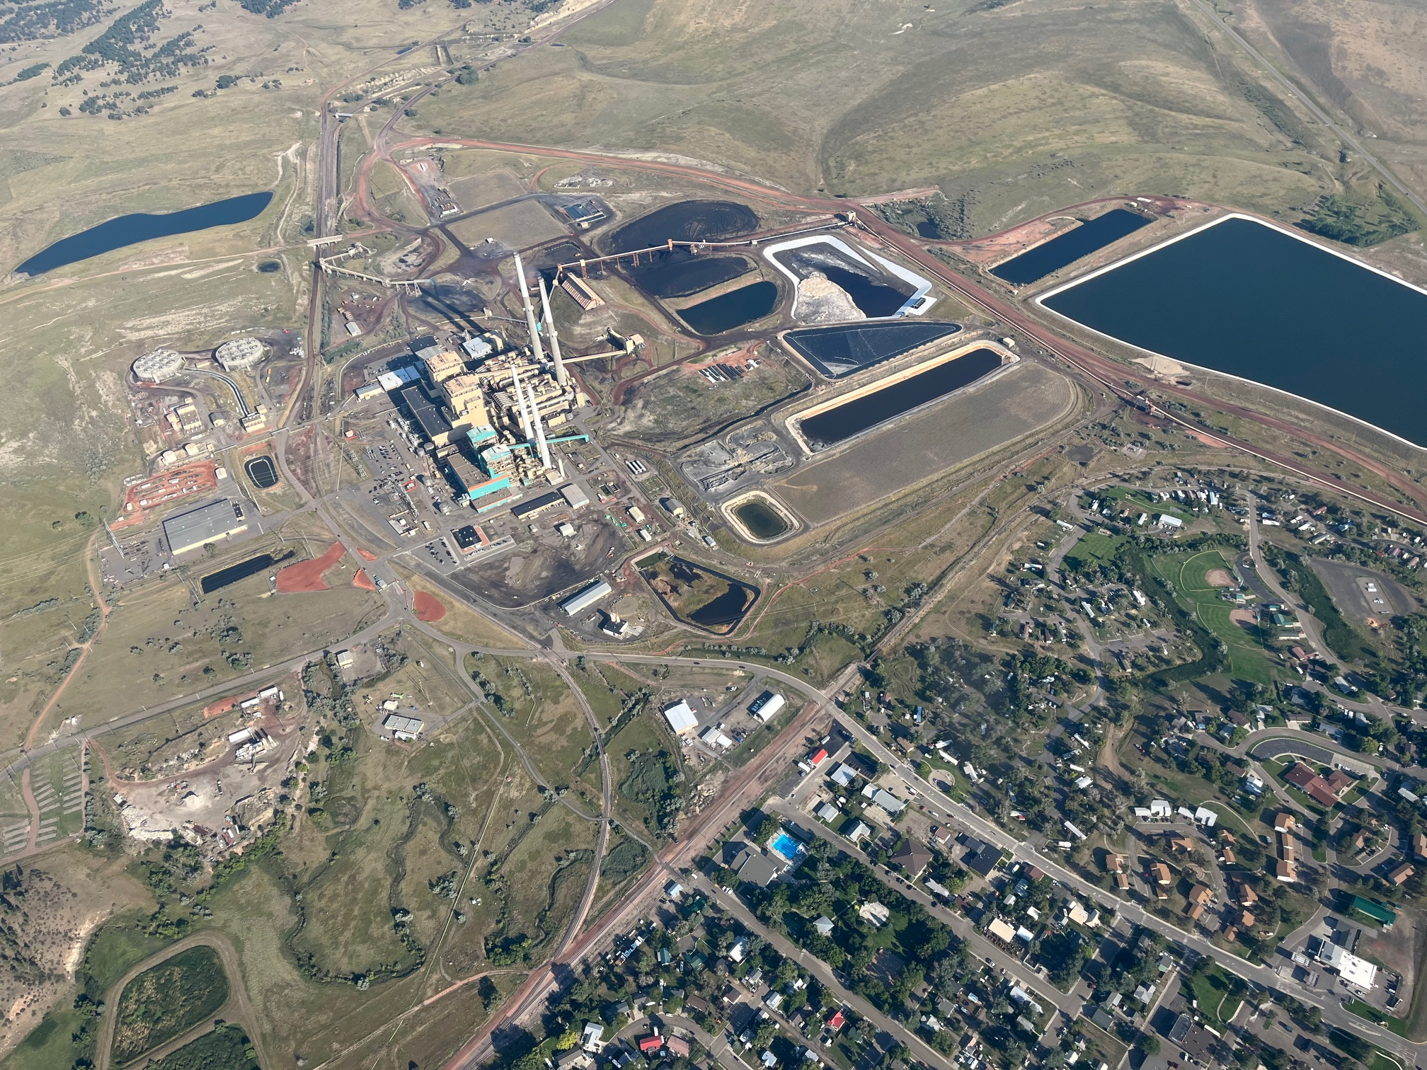

Slide 15
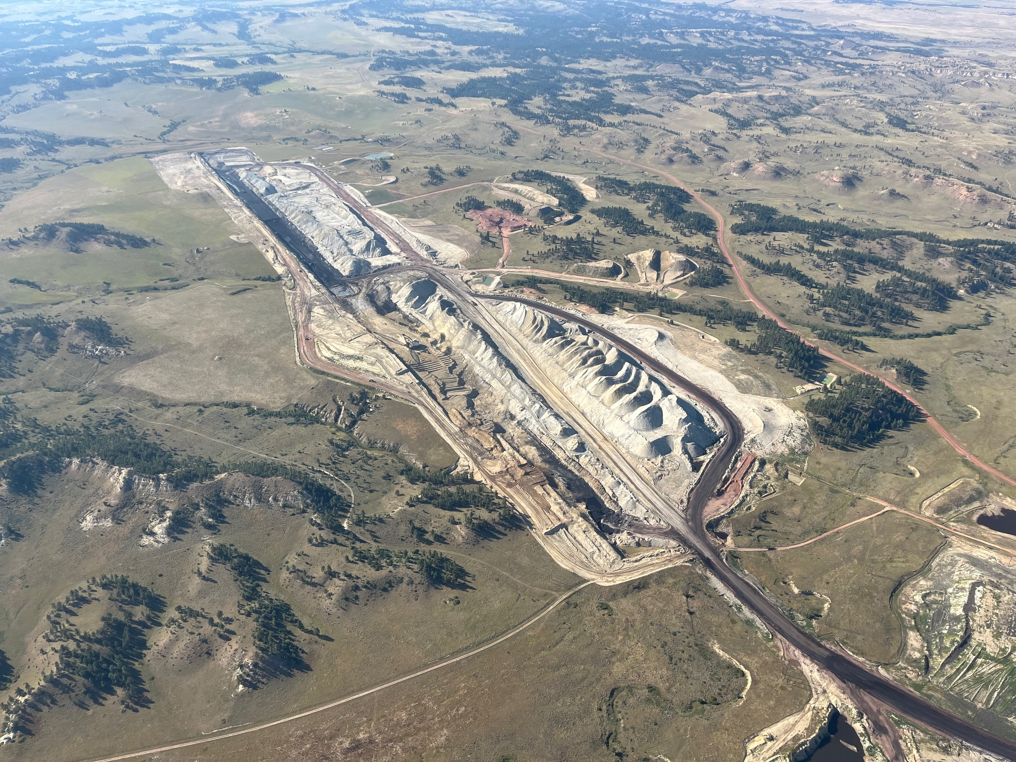

Slide 16
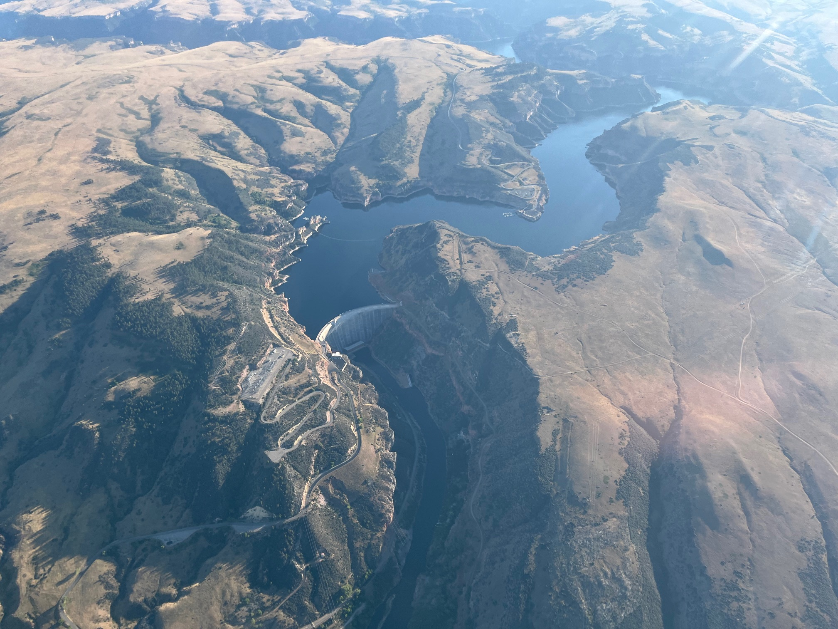

Slide 17
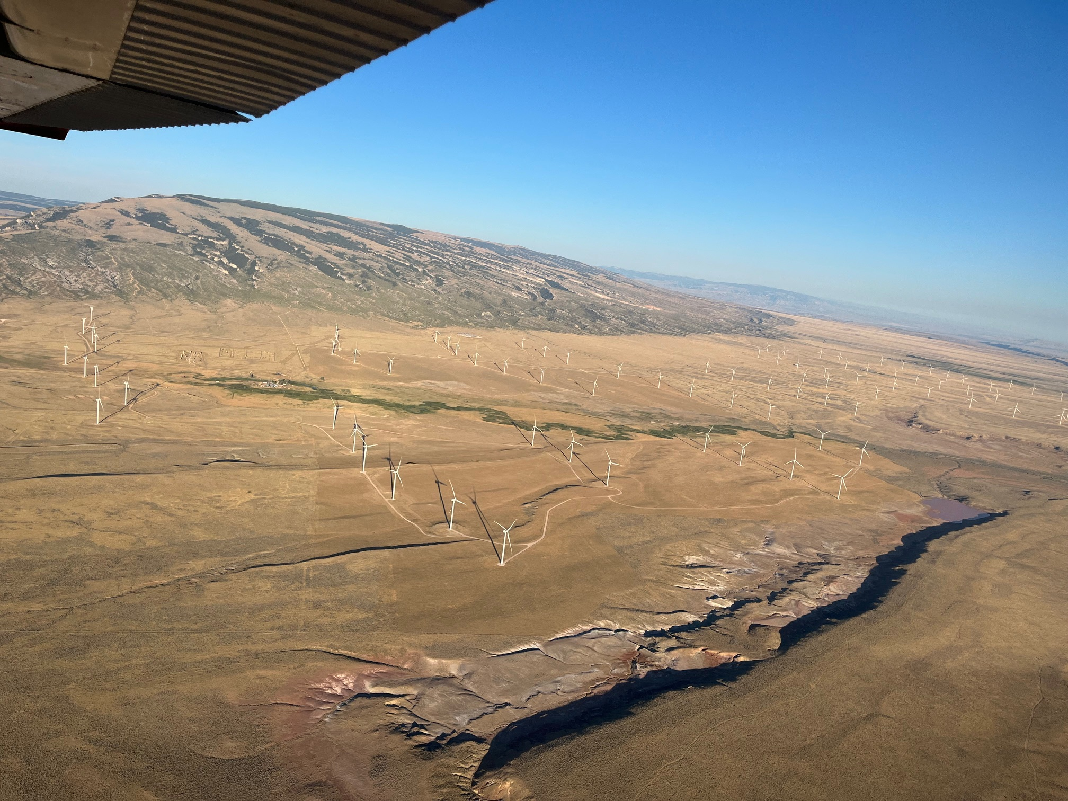

Slide 18
rchaney111@gmail.com
Questions?
Suggestions?
Corrections?

