Slide 1
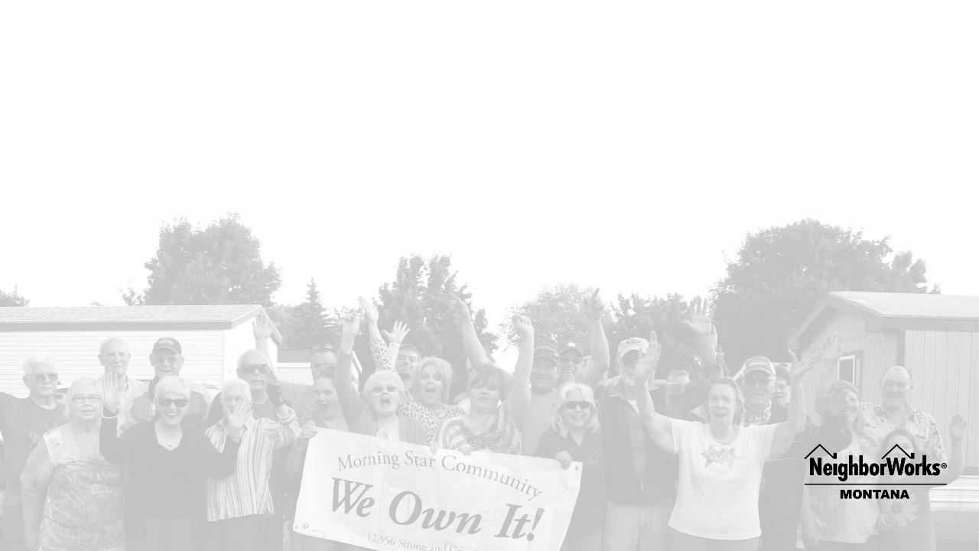
NEIGHBORWORKS MONTANA
Together we strengthen our communities by providing education and financing that gives every Montanan the opportunity to live in a safe and stable home where they can thrive.

Slide 2


LENDING
Serving Montanans Statewide Since 1998
20 full-time staff in Great Falls, Missoula, Kalispell, Helena, Pablo, and Livingston
17 board members representing government, non-profit, and private sectors

Slide 3
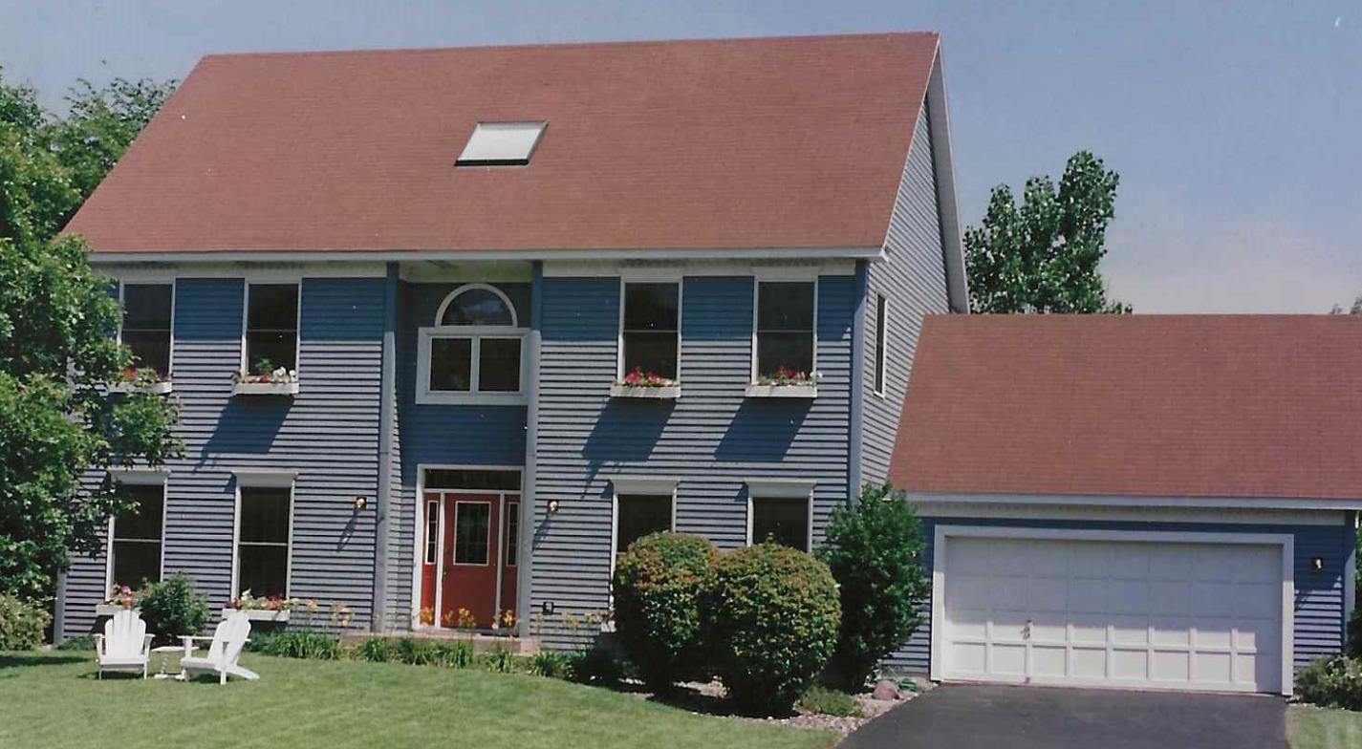
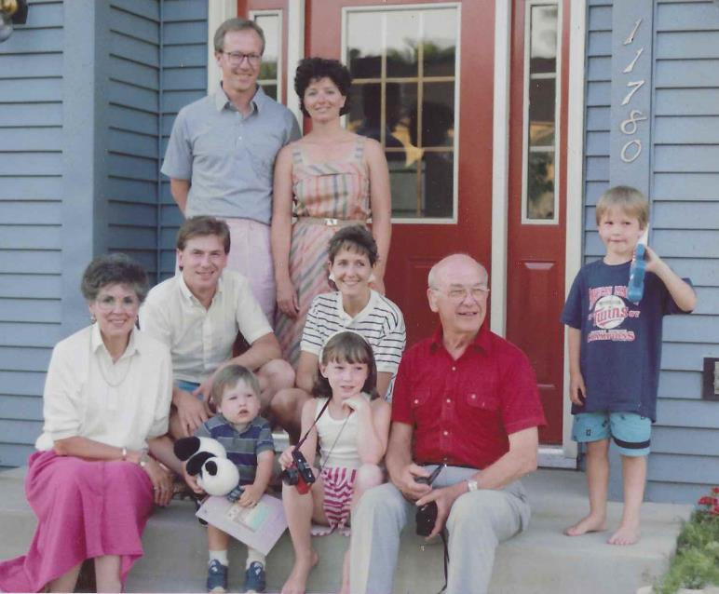
LENDING

Slide 4
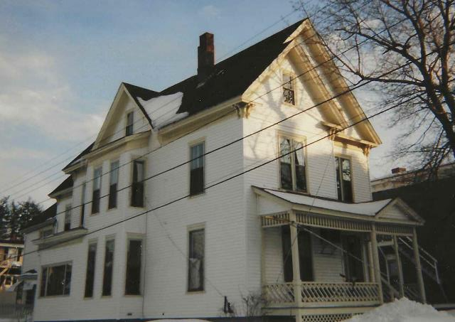
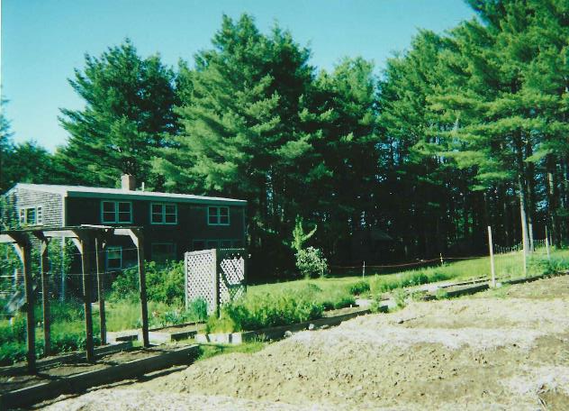
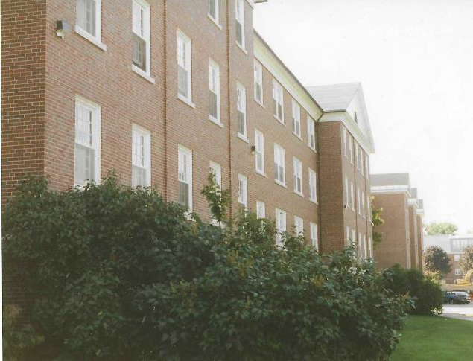
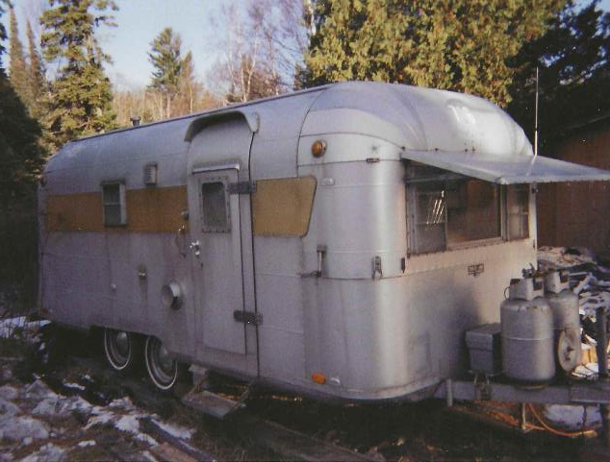
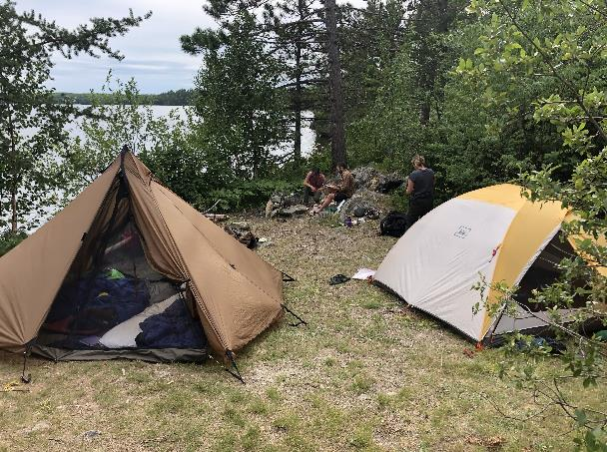
LENDING

Slide 5
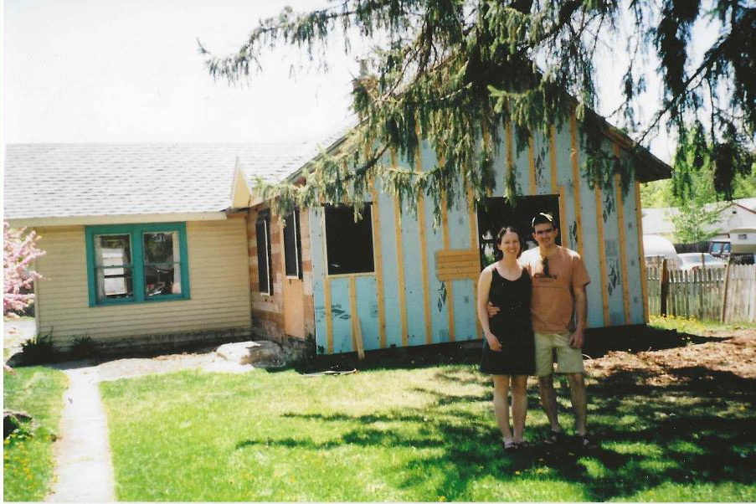
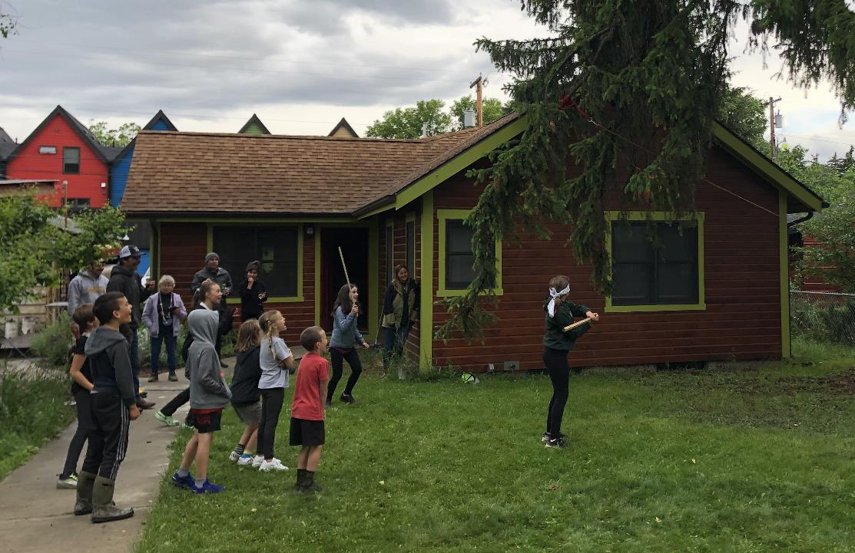
LENDING

Slide 6

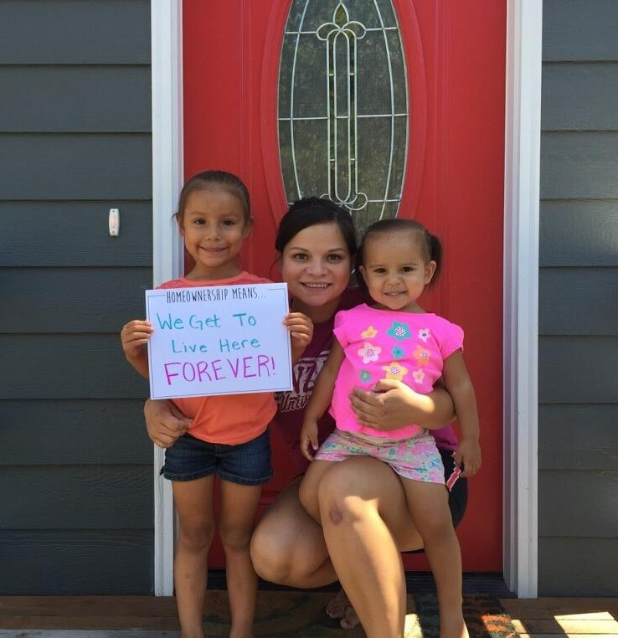
LENDING
Down Payment Assistance

Slide 7
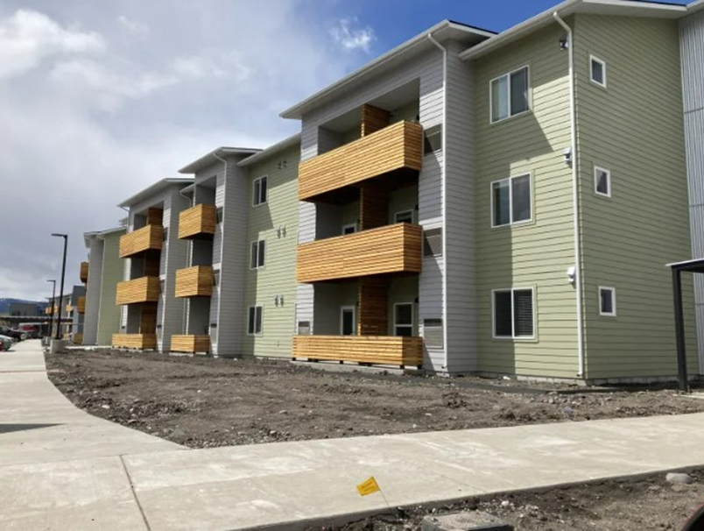
LENDING
Financing Affordable Housing Opportunities
Homeownership
Down payment and closing cost assistance for homebuyers
Real Estate Development & Acquisition
Flexible financing for preservation, new construction, and adaptive reuse
Resident Owned Communities
Long-term financing for acquisition and preservation of manufactured home parks

Slide 8
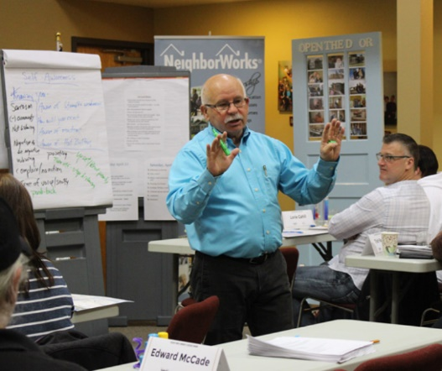


LENDING
NWMT Expertise
Housing Education
We provide housing education and counseling across Montana through a network of HUD-approved housing counseling agencies.
Lending
We provide home loans for individual homebuyers and financing for affordable housing developers. We work to make homeownership affordable.
Manufactured Housing
We help homeowners purchase and successfully manage their mobile home parks through our resident owned community program.

Slide 9

LENDING
Resident Ownership
Supporting homeowners in manufactured home communities to cooperatively purchase and manage their communities
Housing Stability
Homes that are Affordable
Infrastructure Improvements
Leadership Development
Community Engagement
Individual Asset Building

Slide 10
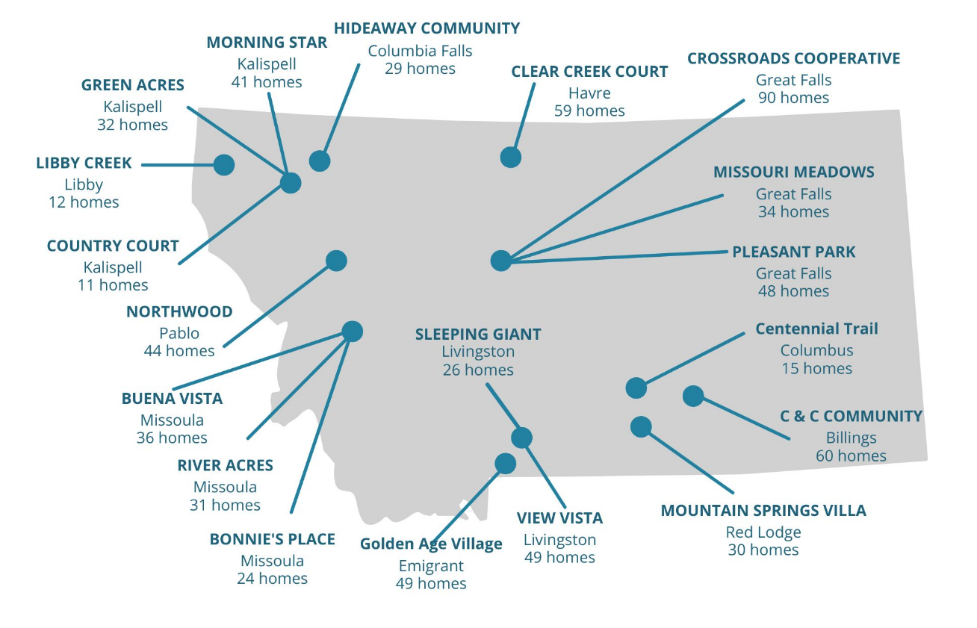
LENDING
Montana ROCs
21
Communities
·
800
Homes
·
1,300+
Residents

Slide 11
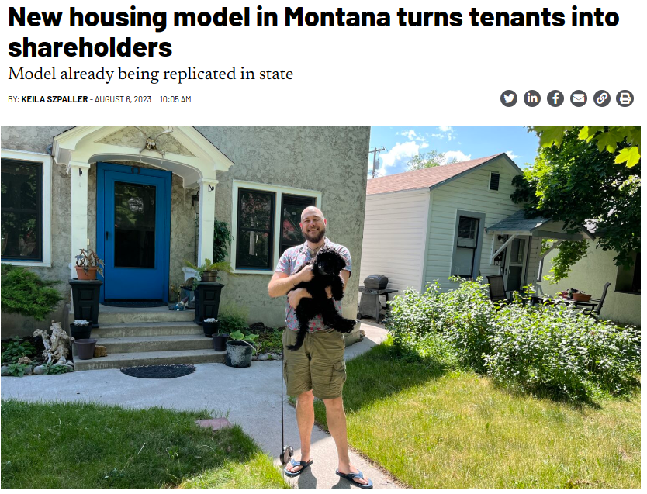
LENDING

Slide 12

LENDING
Collaboration + Innovation
Housing Cooperatives
Community Land Trusts
Native Homeownership Coalition
MSU Reimagining Rural
Individual Matched Savings Accounts

Slide 13

LENDING
'Double-edged sword': Montana's housing market least affordable in entire U.S.
David Erickson Lee Newspapers
Sep 18, 2024

Slide 14
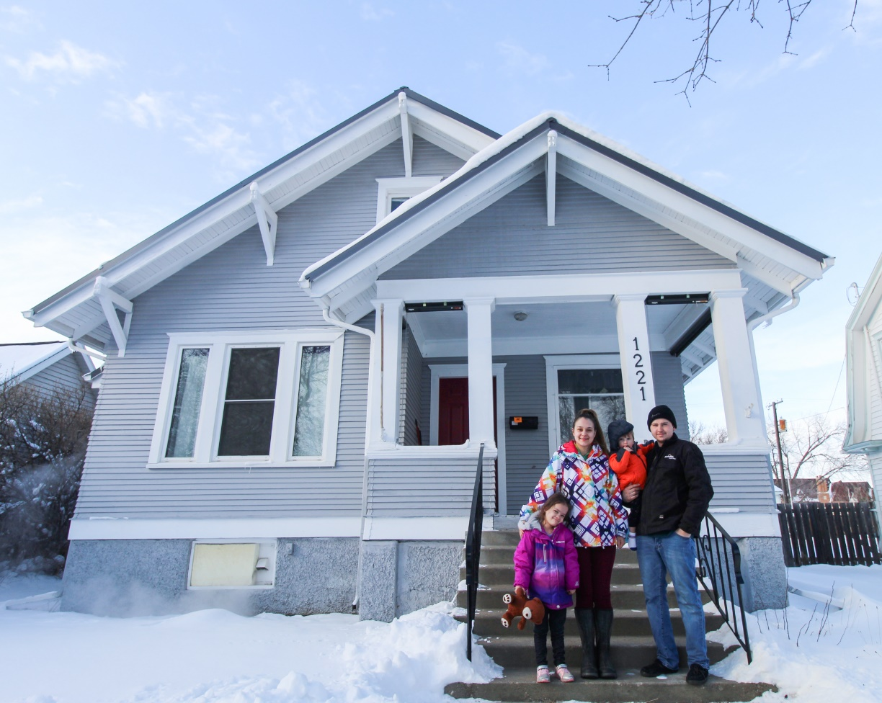
LENDING
Key Drivers of Housing Inaffordability
Demand – Montana is a great place to live
Supply – not building enough to keep pace
Underlying regulatory environment
Slow wage growth
Government and philanthropy dollars don’t go as far

Slide 15
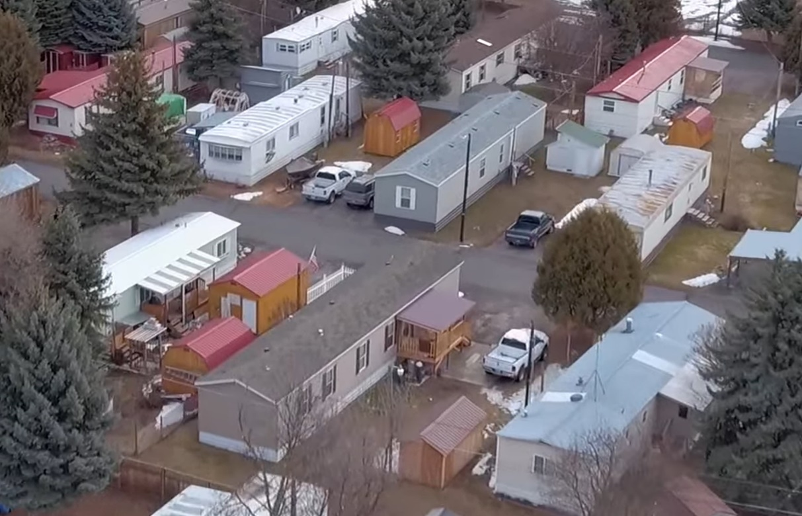
LENDING
Stories to Watch
Zoning and code reform
Employer-based housing solutions
Building innovation
Diverse housing types

Slide 16
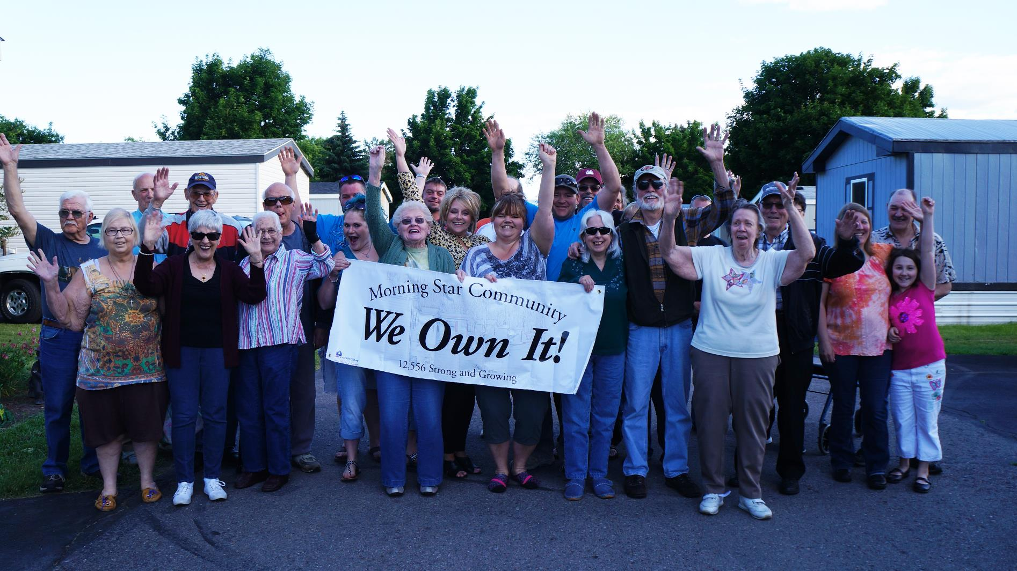
LENDING
Housing is About People

Slide 17


Thank You!
Kaia Peterson, Executive Director
406.531.3449
kpeterson@nwmt.org

