Slide 1
Tribal Sovereignty & state intersection
By Shane A. Morigeau

Slide 2
Who the heck am I?
Background and Intro
Shane Morigeau, member of the Confederated Salish and Kootenai Tribes
My parents are Constance Morigeau and Victor Morigeau. I am a descendent of Chief Charlo on my dads side. My grandmother was Genevieve Mary Charlo and my grandfather was Jack Alexander Morigeau. My grandmother on my mothers side was Edna Dorine Garrin Whitworth.
Montana State Senator (former State House Rep)
Member of the Montana State Bar - barred in 2011
Tribal Attorney & Public Affairs Officer for the Confederated Salish and Kootenai Tribes
Have served as a criminal prosecutor, Deputy Executive Officer – Public Affairs & Communications, and general legal counsel for Confederated Salish and Kootenai Tribes with over 13 years

Slide 3
Before we get started
Recognize Aboriginal homelands of the Confederated Salish and Kootenai Tribes
Territory now known as western Montana, parts of Idaho, British Columbia and Wyoming
Territory exceeded over 20 million acres at the time of the 1855 Treaty of Hellgate

Slide 4
sovereignty can be confusing?
https://www.youtube.com/watch?v=kdimK1onR4o

Slide 5
What does sovereignty really mean?
Inherent right and power to govern oneself
Tribal sovereignty refers to the right of American Indians and Alaska Natives to govern themselves.
The U.S. Constitution recognizes Indian tribes as distinct governments and they have, with a few exceptions, the same powers as federal and state governments to regulate their internal affairs.
Sovereignty for tribes includes the right to establish their own form of government, determine membership requirements, enact legislation and establish law enforcement and court systems.1
The Constitution gives authority in Indian affairs to the federal government, not to the state governments. Just as the United States deals with states as governments, it also deals with Indian tribes as governments, not as special interest groups, individuals or some other type of non-governmental entity.
Some states have explicitly recognized the governmental status of Indian tribes through various state recognition processes.2

Slide 6
Policy eras – How’d we get here
Establishment of Federal Role: Colonial Times to – 1820
Tribes conducted their own affairs and depend on no outside source of power to legitimize their acts and government
Initially Tribes were treated as sovereign foreign nations w/ British crown (colonial powers) – left to regulate their own affairs
When colonies revolted a lot of tribes allied as the Crown had treated them and protected them from colonists
July 4, 1776 → Declaration of Independence
Upon independence congress regulated commerce with Indian Tribes and the President was empowered to make treaties w/ consent of the senate (US Const Art I, Section 8, cl. 3; Art II, section 2, cl.2.)
Trade and intercourse acts passed between 1790 and 1834 (1 stat 137 (1790); 2 stat. 139 (1802); 4 stat 729 (1834
Separating Indians and non-Indians and subjecting interactions to federal control.
Boundaries established and Indians protected from incursion by non-Indians. (ie. non-Indians couldn’t acquire Indian lands from them).
Federal crimes established by non-Indians against Indian (ie depredations).
Indian tribes left to regulate their own conduct
On one hand you had the Europeans claiming dominion over all territories of the new world which would end up limiting sovereignty and clouded tribal nations sovereignty status
This left the status of Tribes to the US Supreme Court…

Slide 7
Marshall Trilogy & Indian removal
Marshal Trilogy and Indian Removal Era – 1820-1850
Extinguishment of Indian title to eastern lands and removal of Indians beyond state boundary lines westward
Ushered by Presidents Monroe, John Quincy Adams and most vigorously, Andrew Jackson (trail of tears and removal of Southeastern Tribes to Oklahoma → 60,000 Cherokees displaced and 4,000 died)
Friction primarily over demands for land
BIA was under War Department from 1824 to 1849 before moving to Department of Interior (to give you a sense of how the US felt about Indian tribes)
Simultaneously the US Supreme Court was developing legal doctrines for Indian law, structuring the future of Tribal Sovereignty

Slide 8
Marshall Trilogy & Indian removal continued...
Johnson v. McIntosh, 21 U.S. 543 (1823)
Indian tribes can only grant lands to the fed government
Exclusive title to those who discovered it under the doctrine of discovery
Right to occupy but right to dispose of soil diminished
Marshall was a well-known land baron, arguably a conflict
Was like the stock market at the time – buy low and sell high

Slide 9
Marshall trilogy & Indian removal continued...
Cherokee v. Georgia, 30 U.S. (5 Pet.) 1 (1831)
Cherokees not regarded as “foreign state” within the meaning of Article III of the Constitution but qualify as a “state”
Distinguishing political society separated from others managing its own affairs and governing itself
This coined the phrase as “domestic dependent nations”

Slide 10
Marshall trilogy & Indian removal continued...
Worcester v. Georgia, 31 US (6 Pet.) 515, 559 (1832)
Supreme Court stated that Indian nations had always been considered a distinct, independent, political communities, retaining their original natural rights, as the undisputed possessors of the soil, from time immemorial, with the single exception of that imposed by irresistible power, which excluded them from intercourse with any other European potentate that the first discoverer of the coast of particular region claimed.
Determined that the laws of Georgia could have no force in Cherokee Territory
Limited sovereignty: conveyance of land and dealing with foreign powers
Andrew Jackson stated “John Marshall has made his decision, now let him enforce it.” Response to Worcester v. Georgia.

Slide 11
Reservation Era – 1850-87
Treaty era was an attempt to assimilate and take lands of Tribal people
Hellgate Treaty (signed at Council Grove State Park) established a reservation of 1.317 million acres (Jocko), were over 20 million acres of aboriginal territory existed at the time
Treaty of Hellgate signed in 1855 and ratified by Congress on March 8, 1859
Article 11 – Bitterroot Valley was to be surveyed and examined, and if it shall be proved, in the judgment of the President, to be better adapted to the wants of the Flathead Tribe than the general reservation provided for in the Treaty, then such portions of it as may be necessary shall be set apart as separate reservation for said tribe
The Bitterroot Salish lived in the Bitterroot Valley and as Chief Charlo Said, that is where the bones of our ancestors were buried
In 1871 President Ulysses S. Grant issued an executive order saying the survey was completed and Jocko is better suited (word is that they simply rode a horse around the Bitterroot Area)
Following year congress sent delegation led by President James Garfield to negotiated removal of the Salish, which we refused
Simultaneously the Homestead Act of 1862 was being enacted in Montana, which was competing interests for lands and resources
Congress ended treaty making in 1871
1878 off-rez boarding schools
After 1871 treaties were entered into via statute or by executive order (ended by congress in 1919)

Slide 12
Allotment & assimilation – 1887-1934
1887 general allotment act passed
Get land, prosper, and assimilate as middle-class farmers (agrarian farmers)
Break up land bases for farmers as it allowed disposition of “excess” lands
160 acres to each head of family and 80 acres to others.
Doubled the numbers if only suitable for grazing
138 million acres in 1887 to 48 million in 1934 (90 million acres lost)
October 14, 1891, the Bitterroot Salish were pushed out at gun point and leaving behind their homes, crops, and livestock
Talton v. Mayes, 163 U.S. (1896)
Tribal Powers are inherent – not derived from fed government
Bill of Rights that restrict the federal government do not apply to Tribes
1904 allotment act extended to the CSKT and our land base went from 100% of the rez as tribal ownership to under 30% (now to roughly 67%) (Section 16 & 36 were removed as school sections of each township)
1908-1909 18,766 acres of land was taken from the Tribes to form The National Bison Range
3,000 lotteries issued for homesteading and another 3,000 in 1910
Remaining public lands opened for public sale -- total loss was over 400,000 acres for CSKT (https://iltf.org/land-issues/history/)
1920s had another round of tribal allotments with updated roles w/ timber allotments that were 160 acres
Flathead villa sites act -- 5 & 10 acre parcels along the Flathead Lake were divided out
Only reservation in MT not allotted was the Rocky Boy Indian Reservation (formed in 1916)
1924 we got tribal citizenship (8 USCA Section 1401(b) and also came state citizenship as US citizens
CSKT and many other tribal nations plummeted into deep poverty, resources greatly diminished
Meriam report (1928) --> survey of Indians in the 20’s identified failed policies and dire social and economic conditions
Great Depression starts in in 1929 (ending in 1939) creating even worse conditions

Slide 13
Allotment & assimilation

Slide 14
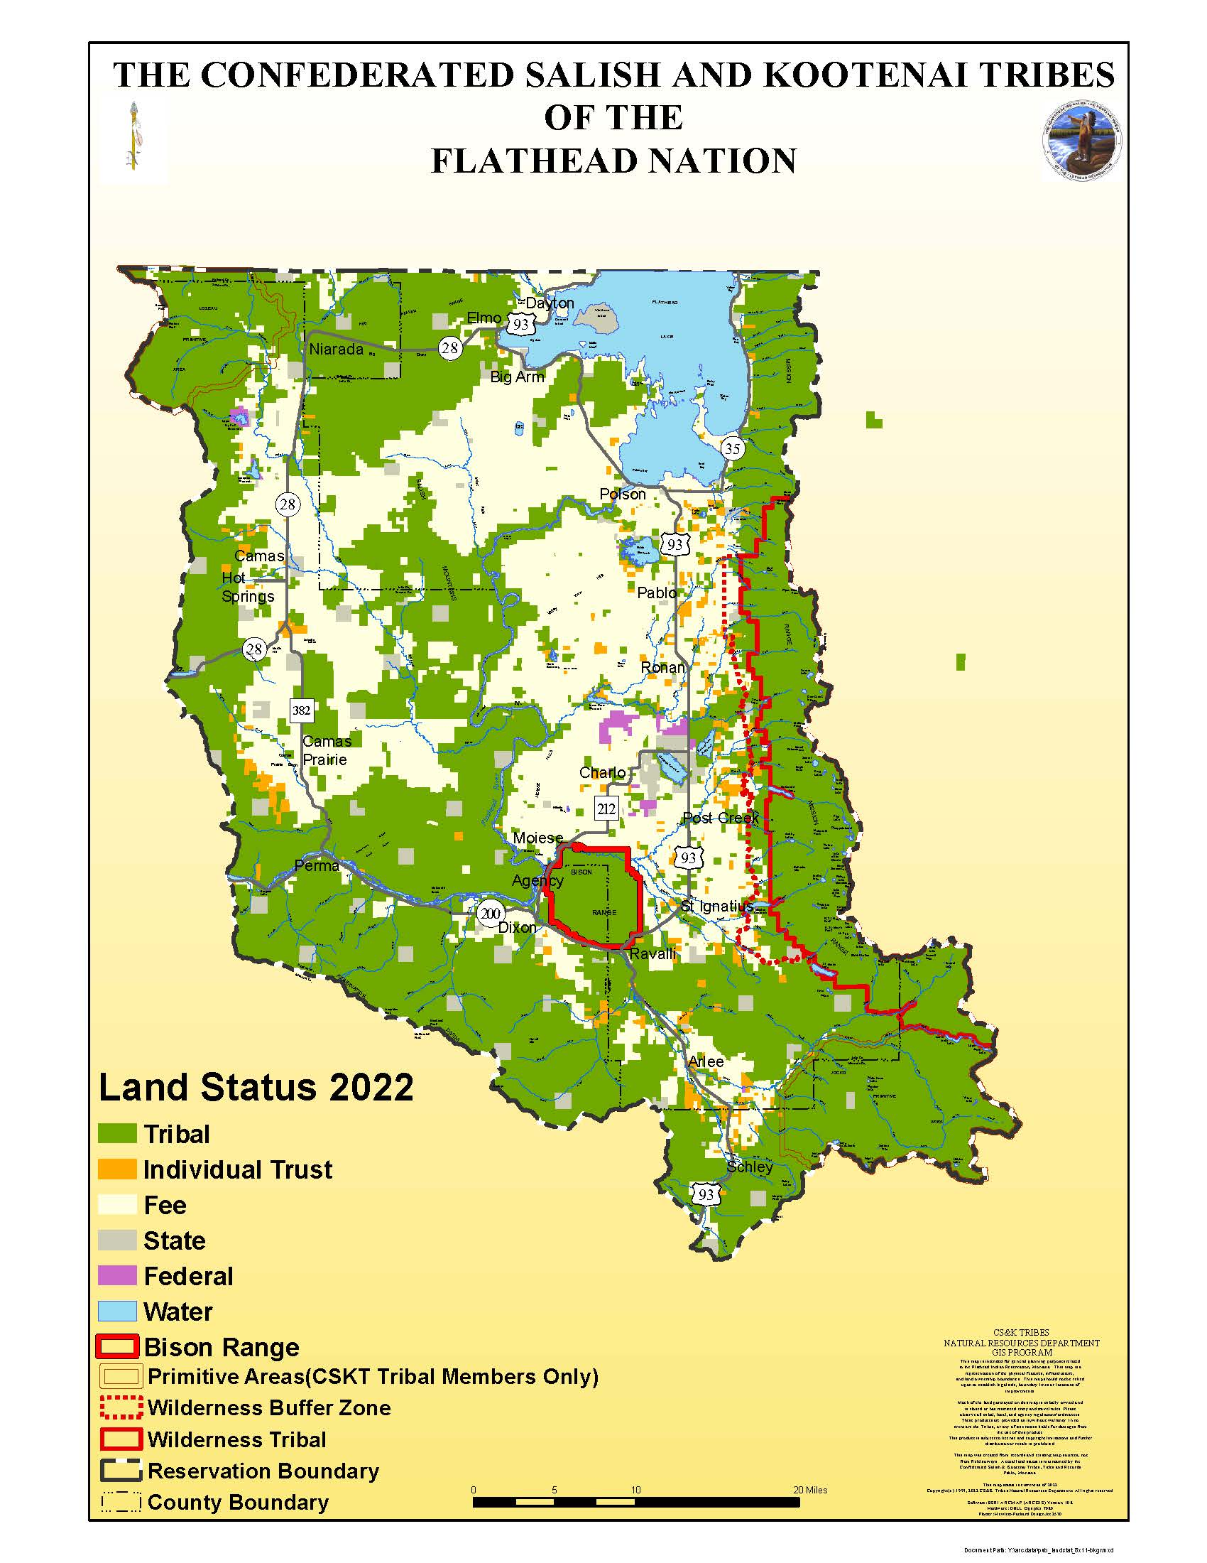
Allotment & assimilation

Slide 15
Indian reorganization & preservation era – 1934-53
Indian Reorganization Act of 1934 aka Wheeler Howard Act 25 USCA Section 461 – protect land base and set up legal structures for government
Ended allotment – reverse the effects of governmental abuse and neglect
Per the Act, constitutions and by-laws subject to approval of Sec of Interior -- self government
IRA constitution (CSKT was the first to submit written constitution) and the org chart and the types of folks in programs and the council structure

Slide 16
Termination and relocation era – 1953-68
Enacted laws to terminate the government's trusteeship of Indian lands and relocate Indians to the nation's cities
Intent was to make us state citizens only, subject to state law
Lands converted into private ownership and most instances, sold
Plunged into deep economic troubles
Public Law 280 in 1953 – diminished the role of Tribes and subjected 5 states to state criminal and civil laws and made it optional for any other state (mandatory states: Alaska, California, Minnesota, Nebraska, Oregon and Wisconsin)
Voting Rights Act of 1965 – strengthen voter protection

Slide 17
Self-determination era – 1968 to Now (Nation Building)
Indian civil rights act of 1968 to impose bill of rights on Tribes and amended PL 280 to where states could not assume criminal or civil jurisdiction without tribal consent.
Termination policies were declared failure by President Nixon and he came up with new policies for local control
1975 Indian Self Determination and Education Assistance
Contract programs federal Indian programs (25 USC 5301; CFR Part 900 of Title 25)
Compact programs ( 25 USC 5361; CFR Part 100 of Title 25)
Why were the feds running programs on reservations and why are we doing a lot of it now?
Goes back into history that the federal government reserved unto itself the right to deal with tribes and primarily in context in getting tribe to relinquish lands.
Part of that process the US deals with tribes, and as part of the land transactions by coercion and force the US made commitments to provide services, underlying agreements, that require ongoing perpetual contributions for vast amounts of lands that make up the US.
Gov programs on reservations turned into a system of patronage where agents were lining their pockets. Indian agents had unlimited authority on decisions and system grew to allow them to take a cut of things.

Slide 18
Self-determination era – 1968 to Now (Nation building) Continued...
Notable Cases:
US v. Mazurie, 419 U.S. 544 (1975)
Self-governing character of tribes has enabled Congress to delegate power to them that could not be delegated to a non-governmental private association. The US Supreme Court upheld federal law to prohibit liquor in Indian Country unless the tribe permitted it.
US v. Wheeler, 435 US. 313 (1978)
No Fifth Amendment violation of double jeopardy as independent sovereign
National Farmers Union Ins. Cos. v Crow Tribe, 471 U.S. 845, 852-53 (1985)
Relevant inquiry is if there is a federal limitation to “prevent” the tribes from acting within the sphere of sovereignty, not whether authority “permits” the Tribes to act
You examine statutes, treaties, executive policies, and administrative and judicial decisions.

Slide 19
Self-determination era – 1968 to Now (nation Building) Continued...
Nation building era – Self-determination era (contracting & compacting BIA functions) slowly transitioned into nation building. Nation building era is strengthening our own capacity for effective and culturally relevant self-government and for self-determined and sustainable community development. (https://nni.arizona.edu/what-native-nation-building)
Ushering in an era of government-to-government relations with tribal governments:
1994 Pres Clinton issued a memorandum each agency to act in “government to government relationships with tribal governments” which has been continued by each President since then
https://www.govinfo.gov/content/pkg/WCPD-1994-05-02/pdf/WCPD-1994-05-02-Pg936.pdf
Government-to-government executive order requiring federal consultation
Executive Order 13175 of November 6, 2000 (Consultation and Coordination With Indian Tribal Governments)
Must be meaningful consultation
https://www.federalregister.gov/documents/2000/11/09/00-29003/consultation-and-coordination-with-indian-tribal-governments
Current Memorandum reaffirming that Executive Order: https://www.whitehouse.gov/briefing-room/presidential-actions/2021/01/26/memorandum-on-tribal-consultation-and-strengthening-nation-to-nation-relationships/

Slide 20
Self-determination era – 1968 to Now (Nation Building) Continued...
Some Notable Plenary Power Cases:
Congress power over Indian affairs is plenary - US v Lara, 541 US 193, 200-02 (2004)
Deemed to arise from the Indian Commerce Clause and the Treaty Clause. US v. Long 324 F.3d 475, 479 (7th Cir.2003)
Examples of plenary power:
Major Crimes Act 18 USCA 1153 -- punishes members for crimes
PL 280 extended state civil and criminal jurisdiction over certain tribes
Civil Rights Act of 1968 which imposed most of the restraints of the Bill of Rights on the Tribes

Slide 21
Compacting and contracting today - means to tribal sovereignty
Laws and what they mean?
Self-governance can reprogram to meet the tribes needs
Compacting is more respectful and allows for changes if needed
Contracting is specific to one program and they disburse as they would to a program
MVP requests the funds to be released
Contracts there needs to be separate contracts for each program
Less ability for redesigning program - streamlined under compacting and give you all the money and more flexibility to move funding around and redesign
Federal Program examples
Compacted
IHS
Lands
Contracted
Fire
MVP
TERS (grant contract)

Slide 22
Tribal sovereignty & state intersection
How does this all connect? And why can things be complicated?
After allotment and assimilation era for CSKT
80% of population is non-Indian
70% is CSKT land today
Checkerboarded reservation with mixed populations and jurisdictions
Citizenships - Tribal, US, and State
As mentioned prior, it wasn't until 1924 that U.S. citizenship was generally conferred on Indians
Before then, some treaties or allotment acts extended citizenship to individual Indians and members of certain Indian tribes.
Since 1924, all Indians born in the United States, or born to citizen parents outside of the country, are U.S. citizens, with all of the attendant rights and responsibilities.
Indians are also citizens of the states in which they reside.
Indians are citizens or members of Indian tribes.
U.S. citizenship is not inconsistent with tribal membership, nor does it affect the special relationship that exists between Indian tribes and the federal government.

Slide 23
Tribal sovereignty & state intersection Continued...
This history created overlapping jurisdictions, citizenships, and complex issues
Statehood, Fed Constitutions, and Tribal Constitutions
Taxation Issues –
Limited taxing authority → left to diversify portfolio - we don't want to tax low income & small populations
Revenue Sharing Agreements – taxation on rez (Indians v. non-Indian)
Education system
As U.S. citizens and as citizens of the state in which they reside, Indian students are entitled to participate in public education programs. However, prior to their being granted citizenship in 1924, Indian students attended schools operated by the U.S. Department of the Interior–Indian Affairs.
TERS is a Tribally Controlled Grant School

Slide 24
Tribal sovereignty & state intersection Continued...
Intersection of Jurisdictions
Overlap of wildlife, resources (Aquatic Invasive Species), education, gaming, alcohol, tobacco, criminal law, language, water, air
Federal programs – funding, grants, direct etc
State Pass through funds
ECS directly through contracted grants
SKHA direct fed funds

Slide 25
Helpful resources
Canby’s American Indian Law in a Nutshell, 7th Edition
https://leg.mt.gov/content/Publications/services/2020-agency-reports/tribal-nations-handbook-nov-5-2020.pdf
https://indianlaw.mt.gov/fedstate/acts/cskt
https://turtletalk.blog/
https://www.ncai.org/resources
https://narf.org/our-work/
https://montanabudget.org/resources
https://www.ncsl.org/legislators-staff/legislators/quad-caucus/an-issue-of-sovereignty.aspx#:~:text=Tribal%20sovereignty%20refers%20to%20the,to%20regulate%20their%20internal%20affairs

Slide 26
THANK you!

