Slide 1

AN OVERVIEW

Slide 2

OUR MISSION
Homeword uses sustainable methods to strengthen Montana communities by teaching homebuyer education and financial skill building and creating safe, healthy homes people can afford

Slide 3
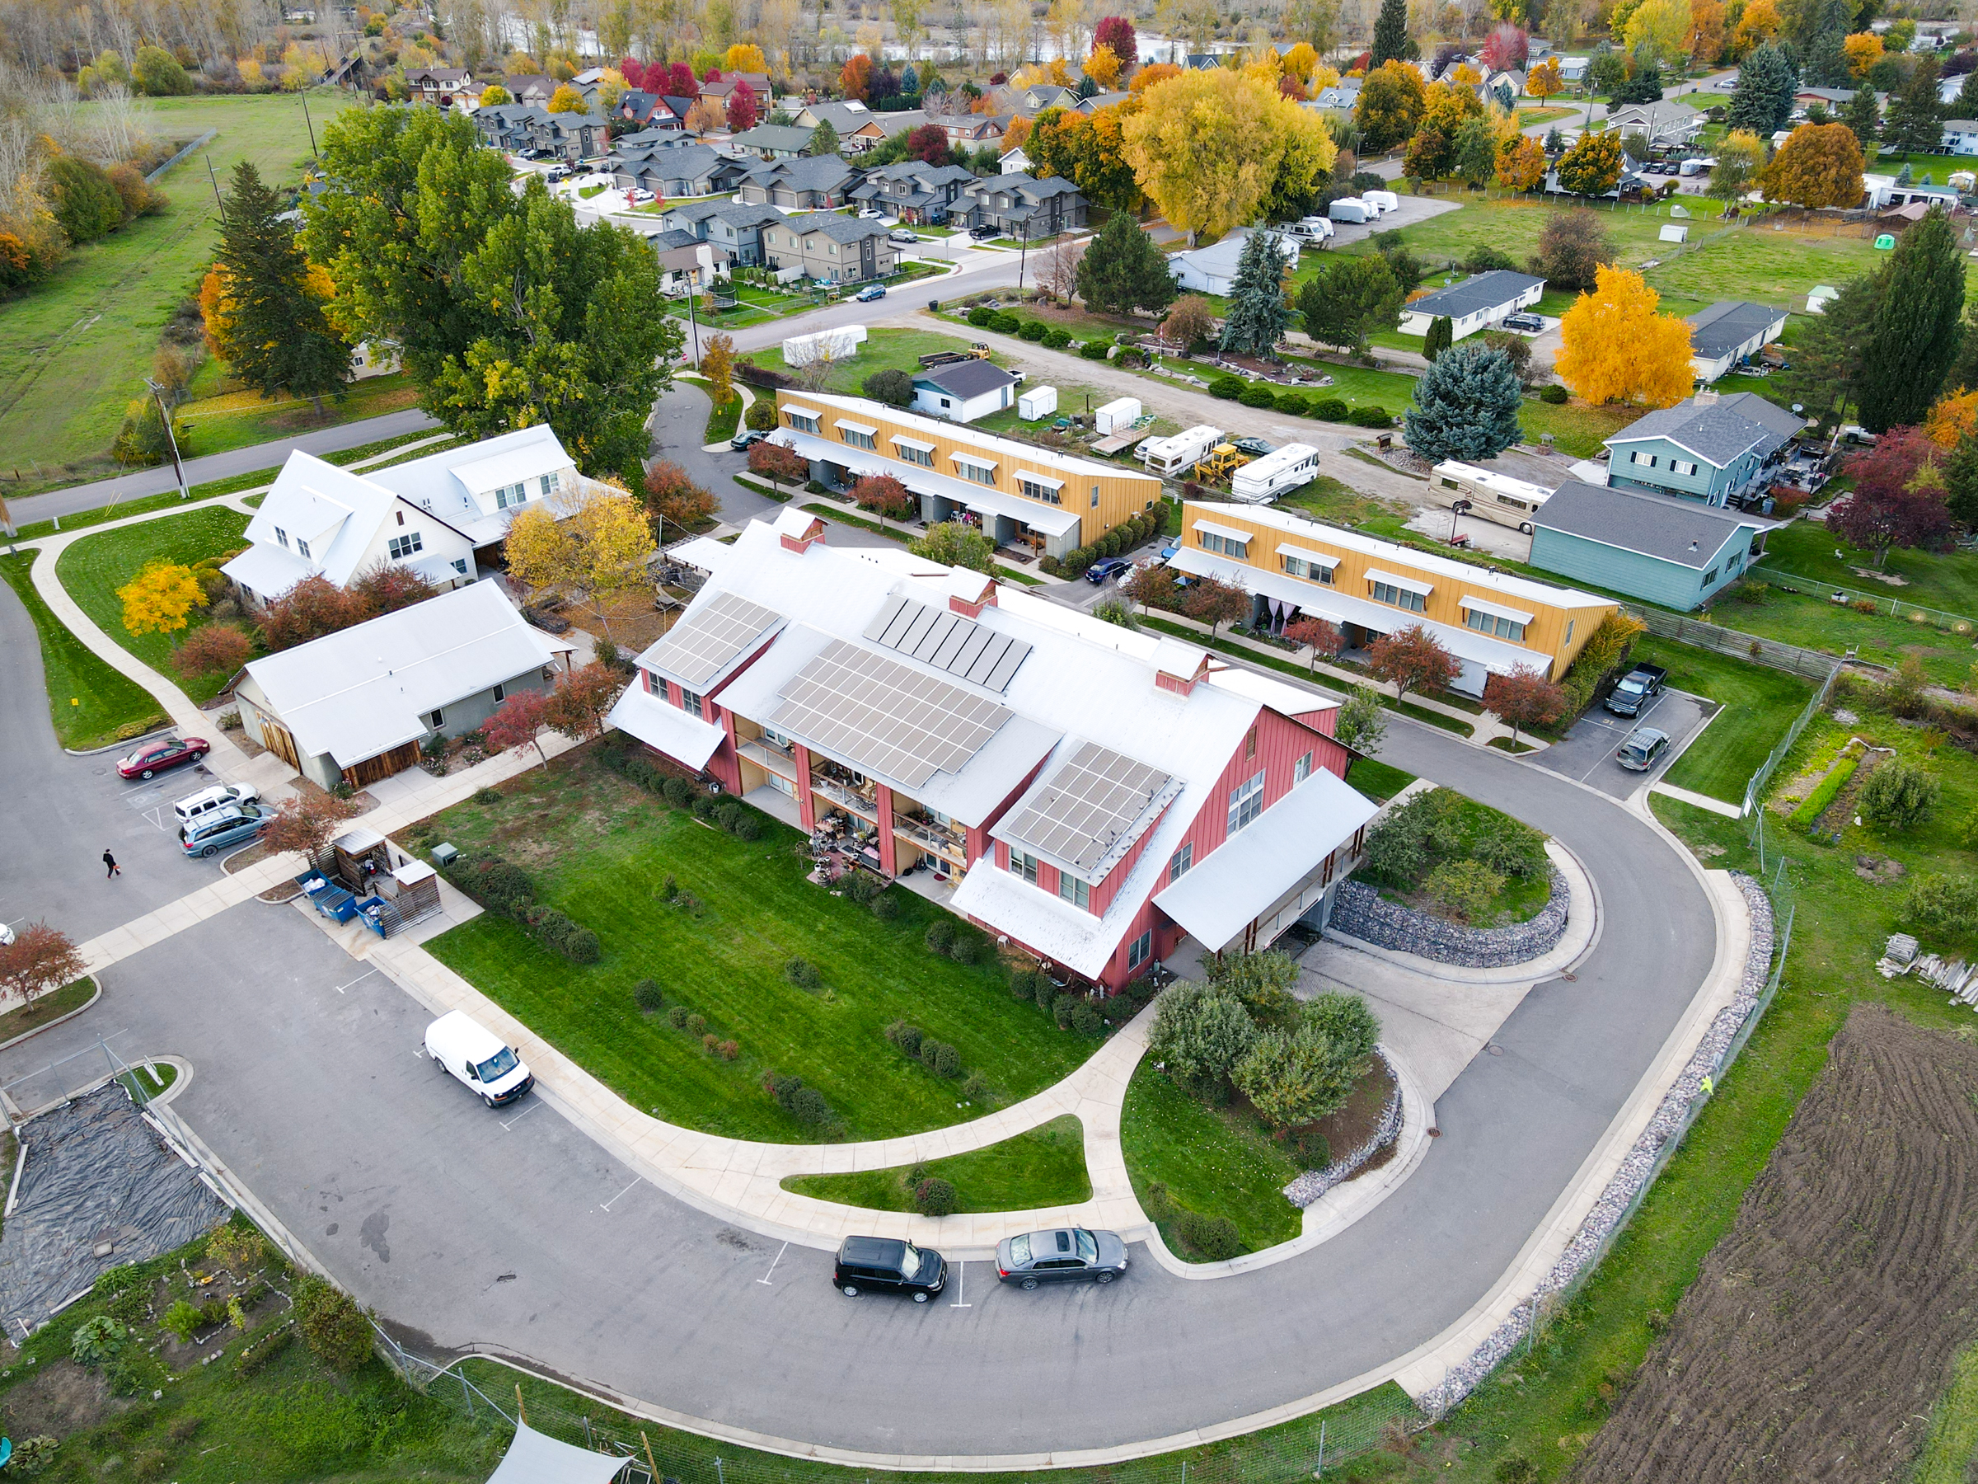
ABOUT US
Nonprofit established in 1994
Montana Community Housing Development Organization
Creates and rehabilitates homes Montanans can afford
Provides homebuyer and financial education and counseling

Slide 4


HOME DEVELOPMENT
Our communities are stronger when everyone can afford to live in a safe and healthy home. We create homes with our residents and communities in mind and strive to use land wisely.

Slide 5
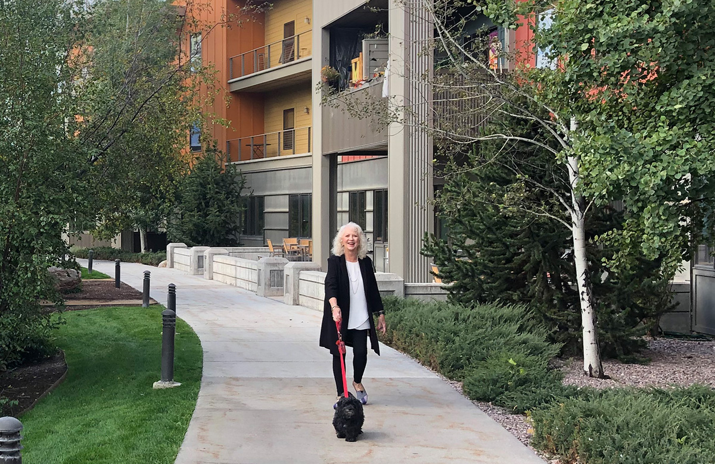
IMPACT
Over the past 29 years, we have created or preserved 1,537 homes at 32 properties in 14 communities that are home to 2,000 Montanans, including 600 children.

Slide 6
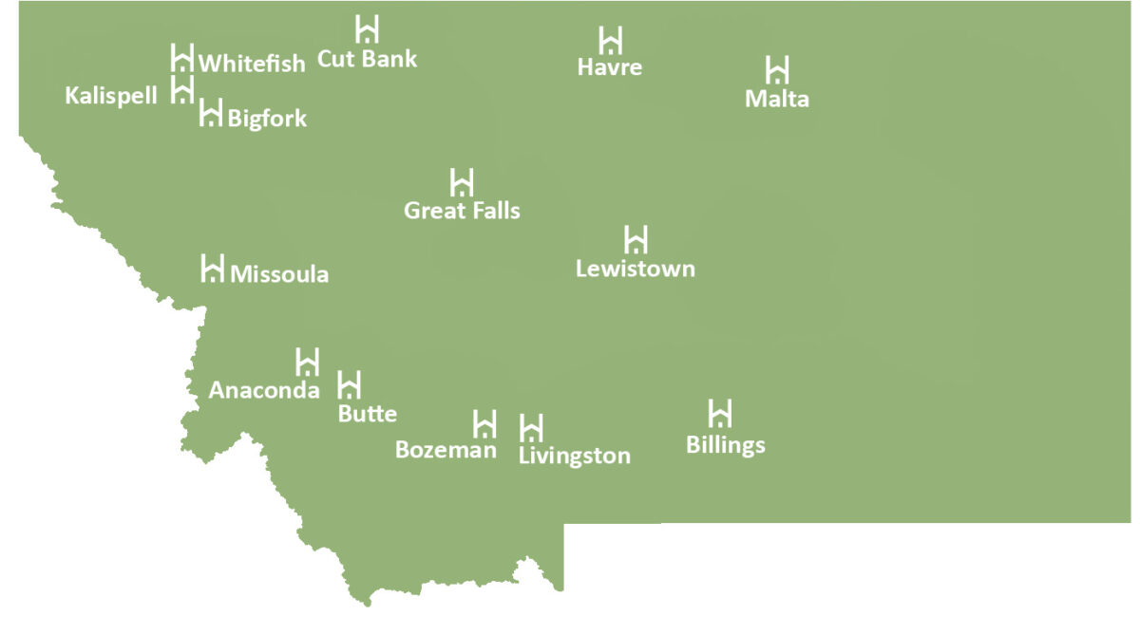

Slide 7
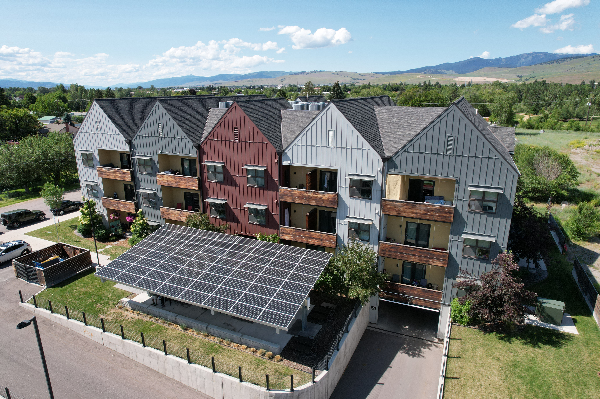
SUSTAINABILITY
Beautiful homes residents are proud to live in
Green spaces and gardens
Reuse and recycle materials
Free of toxins
Well insulated to decrease power costs
Solar generation at 14 properties to decrease residents’ power bills

Slide 8



HOMEOWNERSHIP CENTER
We are a HUD Certified Housing Counseling Agency offering a full range of services to empower Montanans reach their financial and home-related goals.

Slide 9
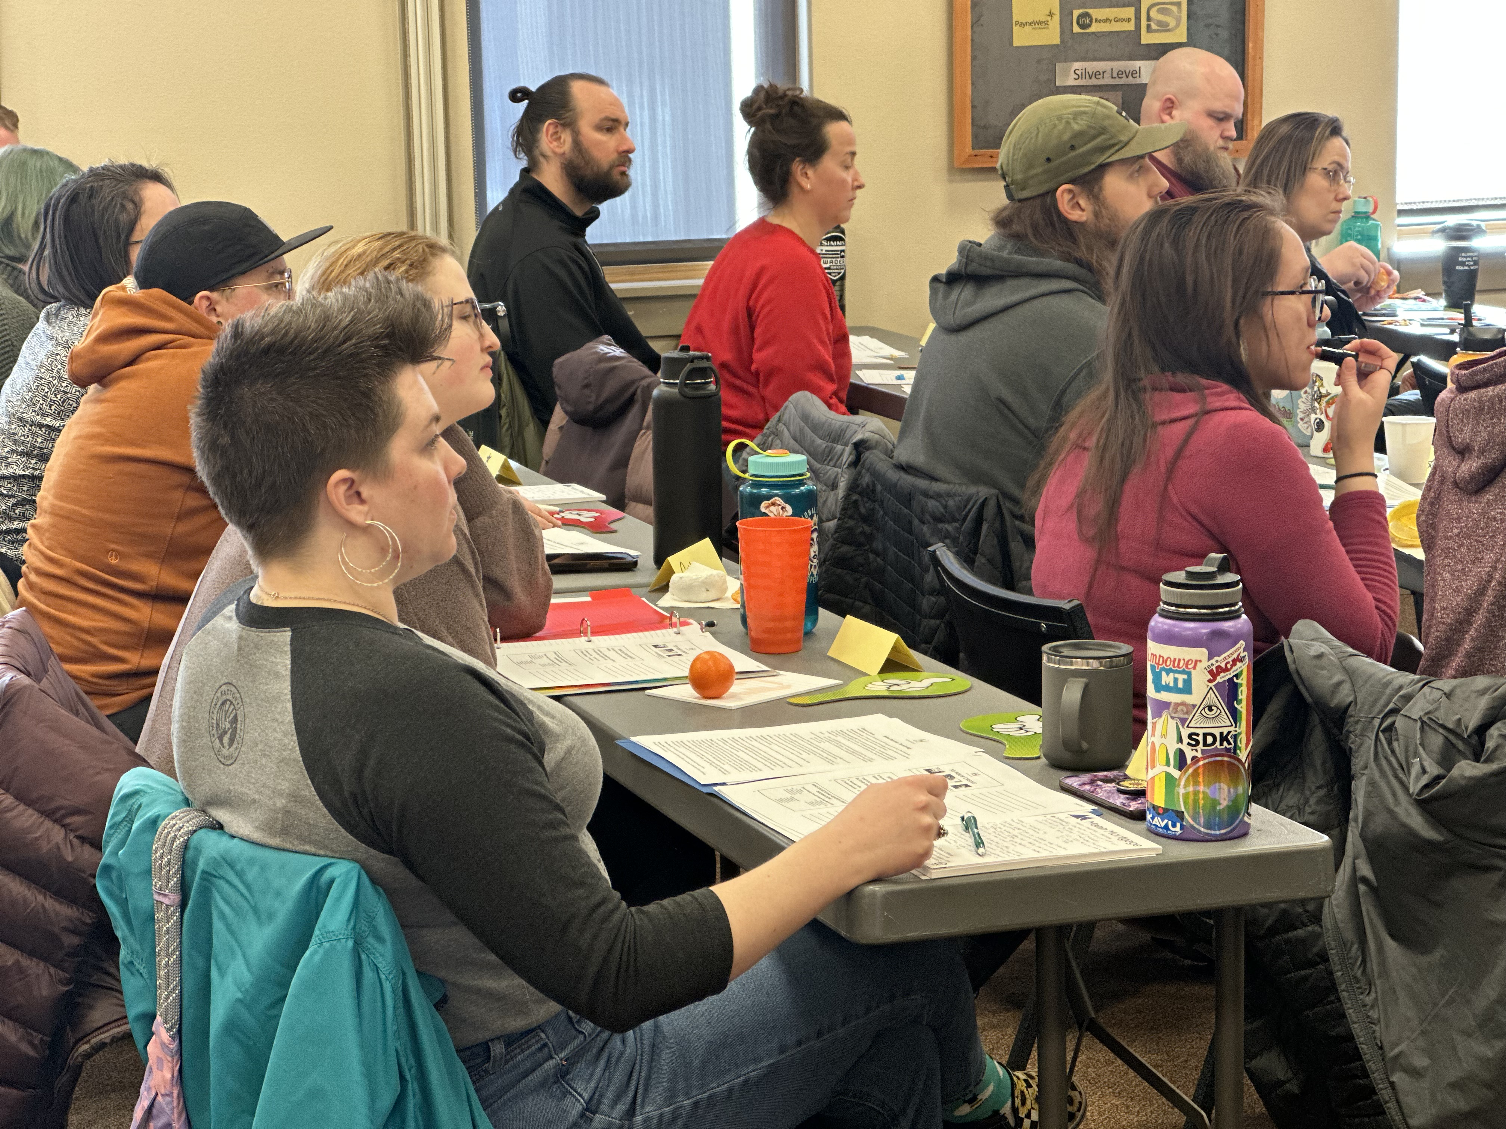
IMPACT
One of only three Regional HomeOwnership Centers® in Montana
Empowered 20,000+ people since 1997
Empowers 1,000+ people annually
Homebuyer and financial education
Individual counseling

Slide 10

GET READY FOR HOMEOWNERSHIP CLASS
HUD-certified
Nine hours
Offered monthly
$35 per person
Participants learn how to select a lender, determine what they can afford, distinguish between different types of loans, evaluate the pros and cons of homeownership and more.

Slide 11
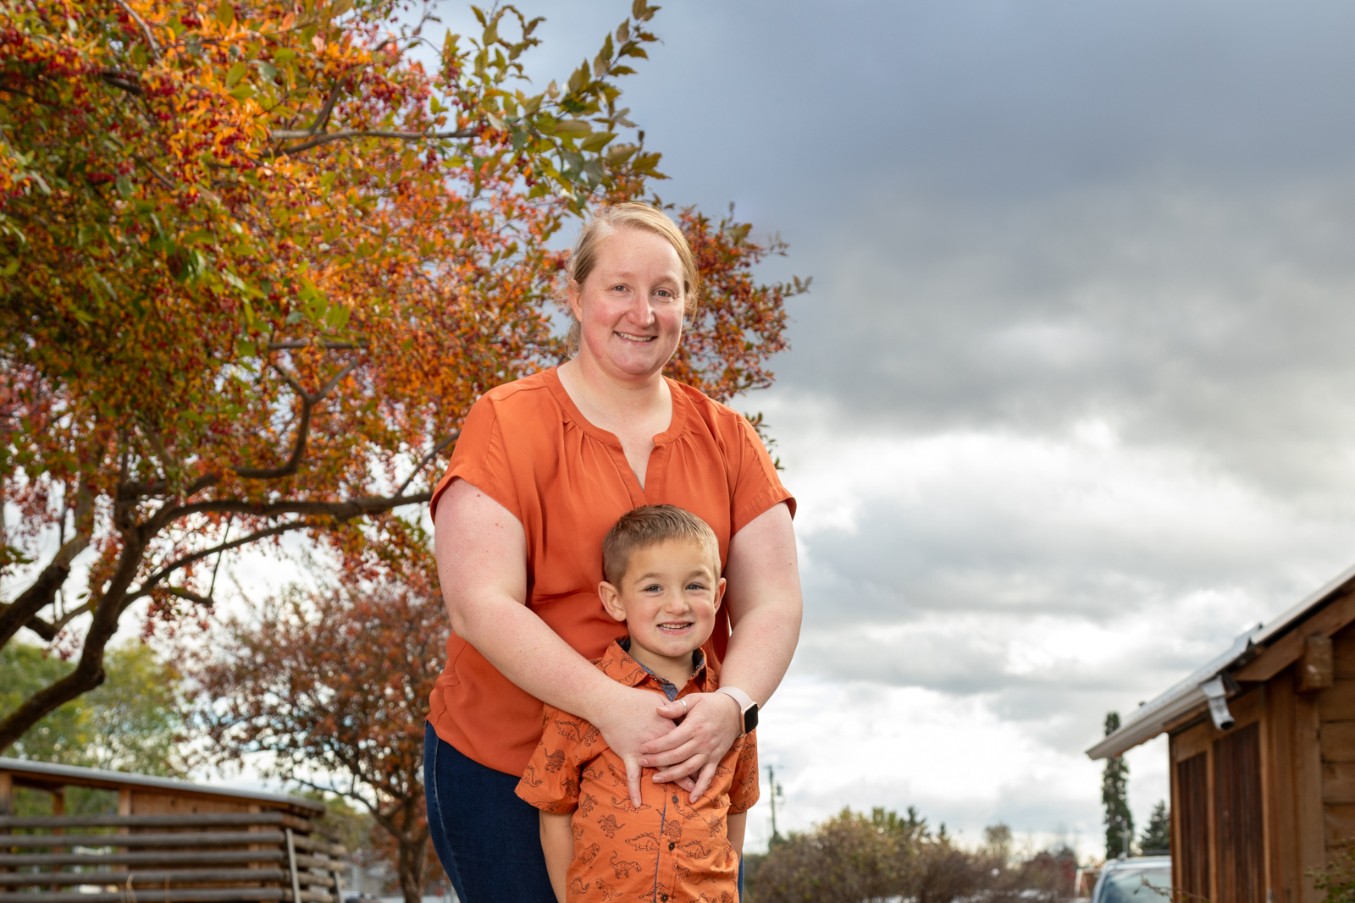
FINANCIAL SKILL BUILDING CLASS
Free
Statewide
Offered semi-monthly
Participants learn to quickly adapt to income or expense changes, build solid financial judgement and address credit or debt challenges.

Slide 12


RESOURCES
It takes all of us working together to build sustainable communities!

Slide 13
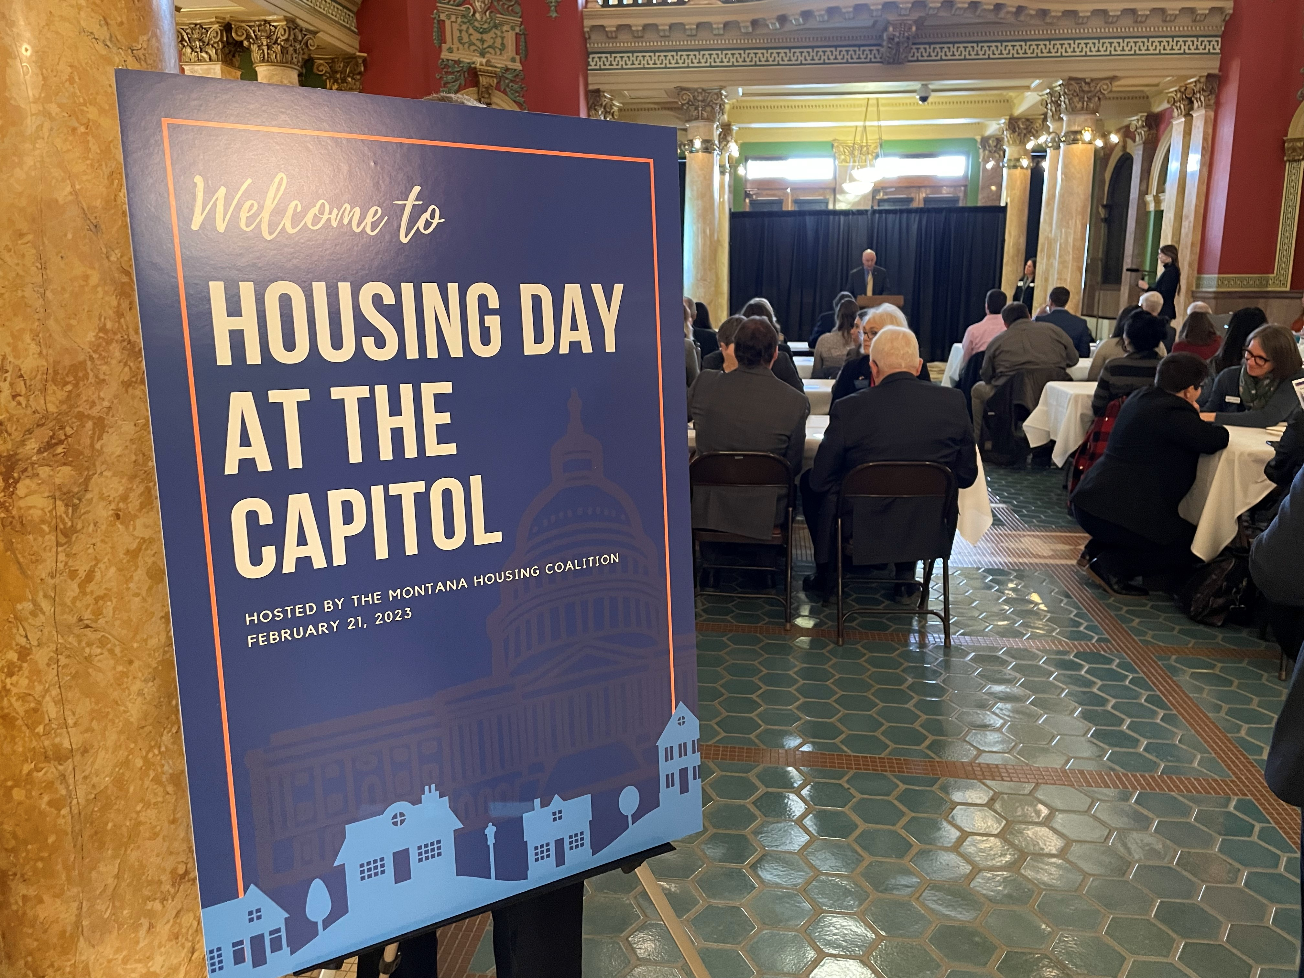
PARTNERSHIPS
NeighborWorks Montana
Social service agencies
City, County and State governments
Government representatives
Housing agencies and advocates

Slide 14
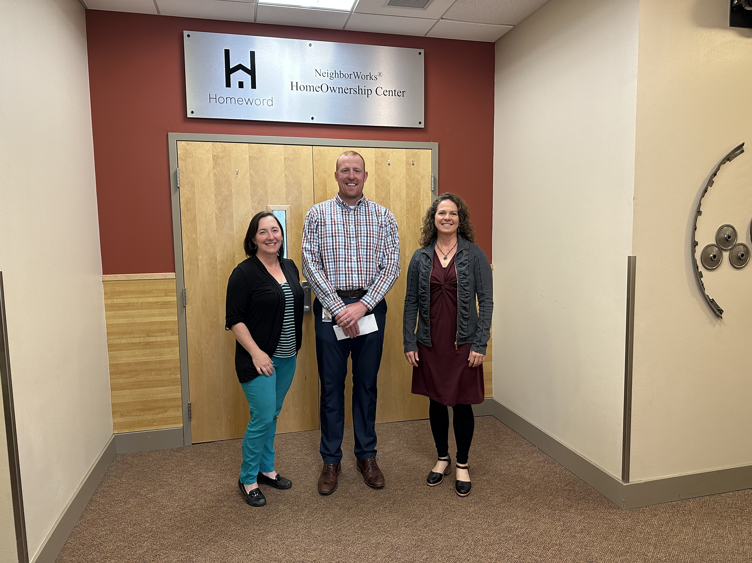
FUNDING
Housing Tax Credits
HUD mortgage and rental assistance programs
In-kind gifts
Fees for service
Mortgage financing, interest
Federal, public and private grants
Sponsorships and business donations
Individual gifts

Slide 15
PROJECTS
Homeword has been working closely with Montana Healthcare Foundation. Housing is healthcare, partnerships work.

Slide 16
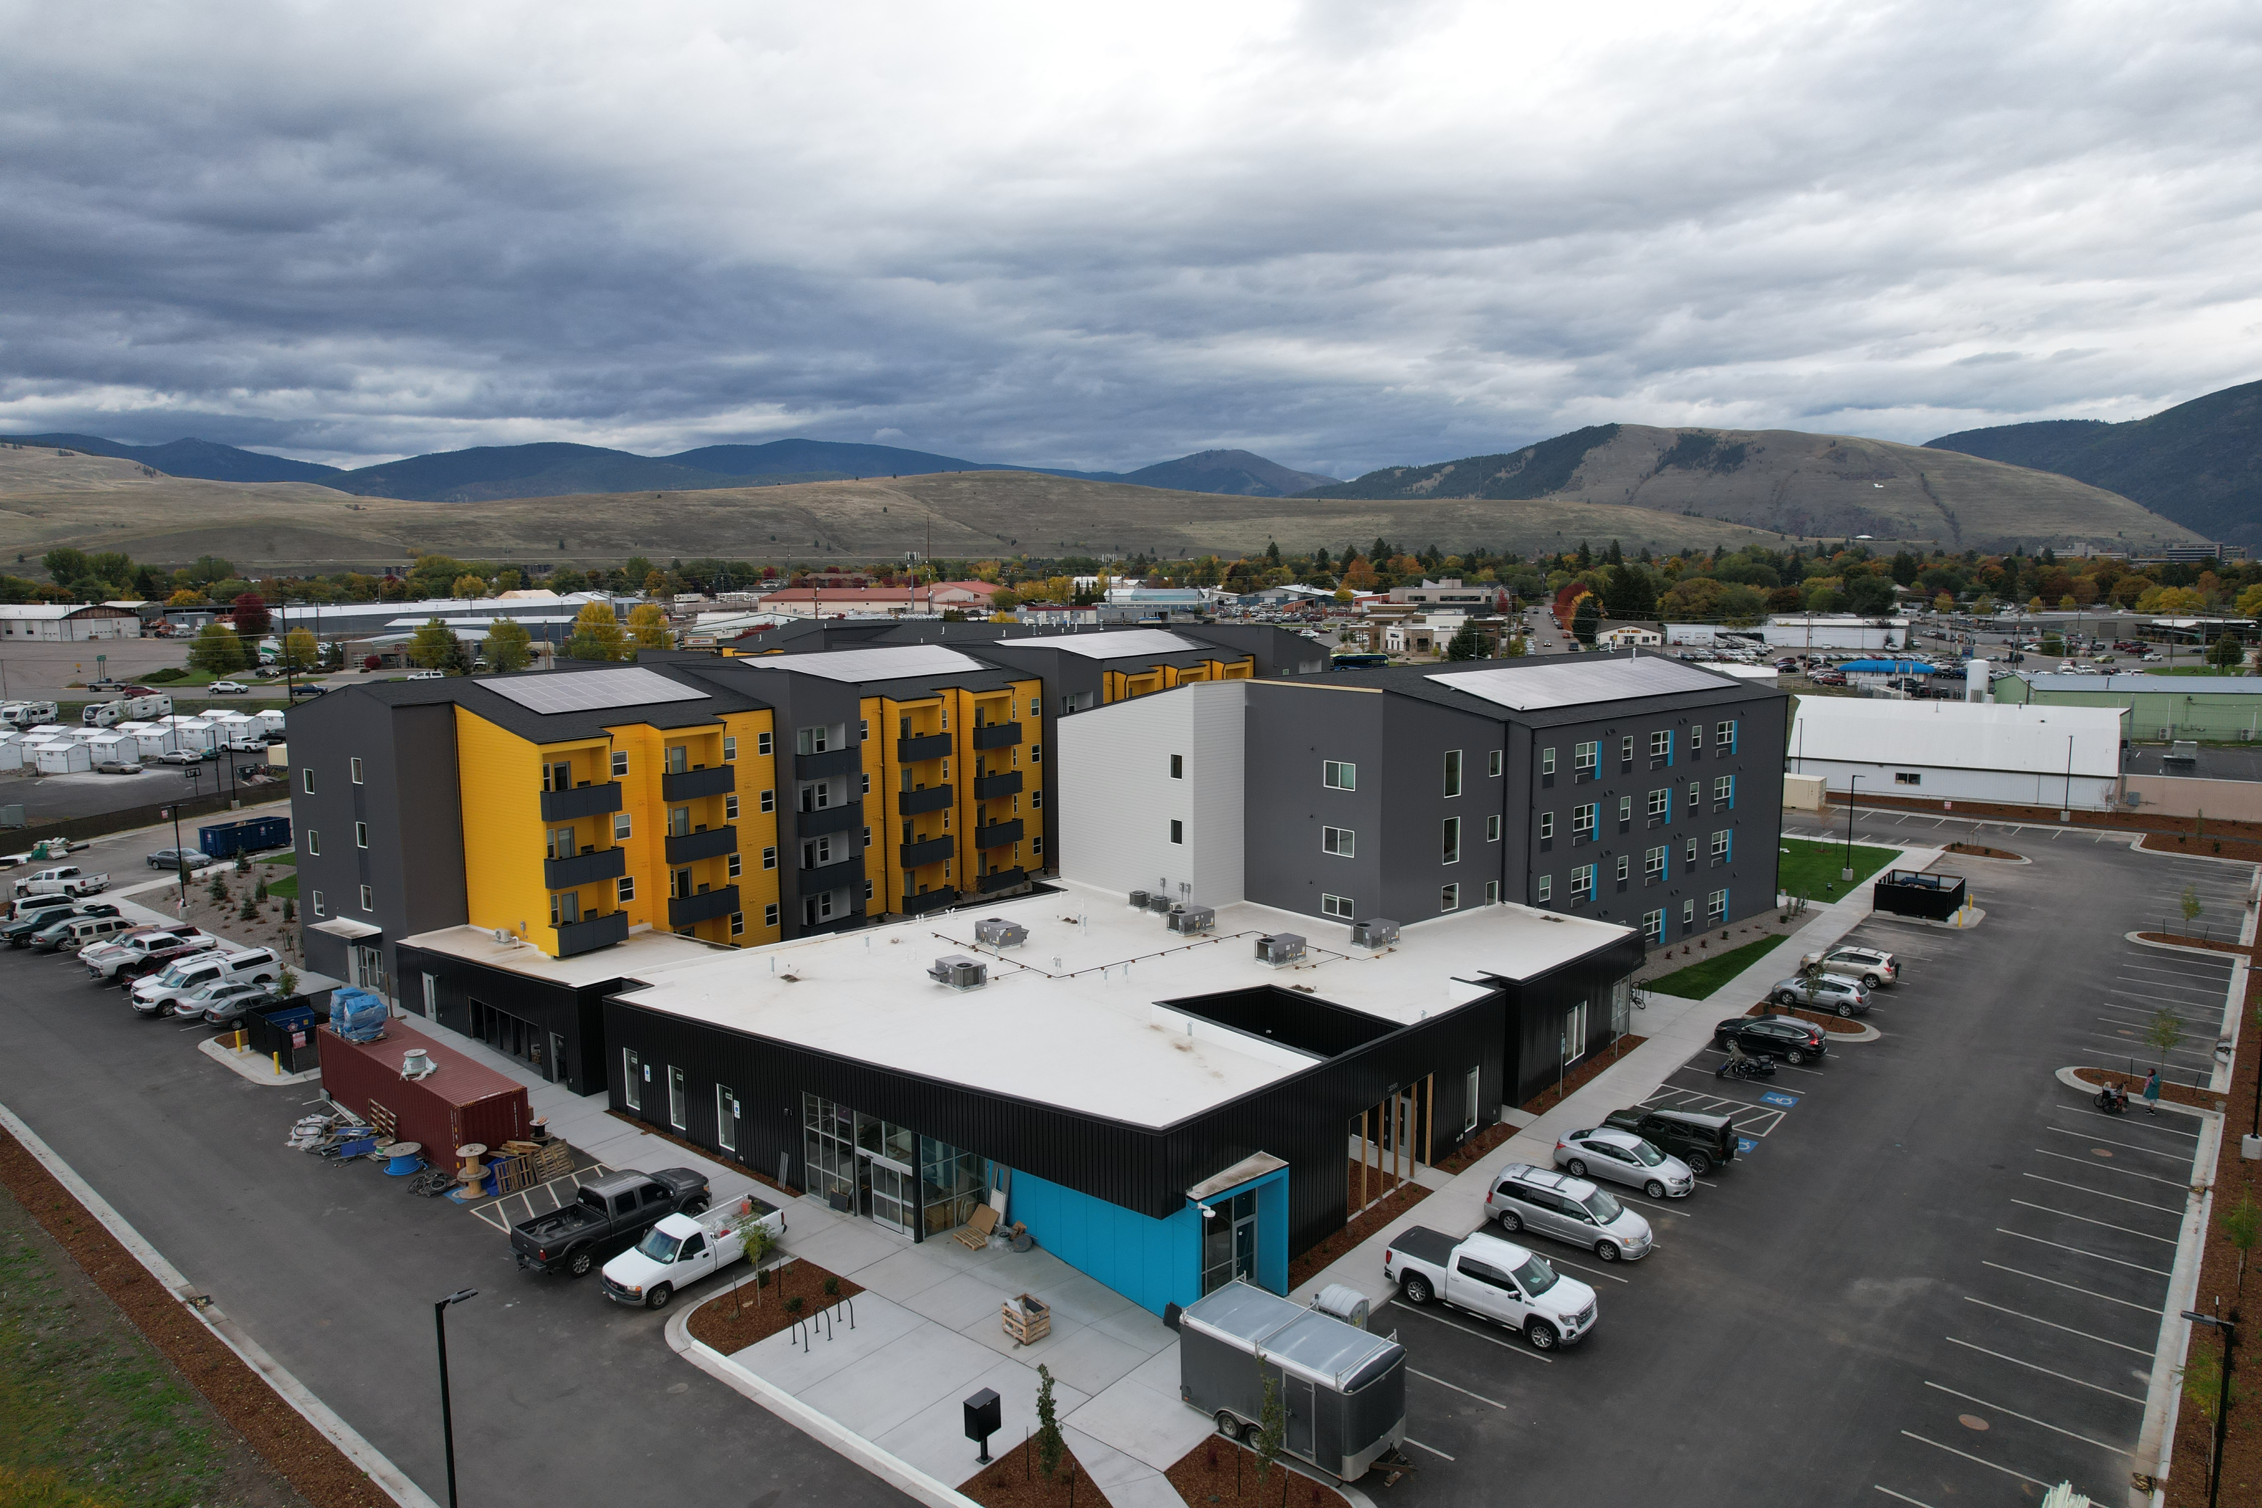

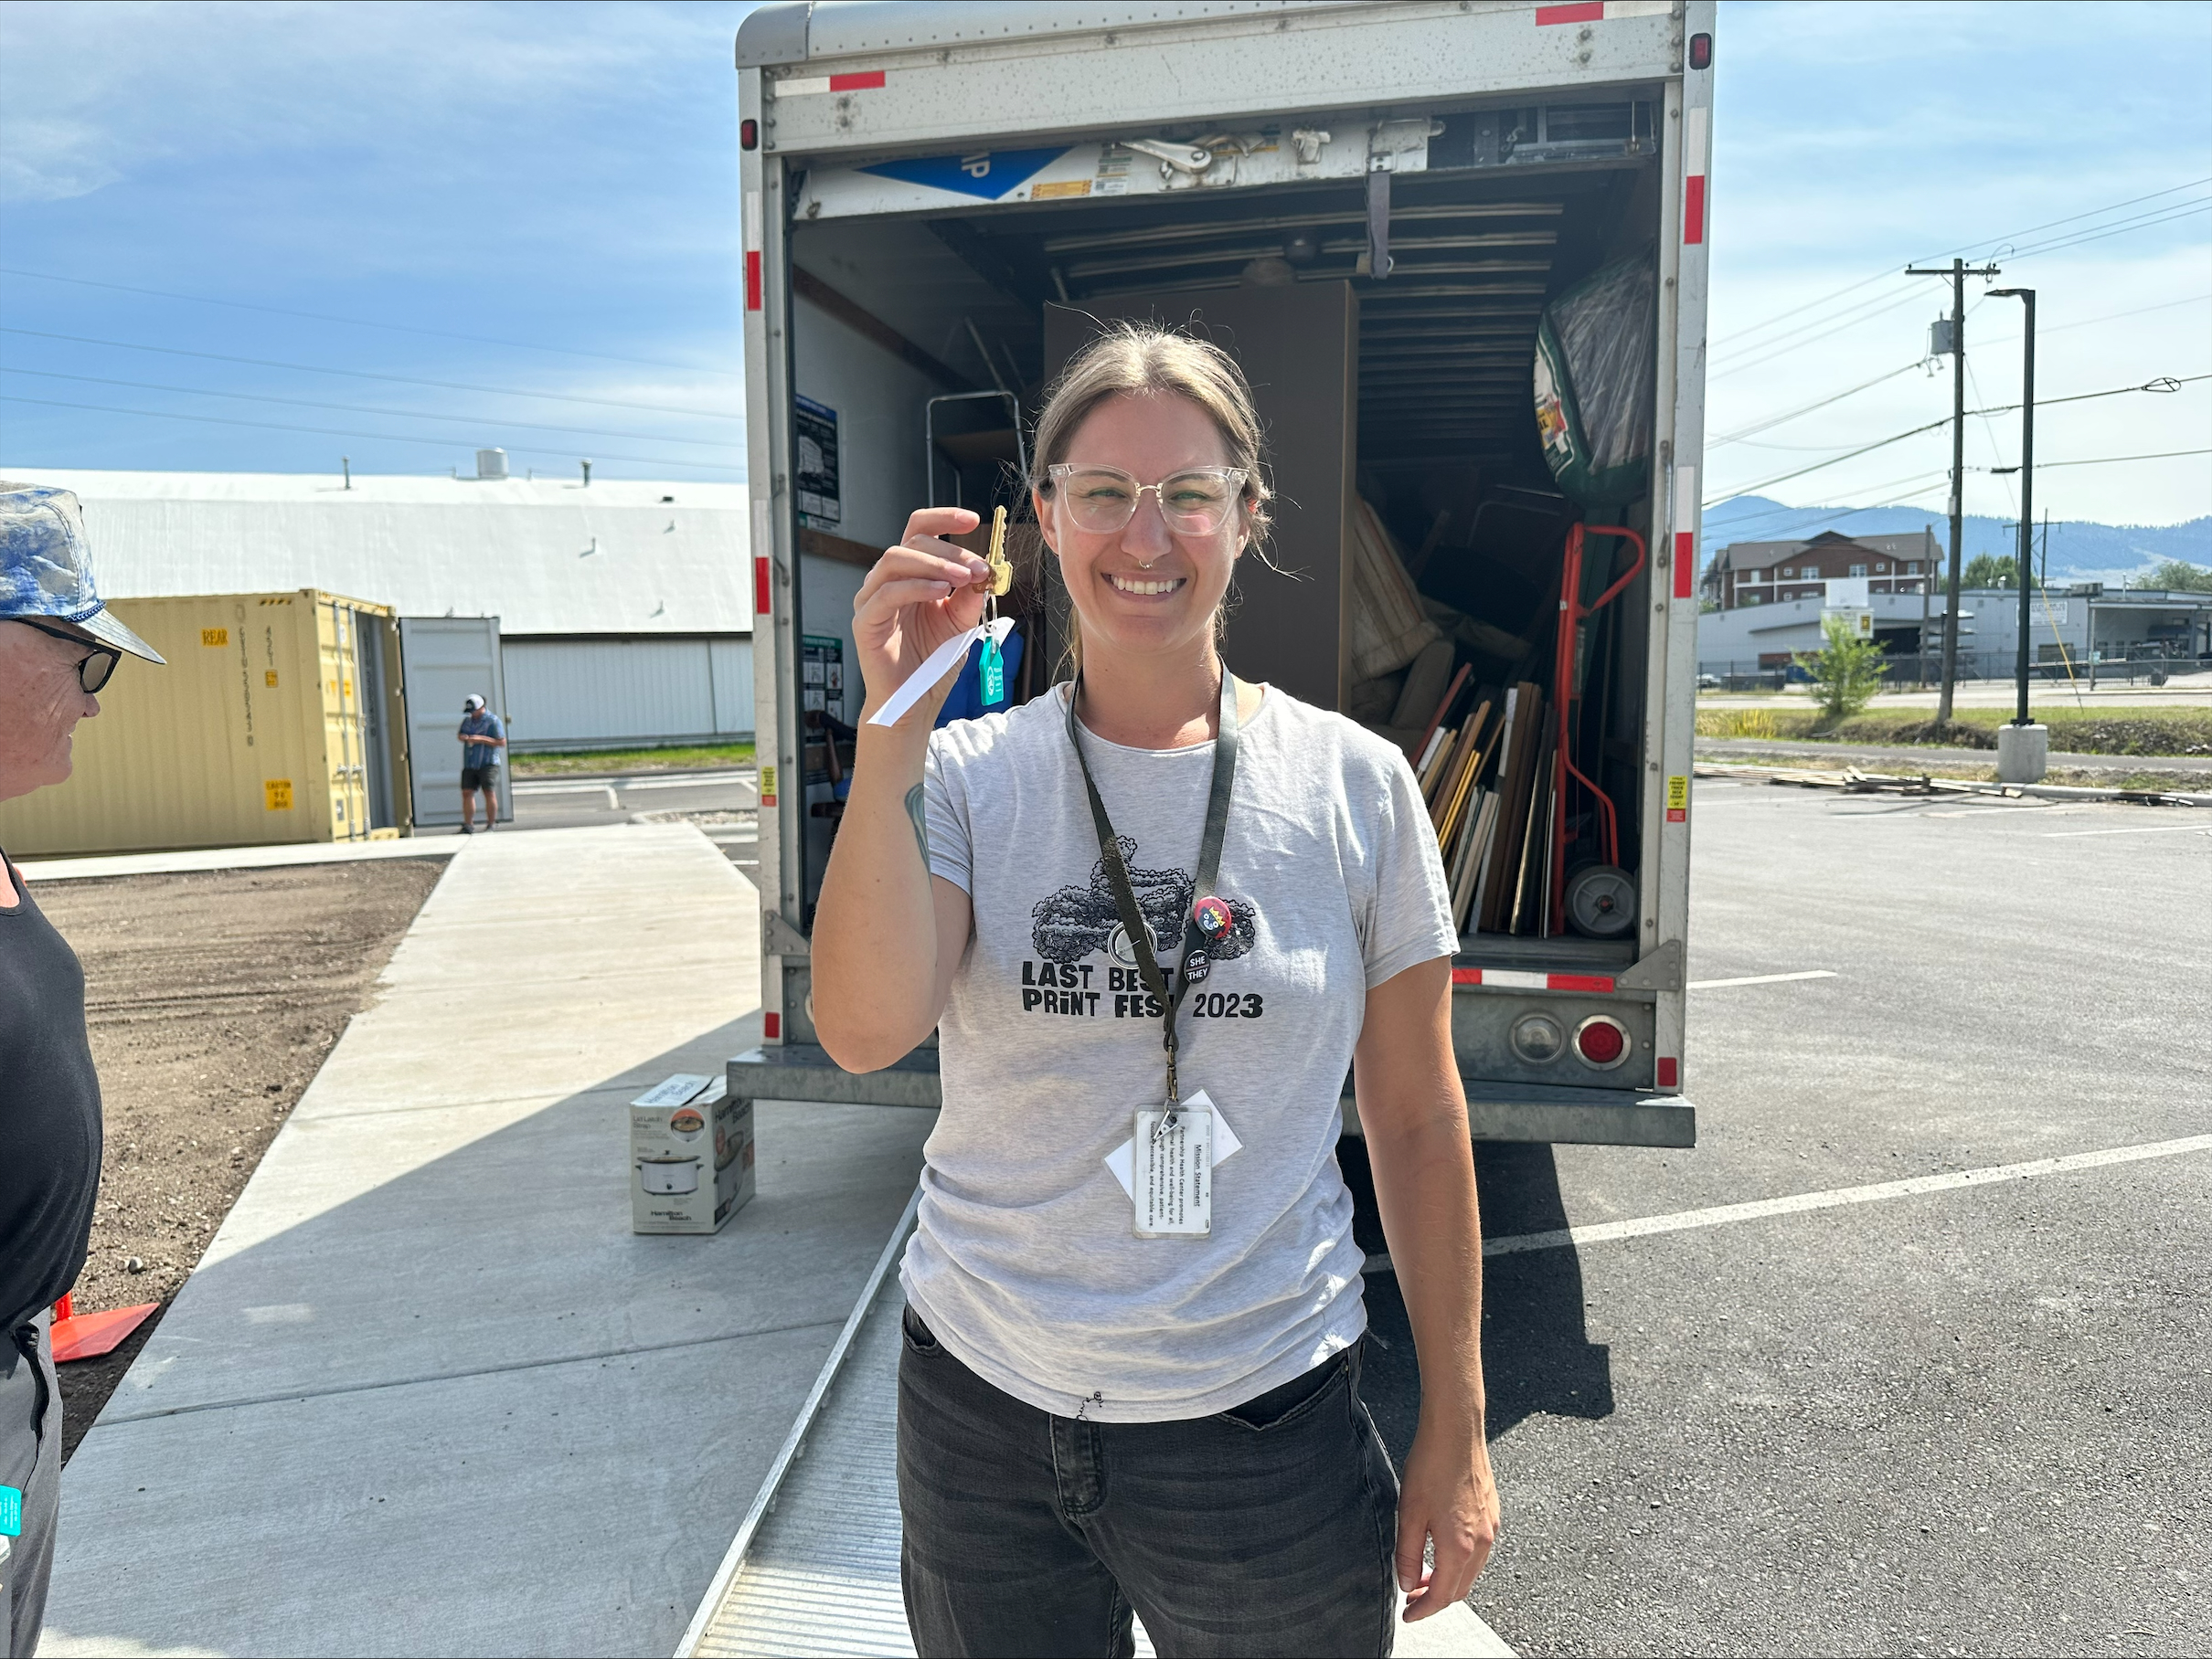
TRINITY APARTMENTS
Missoula, MT
202 Homes, including 30 Permanent Supportive Homes in Blue Heron
Homes Complete and Occupied
Partnerships
Owners
Developers
Service Providers
Montana Healthcare Foundation
Notes:
Owners: HW & MHA
Developers: HW, BLD & MHA
Service Providers: Partnership Healthcare, Poverello Center, All Nations
Montana Healthcare Foundation impacts
Funding for Missoula’s initial assessment – essential for initiating this project as one slice of the overall houseless need
Funding for Partnership Health – for Blue Heron services as well as activities associated with other Missoula FUSE initiatives
Services essential, this model and Blue Heron is working;
Helped up front concerns with gaps in billable services and new scopes of work for PHC
Continued ongoing concerns for long-term sustainable operations
Funding for the Navigation Center
Partnership Health has a clinic space, similar model as other locations but goal to be open for walk ins
Main concern is a Services Facilitation position(s) for Resource Center side
Main points:
New model for us as housing agencies as well as new for all service providers – each stretching to meet the specific need.
Took twice as much time as a traditional housing project
Long term sustainable operations a concern - $1M paid dev fee finite, gap in very necessary billable services for this model, policy changes necessary
Lessons learned ongoing – property management and service providers have valid reasons for perspectives (give guest example from Blue Heron)
Huge success – really working for residents (Thanksgiving dinner picture included)

Slide 17
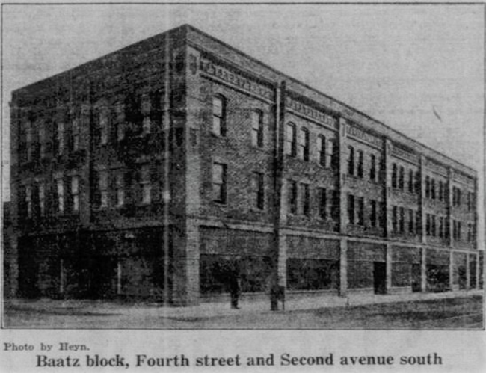
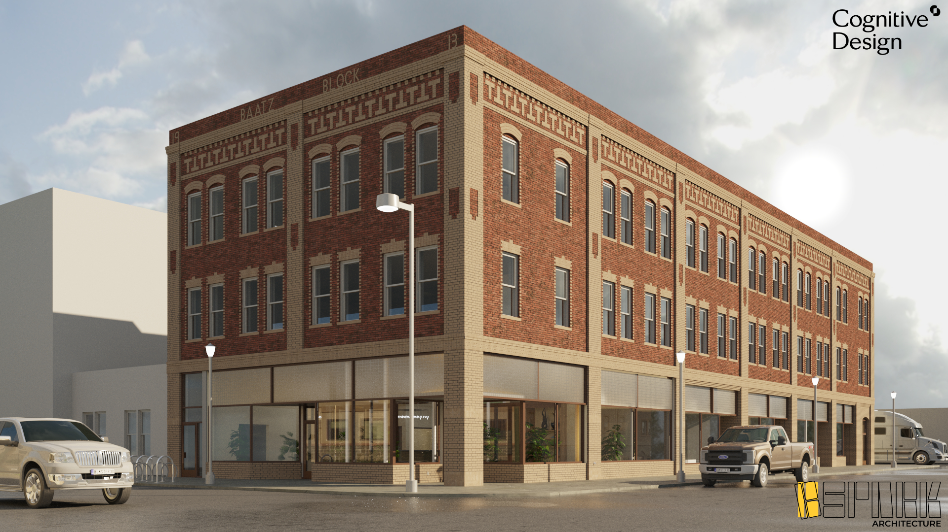
BAATZ BLOCK APARTMENTS
Great Falls, MT
25 Permanent Supportive Homes
Homes Under Construction
Partnerships
Owners
Developers
Service Providers
Montana Healthcare Foundation
Notes:
Owners: HW & NWGF
Developers: HW & NWGF
Service Providers: Opportunities, Inc., Many Rivers Whole Health
Montana Healthcare Foundation impacts
Funding for Great Falls initial assessment – essential for initiating this project as one slice of the overall houseless need
Funding coordination with and assessment of service providers capacity and interest
YWCA was initially interested, but found insufficient capacity and not a Medicaid/Medicare billing organization;
Opportunities Inc and Many Rivers identified and agree to be lead service providers
Funding for the coordination and mobilization of service providers prior to construction completion and occupancy
Critical for roles and responsibilities – HW & MHA spent enormous amounts of time during the full two-year construction period for Trinity
Establishing up front coverage of service gaps and planning ongoing sustainable operations
Main points:
All lessons learned and ongoing lessons from Blue Heron all being transferred to Baatz.
Pull every soft source possible into the project to insulate risks up front
Navigating the rules of traditional housing funding and new funding opportunities, its clear policy work needs to be done. HUD rules not supportive to actual operational realities of PSH
Long term sustainable operations a concern - $1M service reserve finite, gap in very necessary billable services for this model, policy changes necessary

Slide 18
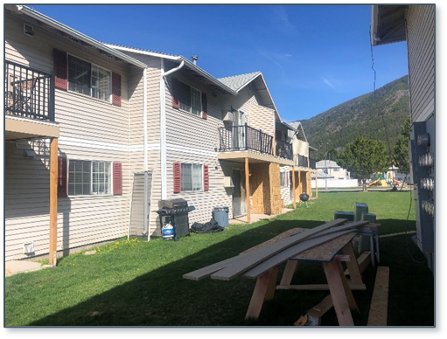
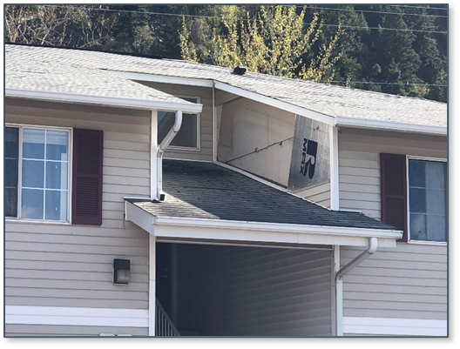
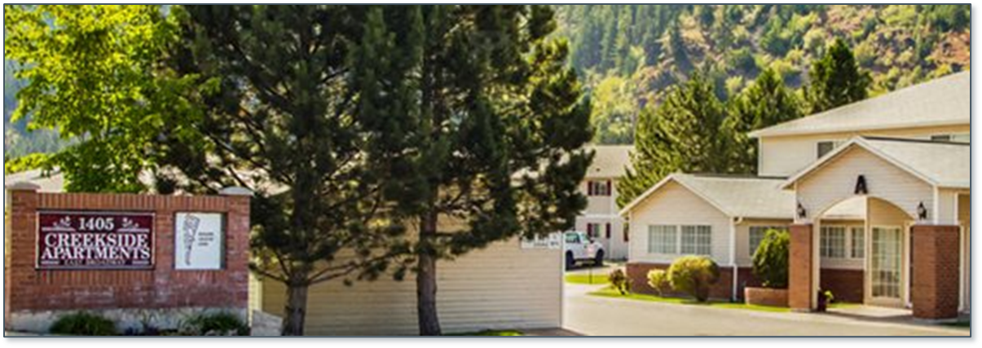
CREEKSIDE APARTMENTS
Missoula, MT
161 Homes
Acquired & Preserved 2017
Significant Rehabilitation Required
Montana Healthcare Foundation
Notes:
Owners: Homeword, Inc.
Developers: Homeword, Inc.
Acquired and Preserved in 2017 – competed against market rate developers that would take it out of the affordable program, many units lost and being lost in MT.
Affordability restrictions sunsetting in 2026
Knew essential rehab needed within 5-7 years, this is now
Utilized a 501c3 conduit bond to acquire, leveraged as many resources as possible to compete.
Rehabilitation now is a challenge, market conditions – labor, materials, financing, etc. explode.
Unique to this project, Glacier Bank is willing to recycle the bond proceeds when repaid and use the proceed in our new tax-exempt bond for the rehabilitation with a blended rate far less than current market provides.
Montana Healthcare Foundation impacts
Funding crafted to work both short term and long term for Creekside
Phases of the loan most helpful to phase of the rehabilitation – early funding to assist with predevelopment, interest only while we have intentional vacancies for rehab work, full loan payments once we are done and closer to full occupancy – terms far more favorable than market.
Main points:
Residents were at a very high risk of displacement which could likely end in homelessness and/or leaving the community altogether.
Restrictions burning off, market appeal directly across from the university
Very low vacancy rates in Missoula, rents continuous increases
Homeword knew significant rehabilitation would be required within 5-7 years; All major building systems at the end of their useful lives, significant rehabilitation necessary.
Adding traditional debt not feasible, these long term MHCF funds are significant and make a difference.

Slide 19



QUESTIONS?
Learn more by visiting our website at homeword.org and connecting with us on Facebook, X (Twitter), LinkedIn, Instagram and YouTube! Search “homewordmt” to find us on these channels.

Slide 20
ALL NATIONS
Missoula, MT
All Nations Health Center
Feasibility to include Housing
Montana Healthcare Foundation
Notes:
Montana Healthcare Foundation impacts
Funding for Missoula’s initial assessment – essential for All Nations considering housing as part of their project, potentially an additional slice of the overall houseless need or a version of traditional family housing
Funding to assess including housing in their new facility
Main points:
The ongoing impacts from the initial funding to address houseless need evident in Missoula. All Nations’ consideration to include housing in their new facility is a great example of the fact that service providers and housing entities are continuing to work together on our housing issues – housing is a full circle continuum. Houseless to Market Rate

