Slide 1
Summarizing the Science of Vaccination ...
Vaccines for Fall and Winter
William Schaffner, MD
Spokesperson, National Foundation for Infectious Diseases
National Press Foundation, CVEEP Webinar
July 24, 2024
www.nfid.org
Notes:
I am Dr. Bill Schaffner, spokesperson for the National Foundation for Infectious Diseases, or NFID.
NFID is a non-profit organization dedicated to educating and engaging the public, communities, and healthcare professionals about infectious diseases across the lifespan.
Each year, NFID sponsors an annual news conference, held in partnership with the Centers for Disease Control and Prevention (CDC), to kick off each respiratory season with the latest CDC data, NFID survey findings, and insights from public health leaders.

Slide 2
COVID-19 and Influenza Vaccine Recommendations
COVID-19
Everyone age 6 months and older should receive an updated 2024-2025 COVID-19 vaccine to protect against potentially serious disease this fall and winter
Updated vaccines are expected to be available this fall
Influenza (Flu)
Everyone age 6 months and older should get an annual flu vaccine to protect against potentially serious disease this fall and winter
3 flu vaccines are preferentially recommended for adults age 65 years and older, including high dose. adjuvanted, and recombinant flu vaccines
High-dose and adjuvanted inactivated flu vaccines are acceptable options for solid organ transplant recipients age 18-64 years who are taking immunosuppressive medication

Slide 3
Other Vaccines You May Need This Fall and Winter
Respiratory Syncytial Virus (RSV)
Updated recommendations for older adults: Single dose for adults age 75 years and older and those age 60-74 years with risk factors
RSV vaccine is recommended for pregnant women (32-36 weeks) to protect infants via maternal immunization
Infants born to unvaccinated mothers should receive nirsevimab (monoclonal antibody)
Pneumococcal Disease
New vaccine PCV21 is tailored for strains causing disease in adults
Pneumococcal vaccine is recommended for children younger than age 2 years, adults age 65 years and older, and people with certain medical conditions

Slide 4
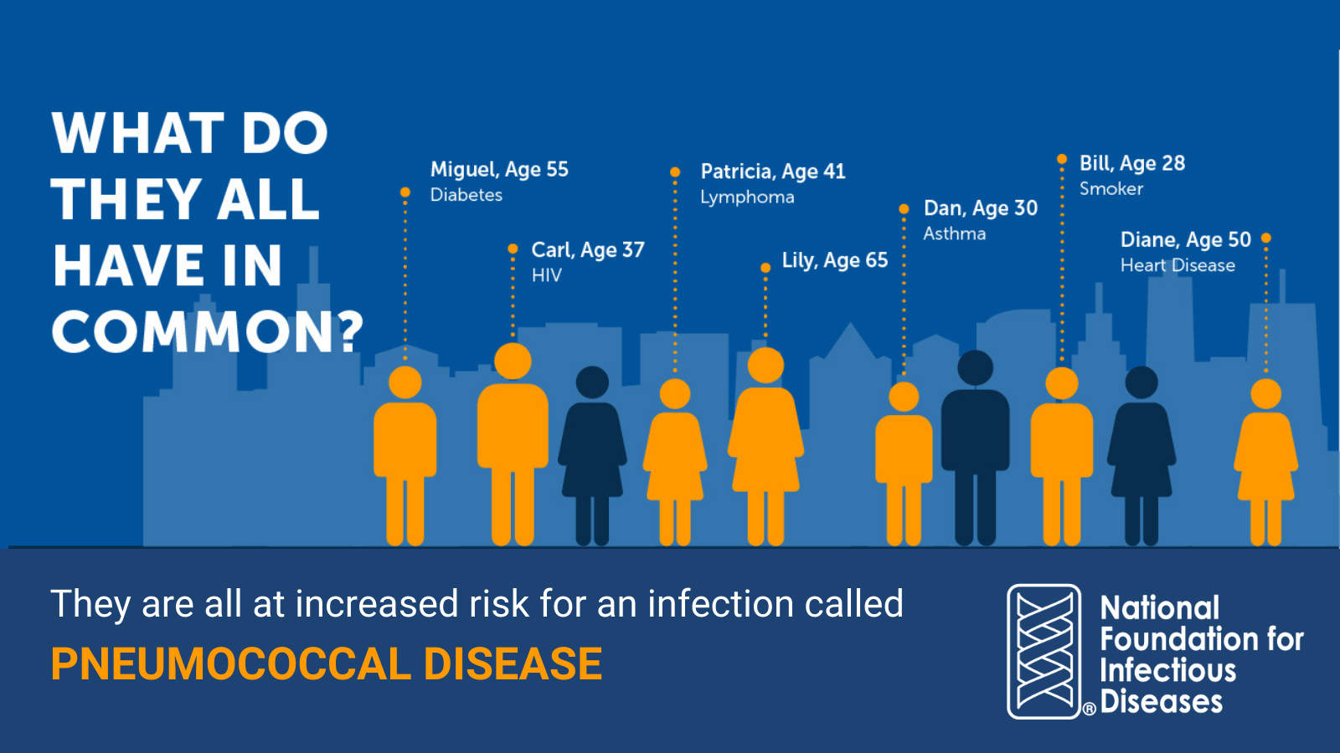
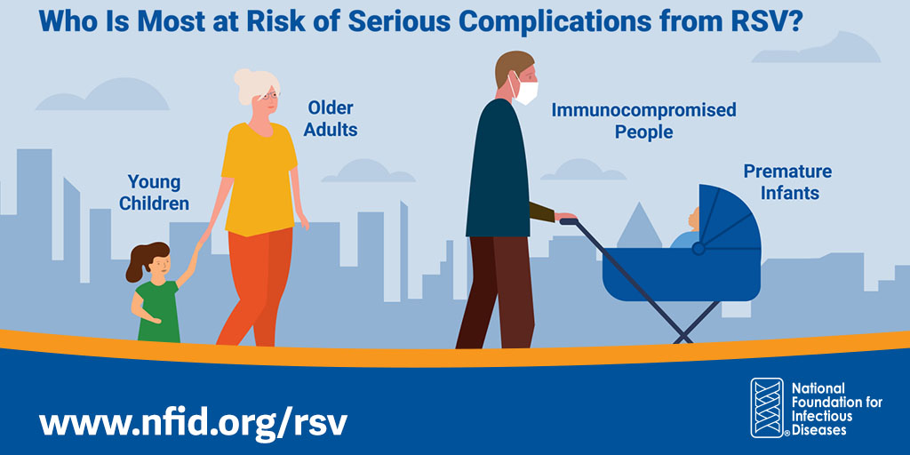
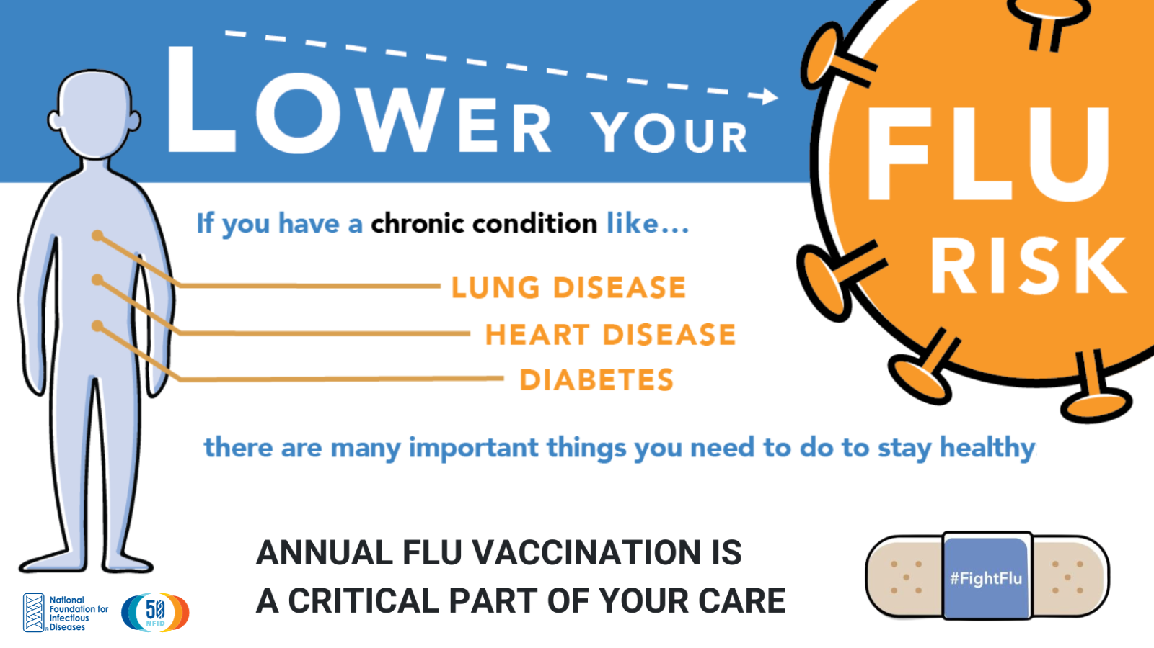
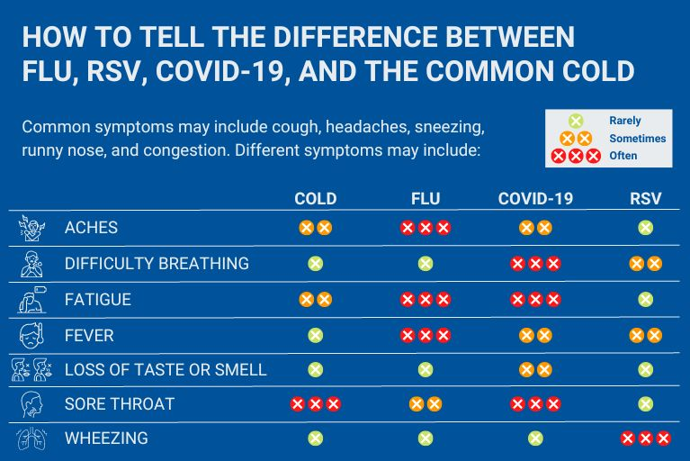
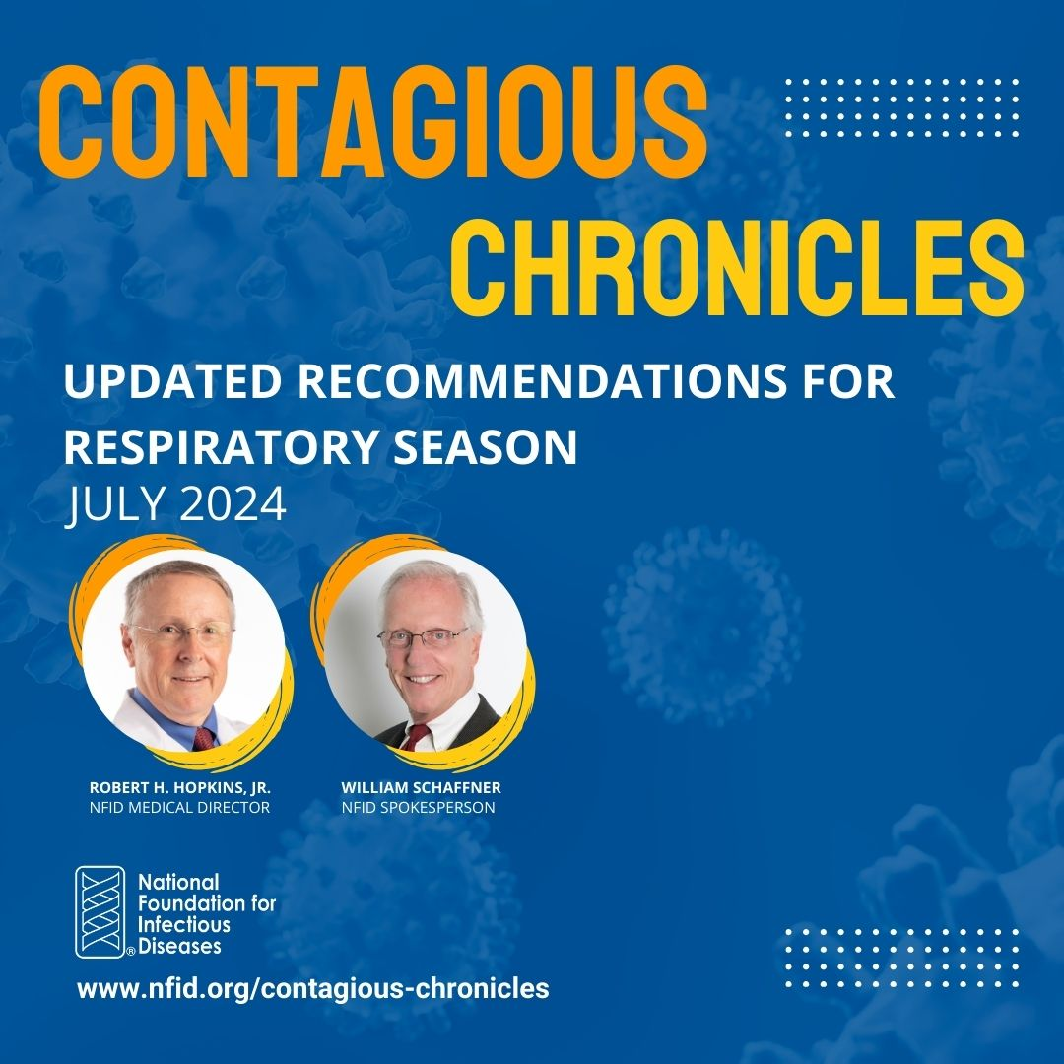
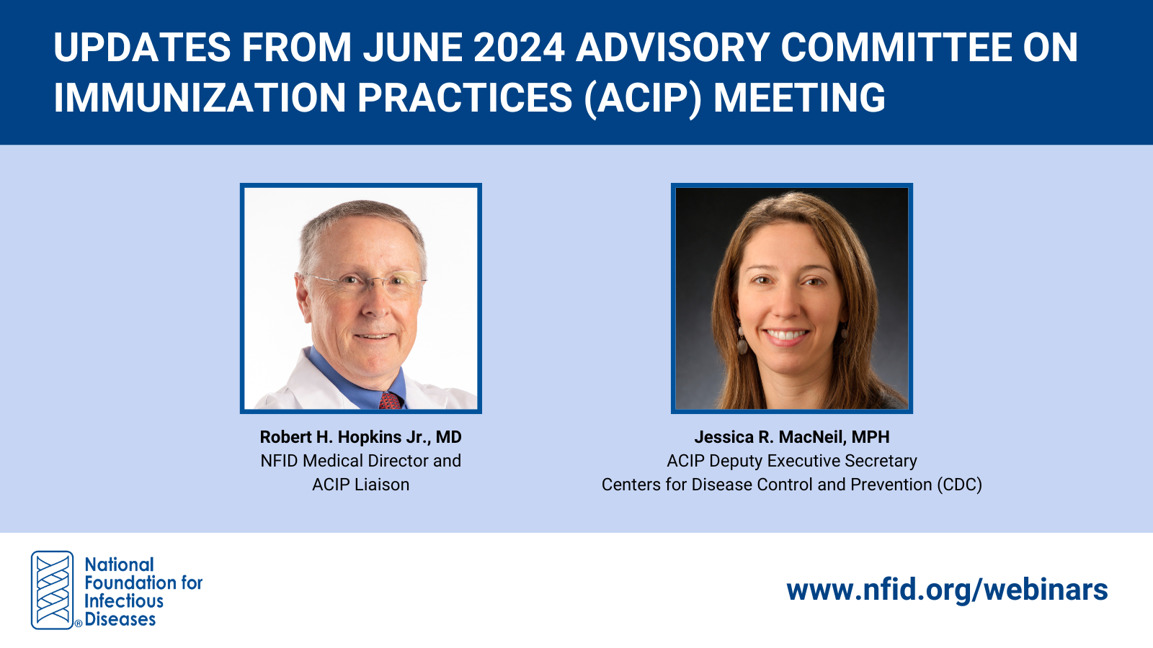
www.nfid.org
Save the Date:September 25, 2024
NFID Annual News Conference with CDC Director Mandy K. Cohen, MD, MPH
National Press Club, Washington, DC
Notes:
Save the date and plan to cover the NFID annual news conference on September 25, 2024 featuring CDC Director Mandy Cohen and other experts.
Information about the news conference and other NFID resources to help inform the media’s coverage of COVID-19, flu, and other infectious diseases is available at www.nfid.org.

