Slide 1
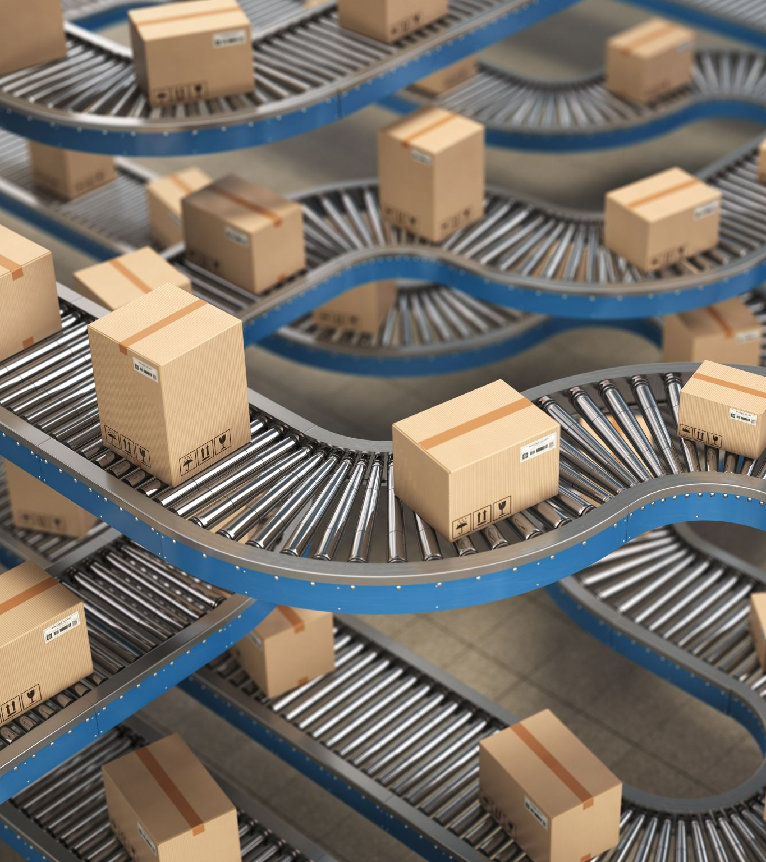
China’s Export restructuring and Manufacturing Outsourcing
Chen Gang, East Asian Institute, NUS
9:30 am, 26 June 2024, Hinrich Foundation office

Slide 2
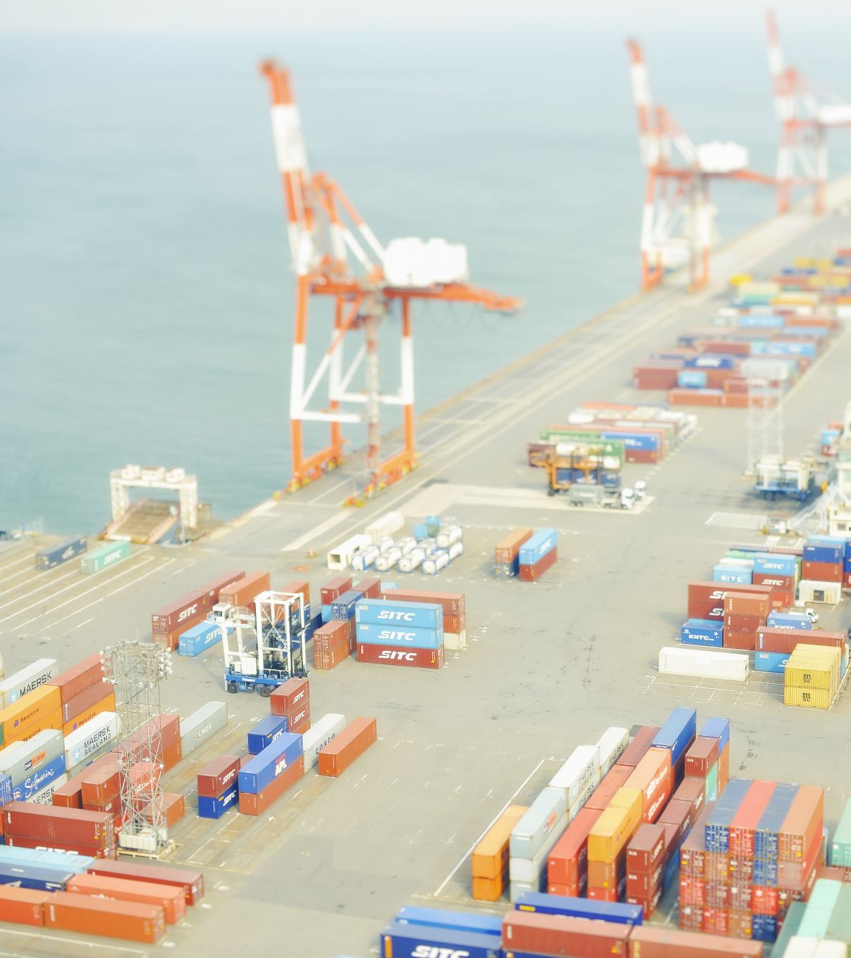
Key questions: identify the critical sectors of china’s export growth and its export ambitions to major markets like europe and the global south. Analyze the movement of china's manufacturing outsourcing and its impact upon trade.

Slide 3
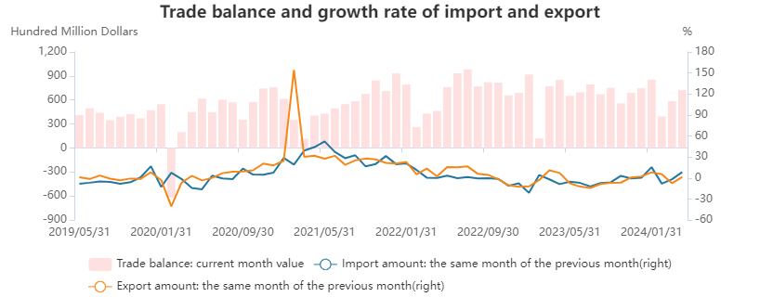
Compiled by Yao Jielu, EAI

Slide 4
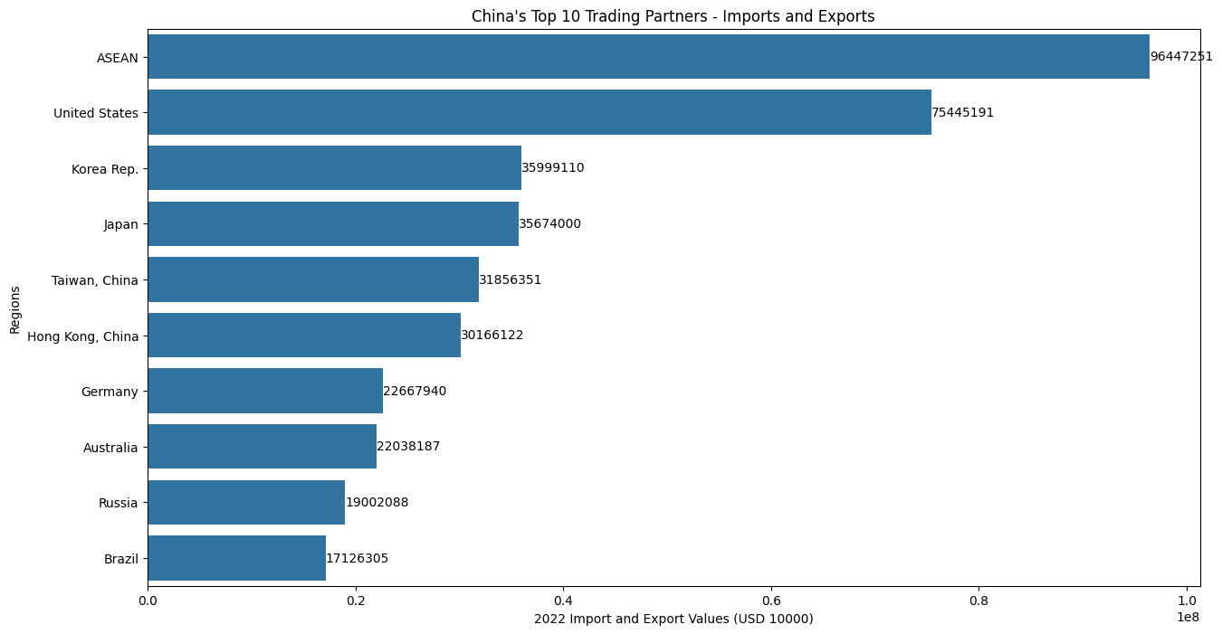
National Bureau of Statistics of China

Slide 5
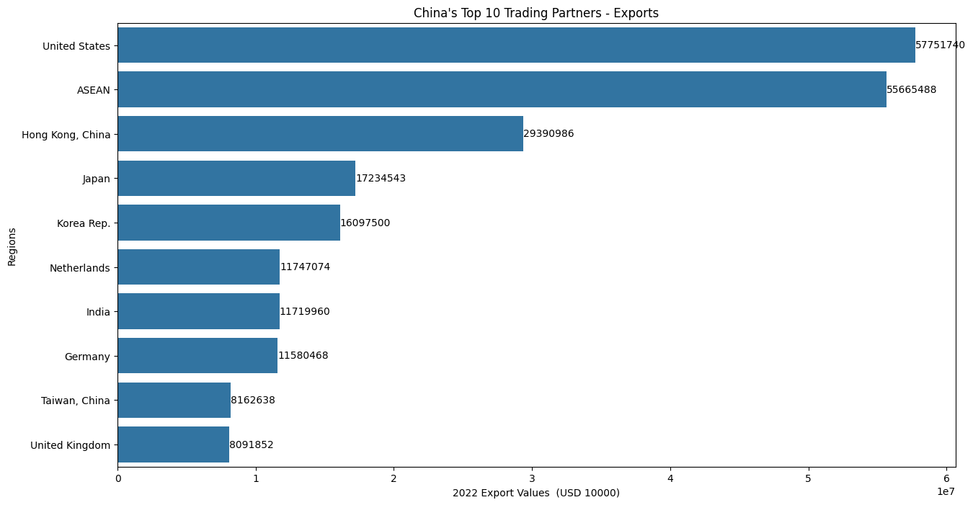

Slide 6
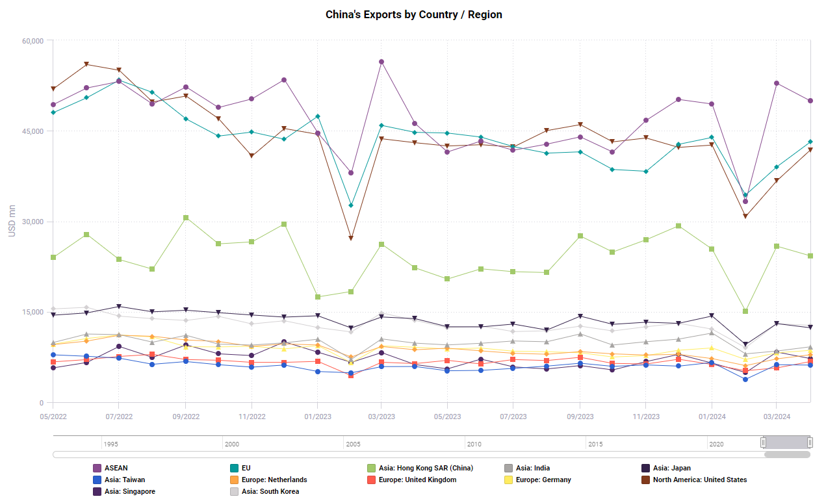

Slide 7
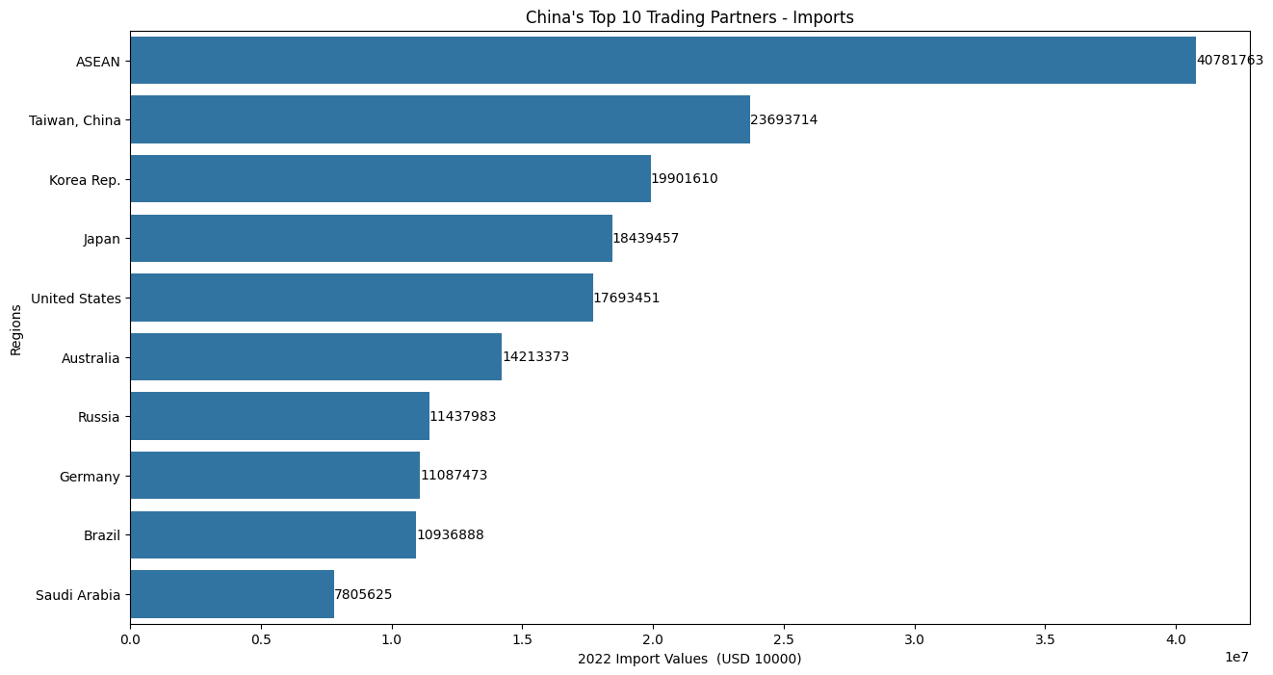

Slide 8
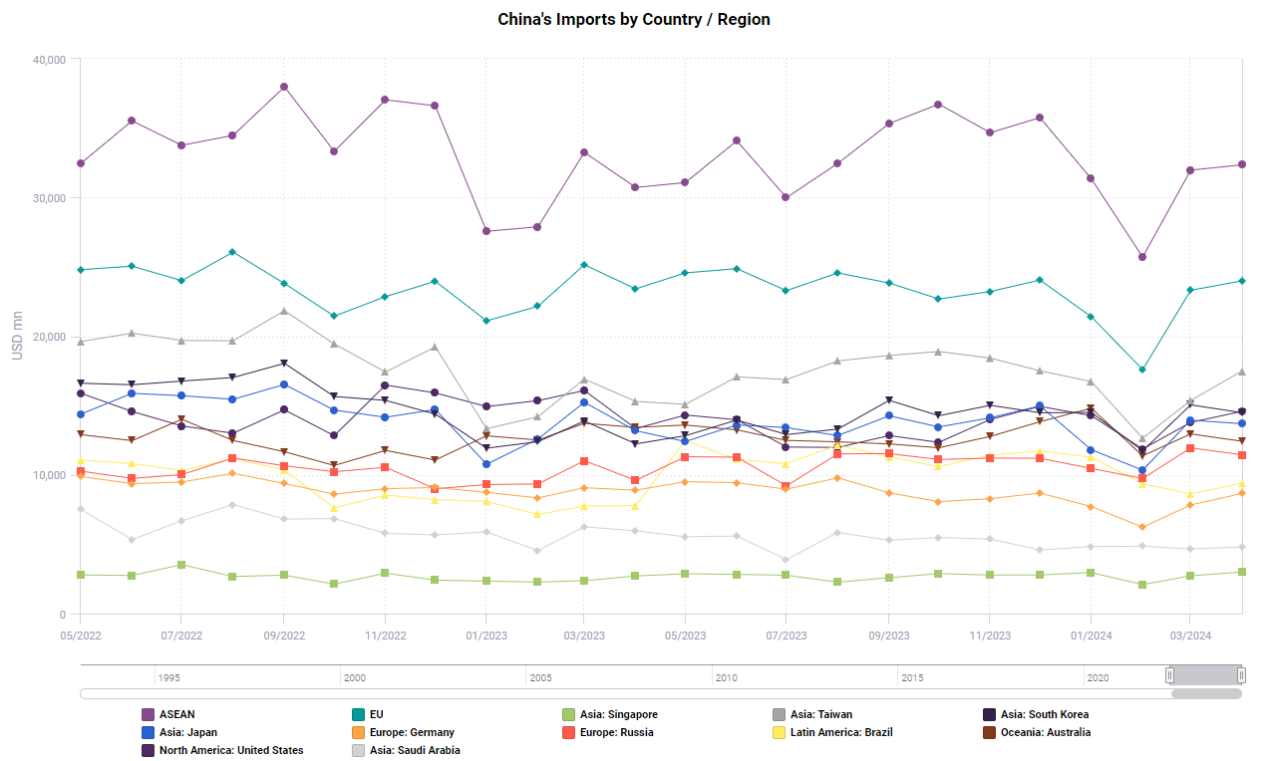

Slide 9
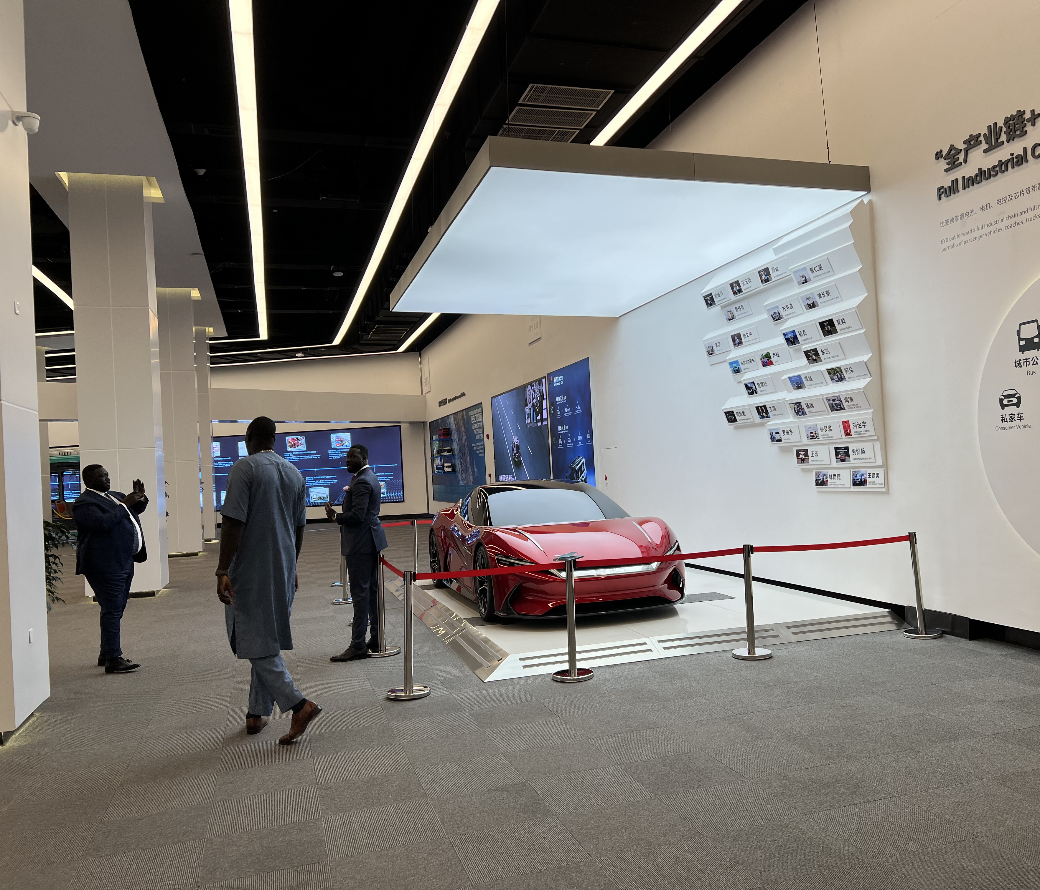
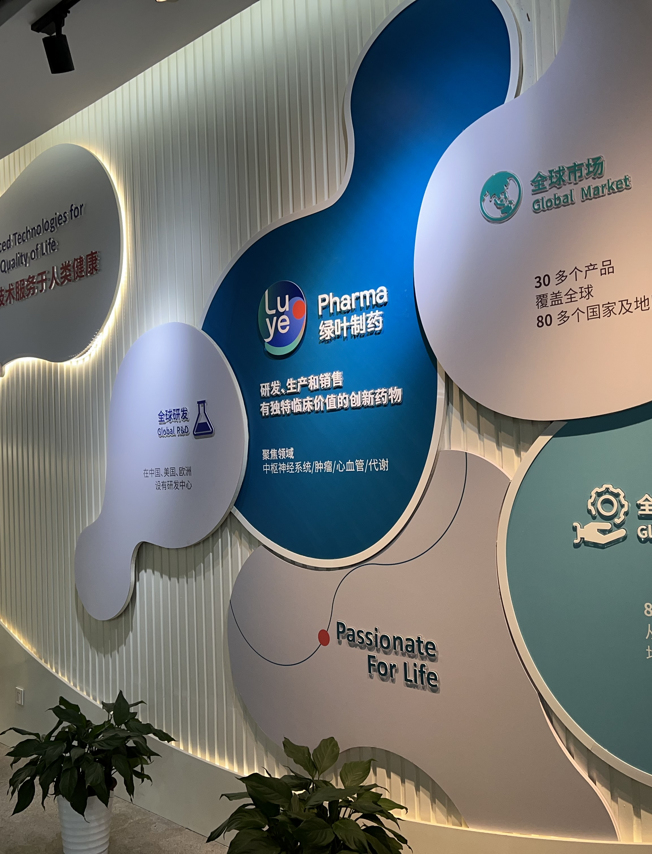
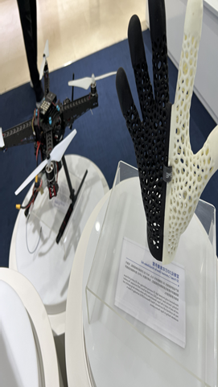
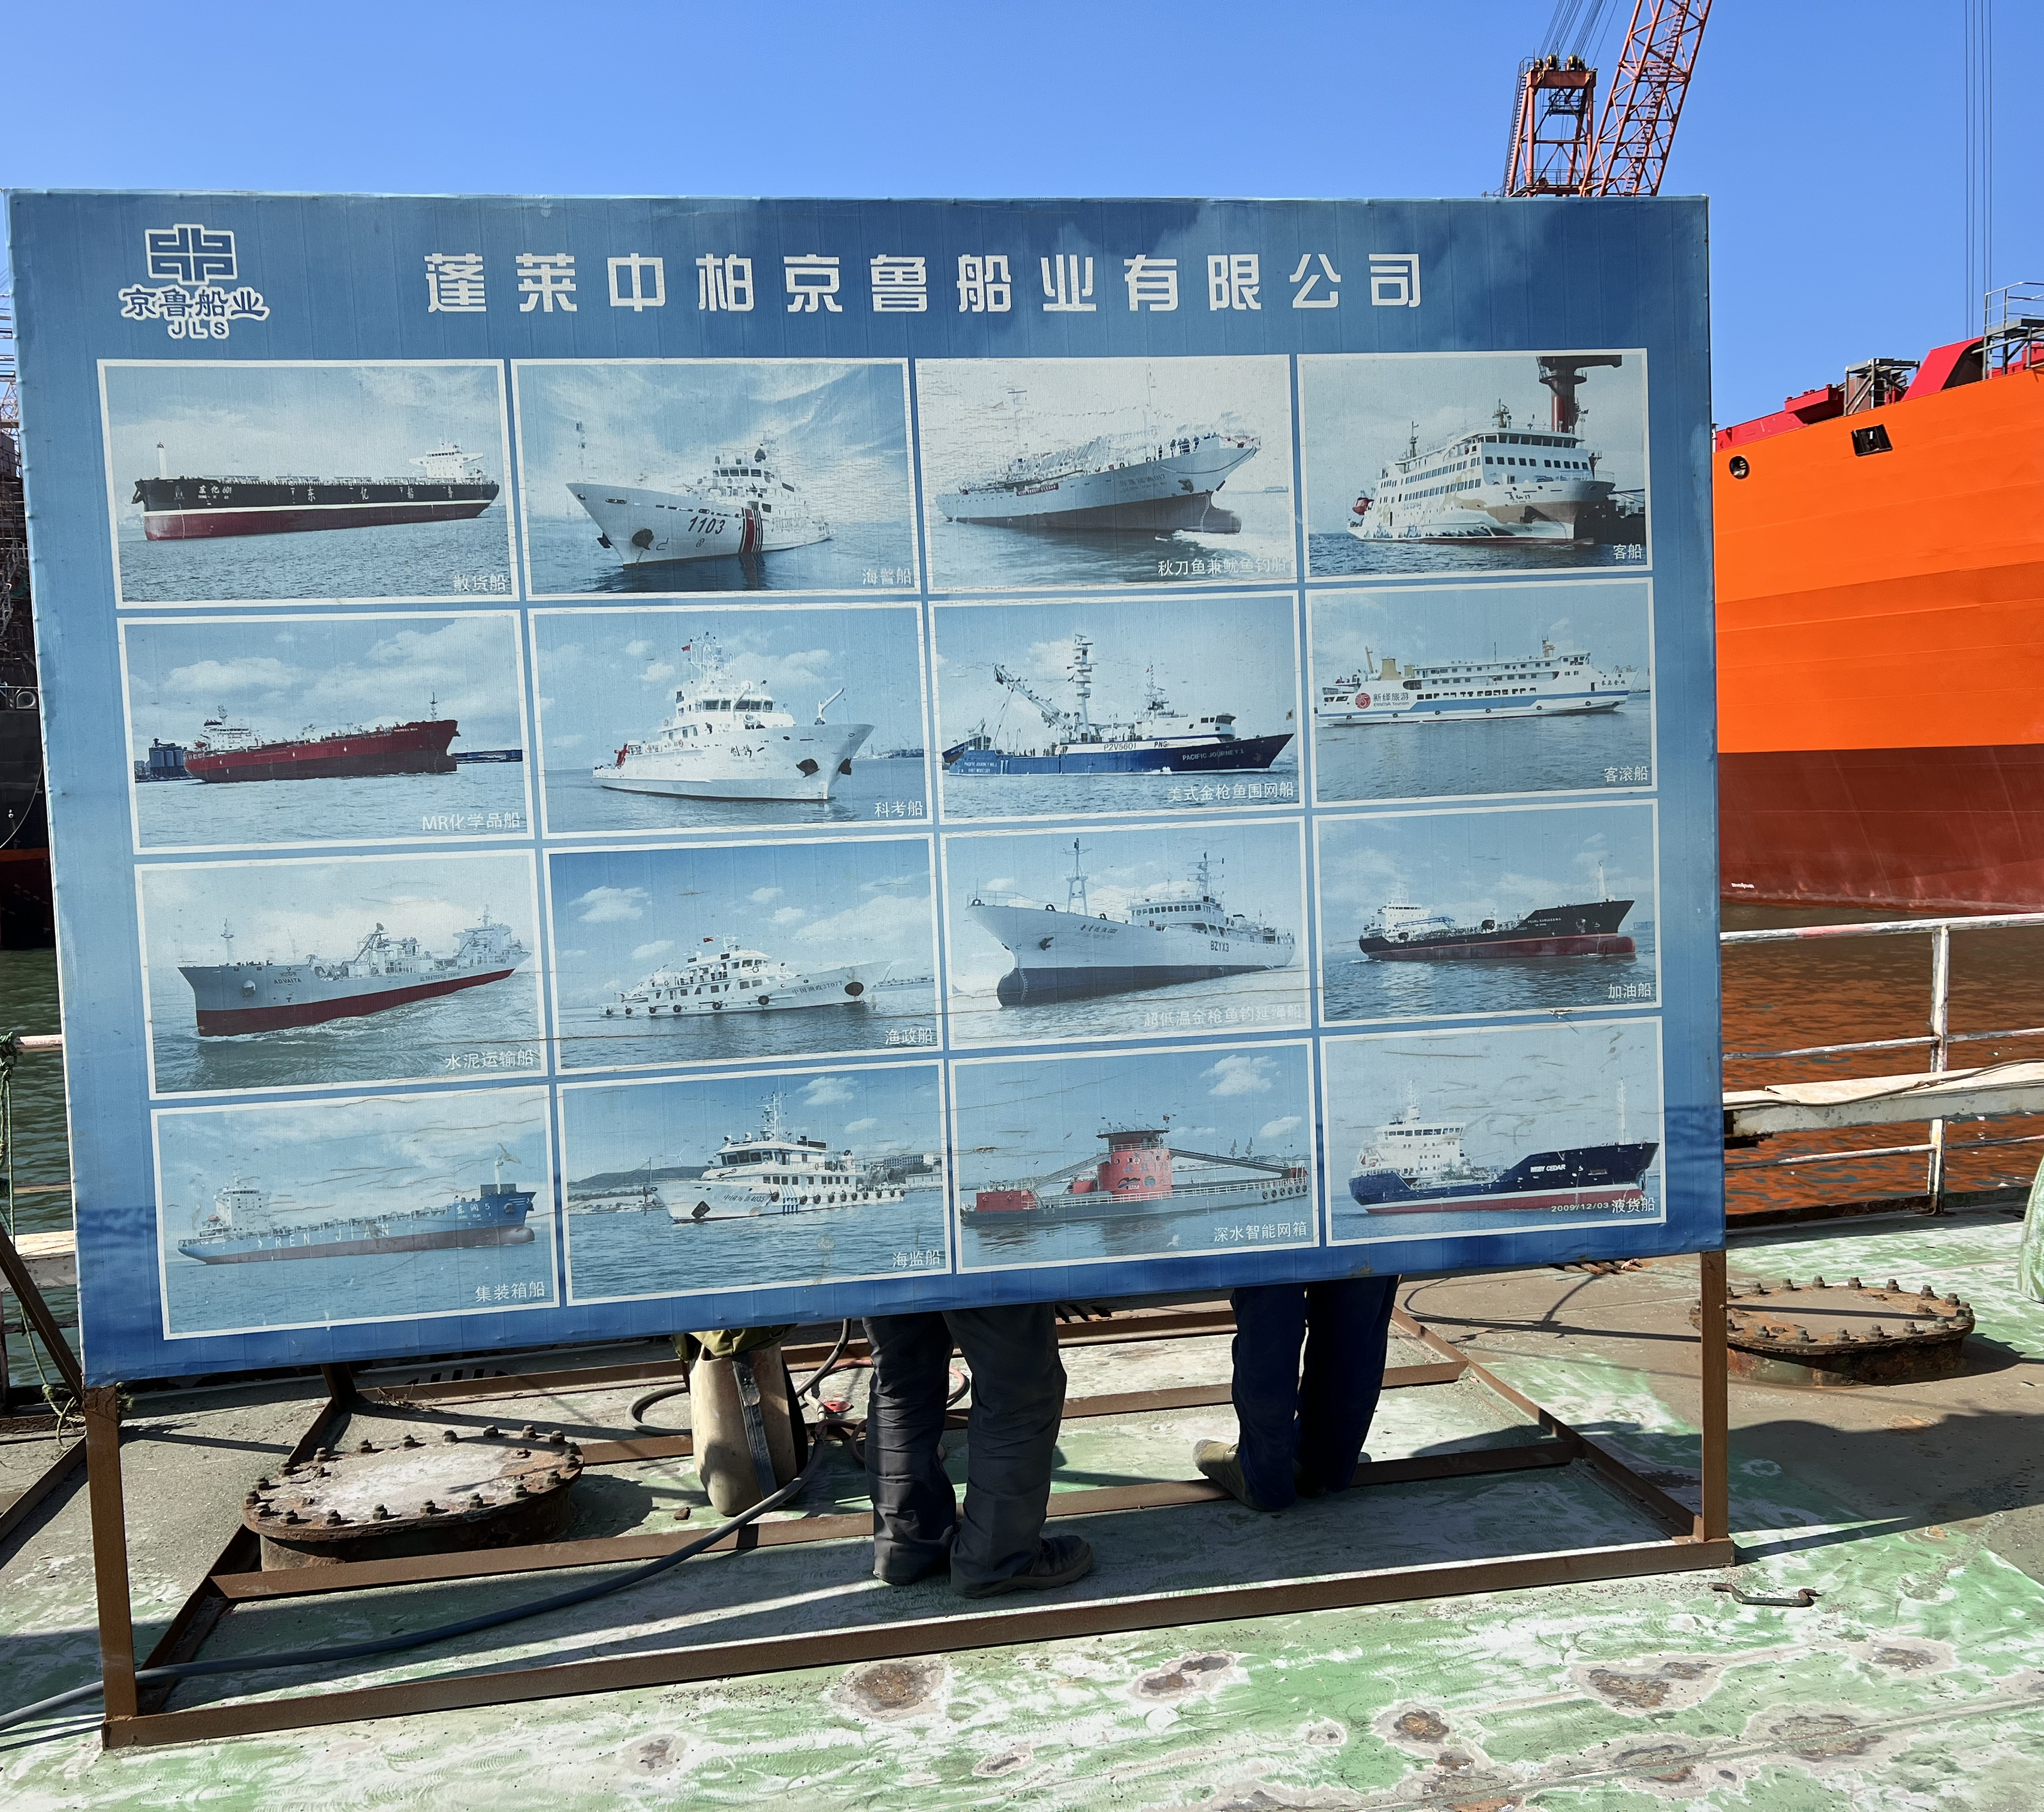
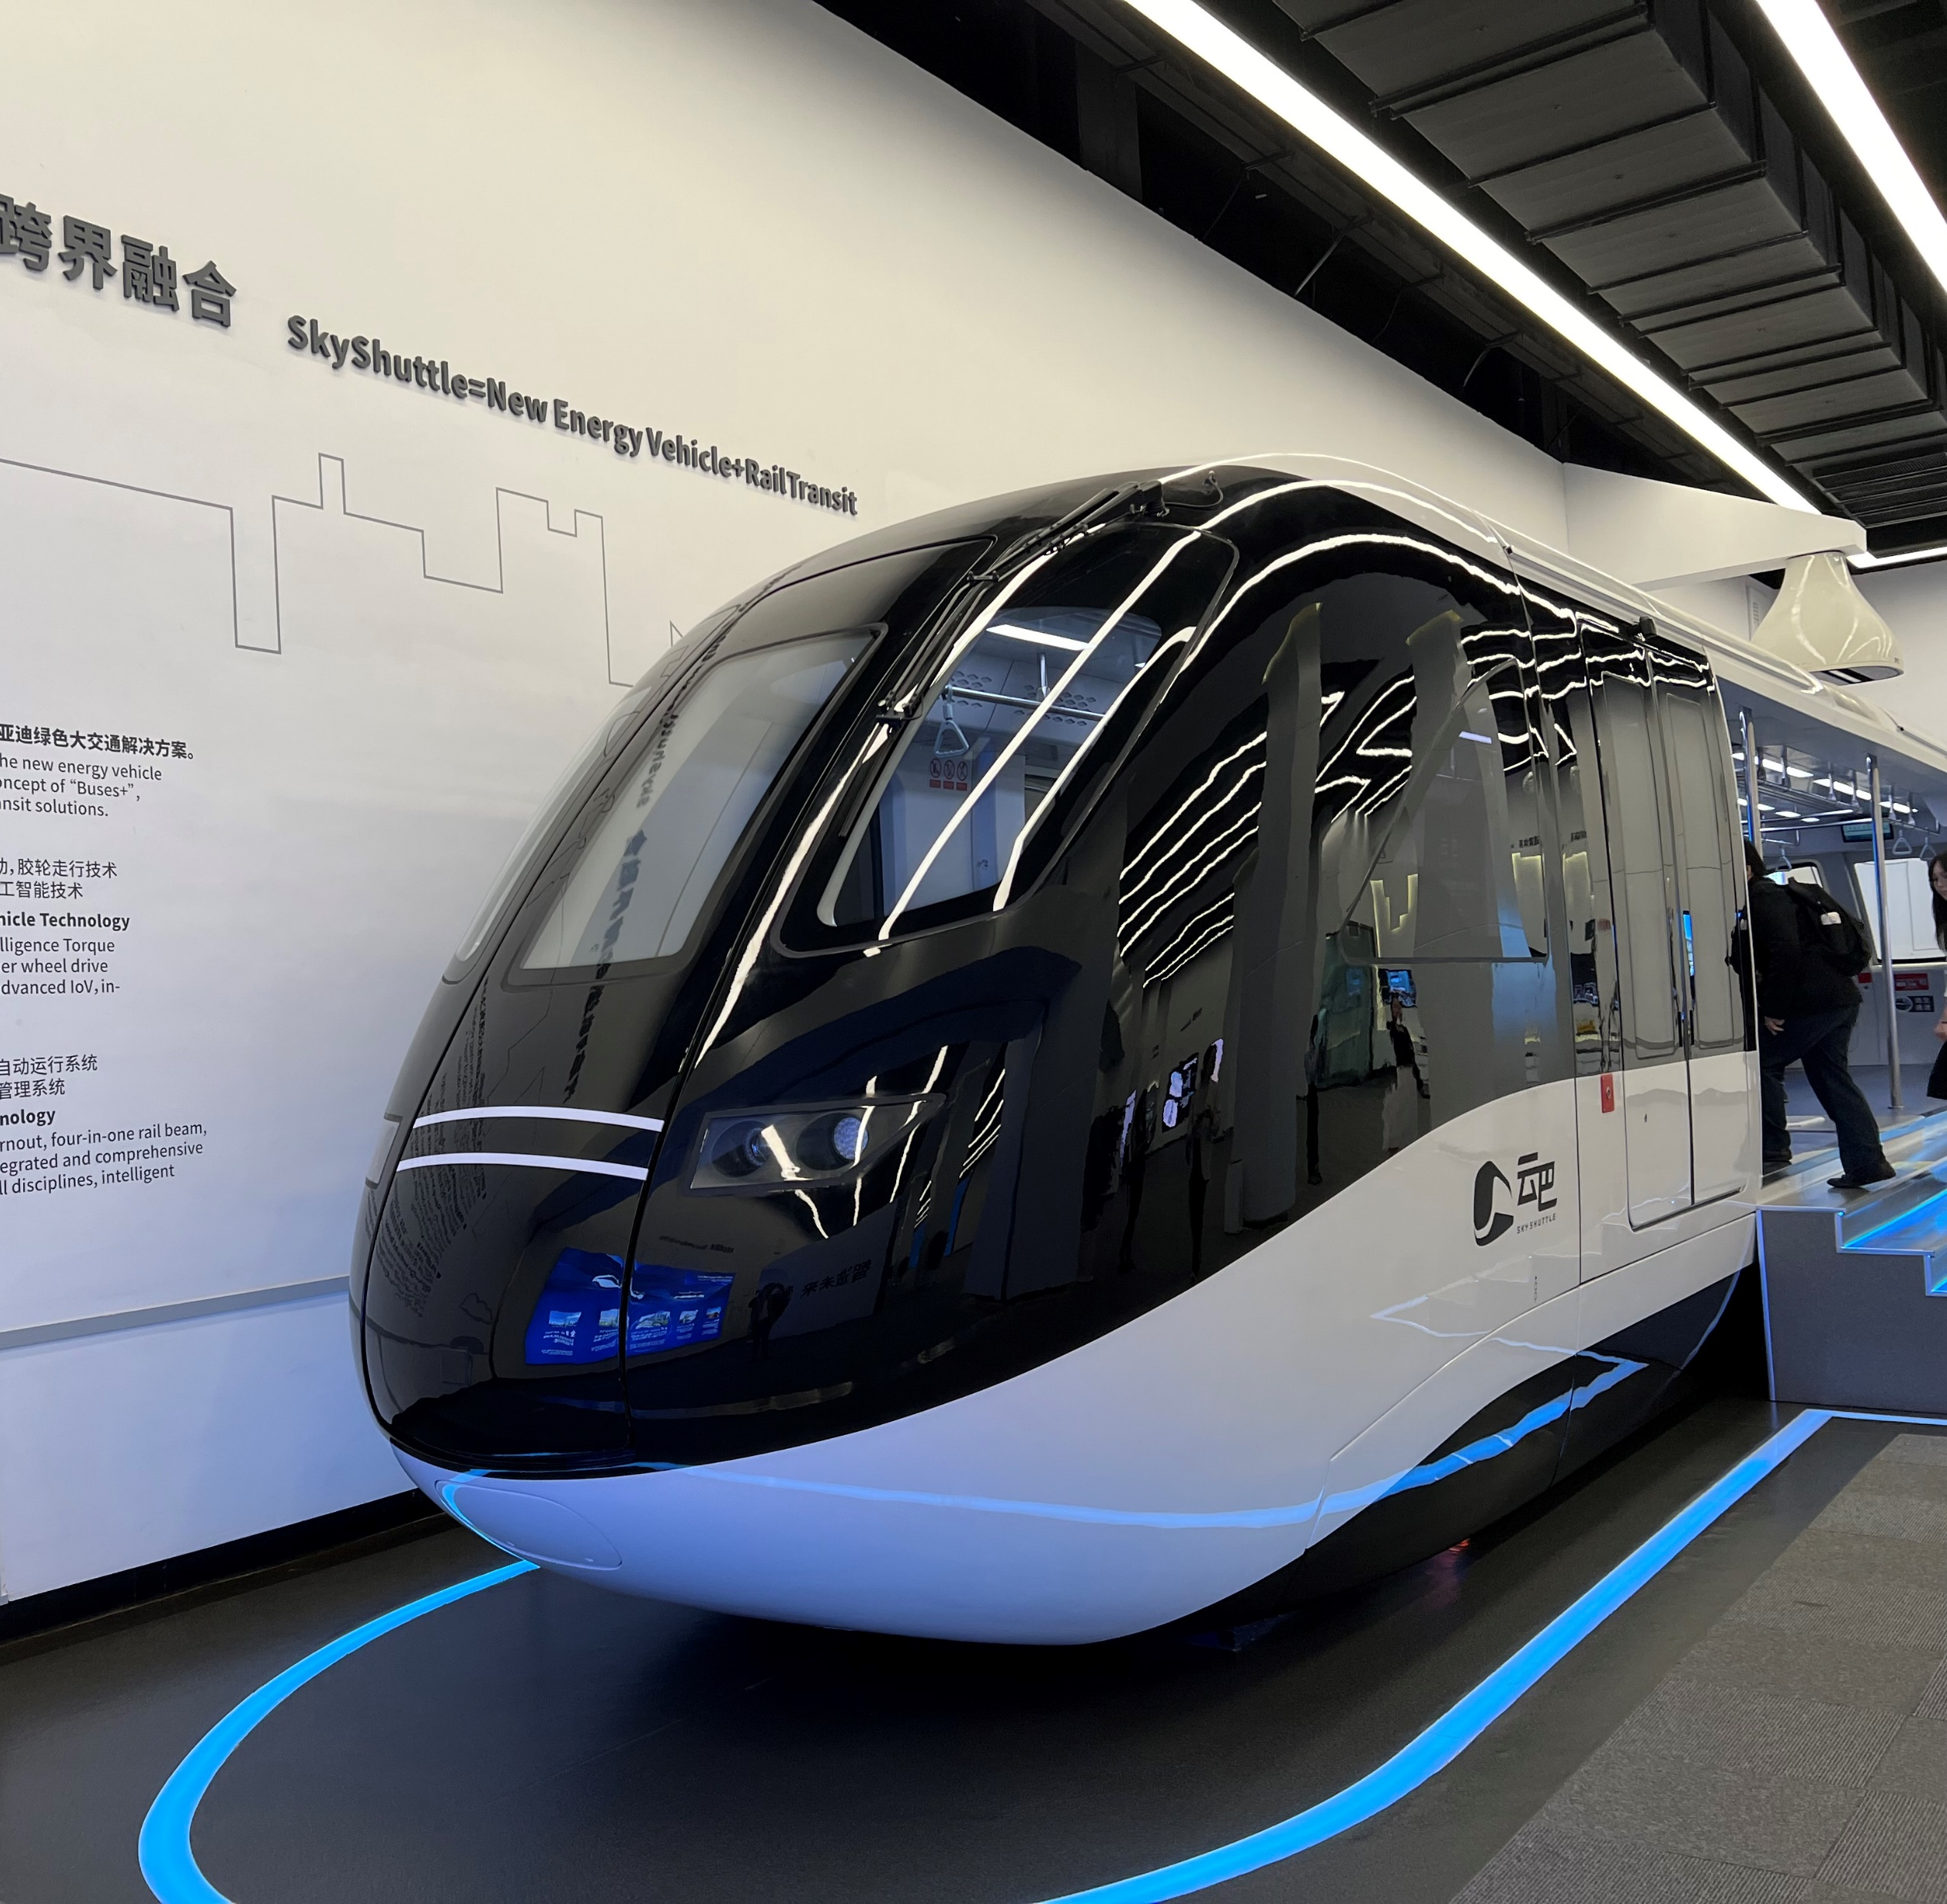
Evs, Batteries, Solar Panels, pharmaceutical products, ship making, nuclear power equipment, 3D printed products… (photos from field trips)

Slide 10
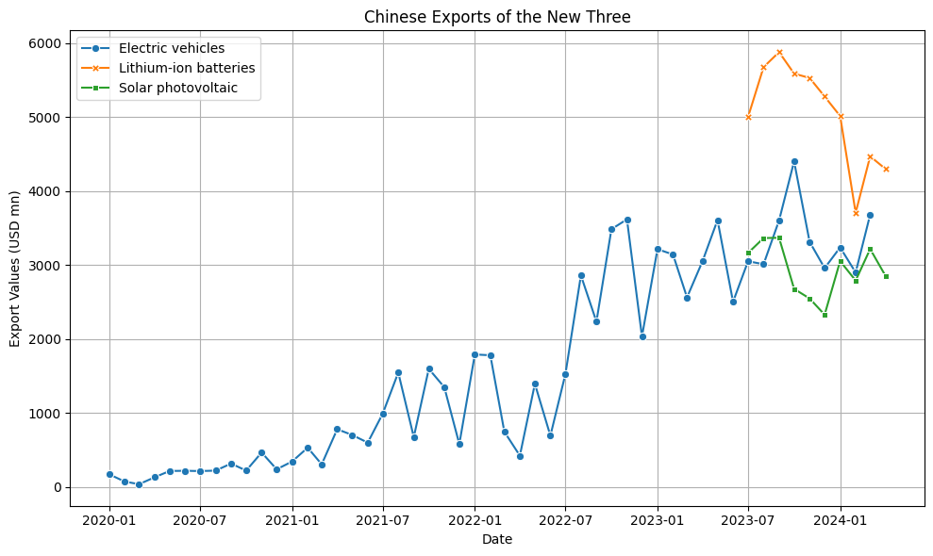

Slide 11
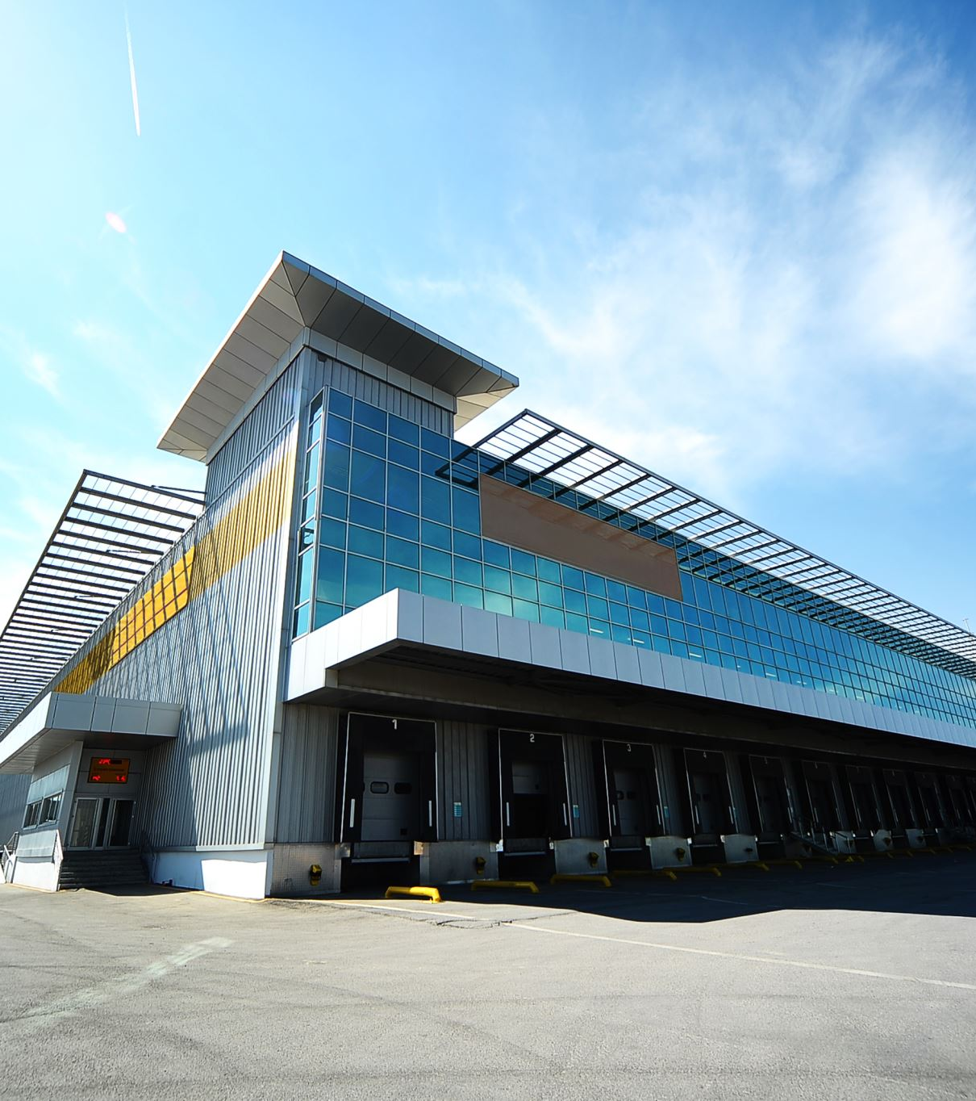
China is currently undergoing significant industrial, trade, and investment restructuring. The country is shifting its economic focus from real estate, infrastructure building, and labor-intensive manufacturing to high-tech research and development, logistics, advanced manufacturing, and cultural/tourism consumption.

Slide 12
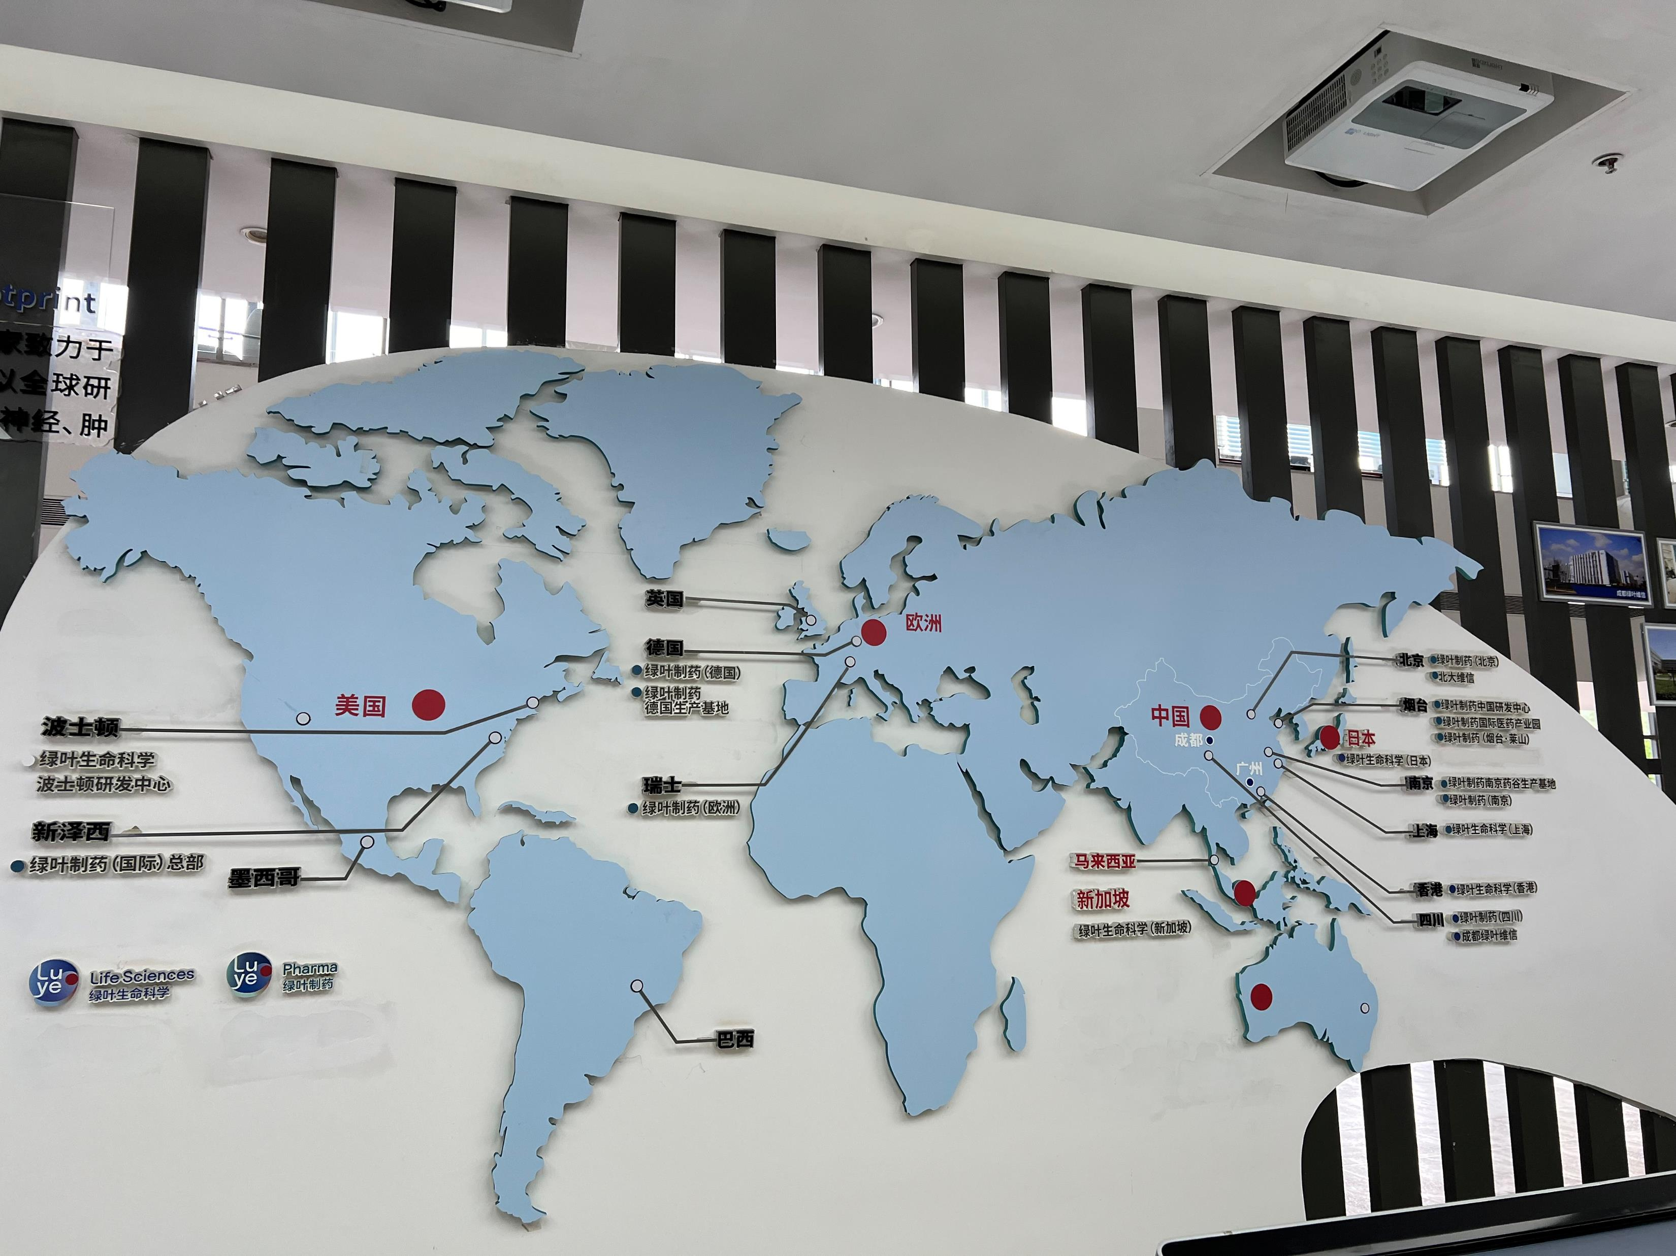
The Chinese government is encouraging some supply chains to be moved out of China due to tariff wars with Western countries, higher labour costs, and environmental concerns. However, China aims to retain high-end research and development, manufacturing, and final assembly within the country.

Slide 13

Economic hubs like Shenzhen and Suzhou have redirected its strategic focus from the United States and Europe to Southeast Asia. Local universities and governments are assisting Chinese companies in relocating parts of their supply chains to other Southeast Asian countries.

Slide 14
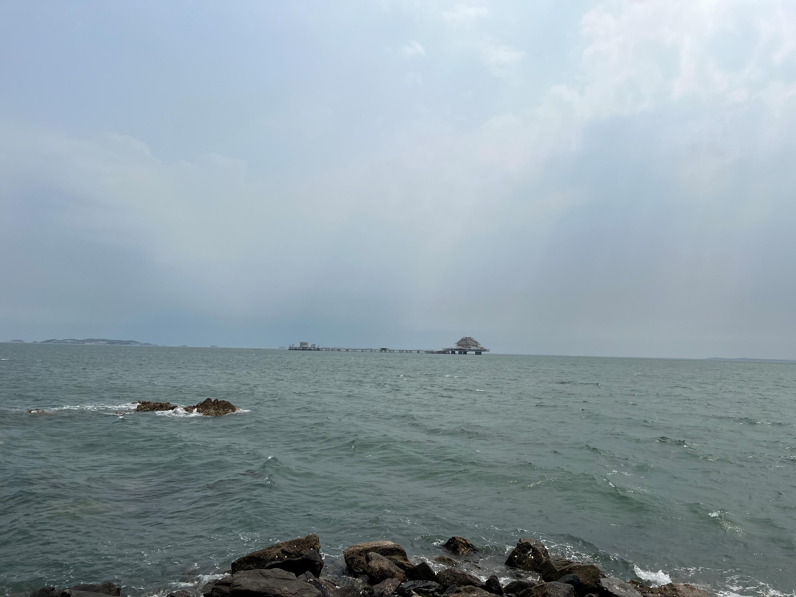
Huge investment in nuclear power plants, oceanic equipment, petrochemical projects, satellite launching businesses…

Slide 15
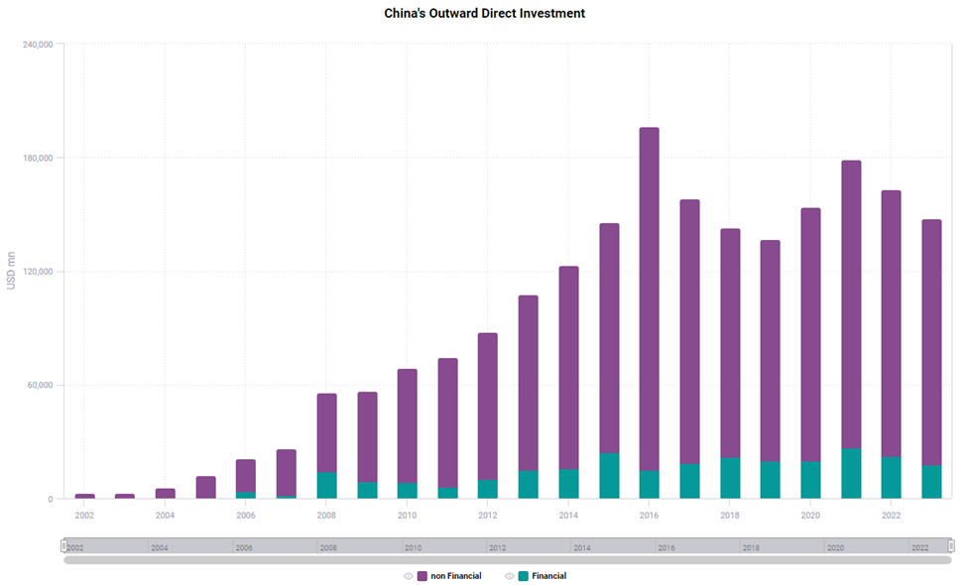
Outward Investment
In 2023, China's overall outward direct investment (ODI) reached US$147.9 billion, up 0.9% YOY (in terms of RMB1,041.9 billion, up 5.7% YOY). Non-financial ODI amounted to US$130.1 billion, up 11.4% YOY (RMB917 billion, up 16.7% YOY).
SOURCE: CEIC

Slide 16
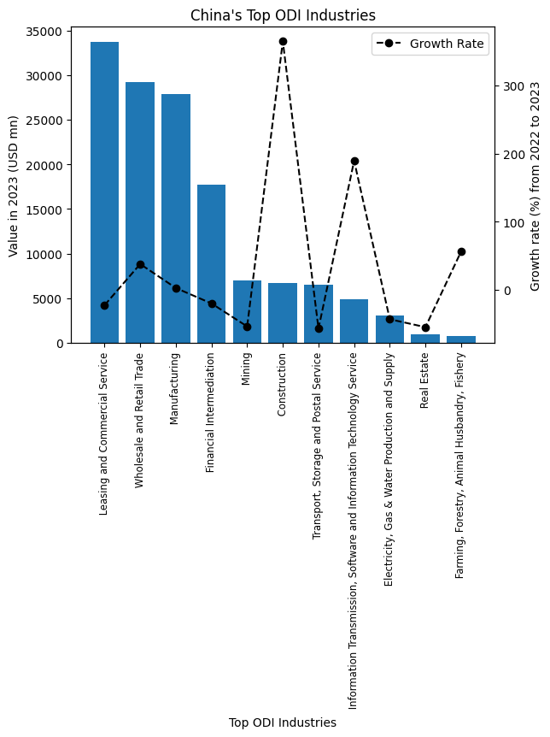

Slide 17
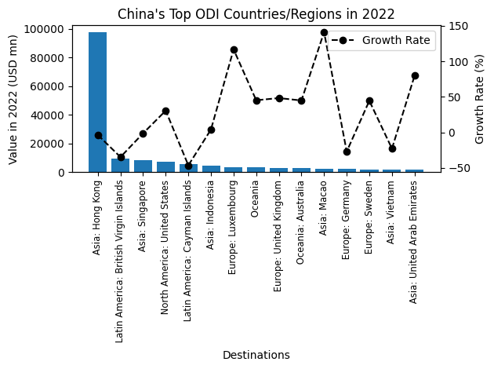

Slide 18

Thanks

