Slide 1

Advancing the Digital Trade Ecosystem: The Role of Standards in Digital Transformation of Trade
Daniel W. Giles – International Public Policy, Asia-Pacific, GS1
25 June 2024

Slide 2

GS1 is a global standards organisation
that helps companies do business
across the world
Global community
25 industries served
More than 2 million companies
116 Member Organisations
GS1 Global Office
We are:
Neutral and not for profit
User-driven and governed
Global and local
Inclusive and collaborative

Slide 3



GS1 standards at-a-glance
GS1 standards create a common language to identify, capture and share product data, ensuring important information is accessible, accurate and easy to understand.
Identify Uniquely identify products, places and assets
Capture Capture identity and more in a barcode or RFID tag
Share Share data with trading partners, authorities and consumers
Notes:
GS1 standards create a common foundation for business by uniquely identifying, accurately capturing and automatically sharing vital information about products, locations, assets—and more.
Through the power of GS1 Standards, organisations can use accurate, robust information that makes it possible for the right product to be in the right place at the right time, allowing consumers to find the products they are looking for. Businesses can also combine different GS1 standards to streamline business processes such as traceability.

Slide 4




How we develop standards
Our Global Standards Management Process ensures our standards are truly global.
1
Determine relevance
2
Gather requirements
3
Create standards
4
Develop adoption tools
Notes:
The GSMP (Global Standards Management Process) is a community-based forum for businesses facing similar problems to work together and develop standards-based solutions. Standards created by industry, for industry.
As a neutral participant, GS1 facilitates dialogue and the development of standards-based solutions among business and technical people from nearly 60 countries.

Slide 5

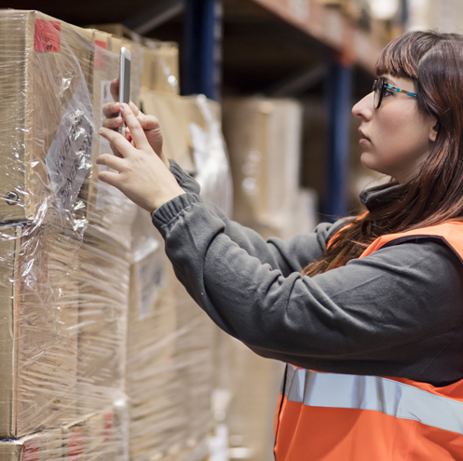

50 years ago,
the GS1 barcode
started a revolution…

Slide 6

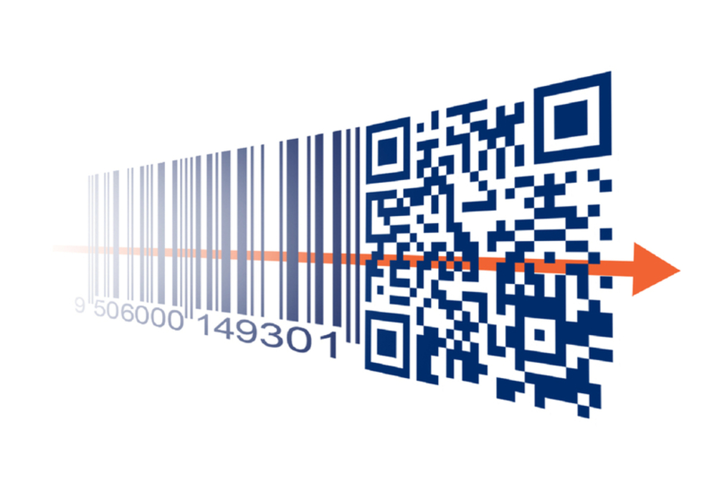
GS1 and the digital transformation of industry
GS1 aims to empower industry
Ambition 2027
Linear barcodes → 2D
2D barcodes powered by GS1, GS1 Digital Link and the GS1 Registries Platform help our members bridge the physical and digital worlds
In a decentralised, multipolar world common global standards become more important, not less.

Slide 7
Digitalisation of trade – what is it?
OECD Definition:
“Digitalisation of trade is the trade in products and services enabled by electronic means. It is digitally-enabled transactions of trade in goods and services that can either be digitally or physically delivered, and that involve consumers, firms, and governments. That is, while all forms of digital trade are enabled by digital technologies, not all digital trade is digitally delivered.”
The digitalisation of trade will make international trade quicker, cheaper and more secure
For governments: better risk management, more accurate tax collection, quicker interventions in crises.
For business: greater speed and efficiency, lowers barriers for SMEs to grow globally.
For consumers: greater confidence in the provenance and safety of the products they buy.

Slide 8
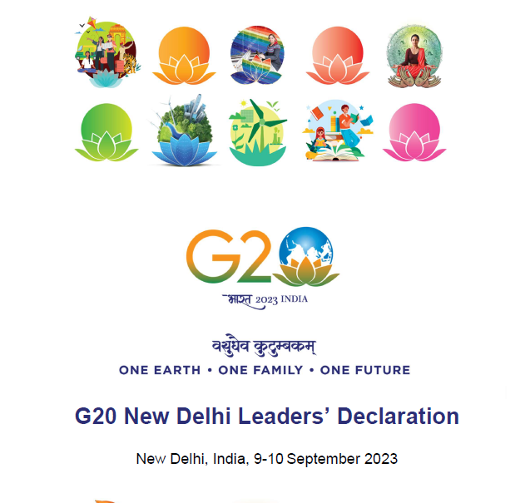
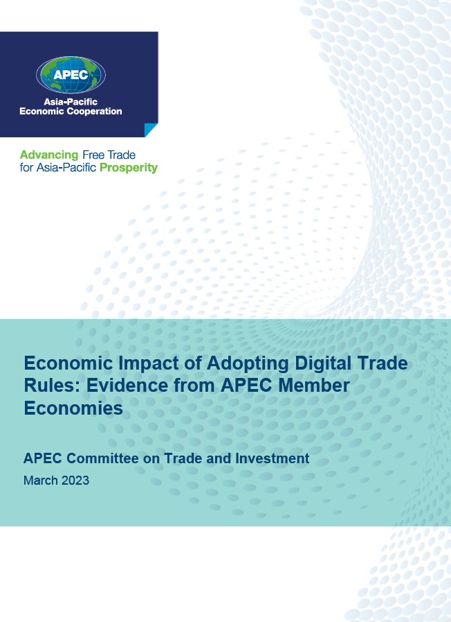
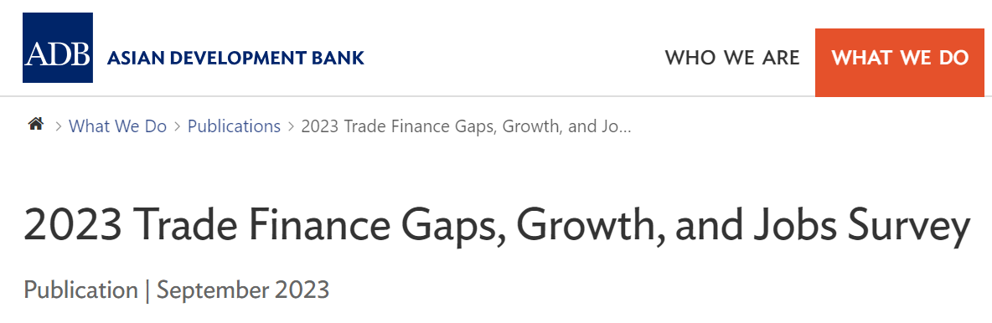
Everyone is talking about it…
“Digitalisation of global trade can reduce the gap, facilitate transparency, and underpin a greater ability to monitor environmental and social standards, but is held back by a lack of harmonized standards for electronic documents and related legislation recognizing electronic trade documents.”
High Level Principles for Digitalisation of Trade Documents
PRINCIPLE 1: NEUTRALITY
PRINCIPLE 2: SECURITY
PRINCIPLE 3: TRUST
PRINCIPLE 4: INTEROPERABILITY
PRINCIPLE 5: DATA PRIVACY
PRINCIPLE 6: RELIABILITY
PRINCIPLE 7: VOLUNTARY SHARING OF DATA
PRINCIPLE 8: COLLABORATION
PRINCIPLE 9: TRACEABILITY
PRINCIPLE 10: SCALABILITY
“digitalisation changes the way that international trade is conducted… Increasingly, economies are including provisions aimed at strengthening digital trade in trade agreements and entering agreements focused on strengthening digital collaboration.”

Slide 9











Digitalisation of trade allows…
Product traceability for safer supply chains
More transparent product information
Circular product lifecycle
Sustainability requirements
Product traceability for safer supply chains
More transparent product information
Circular product lifecycle
Sustainability requirements
Product conformance and accreditations
More efficient ports and waterways
Digitisation of paper processes
Trade tech and border efficiency
Product conformance and accreditations
More efficient ports and waterways
Digitisation of paper processes
Trade tech and border efficiency

Slide 10
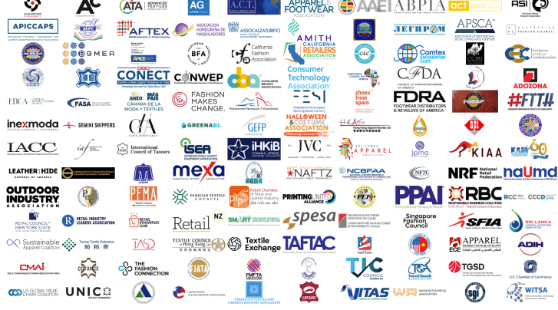
Industry wants this – open letter to regulators asking for digital labels (July 23)
Annually, regulations result in about 9.2 million km of label tape.
Waste tape equals 12 return trips to the moon a year
Digital QR labels could eliminate at least 343,000 MT of CO2 emissions from industry every year.
120 industry signatories

Slide 11
Government wants this - Regulatory reform as a driver for trade digitalisation
Regulation is turning "nice to have" into "must have"
French Anti-Waste for a Circular Economy (AGEC)
Circularity: Preventing waste by entering products into a "re" life where almost everything is reconstituted
Transparency: Ability of a multitude of stakeholders to access information with ease
Visibility: Understanding whereabouts of an item at any given moment
EU Digital Product Passport
(DPP)
New York State Fashion Act
EU Greenwashing bill
- WTO Joint initiative on e-commerce
- UN Framework Agreement on Facilitation of Cross-border Paperless Trade in Asia and the Pacific (CPTA)
- DEPA (SG-Chile-NZ)
- DEA (SG-UK)
German Supply Chain Visibility Act

Slide 12

Confluence of trends driving change
Regulatory demands for more data
Increasing consumer expectations
Strong business applications

Slide 13
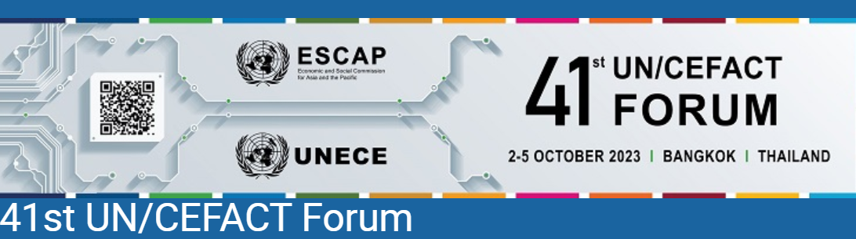

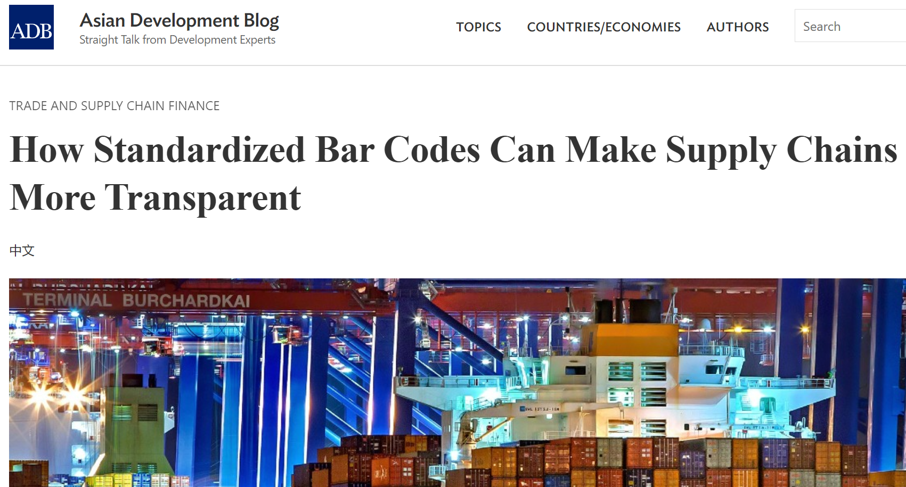
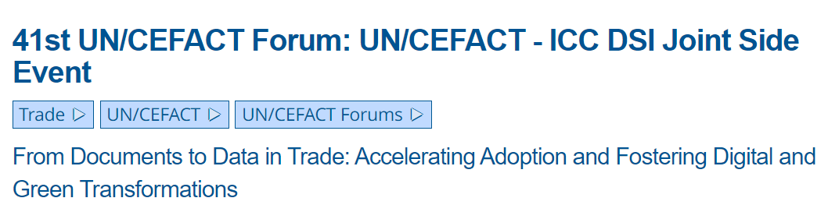
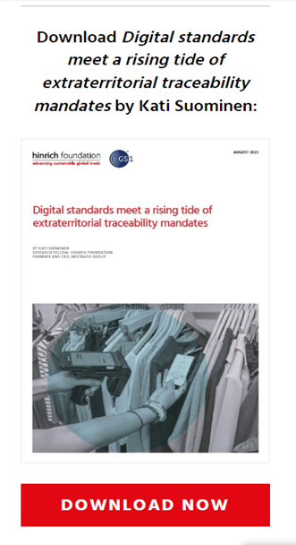
GS1 is actively involved in advancing the digital trade agenda
Speakers include:
Robert Beideman, Chief Product Officer, GS1
Piergiorgio Licciardello, EDI Director, GS1
GS1 Asia-Pacific MOs are collaborating to advance the digital sharing of trusted ESG credentials
Pilot project focused on Apparel sector in Sri Lanka underway

Slide 14

Transforming together through collaboration
Notes:
GS1 global standards and services are providing the foundation for sharing trusted data, across Retail & Marketplaces, as well as in Healthcare.
But to achieve this, collaboration between all Industry participants and collaboration with Governments, are essential. GS1 is providing a neutral space for collaboration, this is the essence of GS1. GS1 is much more than a standards organisation—it’s a community of people. We can truly achieve great things together. Things that none of us can accomplish on our own.
Together, we can transform industry for the benefit of consumers, patients—and the planet.

Slide 15























Collaboration is key to change at scale: GS1 global partner organisations
Notes:
GS1 is also actively engaging with authorities, intergovernmental organisations, industry, trade associations and NGOs in all regions.
ADB (Asian Development Bank): The Asian Development Bank (ADB) is committed to achieving a prosperous, inclusive, resilient, and sustainable Asia and the Pacific, while sustaining its efforts to eradicate extreme poverty. It assists its members and partners by providing loans, technical assistance, grants, and equity investments to promote social and economic development.
IATA (International Air Transport Association): The International Air Transport Association (IATA) is the trade association for the world’s airlines. They support many areas of aviation activity and help formulate industry policy on critical aviation issues.​
APEC (Asia-Pacific Economic Cooperation): APEC is the premier Asia-Pacific economic forum. Their primary goal is to support sustainable economic growth and prosperity in the Asia-Pacific region.
FIATA (International Federation of Freight Forwarders Associations): FIATA is a reference source on international policies and regulations governing the freight forwarding and logistics industry.
IFRS (International Financial Reporting Standards): The IFRS Foundation is a not-for-profit responsible for developing global accounting and sustainability disclosure standards, known as IFRS Standards.
EC (European Commission): The European Commission is the EU's politically independent executive arm. It is alone responsible for drawing up proposals for new European legislation, and it implements the decisions of the European Parliament and the Council of the EU.
United Nations: The United Nations is an international organization founded in 1945 after the Second World War by 51 countries committed to maintaining international peace and security, developing friendly relations among nations and promoting social progress, better living standards and human rights.
ISO (International Organisation for Standardisation): ISO is an independent, non-governmental international organization. It brings global experts together to agree on the best ways of doing things, from making products to managing processes.
CEN/CENELEC: SDO responsible for developing and defining voluntary standards at European level.
WCO (World Customs Organisation): WCO is an independent intergovernmental body whose mission is to enhance the effectiveness and efficiency of Customs administrations.
Fight the Fakes: Fight the Fakes (FTF) Alliance (commonly referred to as ‘Fight the Fakes’) is a multi-stakeholder non-profit association that aims to raise awareness and influence change about the proliferation of substandard and falsified medicines.
ICC (International Chamber of Commerce): the ICC is the voice of world business championing the global economy as a force for economic growth, job creation and prosperity.
The Consumer Goods FORUM: They bring together consumer goods manufacturers and retailers in pursuit of business practices for efficiency and positive change across our industry benefiting shoppers, consumers and the world without impeding competition.
International Hospital Federation: The International Hospital Federation is a global not-for-profit, non-governmental, membership organization.
ITC (International Trade Centre): The International Trade Centre (ITC) works towards global prosperity by connecting small businesses in developing countries to international.
OECD (Organisation for Economic Co-operation and Development): an international organisation that works to build better policies for better lives, to foster prosperity, equality, opportunity and well-being for all.

Slide 16
GS1 Standards in action

Slide 17
GS1 Standards Adoption by China Customs
Feasibility study and pilot using product ID (GTIN, CAS and VIN etc.) in customs clearance process started.
As of Aug. 1st 2019, Official promotion of GTIN @ Single window by China Customs has rolled out.
Pilot of GTIN declaration @ Single window for cross-border e-Commerce (CBEC) retail imports started.
Since Februry 2023, promoted GTIN declaration for CBEC nationwide
2012
2019
2021
2023
2018
2020
2022
Strategic cooperation Agreement signed btw GS1 China and China customs
GTIN verification & data sharing with China customs has started
As of 1 January 2022,
GTIN as mandatory field for several categories for general trade@ Single window

Slide 18
What are the Benefits for Relevant Parties?
Cross-border
Trade Businesses
China Customs
Consumer
Importer/FF/broker:
Easier declaration (accuracy and efficiency);
Improve efficiency of warehousing tally and port inspection;
Cross-border online retailer:
Accurate category management and rich product data;
Efficient logistic distribution;
Increased Web traffic.
Simplifying declaration procedures;
Improving declaration accuracy;
Better “Positive list” management;
Enhancing product safety & quality monitoring and trade facilitation;
Speeding-up cross-border goods flow;
Creating faithful & transparent e-commerce ecosystem;
Protecting consumer rights & interests better engaging with relevant government departments.
Accurately locate products and merchants searching by GTINs/GLNs;
Safer purchasing of imports;
More transparent purchasing of imports;
Being more confident of buying imports

Slide 19



GS1 in Asia-Pacific partnership with Asian Development Bank (ADB)
Initial source of funding:
GS1 lead consultant in partnership with IFRS/ISSB:
Strategic partnership with global development bank bringing together a GS1 project team from countries across Asia-Pacific to help companies in developing markets meet growing regulatory demands related to sustainability and circularity.
Aim to use digital labels and GS1 Digital Link to build trust in ESG claims
Full value chain collaboration: ADB, IFRS/ISSB, Brand owners, Trade finance banks, manufacturers, suppliers, NGOs
Outcome: Prototype that results in scalable framework that can be applied across industries and geographies. Potential for global impact.
Notes:
IFRS =International Financial Reporting Standards ISSB = International Sustainability Standards Board
Undertake thorough assessment of existing and emerging regulatory requirements in the field of ESG compliance.
Understand the most common ESG data exchange needs among key market participants.
Design and implement ESG data exchange pilots as agreed with stakeholders and the ADB (initial focus on Sri Lanka and the garment sector)
Evaluate and advise on a menu of options to accelerate trusted ESG data exchanges.
Resulting in scalable framework to be applied across industries and geographies.

Slide 20
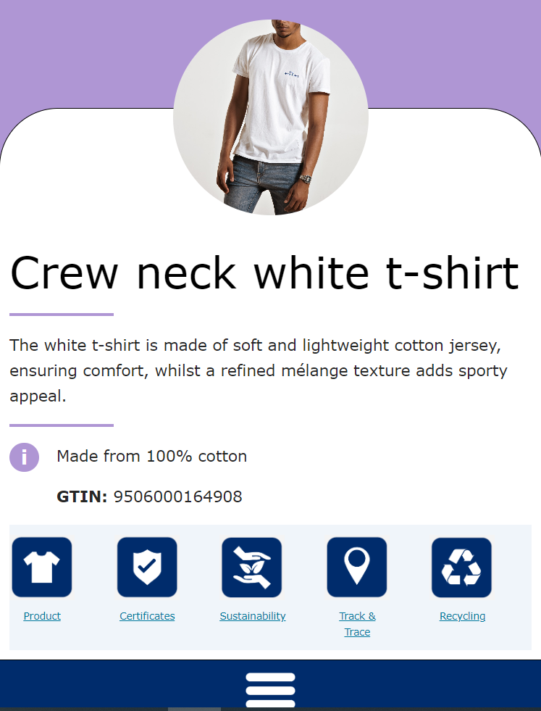
QR-powered outcomes
Meets business needs of value chain actors:
Sustainability Certification Exchange
Regulatory Compliance
Traceability and Transparency

Slide 21

Realising the digitalisation of trade is possible…
Pace of digital transformation is increasing
Rapidly evolving technology landscape leading to increased opportunities
Interoperability; low barrier to adoption is key
Unique identifiers of products, locations, entities already exist
Very little requires invention… … rather it requires EDUCATION and ADOPTION

Slide 22
… But challenges remain
We must ensure secure, verifiable transactions and interoperable frameworks for digital data sharing
All stakeholders must work together to drive consistency of adoption across borders
Collaboration among governments can avoid duplication of investment

Slide 23
Recommendations for governments and business

Slide 24
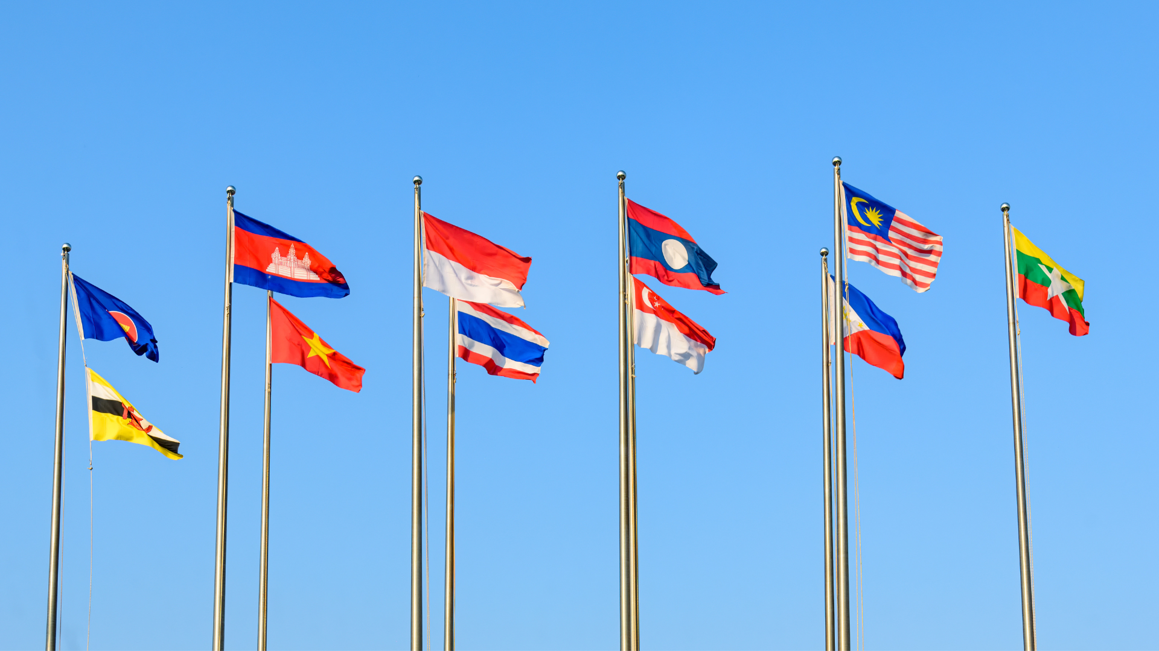

Public Sector actions to realise trade digitalisation
Harmonize Regulatory Processes
Collaborate with other governments to establish uniform rules.
Facilitate seamless information sharing across international supply chains.
Promote Trade Digitalization
Consider aligning legal systems with UNCITRAL Model Law on Electronic Records (MLETR).
Demonstrate visible support for digital trade documentation, including those for government border processes.

Slide 25

Public Sector actions to realise trade digitalisation
3. Standardize Border Processes
Align national border procedures with globally interoperable standards.
Ensure smooth transition and compatibility across borders.
4. Facilitate Digital Identity Adoption
Advocate for the adoption of global digital identity standards like LEI, GLN, or GTIN.
Establish mutual recognition or interoperability guarantees with national digital identity standards to streamline processes

Slide 26

Encouraging Private Sector transformation
Integrate Digital Infrastructure
Incorporate digital tools and technologies into corporate operations.
Embrace modern solutions for enhanced efficiency and competitiveness.
2. Standardize Data Exchange
Utilize global data standards to facilitate seamless communication.
Streamline processes and improve interoperability.

Slide 27

Encouraging Private Sector transformation
3. Embrace a "Digital First" Approach
Prioritize digital initiatives and services in business development.
Base strategies on globally interoperable standards for scalability and adaptability.
4. Optimize Trade Finance Processes
Explore digitalization opportunities within trade finance.
Utilize existing supply chain data to enhance efficiency and accessibility for underserved markets, particularly in financial institutions

Slide 28

Thank you
Daniel W. Giles
Senior Manager, International Public Policy, Asia-Pacific
GS1
M
+65 8332 5375
E
daniel.giles@gs1.org
www.gs1.org

