Slide 1

Congratulations, you’re an engagement journalist!
Nicole Hernandez

Slide 2
Some of the reasons people pursue journalism
Holding the powerful accountable
Serving as a voice for the voiceless
Informing the public on issues that affect them
Telling stories that matter
… becoming famous

Slide 3
Why I went into journalism

Slide 4
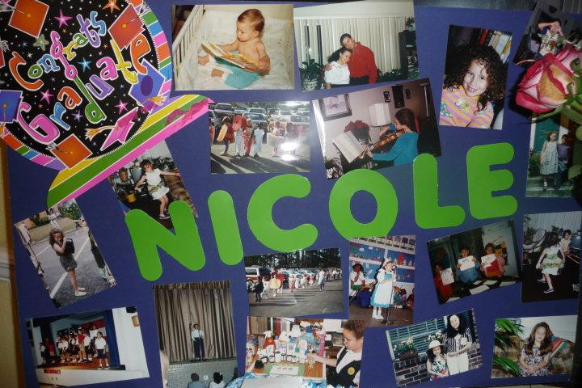
Now here’s what happened…

Slide 5
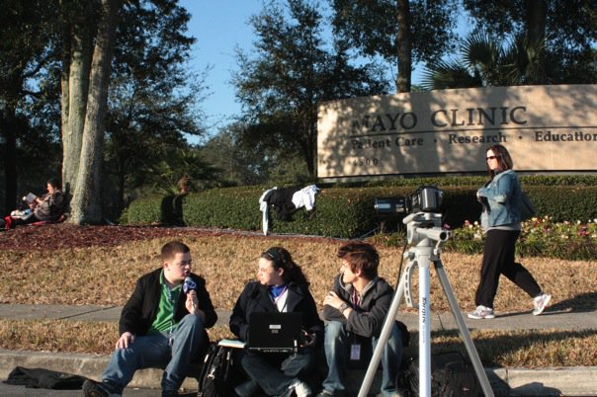

Slide 6


Slide 7
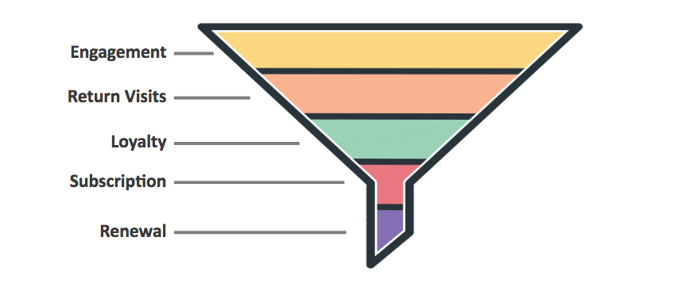
Audience. Matters. Period.
Better News

Slide 8
Some questions and tips to apply NOW
(that you may already be doing)
What are the one to two sentences I would say at a partner/friend’s office event to people I don’t know to keep them interested in this?*
*Remember to consider the audience your organization has AND is trying to develop
What is THE THING the intended audience is supposed to take from my story?
What is the thumbnail / promo image? And can I A/B test these?
Check Google Trends for insight into people’s Search behaviors and terms.
Peep the National Press Foundation’s May piece on other Google tools that can help.

Slide 9
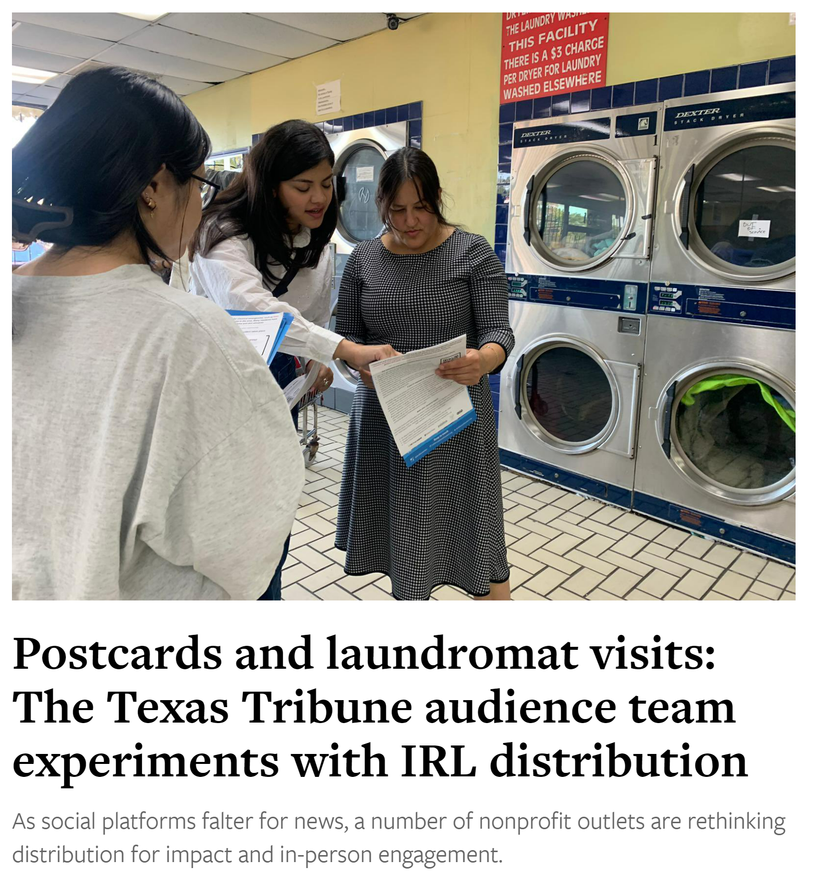
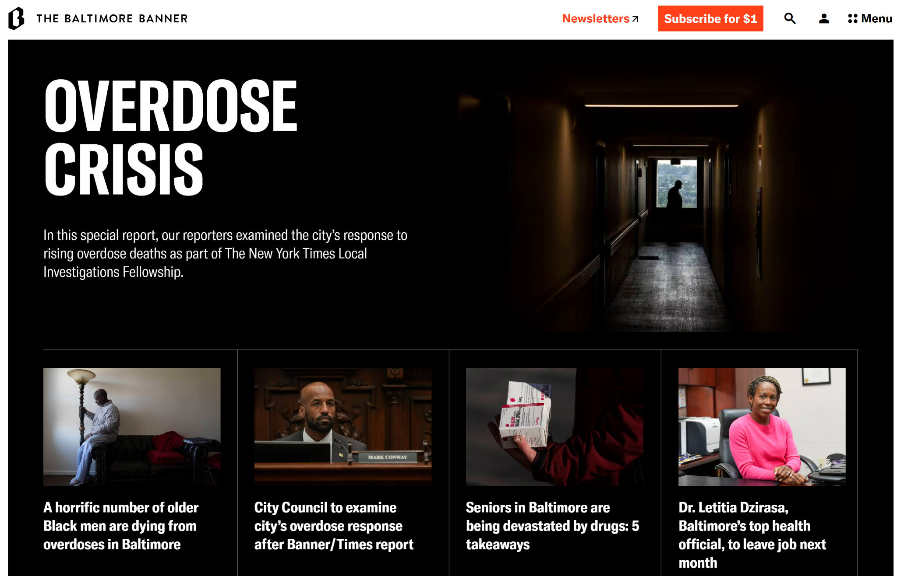
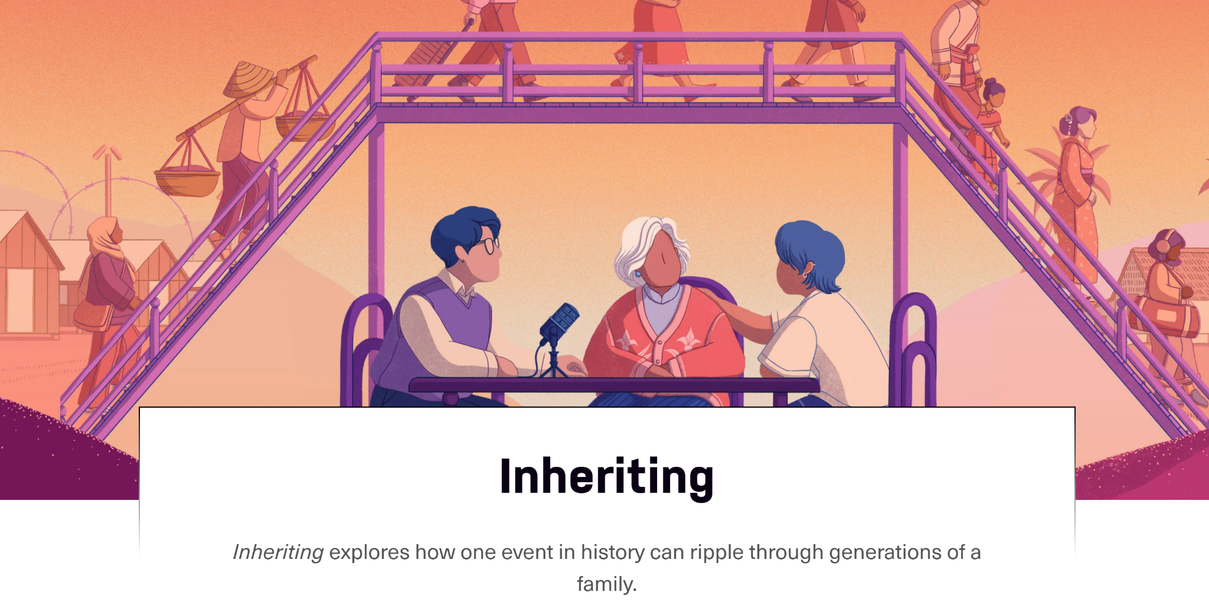
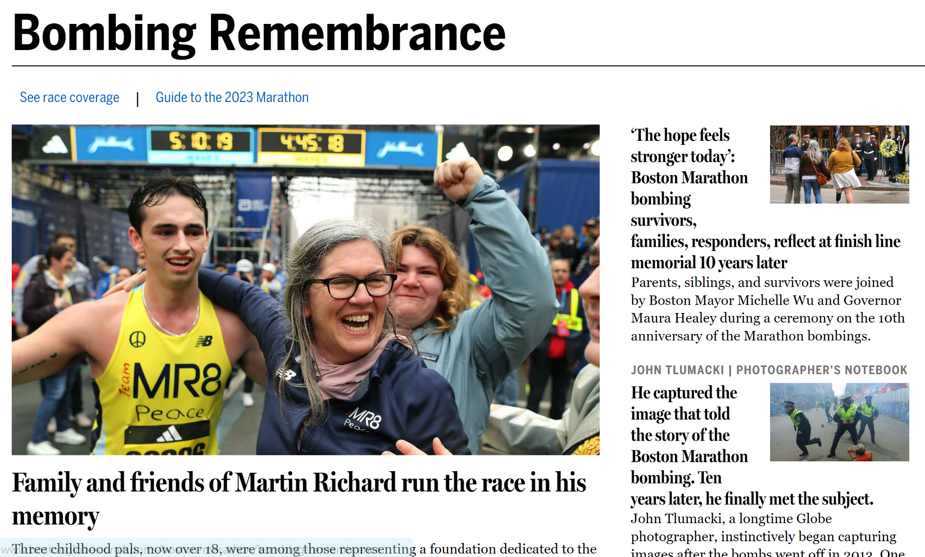
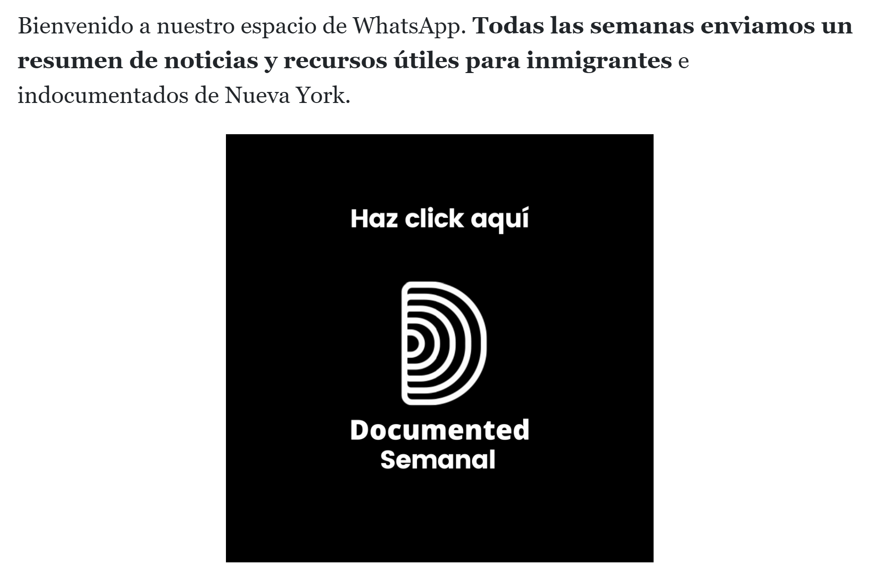
Engagement journalism is:
Notes:
Documented: https://documentedny.com/whatsapp/
Inheriting: https://laist.com/podcasts/inheriting
Nieman Lab write-up of Texas Tribune’s Cloverleaf coverage
Baltimore Banner partnership with NYT about city’s overdose deaths/impact on Black community
BostonGlobe.com / remembering the Marathon bombings

Slide 10
It’s journalism.

Slide 11
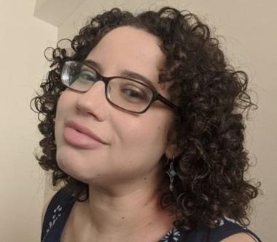
📣Wanna connect?
calendly.com/nicolehernandez-news
nhernandez@ap.org
nrhsjax@gmail.com

