Slide 1
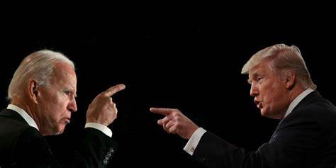
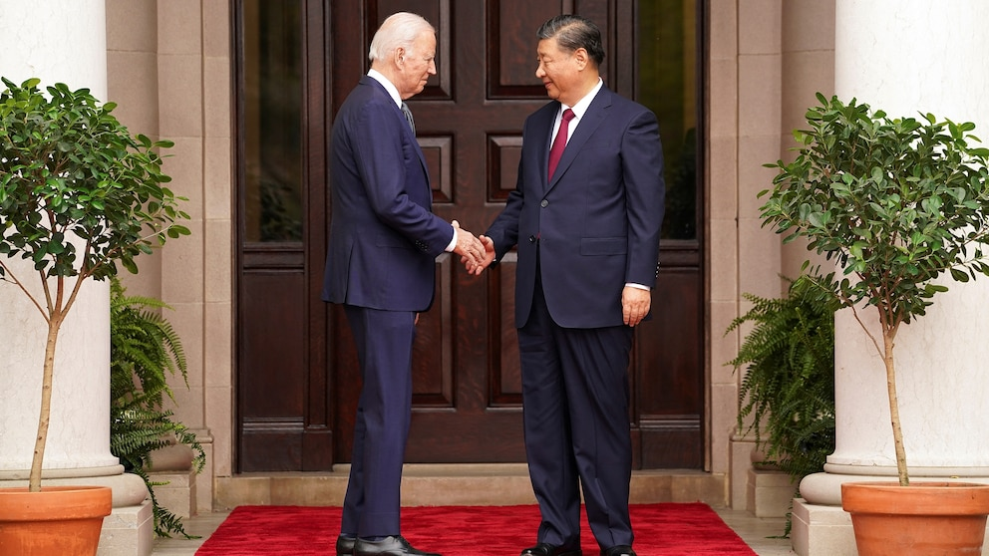


Geopolitics in the Year of Elections
Biden v Trump 2.0
Geopolitics "On the Ballot"
Steven R. Okun
June 24, 2024
Steve Okun 20/09/2020

Slide 2
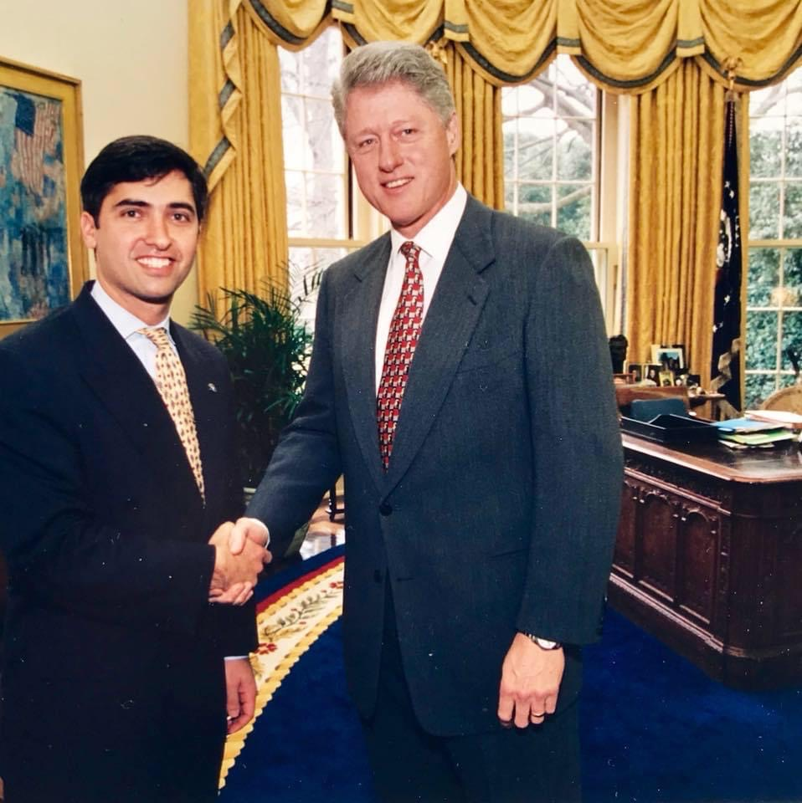
About Steven Okun
Served in Clinton Administration from 1993-1999
Veteran of Presidential Campaigns in 1992, 1996 and 2000
Democratic National Convention Staff in 1988, 1996 and 2000
Living and Working In Singapore Since 2003
CEO of ESG Consultancy APAC Advisors
Senior Advisor, McLarty Associates
Created KKR Asia Public Affairs
Chair, AmChams of Asia Pacific
More than a decade as a practitioner of ESG
Bill Clinton is younger than both Joe Biden and Donald Trump – and he left office more than 23 years ago

Slide 3
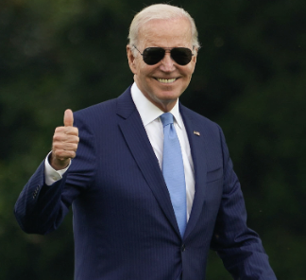
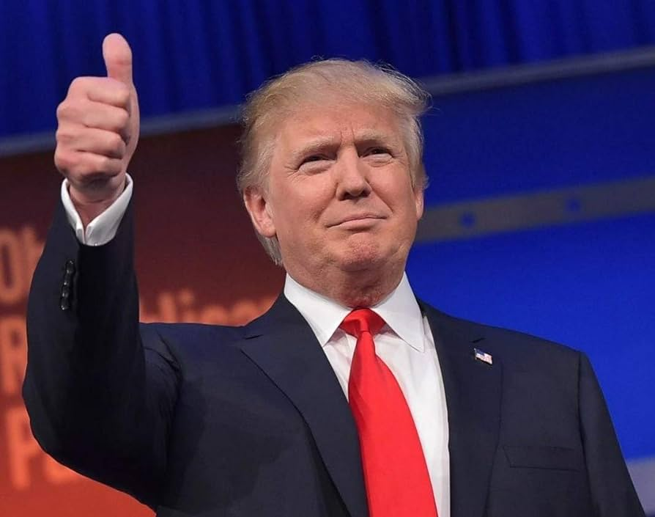
Poll Question: Who Will Win?

Slide 4
The Electoral College: 270 to Win
270 to Win
538 Votes: Each State plus DC = House + Senate
Notes:
https://www.waystocap.com/blog/international-trade-for-beginners/
https://www.cnbc.com/donald-trump/
https://www.procurehere.com/a-global-procurement-perspective-on-international-trade/
https://www.econlib.org/library/Enc/InternationalTrade.html

Slide 5
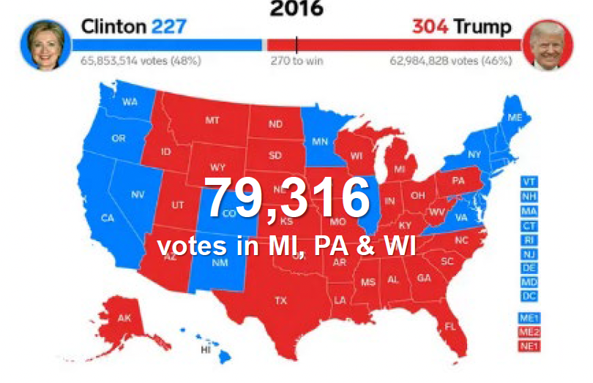
2016 A Close Call for Trump

Slide 6
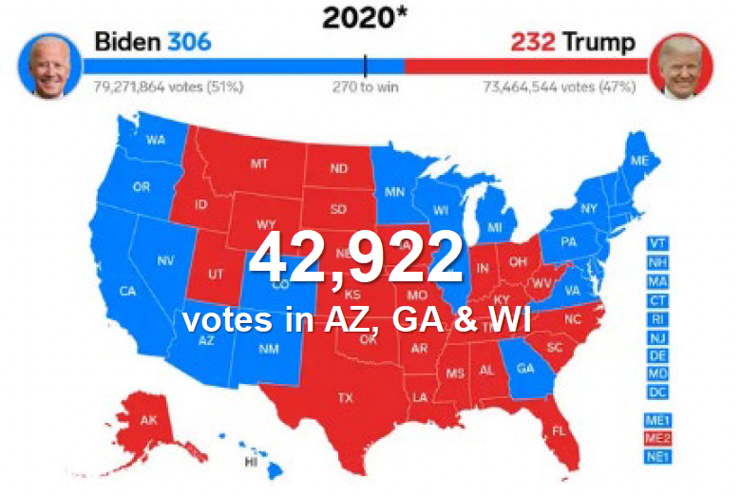
2020 Even A Closer Call for Biden

Slide 7
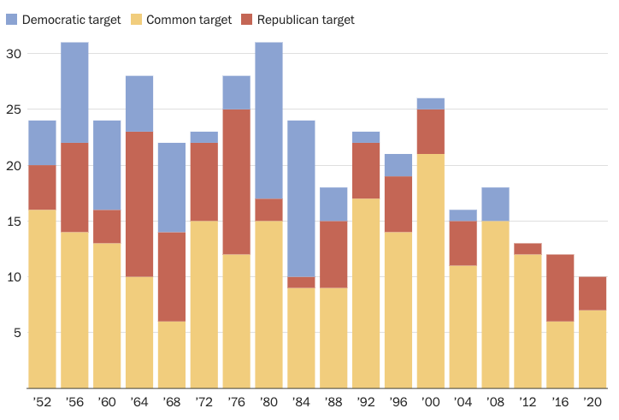
The Election Will Come Down To Just A Few States
2020 Swing States: AZ (.4), GA (.3) , MI (2.8), NV (2.4), PA (1.2), WI (.6), NC (1.30)

Slide 8
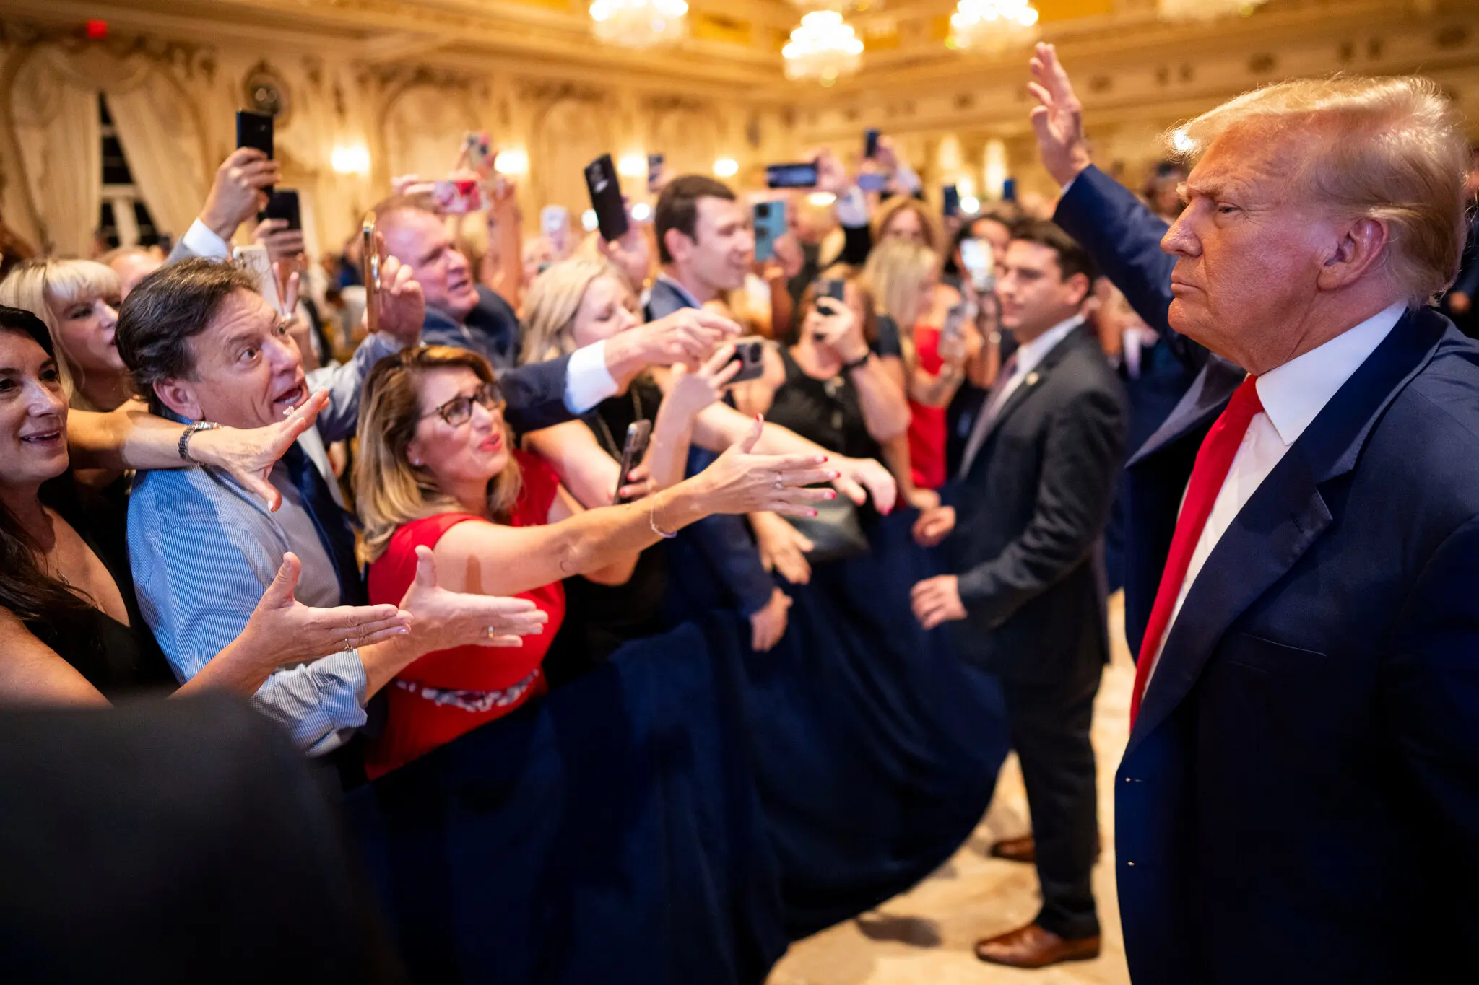
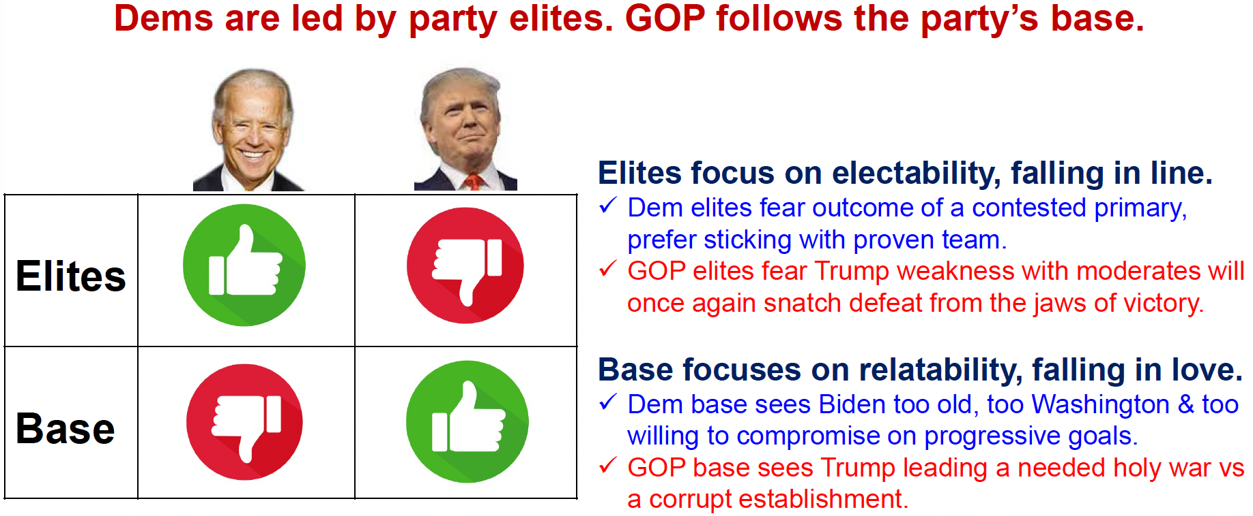
Why We Got the Rematch

Slide 9
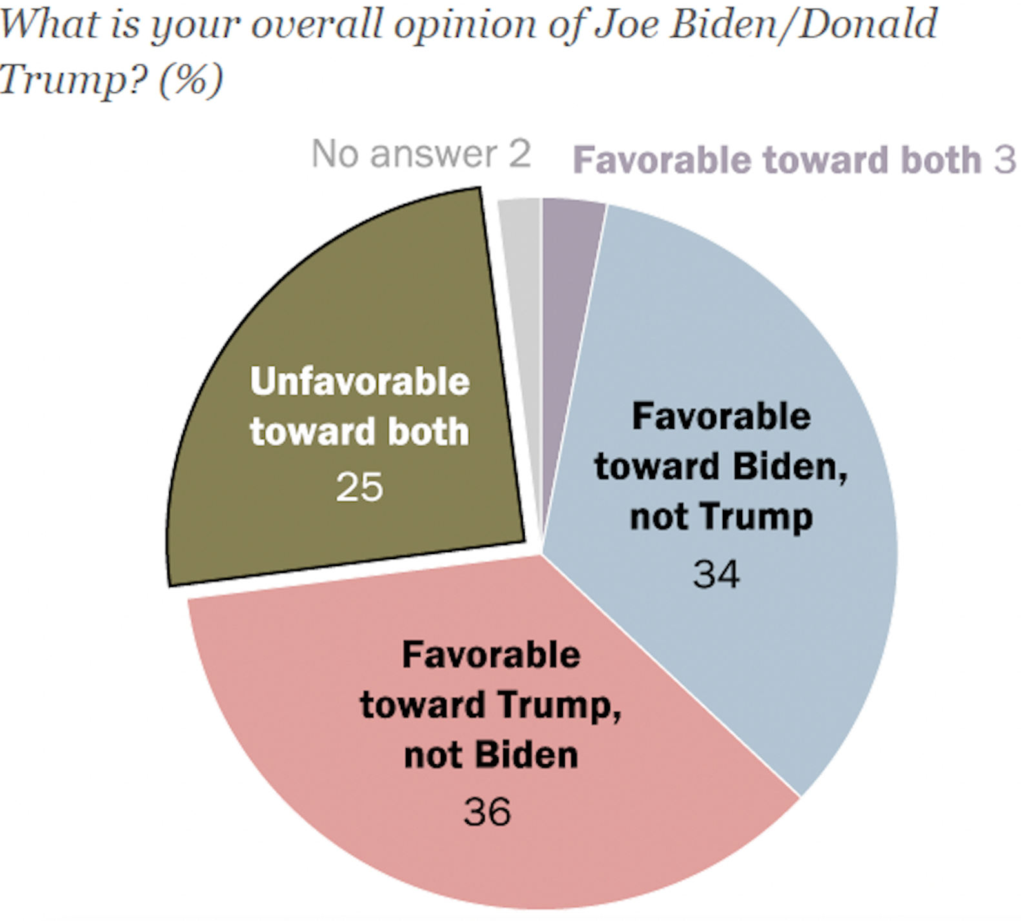
Few Want the Rematch
Source: Pew

Slide 10
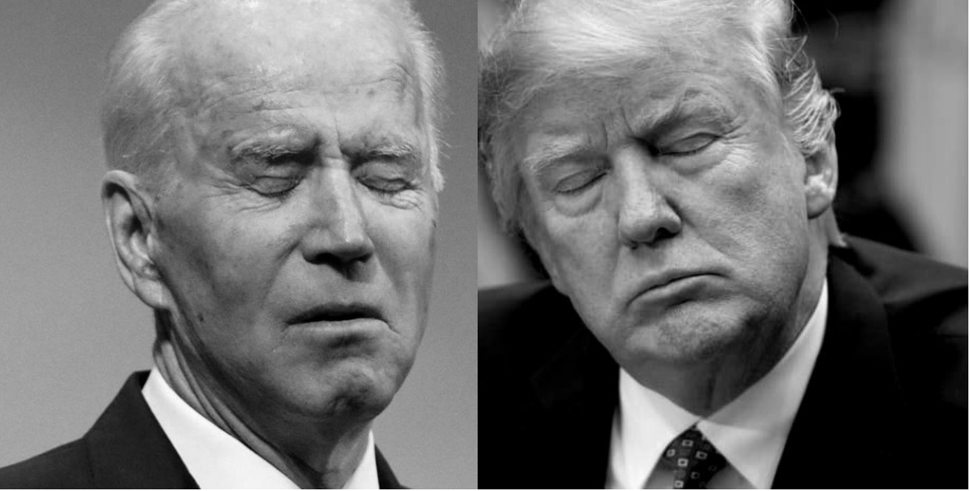
Who Will Get the Most ”Double Haters”

Slide 11
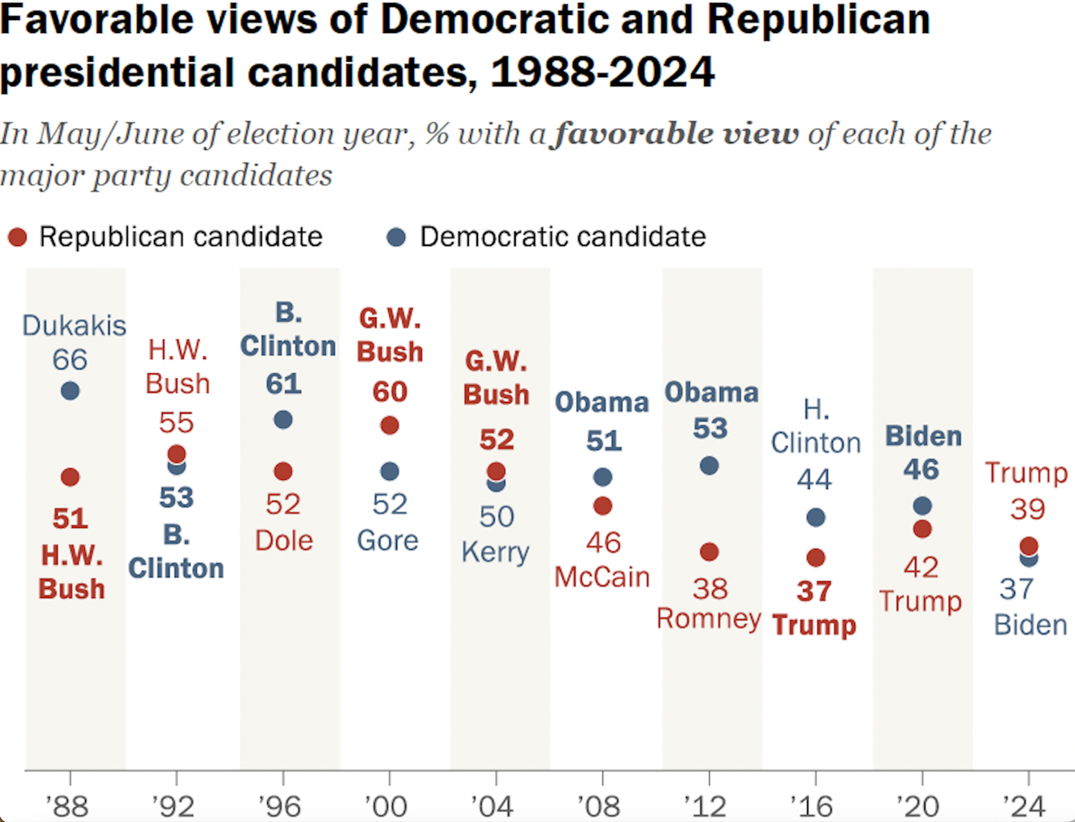
Double Haters is New to American Elections
Source: Pew

Slide 12
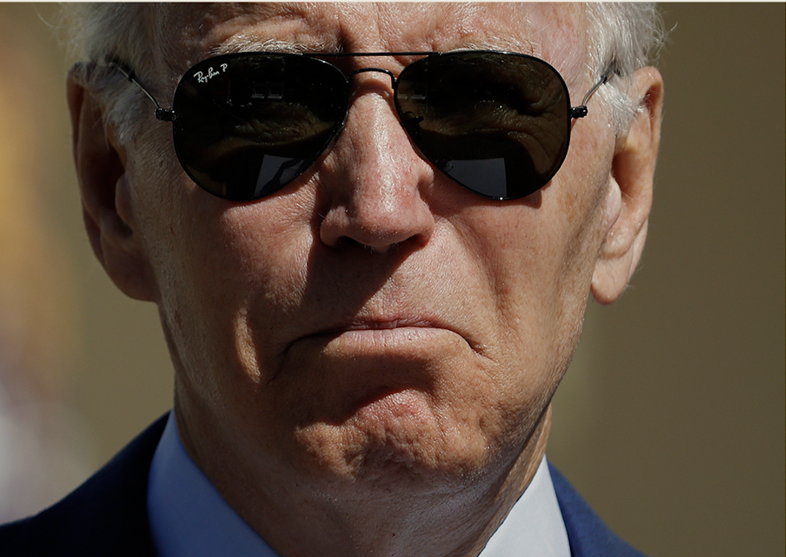
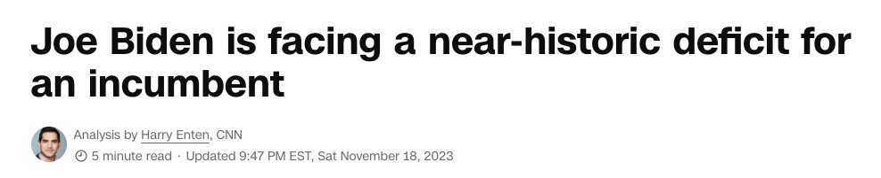
Prognosis for Democrats
https://www.cnn.com/2023/11/18/politics/joe-biden-donald-trump-election-2024

Slide 13
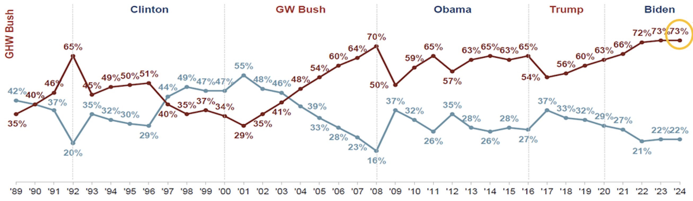
Americans Really Unsatisfied
American Voters Believe Country on the “Wrong Track”
Haven’t Been Going in Right Direction for 20+ Years
Source: Mehlman Consulting

Slide 14
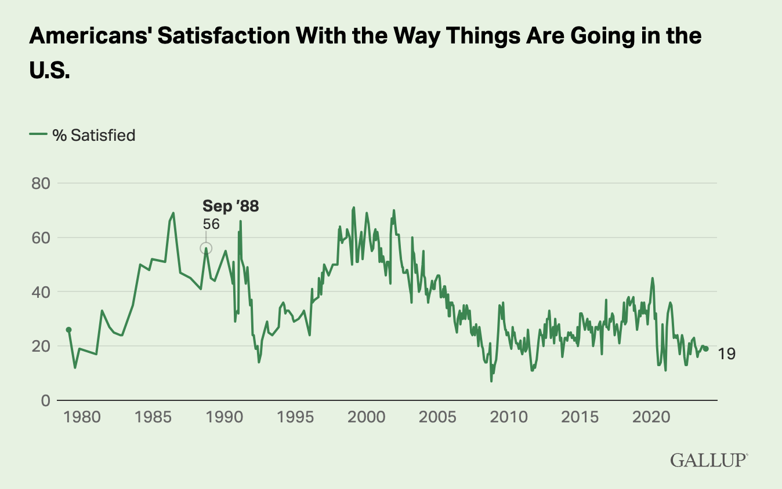
Bad News For Party in the White House
Satisfaction with the country is about as low as it was in 1980, 1992, 2008 and 2020 — years when the president’s party was defeated.
Source: Gallup

Slide 15
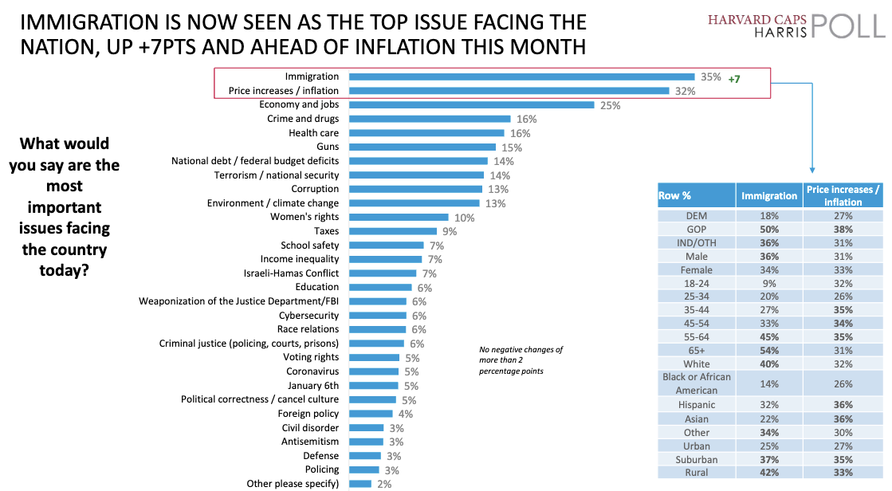
The Top Issues for Voters
Immigration; Inflation and The Economy; Crime and Drugs

Slide 16
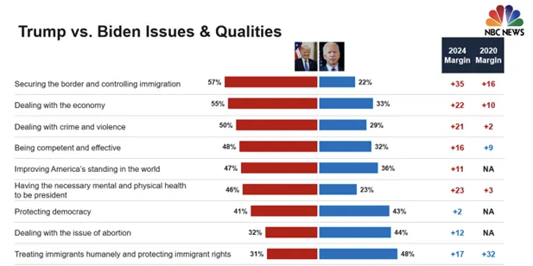
Biden Trails Trump on Key Issues

Slide 17
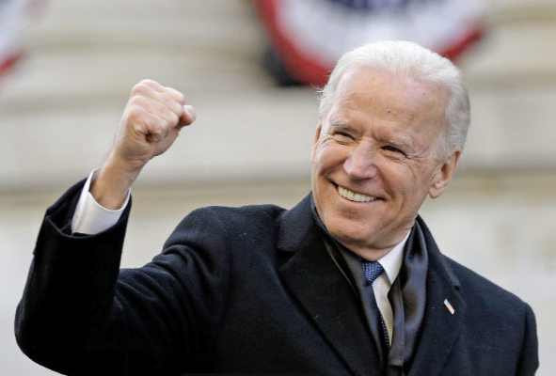
But You Never Know

Slide 18

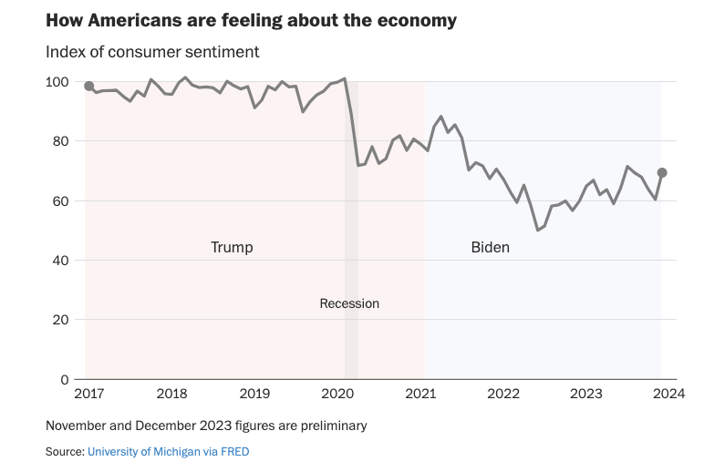
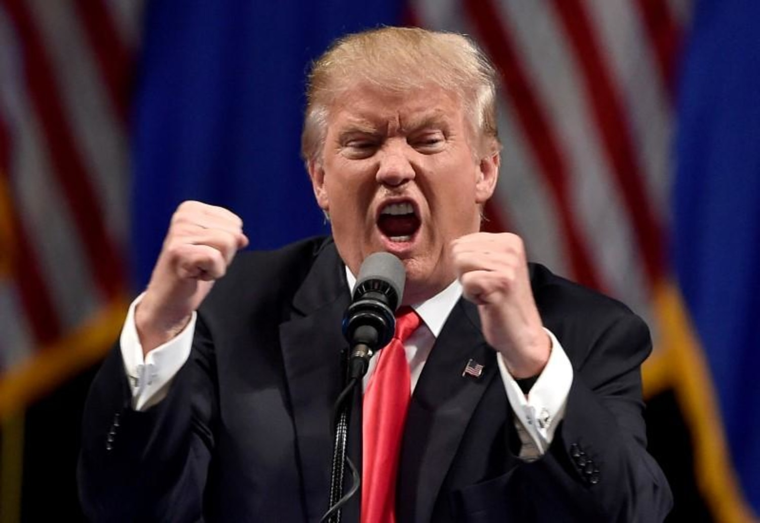
Biden’s Path to Victory: Record, Abortion, Trump

Slide 19
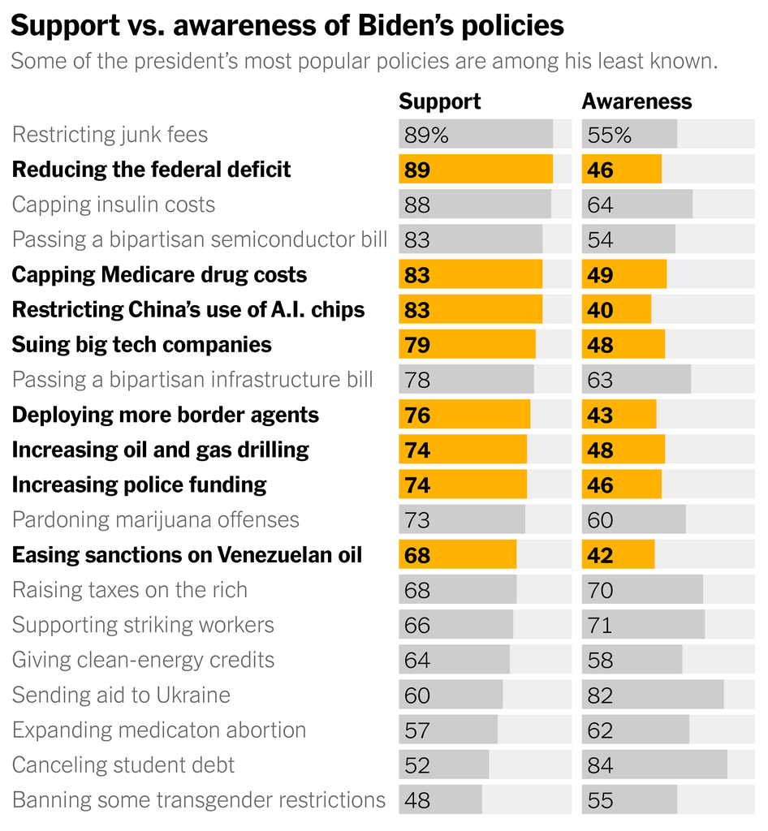
Can Biden Campaign Get His Message Out?
Obstacles:
Trump
Israel-Gaza
Biden’s Campaign

Slide 20
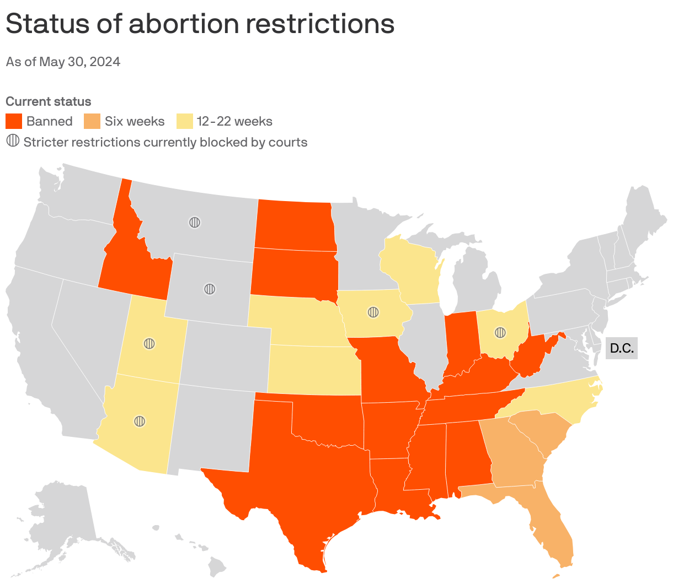
Abortion Bans Post-Dobbs

Slide 21
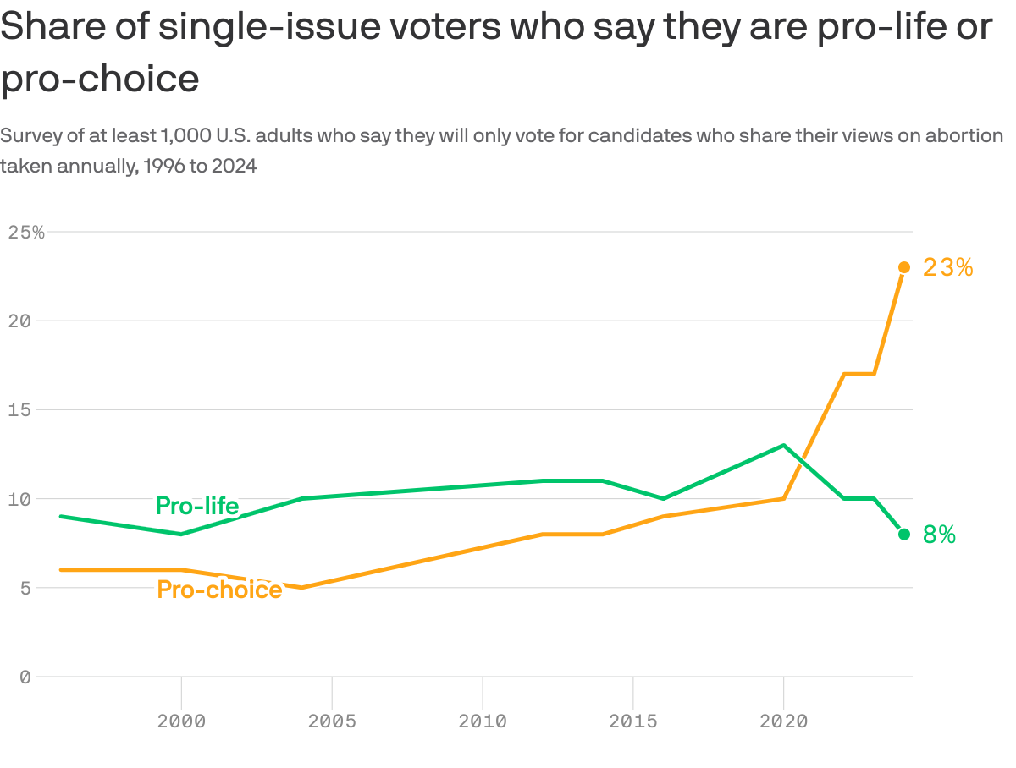
Pro-Choice Now A Single Issue for More Voters

Slide 22
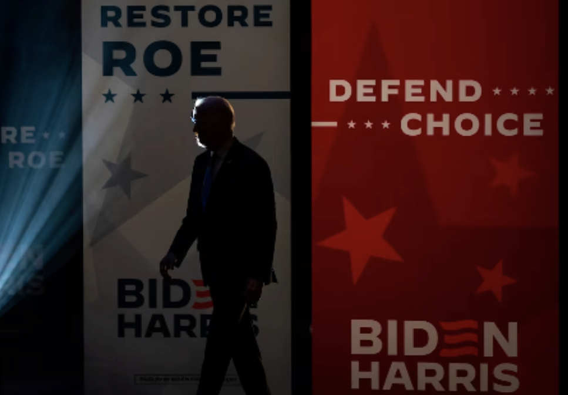
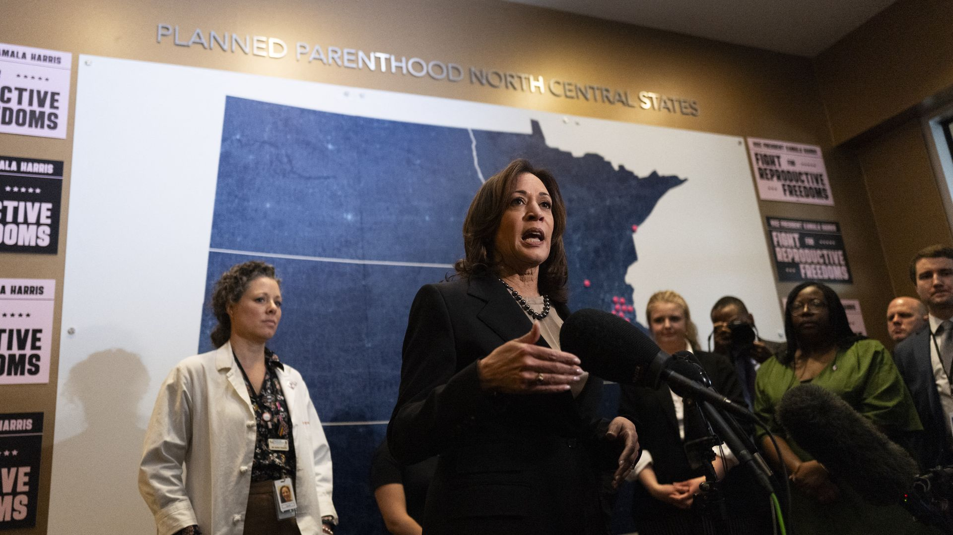
Abortion: Republicans Continue to Struggle
"Those bragging about overturning Roe v. Wade have no clue about the power of women in America. But they found out when reproductive freedom was on the ballot and won in 2022, 2023, and they will find out again in 2024.”
President Biden
2024 State of the Union

Slide 23
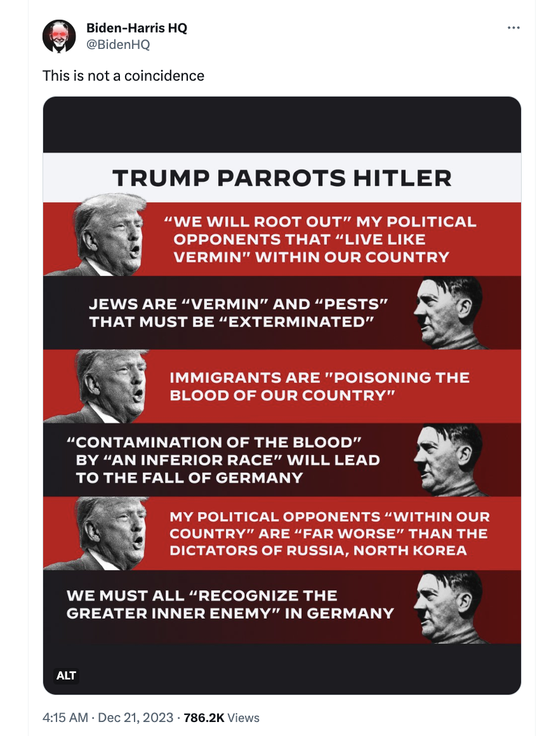
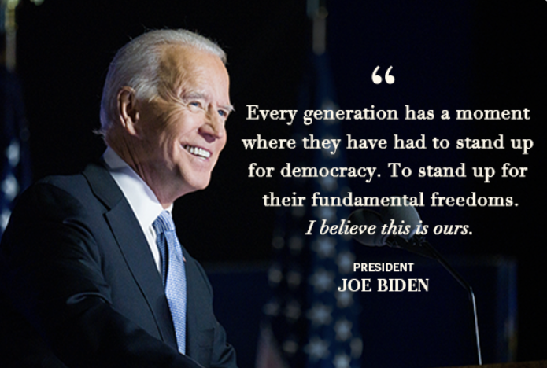
Biden v The Couch: Sound the Trump Alarm

Slide 24
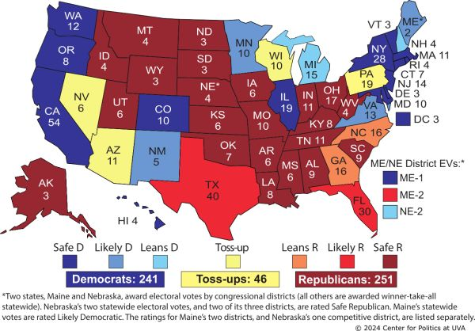
The 2024 Electoral College Right Now

Slide 25
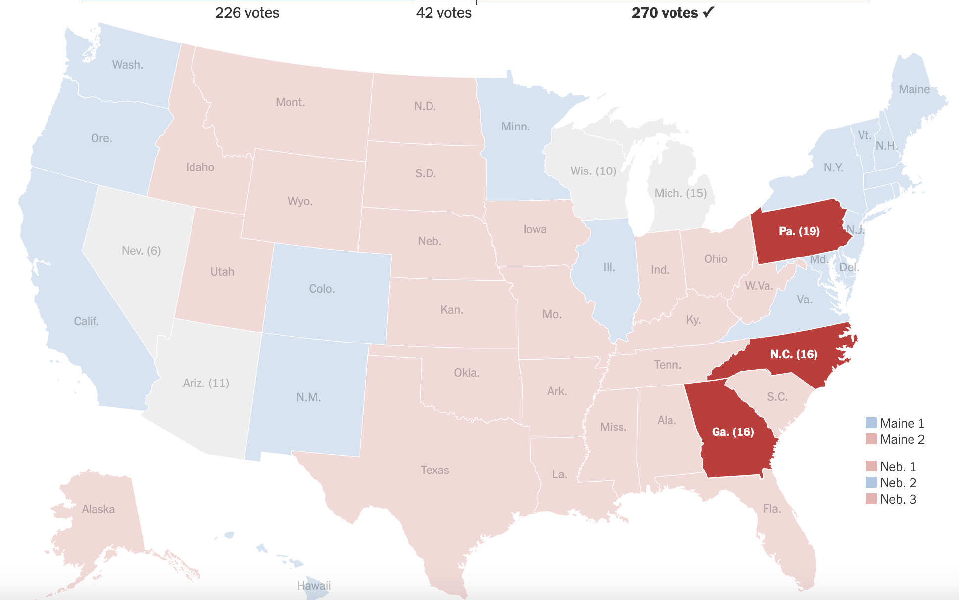
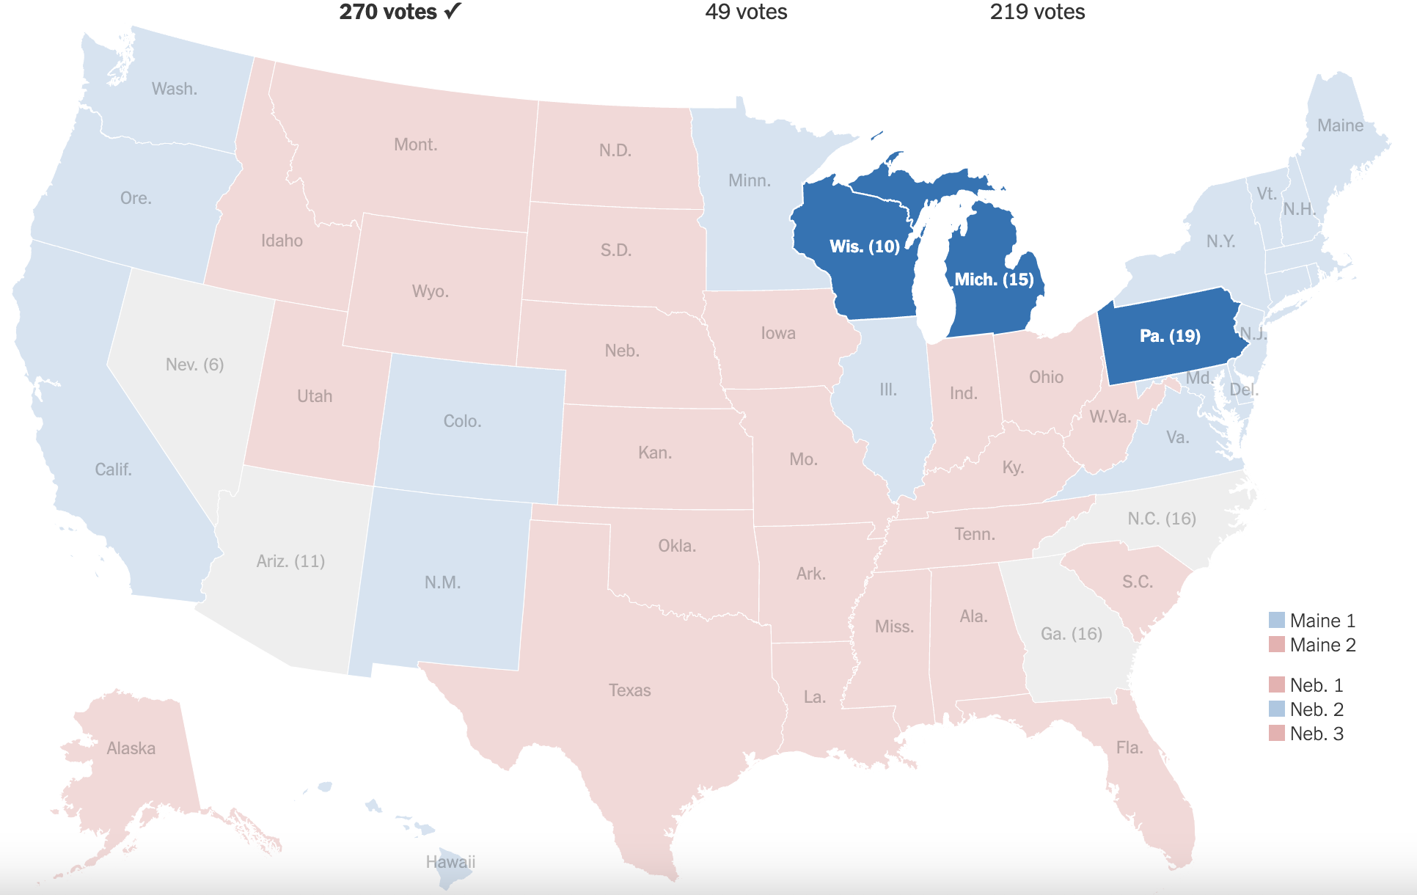
Will Pennsylvania Decide a 1-EV Margin Election?
https://www.nytimes.com/interactive/2024/04/16/opinion/electoral-map-outlook.html

Slide 26
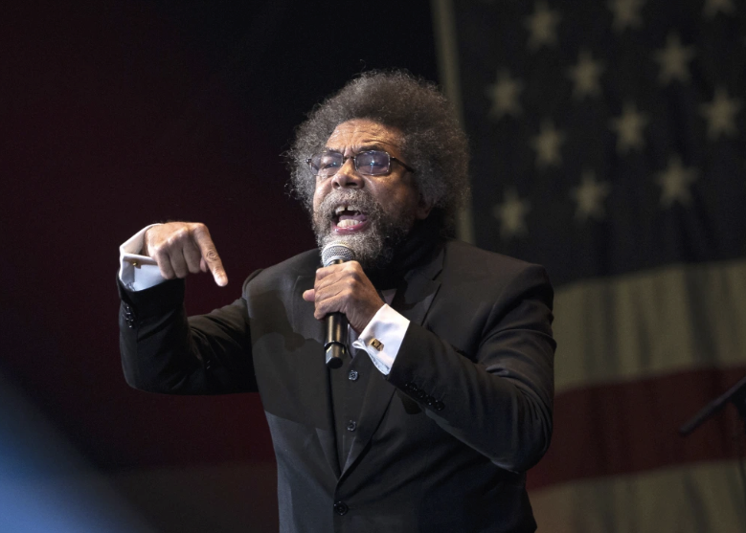
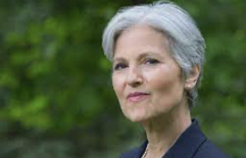
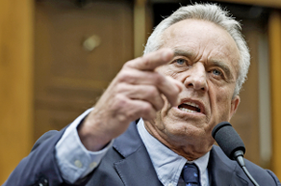
Could These People Decide the Election?

Slide 27
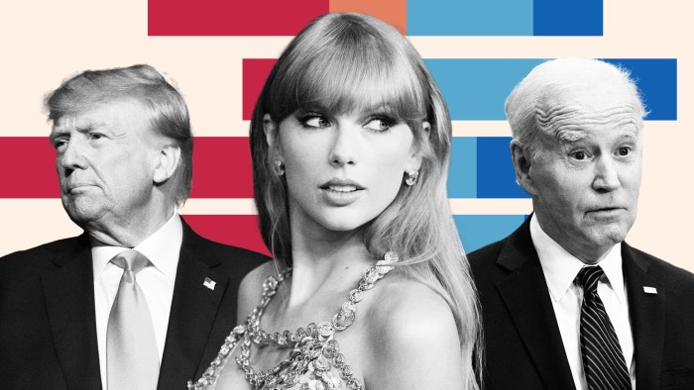
Or Could This Person?

Slide 28
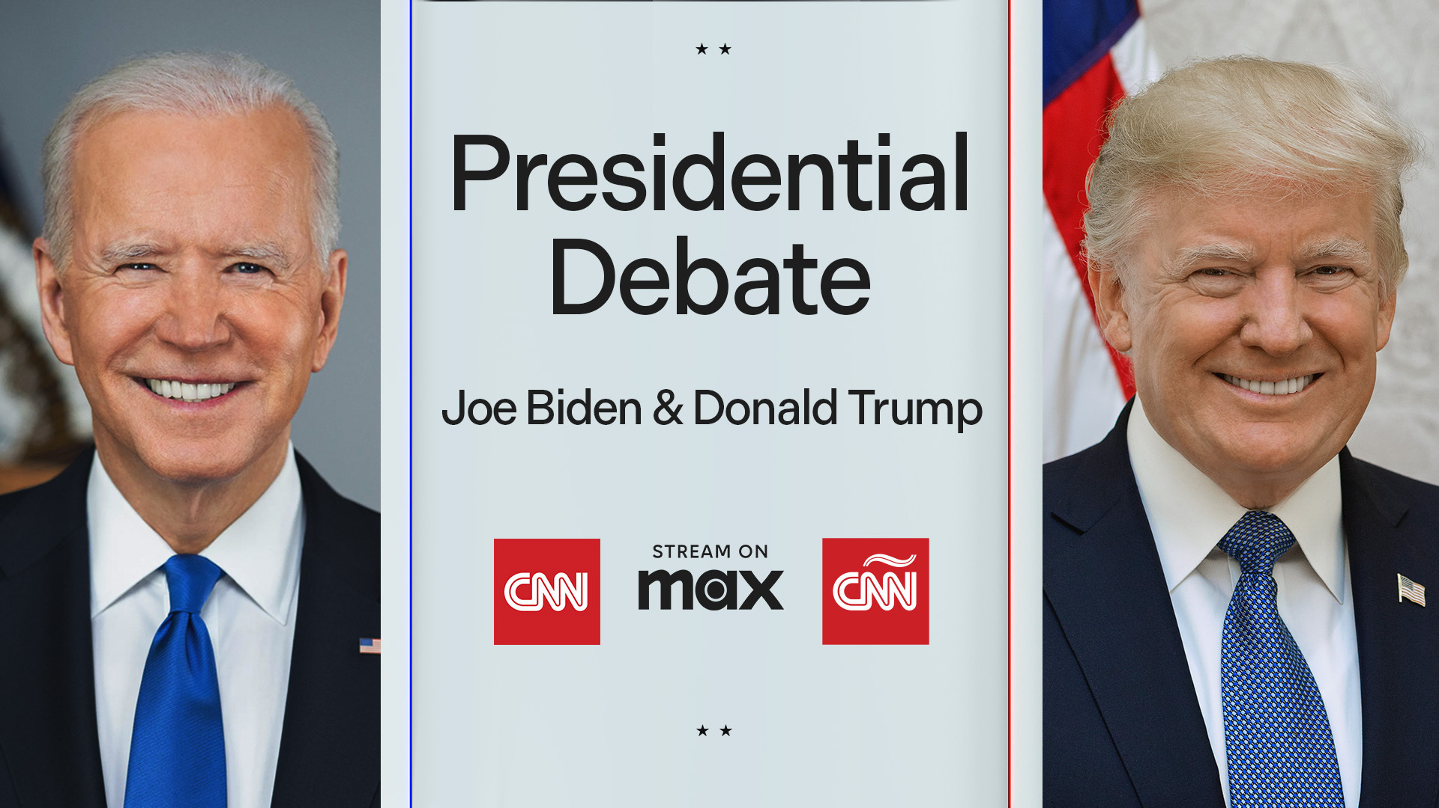
A New Wildcard (if it happens)

Slide 29
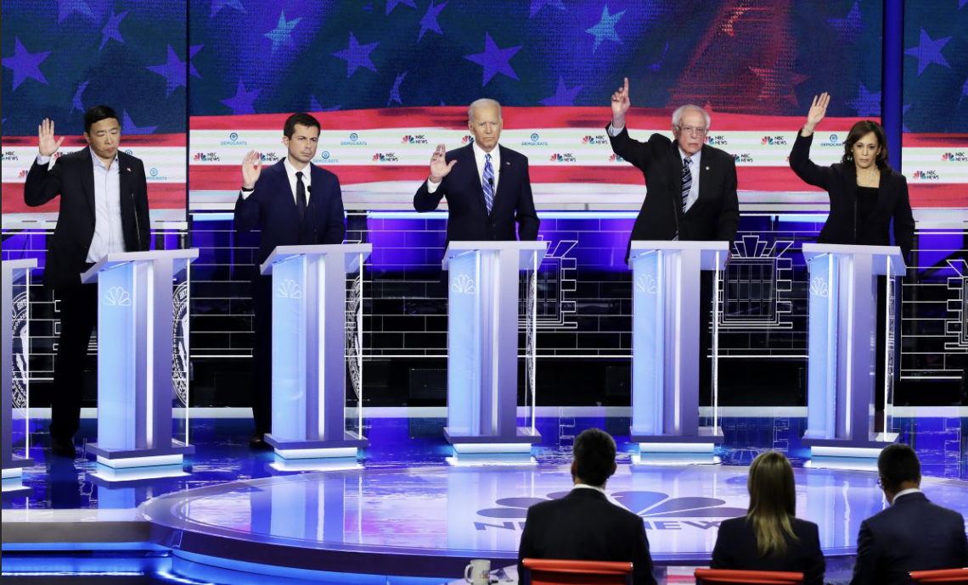
Questions on the US Political Scene

Slide 30
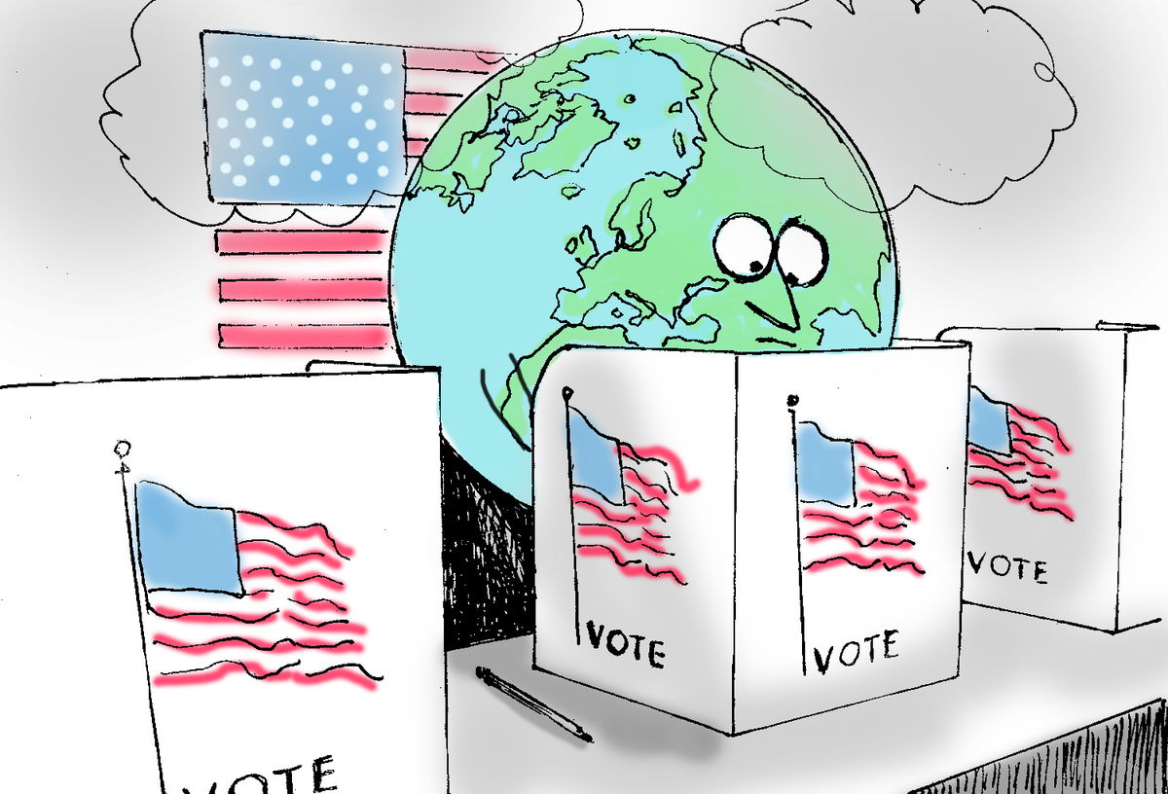
The 2024 US Election and Sustainability
Steve Okun 20/09/2020

Slide 31
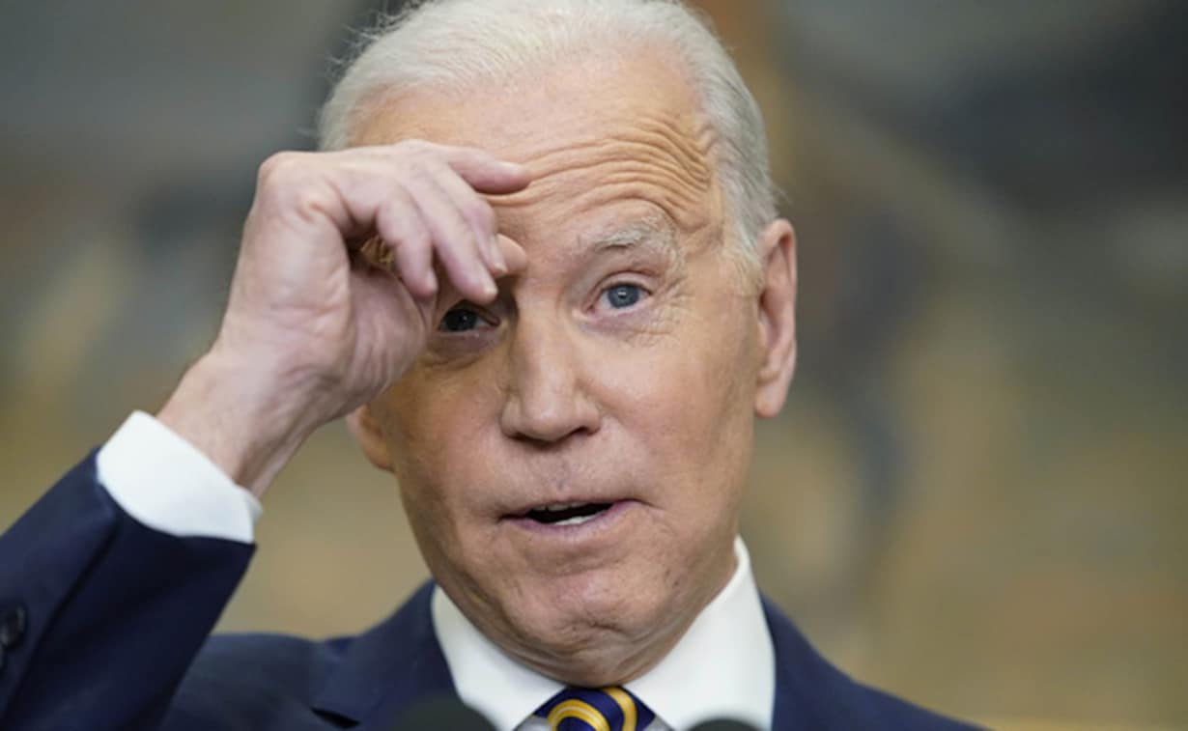
What Worries Joe Biden the Most?
"We have a crazy SOB like that guy Putin and others, and we always have to worry about nuclear conflict. But the existential threat to humanity is climate."
Source: https://www.reuters.com/world/us/biden-calls-putin-crazy-sob-during-san-francisco-fundraiser-2024-02-22/

Slide 32
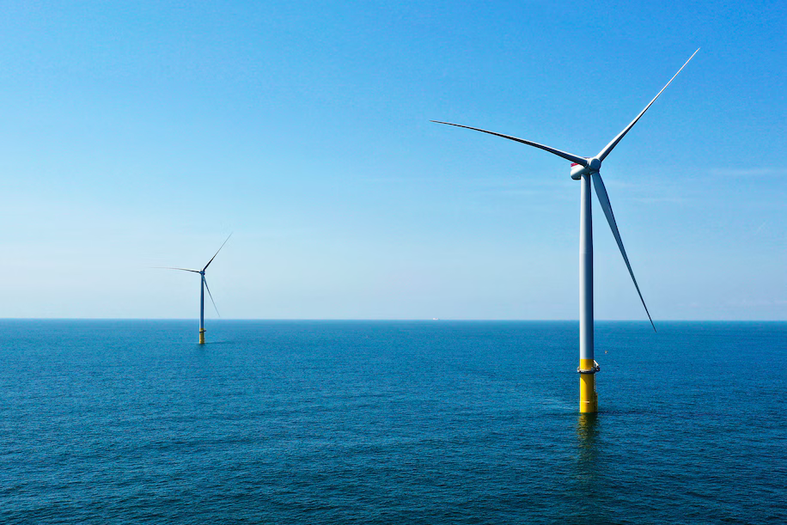
Donald Trump Has a Different Take
“I Hate Wind”
“If you have a windmill anywhere near your house, congratulations, your house just went down 75 percent in value . . . And they say the noise causes cancer. And of course it’s like a graveyard for birds.”
Source: https://www.washingtonpost.com/climate-environment/2024/04/17/trump-wind-power-oil-executives/

Slide 33
Biden 2.0: The Regulatory State
Aim for Net Zero by 2050
Tougher Limits on Vehicle Emissions to Boost EVs
Increase in EPA Funding
End Oil Subsidies
Contribute $500 million+ to Global Climate Finance

Slide 34
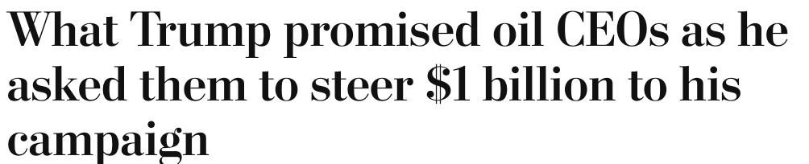
Trump 2.0: Roll Back
Withdrawal from Paris Climate Accords
End/minimize US Participation in COP Summits
Reneging on US pledged finance commitments
Repeal of Inflation Reduction Act / Executive Changes to IRA
Slash EPA Funding and Redistribute Power towards States
Ban ESG investment in 401(k) plans by Executive Order
Slow / Cut / Claw Back funds under the Bipartisan Infrastructure Law to build out national EV charging network
Immediately end freeze on permits for new LNG exports
https://www.washingtonpost.com/politics/2024/05/09/trump-oil-industry-campaign-money// ; other

Slide 35
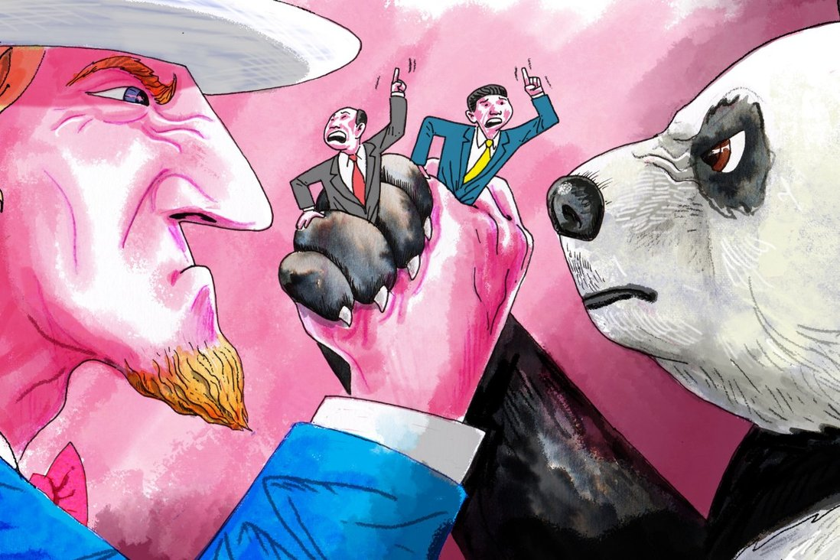
What the 2024 US Election Means for Asia
Steve Okun 20/09/2020

Slide 36
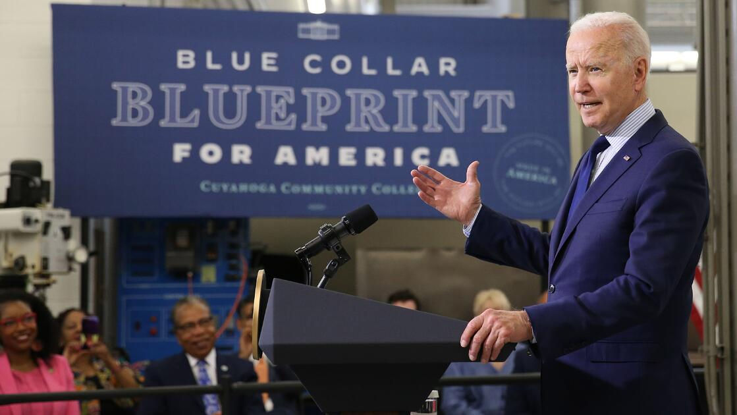

Sound Familiar?
“What we’re trying to do in this corrective phase of globalization . . . is to focus on the individual, the human being, the worker, the community, which forms really the human component of our economy.”
“Our guiding principles are . . . The primacy of American workers, families and communities in all we do.”
Sources: https://insidetrade.com/daily-news/tai-administration-has-not-%E2%80%98sworn-%E2%80%99-traditional-market-oriented-trade-policy; https://americafirstpolicy.com/
Notes:
https://en.irna.ir/news/83339486/China-protests-US-irresponsible-trade-war-with-white-paper-statement

Slide 37
Bipartisan Economic Focus Areas On China
US Industrial Policy and Subsidies Continues
New Protectionism
Bans
Export Controls
Tariff
Focus on Trans Shipments
Protect Against Excess Capacity
Batteries
EVs
Legacy Chips
Solar Panels
Steel

Slide 38
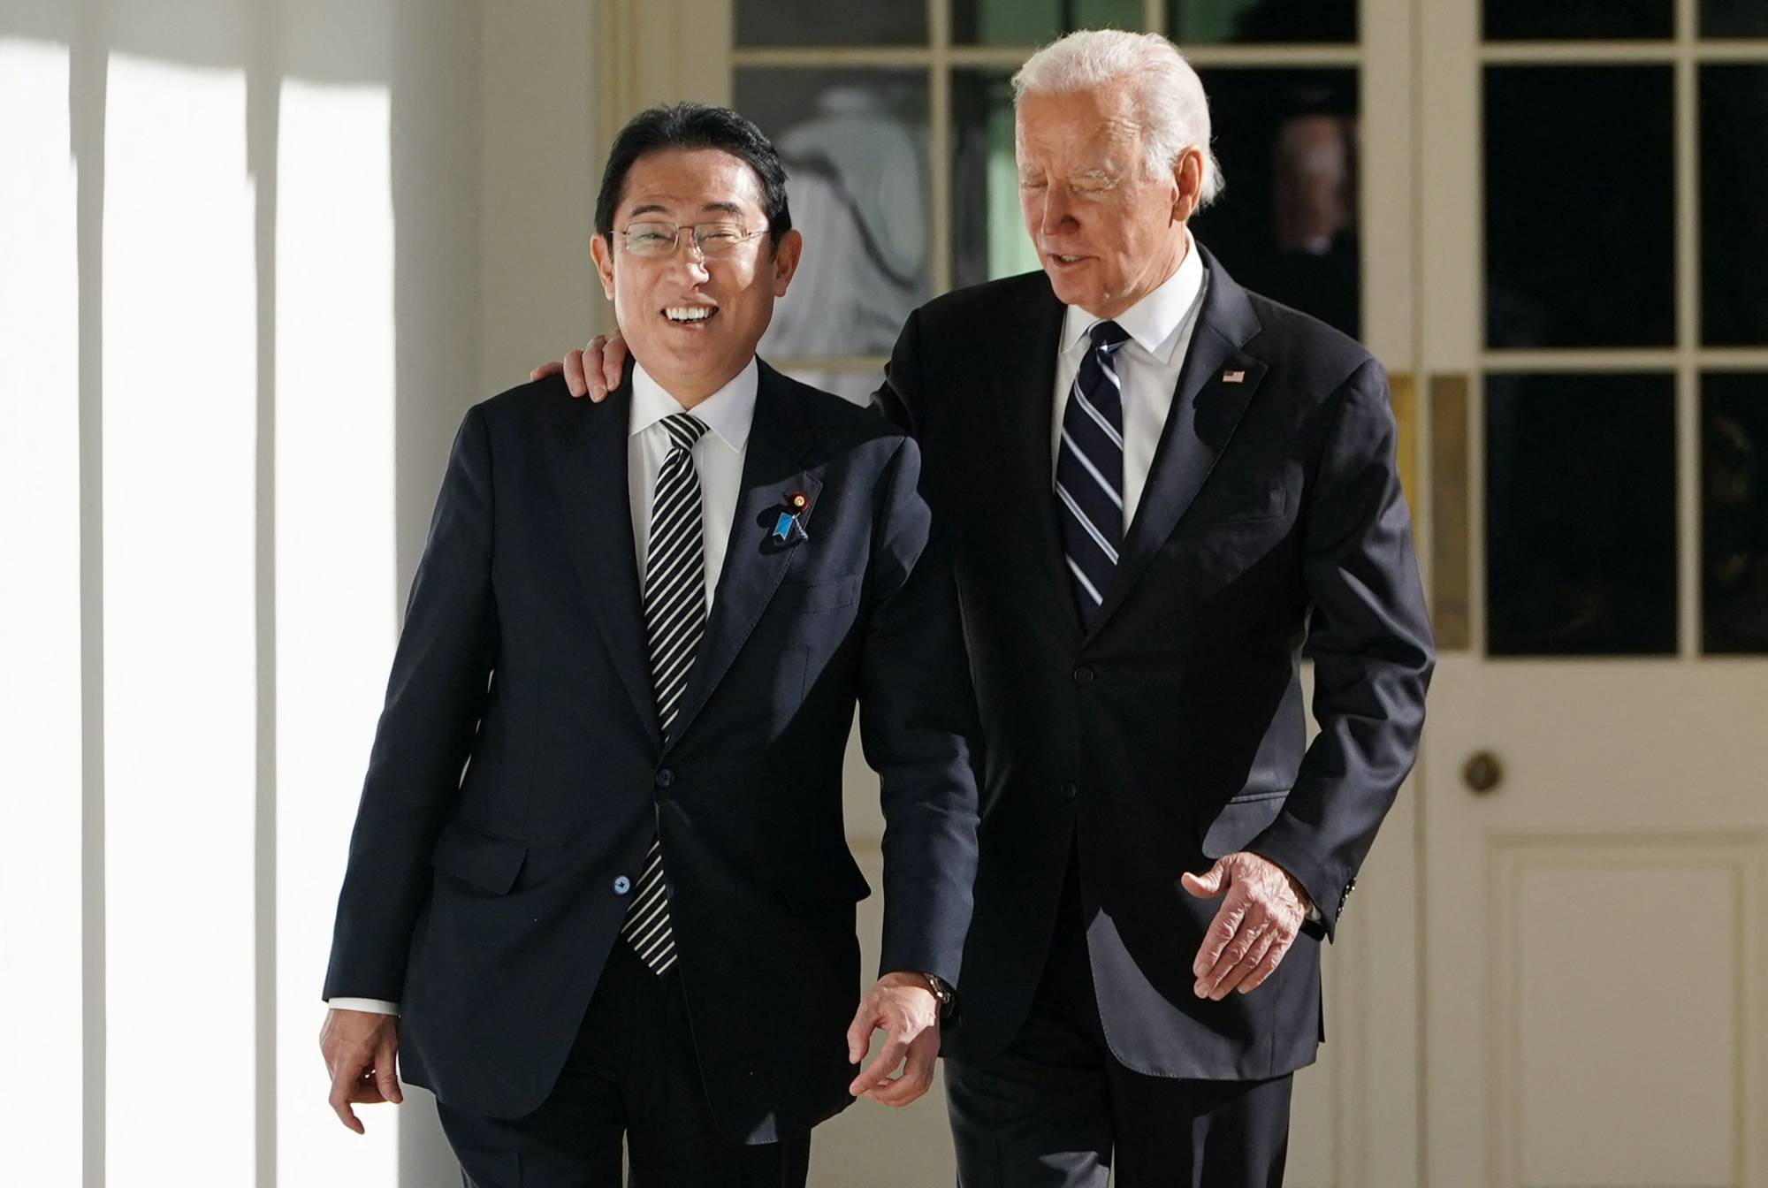
Biden’s Lattice Asia Policy
US and Japan highlight rewards to both of major new private sector investments (while sidestepping politics of proposed US Steel acquisition by Nippon Steel).
US had over 70 business deliverables announced during the visit.
Biden and Kishida highlighted that Japan’s bullet train technology could be used in the Texas Central High Speed Rail Project to connect Houston and Dallas.
Considering adding Japan on to AUKUS (JAUKUS)

Slide 39

Trump’s Foreign Policy: Transactional Isolationism
“China has risen, the Middle East has burned, and Russia has rampaged in Ukraine” -- Robert C. O’Brien, NSA, 2019-21
If South Korea doesn’t pay more to support U.S. troops to deter Kim Jong Un’s, Trump suggests the U.S. could withdraw: “Why would we defend somebody? And we’re talking about a very wealthy country.”
Following Ukraine Vote: “You can’t depend on him for anything,” the source, who has publicly weighed in for Trump, said bitterly. “He didn’t do anything to stop it. He’s only motivated by self-interest.”
https://time.com/6972021/donald-trump-2024-election-interview/
Notes:
https://en.irna.ir/news/83339486/China-protests-US-irresponsible-trade-war-with-white-paper-statement

Slide 40
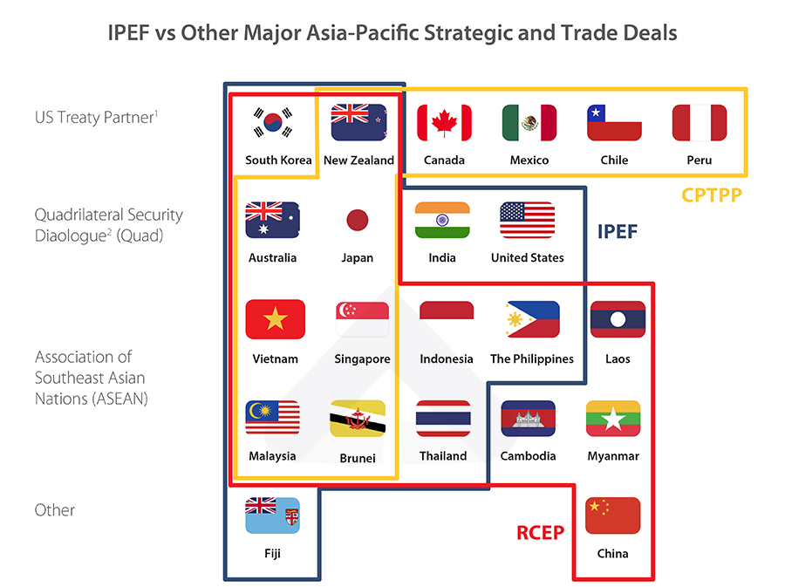
Opportunities in CPTPP, RCEP and IPEF
The Indo-Pacific Economic Framework for Prosperity (IPEF) includes 4 pillars:
Resilient Economy: covers supply chains
Clean Economy: covers clean energy and strengthening energy security
Fair Economy: covers tax and anti-corruption
Clean Economy Pillar: Energy security and transition; GHG emissions reductions; Sustainable land, water, and ocean solutions; Innovative technologies for GHG removal; Incentives to enable clean economy transition.
Notes:
https://en.irna.ir/news/83339486/China-protests-US-irresponsible-trade-war-with-white-paper-statement

Slide 41
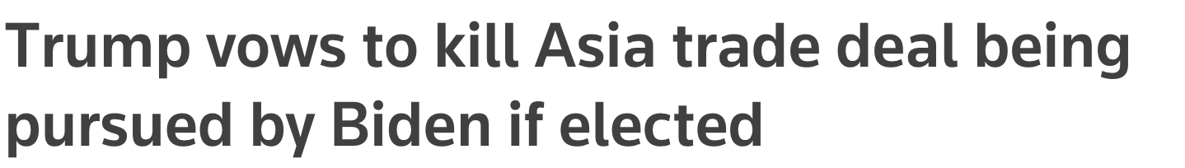
Does IPEF Survive if Trump Wins?
"Under the next administration... the Biden plan for 'TPP Two' will be dead on day one," Trump said at a campaign event in Iowa.
"It's worse than the first one, threatening to pulverize farmers and manufacturers with another massive globalist monstrosity designed to turbocharge outsourcing to Asia."
https://www.reuters.com/world/us/trump-vows-kill-asia-trade-deal-being-pursued-by-biden-if-elected-2023-11-19/
Notes:
https://en.irna.ir/news/83339486/China-protests-US-irresponsible-trade-war-with-white-paper-statement

Slide 42
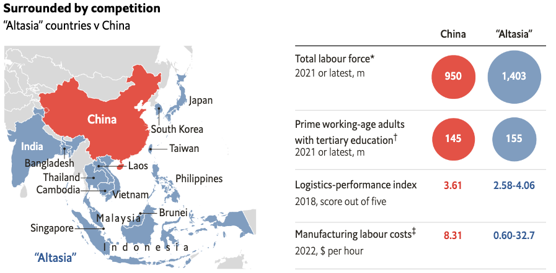
Alternative Asian Supply Chain
“Altasia” is a result of the US-China geopolitical rift, forcing global manufacturers to look elsewhere in Asia for new production sites.
BUT: Chinese production capabilities will be tough to replicate. The diverse economies of Altasia do not work together as a single entity. Infrastructure and logistics are huge challenges, though a number of trade pacts are easing regulatory barriers.
Source: https://www.economist.com/graphic-detail/2023/03/03/these-countries-could-lure-manufacturing-away-from-china

Slide 43
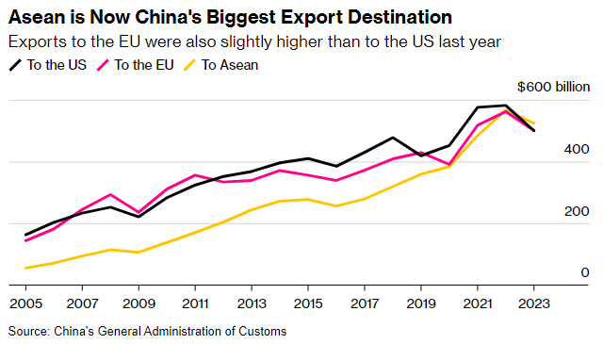
ASEAN Benefits from US-China Tensions
For the first time, China exported more to Southeast Asia than the US last year, highlighting the realignment of global trade. The 10 nations in ASEAN bought $524 billion of goods last year, higher than the $500 billion worth sold to the US or the value of shipments to the EU.
https://www.bloomberg.com/news/newsletters/2024-01-15/supply-chain-latest-how-china-s-exports-are-shifting-away-from-the-us

Slide 44
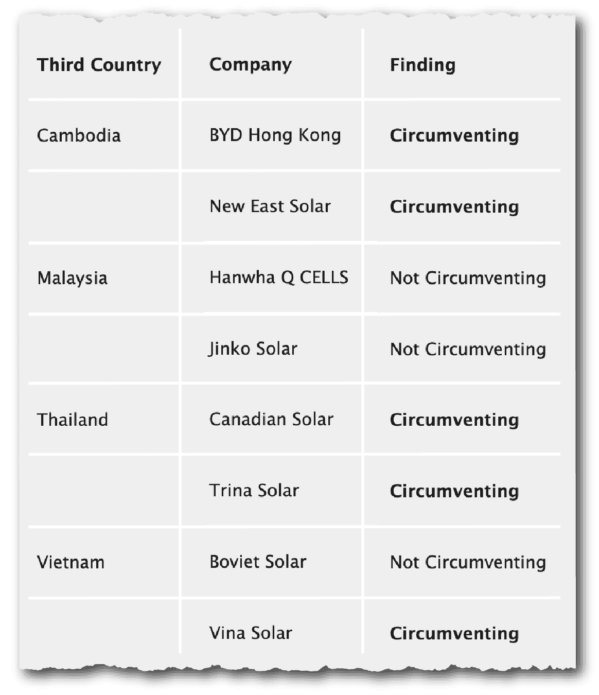
US Already Investigating Trans Shipments
A summary of findings from the Commerce Department’s circumvention inquiries of solar cells and modules from China, August 18, 2023.
Source: The Wire

Slide 45

Supply Chain Resilience: Where are the Funds?
China’s ports handled 300.5 mill TEU in 2021 vs. VN’s 19.6 mill TEU.
If 5% of the manufacturing export market were to pull out of China and move to Vietnam, it would require investment equivalent to 76.5% of Vietnam’s existing infrastructure.
Notes:
https://en.irna.ir/news/83339486/China-protests-US-irresponsible-trade-war-with-white-paper-statement

Slide 46


Long Term Trends Regardless: Business IN Government
Populism is Here to Stay
Globalization will continue to fracture:
- national security to reject foreign investment;
- countries determined to protect themselves against adversaries and against other country’s protectionist approaches
US foreign policy will be transactional, either “polite” or “in your face”
Climate Crisis Will Get Worse: Net Zero Targets Remains

Slide 47


ESG Gets Another G
https://www.eco-business.com/opinion/its-time-for-a-second-g-in-esg-geopolitics/

Slide 48

Closing Dialogue

Slide 49
Geopolitics in the Year of Elections
2024: The Year of Elections
Geopolitical and Economic Implications for Asia
Steven Okun
steven.okun@apacadvisors.com
+65 9173 8923
Steve Okun 20/09/2020

